Slide 1
CS 147: Focus Studio
Exploring Focus in Music
By Nathalia Scrimshaw, Marilyn Harris, Thu Ngo, Jamison Searles
Notes:
Problem domain: Focus in music. All agreed musicians would be a cool user group to focus on → sort of non-traditional. Not sure exactly what we were expecting to find - but that ambiguity is what made us want to research this space more!

Slide 2
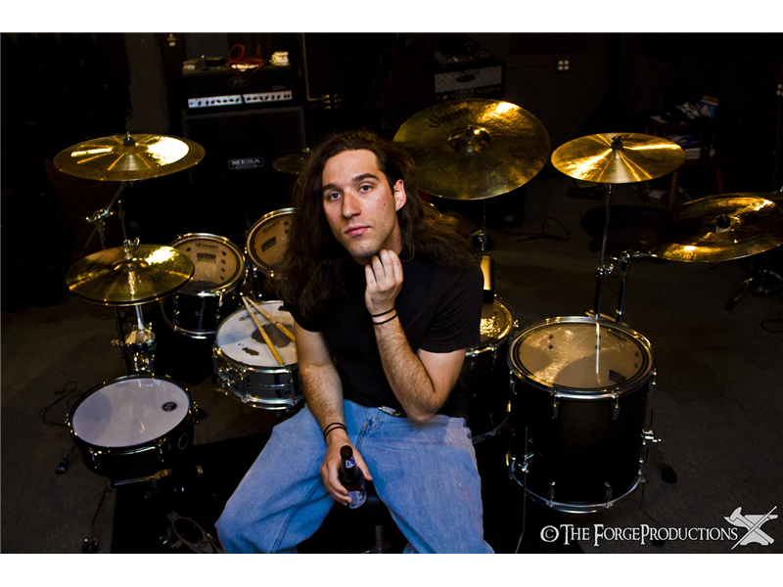
Brian Camara
Drummer
How do you communicate with your other band members when you are improvising during a gig?
How do you find time to practice?
How do you know when you’re “in the zone?”
Has teaching drum lessons influenced the way you approach your instrument?
Notes:
Make sure you say who your participants were, why chosen, how they were recruited, and where they were interviewed
Participant: Full-time electrician, plays in latin and jazz groups, teaches drum lessons, wants to make a career of music. Chosen because of his serious interest in his profession, recruited through a friend of the group (he is the older brother of a salsa dancer)
interviewed in Pleasanton at the drum studio where he teaches

Slide 3
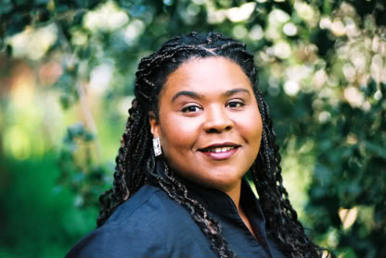
Amanda King
Jazz Vocalist
What’s your typical practice routine?
What do you do to prepare for a gig?
How do you choose what songs to sing?
Do you use singing as an outlet for your emotions?
What are obstacles you encounter while performing or practicing?
Notes:
Make sure you say who your participants were, why chosen, how they were recruited, and where they were interviewed
Who: Amanda King, Jazz Vocalist in SF, Mother
Why: Performed at many venues/clubs in SF. Vocalist experience outside of Stanford
How: Approached after performance for interview by Thu
Where: At the venue she had just performed at

Slide 4
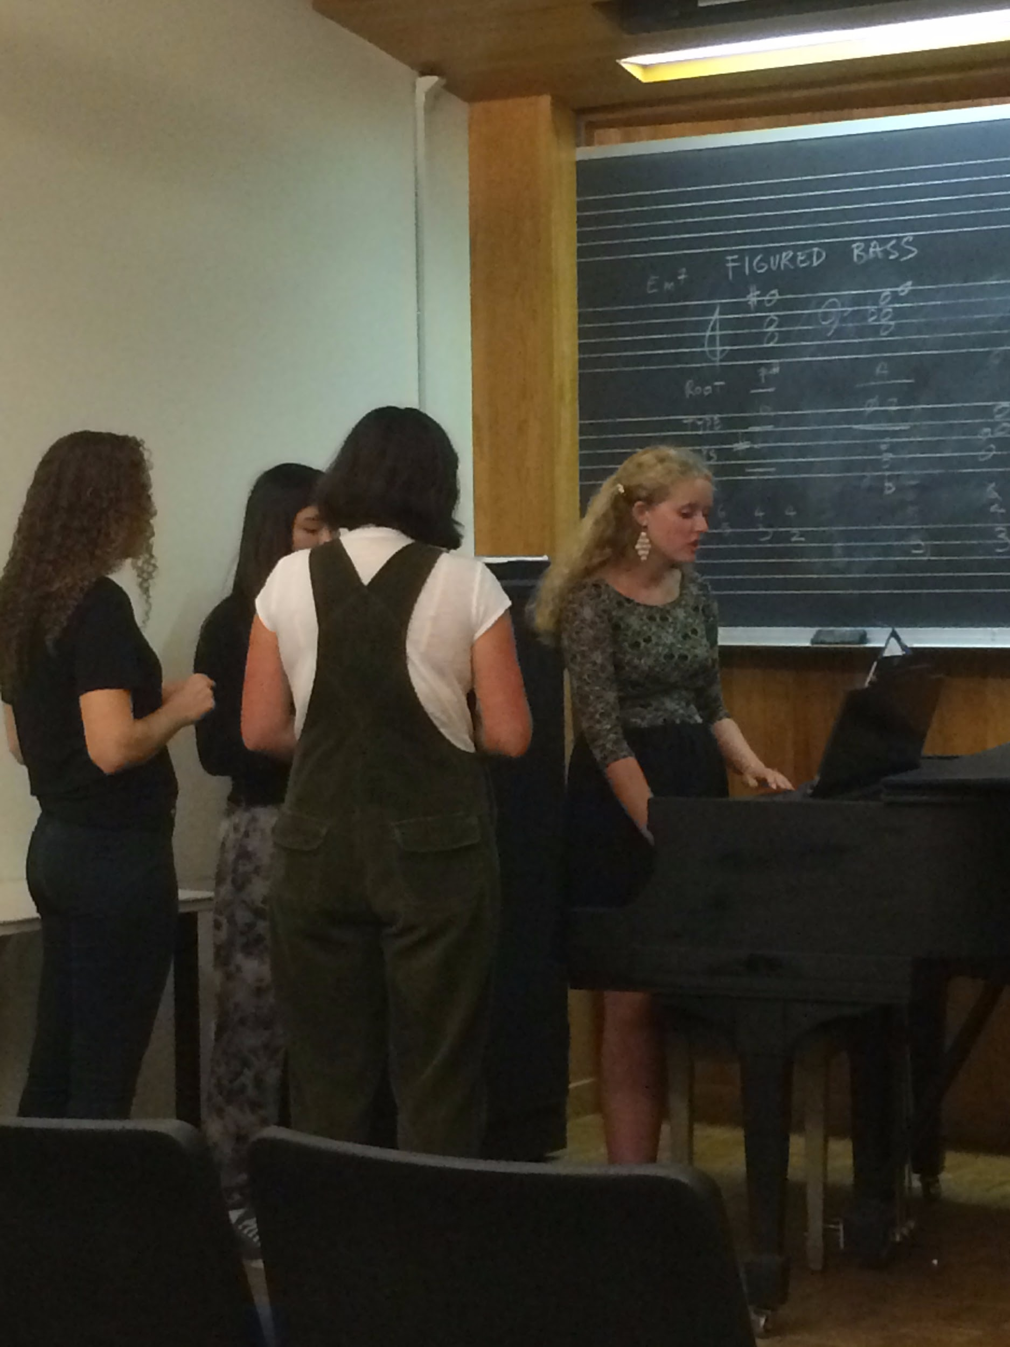
Tessa Eckley
Classically Trained Singer
Musical Director, Counterpoint A Cappella
What’s your opinion on getting started in music in college?
Tell me about your freshman year a capella audition.
What do you think about when performing?
How did you know you needed lessons?
Notes:
Make sure you say who your participants were, why chosen, how they were recruited, and where they were interviewed
Who: Tessa Eckley, Junior, Bio Major, Nathalia’s Roommate
Why: Extensive musical training, solo and group musical experience. Musical director for Stanford Counterpoint A Capella.
How: Asked by Nathalia
Where: Tessa’s dorm room (comfortable environment.) Also observed Counterpoint rehearsal on campus.

Slide 5
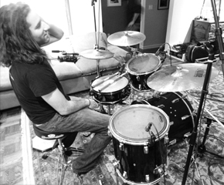
Results: Brian Camara
“How do I teach a six-year-old?”
“When you’re...in the groove, you forget where you are”
“Sometimes, you have to say yes to everything”
Notes:
Brian gave some incredible insights into his experience as a musician trying to break into a full-time career. Brian went to conservatory down in Los Angeles, but struggles to find practice time with his busy schedule balancing a small studio of private students, 10+ gigs a month, and a full-time job as an electrician. Surprising that he still works full time and manages to do all these extra activities!
Clearly deeply passionate about music, Brian talked a lot about “the grooves” (drum patterns) he worked on in practice, what it meant for him to get “in the zone” (akin to achieving a sense of flow, and deep connection and synthesis with the music he was playing), and how he bounces back from a bad day.
Memorable story: It took some time to bring this out, but Brian shared with us the experience of coming into a gig flustered, stressed, and distant from the kind of mindset that would allow him to get “in the zone.” Brian ran a red light before the gig and got a ticket. But Brian told us before entering the venue that he mentally checked in with himself, and decided that he would have to let this experience go and his anxieties about running late if he wanted to play well. This was the same gig that Brian had earlier mentioned was one where him and his group were the most in-sync.
We also talked about Brian’s growing private studio, and how he’s adapting his teaching styles for his youngest student, a six year old named (Robert?). Robert has trouble sitting still and focusing, understandably, so Brian brought him conga drums to bang on and created a special game using the names of fruit to help Robert remember rhythms and patterns. Contradiction: Being a good musician doesn’t make you a good teacher.
Brian also gave us great insight into his often hectic weeks trying to balance his passion and future career and his current job. Telling us that he “often has to say yes to everything,” Brian explained that he networks across the Bay Area by attending open mic jam sessions to play with other musicians, sometimes until 2 AM on weeknights, to help get his name out there and pick up gigs outside of the regular ones he has with his two music groups, a jazz trio and a seven-person latin band called Ruckatan. Even though this and managing his active social media and online presence take time away from practicing, which he is frustrated he isn’t able to do more, these steps help him publicize himself and attract more work so that he can eventually transition to being a full-time musician.

Slide 6
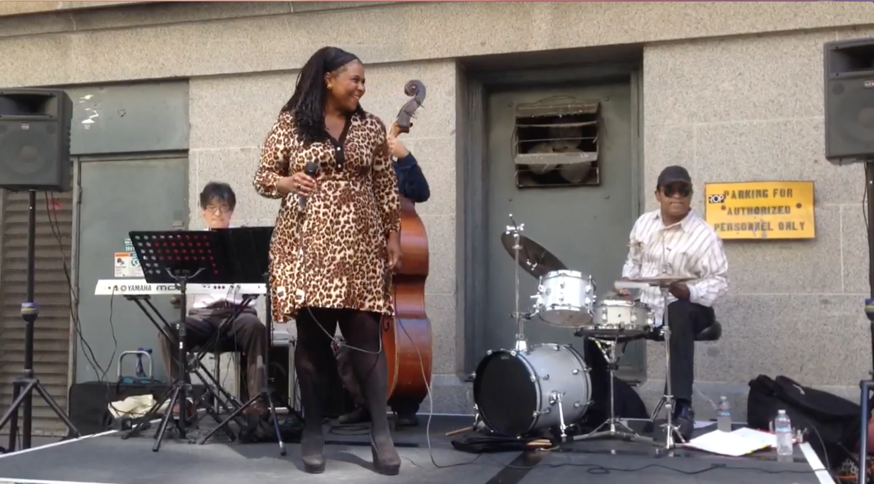
Results: Amanda King
She said she was feeling anxious...?
Notes:
Very fun interview - Watched her perform in a plaza where she looked very comfortable. She was bantering with her bandmates and the audience. She gave a little background to each song she sang.
During the interview, she said how she actually didn’t practice that much because she has a full time job and a son to take care of. Said she was one of the only vocalists she knew in that situation. Her gigs were what she considered “practice”. When she did practice though it would be for a brand new song and she would spend around 20 hours practicing in her car.
In terms of finding new music to practice she said she chose based on her emotion and what she was feeling at the time. The example she gave was when she was going through her divorce she chose a lot of songs that focused on the rough, nitty gritty aspects of love.
She also said that music was her main outlet and that while she was going through a divorce and singing at a gig, someone came up to her afterwards to ask if she felt lonely. She said the fan asked because he noticed that she seemed very moved by the songs she was singing and that a lot of them were about love.
With regards to performing, she said she was actually anxious for this one because she hadn’t sang for 4 months before this. Her bandmates, however, provided her with some familiarity, which made it easier for her to relax a bit. Contradiction: even the most seasoned performers still get nervous.
Surprising:Her biggest obstacle was time and finding sheet music. She would have friends transpose the music for her if she couldn’t find it.

Slide 7
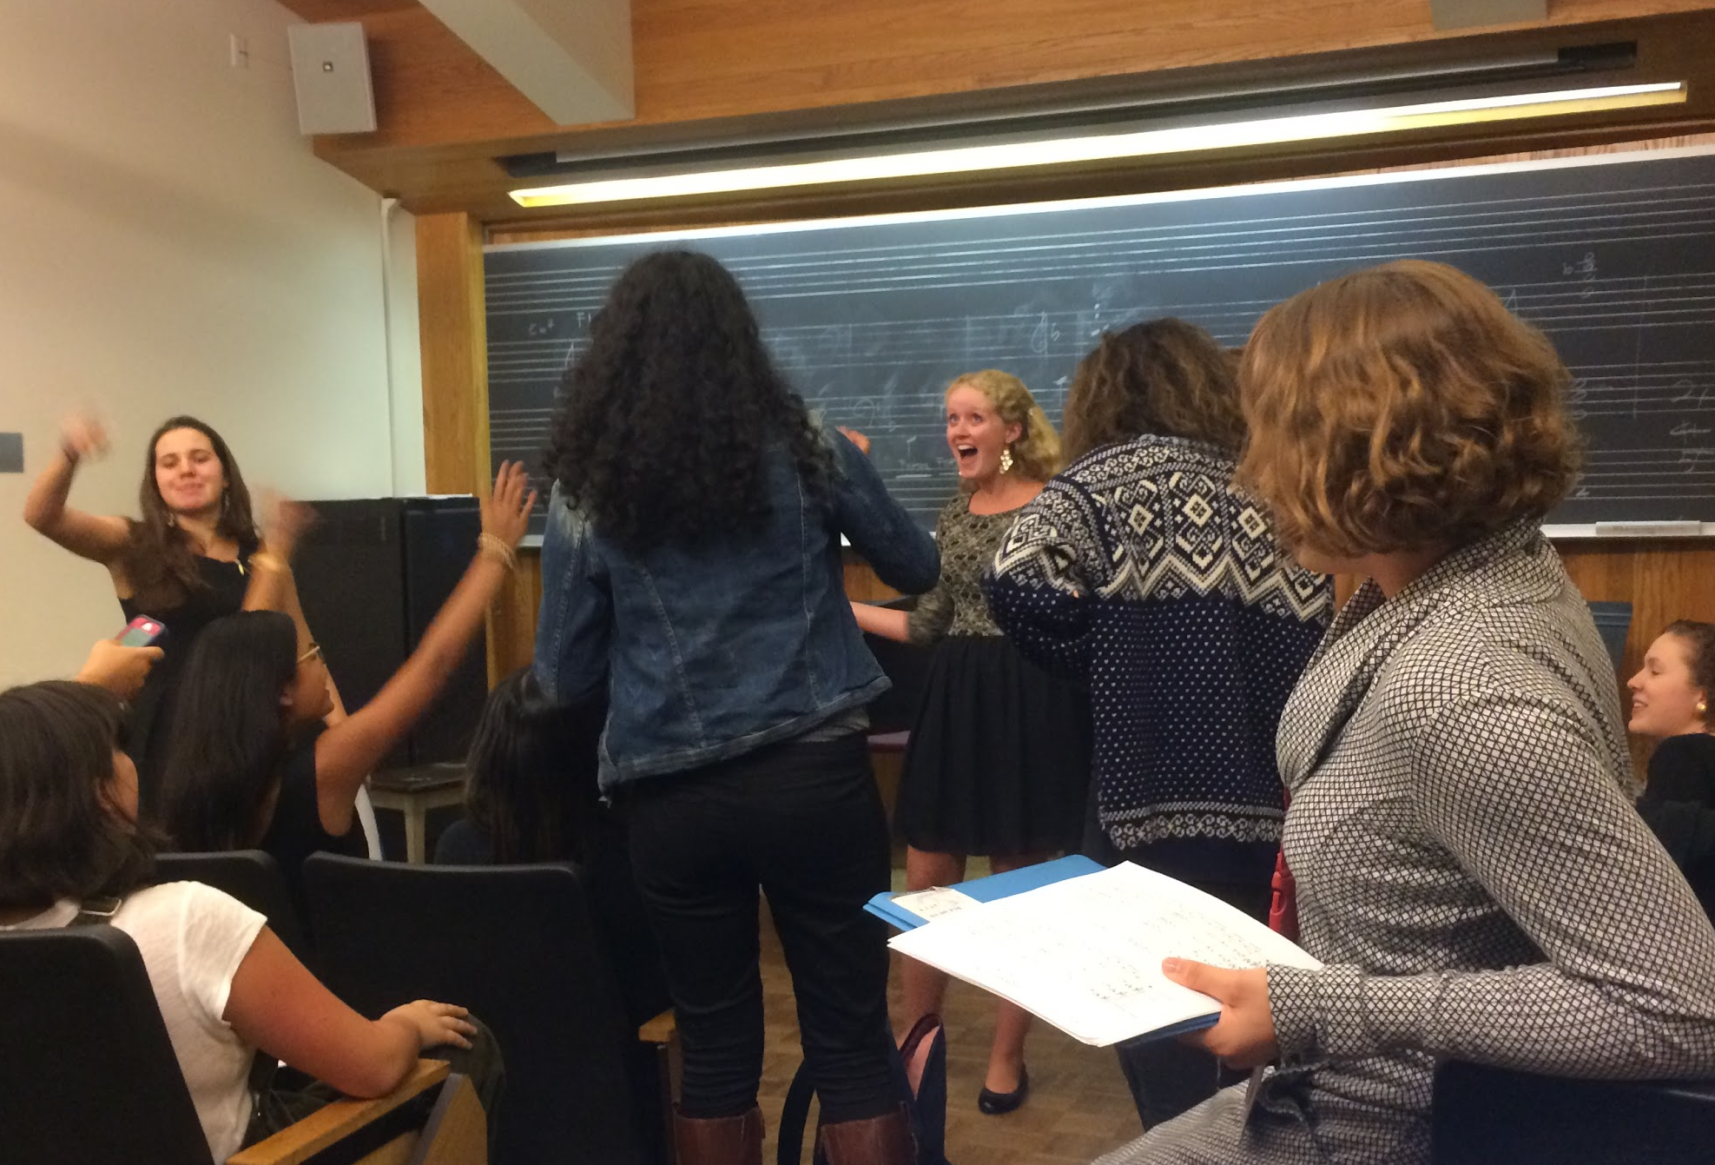
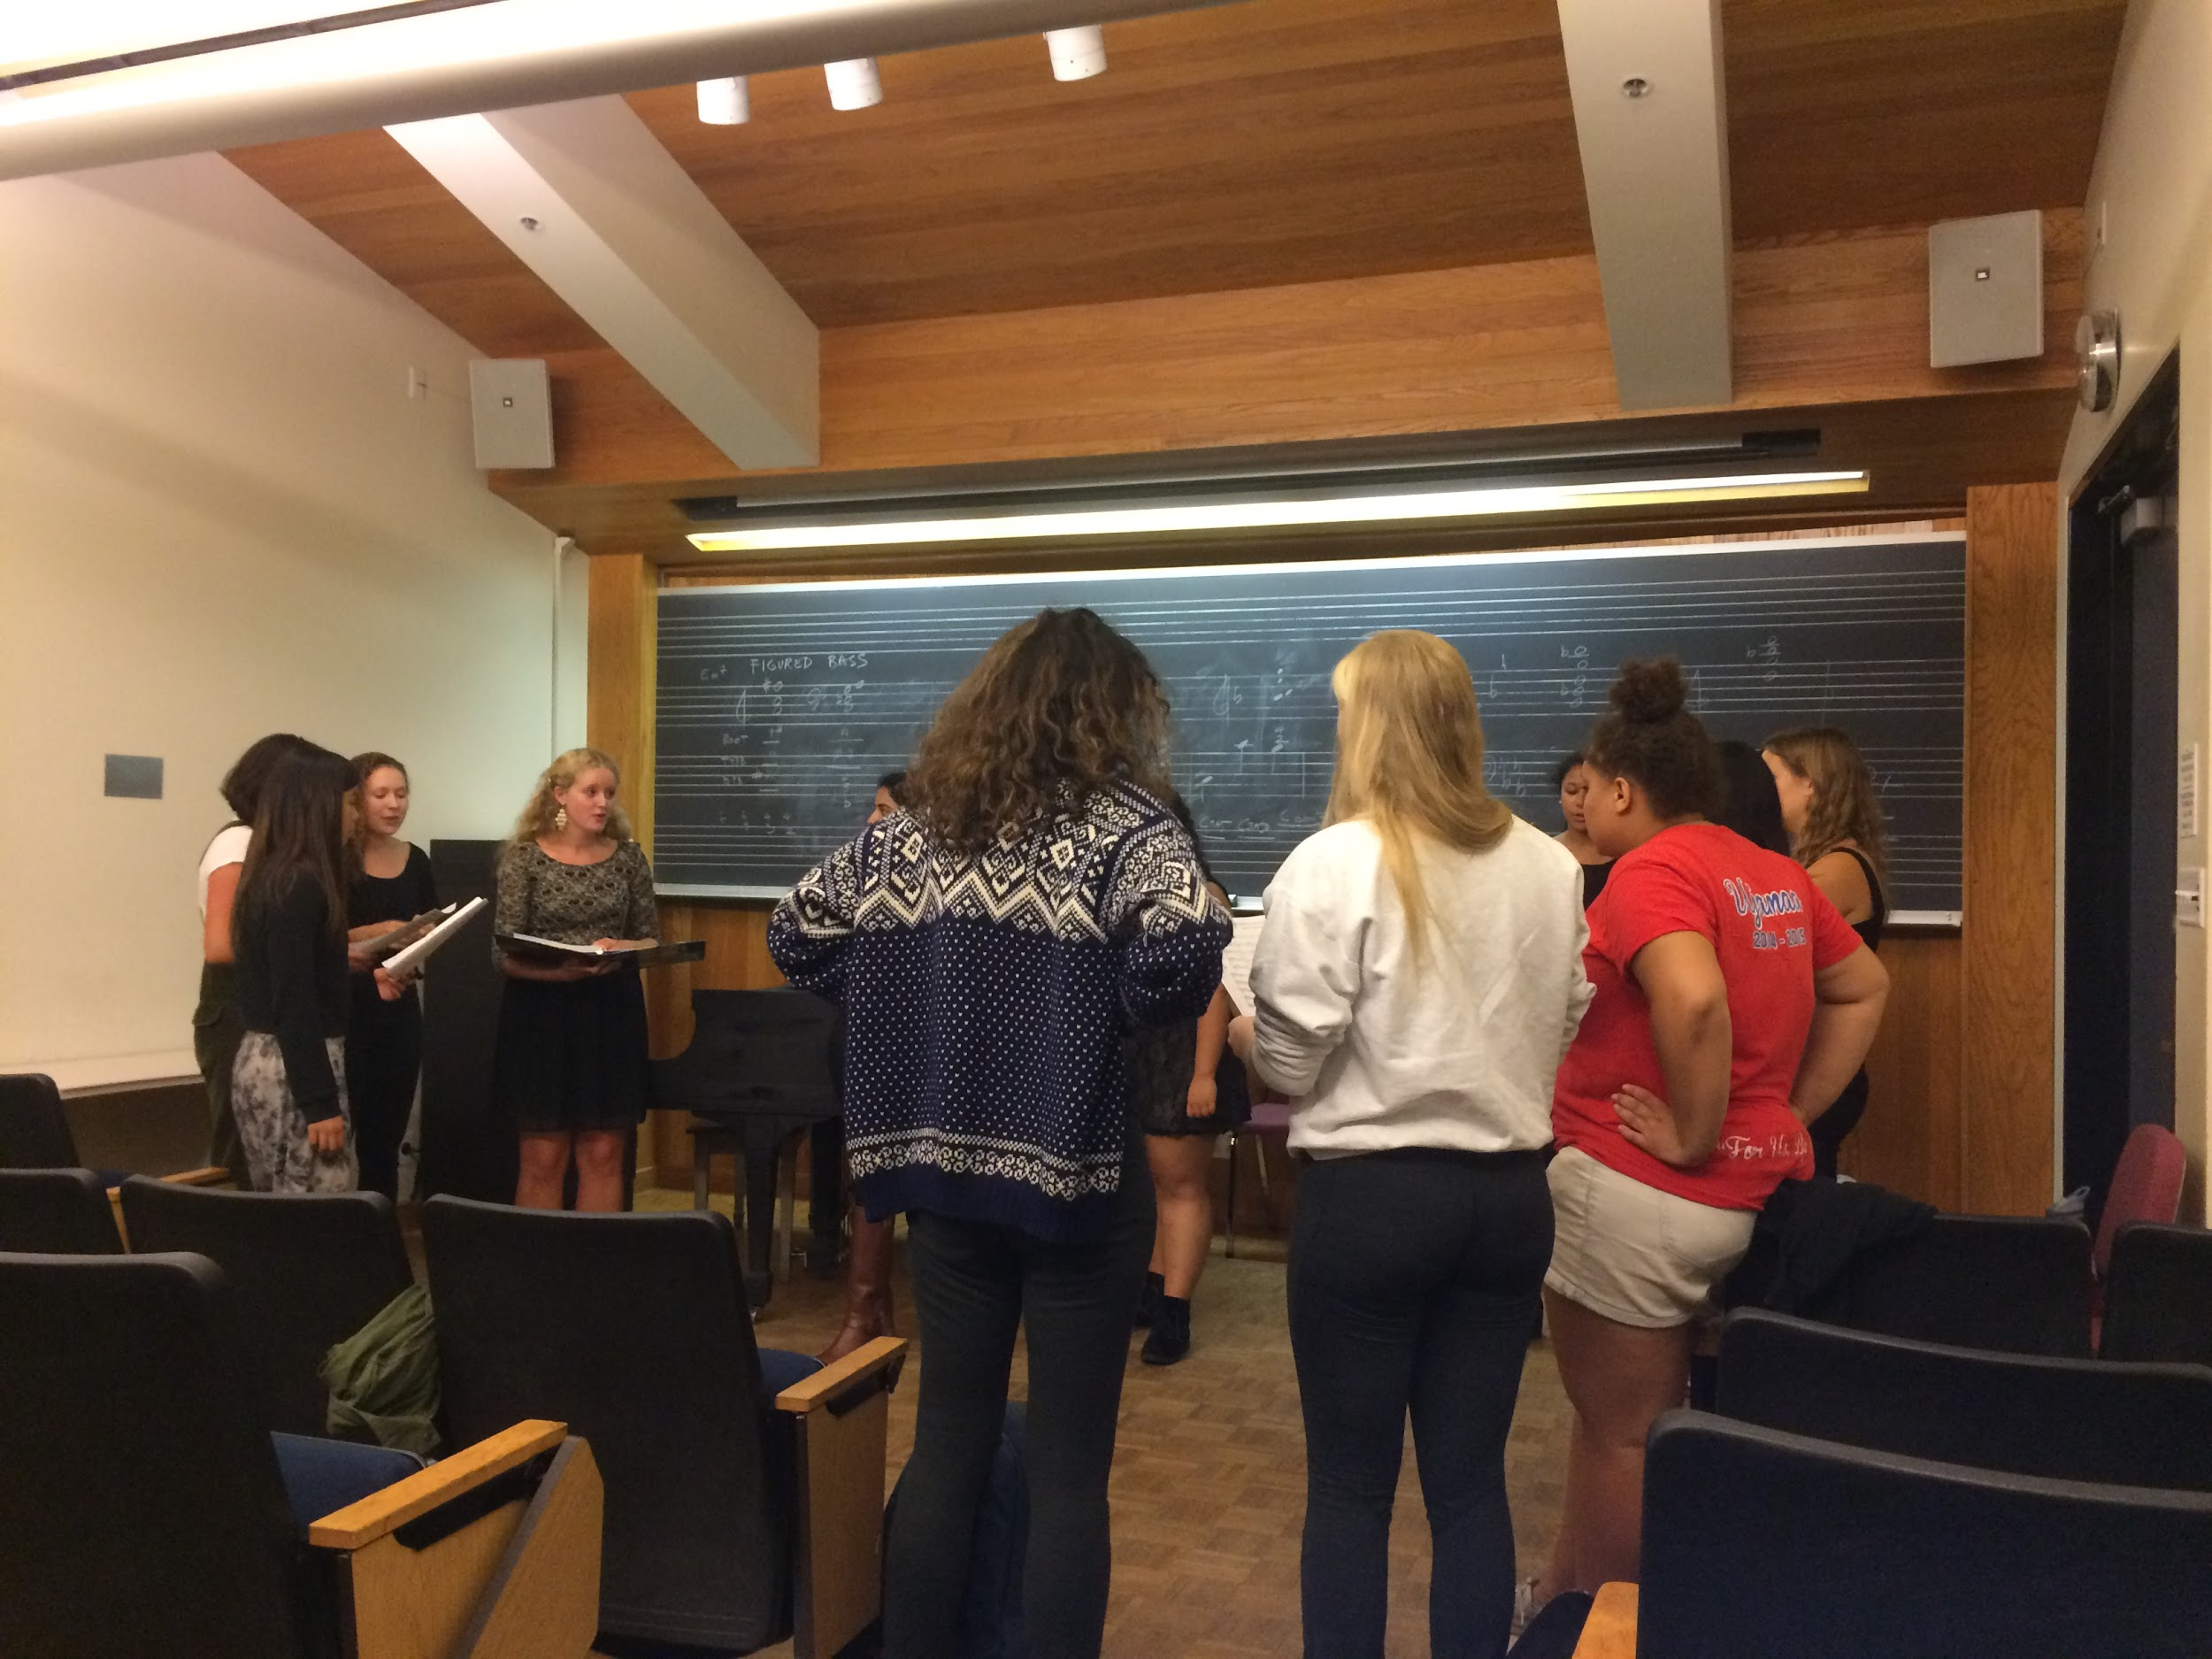
Results: Tessa Eckley
How was this girl ever shy?!
“Mom. I did something crazy. I auditioned for a capella.”
Notes:
Really awesome interview - got many stories of times when she was shy as a child, but a total star in the spotlight. Interesting to see how she applied her classical training to a capella - and how she isn’t necessarily happy with how her voice sounds on the pop-y songs they sing! In fact, she thought pop and a capella was lame before coming to Stanford. But she wanted to try something new and “re-invent” herself when she came, so to avoid the “shy version” of herself, she auditioned. I inferred from this particular action that Tessa may feel more comfortable branching out socially while she is in a group that shares her love of music, and that when performing she can pretend to be someone else. However, as her roommate, I wonder if the information I received from her was more less filtered than if she had talked to a stranger.

Slide 8
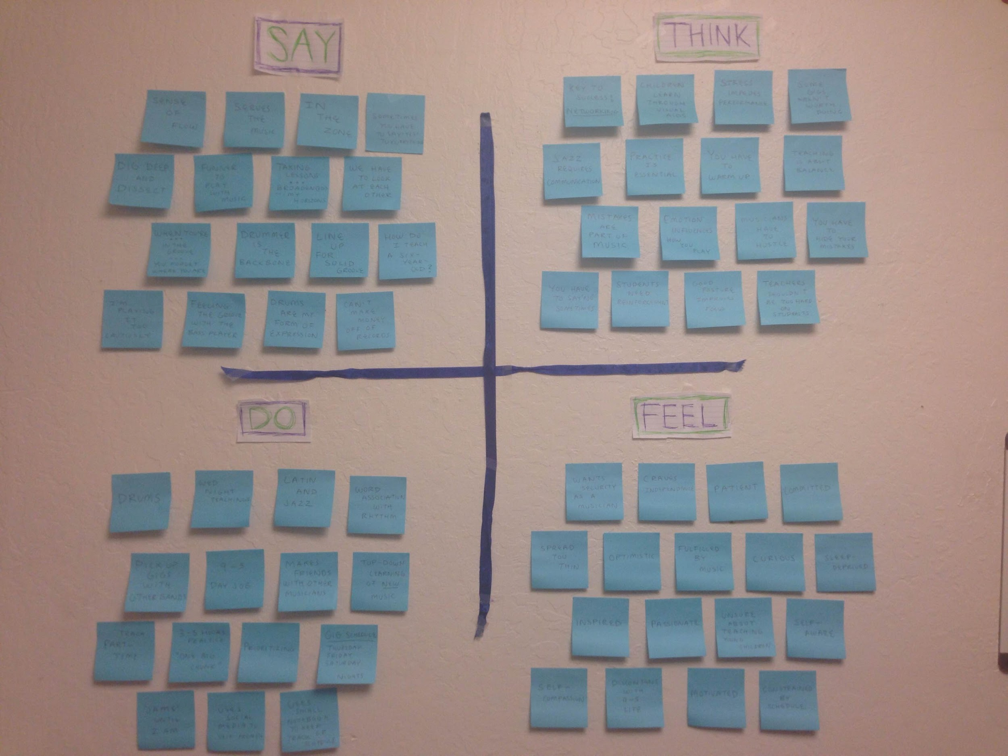
Notes:
Empathy map for Brian

Slide 9
Say
“How do I teach a six-year-old?”
“I’m playing it too cautiously”
“When you’re… in the groove, you forget where you are”
“Dig deep and dissect”
“Sometimes you have to say yes to everything”
“The drummer is the backbone”
“Funner to play (drums) with music”
“Whatever comes out comes out”
“Taking lessons broaden my horizons”
“I keep a huge ear to what the bass player is doing”
“They don’t call them mistakes- they call them happy accidents”
Think
The key to success is networking
Mistakes are part of playing music
Children learn better with visual aids
You have to hide your mistakes when performing
Good posture improves focus
Jazz requires communication
Students need frequent reinforcement
Daily practice is essential
Mindset and emotions influence how you play
Musicians have to hustle
Do
Plays drums in latin and jazz bands
Teaches rhythm with word association
Uses social media to promote self
Keeps track of schedule with small notebook
Learns new music top-down
“Jams” until 2 A.M.
Practices in “one big chunk,” 3 to 5 hours at a time
Teaches part-time
Pick up gigs with other bands
Works 9 to 5 day job
When playing jazz and improvising, makes eye contact with other players to communicate next move
Feel
Wants security as a musician
Craves independence professionally
Committed
Optimistic
Fulfilled by his music
Constrained by schedule
Sleep-deprived
Motivated
Passionate
Inspired
Unsure about teaching young children
Discontent with 9 to 5 day job
Notes:
Empathy map for Brian
Needs:
More time to practice
Connect to a larger network of fellow musicians
Tools such as visual aids to teach young students
His own space to teach
Insights:
Musicians build networks often through open “jam sessions,” which they learn about through word of mouth
Children can have trouble concentrating during music lessons and creative strategies such as practicing without the instrument help keep them focused
Musicians need to practice daily and for several hours at a time
Jazz involves improvisation, the success of which depends on careful, intimate communication between players

Slide 10
Say
Think
“As a singer you gotta keep your repertoire fresh”
“Only singer in SF with a child and full time job”
“Practice for a new show - put in about 20 hours”
“Most time is spent looking or researching for a song”
“One of the biggest obstacles is finding sheet music”
“Love to bring back obscure songs”
“This is the first time I sang in about 4 months, so I was nervous today”
“Big obstacle is not getting enough practice because no sheet music”
“Songs I choose are based on my mood”
“When I chose my songs last time it was when I was going through my divorce”
“All songs were about nitty gritty aspects of love”
“Universe speaks to you through music”
“Use music to soothe the soul”
- Happy that the show went off without a hitch
- It was very fun to performing with my bandmates
- Glad that her bandmates were there to make her feel more at ease
- shows how important her bandmates are to her
- Excited to perform again on a pretty day with blue skies and without the sun on her face
- Wish she had more time so she could practice more
- reveals that she is willing to put singing on the backburner to focus on other responsibilities
- Can’t wait to go home to her son
- Would love to learn and sing some new songs
- Wish there was an easier way for her to find sheet music
Do
Feel
- Put hands on her chest when talking about son
- Pointed to her heart when mentioning story about fan who asked if she was lonely
- Acted out a scene of how she almost crashed a car when her son asked her to play a specific song because she was so excited
- Laughed a lot throughout conversation
- Smiled when I asked her if singing was a form of expression for her
- Laughed especially hard when saying how her first practice spot was actually near a gay pick up spot
- While talking, she periodically made sure her bandmates were ok when cleaning up
- Had a small banter exchange with bandmate when he dropped her equipment
- Seemed more excited when talking about emotional aspects of music
- Was more relaxed than when she was on stage
- Embarrassed (when revealing how little she practices)
- Relieved (that she made no mistakes)
- Relaxed (she was off the stage)
- Nostalgic (when talking about how she would practice in her car)
- Humored (when mentioning that her practice spot was near a gay pick up spot)
- Excited (she was very animated)
- Happy (perform with people she really enjoyed being with)
- Rusty (hadn’t sang for 4 months)
- Flattered (mentioned 2 songs that she didn’t sing live, but has sang in the past
- Cathartic (singing is her way of expressing herself)
- Compassionate (she was with people she cared about and she talked about her son)
Notes:
Needs:
She would benefit from having more time to actually practice since she has a full time job and a child.
It would also be helpful if she could find the sheet music for song more easily without having to depend on her friends to transpose it for her.
Insights: Not all musicians or vocalists are full time performers. Some have a significant amount of responsibilities aside from performing that make it harder for them to spend practice or perform.
Based on my conversation with Amanda, it seems they still try to make time to practice/perform because it is an outlet for them. Some people journal, exercise, paint, dance, or talk to express their emotions. It seems that Amanda expresses her emotions through performing and gains catharsis through that.

Slide 11
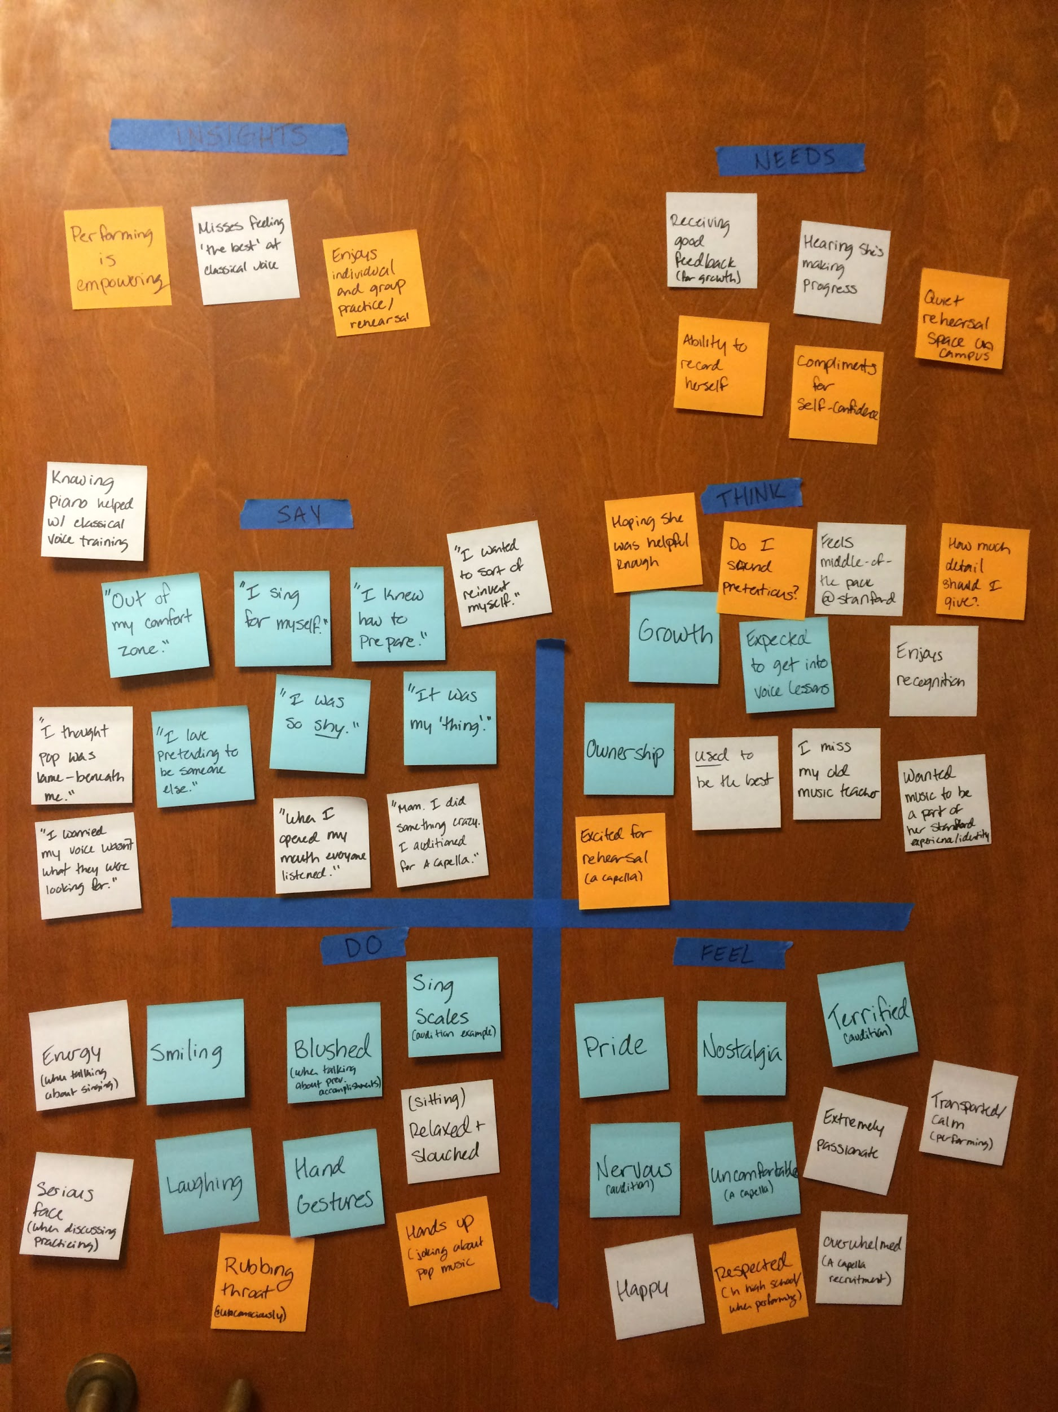
Notes:
Notable points:
“I was so shy.” / “I sing for myself”. Yet when she spoke, she very much had a sense of pride and accomplishment when discussing her voice lessons or a capella group work - smiled a lot, had more energy. “When I open my mouth, everyone listens.” As a shy child, having people pay attention to her was an invaluable confidence booster.
Insight: performing is empowering
Loved music so much, in 1st grade she asked the musical director at her school for the sheet music for ‘Annie’ (the school musical) even though she was too young to perform in it. She later learned all the songs and performed them for friends and the music teacher, who all praised her. She cited this as a major moment when she had the support and push to continue studying music.
Need: Needs to receive good feedback to boost confidence; needs to hear that she’s making progress (to continue to motivate her studies)

Slide 12
Perform
Appreciate
Grow
Notes:
Musicians in different disciplines, in different stages in life, have many different needs and experiences. However, as performers, all the musicians we interviewed do enjoy putting on good performances, sharing and growing in their talents, and receiving audience appreciation. We will take these key needs, along with our insights, to the next stage in the design thinking process!

