Slide 1
MIDWAY MILESTONE
Addison, Joanne, Katherine, SunMi

Slide 2
VALUE PROPOSITION
Connect to people by sharing stories through your favorite discoveries.

Slide 3
INTRO TO PROBLEM & SOLUTION
People are searching for a better way to learn about the lifestyles of the people they like, admire, and respect.
Spiel helps users tell stories about their favorite discoveries. It provides a simpler, more elegant, and more personal platform that allows people to discover new interests through people-centric product recommendations and be inspired by the lifestyles of people they admire.

Slide 4
OVERVIEW OF TALK
Heuristic evaluation results & revised design
Prototype implementation status
Plan to finish
Issues and questions
Demo
Summary

Slide 5
HEURISTIC EVALUATION RESULTS & REVISED DESIGN

Slide 6
HEURISTIC EVALUATION RESULT
“Include an option to delete a spiel on a page that displays a spiel you’ve created.” [Severity: 4]

Slide 7
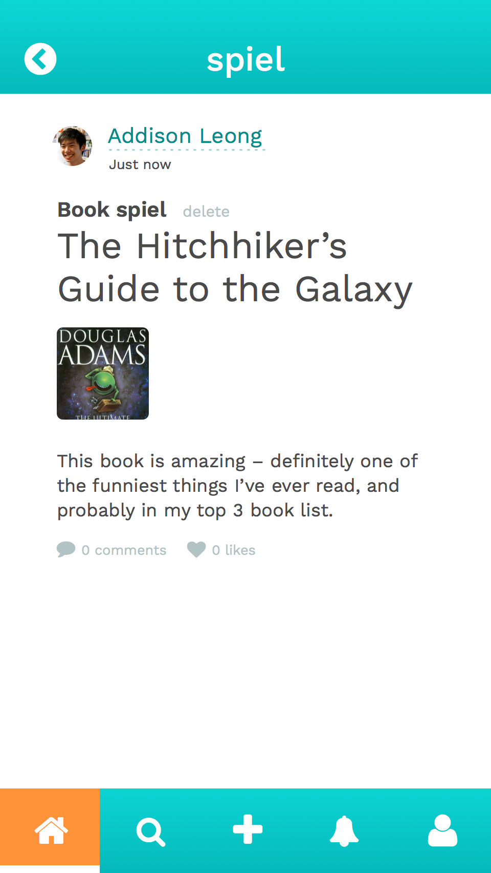
REVISED DESIGN
Added a delete option when viewing your own spiel – includes native confirmation modal in hi-fi to prevent accidental deletions!

Slide 8
HEURISTIC EVALUATION RESULT
“I did not immediately realize what the arrow buttons on Katherine’s profile did.” [Severity: 3]

Slide 9
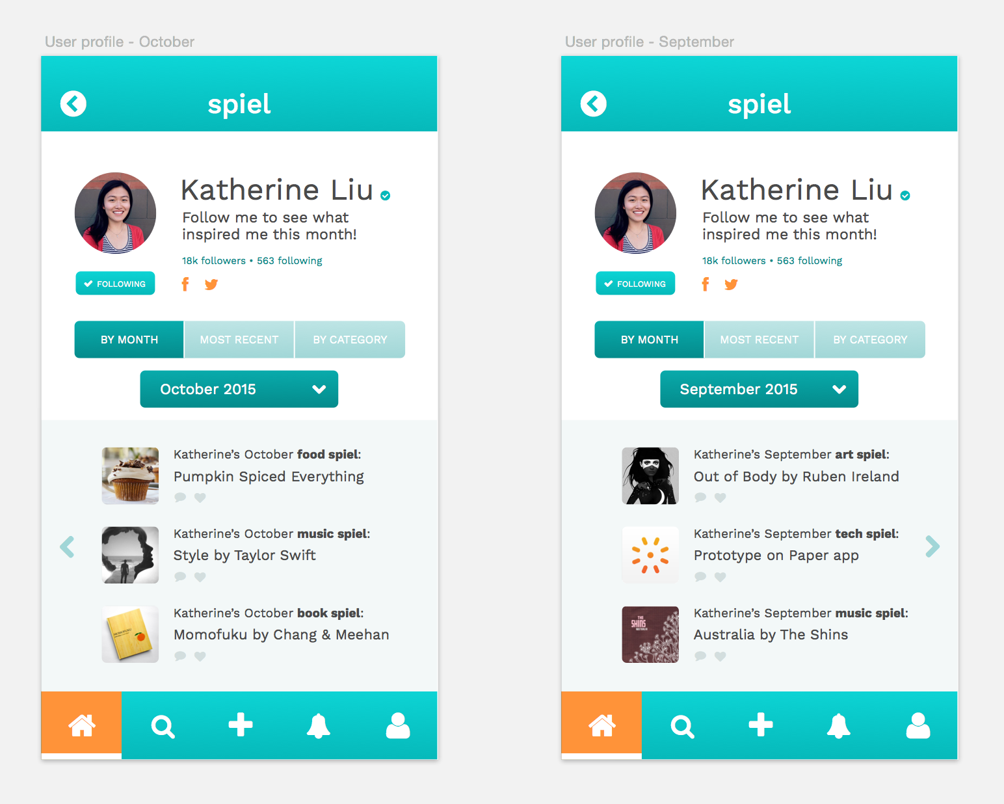
REVISED DESIGN
Arrows lead back to the same screen (either Home or a spiel detail), rather than leading to the previous month

Slide 10
HEURISTIC EVALUATION RESULT
“Right after adding a new spiel, I get a confirmation dialog that tells me I can see my new spiel on the home feed. Clicking next however… looks nothing like my feed.” [Severity: 3]

Slide 11
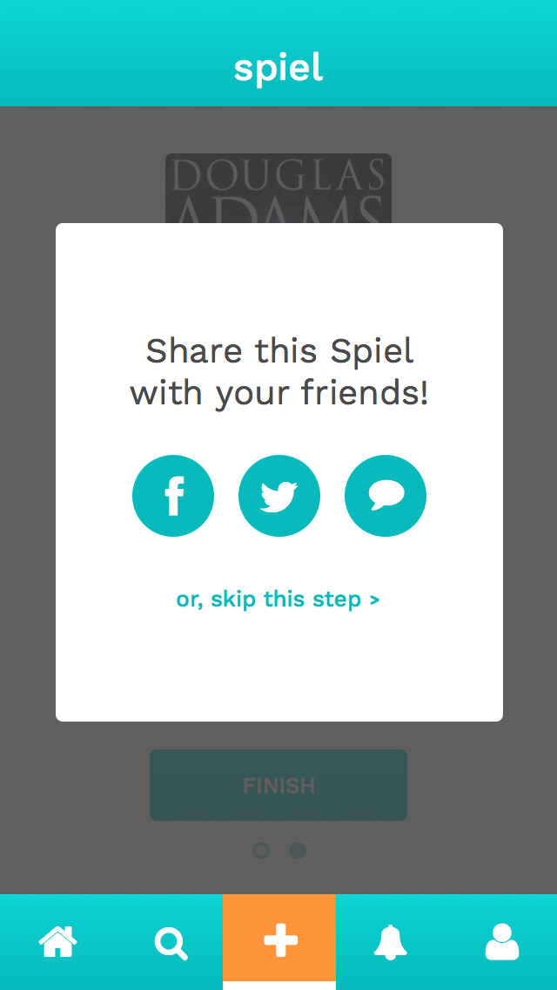
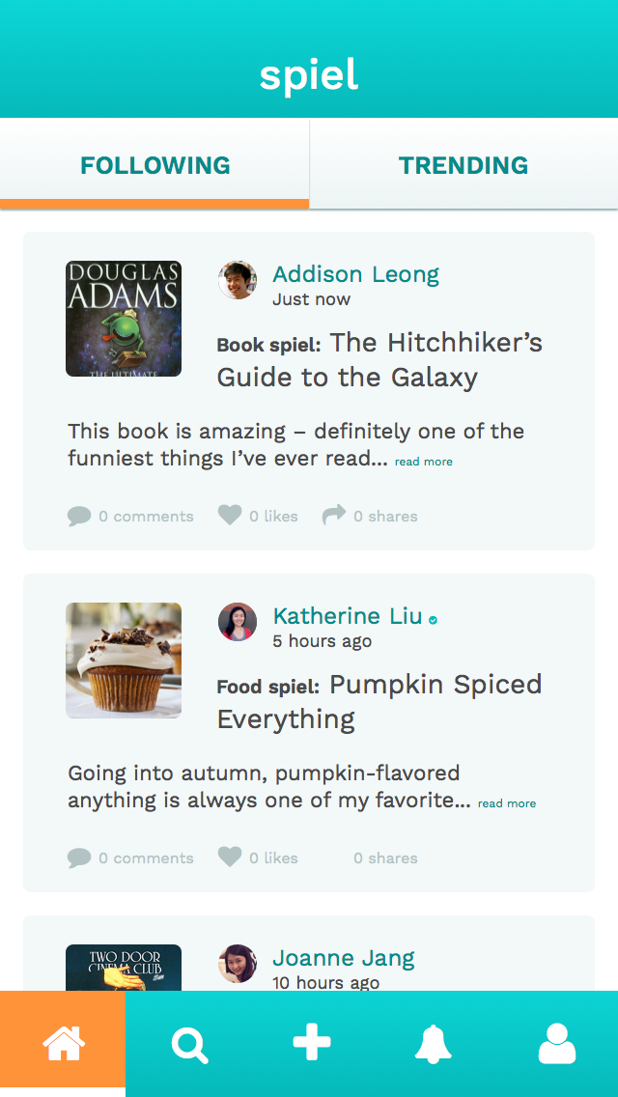
REVISED DESIGN
Took out the confirmation screen (extra step) – once a spiel is posted, you see it at the top of your home feed

Slide 12
HEURISTIC EVALUATION RESULT
“There’s no back/cancel button on the ‘create a spiel’ flow.” [Severity: 3]

Slide 13
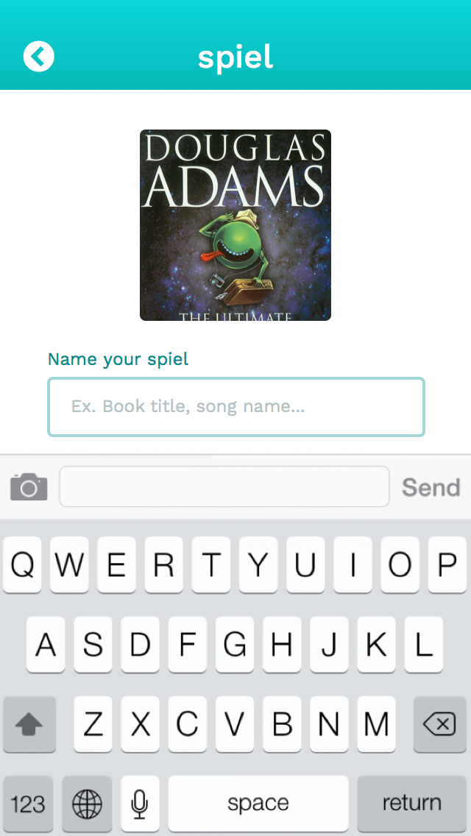
REVISED DESIGN
Added a back arrow – consistent with the other parts of the app for going to the previous screen

Slide 14
OTHER NOTABLE CHANGES (LOWER SEVERITIES)
Selecting multiple photos when posting a spiel
Sharing option on all spiel detail pages
Decreased text content on main feed
Did a size check – increased readability
Fixed small consistency errors
“Picks” instead of “spiels”
“Favorites” vs. “likes” in notifications
And more…

Slide 15
OUR HI-FI PROTOTYPE SO FAR

Slide 16
TOOLS BEING USED
Xcode (Swift)
Parse

Slide 17
IMPLEMENTED FEATURES
MEDIUM TASK
Learn about the lifestyles of people you admire.
HOME FEED |  | SPIEL DETAIL PAGE

Slide 18
YET TO BE IMPLEMENTED FEATURES
SIMPLE TASK
Share interesting spiels with your other social networks.
COMPLEX TASK
Inspire others with your new finds and stories.
SHARE MODAL
CONNECTION WITH OTHER SOCIAL NETWORKS
POSTING PROCESS – CATEGORIZATION, PHOTO SELECTION, TEXT INPUT
UPDATED HOME FEED

Slide 19
PLAN TO FINISH
First build complex task of posting a new spiel
Simple task of sharing happens after content creation
Timeline: Continue building (a lot) after break!
Main challenge is posting – sharing integration with other social networks will follow

Slide 20
WIZARD OF OZ TECHNIQUES
We control some of the elements, such as pre-loading photos that users can choose to upload and pre-populating the home feed

Slide 21
HARDCODED DATA
Profile and spiel data for other users
“Your” profile – no login implementation
Pre-loaded photos

Slide 22
ISSUES AND QUESTIONS
Are we bound to creating a pixel-perfect version of the medium-fi prototype?
Is it alright to leave out small elements in screens that are part of a task flow (ie extra buttons and tabs) if they are not immediately relevant to the task?

Slide 23
PROTOTYPE DEMO

Slide 24
SUMMARY
Revised medium-fidelity prototype to accommodate all high-severity evaluations and several lower-severity evaluations
Implemented one task
Planning next steps for finishing parts of the app relevant to our three tasks

