Slide 1
• CONCEPT VIDEO •
PICKS
Addison, Joanne, Katherine, SunMi

Slide 2
Value Proposition
Pick your inspiration.

Slide 3
Problem/Solution Overview
Right now, recommendations are restricted to word-of-mouth, company-sponsored ads, or posts by a few influential bloggers – there is no go-to way of finding new interests or product recommendations.
Through crowd power, Picks allows people to express themselves through their own recommendations while helping them discover new interests and be inspired by the lifestyles of people you admire.

Slide 4
Tasks
Posting your curated 5 favorite things you’ve been using each month COMPLEX
Following the products and lifestyles posted by people you admire MEDIUM
Sharing interesting picks with your other social networks SIMPLE

Slide 5
Our video planning storyboard process…

Slide 6
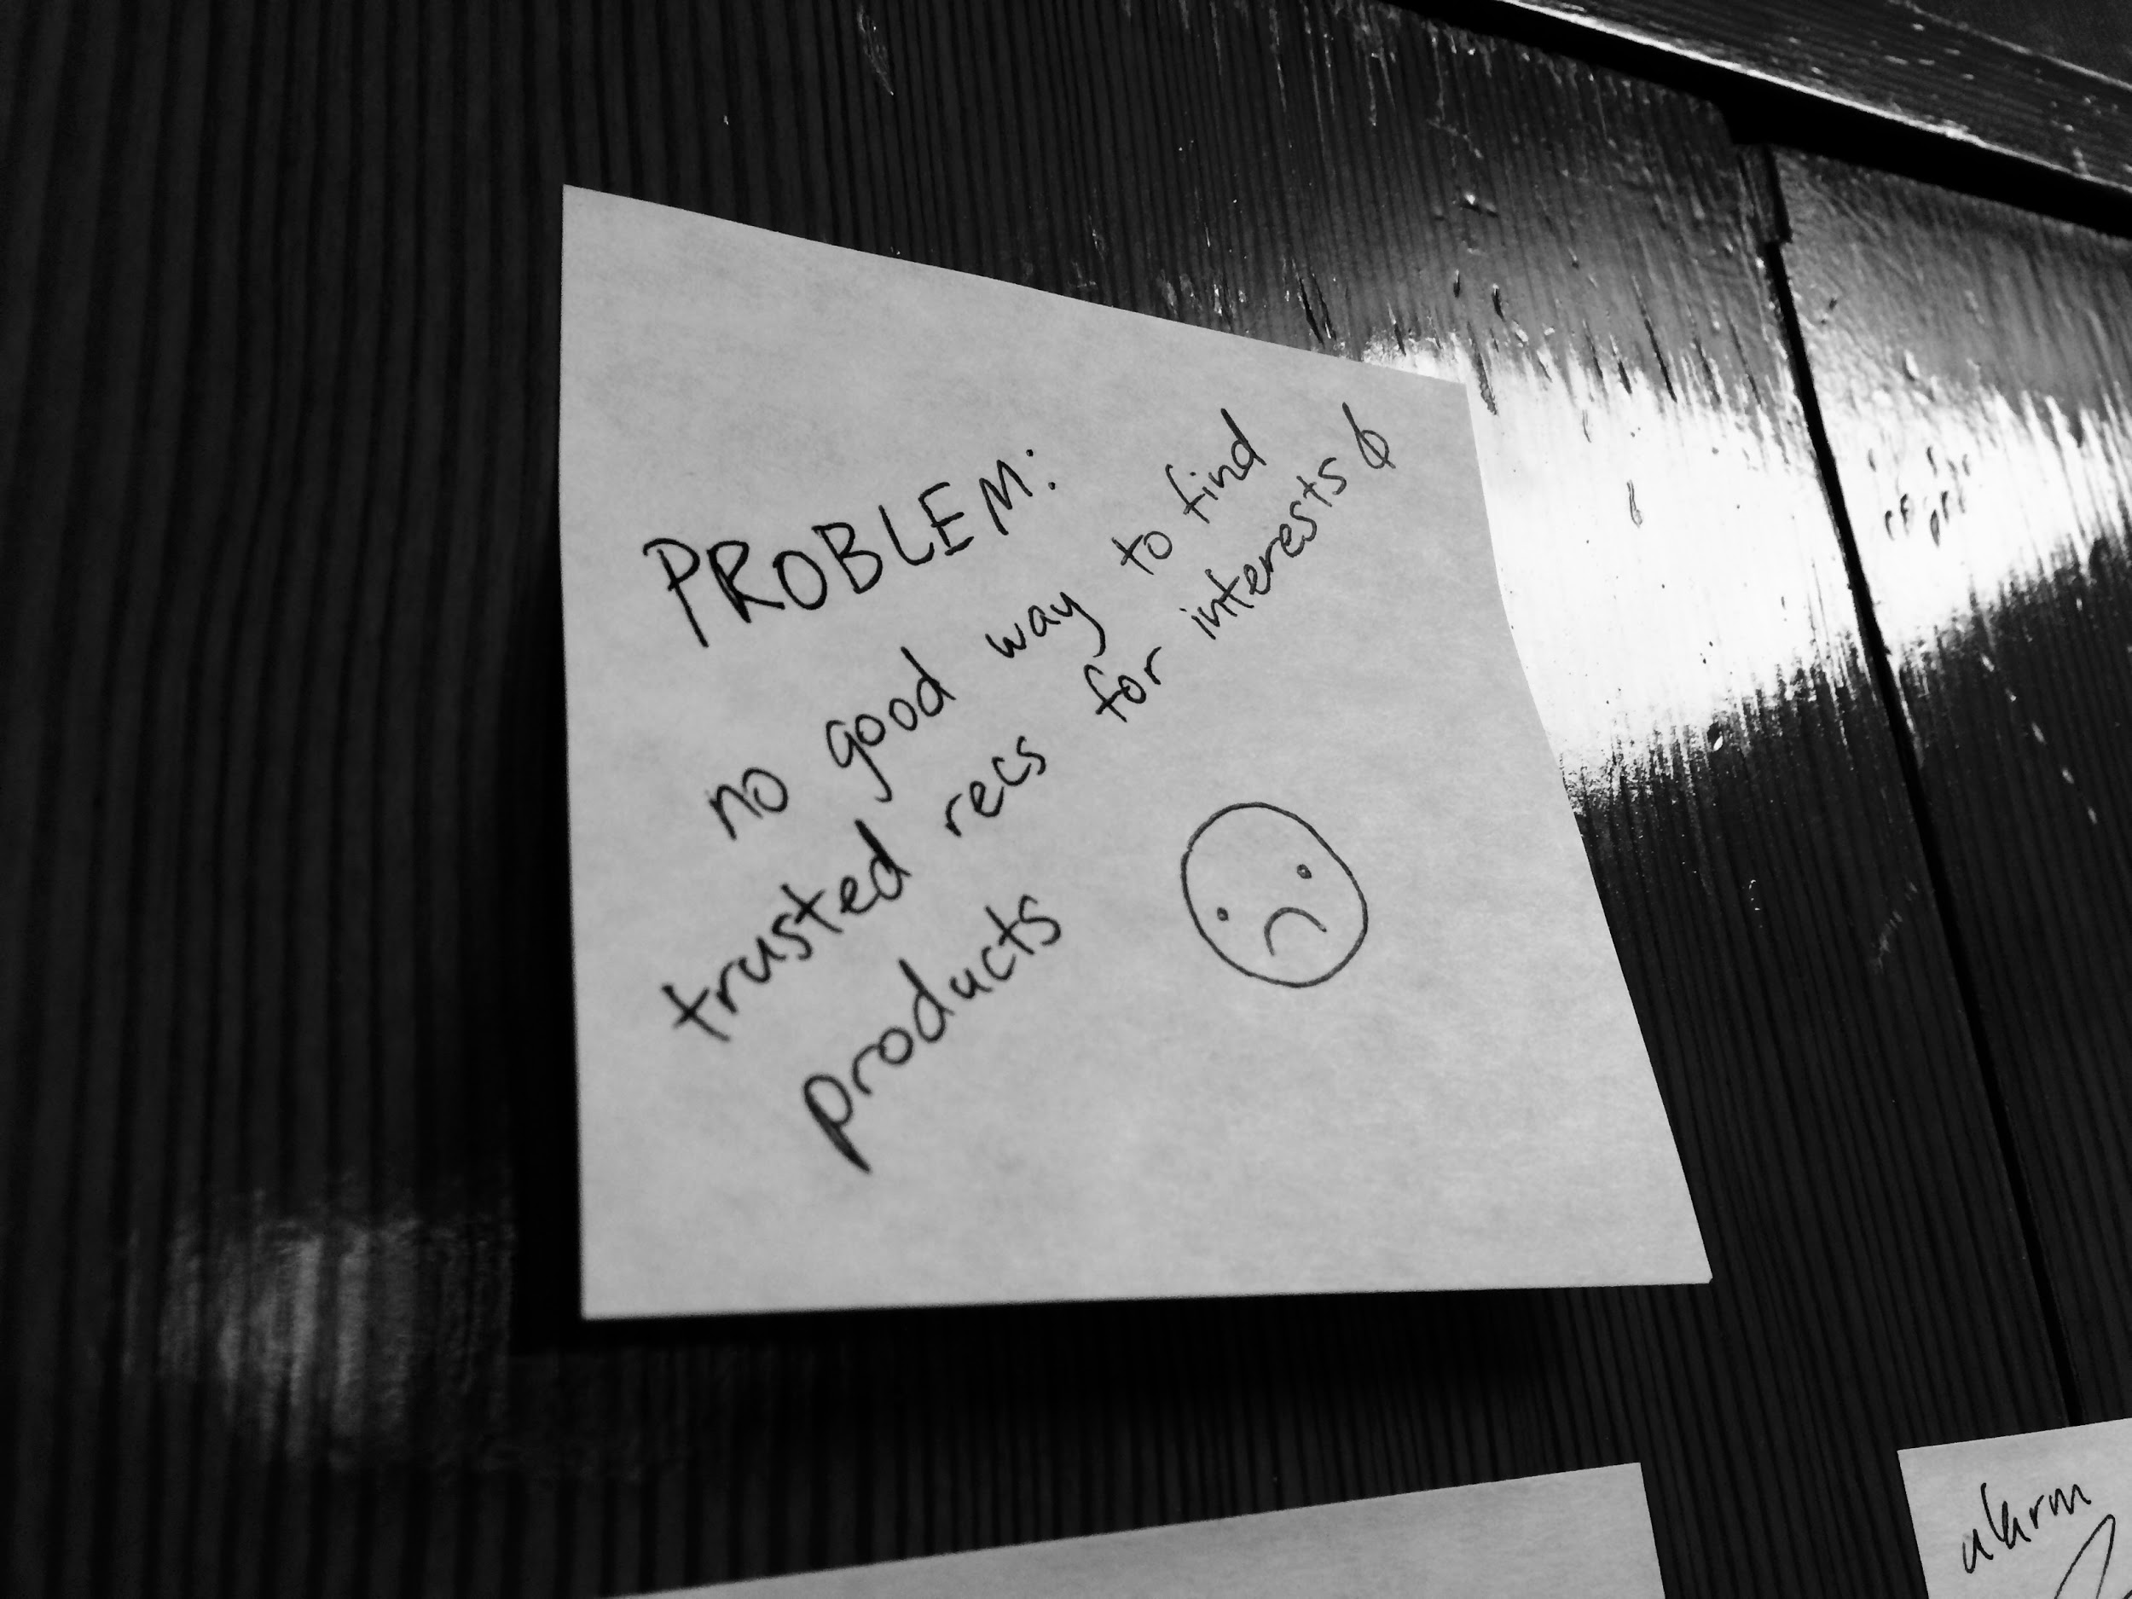
What problem are we trying to convey through our video?

Slide 7
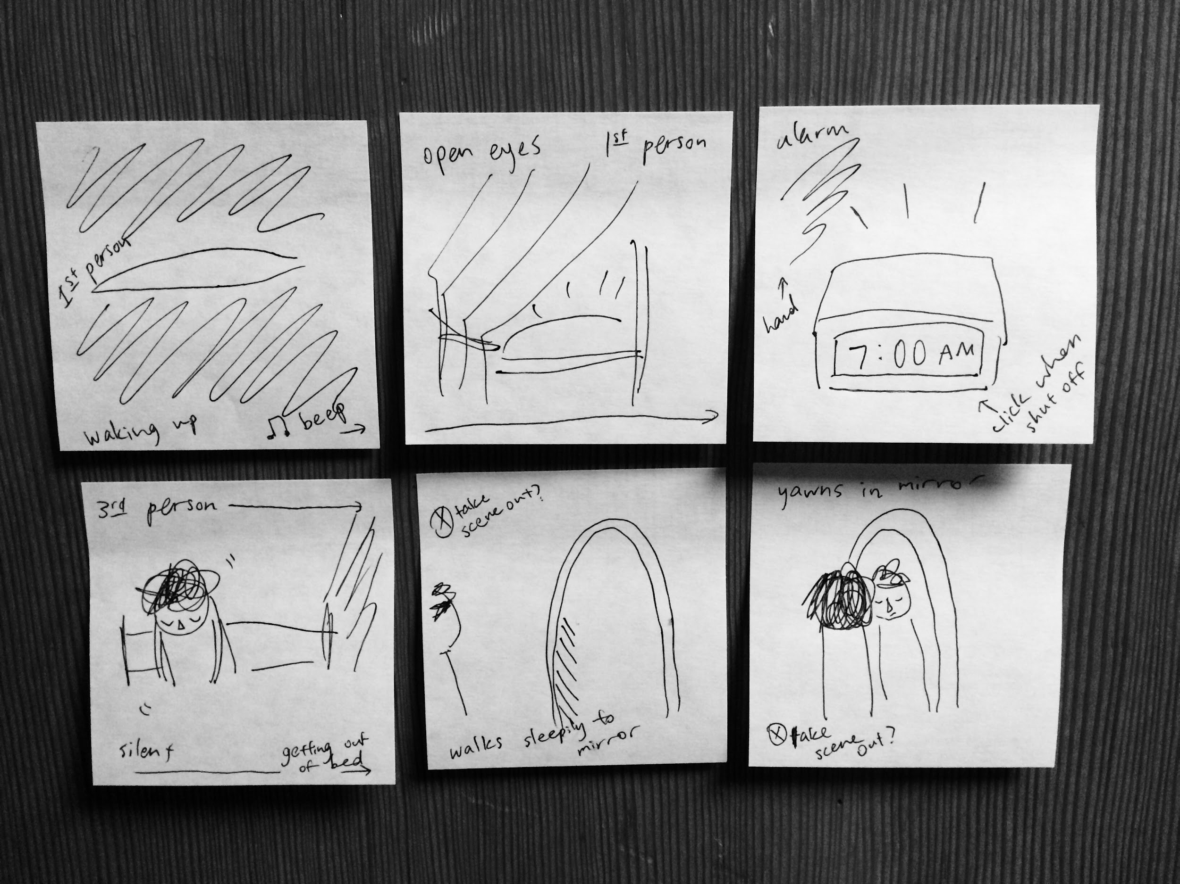

Slide 8
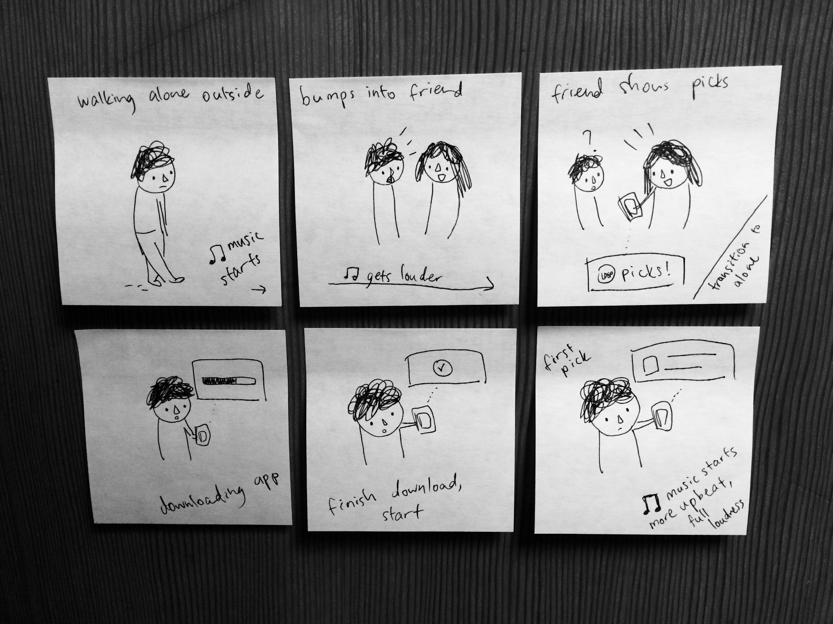

Slide 9
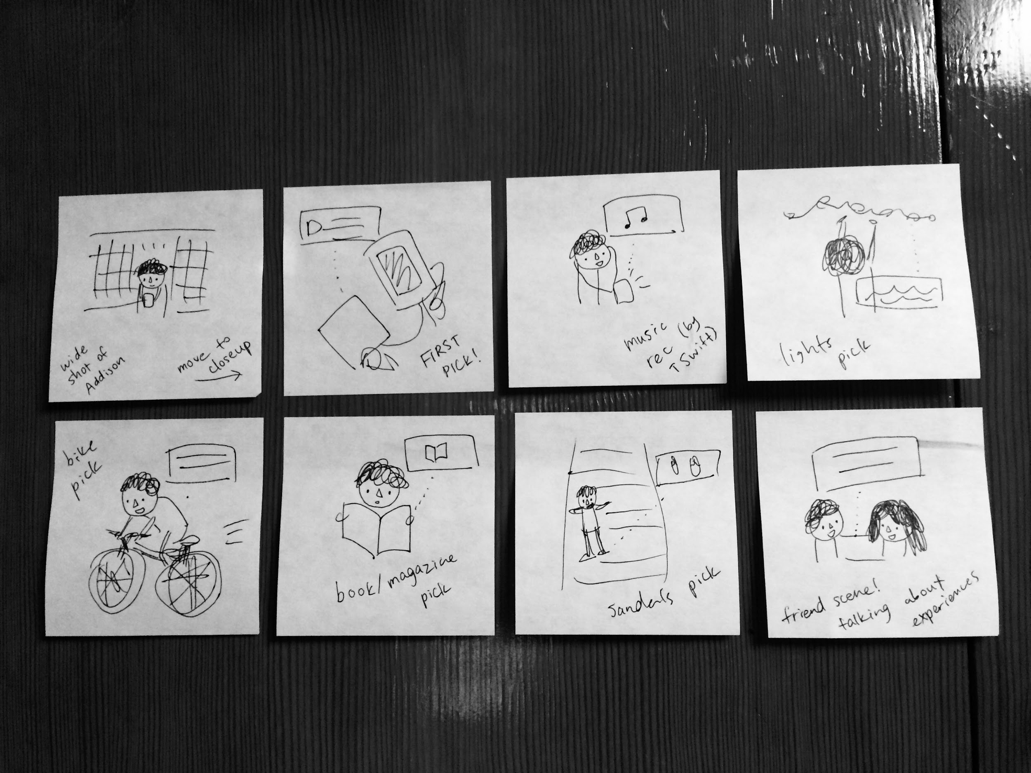

Slide 10
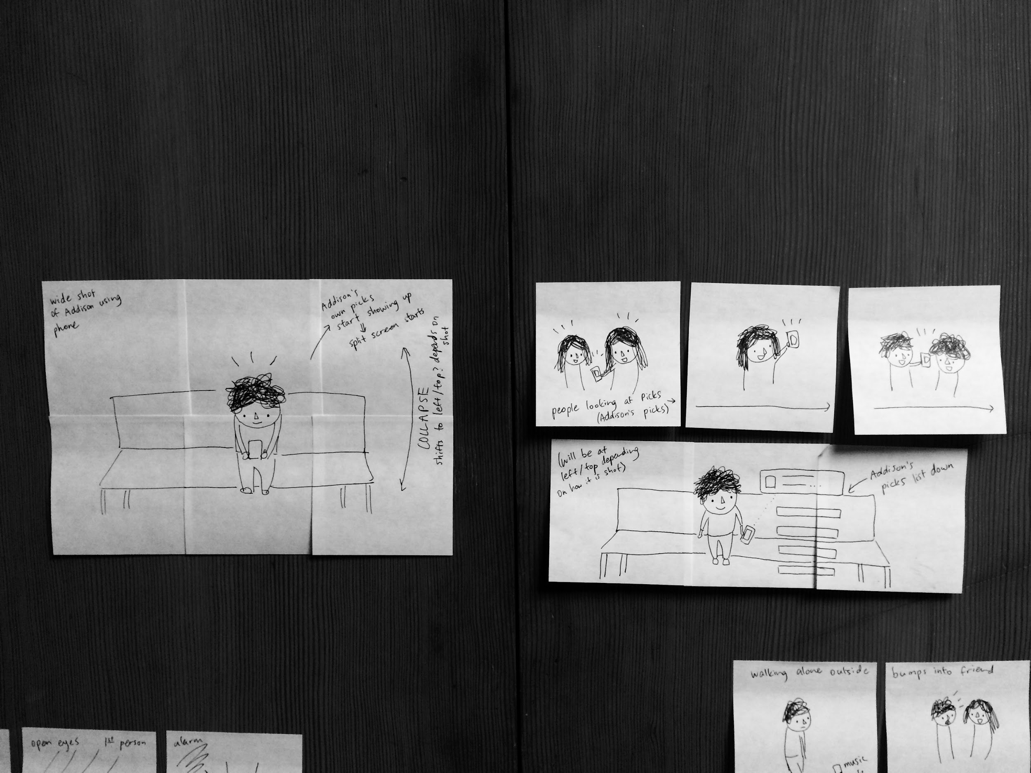
Planning the split screen layout of our final scene...

Slide 11
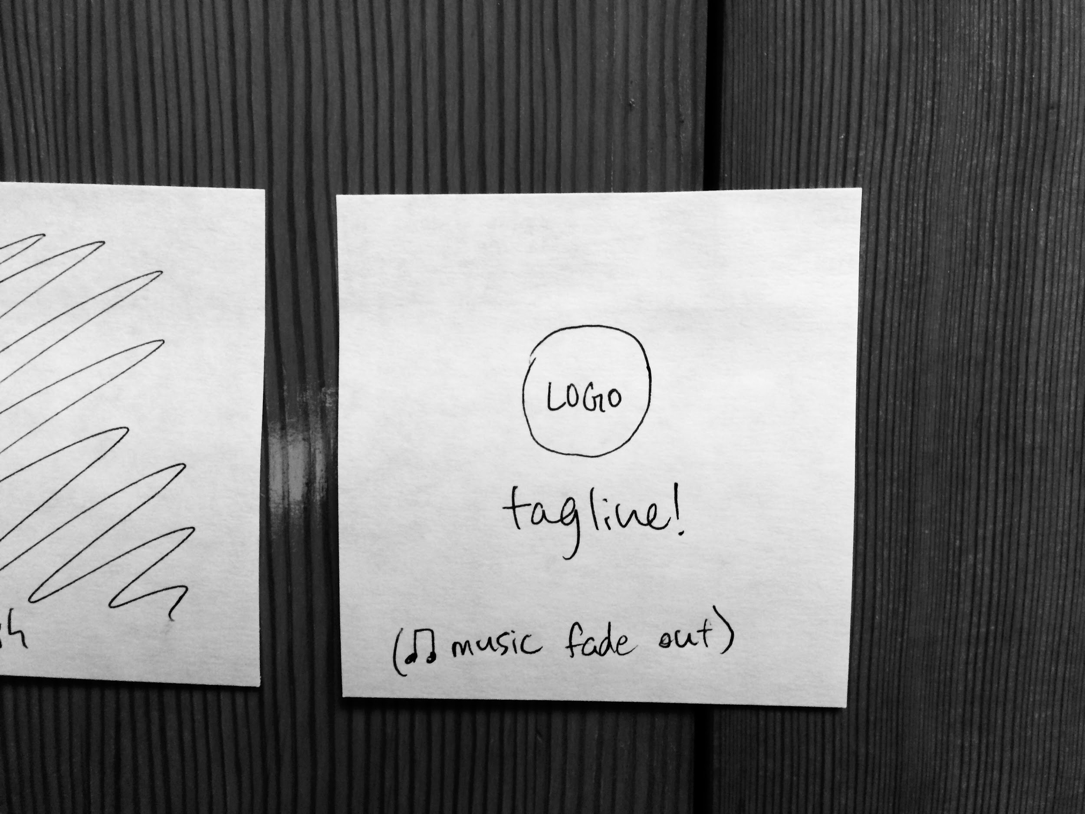
End of the video!

Slide 12
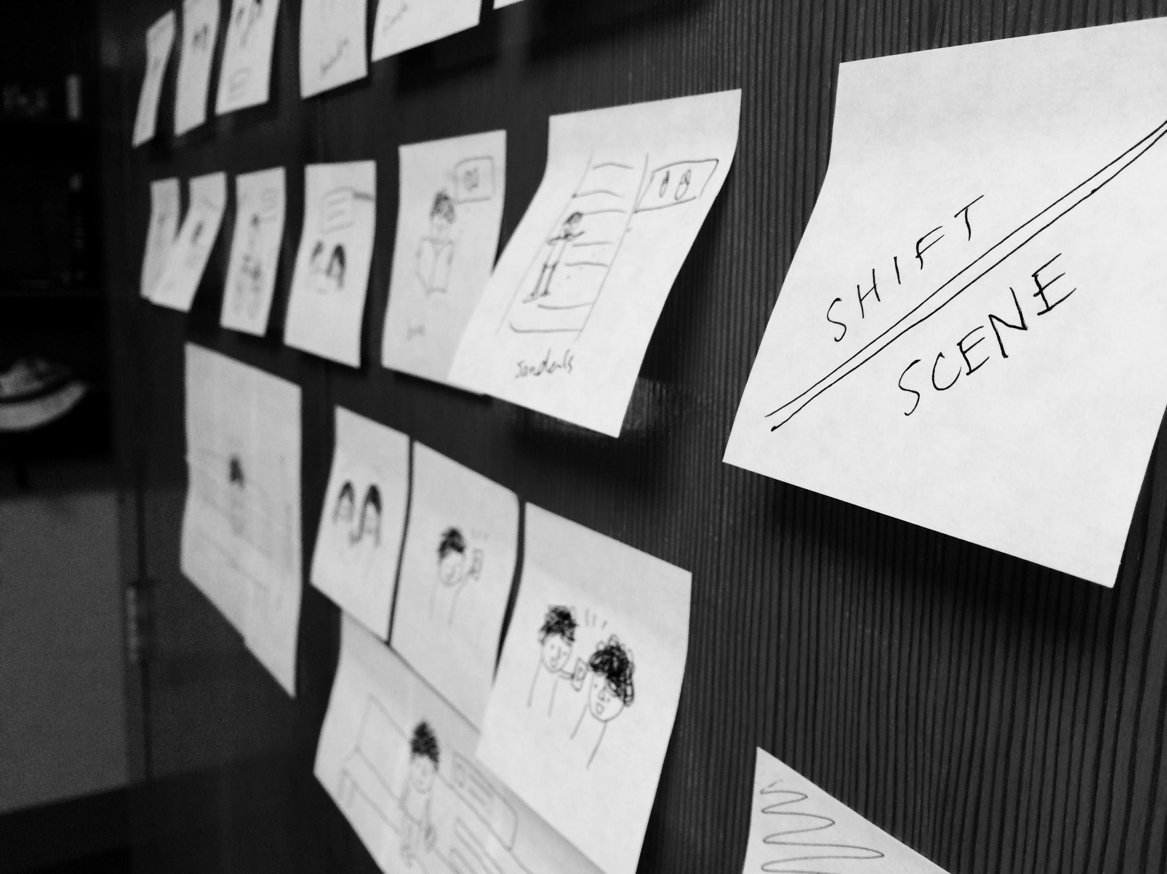
Planning the scene shifts!

Slide 13
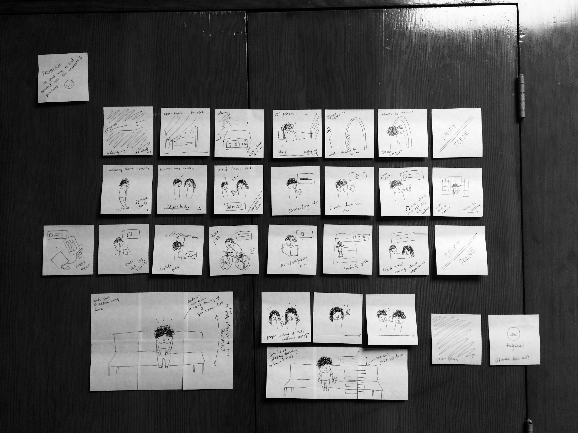

Slide 14
Our concept video
https://vimeo.com/142590174

