Slide 1
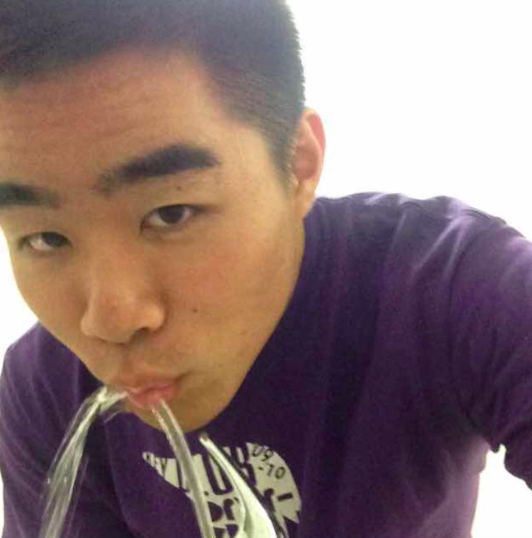


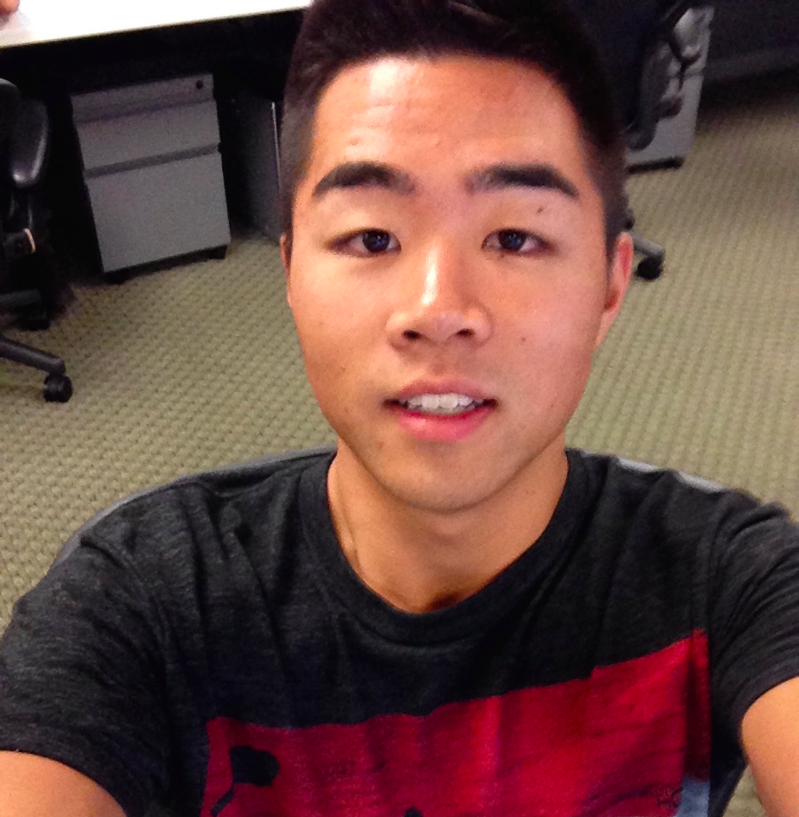
Chapter by Loco Power
Week 10: High-Fidelity Prototype (Milestone)
Dan, Melissa, Irving, & David

Slide 2
1. Problem & Solution
2. Heuristic Results & Changes
3. Prototype Implementation Status
4. Hi-Fi Demo

Slide 3
1. Problem & Solution

Slide 4

How do you find the best activities to
do at a specific location?
Notes:
Problem: Finding exciting and memorable things to do in a new settings is hard, and it's even harder to document all the meaningful interactions you have on a consistent basis.

Slide 5
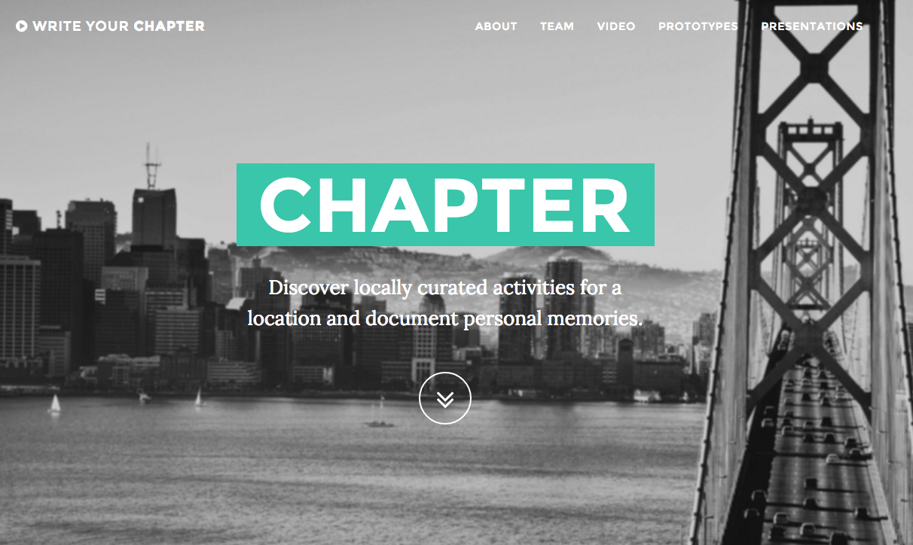
Notes:
Value proposition: discover locally curated activities for a location and document personal memories.

Slide 6
2. Heuristic Results & Changes

Slide 7
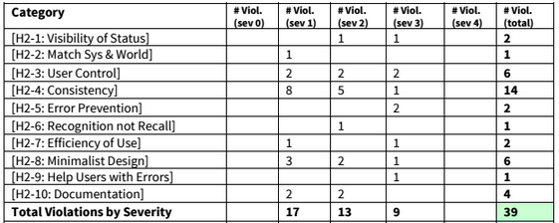
Need to go back to the drawing board for UI design
Double check with a “designer’s eye”
Notes:
With a clear spread of heuristics across the board, we realized that there is no ONE area that we need to focus on, but that there are significant changes that we needed to make, in each task, and even basic functionality.
Continuity, usability, functionality

Slide 8
Overall
Continuity throughout the app’s color scheme & story.
Interface
Reimagine swiping action for ease, intuition, & information.
Additions
Navigation through status changes & reimagined icons.
Add functionalities for increased user control.

Slide 9


Overall
Color Scheme:
Story:
Book Metaphor
Heuristics:
Consistency & Standards [2-4]
Aesthetic & Minimalist Design [2-8]
Notes:
Color: Clashing colors (red and purple) → Teal = bluish hue → laid-back, high saturation → exploratory
Story: icons, actions, and language

Slide 10

Interface
Replace Swiping Action
Information Viewing:
Tap to view more information
AND
Tap to return to original activity page
Heuristics:
Visibility of Status [2-1]
User Control & Freedom [2-3]
Flexibility & Efficiency of Use [2-7]
Help Users with Errors [2-9]
Notes:
Revisit Tinder UI → not symmetric in swiping right and left
Scrap the swiping action → tapping action to bring up information

Slide 11
Additions
Status:
Obvious “Start Activity” Button
New page to: record caption, picture, rate, and submit
Review & Edit:
Create “My Suggestions” list
Include rating in reviews
Select activities to share with checkboxes
Heuristics:
​User Control & Freedom [2-3]
Consistency & Standards [2-4]
Error Prevention [2-5]
Notes:
Status: engaging the user to change the mindset of “embarking on an adventure”
Changes: error prevention and accuracy

Slide 12
3. Prototype Implementation Status

Slide 13
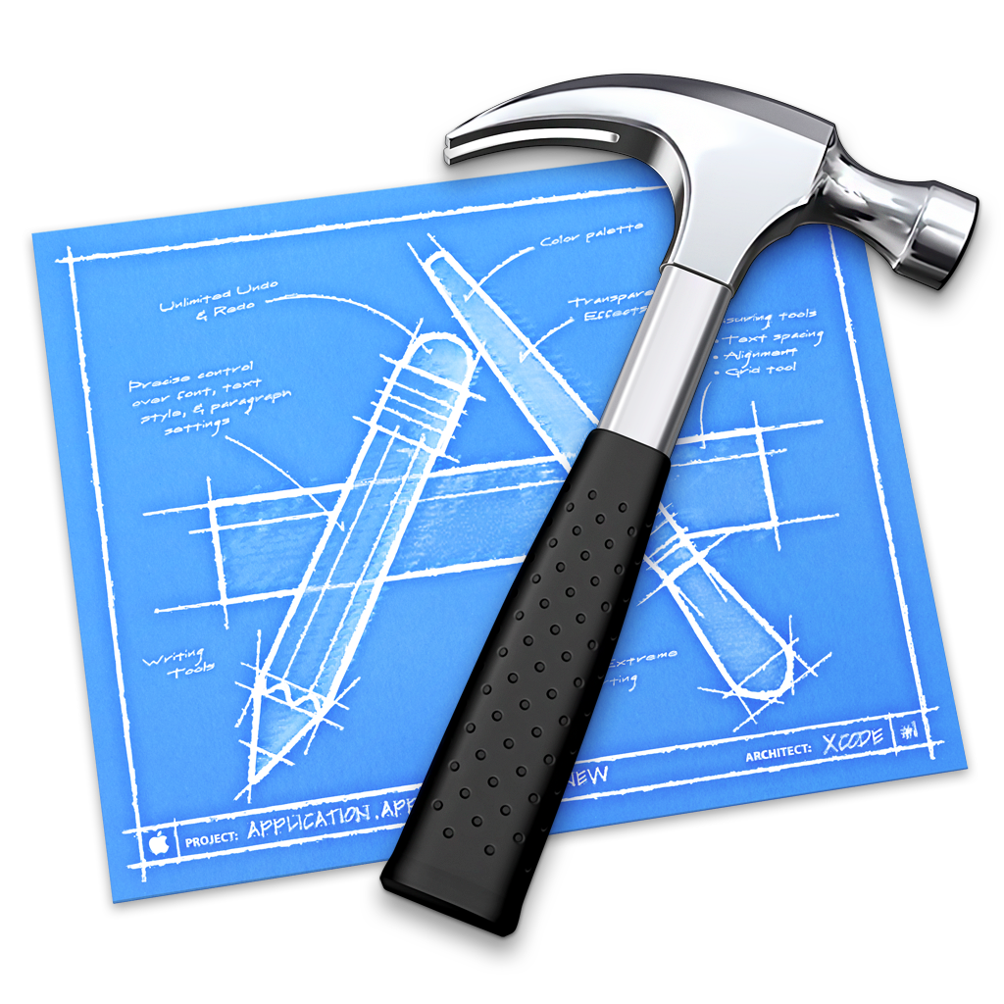
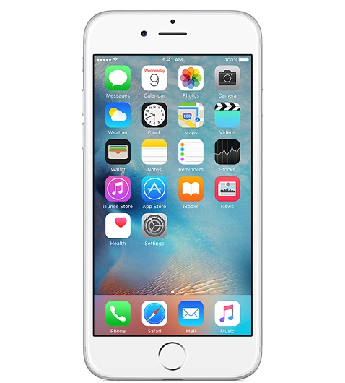
Chosen Tools
Notes:
XCode for developing iOS application in Swift
Storyboards
Container for all scenes (View Controllers, Nav Controllers, TabBar Controllers, etc.)
Good way to manage how different controllers talk to each other
Graphical interface builder
Segues
Syntax-aware + compiler-aware source editor
iPhone simulator
Git for version control

Slide 14
Implemented
Task (Medium): Suggesting an activity
Basic storage for activities
Splash Screen
Basic templates for other tasks (i.e., Play)
Finding + doing activities
  Landing page redesign
Reviewing activities
Saved activities / bookmarks
Planned

Slide 15
Wizard of Oz
Type in location when suggesting an event
Senses your location at Stanford
Signs you in as a user
Activities will be cycled through
Initial Set of Activities
Friends
Sharing between users
Hard-Coded Data
Notes:
Wizard of Oz:
Type in location instead of using a Places autocomplete API (i.e., Google or Apple Maps)
Sensing location at Stanford: not location-sensitive at the moment; location defaults to Stanford
Assumes user is already signed in
Activities currently run in a loop

Slide 16

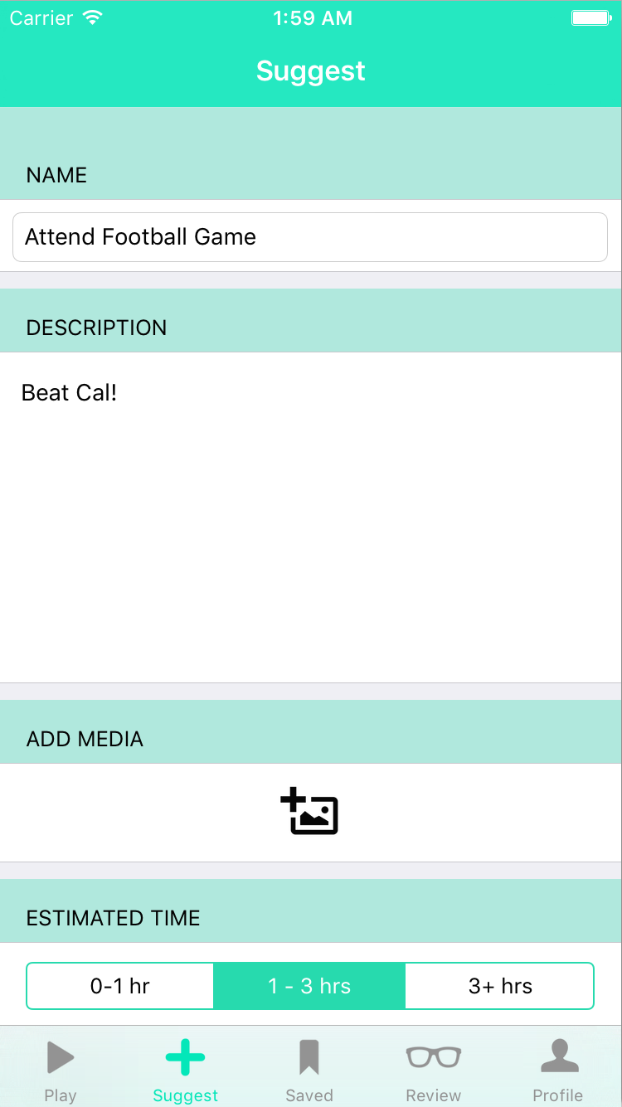
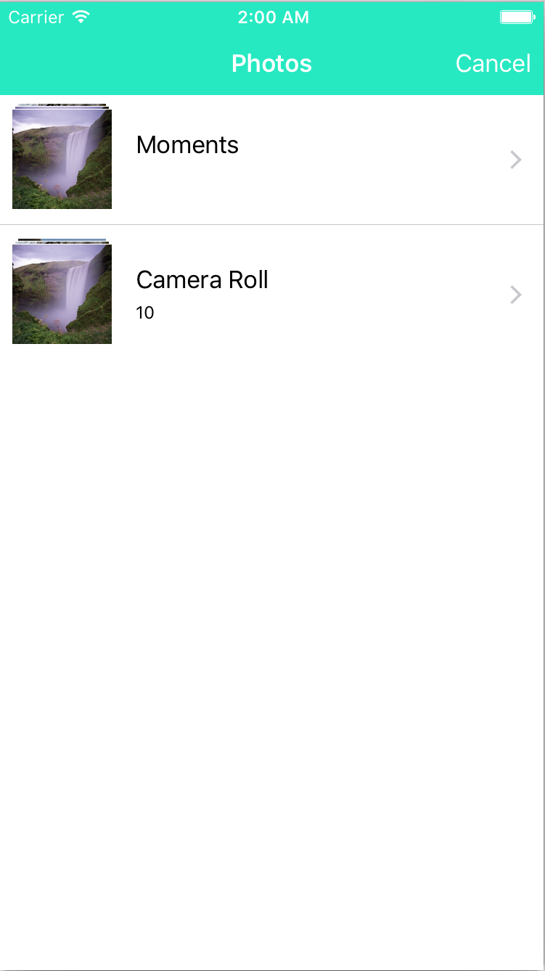
Screenshots

Slide 17
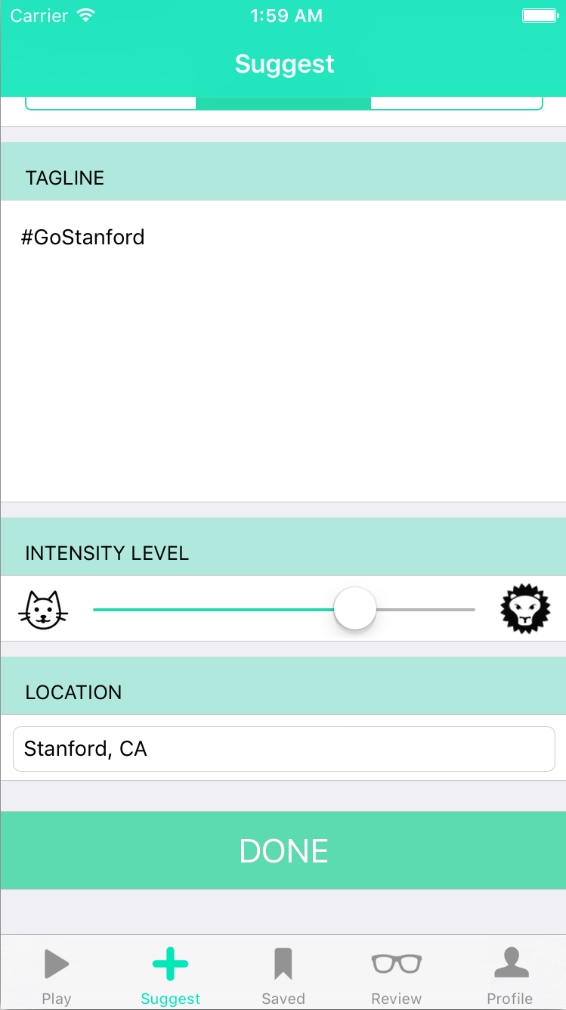
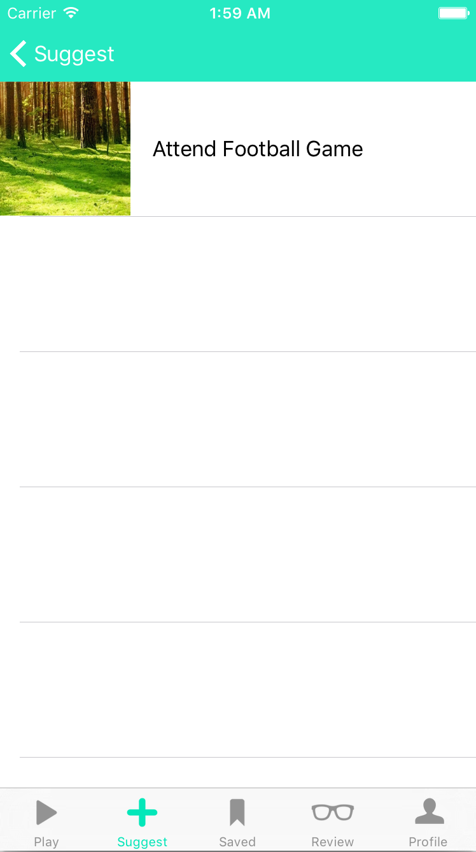
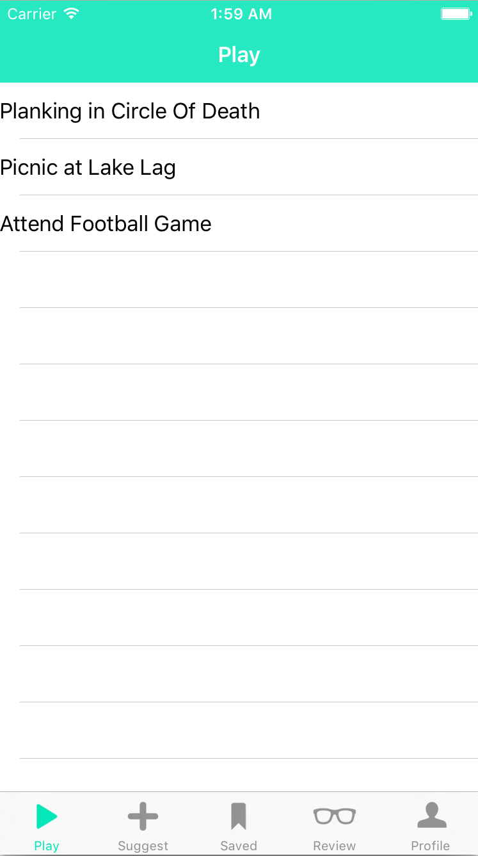
Screenshots

Slide 18
4. Hi-Fi Demo

Slide 19
Design Changes
Completed:
  Suggesting an activity
    My suggestions
  General app layout + flow
https://vimeo.com/146372879
Prototype
Continuity
Reimagined Interface
Increased User Control
Notes:
Summary

Slide 20
Thanks!

