Slide 1
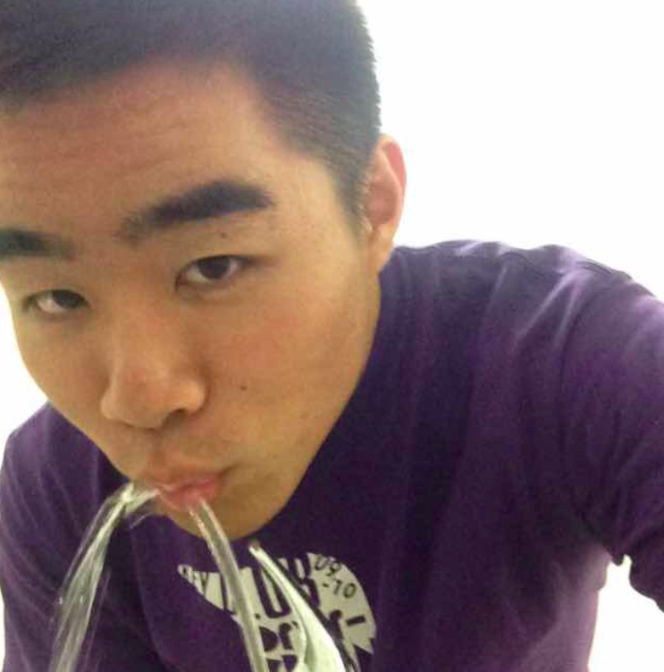

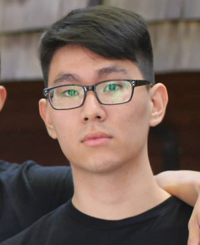
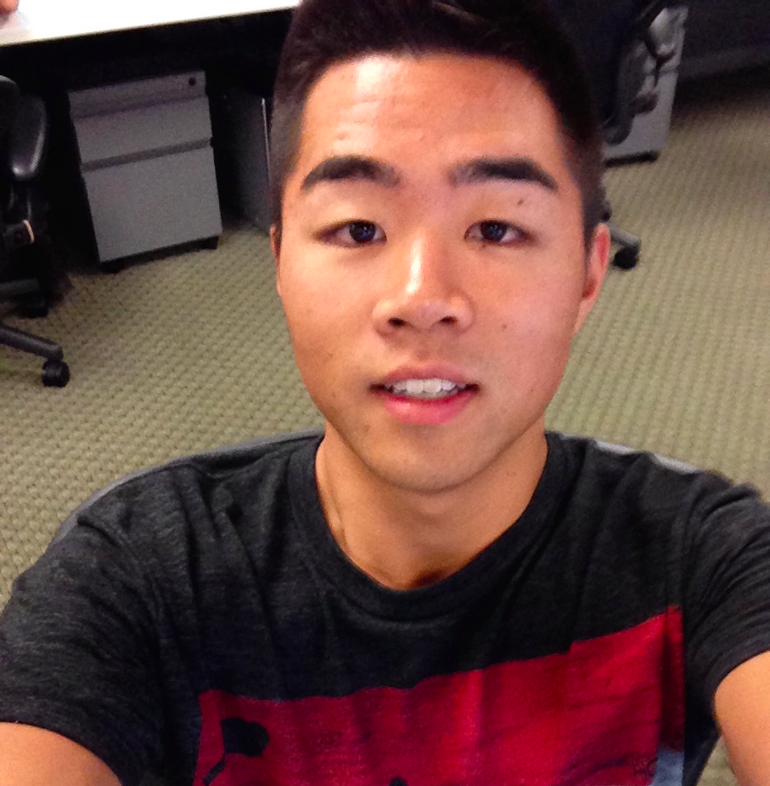
Chapter by Loco Power
Week 6: Medium-Fidelity Prototypes
Dan, Melissa, Irving, & David

Slide 2
1. Value Proposition
2. Tasks & Medium-Fi Flows
3. Revised Interface Design
4. Prototype Overview
5. Additional Prototype Images
Notes:
Overview of the presentation

Slide 3
1. Value Proposition

Slide 4

Discover locally curated activities for a location and document personal memories.
Notes:
1. Value Prop, Problem and Solution Overview (1 slide)
a. if these are already solid, reuse them. Otherwise make recommended revisions.
value prop: discover locally curated activities for a location and document personal memories.

Slide 5
2. Tasks & Medium-Fi Flows
Notes:
Tasks (1-3 slides)
a. 3 representative tasks to test your interface (labeled ​simple, medium, complex)
b. Note any changes you’ve made from the tasks on the low-fi prototype

Slide 6
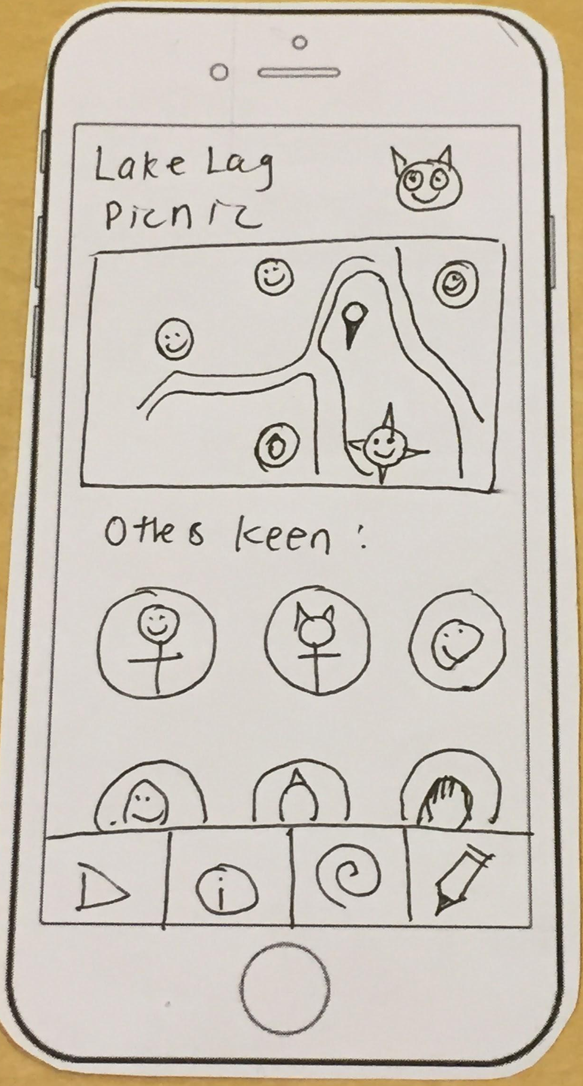
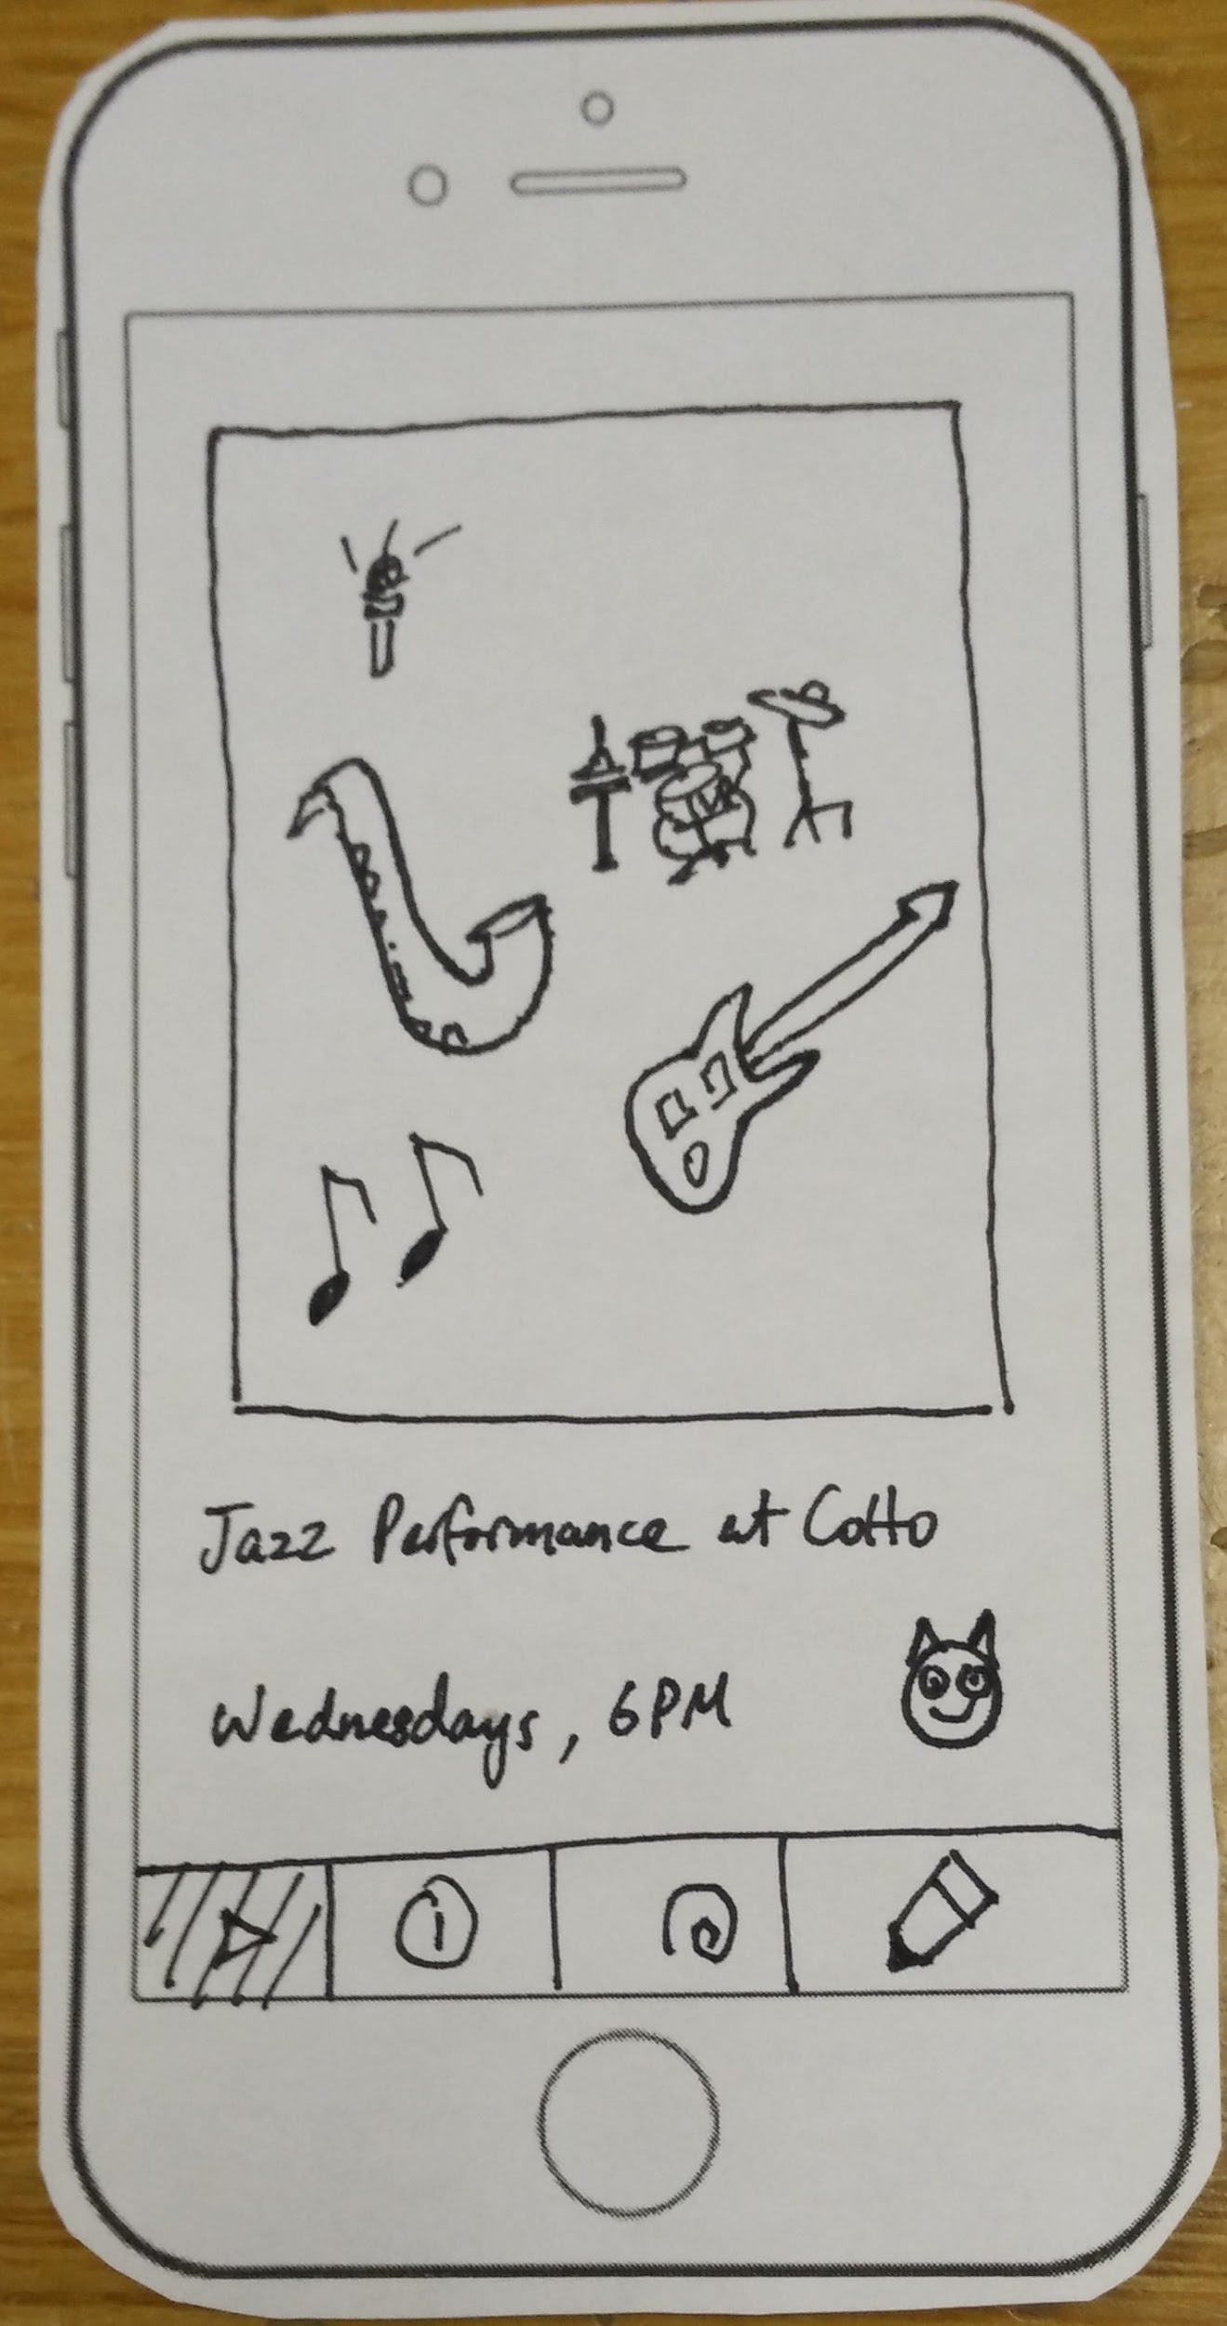
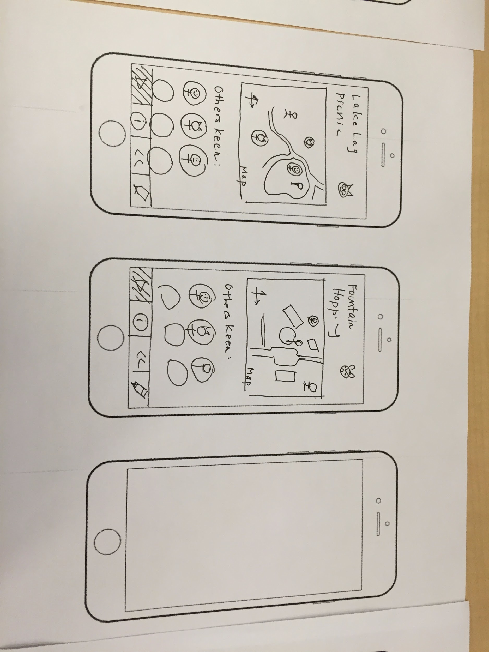
Changes
Notes:
Scrolling Down
More intuitive
Including time constraints on activities:
efficiency and positive user experience

Slide 7
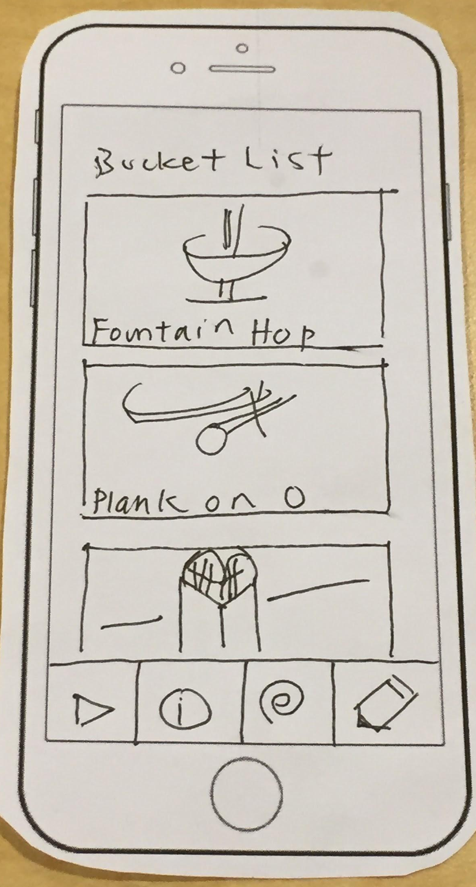
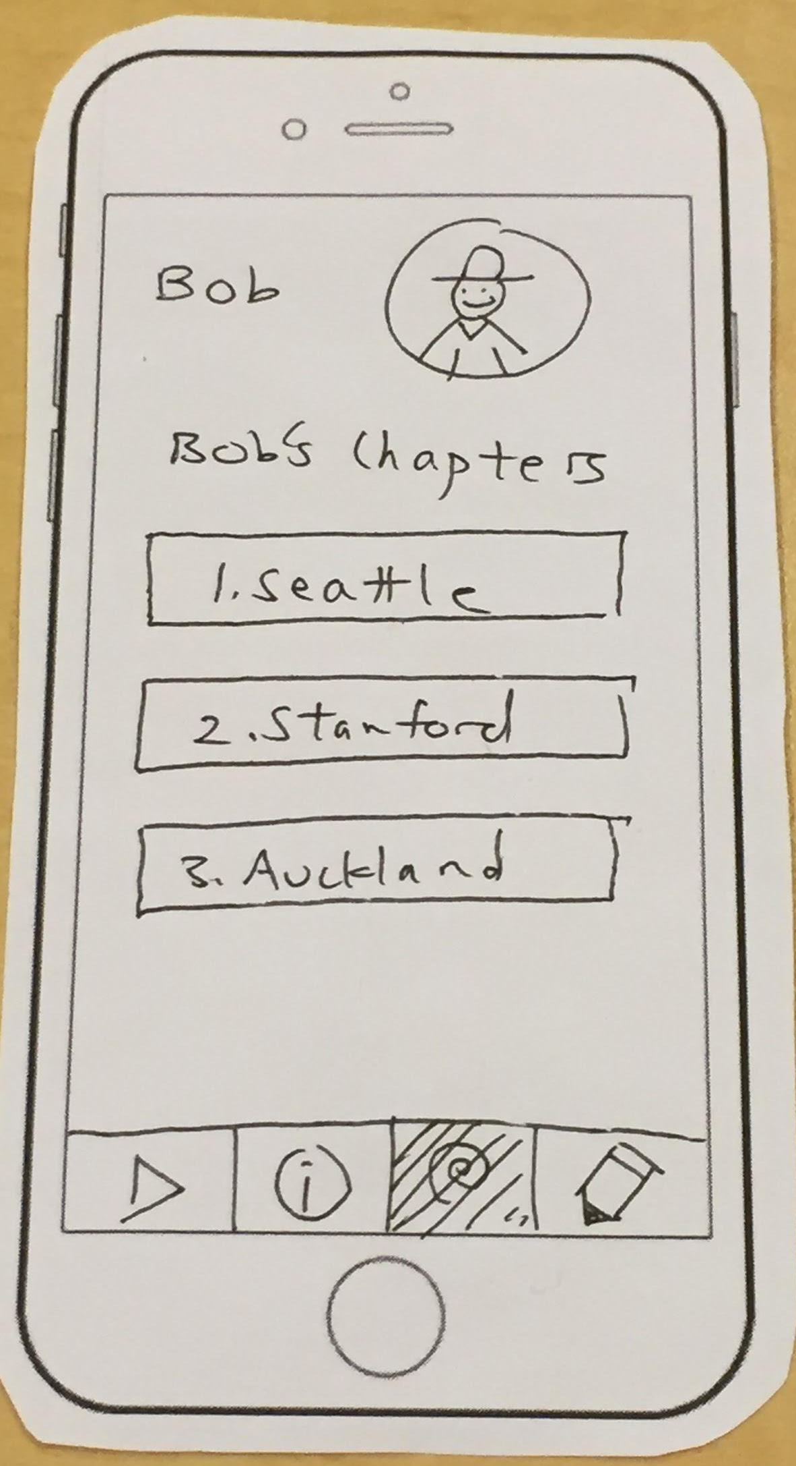
Additions
Notes:
Viewing Other User Profiles
Social networking aspect
Saving Activities
View activities later

Slide 8
Task #1: Simple
Task #2: Medium
Task #3: Complex
As a newcomer, finding interesting activities to do at a location
(i.e., Stanford).
As a local, suggesting interesting activities to do or places to go at a location.
As a regular user,
creating a story of memories when in a new place.
Notes:
Working with the same tasks as last week - looking at how different segments of users would interact with Chapter
From the perspective of a newcomer, local, and regular user.
Simple: Finding activities
Medium: Suggesting
Complex: creating a story from your activities

Slide 9
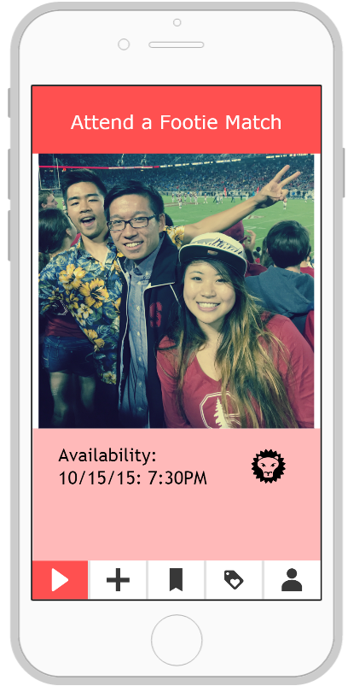
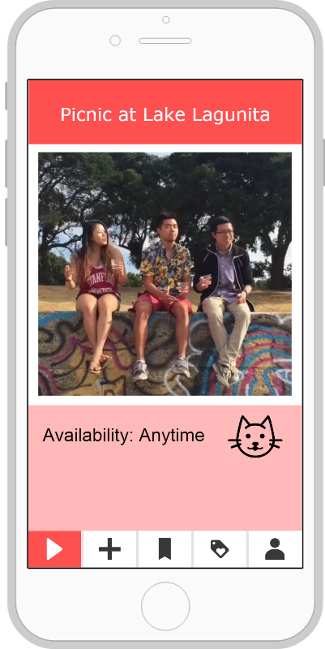
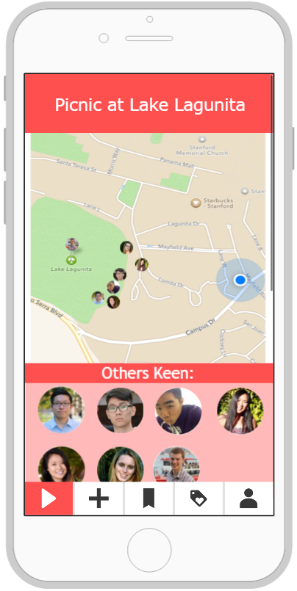
Swipe Left
Swipe Right
Task #1:
As a newcomer, finding interesting activities to do at a location (i.e., Stanford).
Notes:
The app presents activities one by one and user can interact with the suggested activity using “Tinder-esque” actions:
swipe left to pass,
right to accept activity,
and down to save the event for later or “bookmark”.
Each swipe right gives the user detailed information about the locations of the event and others who are currently doing the activity.

Slide 10
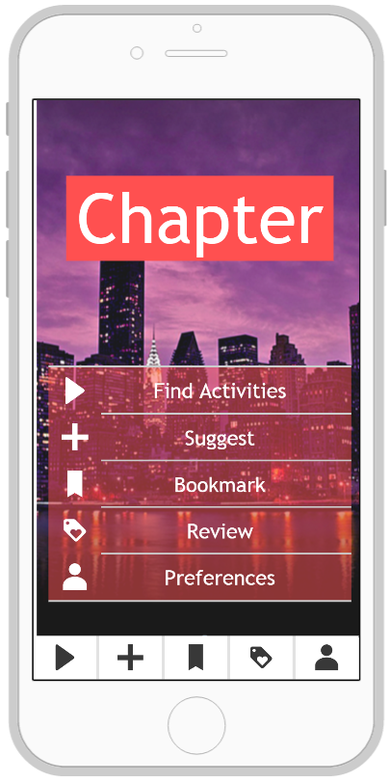
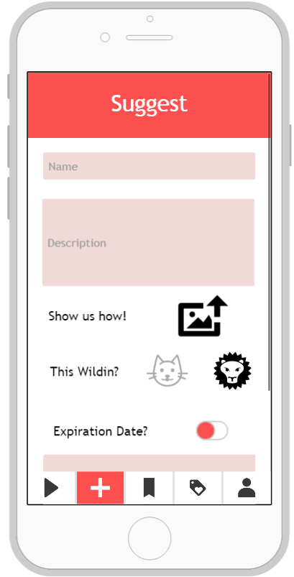
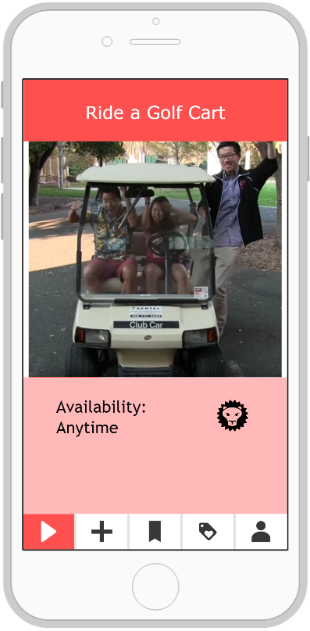
Task #2:
As a local, suggesting interesting activities to do or places to go at a location.
Notes:
In creating or suggesting, we wanted the user to be able to guide those interested in doing the event so we gave the local space to add parameters and insights.
Notice: insight we got from experience prototypes was adding notable restrictions to the activity description

Slide 11
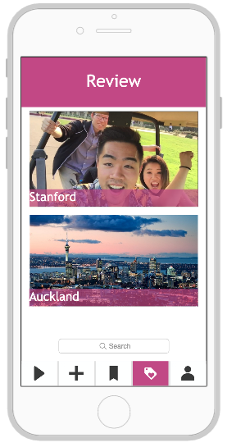
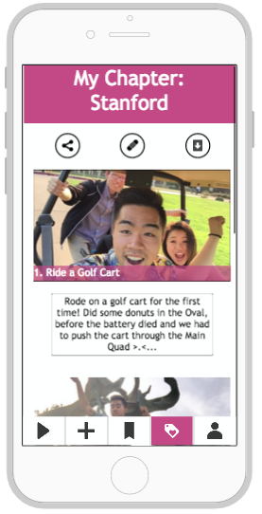
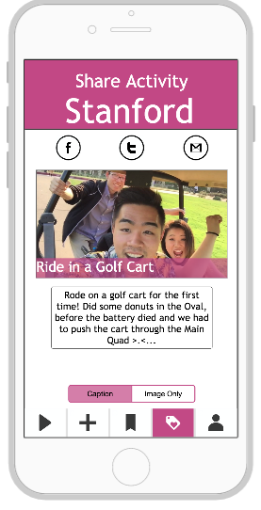
Task #3:
As a regular user, creating a story of memories when in a new place.
Notes:
Final task, creating a story from your memories to be logged in your Chapter.
Addi
Notice: different color is used for “documenting personal memories” vs. “finding activities” in order to make it more intuitive for the user to know what feature they are exploring.

Slide 12
3.Revised Interface Design
Notes:
3. Revised Interface Design (~6 slides)
a. Major Design Changes​- Present the 3 biggest changes between your low-fi sketches (from last week) and the new sketches of your updated interface. Show the before​and after sketches and explain your rationale ​for making those changes.
Icons
bookmarks
“others keen” - social network

Slide 13
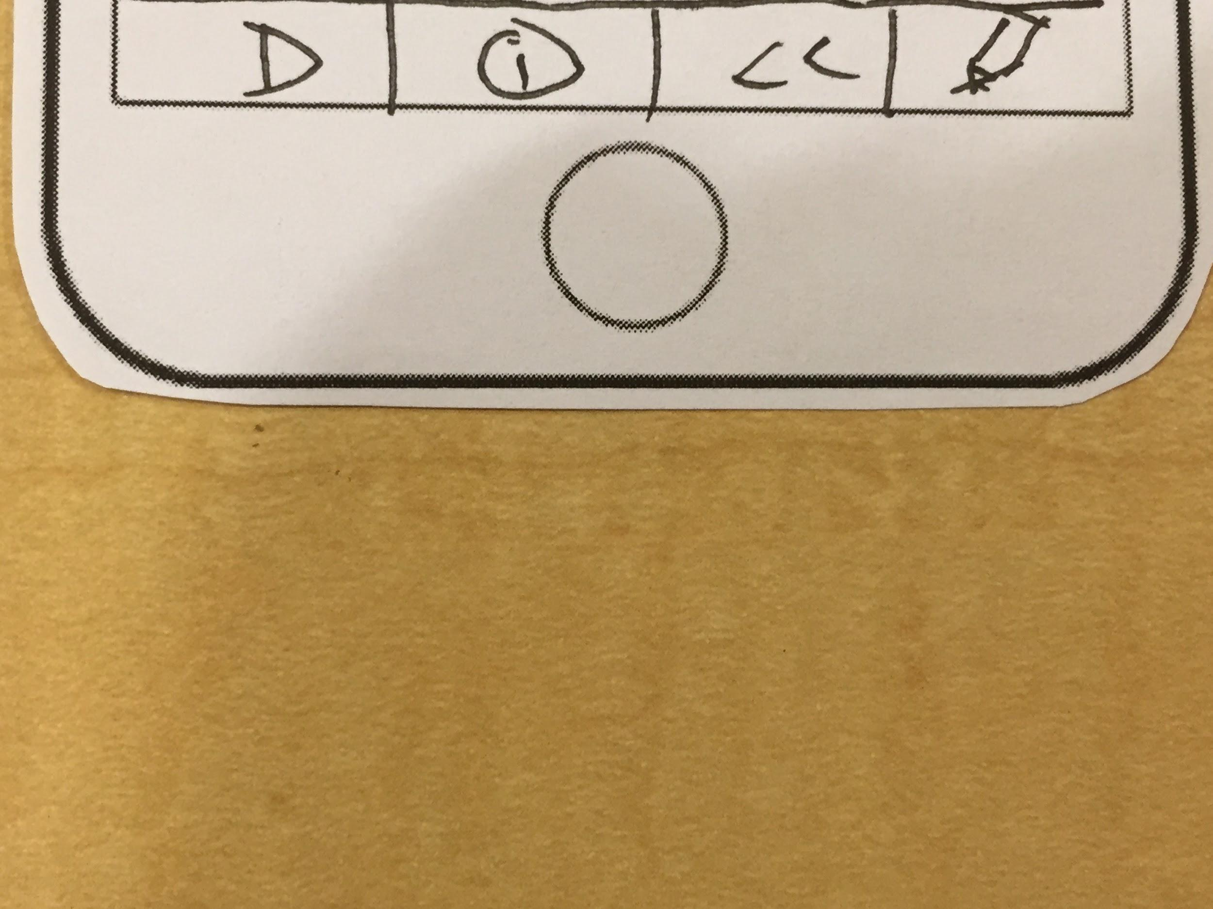
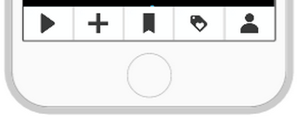
Change #1:
Clarify all components needed for functionality
Include new functions gleaned from prototype interviews
Key: Intuition
Icons

Slide 14
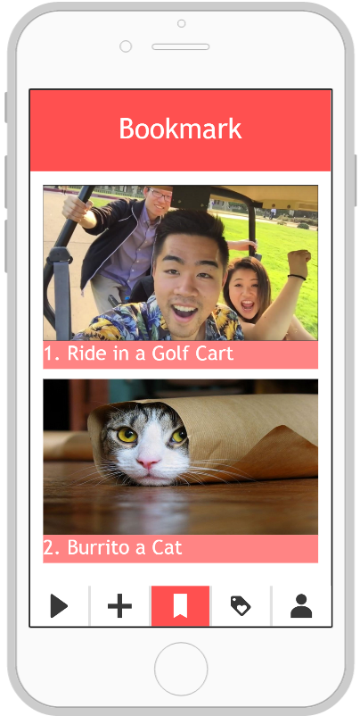
Change #2:
“What if I don’t have time to do the activity now, but want to save it for later?”
Key: Continued use
Bookmark

Slide 15
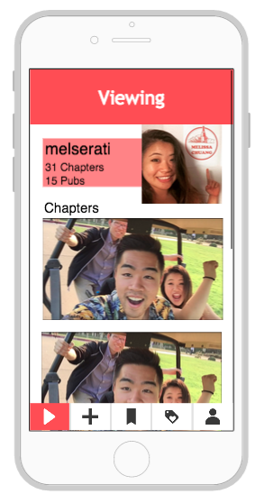
Change #3:
“Can you see your friends’ Chapters?”
View other people’s profiles in your radius
Key: Social networks
Others Keen

Slide 16
4.Prototype Overview
Notes:
Prototype Overview (3 slides)
a. Prototyping Tools
■ What did you use?
■ How the tool helped
■ How the tool did not help
b. Limitations/tradeoffs of the current prototype (What was left out and why)
c. Any Wizard of Oz techniques required to make it work
d. Hand-coded features and why required

Slide 17

Pros
Cons
Lots of preset icons & templates.
Multi-user functions
Simple, clean interface
Collaboration
Many functions not intuitive
Plain native project assets
Steep learning curve
Notes:
Pros
able to drag and drop

Slide 18
Limitations
Wizard of oz
Crowdsourcing aspect could not be implemented
Real-time location tracking
Cannot create social network, implement “Bookmarking”, or personalize
Looped constant activities
Hardcoded people and maps
Import from external source

Slide 19
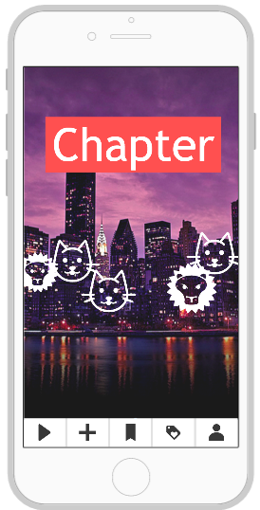
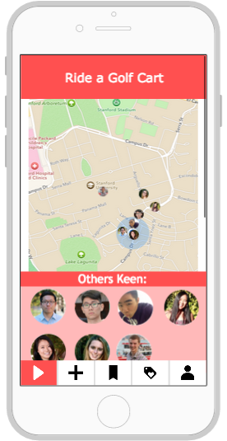
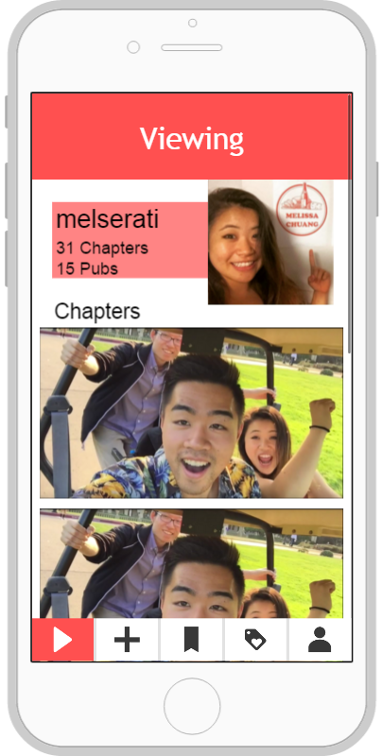
Hardcoded Features
Notes:
Homescreen background changes based on location, static for now
Navigation is all hardcoded, not dynamic and you cannot set a radius at this point in time.
For each profile, everything is hardcoded. Only Melissa’s profile can be viewed
Additionally, you can’t discard an activity or bookmark an activity for later. With only 3 activities, you will cycle between these 3 activities forever.

Slide 20
5. Additional Prototype Images
Notes:
5. Any additional prototype screenshots (as many as needed)

Slide 21
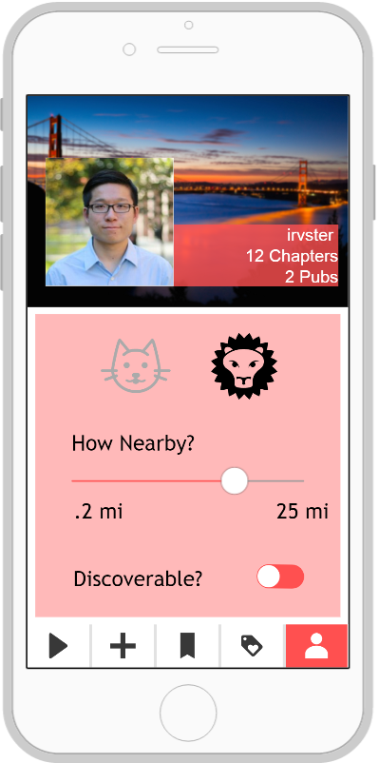

Slide 22
Links
Website
Medium-Fidelity Prototype
Notes:
Lowly Rated Activities
Delete activities with many low ratings
Scrolling Down
More intuitive
Saving Activities
View activities later
Viewing Other User Profiles
Social networking aspect

Slide 23
Thanks!

