Slide 1
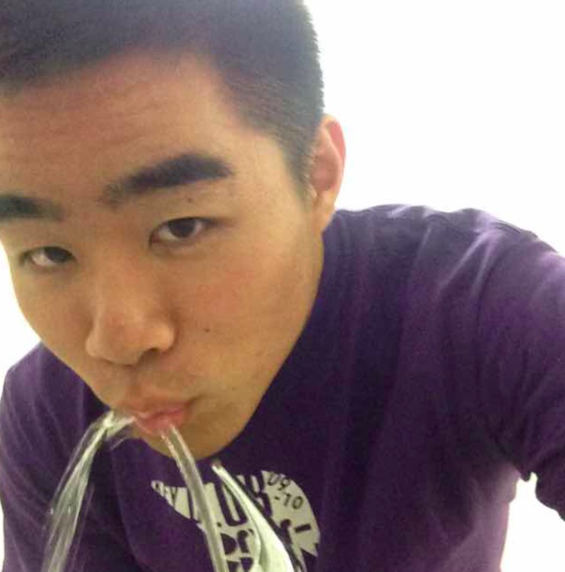
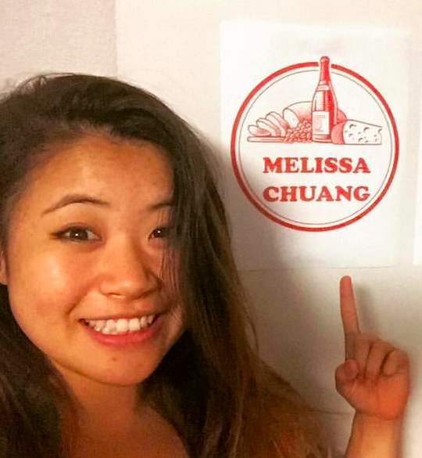
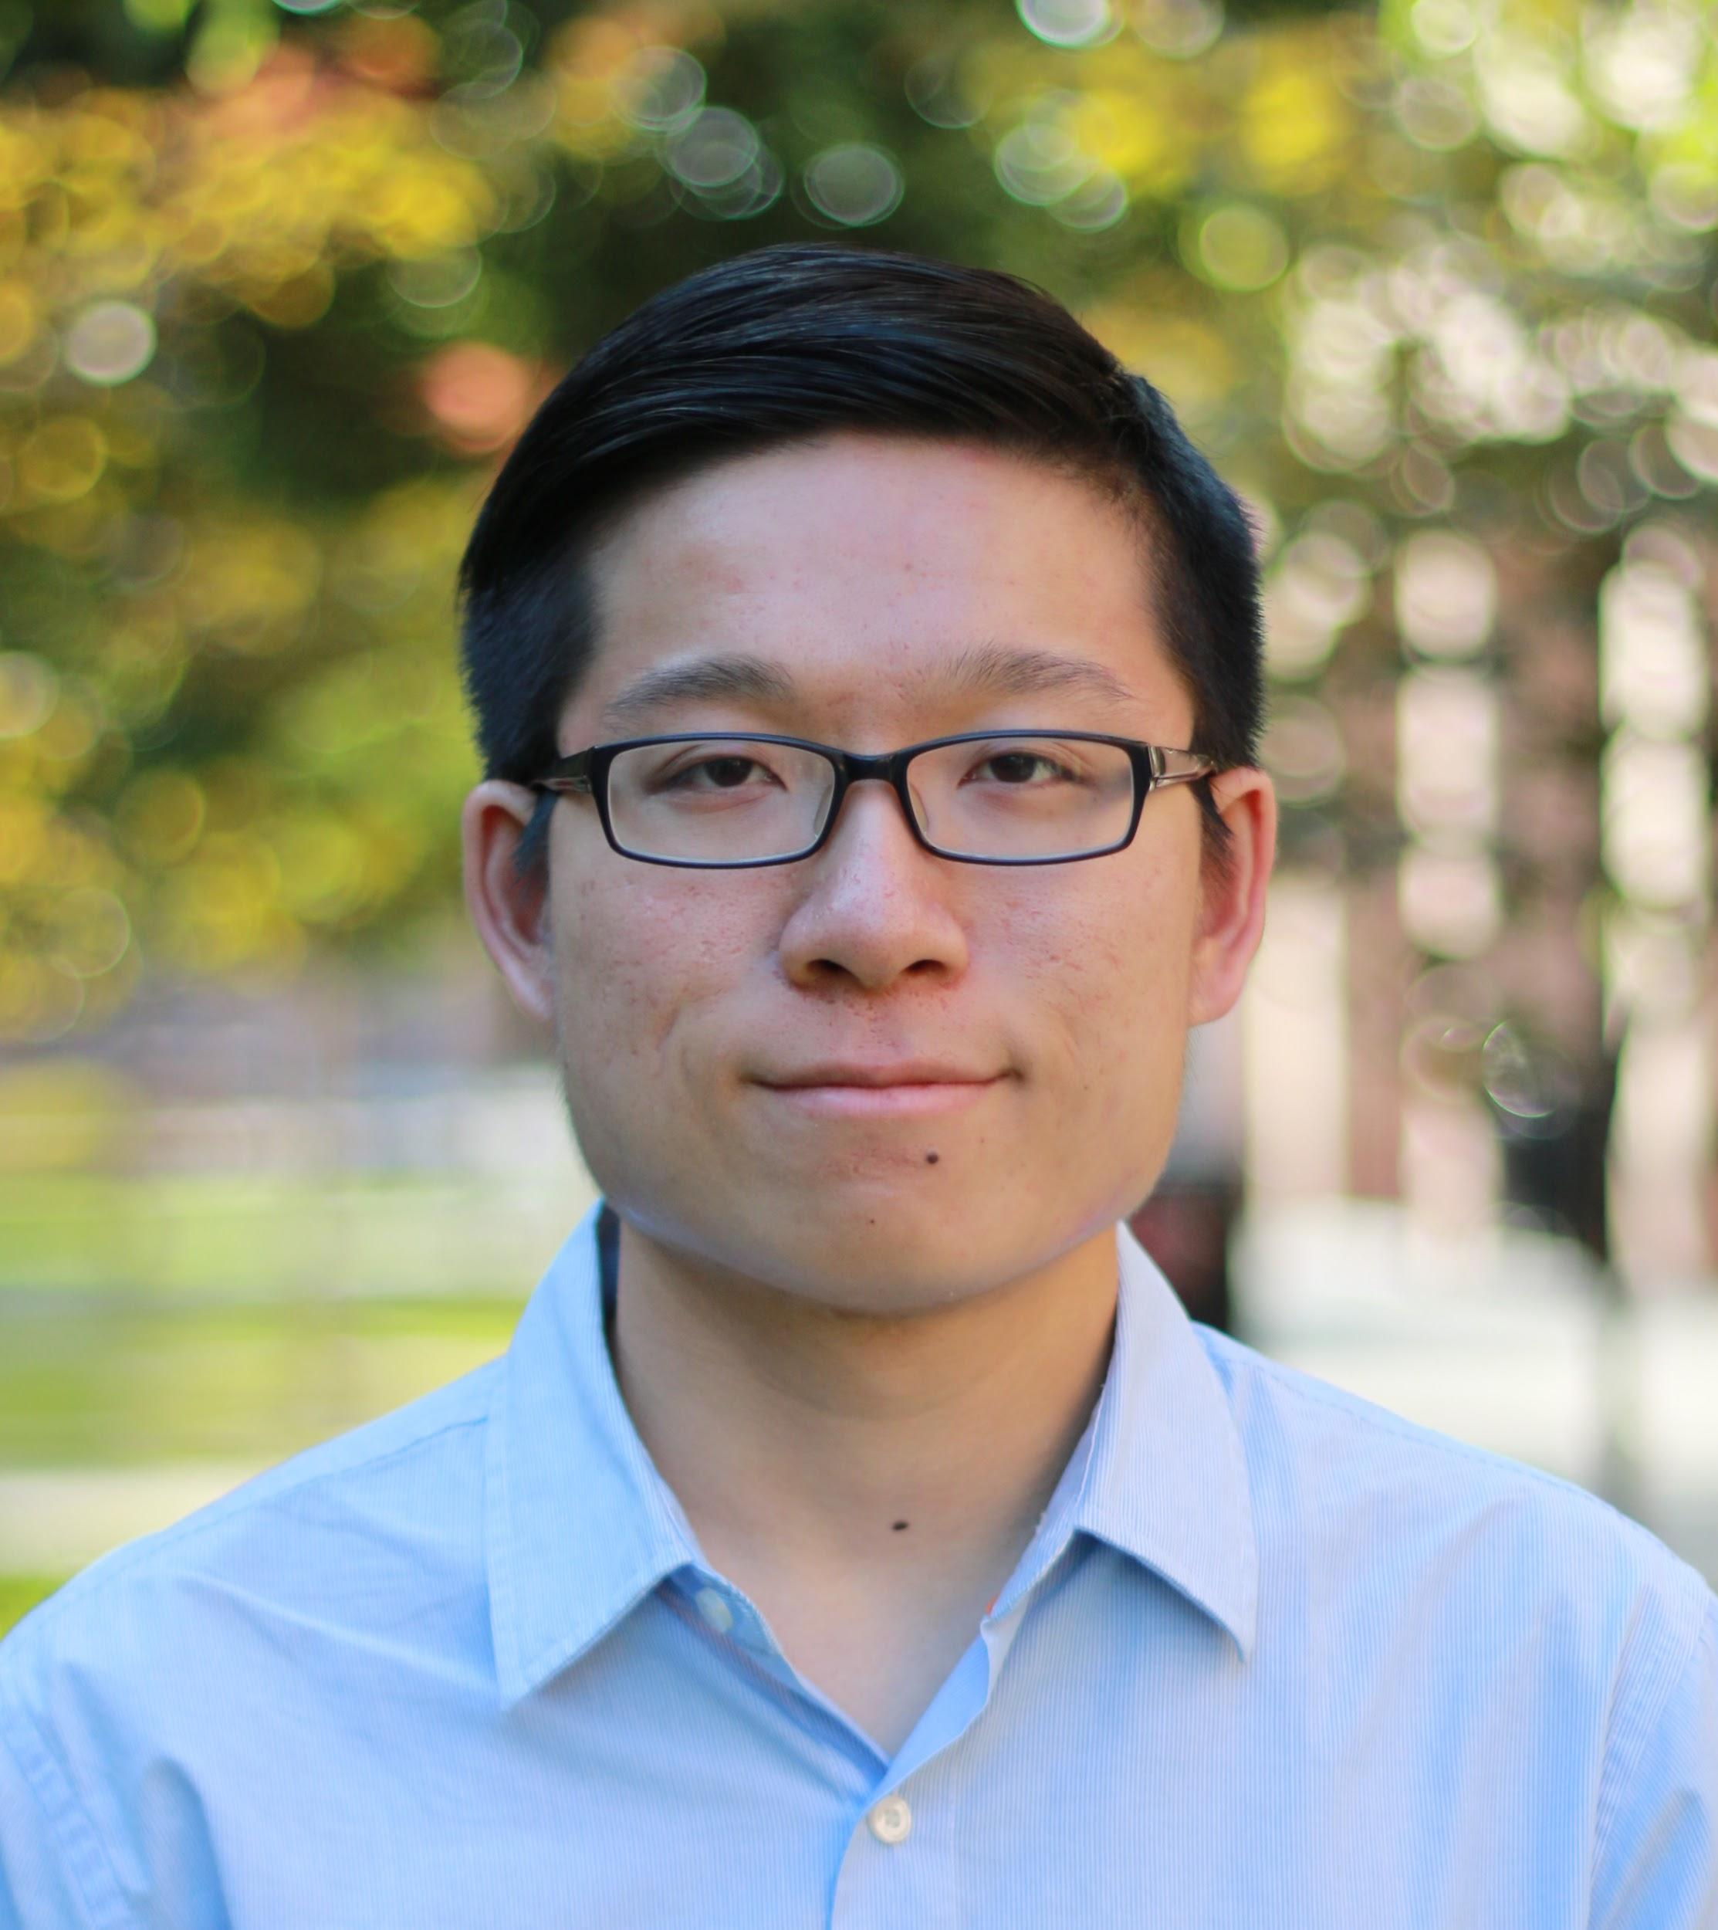
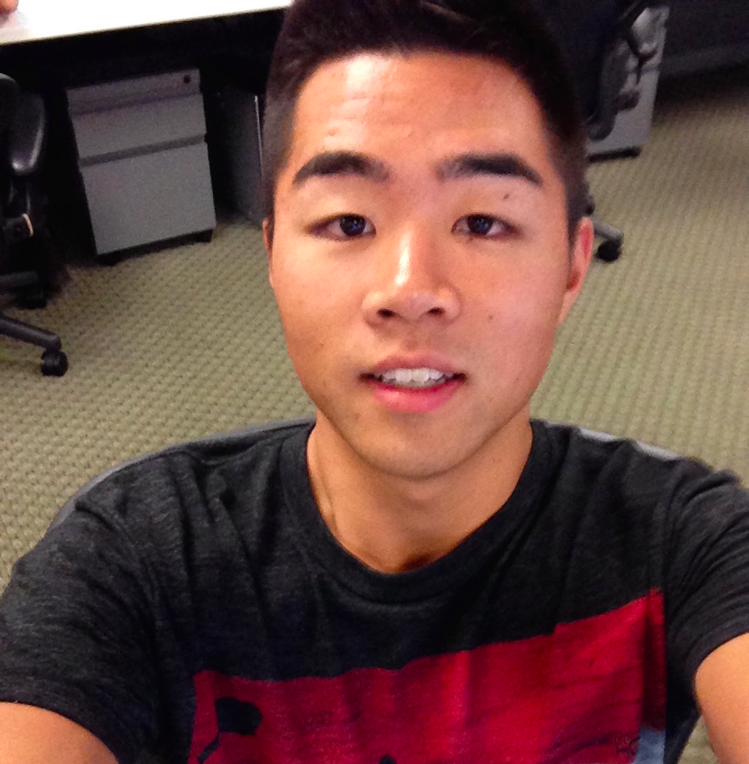
Crowd Power: Location
Week 3: Concept Video
Dan, Melissa, Irving, & David

Slide 2
Value Proposition
Problem/Solution Overview
Three Tasks
Video Storyboards
Concept Video

Slide 3
Chapter
“Find your next adventure”

Slide 4
Value Proposition
Discover your activities in a location, crowdsourced by those who know best.

Slide 5
Problem/Solution Overview
How do you find the best activities to do at a location? Because locals in the area know the coolest spots around, they can help crowdsource fun, engaging activities to do. After doing these activities, Chapter creates a new story in your book of adventures for you to relive.

Slide 6
Three Tasks
1.As a newcomer, finding interesting activities to do at a location (i.e., Stanford) (Simple)
2.As a local, suggesting interesting activities to do or places to go at a location (Moderate)
3.Creating a story of memories when in a new place. (Complex)

Slide 7
Concept Video
YouTube: https://youtu.be/ZGQXWJ2bgXk
Vimeo: https://vimeo.com/142613820

Slide 8
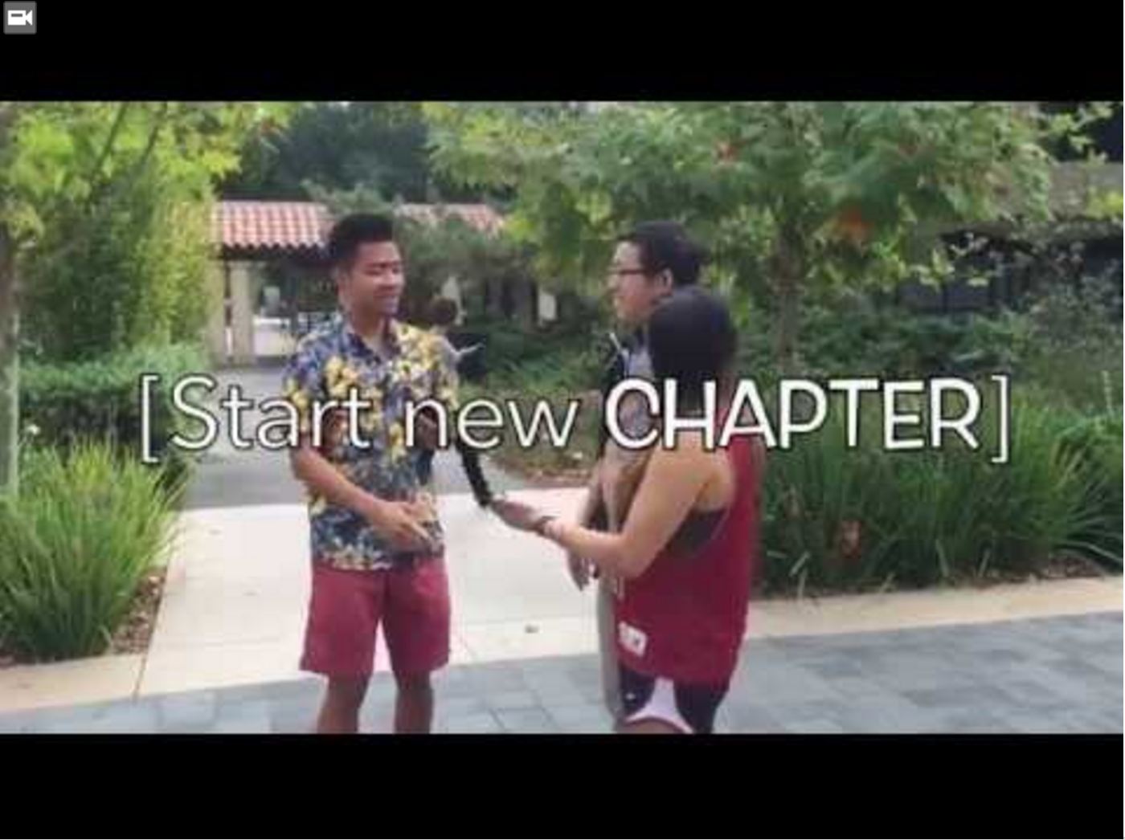

Slide 9
Video Storyboards

Slide 10
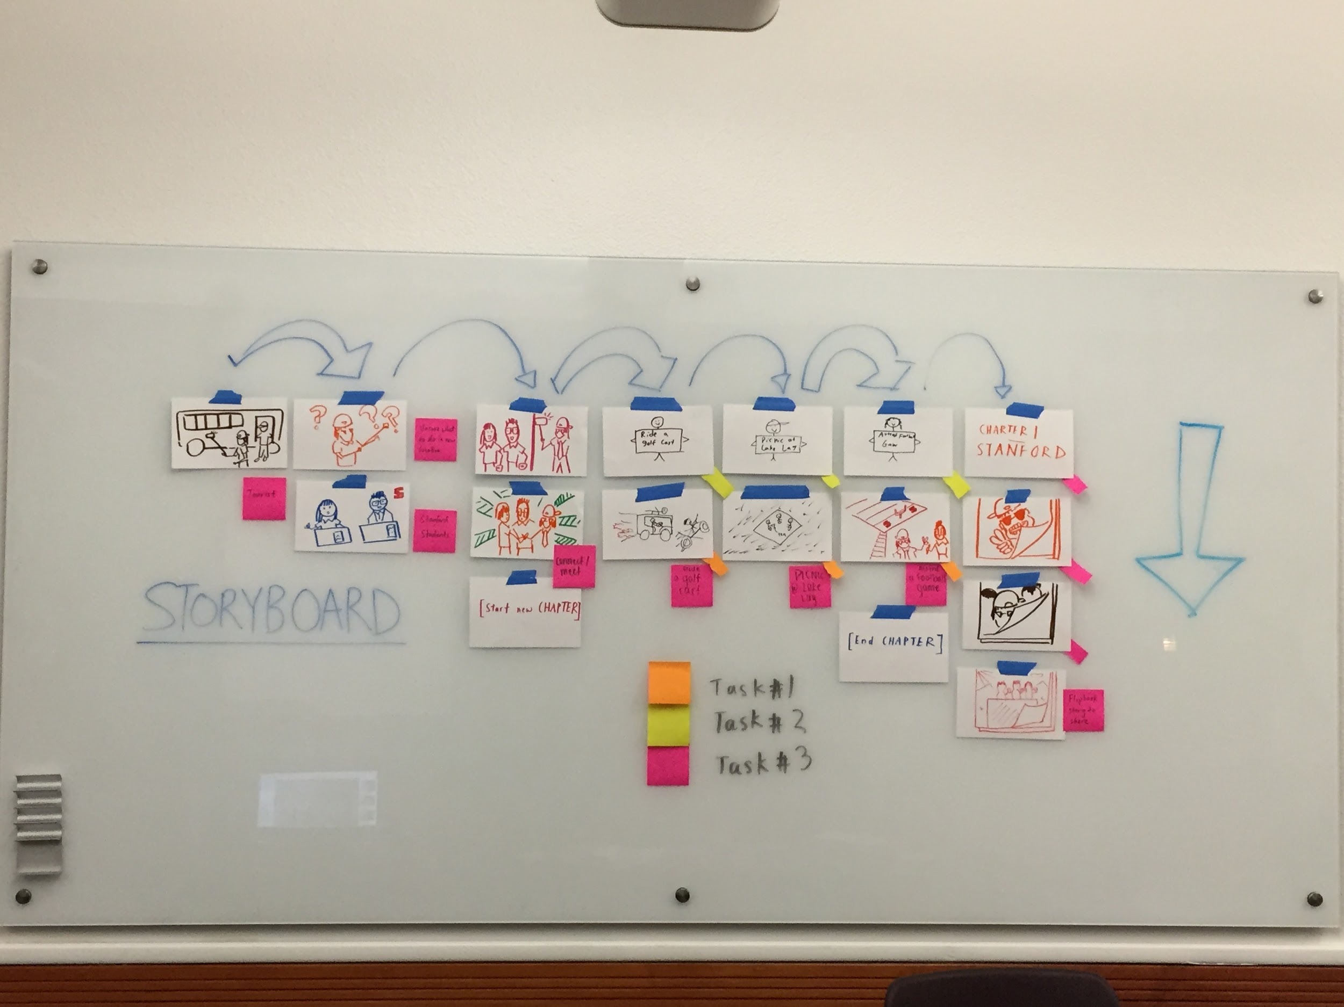
Notes:
Storyboard overview

Slide 11
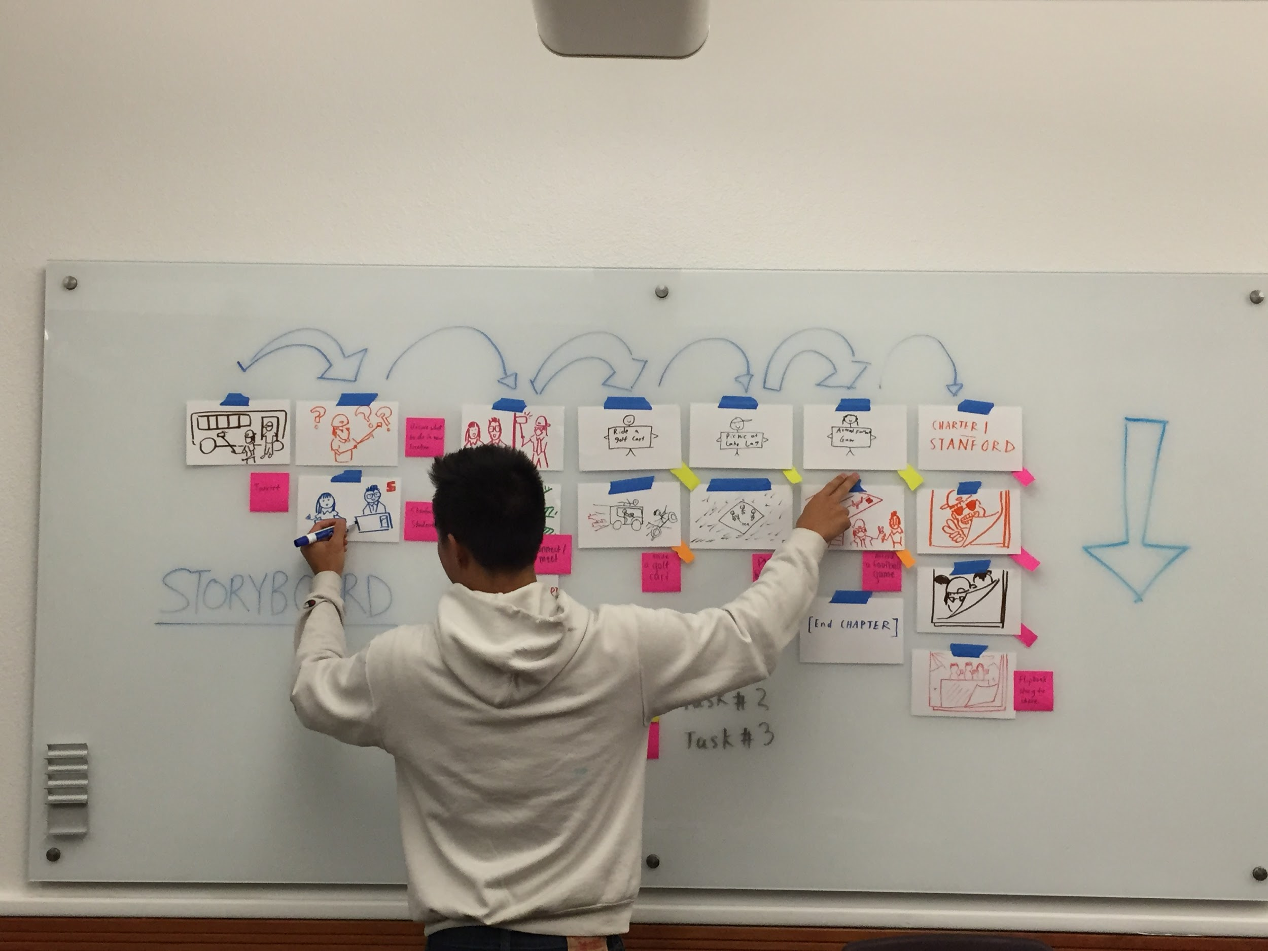

Slide 12
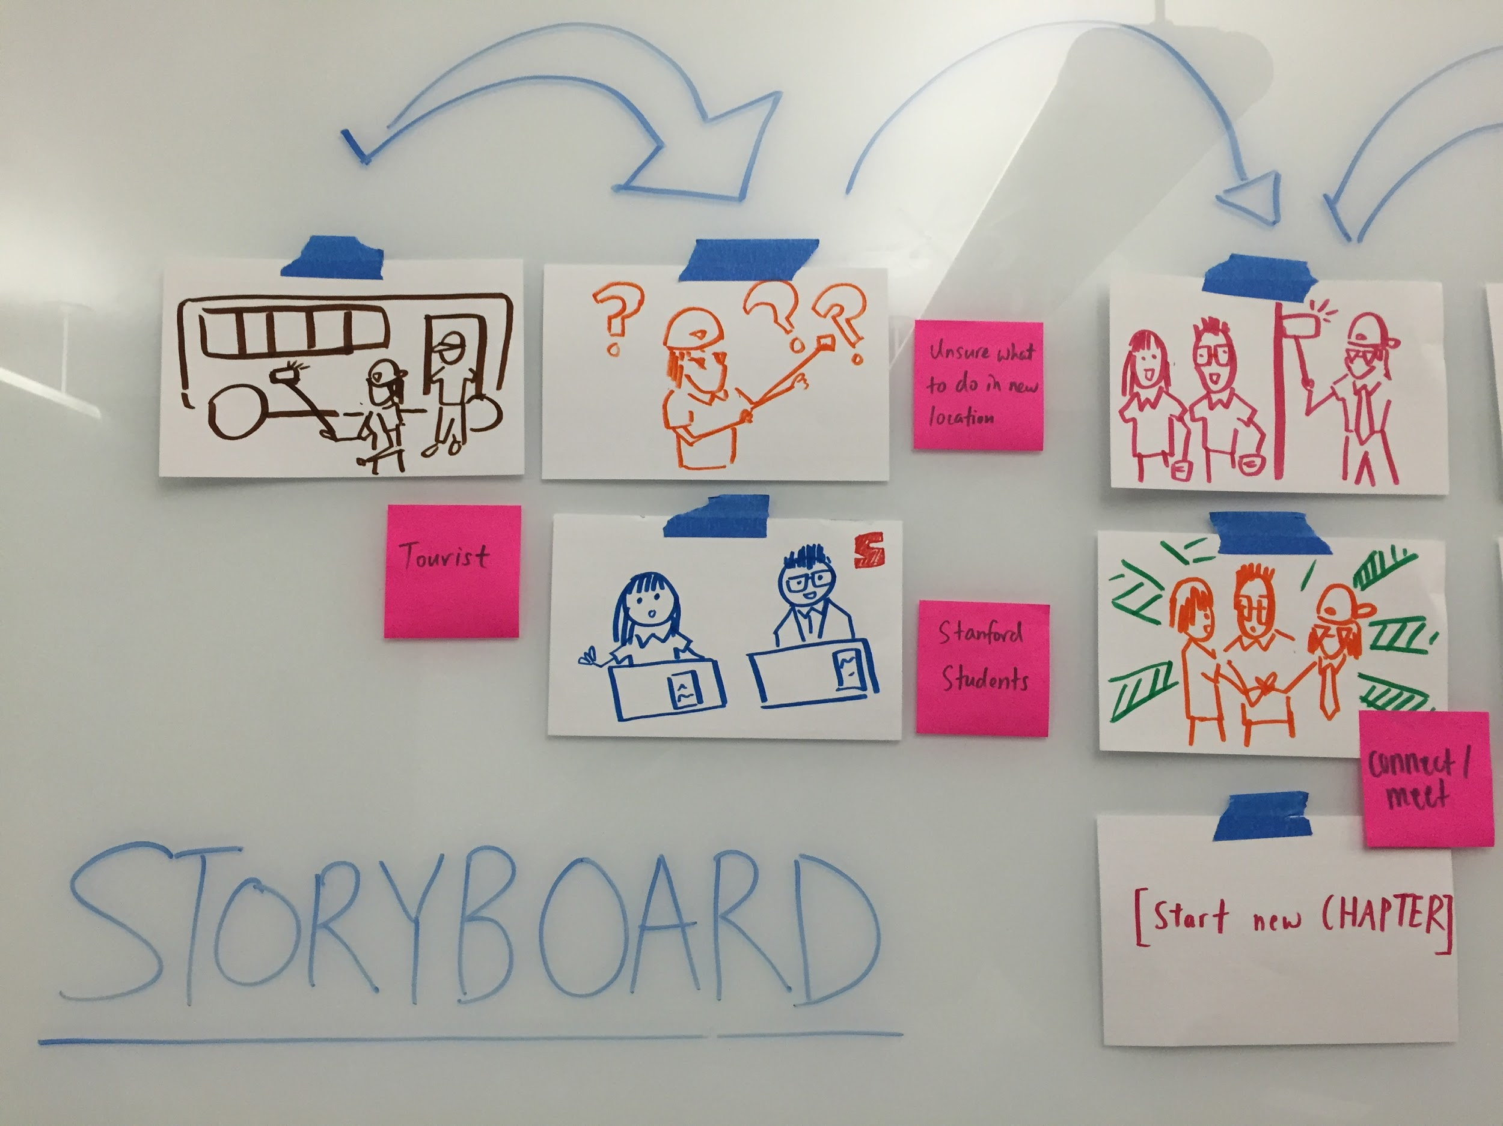
Notes:
1. As a newcomer, finding interesting activities to do at a location (i.e., Stanford) (Simple)
2.As a local, suggesting interesting activities to do or places to go at a location (Moderate)
3.Creating a story of memories when in a new place. (Complex)
The video begins with a tourist arriving at Stanford, excited to explore the new location. He wanders into a hallway with a large number of posters and advertisements, and doesn’t know what to do next. Meanwhile, two Stanford students bored of studying decide to start a spontaneous adventure, consisting of crowdsourced activities. The tourist is notified of this event, meets up with the students, and starts a new chapter in his visit to Stanford.

Slide 13
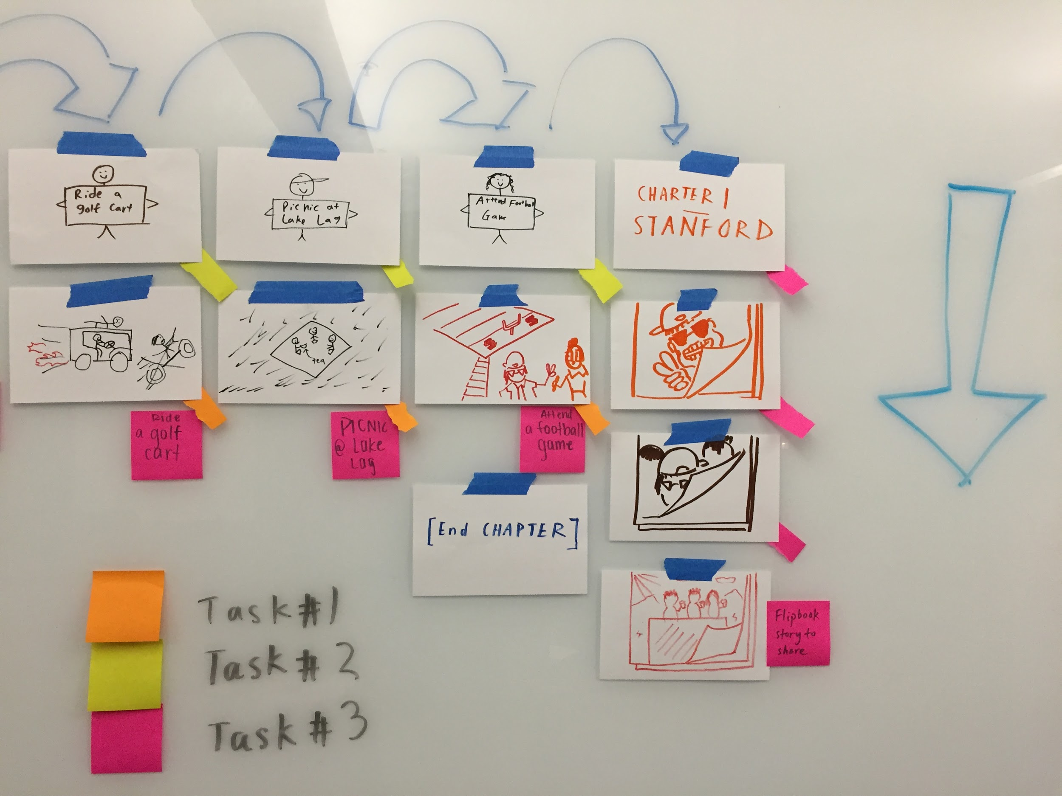
Notes:
The video proceeds with the tourist and the students engaging in a series of activities. Together, the group of friends accept and complete a series of spontaneous activities, forming lasting memories in the process. The activities shown in the video include: 1) Riding a golf cart
2) Picnicking at Lake Lagunita
2) Attending a football game
During each activity, the friends take snapshots of particularly memorable scenes. Together, the pictures form a scrapbook-like story journaling the adventures of the group, and the tourist’s latest chapter at Stanford.

Slide 14
Thanks!

