Slide 1
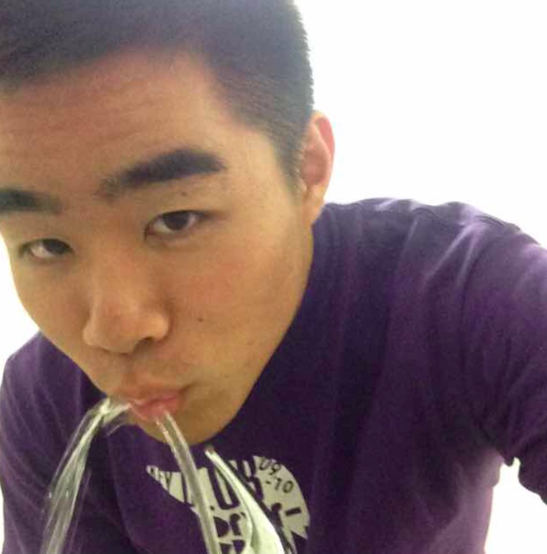
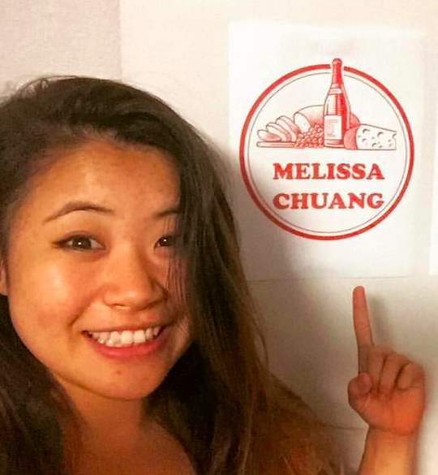
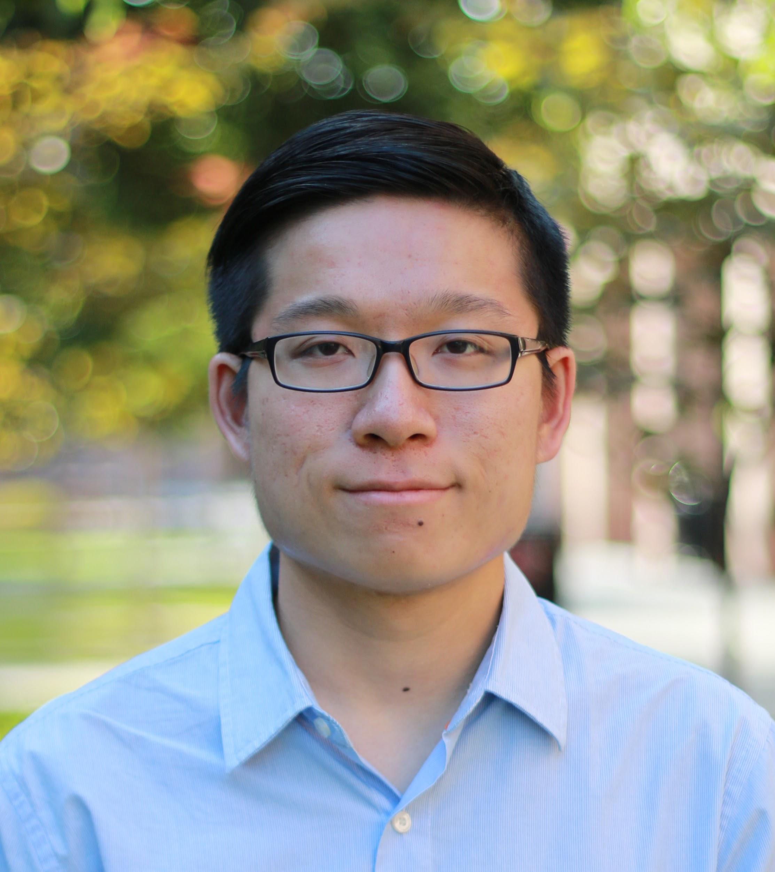
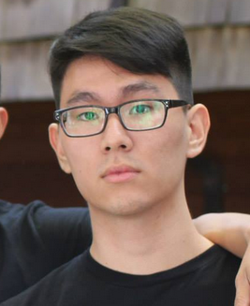
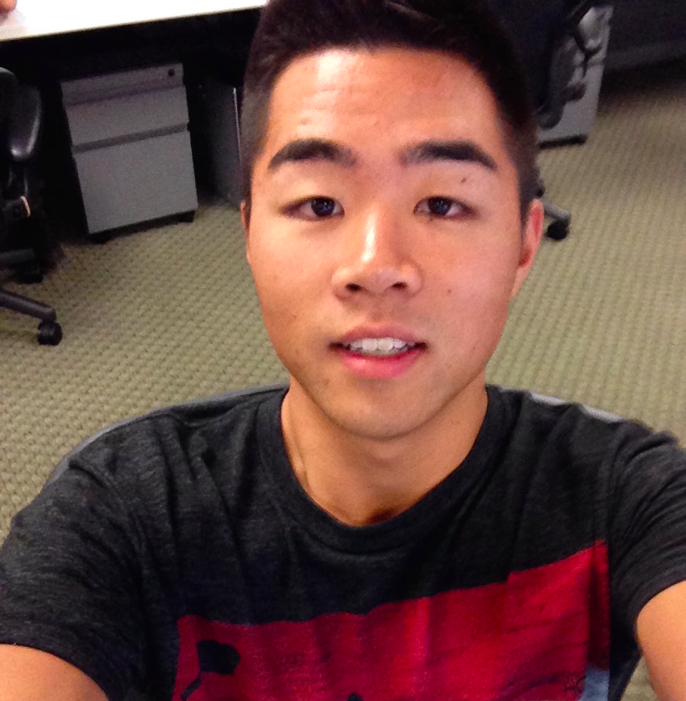
Crowd Power: Location
Week 2: POV & Experiences
Dan, Melissa, Irving, & David
Notes:
Hi, my name is Dan. Our domain of interest was location, and how to harness crowd power to inform and color people’s experiences in a new environment

Slide 2
Initial POV
Interviews
Revised POVs
+ Solution + Prototype
Notes:
This presentation will be divided into four parts.
Initial POV
The needfinding results we obtained from our additional interviews.
Three revised POVs based on the new insights we gained from the interviews, and present the corresponding top 3 HMW statements. Finally, we conclude with our experience prototypes, and the insights gained from them.

Slide 3
Initial POV

Slide 4
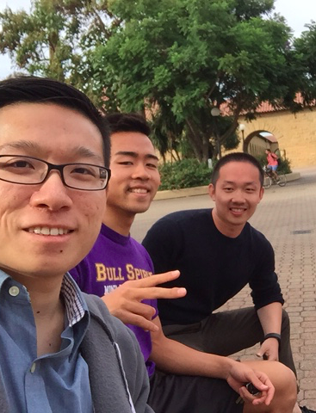
Met…
Amazed that…
Game Changing to…
he talked at length of using social apps to meet people, but very little on actual physical interactions
lower the risk of forming relationships with people in a new place.
Notes:
Through initial need finding, we created the following POV.

Slide 5
2. Interviews
Notes:
During the initial interviews, we focused on new places, in the context of a vacation. In this iteration, we interviewed people who traveled to new places as a part of their occupation.

Slide 6
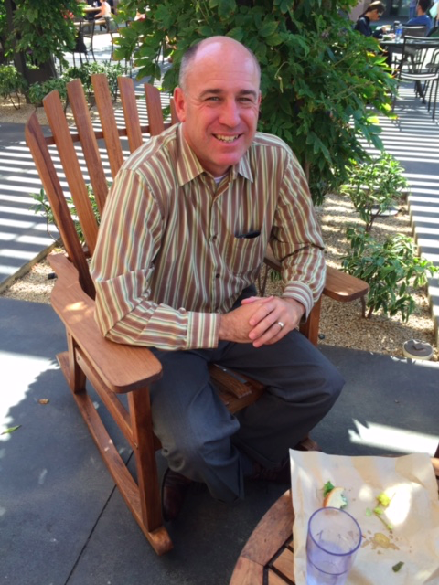
Say/DO
Darin Evans
“My job’s to provide ample time for relationships and pastimes to rekindle.”
“Scavenger hunts...don’t force us to be social if we don’t have to be.”
Notes:
Senior event planner at Stanford University, traveling a lot for events.
A lot of thought into what makes a good event - cater toward final goal.

Slide 7
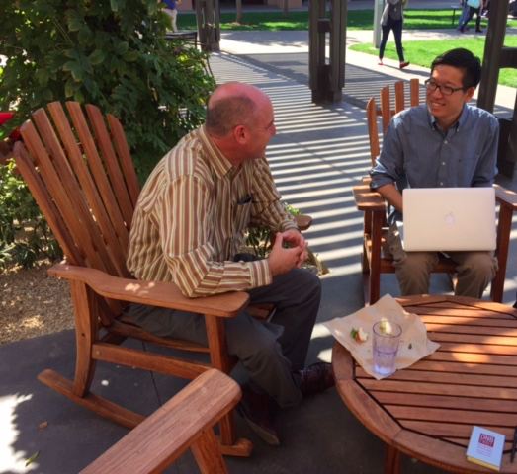
Darin Evans
Think/Feel
Embraces a people-centric job, but hints at his introversion*
Empathizes the audience’s needs for events.
Understands how requirements change depending on the type of event/party.
Notes:
Contradictions
“don’t force us to be social”
Above quotation on scavenger hunts suggests that Darin is an introvert, which was a contradiction to a very people-centric job like events planning. This made us appreciate the need for someone not necessarily extroverted to pay attention to detail and the necessary structure to be able to make an event successful.

Slide 8
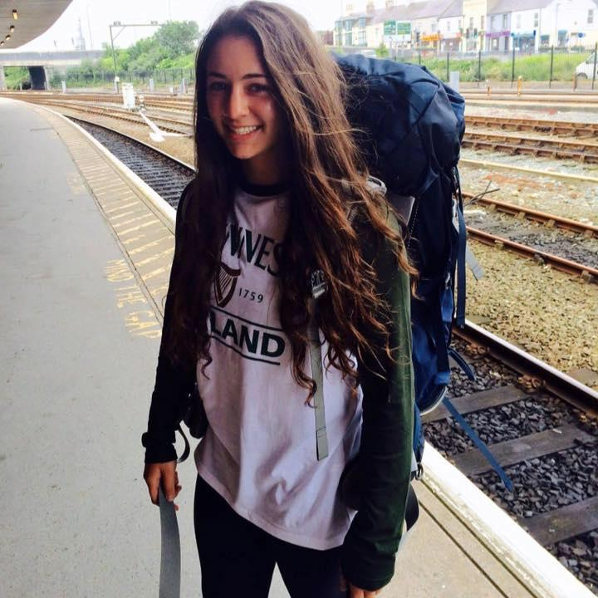
Say/DO
Haley Spector
“Competition in the middle of nowhere...with limited time, I chose to do the first activity I saw...”
Notes:
Gymnast, travels a lot for sport

Slide 9
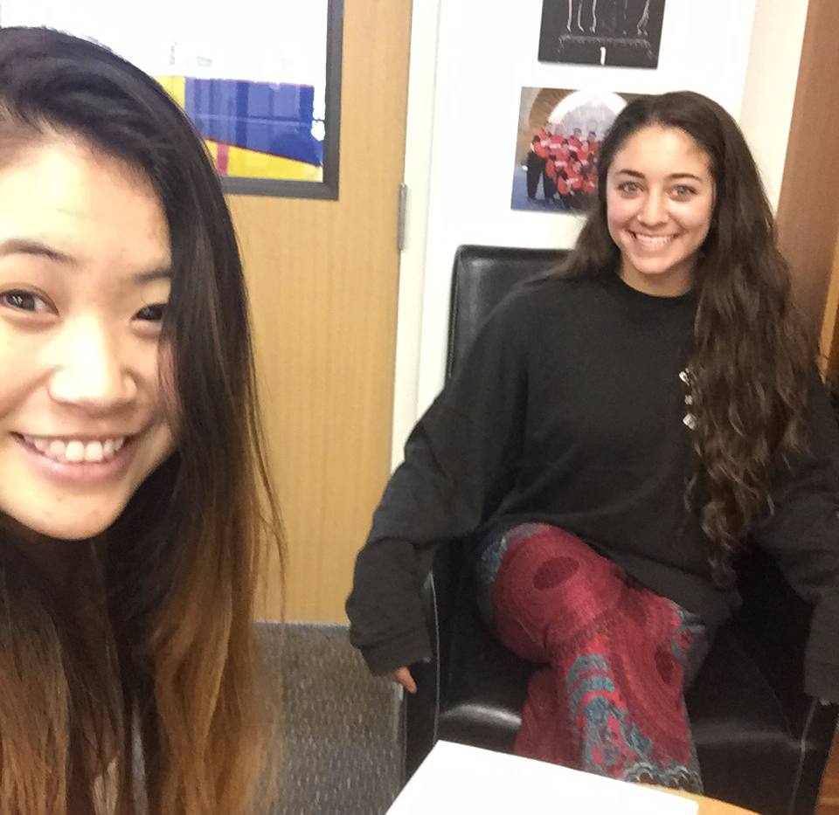
Haley Spector
Think/Feel
No time to plan trips given scheduling constraints.
Wants to find exciting activities wherever she goes.
Apprehensive about meeting new people in a new place.
Notes:
Contradiction:
Haley, though she has been traveling for gym competitions for around a decade now, still does something as arbitrary as “pick the first activity I saw.”
A source of contradiction and subsequently hope that we can change frequent travelers behaviors.

Slide 10
Revised POV #1

Slide 11
Met...
Amazed that...
Game Changing...
she does not have a well-structured protocol when at a new city.
travelers to become acclimated to a new place right when they step into a new country.
Notes:
Haley

Slide 12
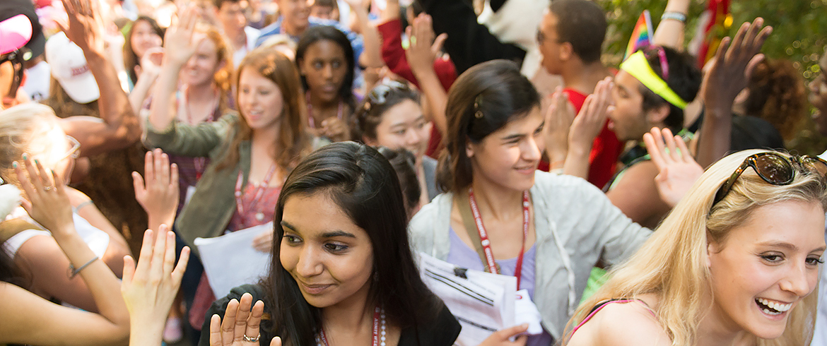
HMW make a foreign place more like NSO?
HMW make a foreign place more like NSO?
HMW make talking with some new like talking to a close friend?
HMW give people the freedom of shopping alone and the social aspect of shopping in groups?
Notes:
Haley’s POV

Slide 13
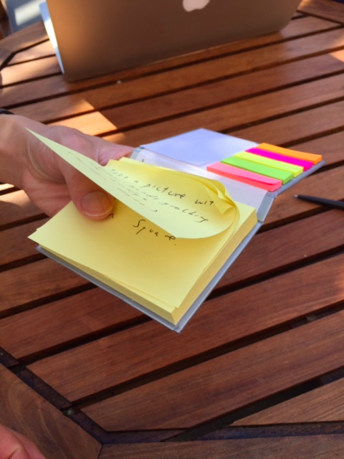
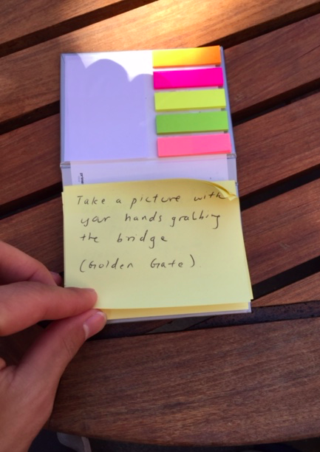
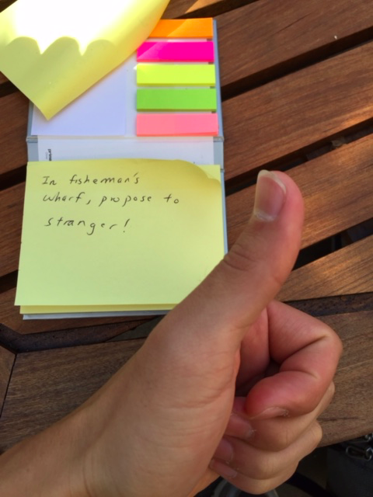
“City Hunt”
Notes:
“City Hunt” brings the flavor of the freshman year Scavenger Hunt to any city. The idea is to bring a group of new people in a city together, to complete a group of tasks. Based on their reactions to each task, a next suitable task will be given. To simulate this, we had a stack of post it notes with possible tasks. We tested our prototype on Cassandra, a 2nd-year student at the Stanford GSB. Dan would hand a new task each time Cassandra, our test subject, “completed” a new task.
Assumptions:
People like the element of spontaneity
People would like being told where to go next
People were keen on doing this with random people.

Slide 14
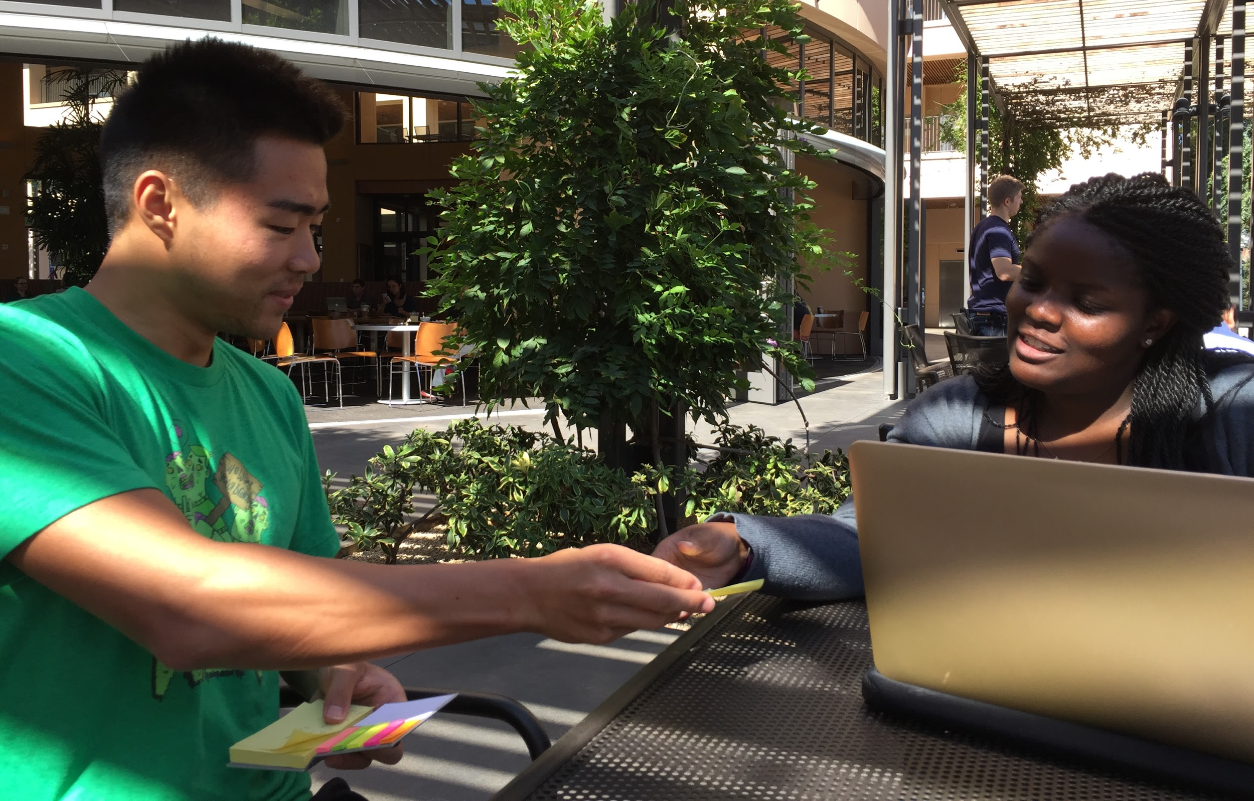
“City Hunt”
Notes:
Methods:
Quickly realized the high level of randomness in the solution and the “command” style of being told where to go next.
Assumptions:
Cassandra liked performing a scavenger hunt in both a foreign city with close friends or in a familiar city with new people. But what she was apprehensive about was the thought of doing this in both a foreign country with unknown people.
We were surprised by how receptive Cassandra was about being told to do something by a post it note. Perhaps she is less embarrassed to go out of her comfort zone when she can scapegoat “City Hunt” into making her do something, and especially if she had friends by her side.
Cassandra liked performing a scavenger hunt in both a foreign city with close friends or in a familiar city with new people. But what she was apprehensive about was the thought of doing this in both a foreign country with unknown people.
Concerns:
Who is paying for this?
Users have sufficient incentive to complete a scavenger hunt—Cassandra mentioned that she may need the continual incentive to finish, perhaps a prize at the end or her social media circles to cheer her on.

Slide 15
Revised POV #2

Slide 16
Met…
Amazed that…
Game Changing to…
although he was an event planning specialist, he seemed more of an introvert than a people person.
design bonding events with careful management of time, space, and inclusion of a diverse set of people.
Notes:
Darin
We met Darin
Surprised us that although he was an event planning specialist, he seemed more of an introvert rather than a people person, making us realize that event planning requires meticulous attention to detail
It would be game changing to design bonding events with careful attention to management of time, space and inclusion of a diverse set of people.

Slide 17
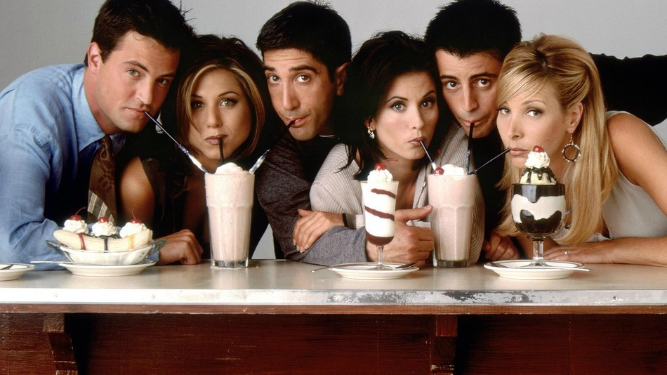
HMW make talking with a stranger like talking to a close friend?

Slide 18
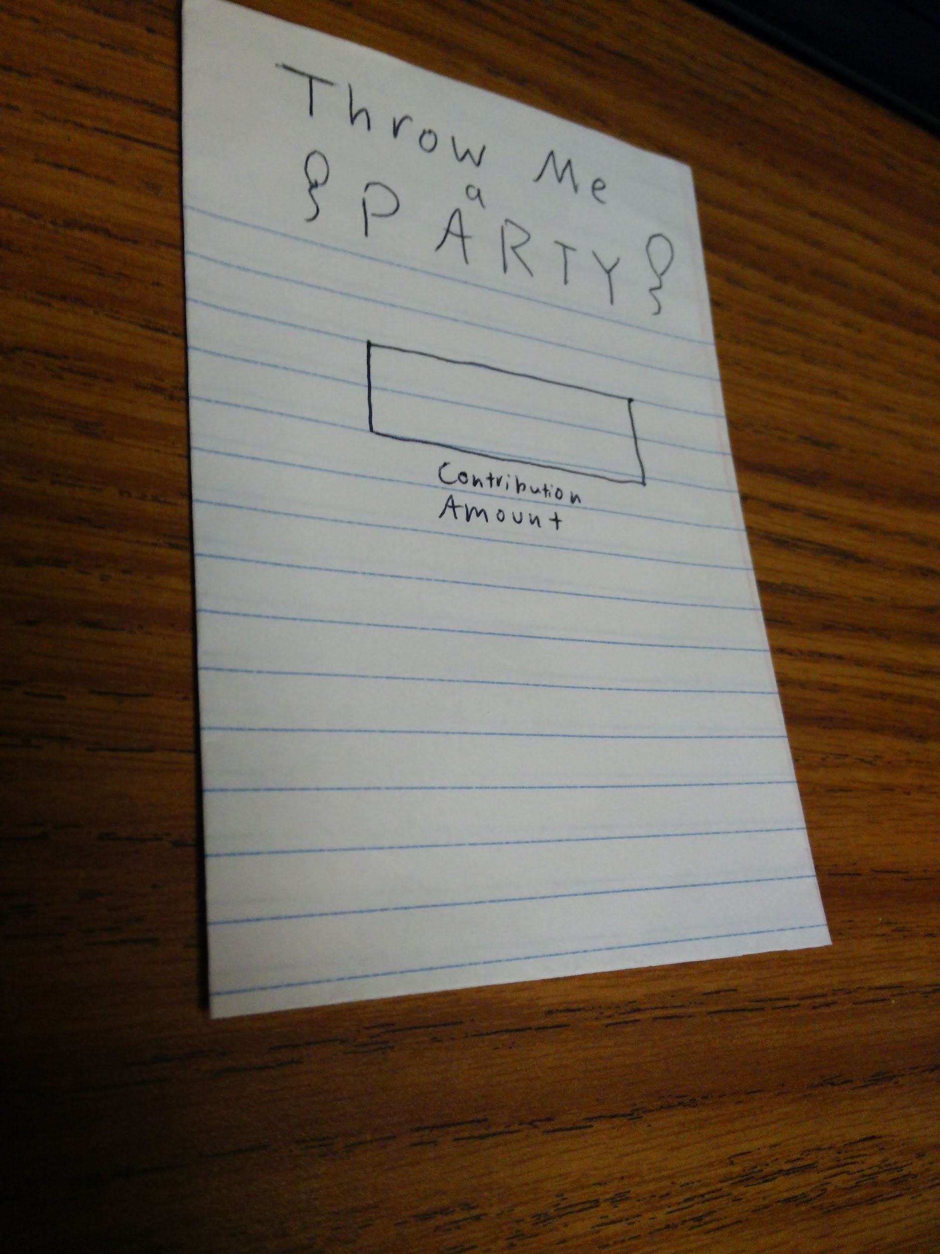
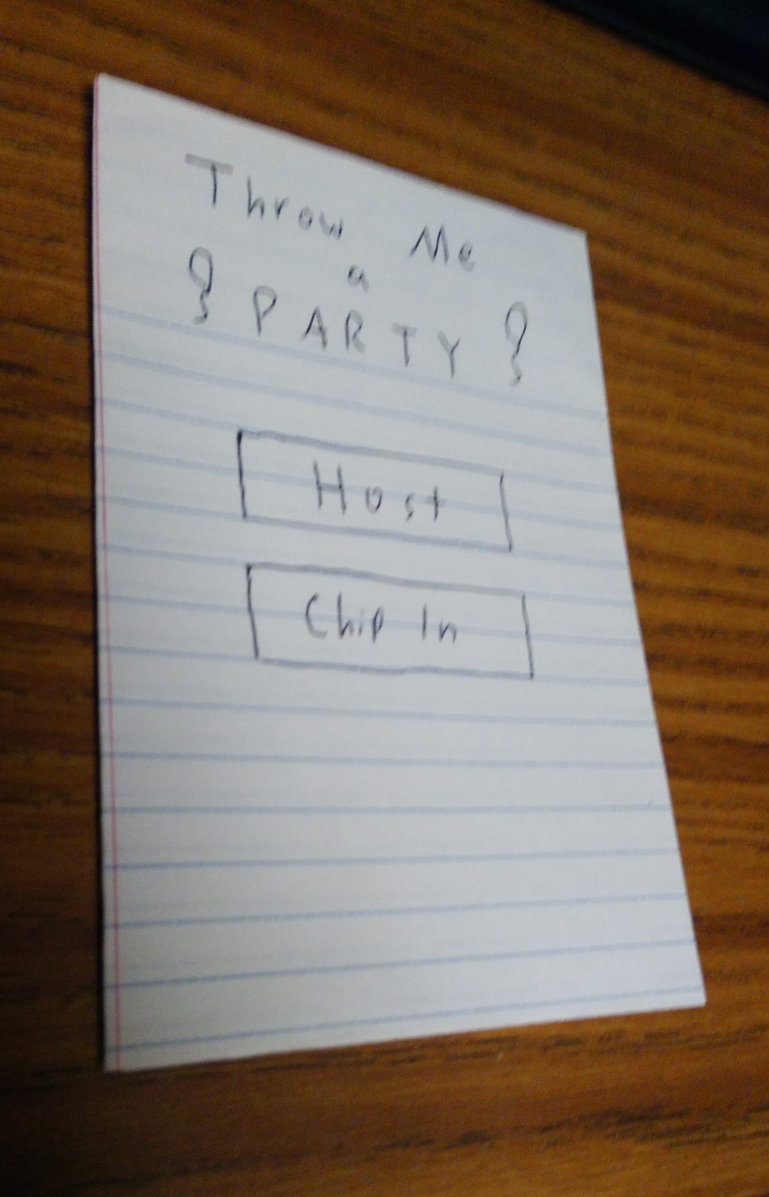
“Throw Me a Party”
Notes:
“Throw Me a Party” is a way for people to crowdsource a party. People can decide to host a party, and on the other end, interested attendees can support the events financially. This enables people in a new or local place an opportunity to meet new friends, experience the culture in a given location, and have fun.
We had two main assumptions:
People were willing to meet strangers at a party location
People were willing to defer their purchasing power to people in charge of the event (e.g. choice of guacamole)

Slide 19
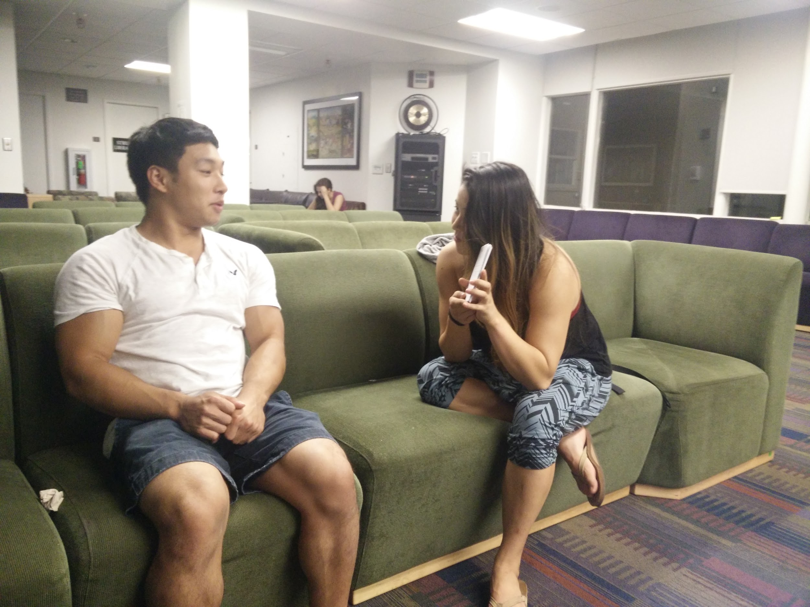
“Throw Me a Party”
Notes:
1) Method:
Josiah, Stanford men’s gymnastics team.
Josiah went through the prototype and “chipped in” an amount of money he was comfortable spending for a party. This allowed us to gauge how much people are willing to spend on a party.
Josiah thought the idea was novel, but many questions came up.
How credible were the people hosting the party?
How could you avoid people who had ulterior motives?
Would you allow random people to have a party at your house?
2) Our assumptions:
People were willing to give money to strangers was slightly incorrect. To mitigate this, profiles would show how credible someone was. We could also implement an invite feature that could filter people.
People were willing to meet strangers at parties was half valid—people wanted to meet non-awkward or creepy and preferably those who had common interests. When comparing if the user would also use this app in a new country, Josiah mentioned that he’d rather go to a club or an established party to meet new people. Finally, if you weren’t comfortable throwing a party at your house, we suggested creating a budget for the venue or an attendance cap.

Slide 20
Revised POV #3

Slide 21
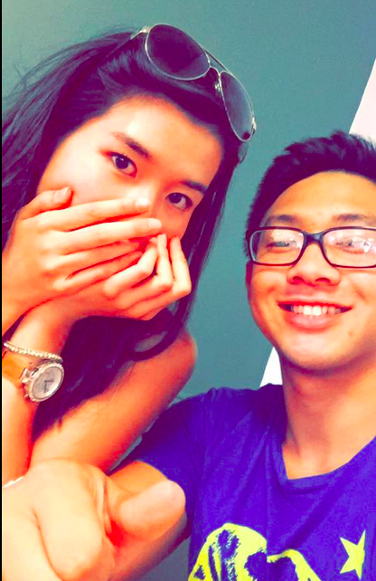
Met...
Amazed that…
Game Changing to…
she goes out of her way to shop alone to feel less like a burden.
retain the social aspect of shopping but relieve people of the social pressure of group shopping.
Notes:
Christie

Slide 22
HMW give people the freedom of shopping alone and the social aspect of shopping in groups?

Slide 23
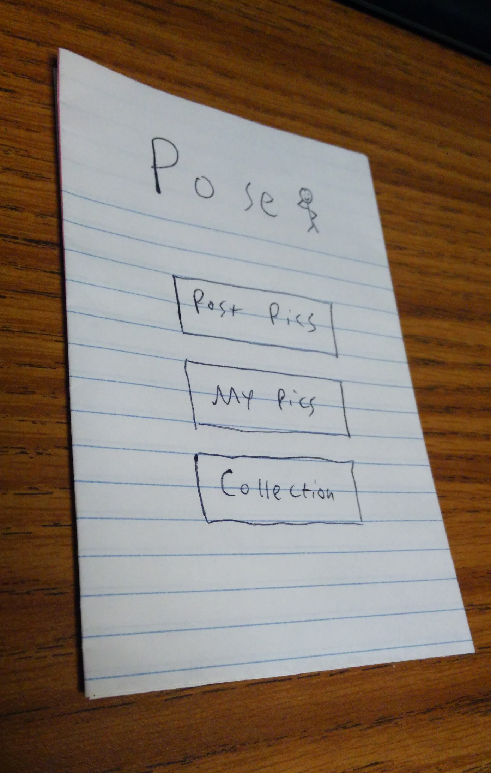
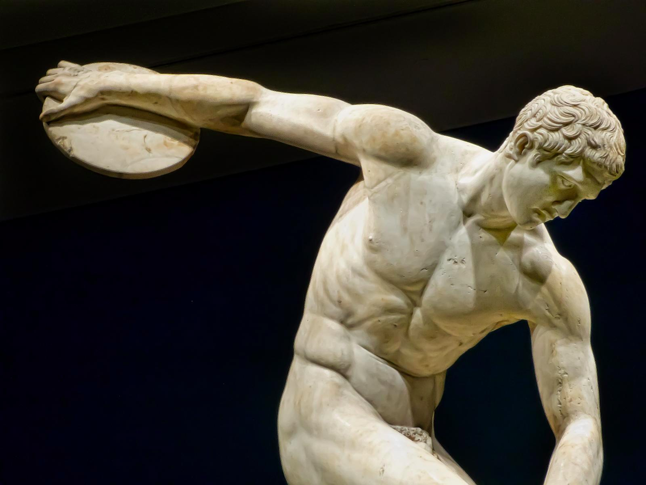
“Pose”
Notes:
“Pose” allows people to take and share pictures of themselves wearing store brand clothes. After taking a selfie, the photos will be shared and based on popularity, can be used to model for the actual brand.
The prototype consisted of a mobile phone-sized paper with buttons drawn in. The prototype was focused mainly on juggling shopping and handling clothes, while posting on “Pose”.
Assumptions:
People are curious about what clothes their friends wear.
People are willing to share their fashion secrets and their photos with friends and strangers.

Slide 24
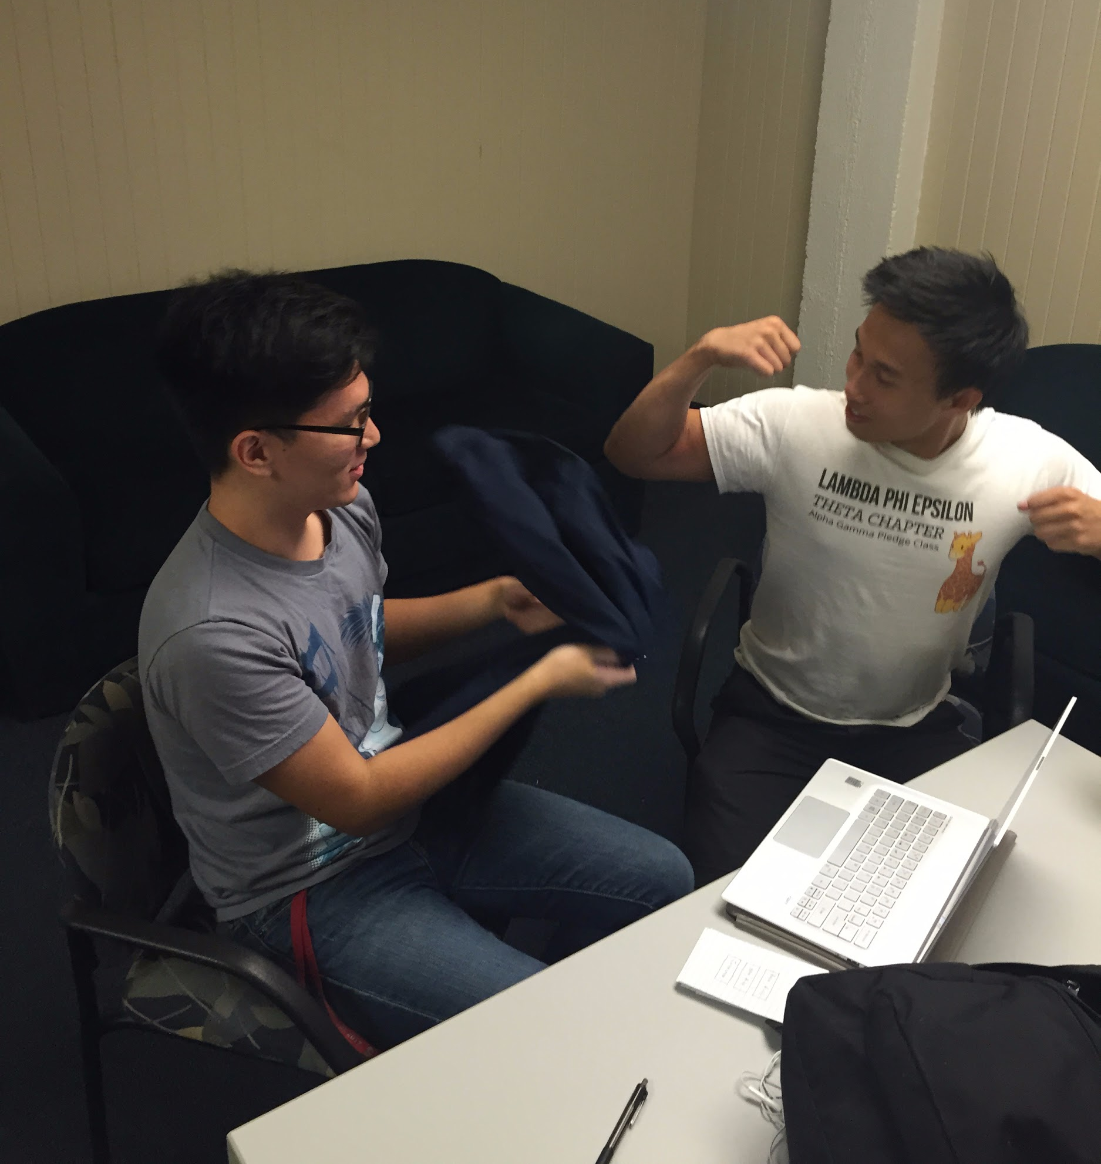
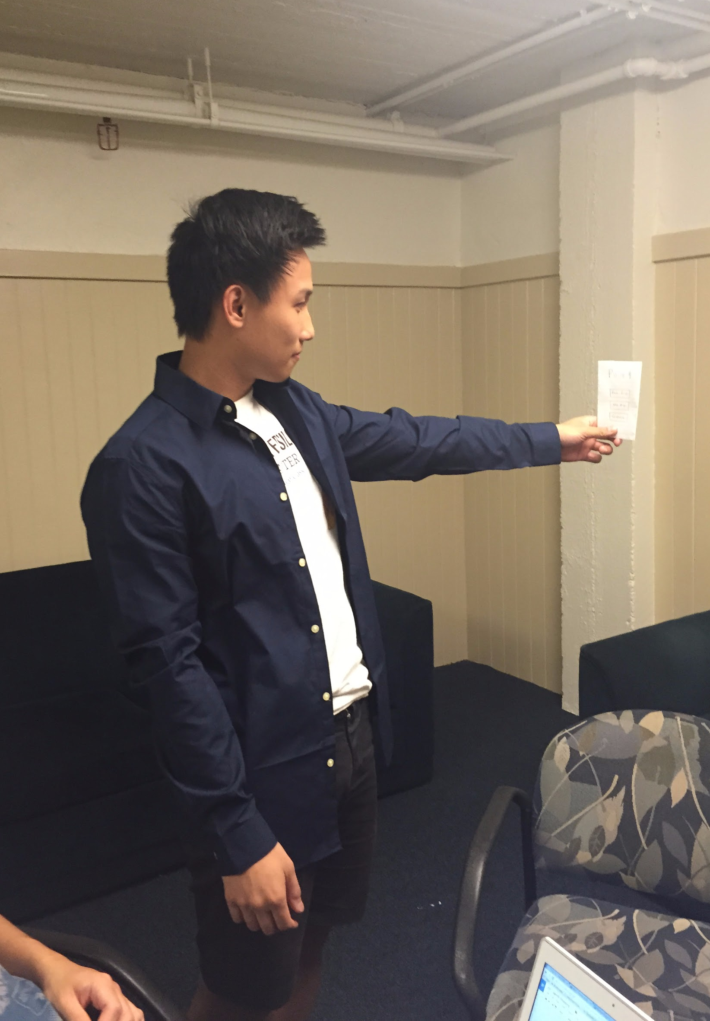
“Pose”
Notes:
Quan, our participant.
Methods:
a sample shirt as well as our low-fidelity prototype. We explained that if he were to take a selfie with his new outfit that he would be able to post it online and have people like the photo. If he got the most likes within that day for that brand, the brand/store would give discounts/gift cards to the winner or use the photo as a modeling picture for the store.
2) Test assumptions
-People were willing to share their photos. There are already platforms(Instagram, Facebook) that exist to share outfits with other strangers, so the idea is very familiar.
-The idea of providing discounts and gift cards seemed to have strike a chord with the participant. Especially if you’re a loyal to a certain brand, showing off the clothes and also getting rewarded for it seems to be a bonus.
-Sharing outfits with friends was far less popular than expected. The participant much rather preferred to share their outfit with random strangers. Also, our assumption that people were curious about their friend’s clothes was not entirely true- it can be too invasive for certain people, and would only work if both sides were interested in sharing that information. In addition, People valued their individuality, and would rather not wear clothes that homogenized them.

Slide 25
Thanks!

Slide 26
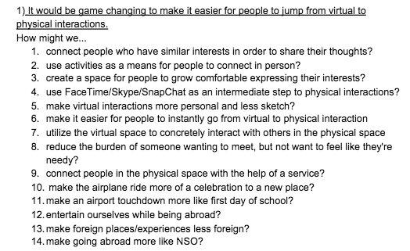
Appendix 1.0

Slide 27
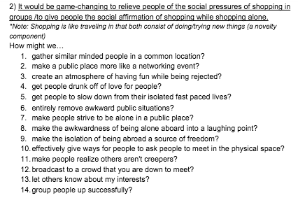
Appendix 1.1

Slide 28
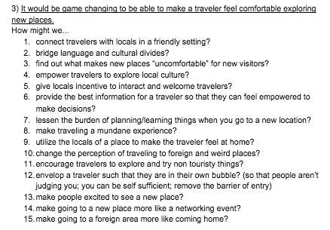
Appendix 1.2

