Slide 1


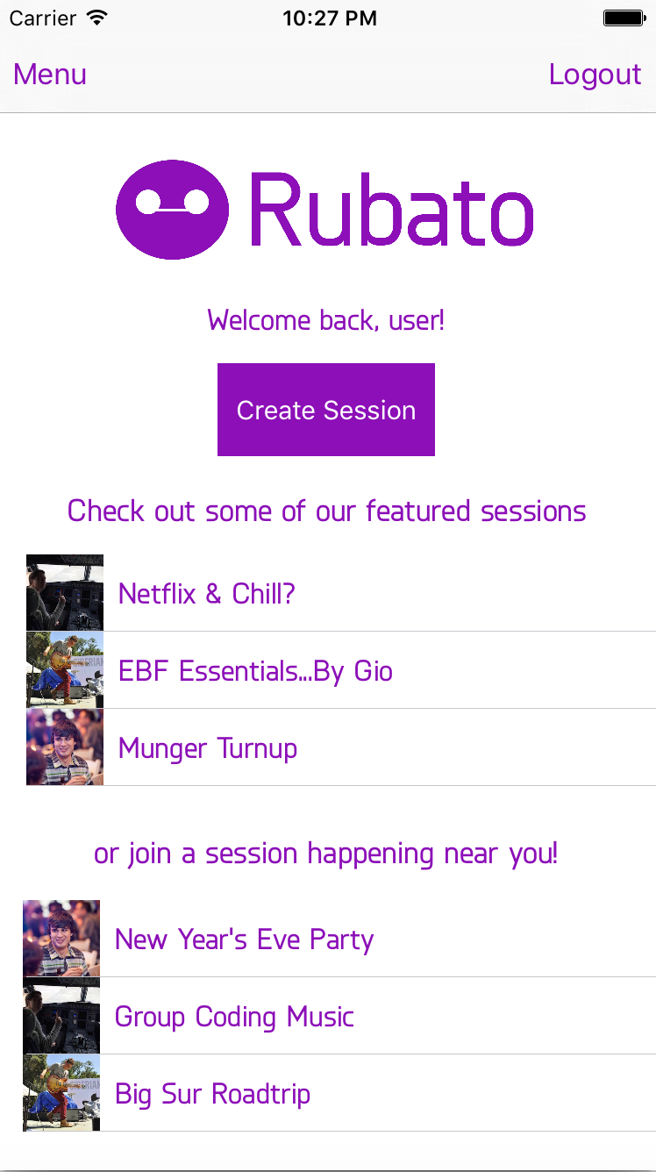
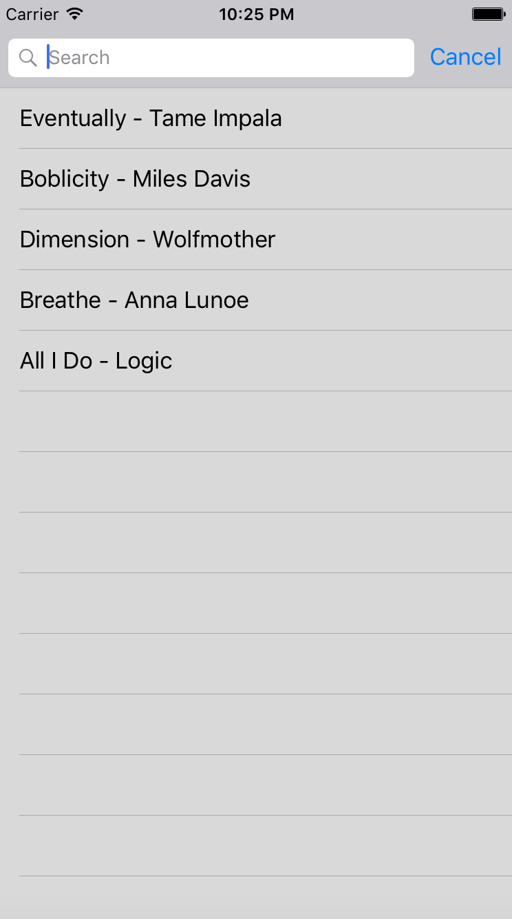
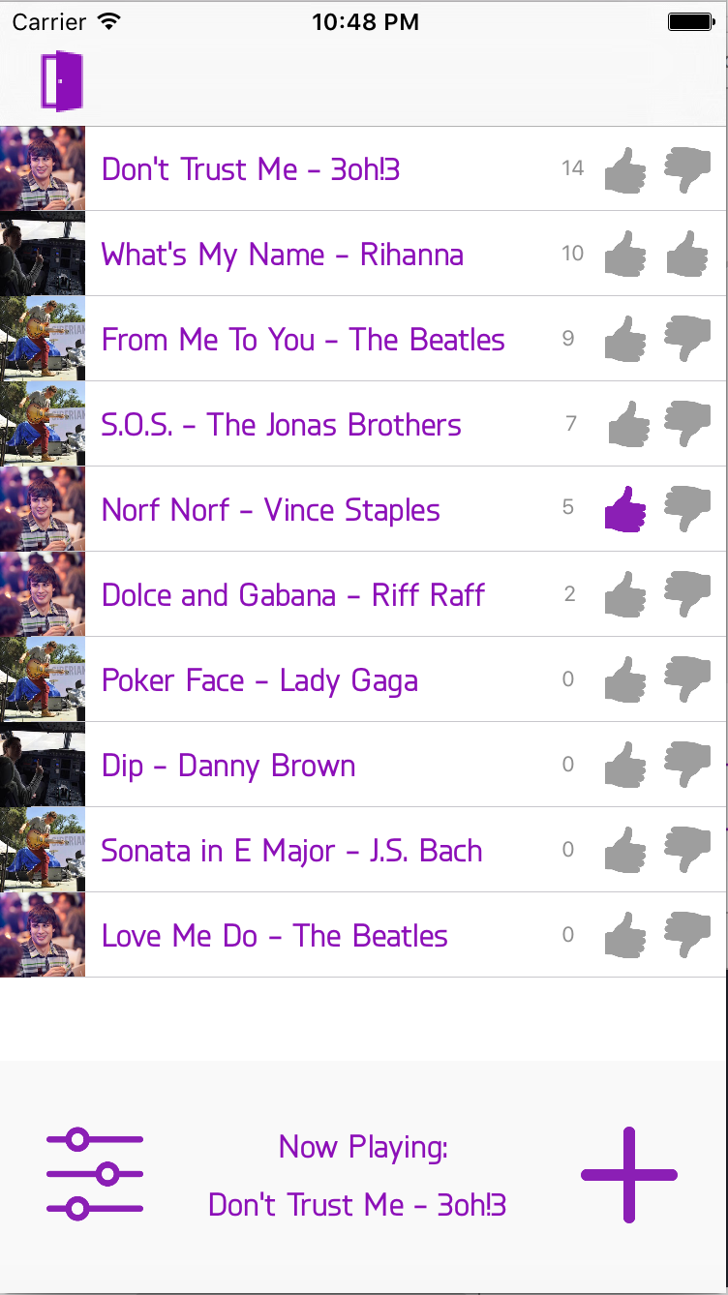
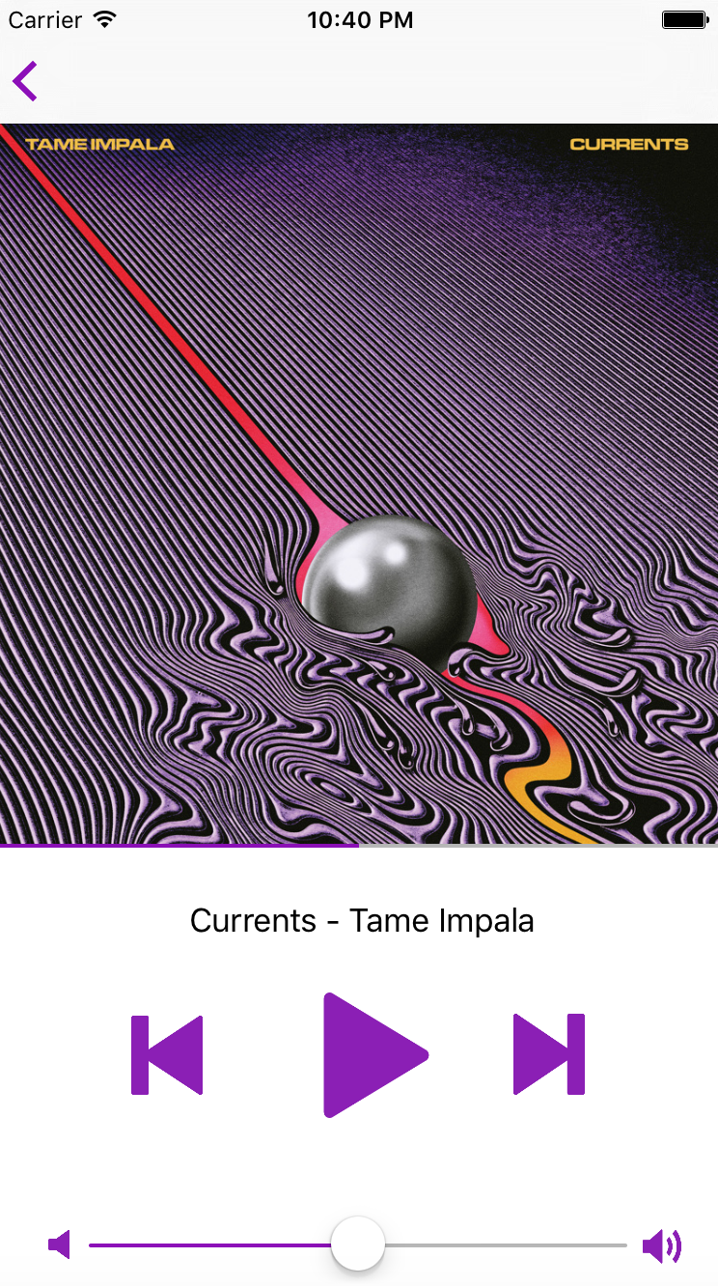
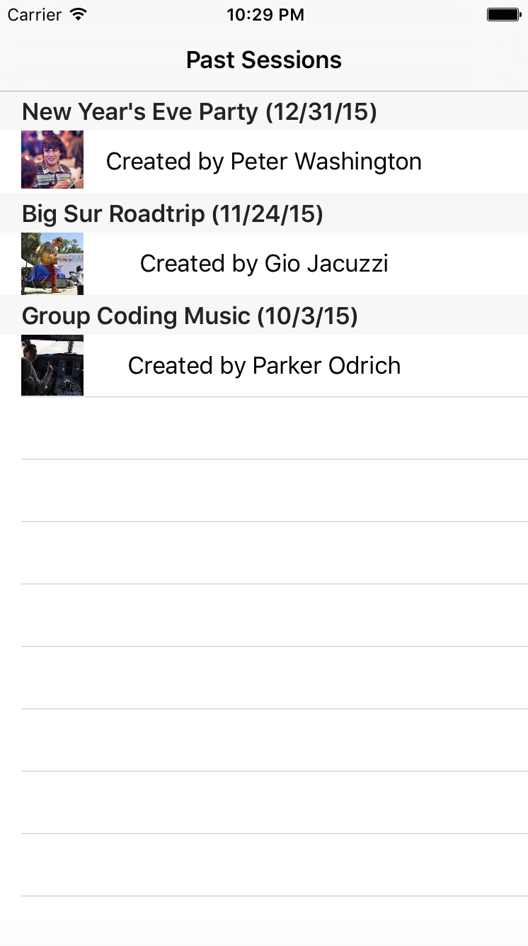
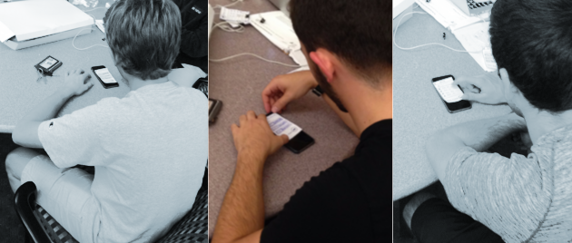
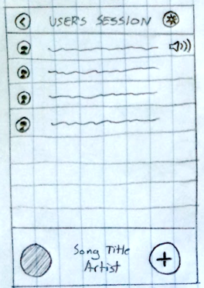
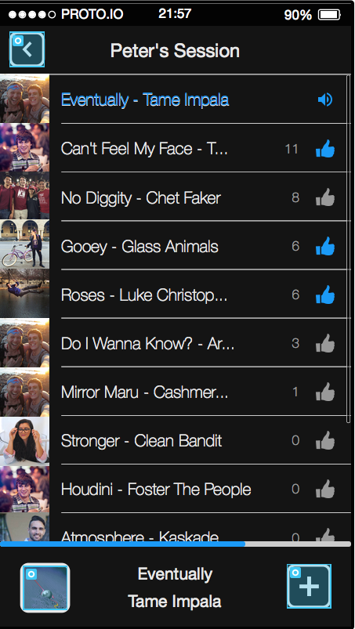
SOCIAL MUSIC PLAYLIST CREATION IN REAL-TIME
Overview
Music is a dynamic force that brings communities together. Rubato allows users to create and join nearby live playlist sessions with the ability to update the playlist in real-time. This makes the playlist curation process more engaging for everybody at the event and taps into the social nature of music.
Our Solution
Allow users to aid in the creation of a playlist in real-time by adding and voting on songs in real-time.
Search and Add Songs
Vote on Songs
Homescreen: View Nearby and Featured Sessions
User Testing
Stay In Control of Your Session
Relive Past Sesions
Design Iteration
User testing on low-fidelity prototype showed that users can have malicious intent, so we implemented voting.
Heuristic evaluations on the medium-fidelity prototype inspired us to simplify the design, add downvoting, and stray away from Spotify-like design features.
Low-Fi Prototype
Medium-Fi Prototype
High-Fi Prototype
Peter Washington . Gio Jacuzzi . Parker Odrich
hci.stanford.edu/courses/cs147/2015/au/projects/creation/rubato
CS 147
Autumn 2015

