Slide 1
Rubato
Gio Jacuzzi, Parker Odrich, Peter Washington
Assignment 6: Medium-Fi Prototype
Studio: Creation

Slide 2
Value Proposition and Solutions
Value Proposition: Communal playlists in real time.
Problem: Music is a dynamic force that brings communities together, but there is currently no way for all listeners to engage with each other in the creation process in real time--together, right here, right now.
Solution: Rubato allows everyone at an event to contribute in real time to the music. The result is a constantly evolving playlist, curated by the entire community.

Slide 3
Representative Tasks
Task 1: Create a communal playlist (easy).
Task 2: Update the playlist in real-time (medium).
Task 3: Play songs from any event attended in the past.

Slide 4
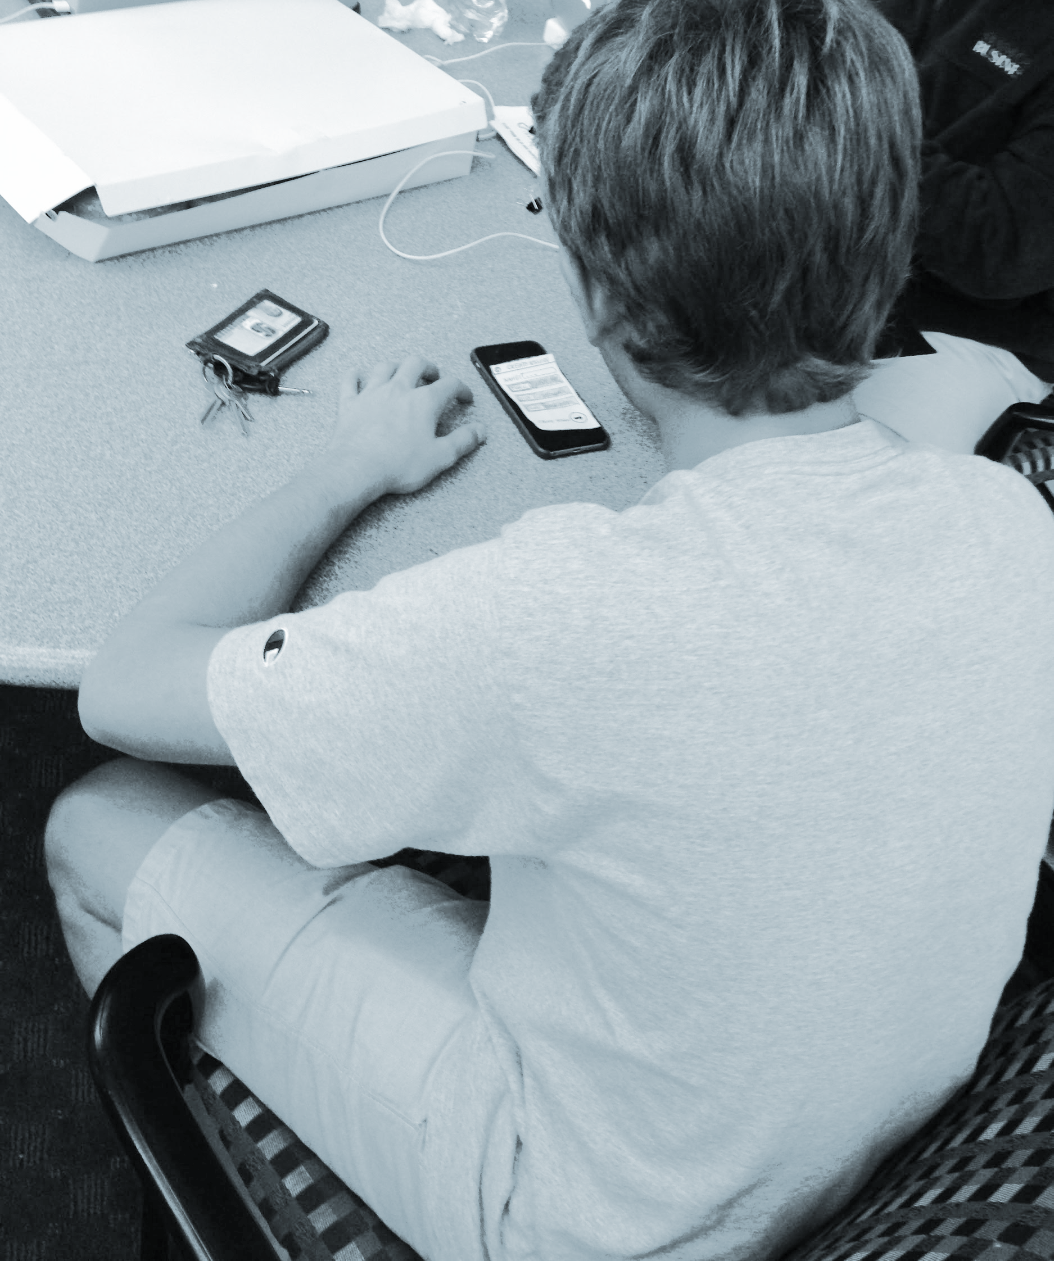
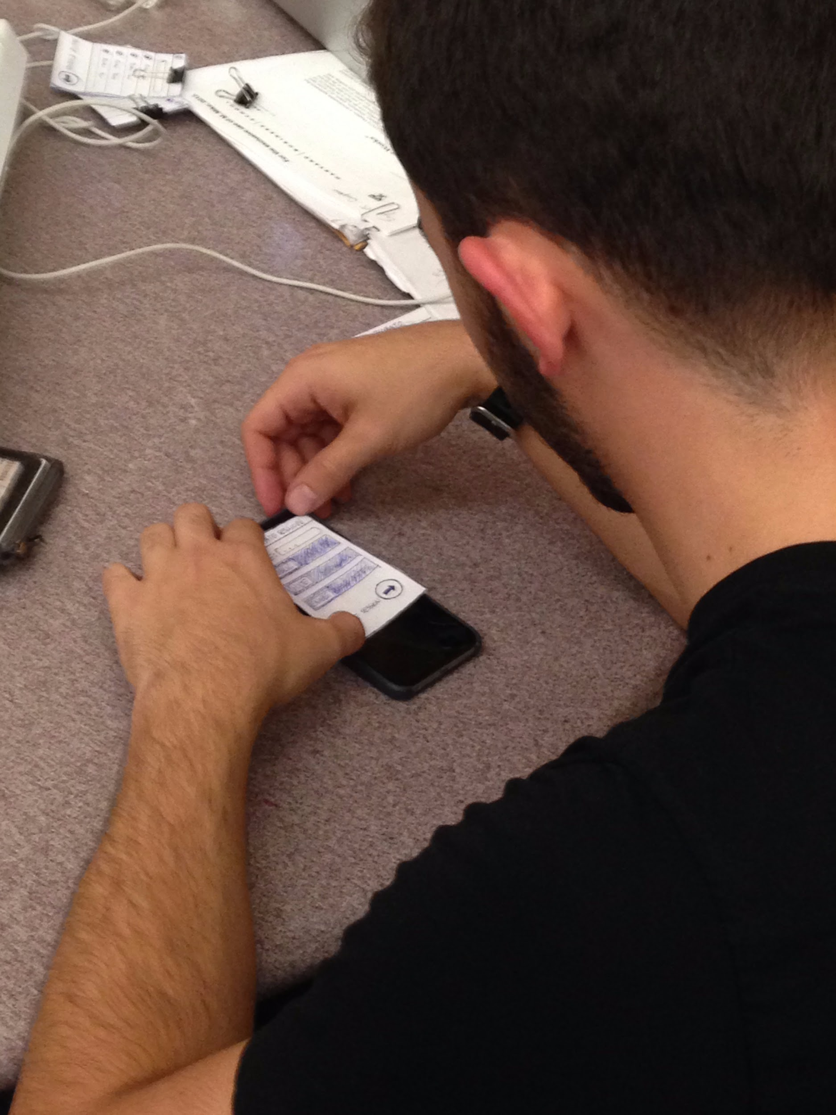
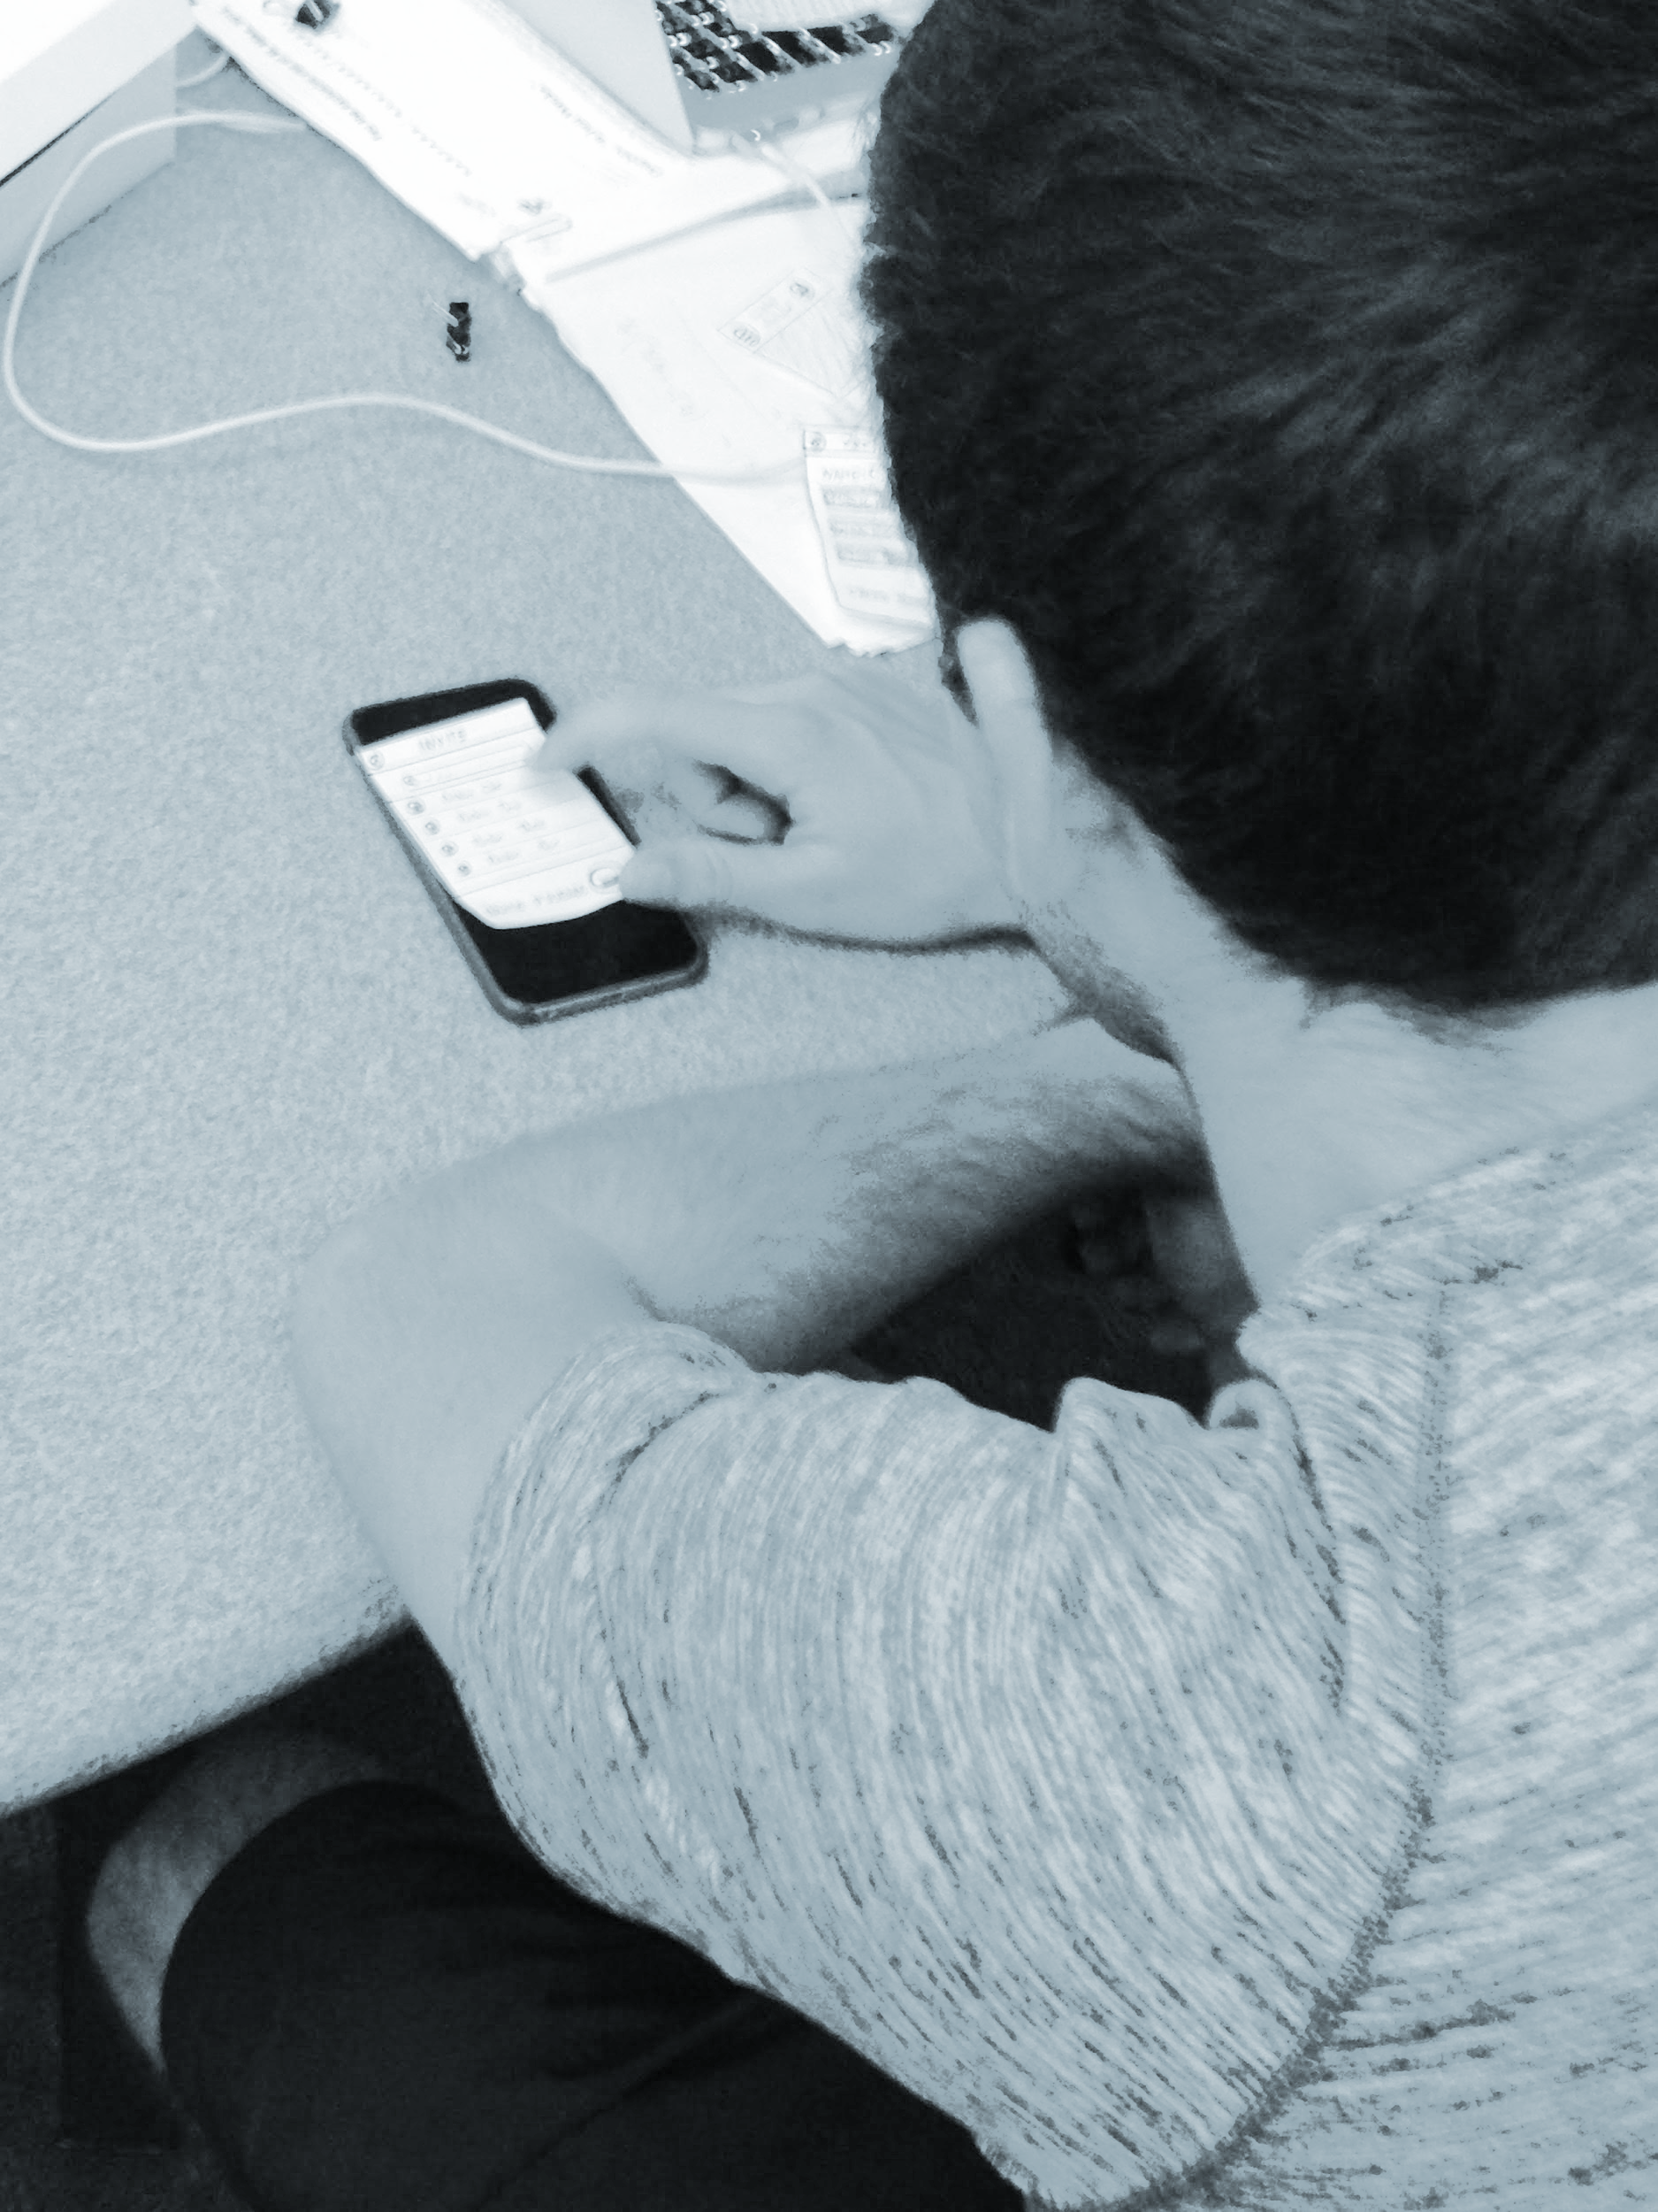
Problems Found in User Testing
Users played songs with “malicious” intents.
Users found the interface to be too confusing due to the over-complexity of the design.
The meanings of buttons were ambiguous (specifically for settings and adding songs).

Slide 5
Design Change 1: Add Upvoting To Songs
Upvoting prevents a single user from hijacking the playlist.
Adds more user interactivity to the party.
Doesn’t require excessive interaction during the party.

Slide 6
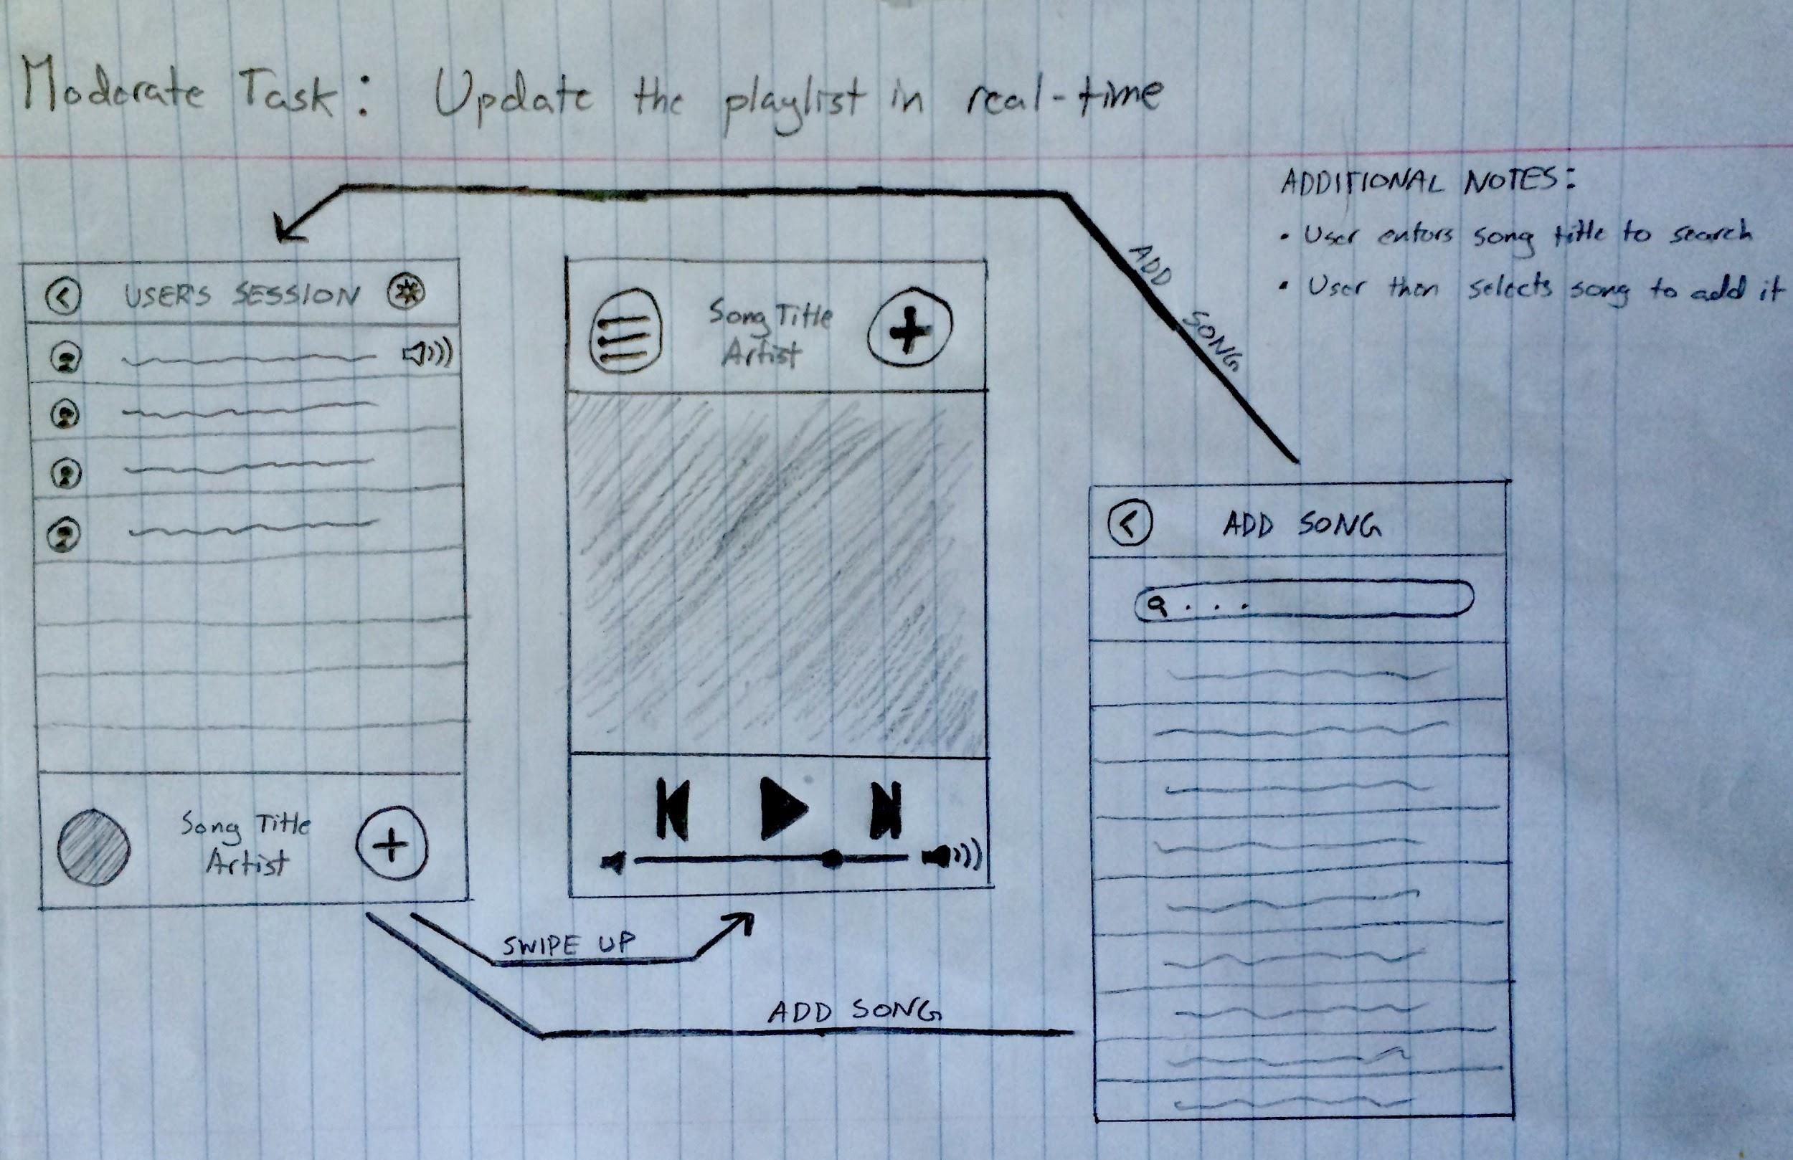
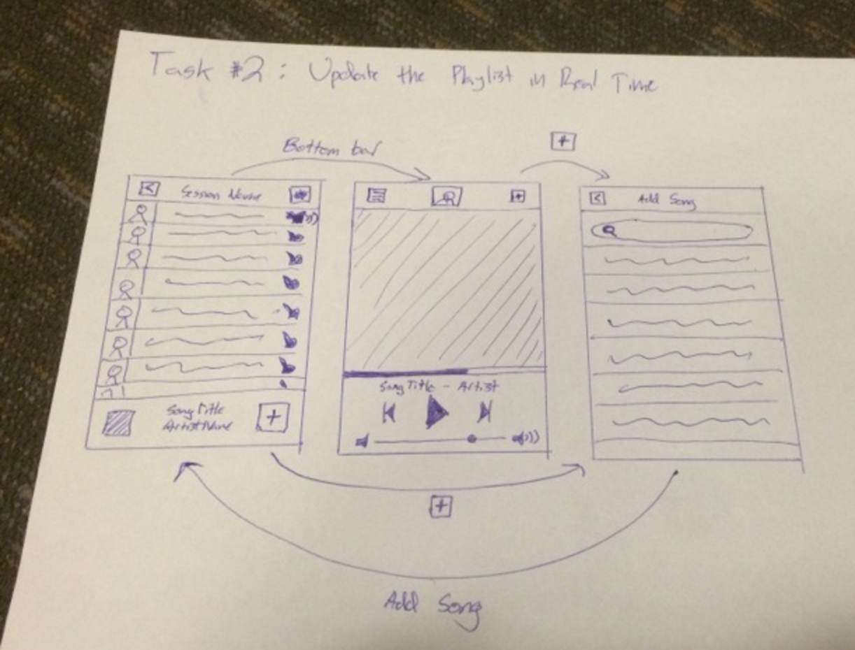
Design Change 1: Add Upvoting To Songs
Before
After

Slide 7
Design Change 2: Centralized Home Screen
A central screen makes it easier for user to navigate throughout the app.
Prevents the user from being “stuck” in a certain screen.
Prevents the user from clicking an unnecessary number of buttons and navigating through many screens.

Slide 8
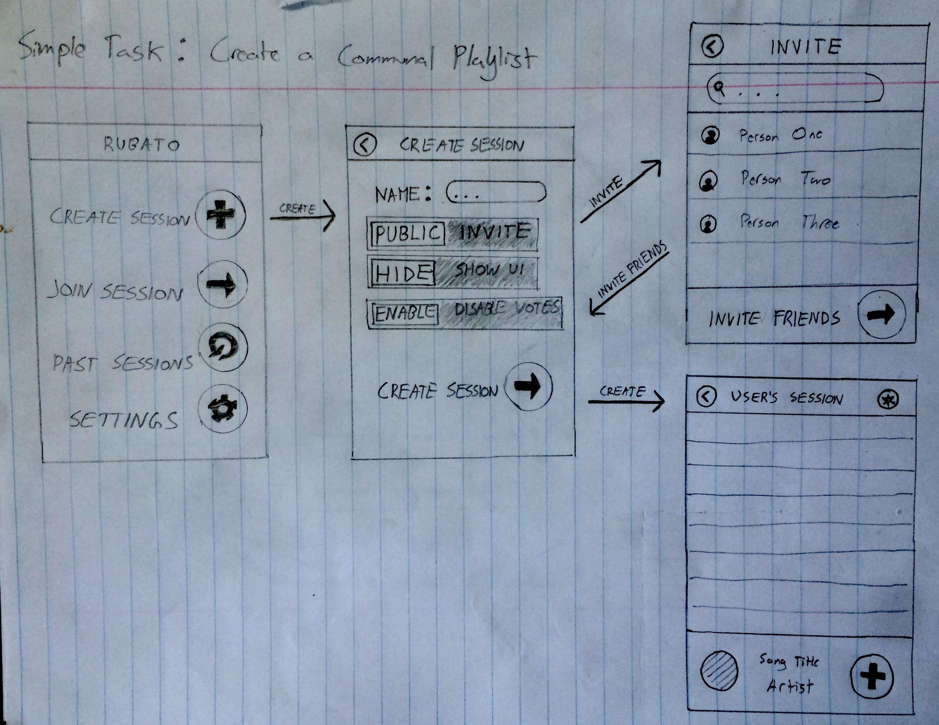
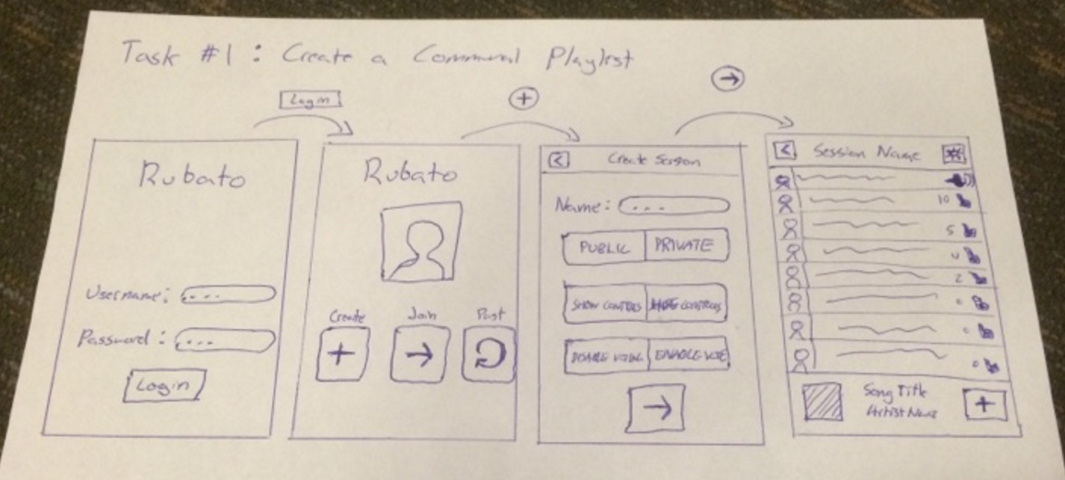
Design Change 2: Centralized Home Screen
Before
After

Slide 9
Design Change 3: Remove Global Settings
Global app settings were largely irrelevant to the app.
Settings were per-session and could just be done during session create-time.
Settings button clogged the home screen. Now, have a much prettier home screen.

Slide 10
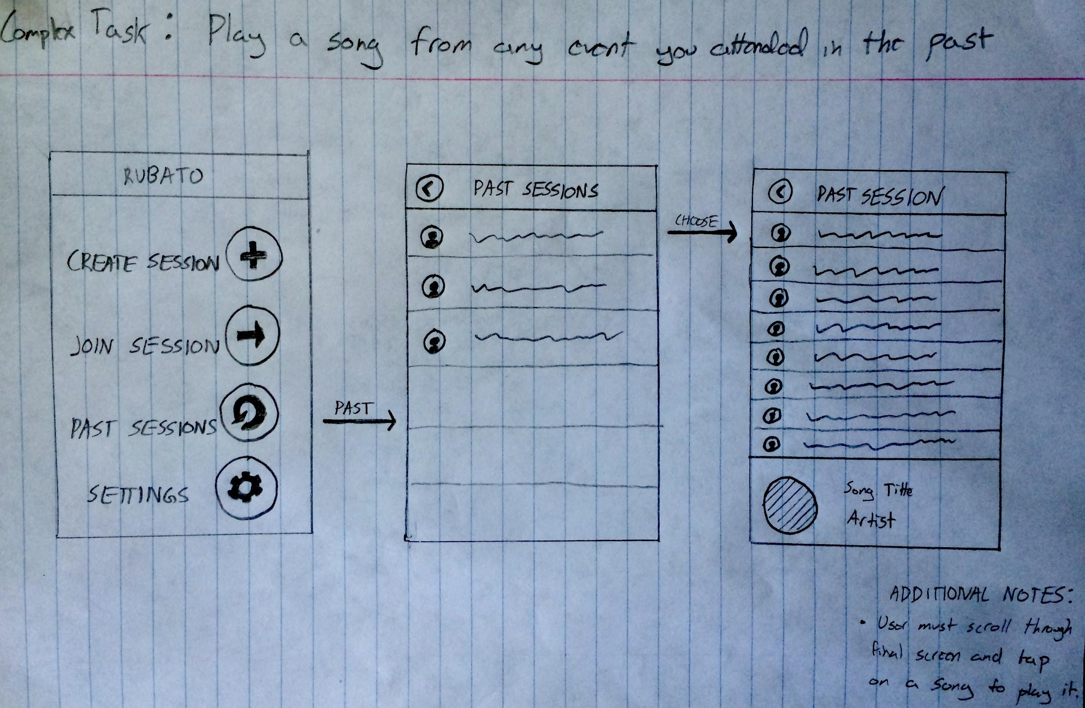
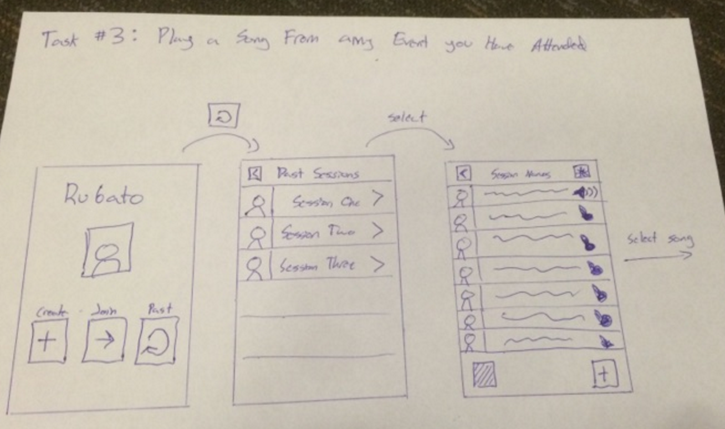
Design Change 3: Remove Global Settings
Before
After

Slide 11
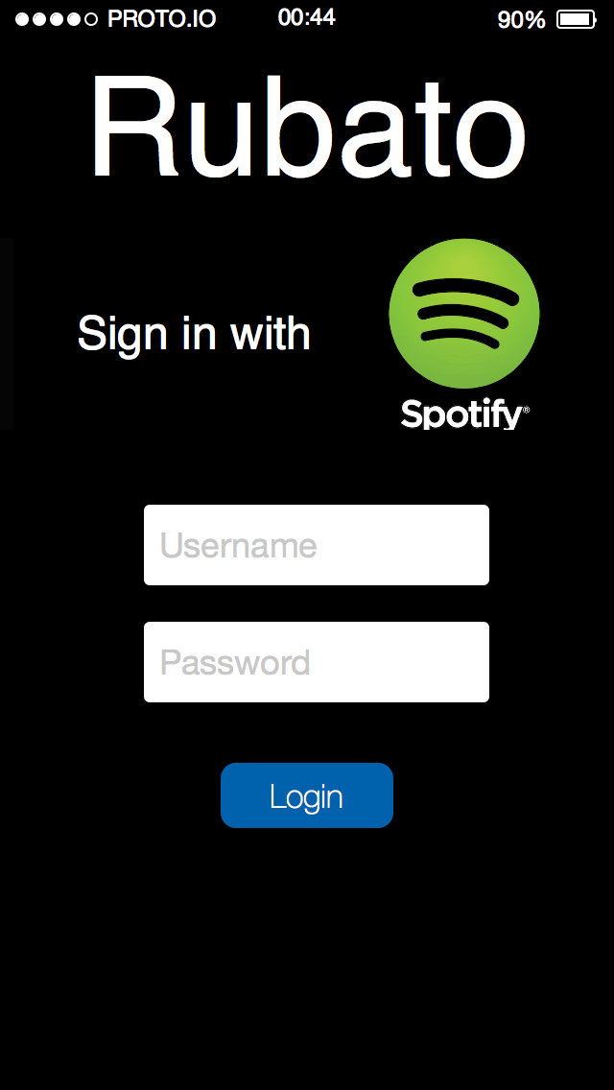
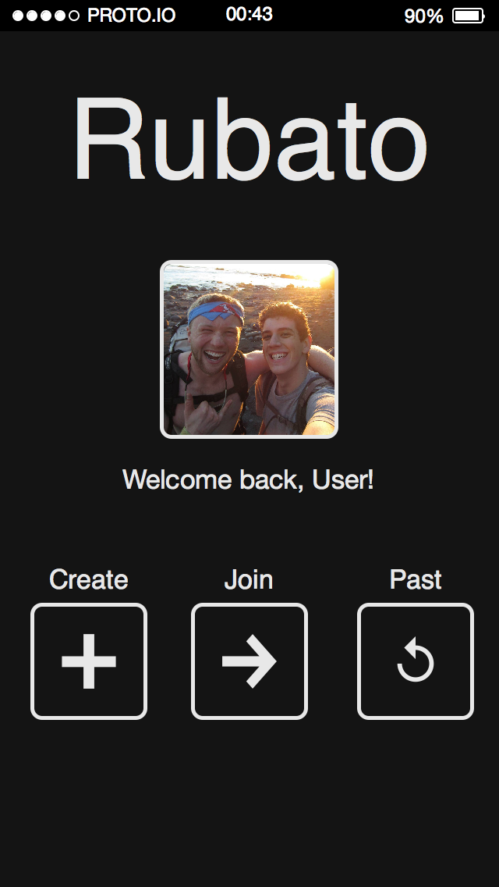
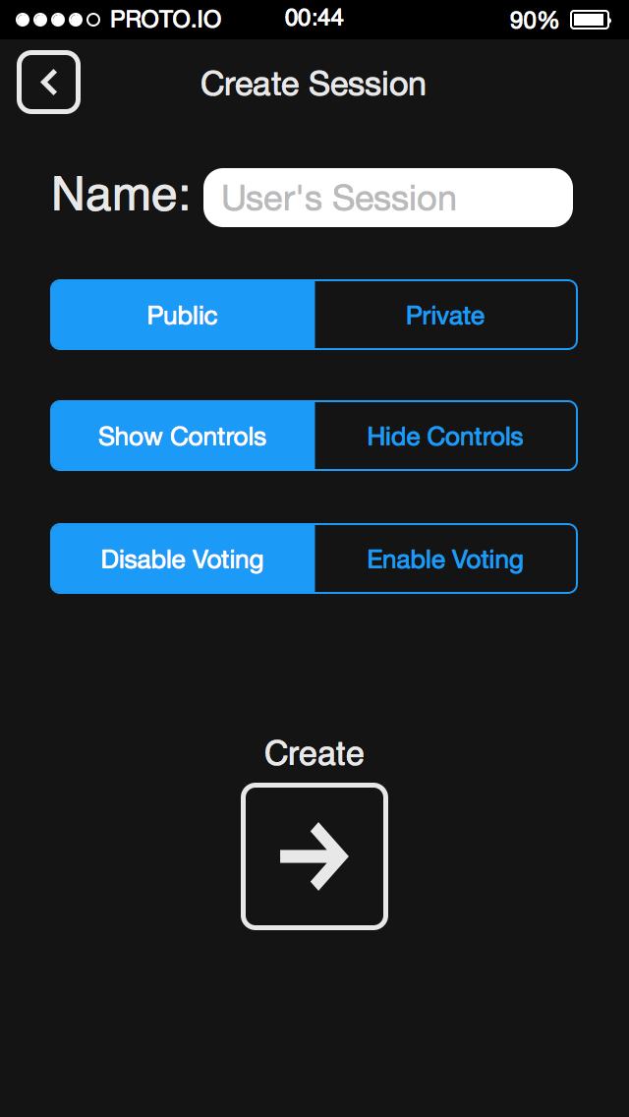
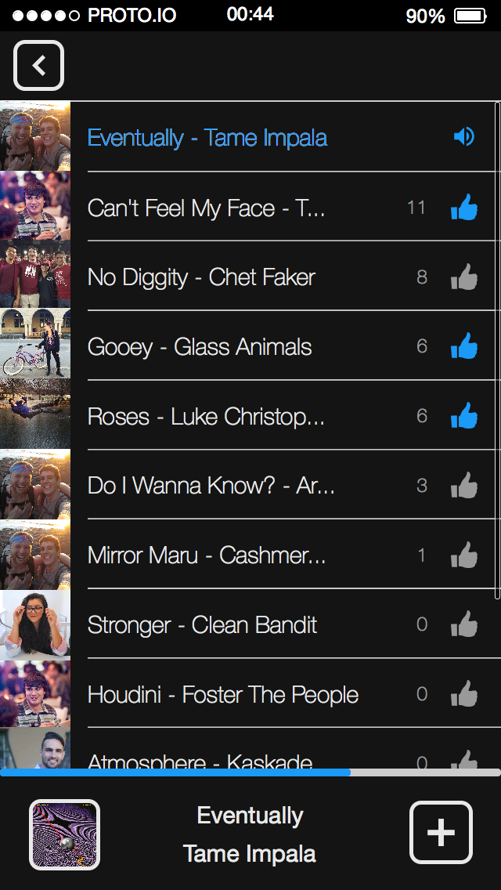
Task Flow #1: Create a Rubato Session

Slide 12
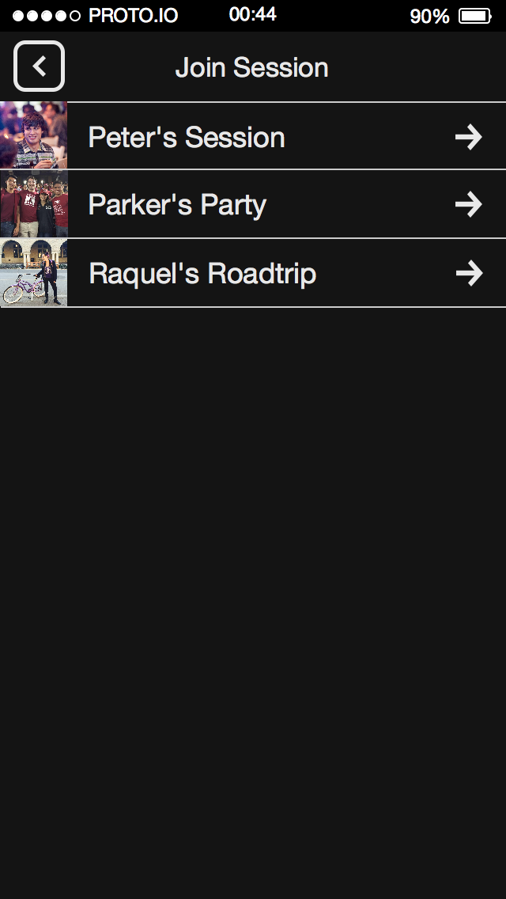
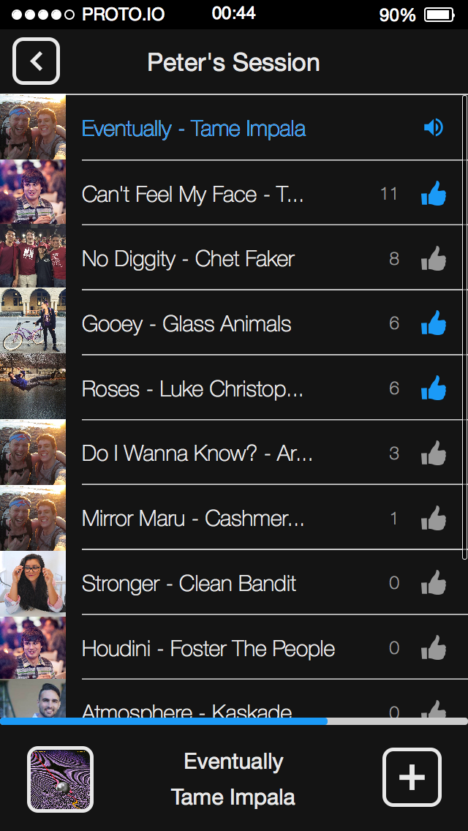
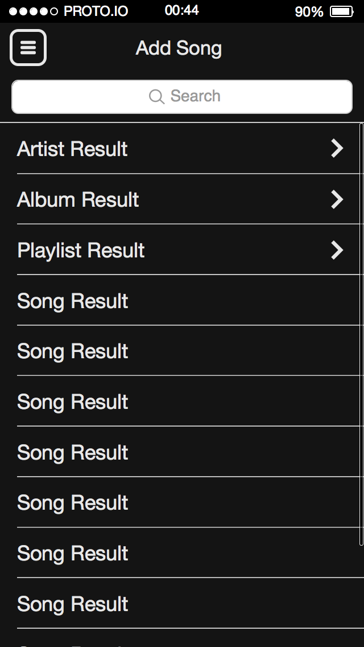
Task Flow #2: Update playlist in real time

Slide 13
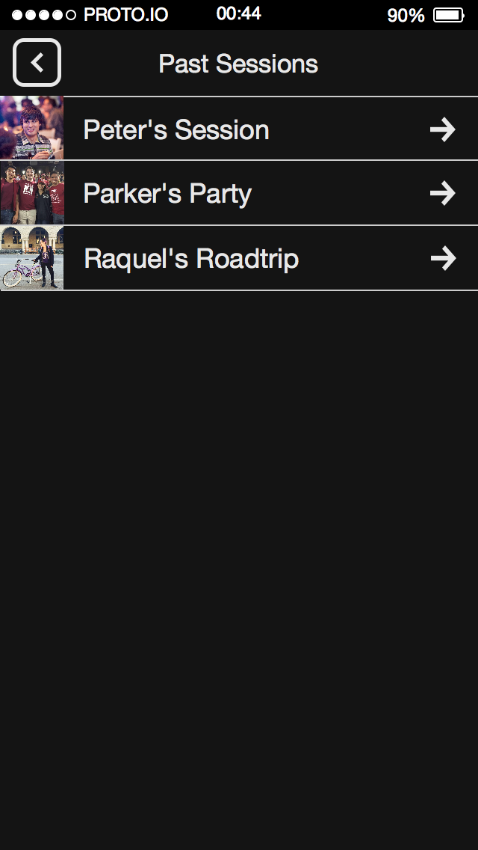
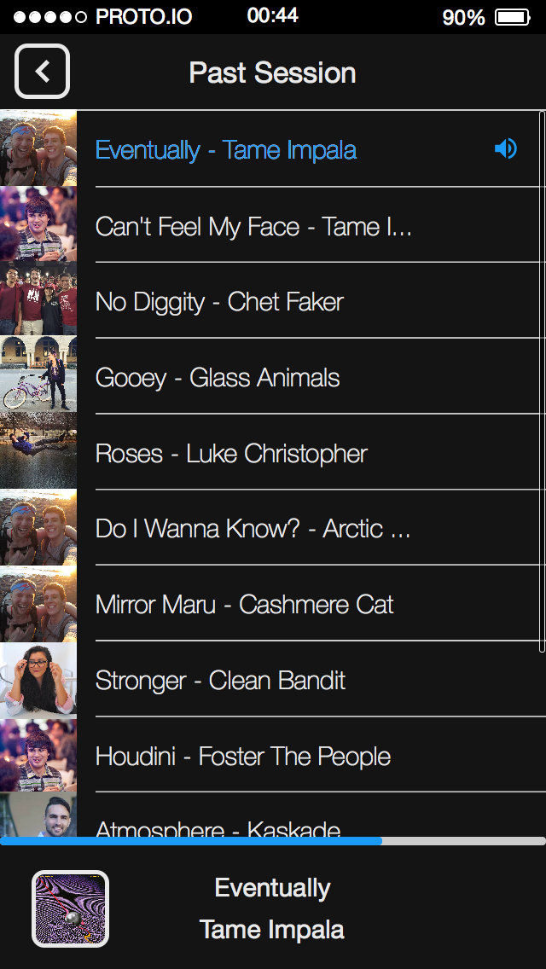
Task Flow #3: Relive the playlist

Slide 14
Prototyping Tool
Used Proto.IO
Makes iOS prototypes that seem real
Lots of features
Great for collaboration
Free trial

Slide 15
Limitations of Proto.IO
No “conditional” logic prevented many simple prototyping features from being added
Selected songs couldn’t actually be added to playlist
The results of upvoting a song can’t be seen
Long learning curve compared to Marvel and InVision

Slide 16
Wizard of Oz Techniques
When a user wants to add a song, we will tell them that the song is added to the playlist.
When a user wants to play a song, we will play the song ourselves. The prototype cannot play songs.

Slide 17
Hand-Coded Features
Song names
Session names
User profile
Number of likes per song

Slide 18
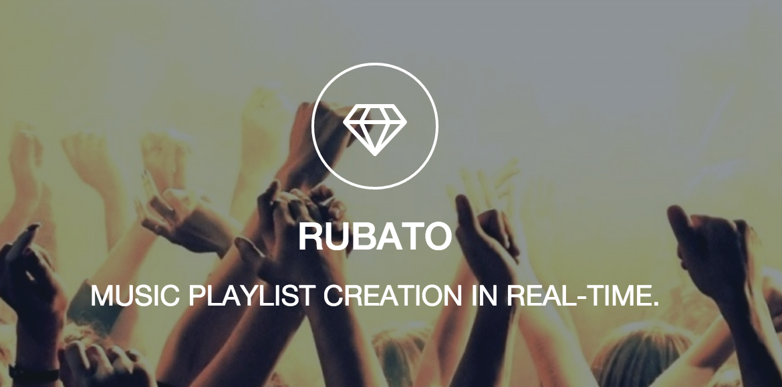
Questions?

Slide 19
Website Link
http://web.stanford.edu/class/cs147/projects/creation/Rubato/index.html

