Slide 1
Rubato
Peter , Parker & Gio
Lo-fi Prototyping & Pilot Usability Testing

Slide 2
Value Proposition
Value Proposition: Communal Playlists in Real Time
Problem: There is currently no way for all listeners at an event to engage with each other in the creation process of music in real time--together, right here, right now.
Solution: Rubato allows everyone at an event to contribute in real time to the music. The result is a constantly evolving playlist, curated by the entire community.

Slide 3
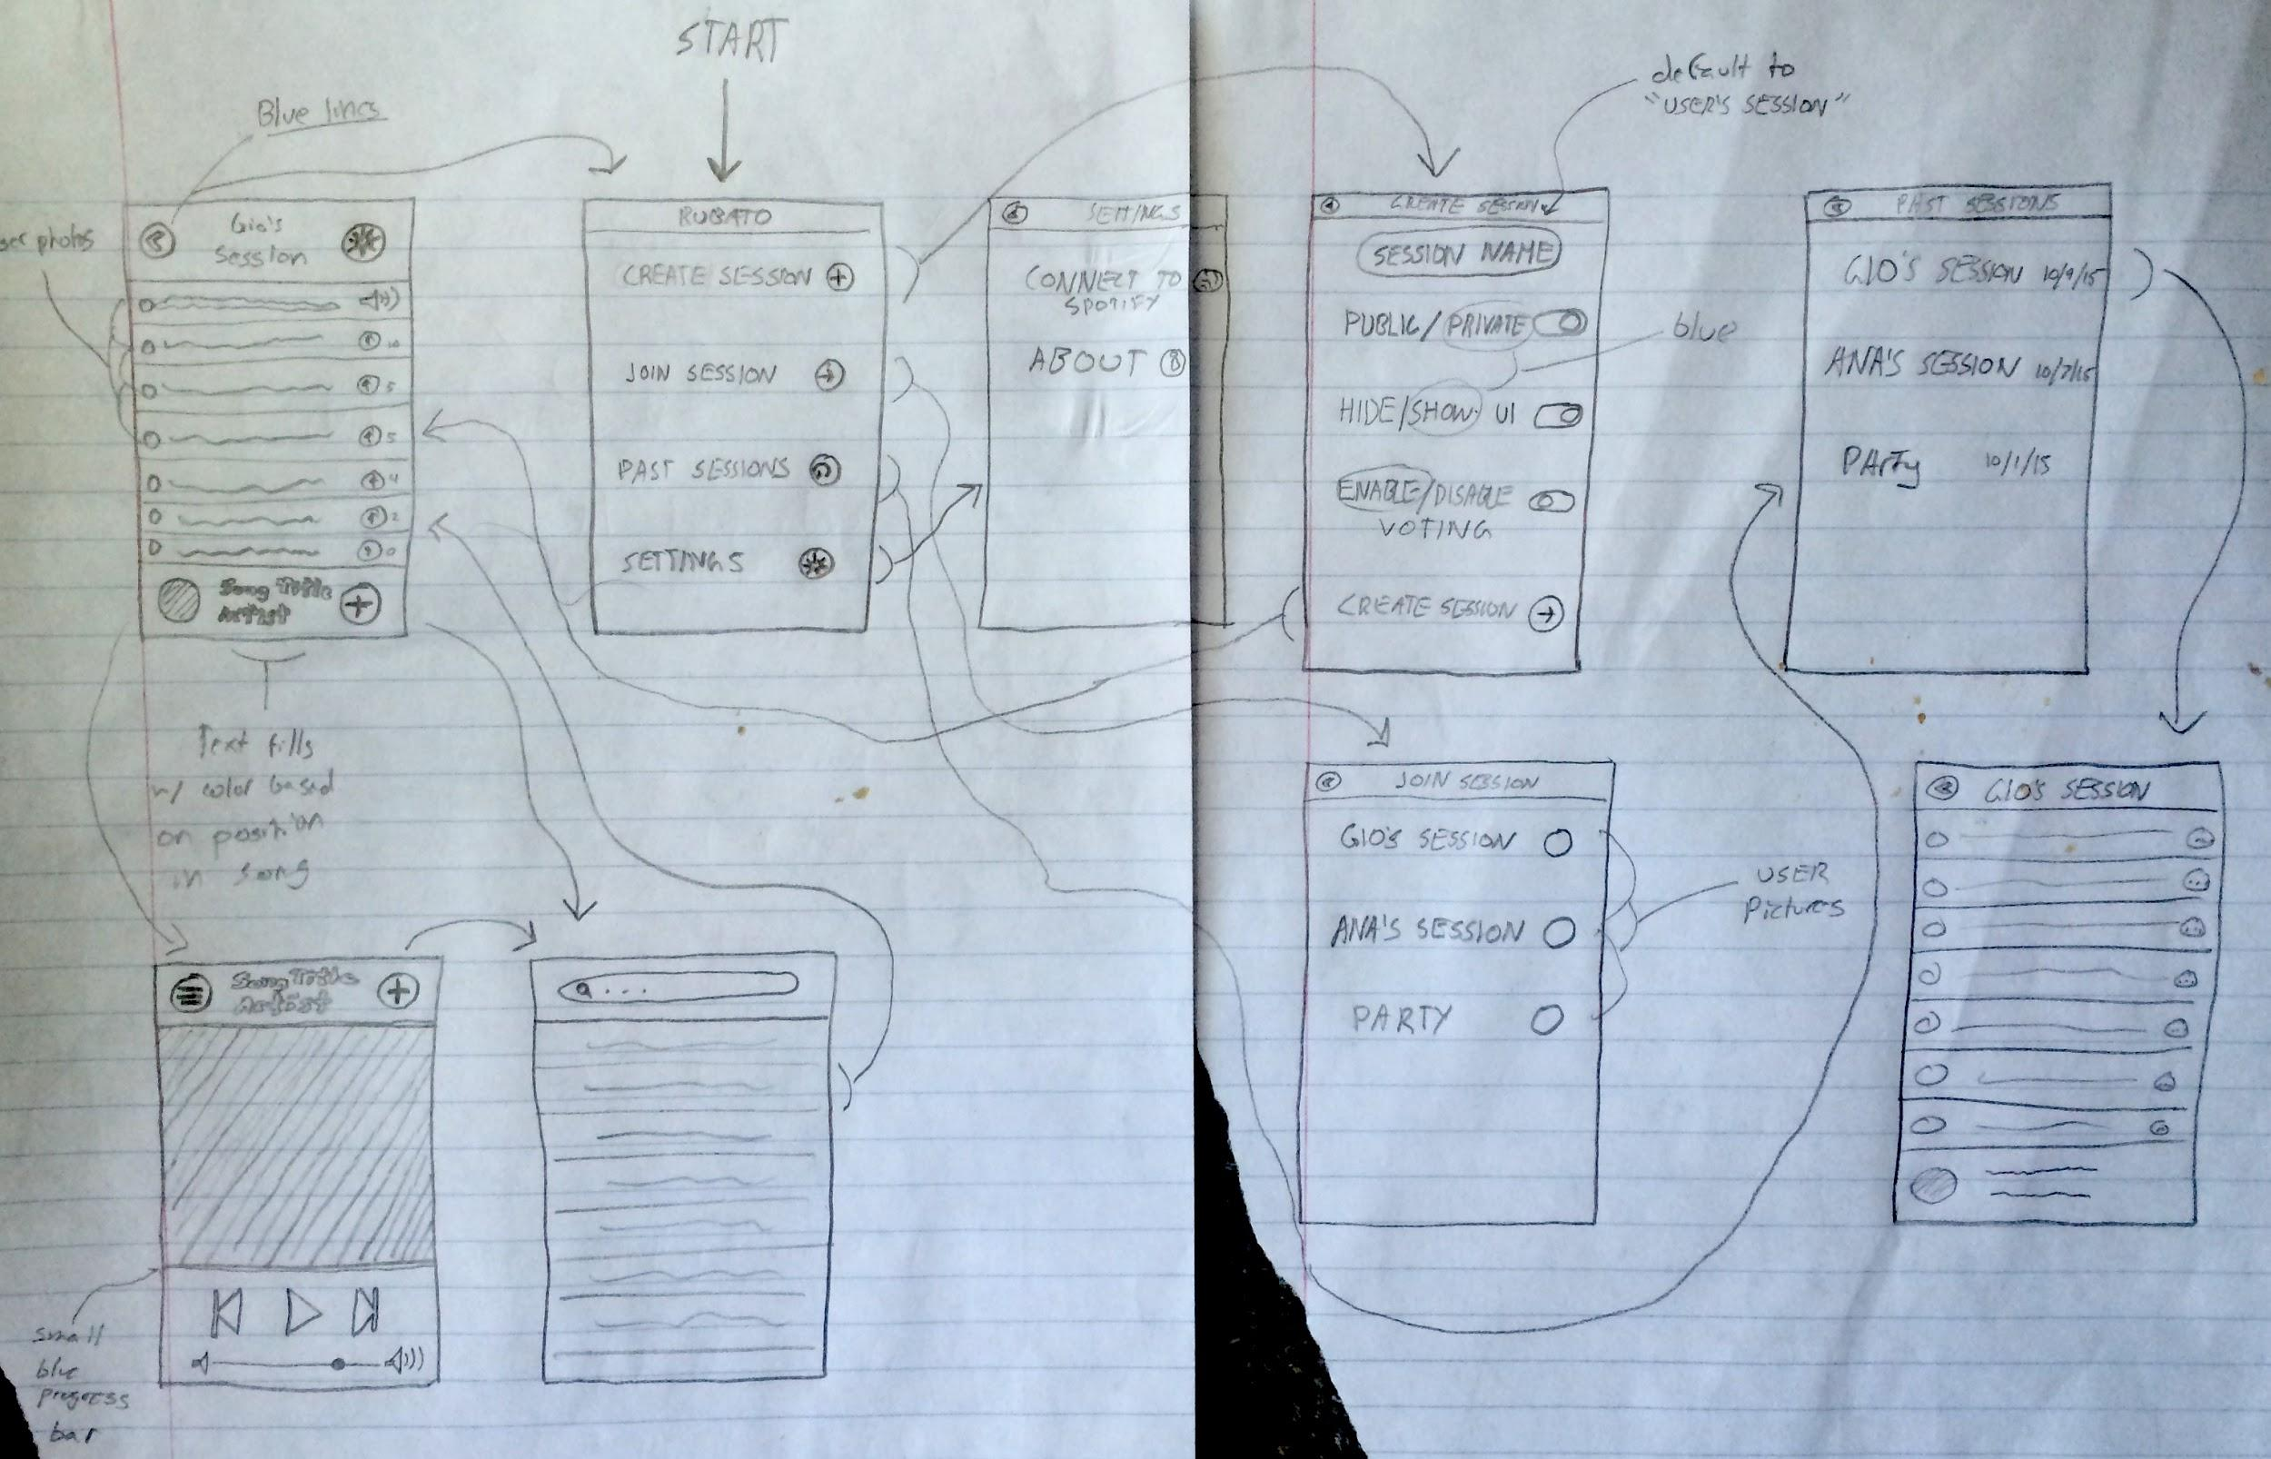
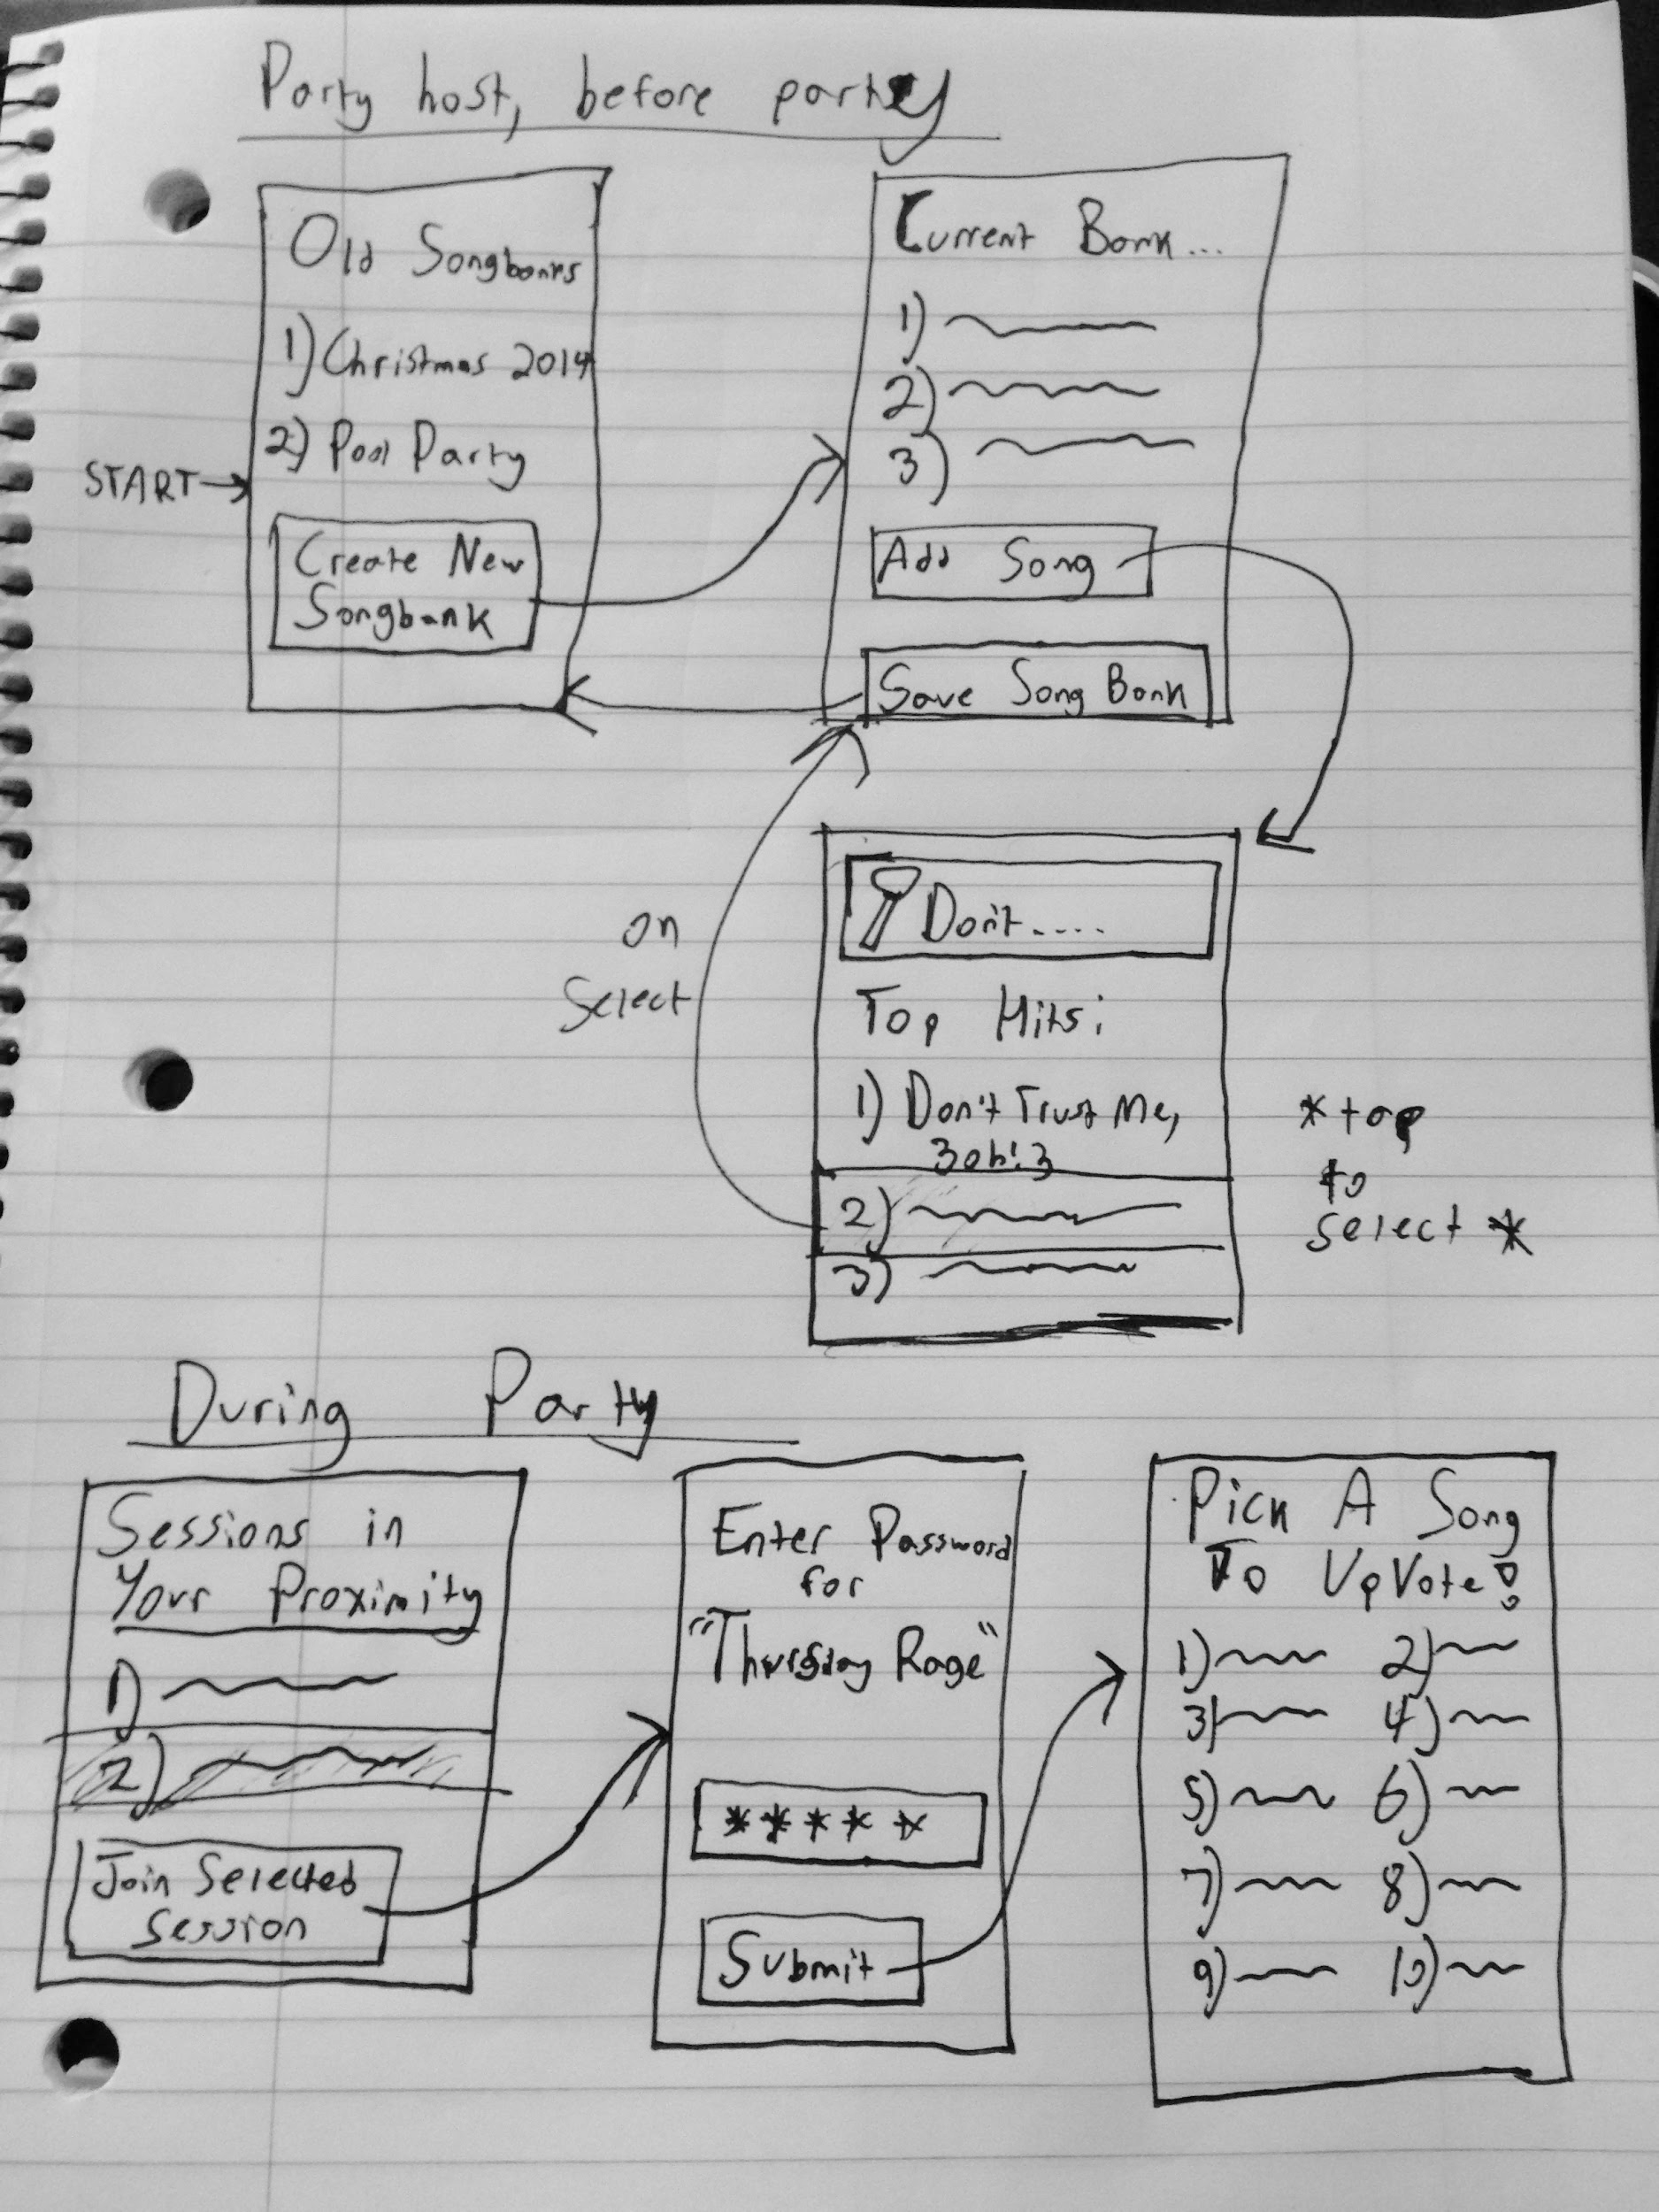
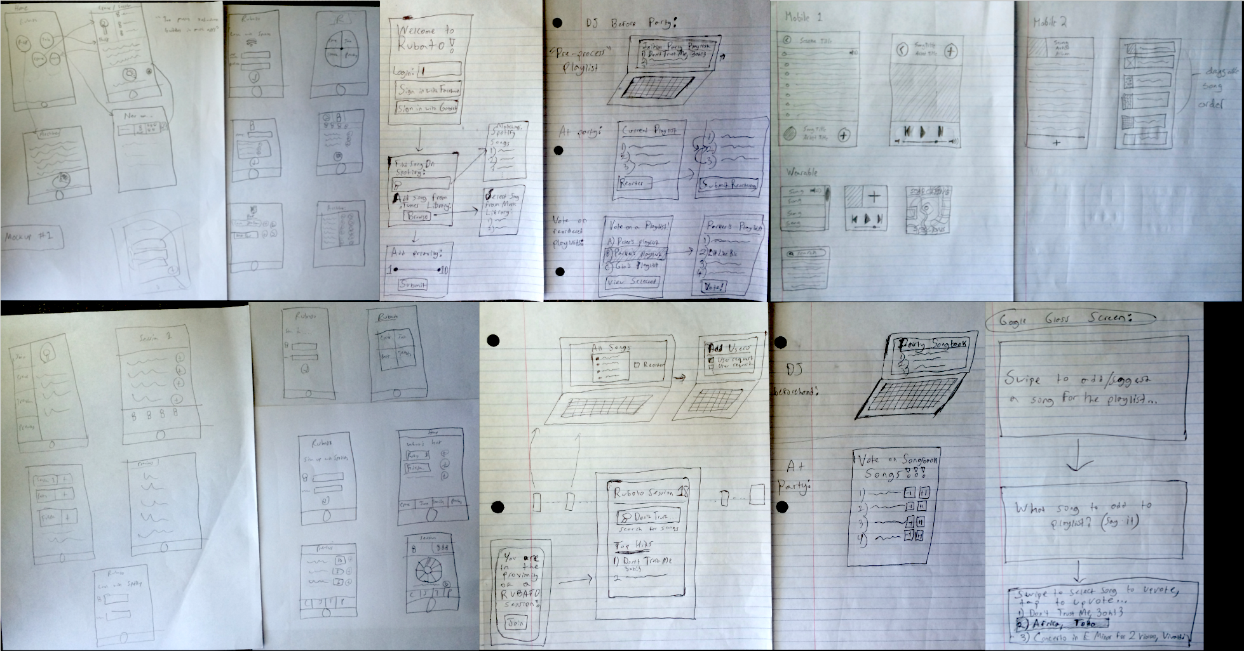
Initial Sketches
iOS + Spotify Mobile
iOS/Computer + Local Host Library

Slide 4
Selected Interface & Rationale → Mobile iOS w/ Spotify
Little host setup
Virtually limitless music library (Spotify)
Large icons/buttons
Reduced controls
No passwords
Simplest and most intuitive design for hosts and clients

Slide 5
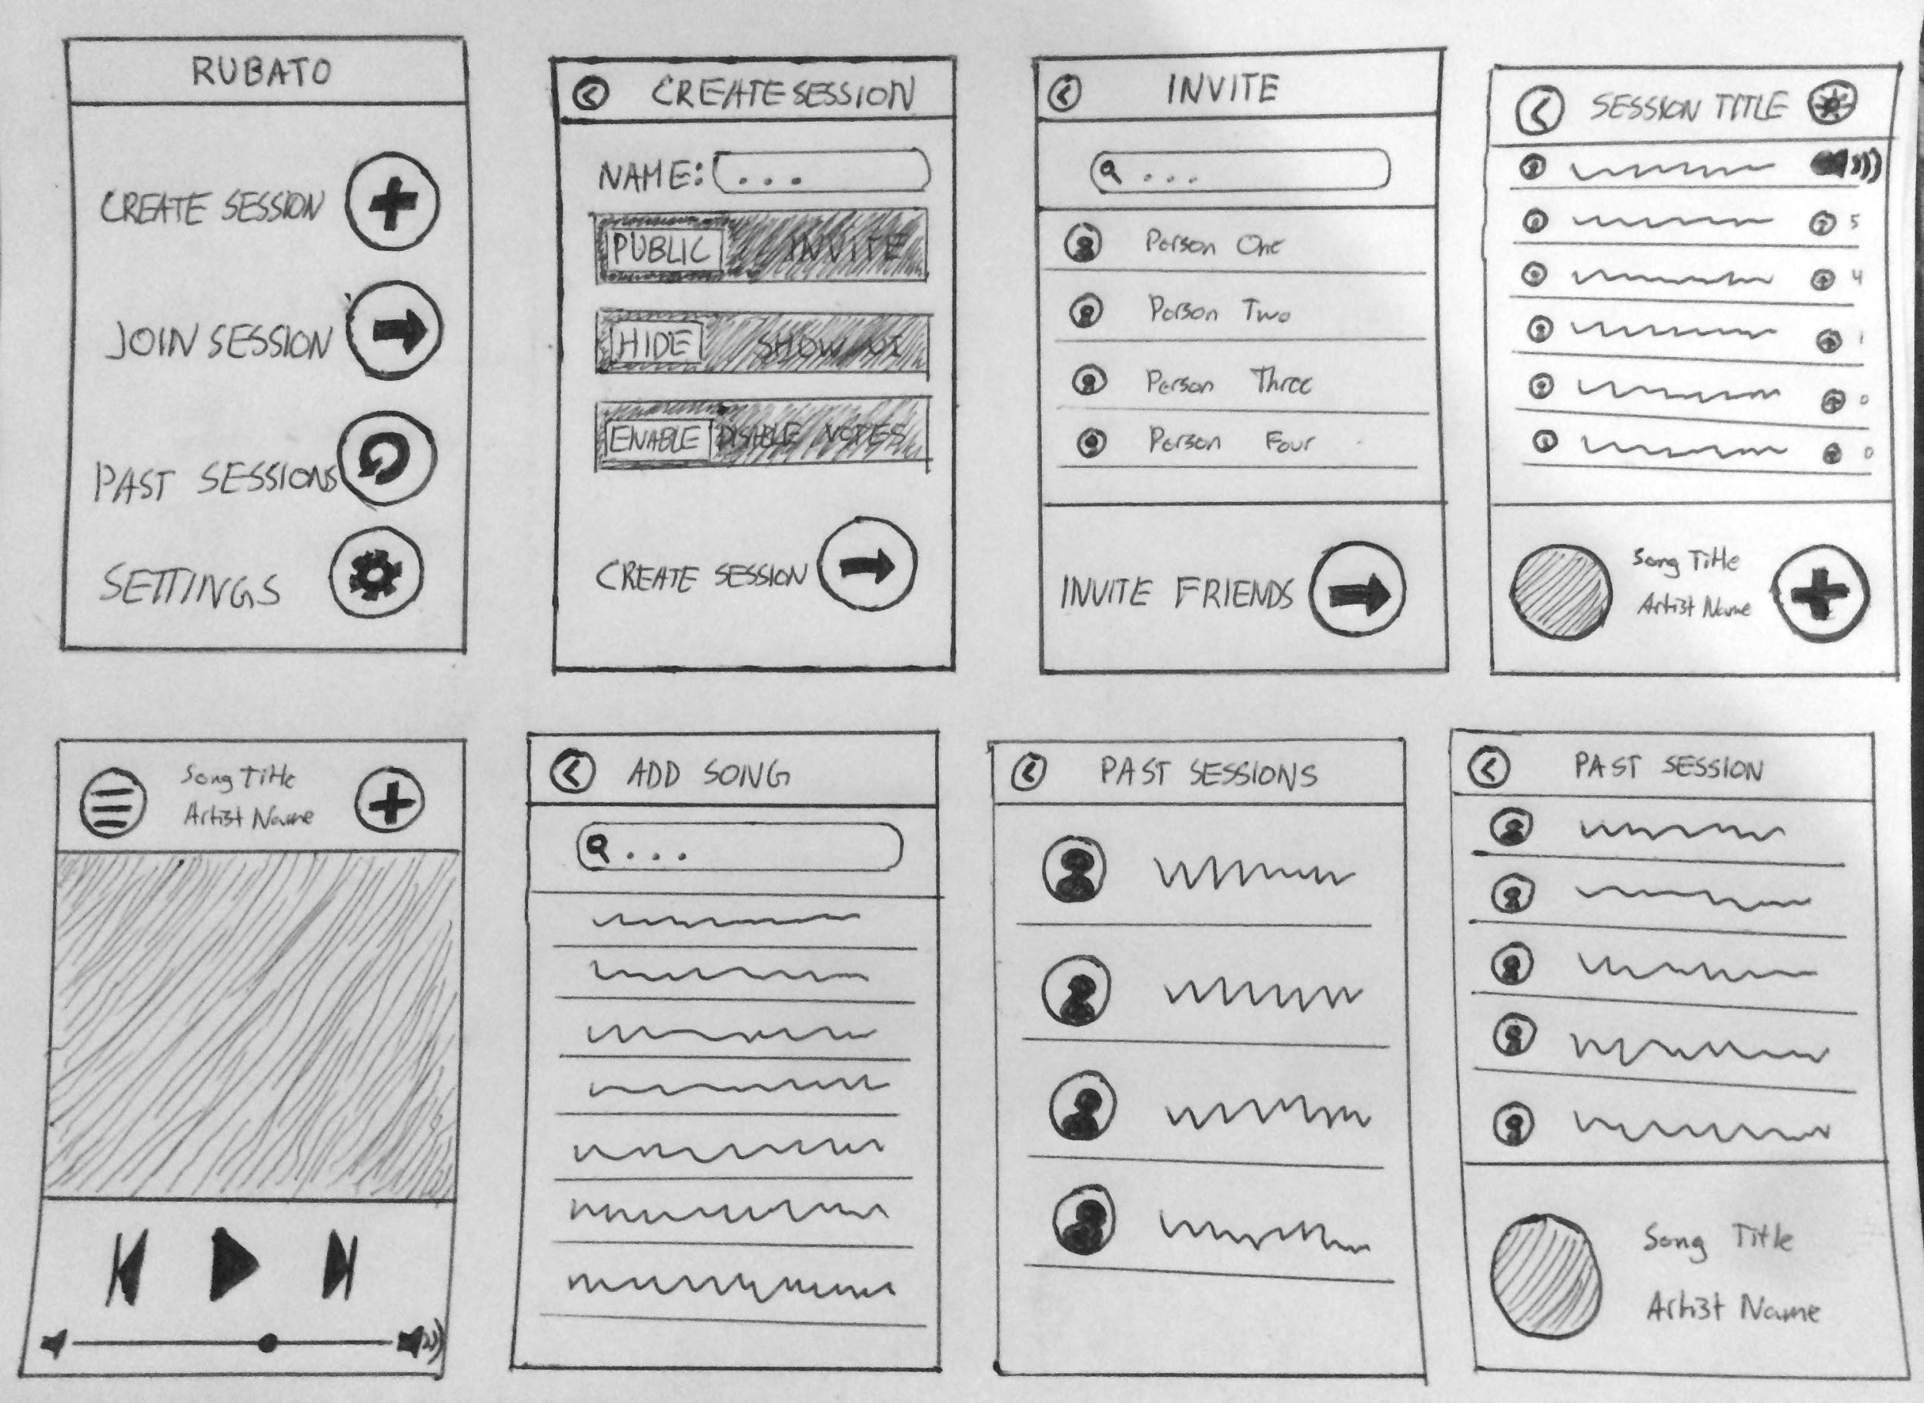
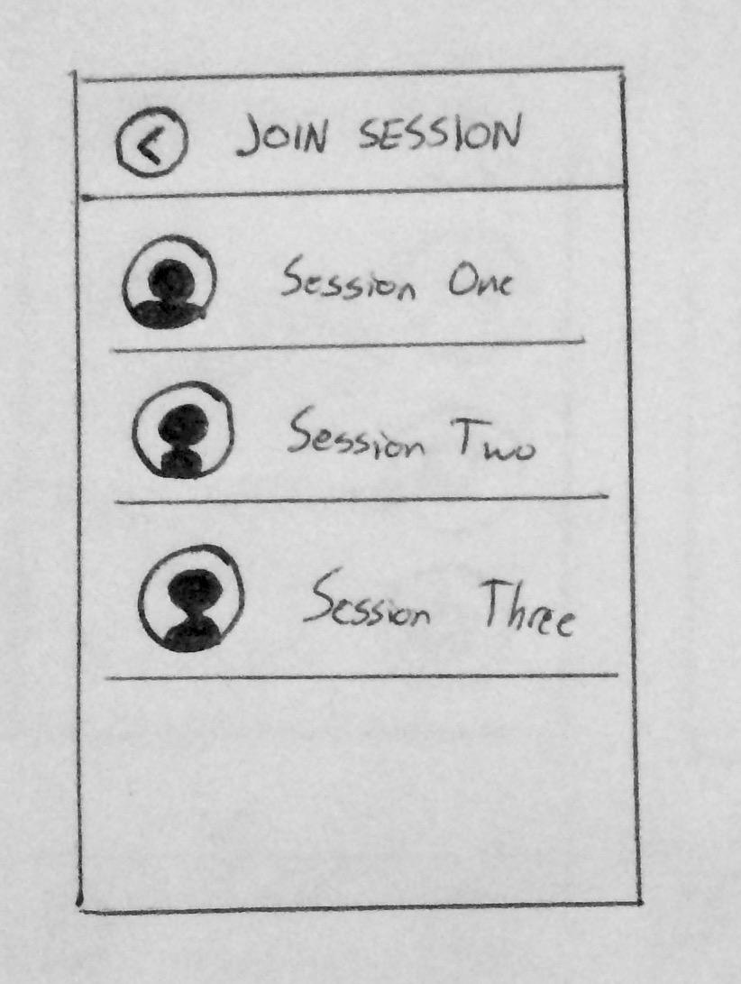
Lo-fi Prototype Structure
Drawn paper prototype
Music played on external speakers in response to user-app interaction

Slide 6
Simple Task: Create a Communal Playlist
Medium Task: Update the Playlist in Real-Time
Complex Task: Play a song from any past session

Slide 7
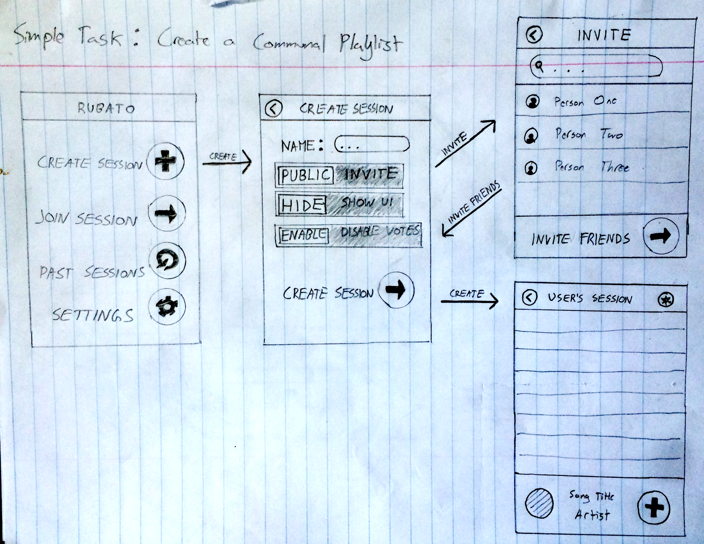
Simple Task: Create a Communal Playlist
Home Screen
Create Session
Edit Session Preferences
Invite Friends
Begin Session

Slide 8
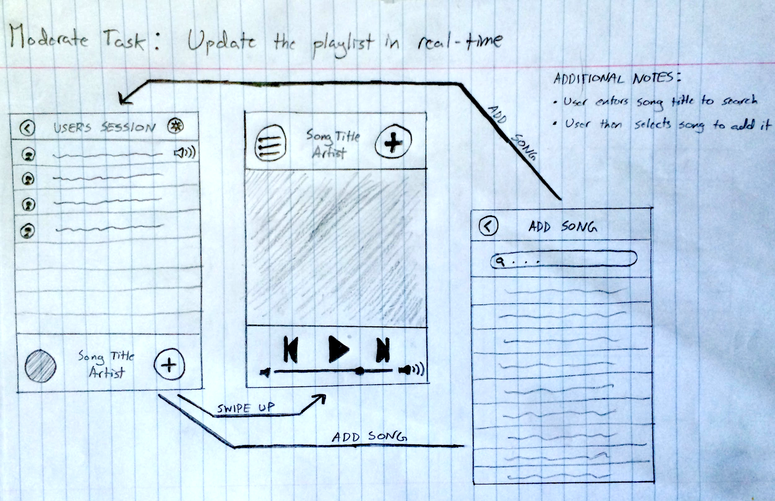
Medium Task: Update the Playlist in Real-Time
Session Screen
Add Song
Or, Add Song from Music Player
Search Song
Queue Song
Return to Session

Slide 9
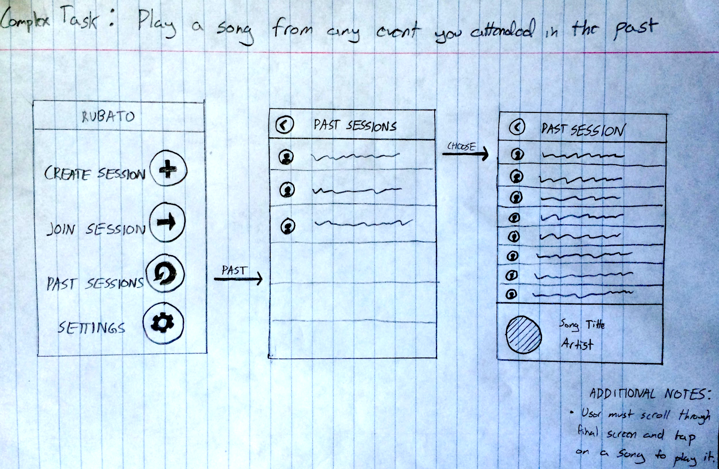
Complex Task: Play a song from any past session
Home Screen
Past Sessions
Search/scroll for past session
Enter Session
Search Song
Search/scroll for specific song
Play Song

Slide 10
Experimental Method
Participants: Asked residents of Roble Hall if they enjoyed attending parties and listening to music. If so, offered donuts as incentive for participation in experiment.
Environment: Conducted at 10PM in Roble Lounge on a weekday night. Many residents socializing, ideal environment to test our preconceptions of the lo-fi prototype.
Procedure: Parker facilitated the prototype while Peter and Gio operated music selection and took notes. Participants attempted to execute our three tasks in order.
When observing behavior, we looked specifically for ease of use, quickness of tasks, and number of errors.

Slide 11
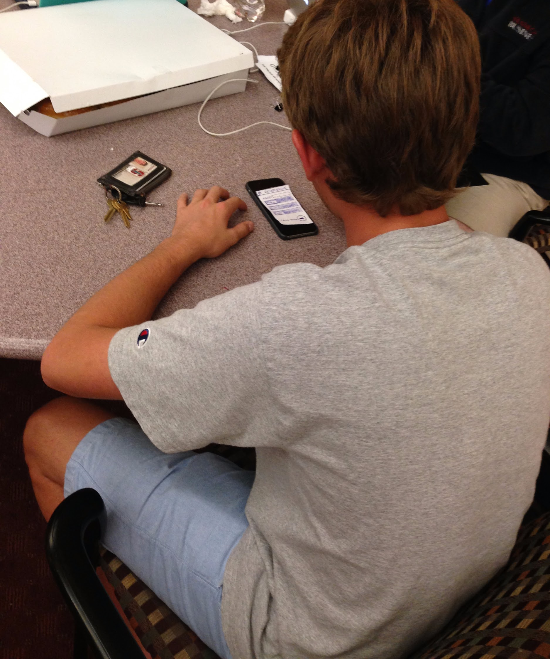
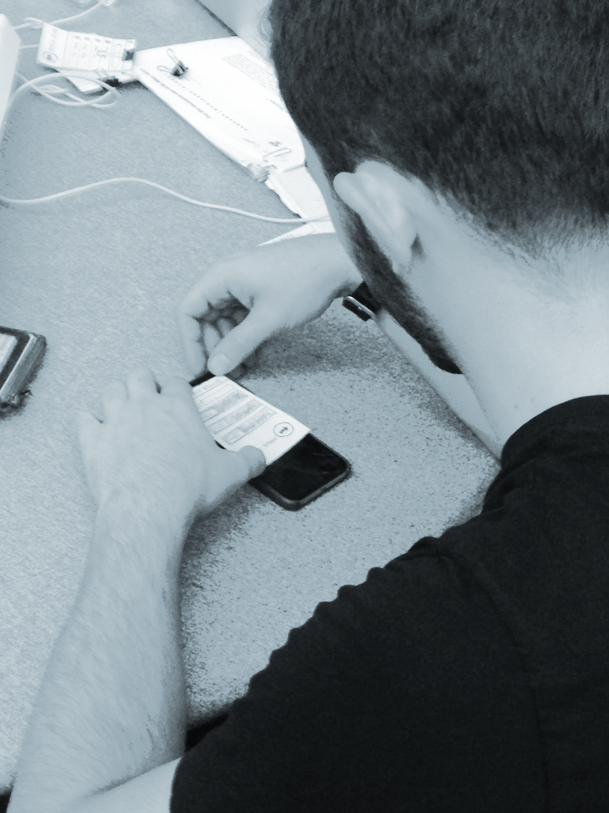
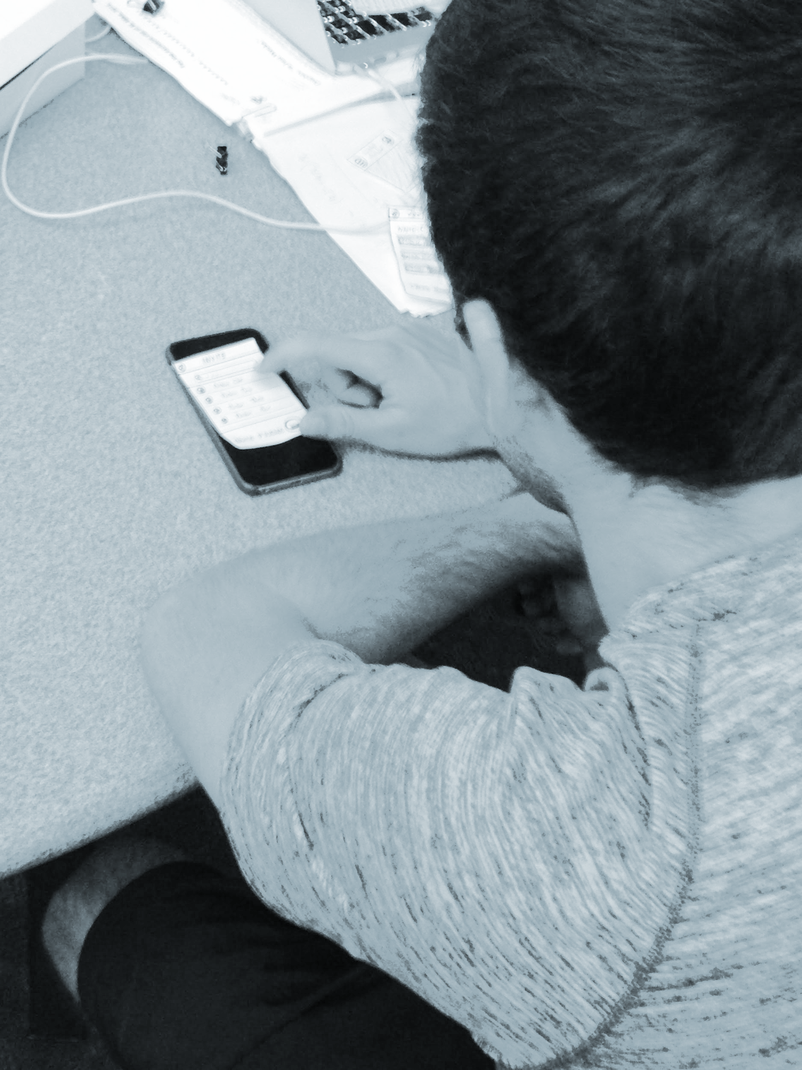
Experimental Results
 | Participant #1
Task 1 | 0: Successfully created the Rubato session.
Task 2 | 0: Was able to create the playlist. 2: Wasn’t sure what to do with the “Hide” vs “Show” switch. 2: Wasn’t sure whether “Settings” button indicated session settings or playlist settings. 3: Added a silly song to the playlist just to “troll”. 4: Added the song to the playlist again in order to keep on spamming the playlist.
Task 3 | 0: Successfully accessed a previous session and listened to a song from it. 3: Had trouble navigating between songs during playback, as the interface was unclear on allowing the user to pick any song rather than listen to the entire session.

Slide 13
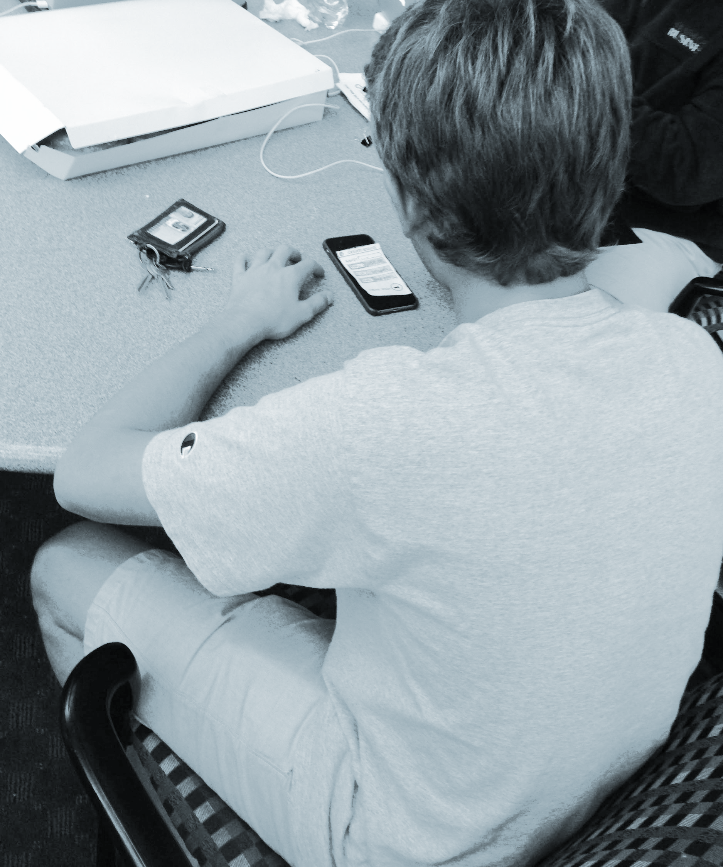
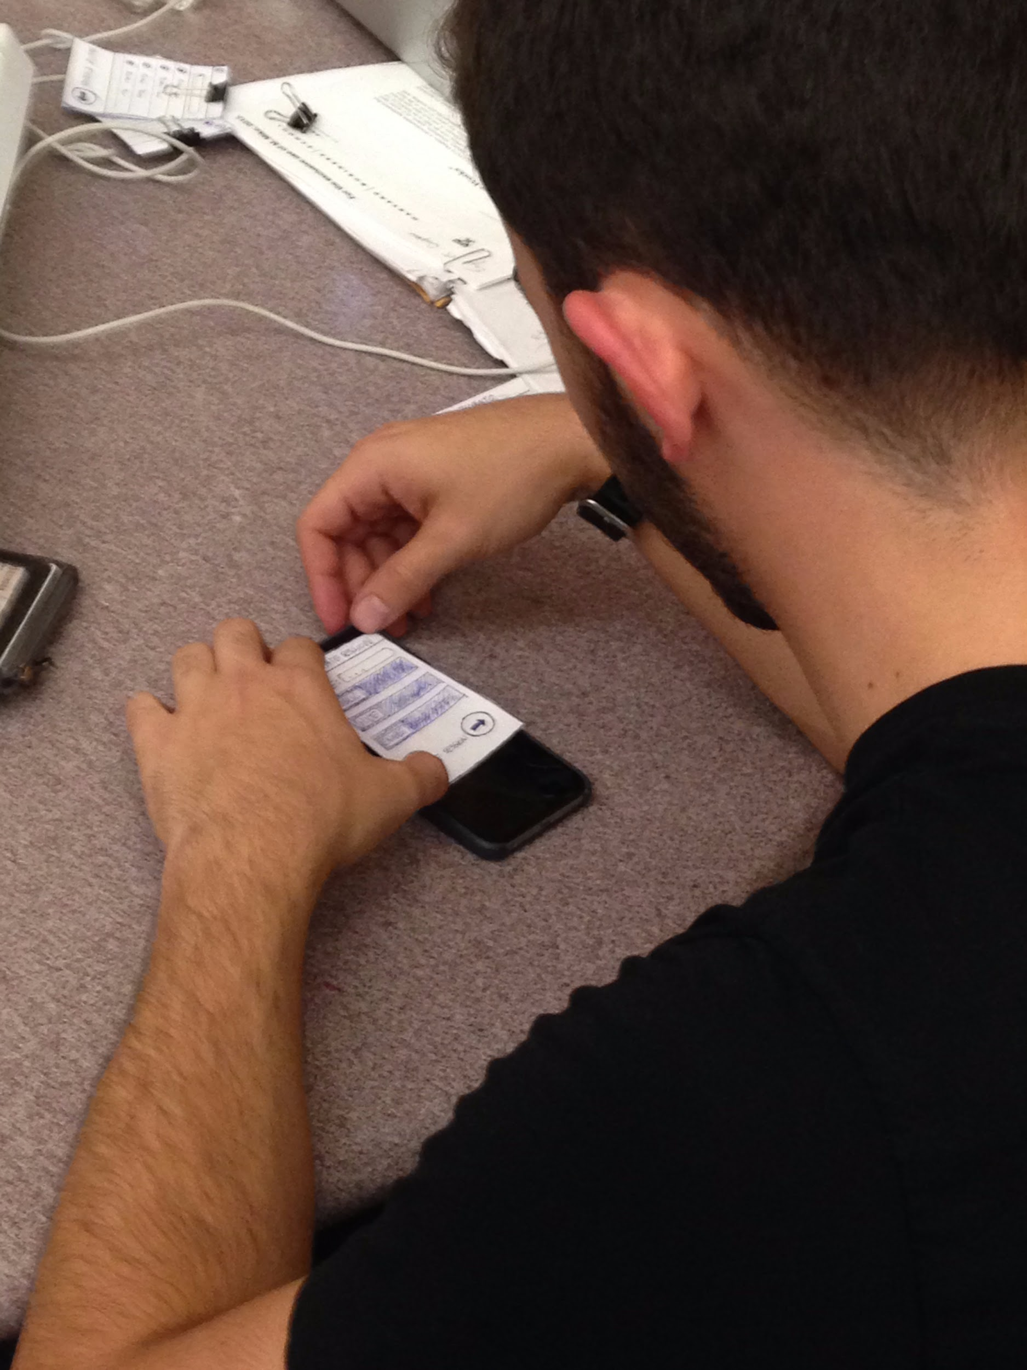
Experimental Results
 | Participant #2
Task 1 | 0: Successfully created the Rubato session.
Task 2 | 0: Was able to create the playlist. 3: Added a silly song to the playlist just to “troll”.
Task 3 | 0: Successfully accessed a previous session and listened to a song from it. 3: Had trouble navigating between songs during playback, as the interface was unclear on allowing the user to pick any song rather than listen to the entire session.

Slide 14
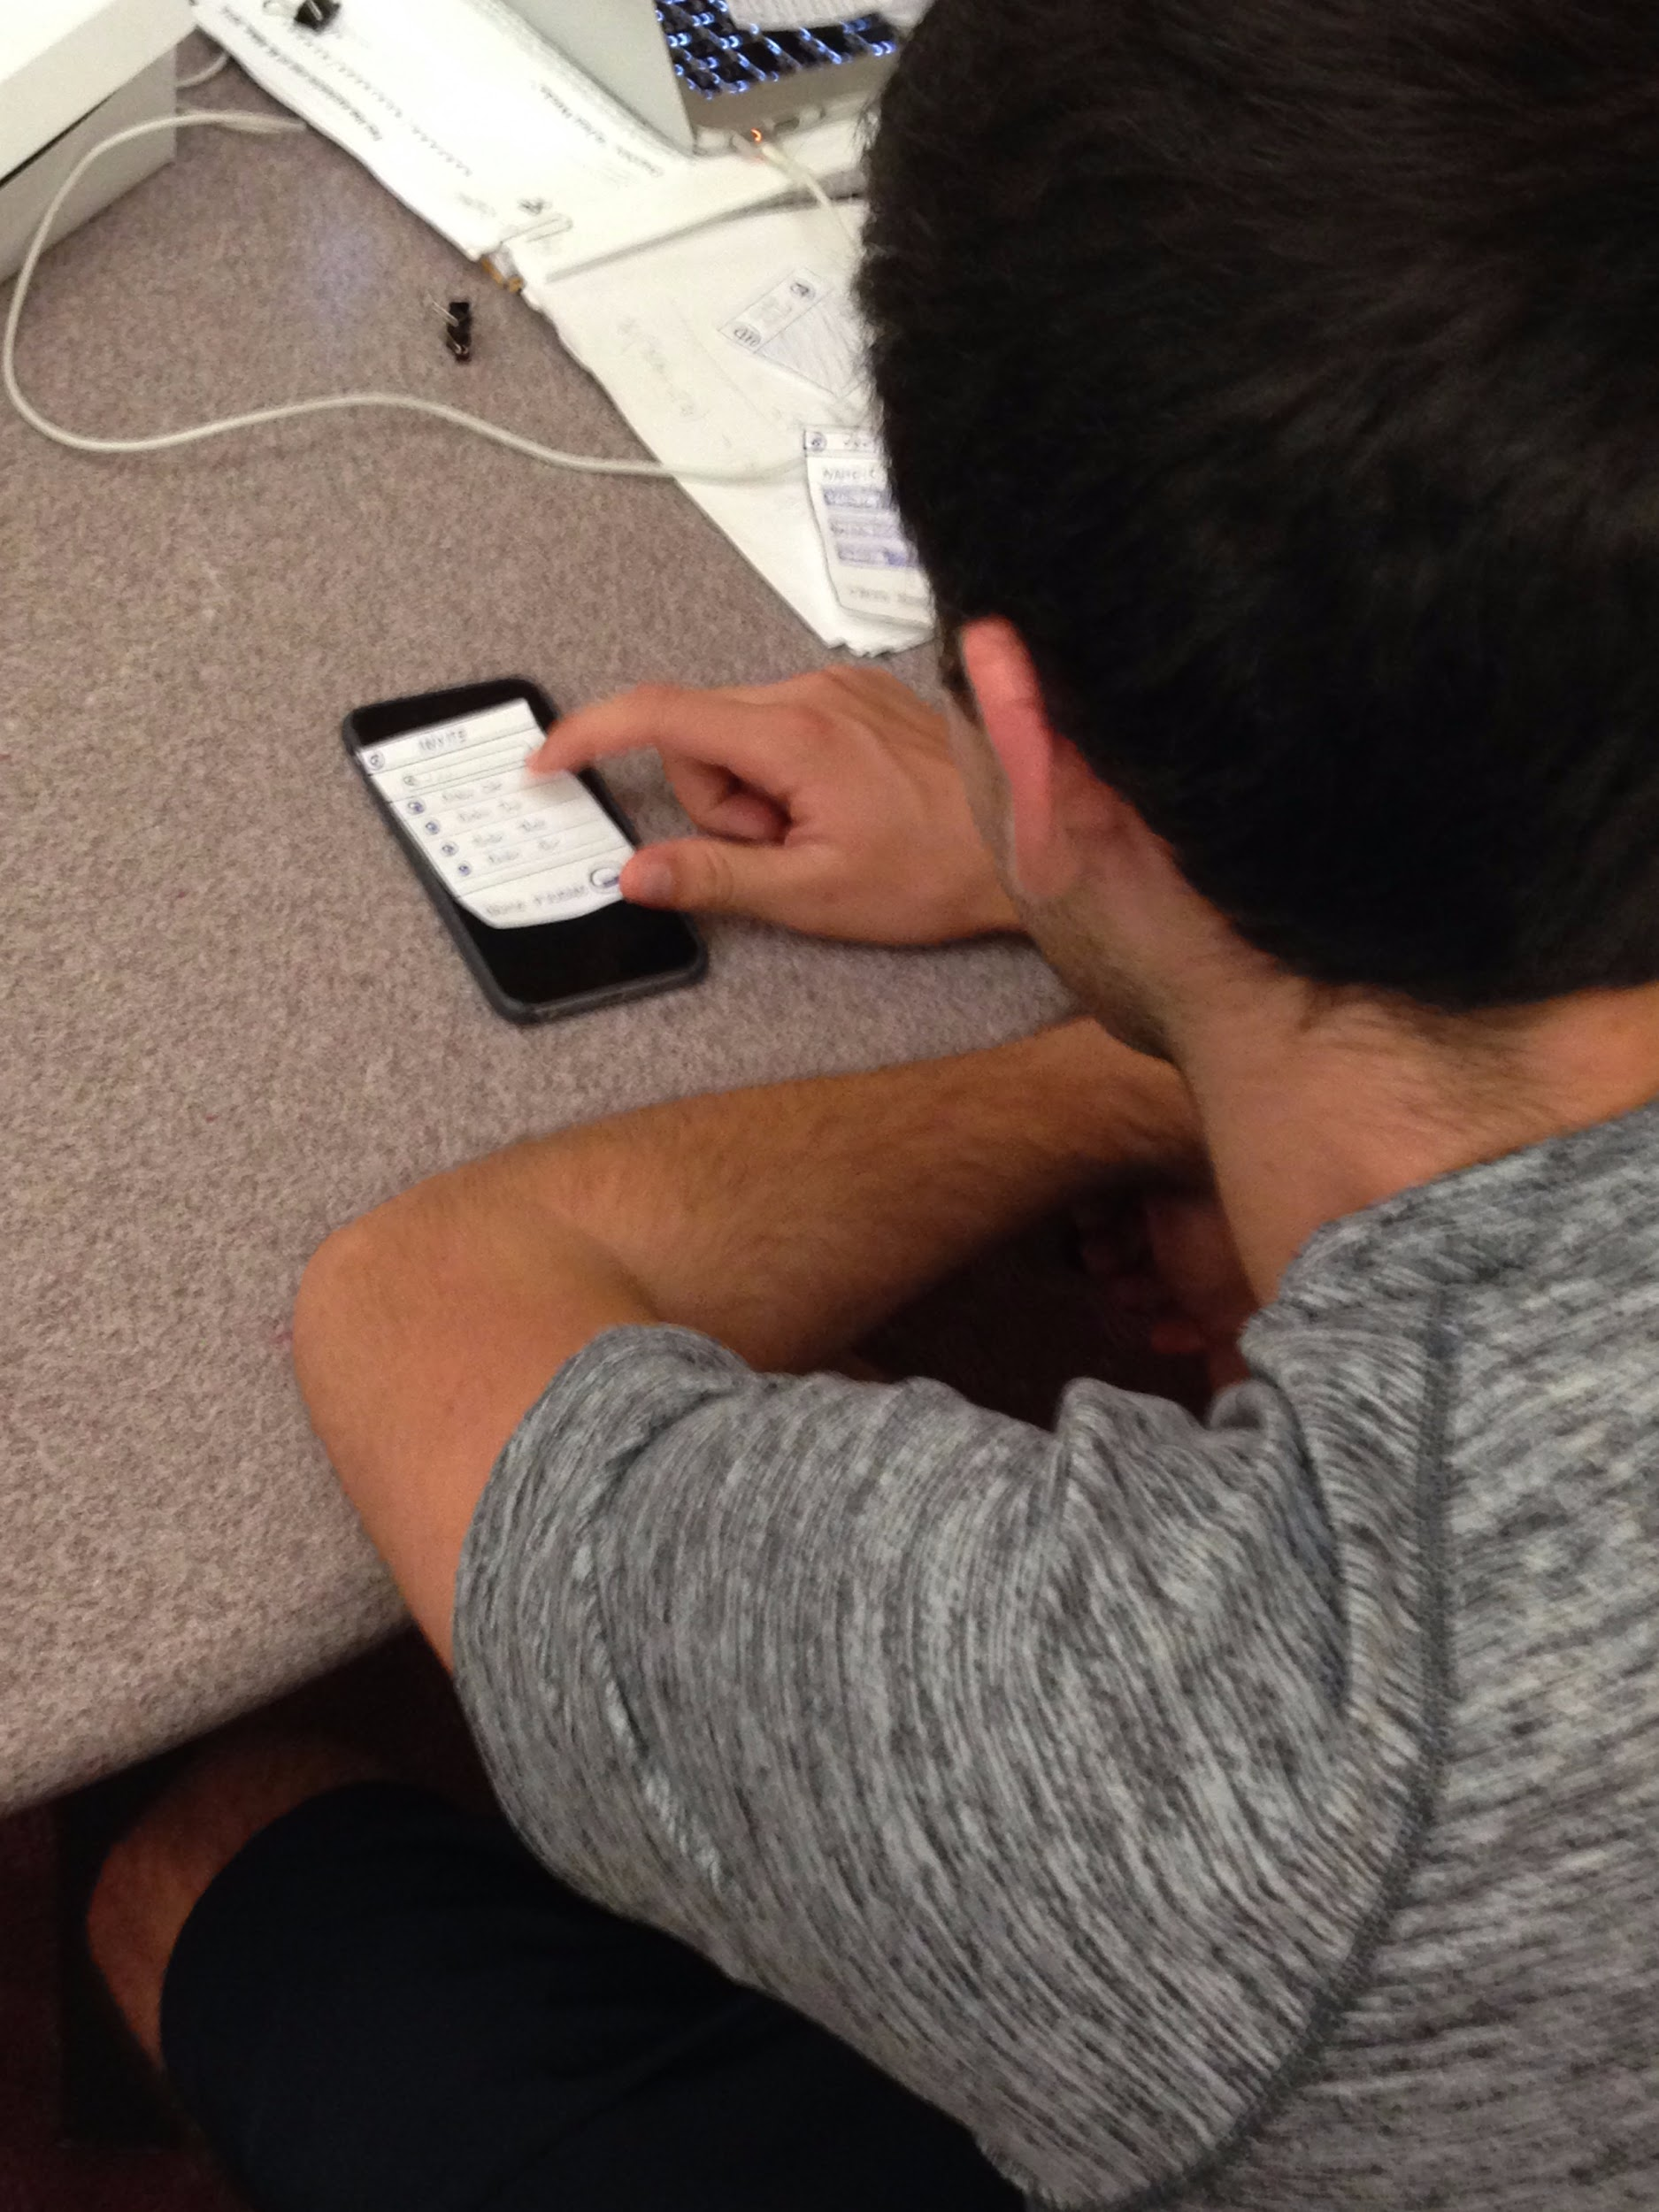
Experimental Results
 | Participant #3
Task 1 | 0: Successfully created the Rubato session.
Task 2 | 0: Was able to create the playlist. 3: When trying to add another song to the playlist, he navigated back to the homepage of the app, ultimately doing a lot more work than was necessary.
Task 3 | 0: Successfully accessed a previous session and listened to a song from it. 3: Had trouble navigating between songs during playback, as the interface was unclear on allowing the user to pick any song rather than listen to the entire session.

Slide 15
Suggested UI Changes
Certain button icons are ambiguous:
Create Session and Add Song are currently identical.
Sliders in session creation preferences are not necessarily intuitive. A first-time tutorial or restructuring of this screen is needed.
Settings for a specific session and the application itself need to be made distinct.
To prevent malicious use (i.e. “spamming” or “trolling”), a real-time upvoting system will be implemented.
Freedom of interaction with Past Sessions unclear, needs to be redesigned.

Slide 16
In Summary...
Participants liked:
Large icons and buttons
Greatly simplified controls
General flow of application
Participants wished:
Icons were more clear
Create Session screen had a tutorial explanation or was restructured to be more intuitive
Past Session interface was more clear despite fundamental difference in interaction freedom.

