Slide 1
Assignment 4: Concept Video
Rubato
Parker Odrich, Gio Jacuzzi, Peter Washington
Studio: Creation

Slide 2
Value Proposition
Value Proposition: Communal playlists, in real time.
Problem: Music is a dynamic force that brings communities together, but too often social events rely on static playlists crafted by a single person.
Solution: Rubato allows everyone at an event to contribute in real time to the music creation. The result is a constantly evolving playlist, curated by the entire community.

Slide 3
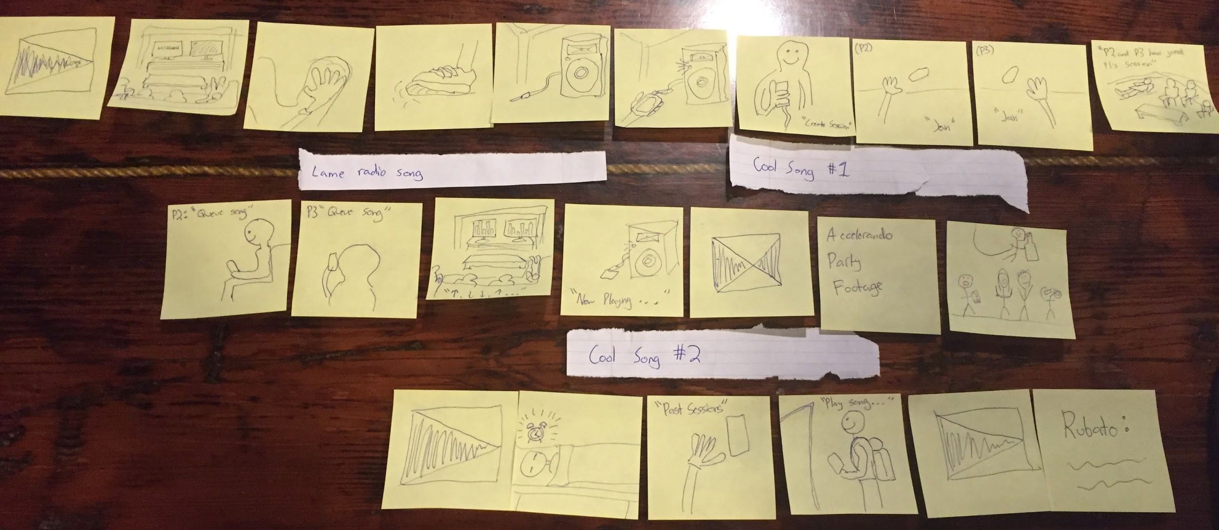
Tasks
Simple: Listening to music with friends in a social setting
Medium: Changing the current song to the most popular song your friends suggest
Complex: Identifying what songs your friends played the previous night

Slide 4
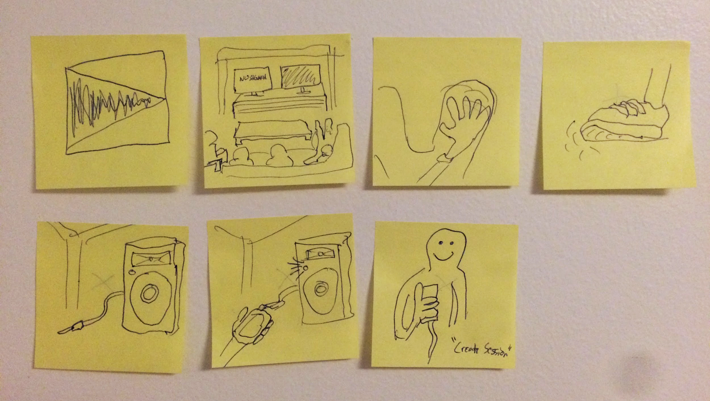
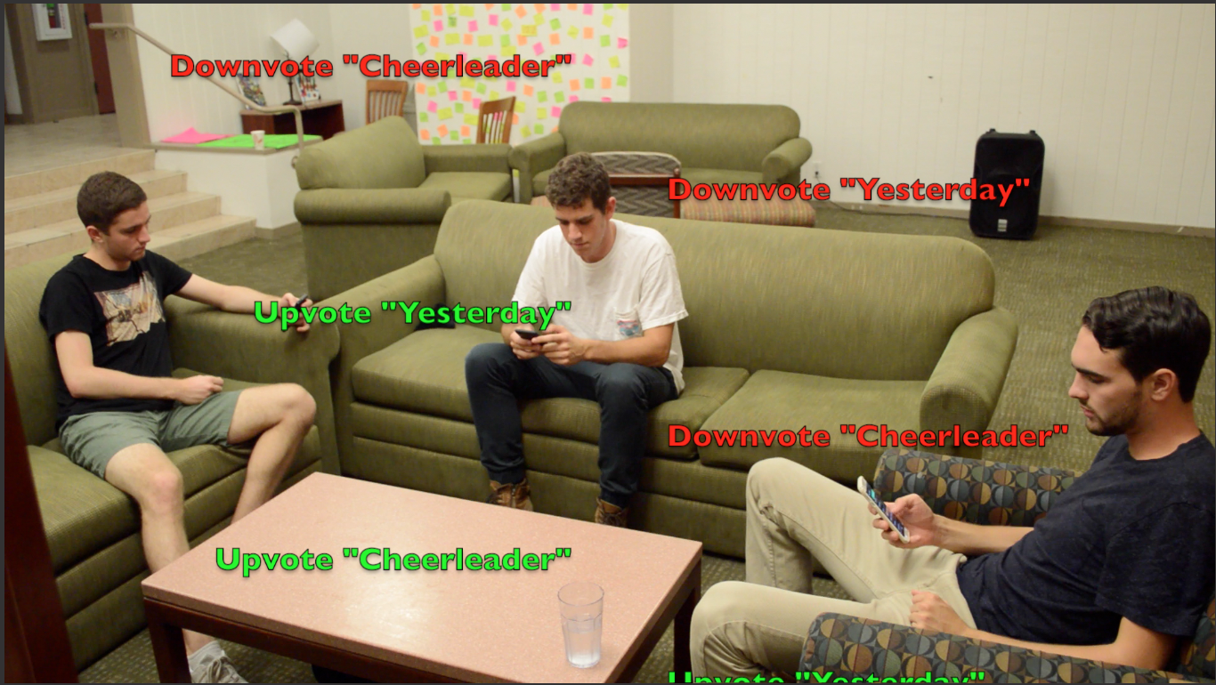
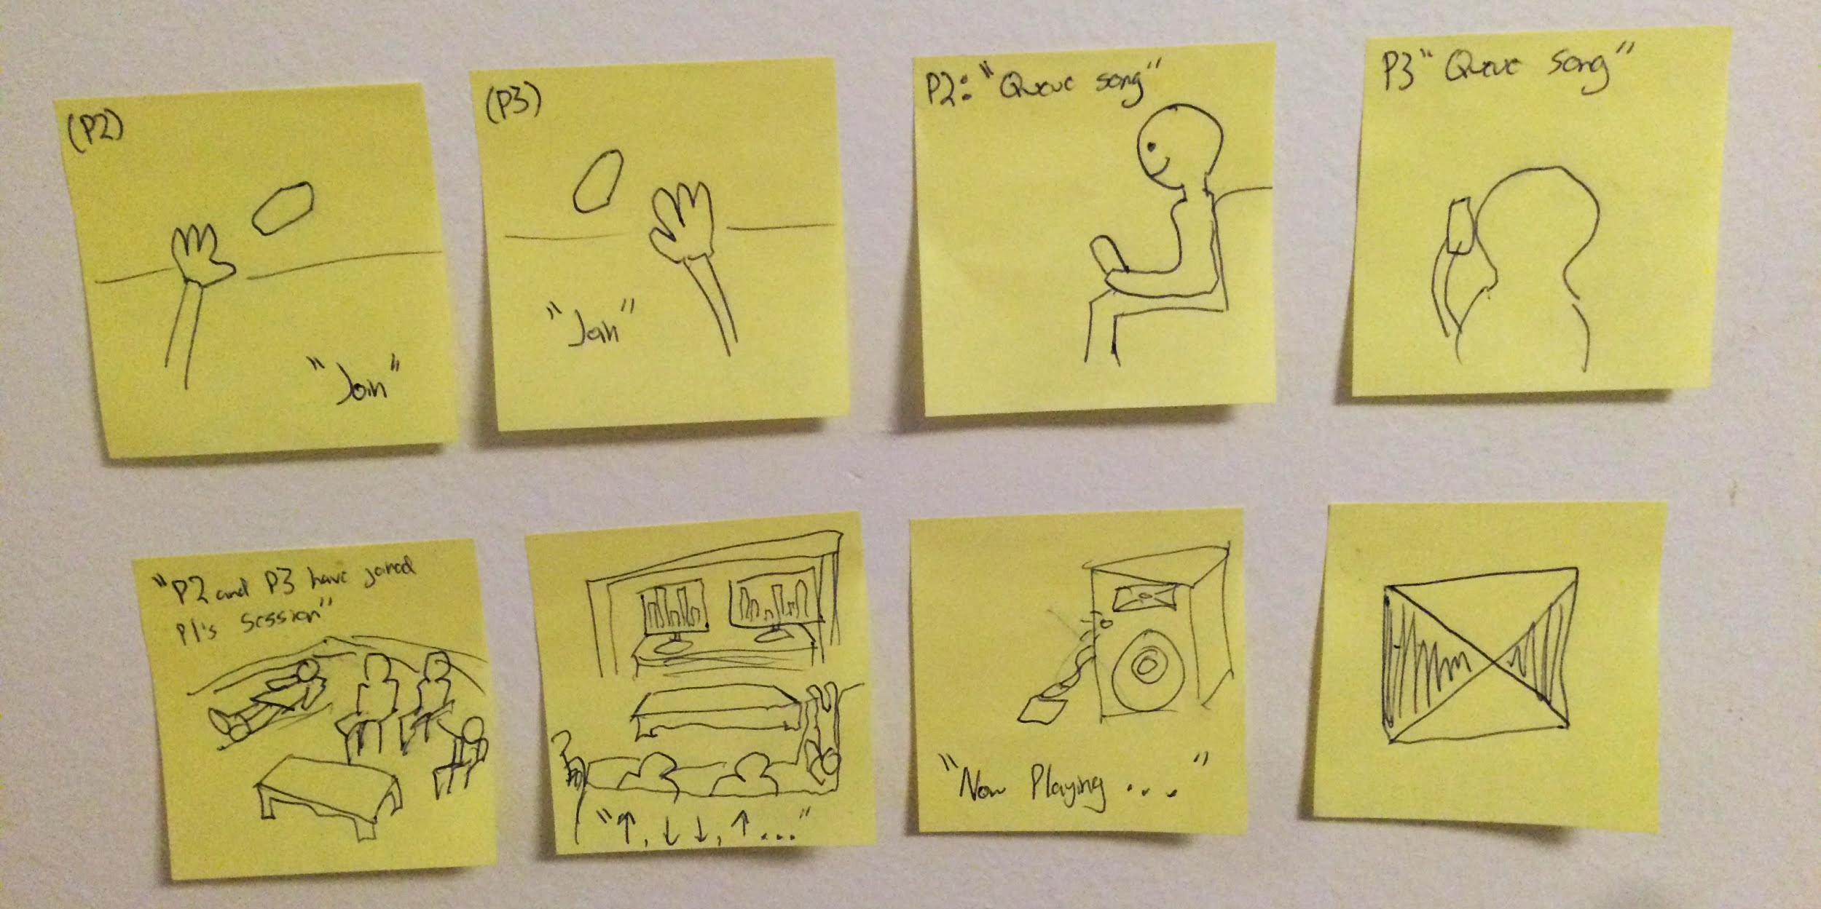
Storyboard

Slide 5
https://www.youtube.com/watch?v=mScWZkUjI1E

