Slide 1
POVs, HMWs, Experience Prototypes, Oh My!
Rubato
Parker Odrich, Gio Jacuzzi, Peter Washington
Studio: Creation
Assignment #2
Presenter: Parker Odrich

Slide 2
Meet the Rubato Team
Studio theme: Creation
Problem domain: Music!
Parker Gio Peter

Slide 3

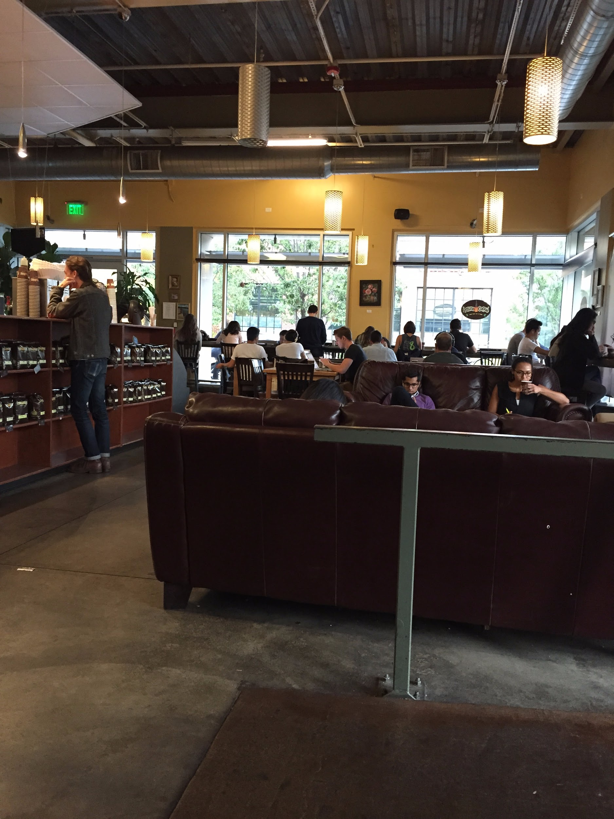
Initial POV
We met Angelica
We were amazed to realize that she was shy about her music taste while being comfortable with illegally downloading music.
It would be game changing to make her less anxious about her musical tastes and expressing them.
… but then we interviewed more people!

Slide 4
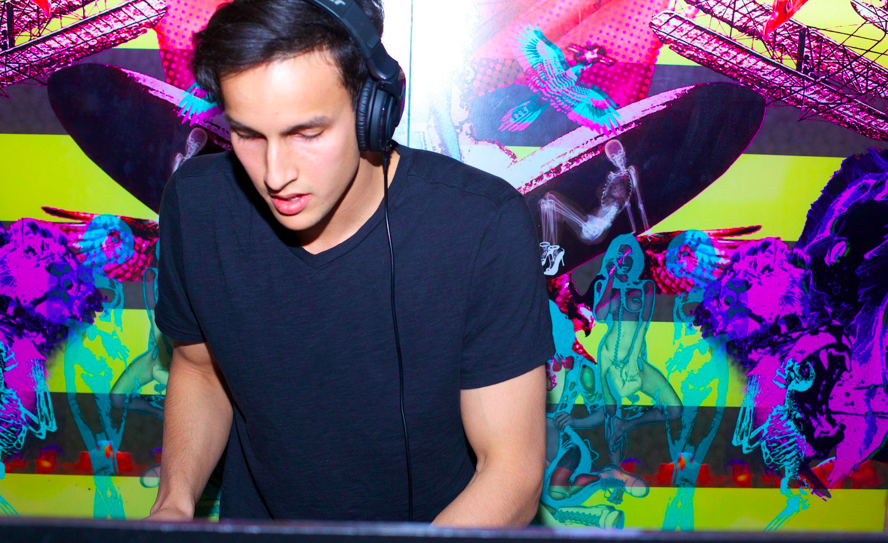
Interview #6: Manek Mathur
DJ who regularly performs in NYC: Electronic, house, EDM
Was open to sharing playlists but not for some of his personal music and mashups
“I like to keep my sets and collection unique, it's more of an identity thing”
“No handbook to tell you what’s right and what’s wrong, its all about constant repetition””

Slide 5
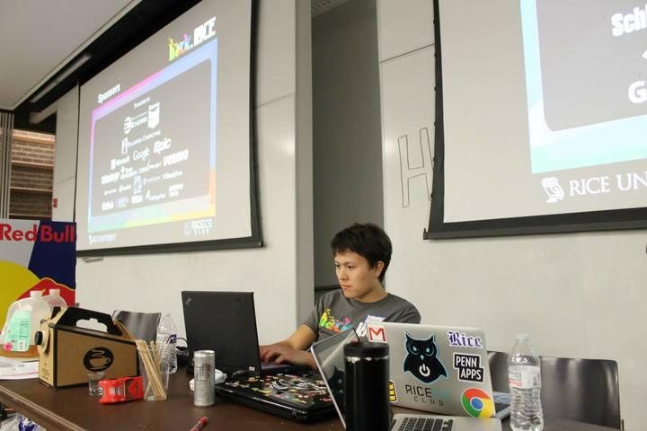
Interview #7: Aaron Roe
Another DJ oriented with house and house derivatives
He’s completely open to sharing, although admits the process is sometimes not easy especially in intimate social settings
Admits song selection process is difficult
“It would help if the DJing process were more visual”

Slide 6
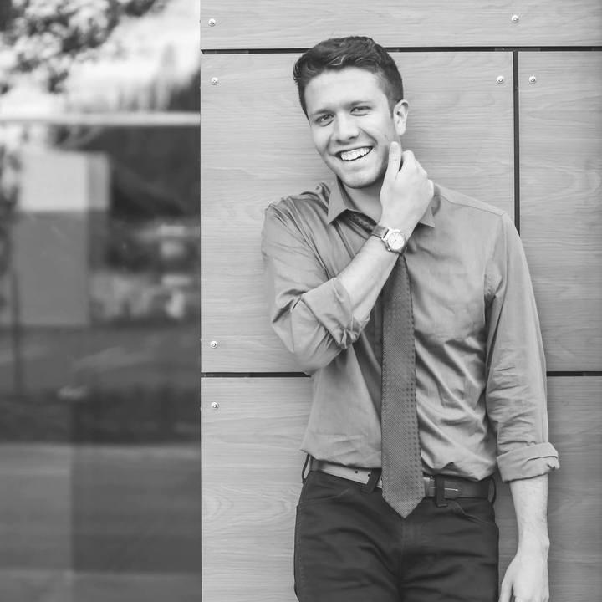
Interview #8: Paton Moody
Music Writer and Blogger/Curator, works at Red Light Management
“Introducing people to music is a rush, especially when you help them find a new favorite song or Artist. That’s what I like most about it”
Admitted that people get embarrassed or even offended when you show them a song you really like and they don’t necessarily like it.

Slide 7
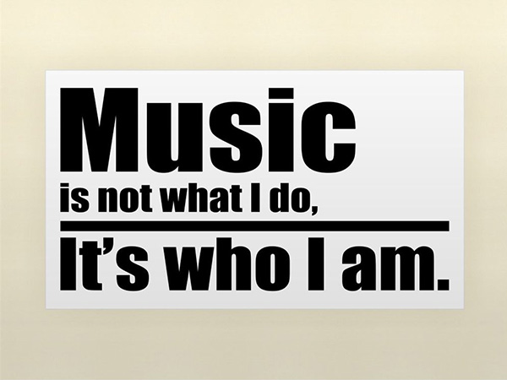
Revised POV #1
We met Manek
We were amazed to realize that despite the fact that he is a DJ and curates a ton of his music and shares it, there are some pieces that he likes to keep private, linking it to his “identity”.
It would be game-changing if we can remove the stigma from publically curating his music while allowing him to feel like his “musical identity” is preserved, or even improved?

Slide 8
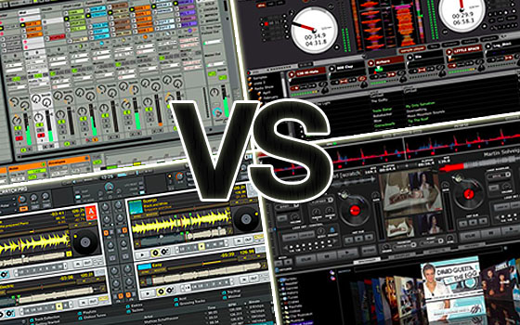
Revised POV #2
We met Aaron
We were amazed to realize that he finds current state-of-the-art DJing software, such as Traktor, to be too complicated to use while still lacking certain important features.
It would be game-changing if we could make DJing software more powerful while still being as simple to use as possible.

Slide 9
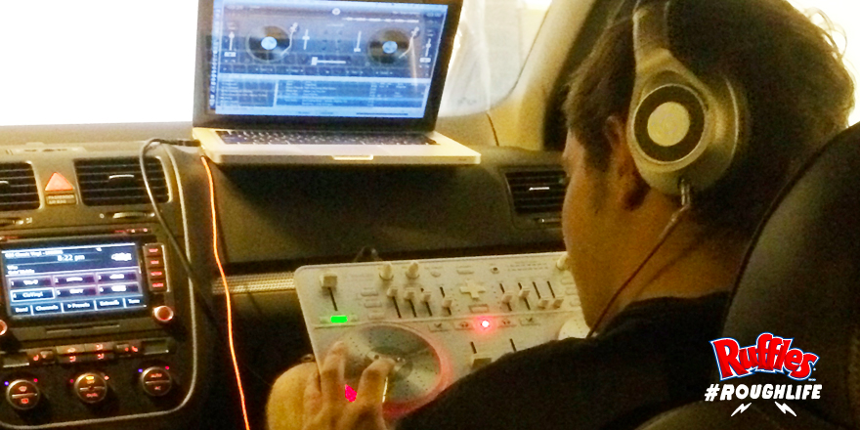
Revised POV #3
We met Paton
We were amazed to realize that choosing the music to listen to with his friends can become logistically awkward or frustrating
when in the car or at parties.
It would be game-changing to develop a way to streamline music playlisting among friends and reduce this tension in the process.

Slide 10
HMW 1
Inspiration: Aaron & Paton
How might we make social music curation less autocratic and more community-driven?
Proposed Solution: Communal playlist creation by all members of a social event in real-time
Assumption: People will enjoy hearing music that other people want to listen to as long as they’re contributing to the curation of the playlist.

Slide 11
Legend for Prototypes
✔: What went well
✖: What didn’t go well
! : Something surprising
★: Something new that we learned

Slide 12
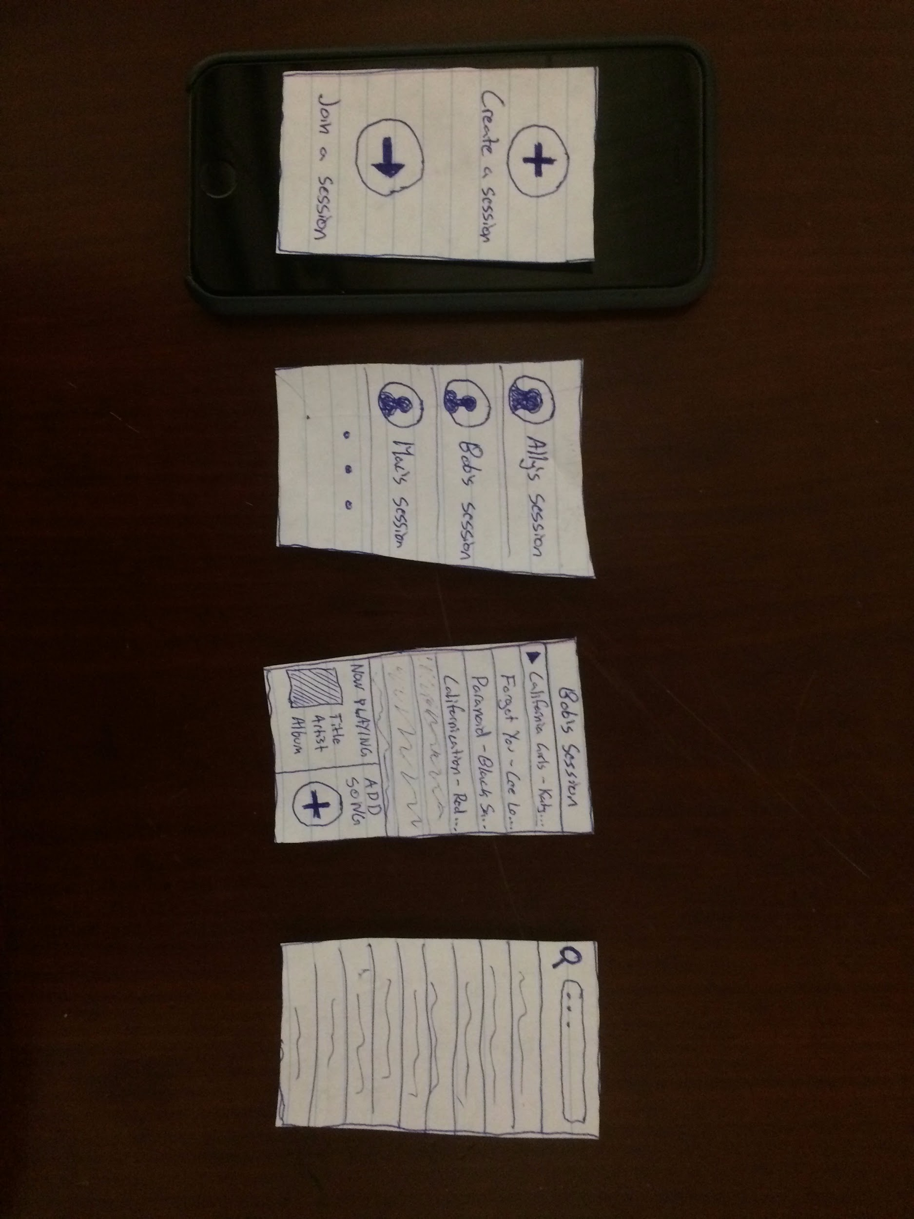
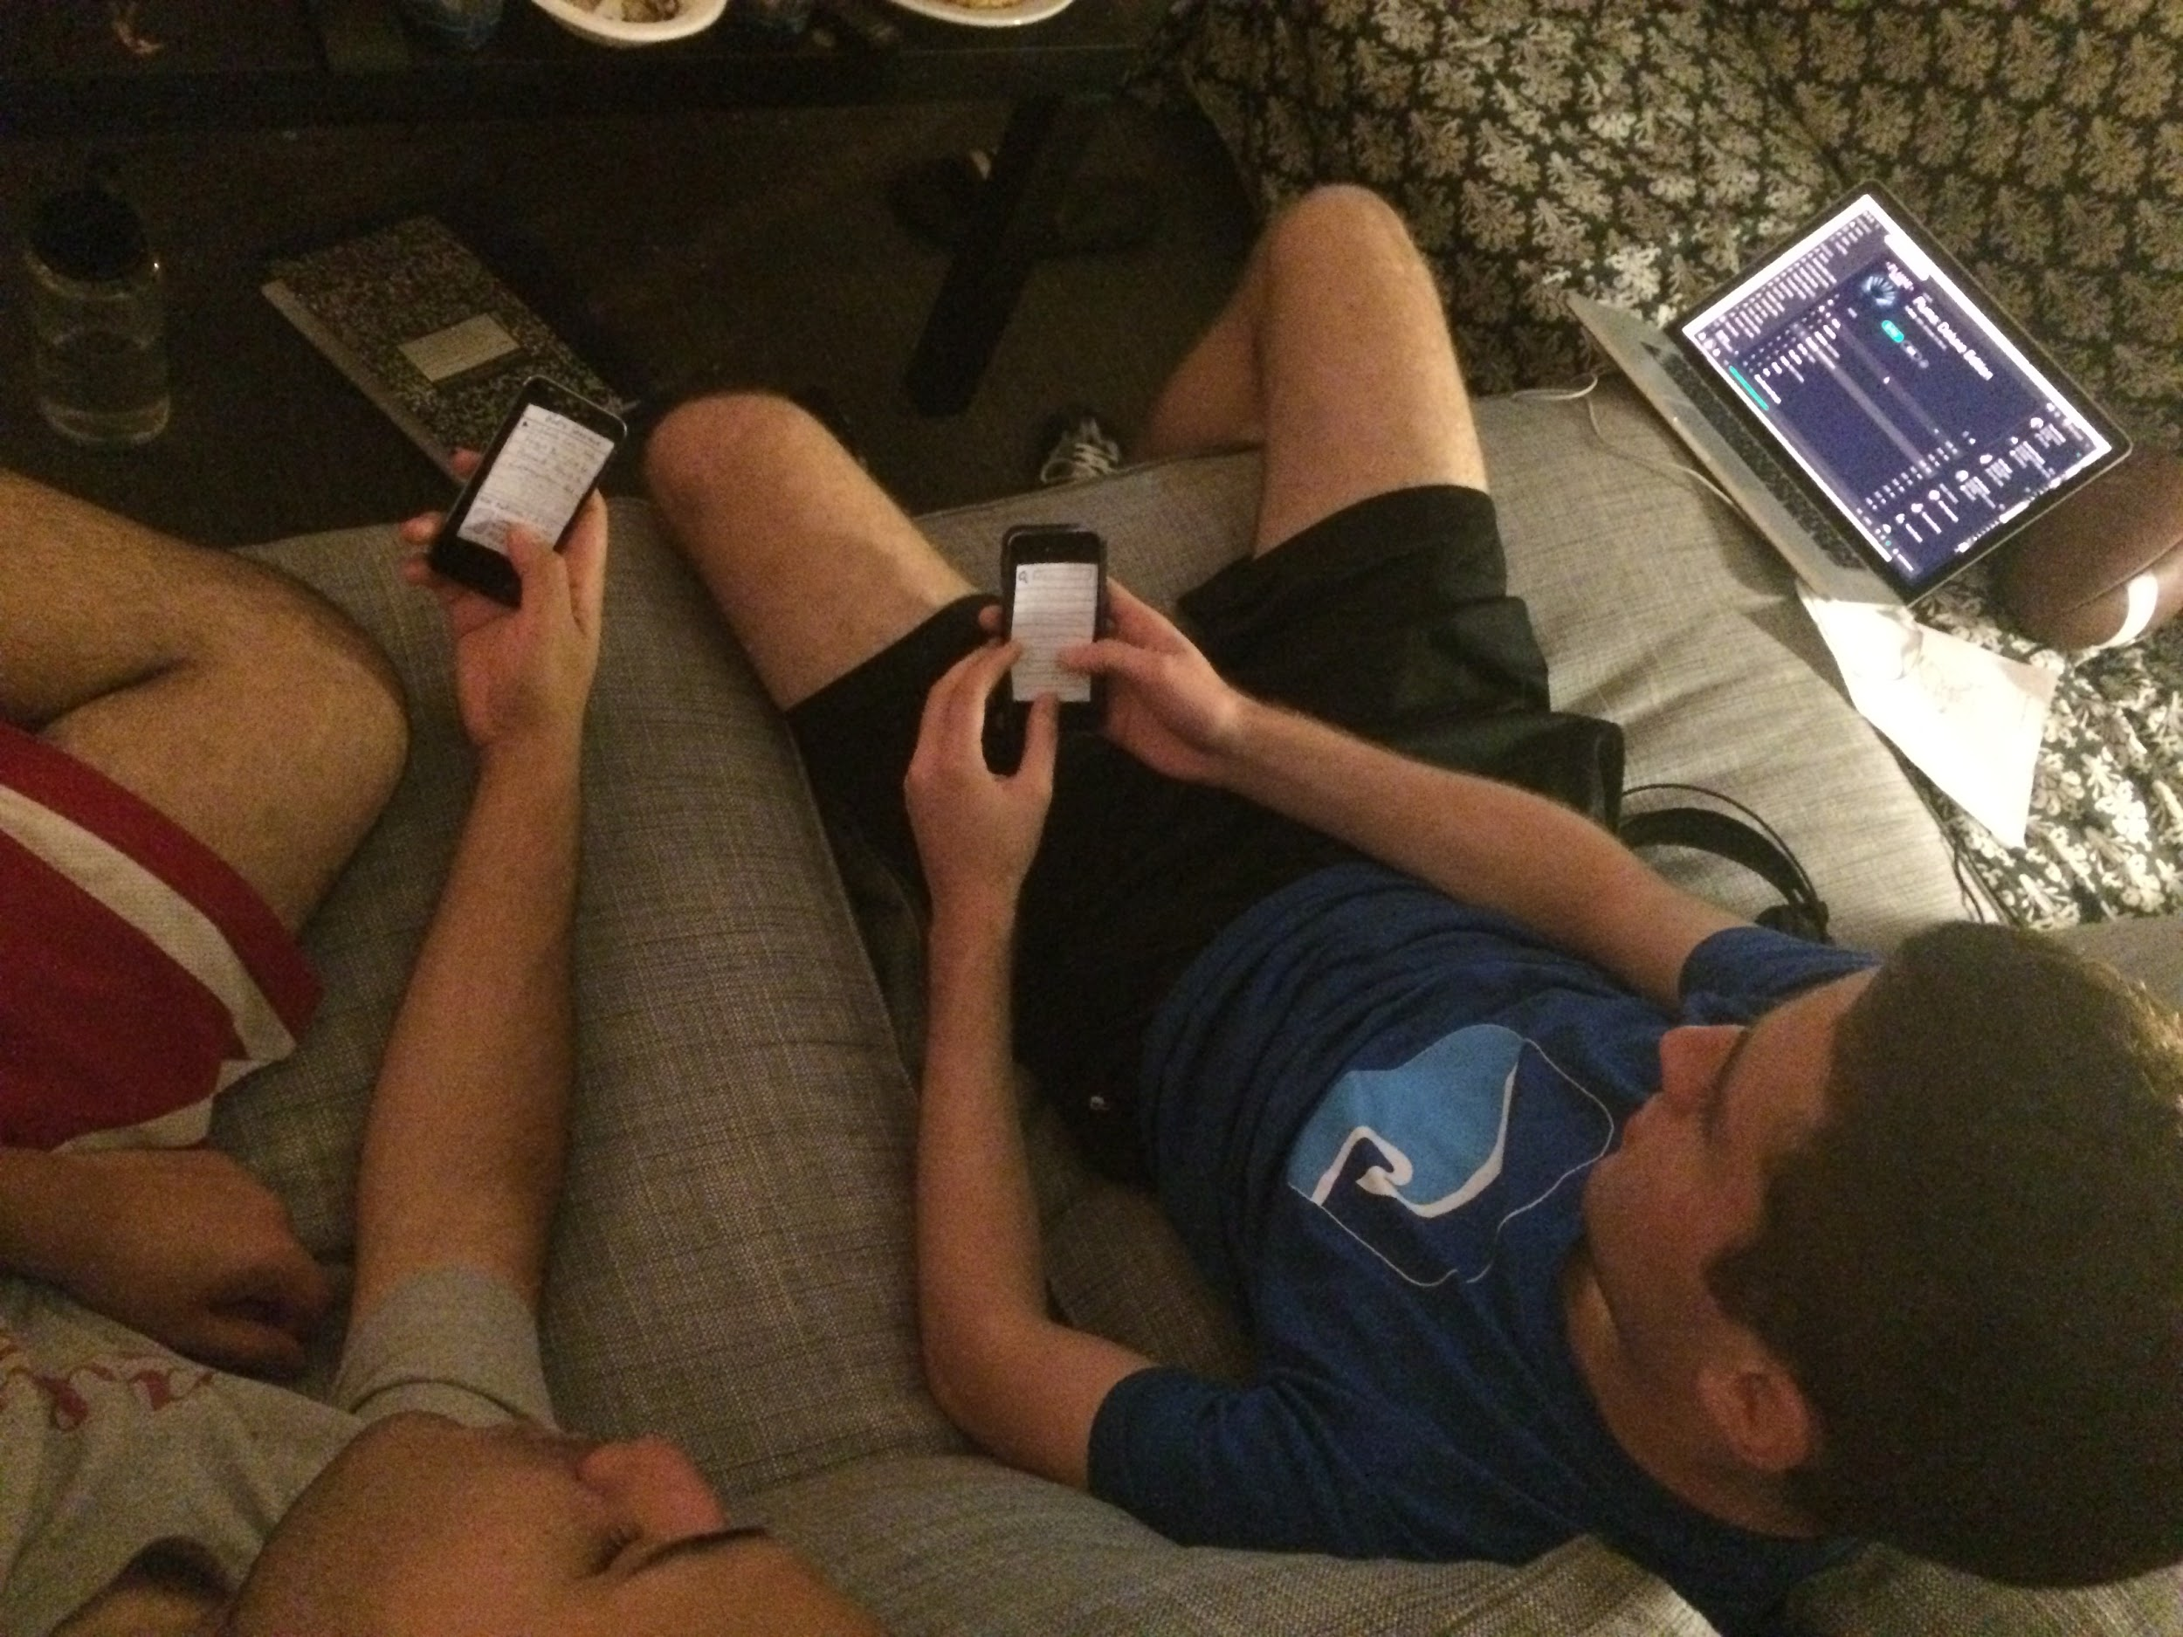
Prototype 1: Mock Communal Music Curator
✔ Very useful and perfect for mobile. No need to a pass a phone around
✖ Need to integrate user pictures and names. Show who is currently playing
! Users suprised host did not have controls for volume, pause, etc.
★ With this being a social experience, up and down votes could enhance it!
Assumption was valid because both users liked communal aspect and not having to pass a phone around

Slide 13
HMW 2
Inspiration: Aaron
How might we make it easier for DJs who are burdened by too much hardware to produce music?
Proposed Solution: Create a fully-customizable mobile GUI that maps parameters from DJ hardware to an easy interface on a phone, allowing the DJ to create music from anywhere.
Assumption: Pre-processing the digital interface for the DJ will be worth the ease of experience during the actual performance.

Slide 14
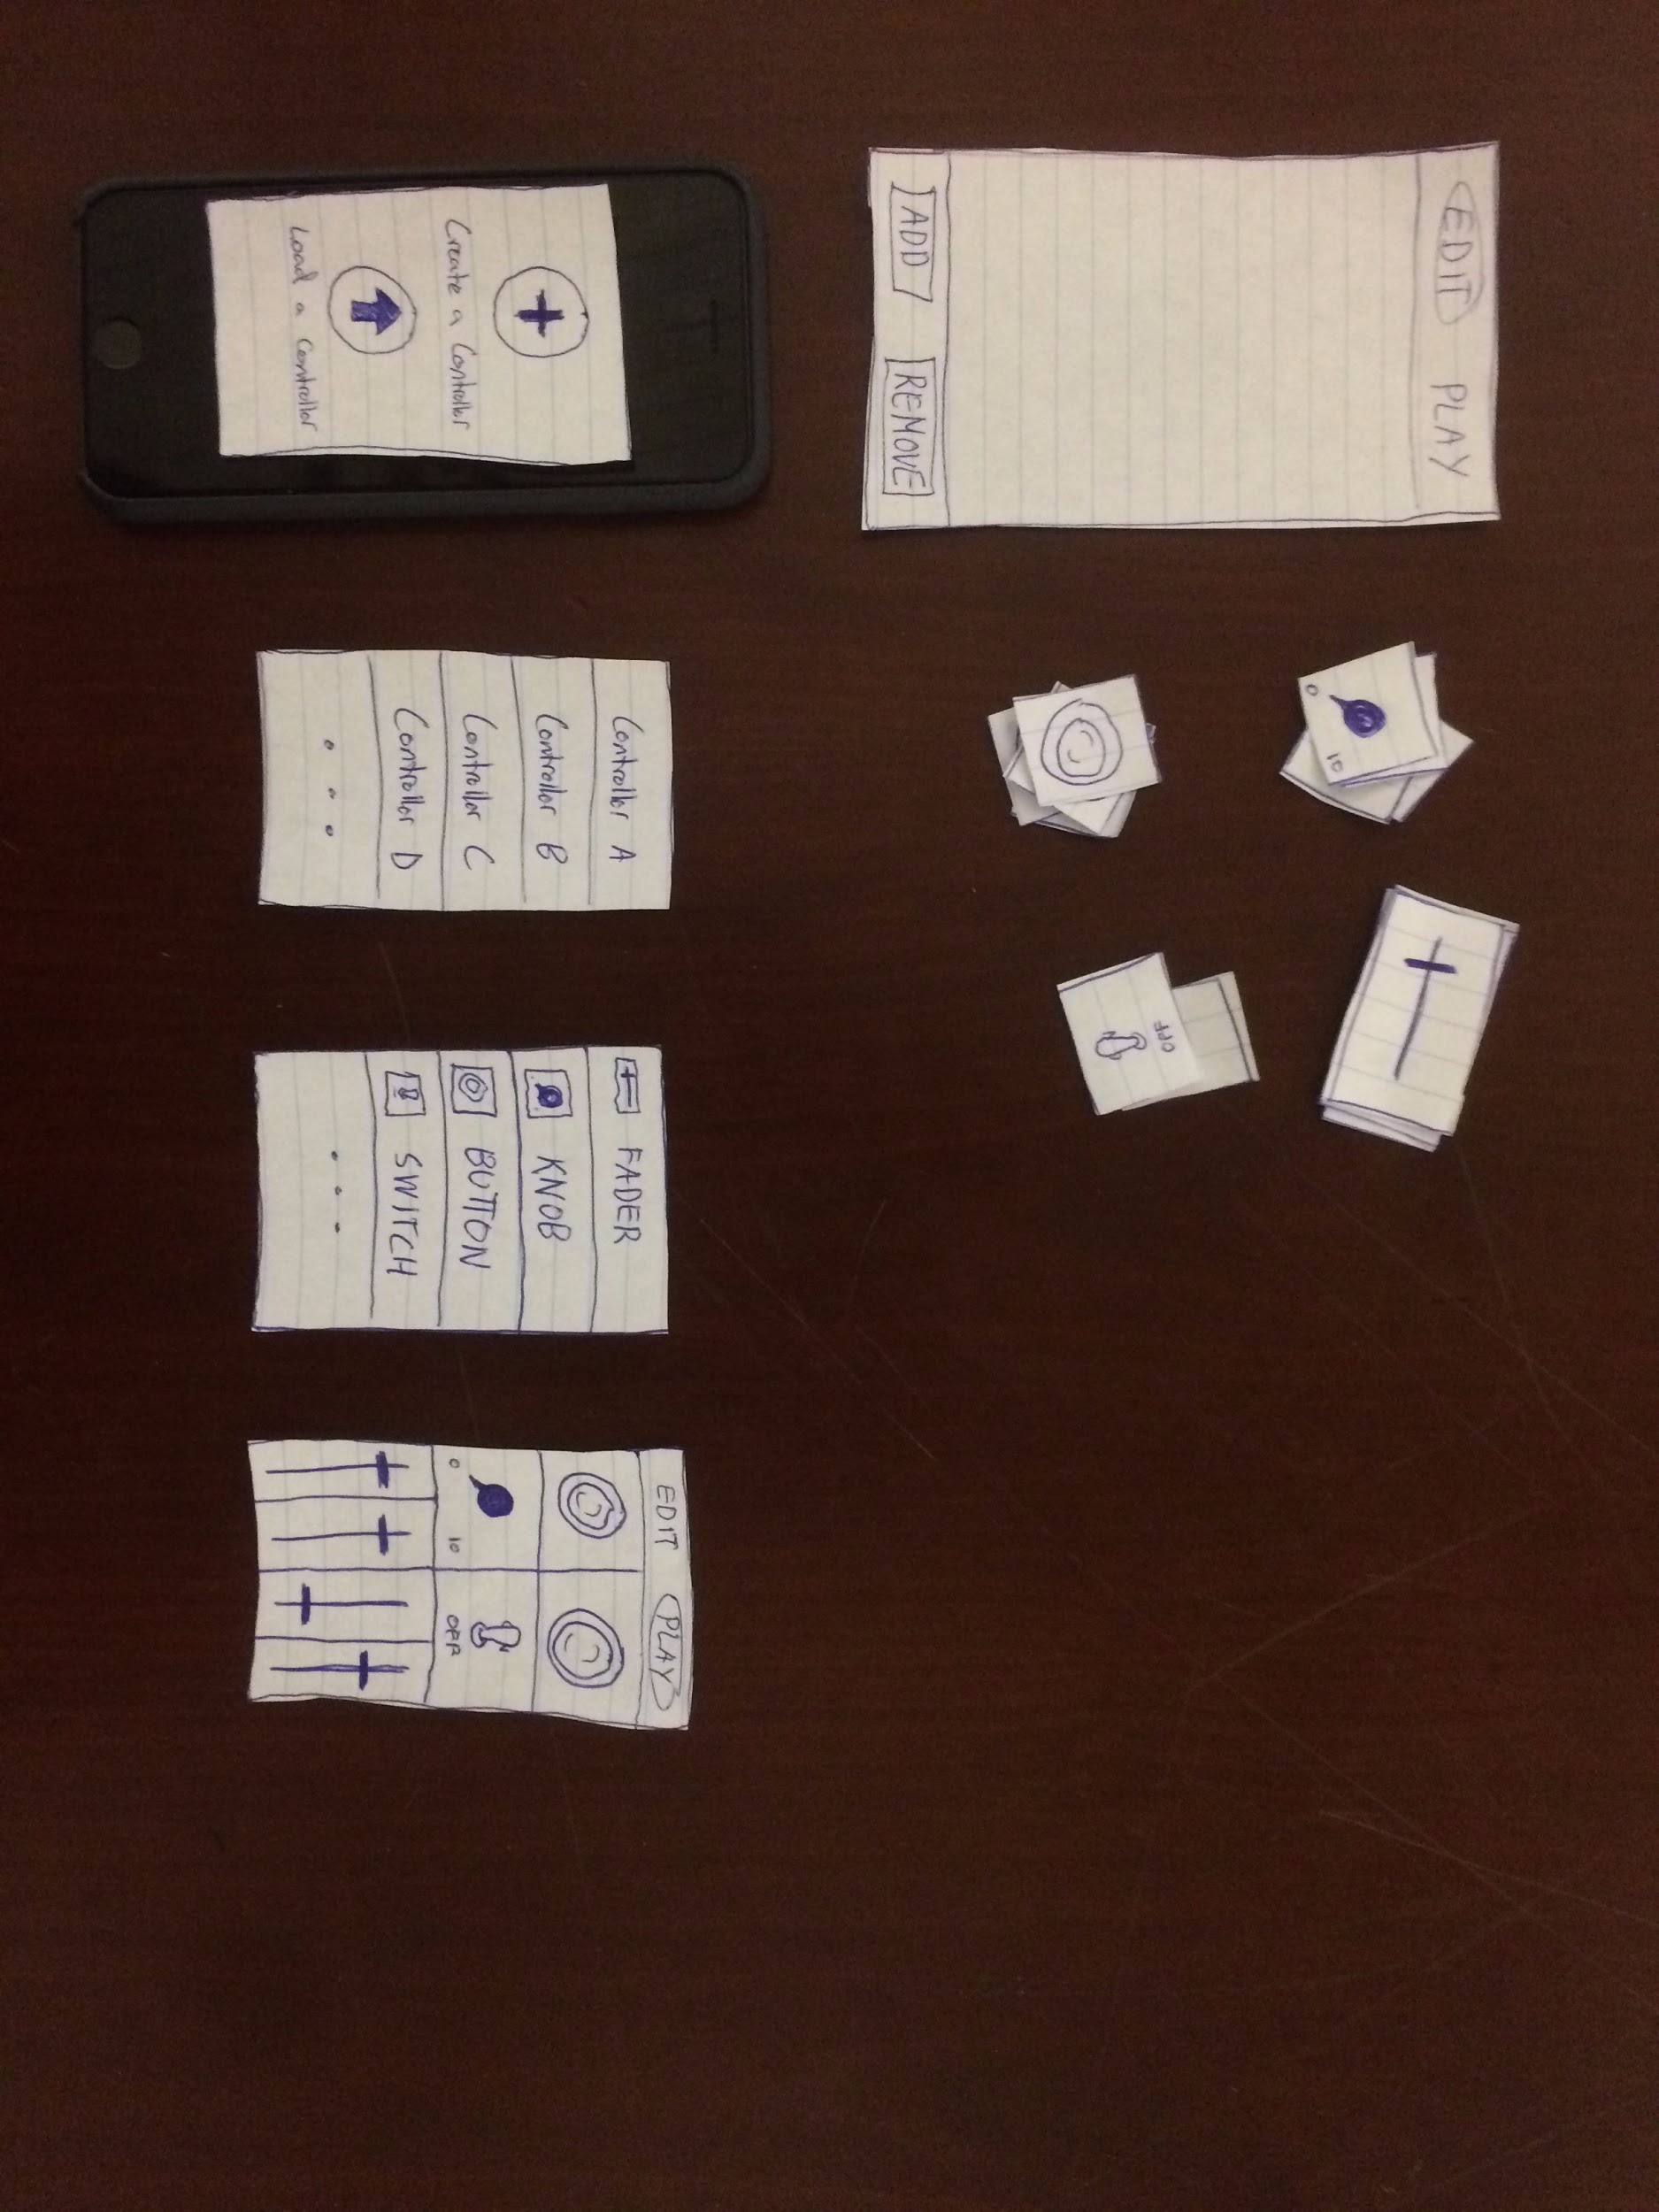
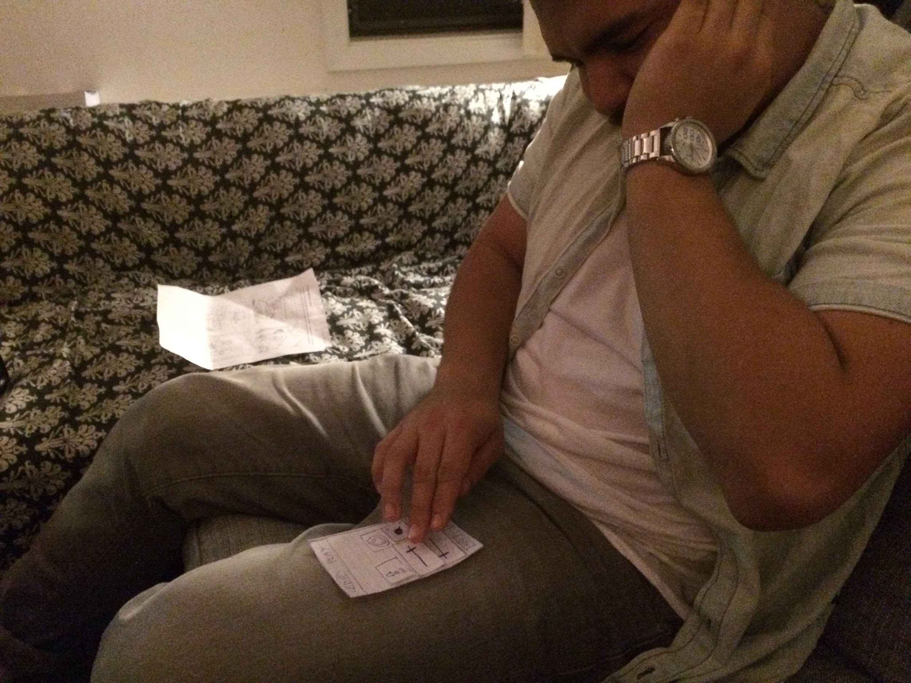
Prototype 2: Mock Customizable UIs for DJs
✔ Loves customizability
✔ Simple interface with large icons/buttons, ! Unclear how to pair with computer software
✖ Tough to mix songs on a small interface like a phone
★ Important to keep in mind the medium matters for the implementation of an idea. Tablet would work, but not phone.
Assumption was valid because he likes the customizability and knowing exactly where things are located for the show.

Slide 15
HMW 3
Inspiration: Angelica
How might we enable people to curate music that better expresses how they feel?
Proposed Solution: A Playlist interface where a user can curate recommended songs based on time of day, current location, and an array of moods.
Assumption: People want to listen to songs that are complementary to their current situation.

Slide 16
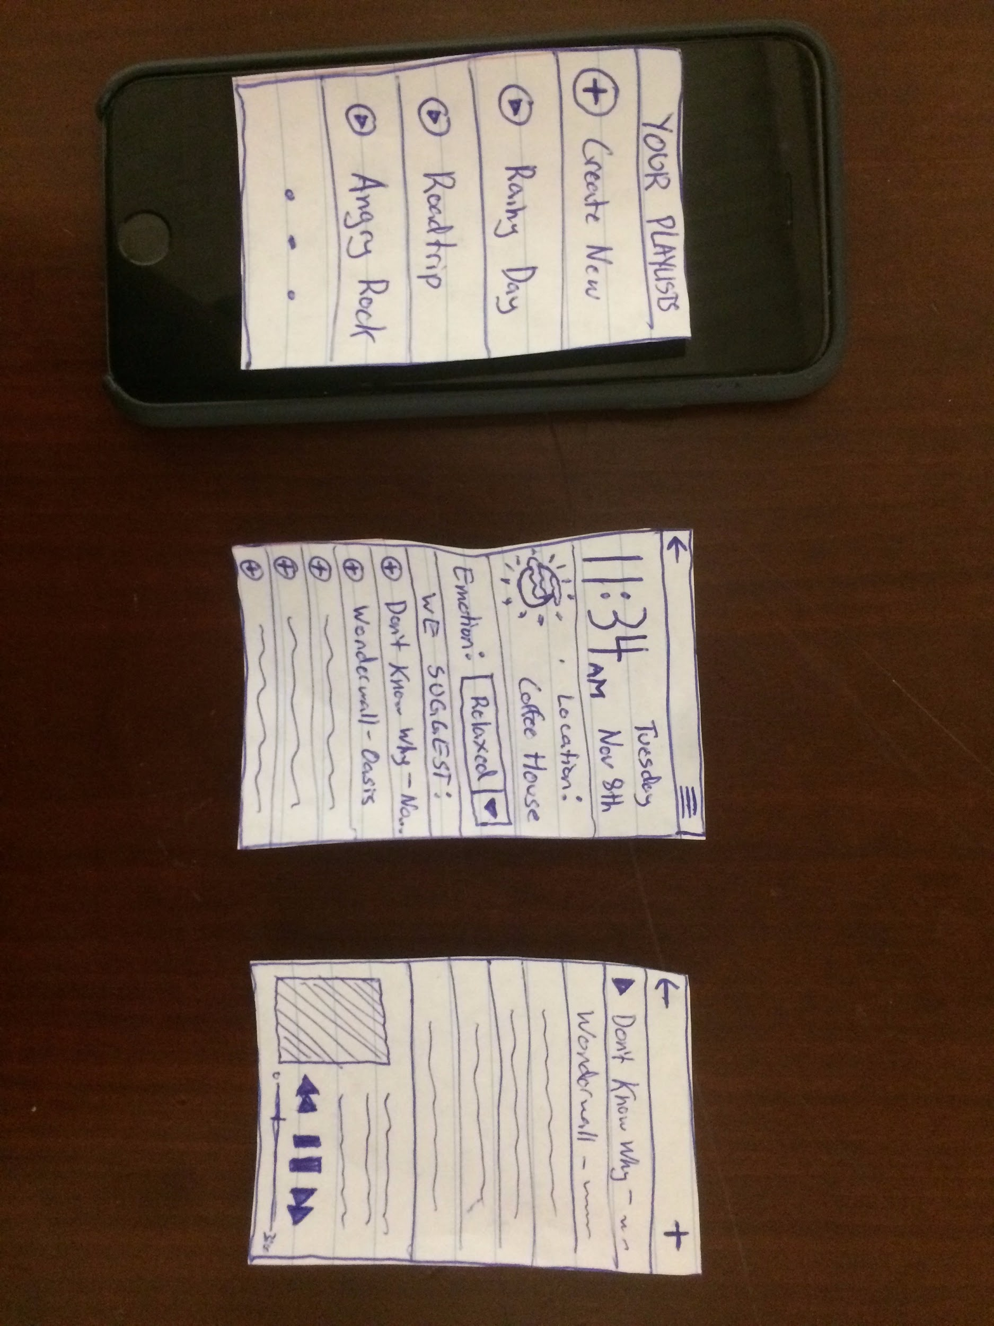
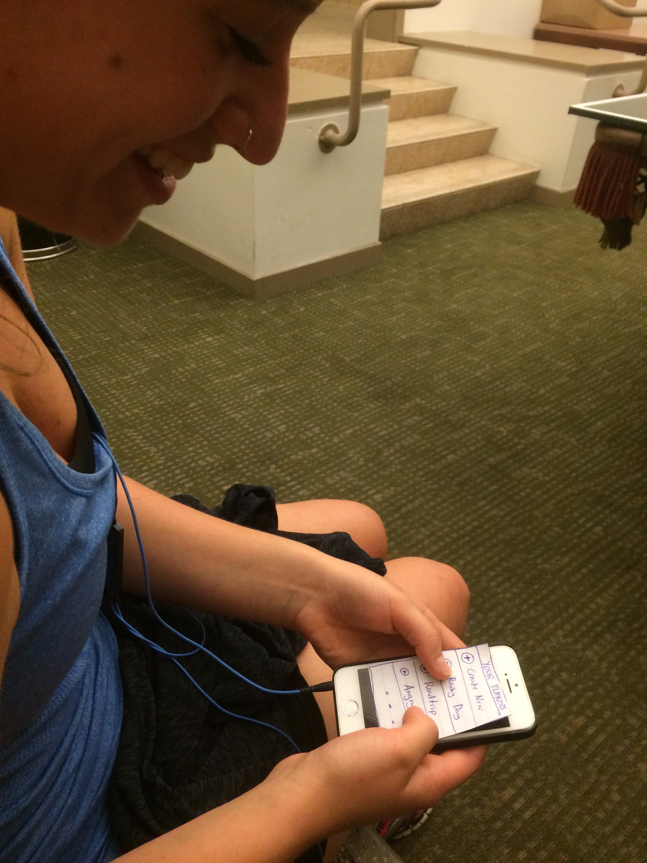
Prototype 3: Mock Situational Music Curator
✔ Likes recommendations based on time, location, and weather
✖ “Emotion:” label with dropdown is reductive.
! “Usually I feel a combination of emotions or something more complicated than ‘happy or sad’”
★ Emotions are complex: typing your custom mood would more empathetic than a dropdown
Assumption was semi-valid because user liked recommendations based on time, location, and weather. However, selecting/indicating your emotion seemed off-putting and cold

Slide 17
Thanks!
Questions? Comments? We’d love to hear them!

