Slide 1
Musical Needfinding
Presenter: Peter Washington
Group: Parker Odrich, Gio Jacuzzi, Peter Washington
Studio: Creation
Assignment #1

Slide 2
Introduction
Studio theme: Creation
Problem domain: Music
Parker Gio Peter

Slide 3
Needfinding Methodology Overview
Listeners of Music
Musicians

Slide 4

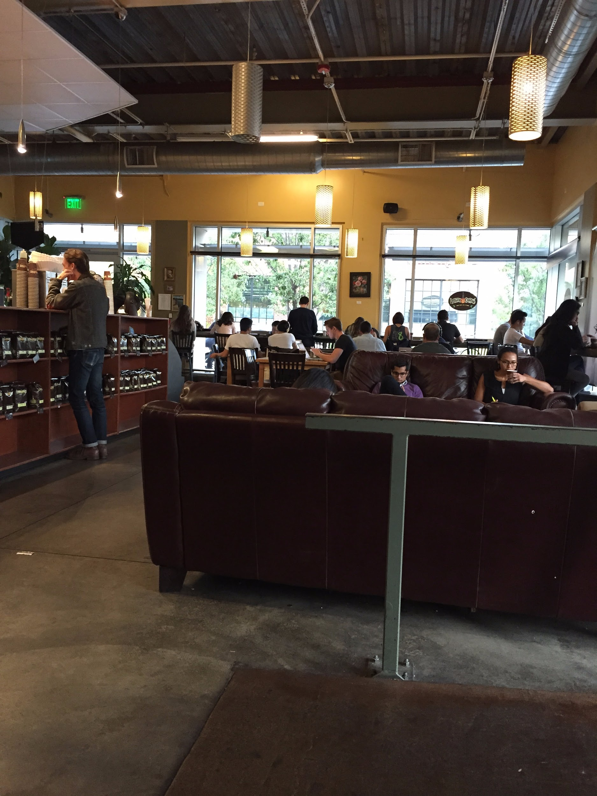
Music Listeners: Philz Coffee
Good place to find young, hip non-Stanford interviewees.
People listened to music while working.
Asked patrons if they had a few minutes for an interview about their music preferences in exchange for a $5 Philz Coffee gift card.
Interviewed at their table.

Slide 5
Base Questions for Music Listeners
How do you listen to music (when/where/how)?
Tell us about your experience with live shows.
How do you get your music?
How do you discover new music?
How does music influence your social life?
What do you think of the current state of the music industry?

Slide 6
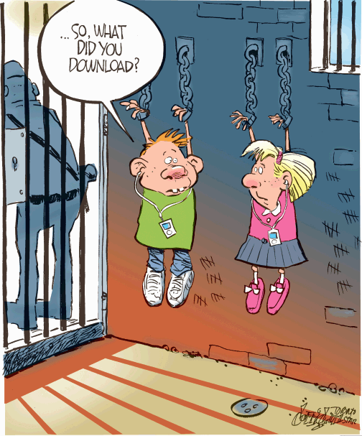
Interview 1: Angelica (Music Listener)
Uses iTunes at home and Spotify (not Premium) at work.
Downloads music for free (illegally), and has no problem with doing so.
Some of her friends download songs illegally; others don’t.
Was clearly shy about talking about her musical preferences with us.

Slide 7

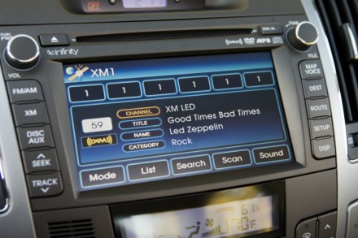
Interview 2: L.J. (Music Listener)
Listens to music on Spotify Premium (with a student account despite not being a student).
Never purchases music.
When driving on long trips, which he does frequently, he uses Sirius XM radio to discover new music.
“Music is ingrained in everything you do.”

Slide 8


Interview 3: Jeremy (Music Listener)
CEO of LA-based startup: PingTank
Listens to music via Spotify Premium.
Discovers new music from HypeMachine and Spotify Premium.
“Music is the world’s to own. It’s only publishers who think that they own it.”

Slide 9

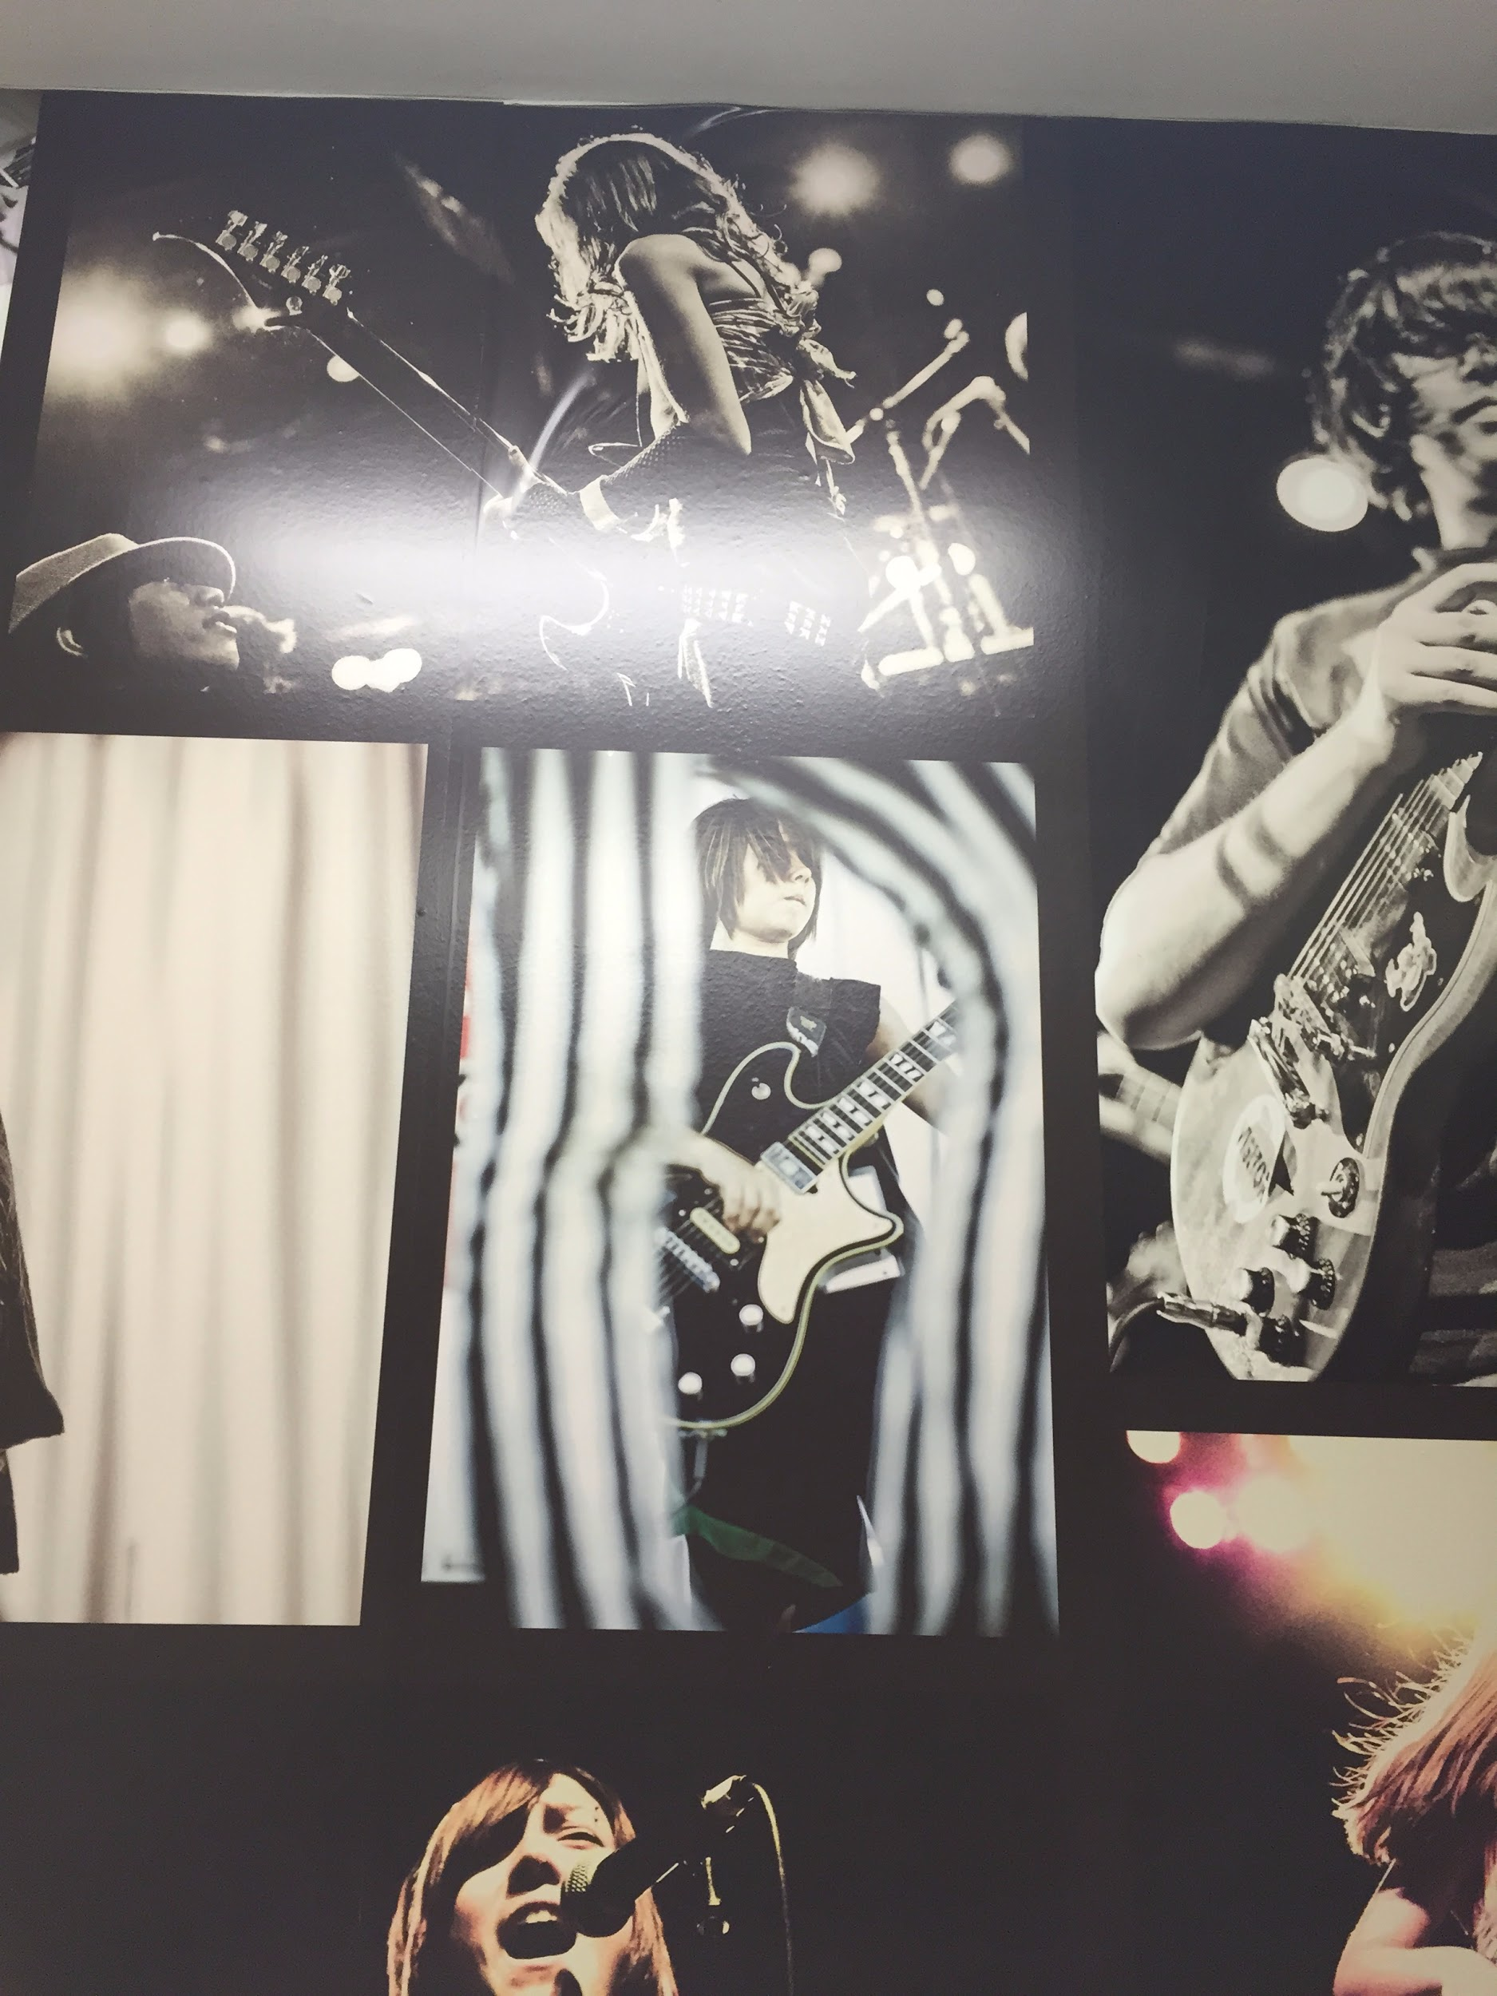
Musicians: School of Rock in Palo Alto
Musicians teach students aged 5 and up how to play guitar, bass, keys, drums, etc.
Most of the teachers are full-time musicians.
The employees were very excited about getting interviewed by Stanford students.
The interviews took place in the main office of the School of Rock.

Slide 10
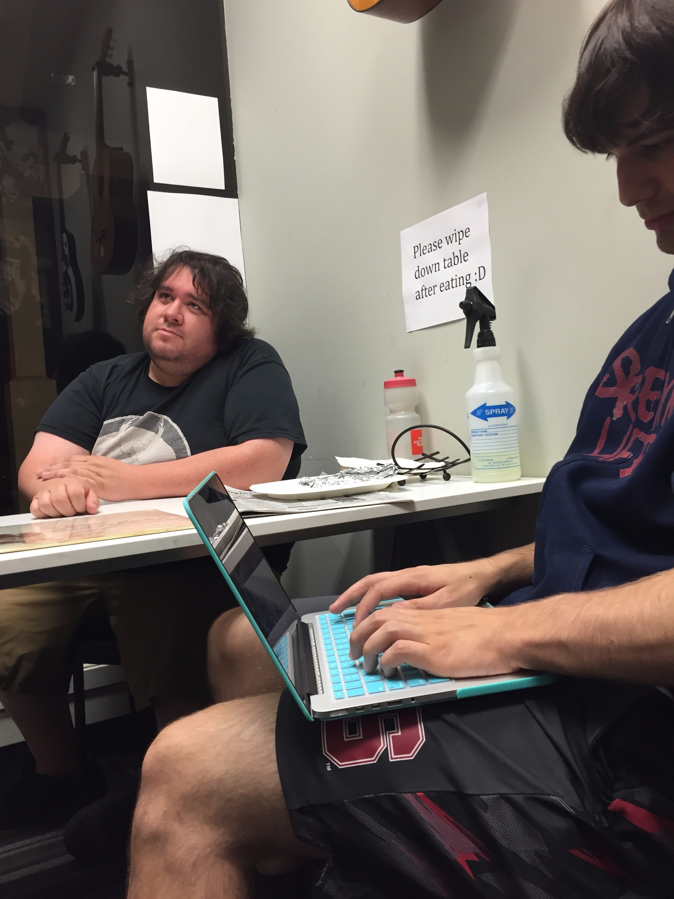
Base Questions for Full-time Musicians
What instrument do you play? What do you find special about it?
How do you write music? How do you find inspiration?
How often do you practice?
What types of people do you enjoy playing with?
What are some challenges you face as a musician?

Slide 11
Interview 4: Felix (Musician)
Parents weren’t musical; started listening to rap in junior high.
Now plays over 60 instruments from all over the world.
Guitar is his favorite instrument for composition because it is portable.
Toured for five years with a 7-person band.
Is now G.M. at School of Rock in Palo Alto.
Refuses to be in a band unless the people are humorous/fun.

Slide 12
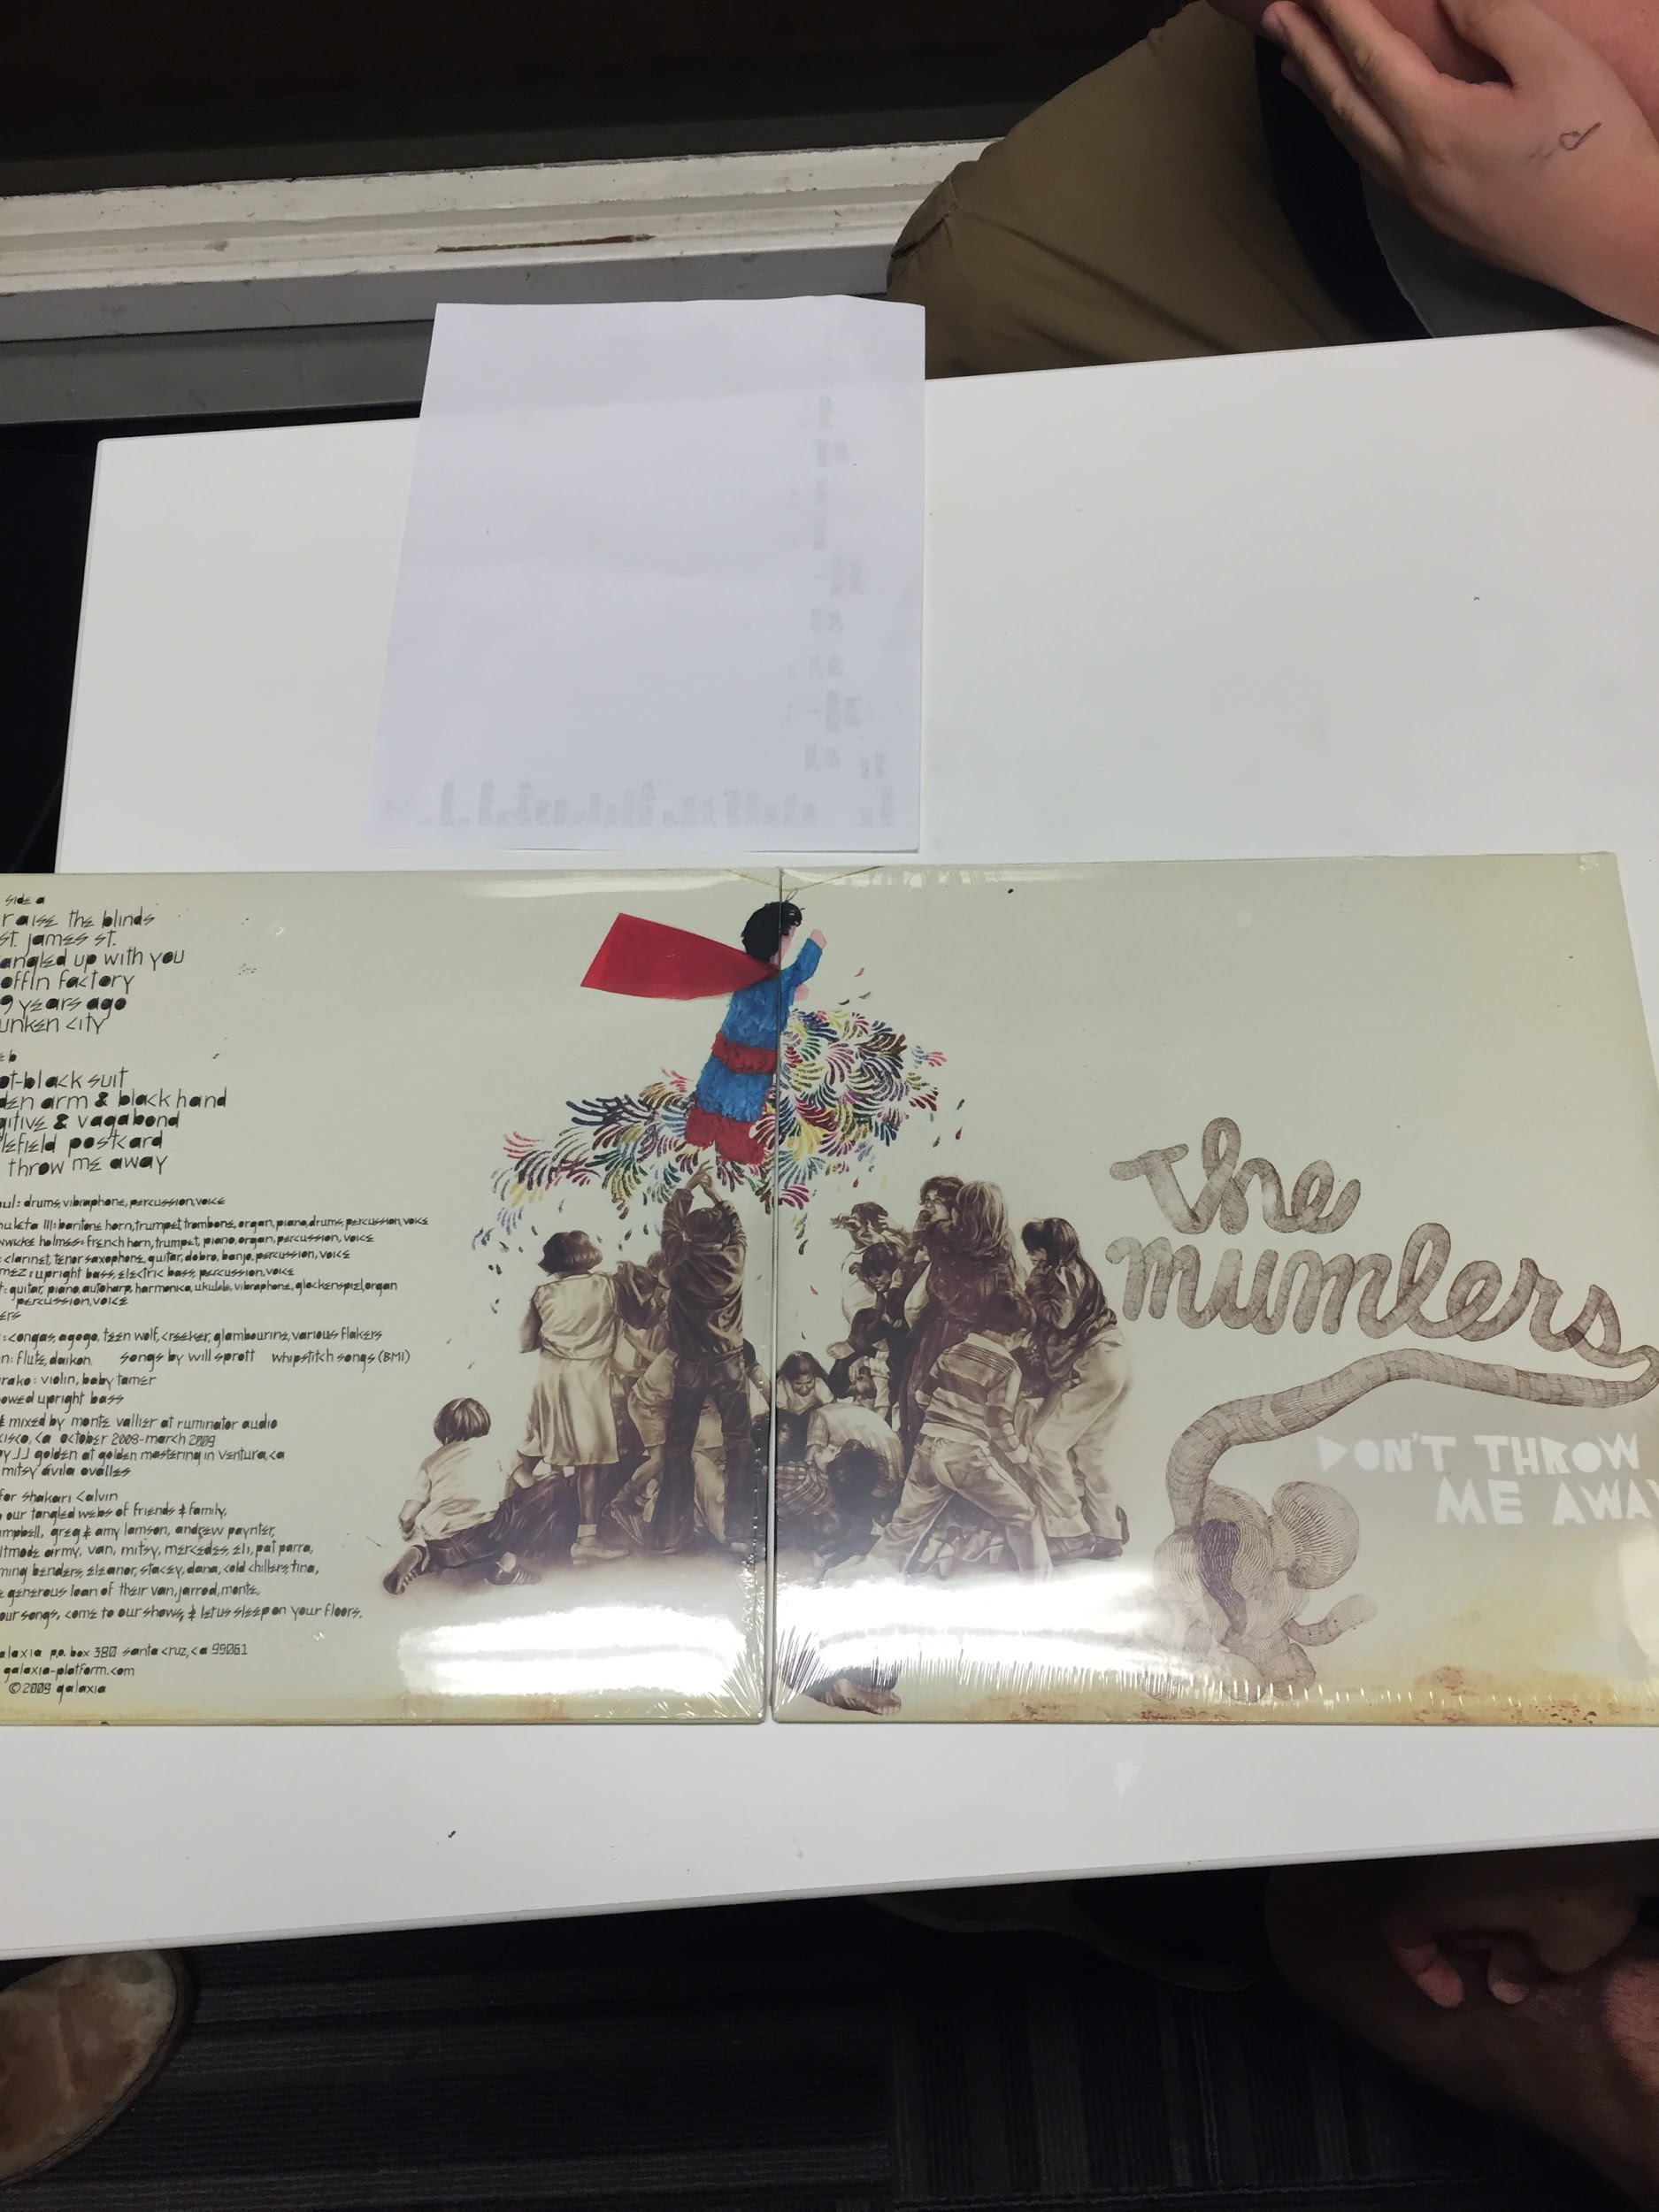
Interview 4: Felix (cont.)
“Selling records and selling CDs is gone. The media tells you what to listen to.”
A lot of tech people come to the School of Rock in order to relax.
Palo Alto kids are “high stress”.
“Practicing? You mean playing?”

Slide 13
Interview 5: Trayen (Musician)
Guitarist specializing in 8-string progressive metal. Also produces.
Noticed that vinyl records are making a comeback.
Until he recently succumbed to using Apple Music, he refused to listen to his music digitally.
Prefers mixing music with tapes.
Admits that Apple Music is great for teaching and producing.
“As a society, we are losing touch with physical things.”

Slide 14
Non-Musician Empathy Map (reference)
SAY
“Music is ingrained in everything you do”
“Music is a universal language”
“Music is the world’s to own. It’s only the publishers who think they own it.”
“I tend to delete songs I’m tired of”
“I illegally download music and am fine with that to be honest”
“I discover music through my friends”
“Playlists are great ways for me to find new music”
“I only go to live shows for bands/artists I really care about”
“I listen to the most music at work and in the car”
“I don’t purchase music”
“I discover all my music on Spotify”
“I am a big fan of HypeMachine”
THINK
Downloading music illegally is socially acceptable to me
Hearing about music from my friends is the most powerful influencer in me listening to it
Music is a great way to get me through workouts
Big fans of services that make it easy to discover music.
Don’t want us to gain too much insight into their musical tastes
Music is a great way to get me to relax
Purchasing music is impractical
Music gets me in a zone to push through work
Thinking I discovered an artist myself as opposed to falling for a marketing ploy builds a strong sense of ownership
Music is a great way to connect with my peers
DO
All three interviewees became visibly shy when discussing their musical preferences and habits
Everyone made it visibly clear that they knew that illegally downloading music was bad but still did it anyways
Tended to give relatively short answers to questions, requiring us to keep prodding them for answers
Were listening to music on their headphones while working
Some patrons were visibly bobbing their head to the music they were listening to
None were using traditional music players--all streaming via the internet
Most people were listening to their own music despite the background music in the coffee shop
They had a relaxed posture prior to the interviews
Their posture became tense during the interviews, but only when they started talking about their personal music tastes
Otherwise, once the “Ice was broken” they started to open up more
FEEL
Your taste in music is a very personal thing
People have deep emotional connections with certain songs and artists
Music can be closely tied to memories and events
Music is useful for getting through hard times and enhancing good ones
Feeling like you can engage with an artist helps build a very strong fanbase
Live music, whether it be shows or parties, is one of the primary ways that people’s social lives are affected by music
There is a balance between falling in love with a new song, and getting sick of it being overplayed
Music can be used to relax or excite you
Some of the people felt self-conscious about their tastes
Some were also happy and even surprised that we were asking them about their musical tastes

Slide 15
Non-musician Empathy Map (highlights)
SAY
“Music is a universal language”
“I illegally download music and am fine with that” (surprise)
“I discover music through my friends”
THINK
Downloading music illegally is socially acceptable to me.
Music is a great way to connect with my peers.
But purchasing music is impractical.
DO
Visibly shy about music listening habits during interviews… (tension)
But would open up after a while.
Were streaming music and listening on their headphones despite background music.
FEEL
People are self-conscious about their musical tastes.
Emotionally invested in certain songs.
Music can be relaxing or exciting.

Slide 16
Musician Empathy Map (reference)
SAY
“It’s interesting how retro stuff comes back”
“Streaming music is extremely convenient”
“Physical records are making a comeback”
“I am not a fan of digital music, but I will say that Apple Music is great for what I do: teaching and producing”
“I miss reading the liner notes that would come with albums and CDs”
“I love watching the kids and adults grow as musicians”
“The kids in Palo Alto are extremely high stressed. They are being primed by their parents to excel in music whether they like it or not”
“A lot of tech people come here. They are not trying to be a rockstar, they just want to chill and play some music”
“If it sounds good to you, it’s gonna sound good to someone else”
“When a parent asks me how much my child should practice, I correct them: it’s playing, not practicing”
THINK
Music should be part of everyone’s lives
Music is becoming too unpersonalized (digitalized)
Kids are way too stressed out in today’s competitive environments like Silicon Valley
Doesn’t want music to influence him in a bad way
Everyday people do not understand the value of music and the effort that goes into making it
Patronage of the arts is fading away as something valued in our culture
People are convinced that they should be able to get any music any time for free
However, fans still want artists to make a living
Educating the next generation of music-makers helps ensure a bright future for music
Kids should learn music to meet other people and develop social skills, not just to become musicians
DO
Had very tight fine-grained schedules, but still made time to talk to us while parents were waiting to talk to them.
Were very enthusiastic to talk to us.
Gave us two copies of a vinyl record that he recorded.
We didn’t even have to ask for the last interview - the guy was genuinely interested in talking to us and started answering our questions that we asked the first guy.
Asked us many questions as well.
Engaged in a conversation with us.
Clearly didn’t want to end the interview; pushed back other obligations (teaching an adult guitar course) to continue talking with us.
At times, it seemed like they were interviewing themselves, going into story mode.
All of the teachers seemed friendly with each other, and would hang out in between lessons.
The teachers were good with kids and very passionate about their work.
.
FEEL
The music you make is a reflection of yourself and your own experiences
Putting your own music out there can be an intimidating but also rewarding challenge
Playing with other musicians is an extremely rewarding way to establish relationships
It’s frustrating to find other musicians
The small amount of money that there is to be made for most musician’s makes living as one very difficult
Taking criticism of your music is difficult, especially from non-musicians
Teaching others how to make music is a very special process
Learning how to play can be intimidating and difficult
Encouragement from friends, family, and instructors helps musician’s continue forward
Living as a touring musician is exhausting but very memorable
Engaging with fans is empowering and builds your relationship with them

Slide 17
Musician Empathy Map (highlights)
SAY
Unlike many kids, tech people come here to relax and just play music.
“I miss reading the liner notes that would come with albums and CDs”
You don’t practice music, you play it.
THINK
Music is becoming too impersonal.
Learning music develops social skills and creates relationships.
Patronage of the arts is fading away. (surprise)
DO
Very enthusiastic about talking to us.
Interested in what our opinions were too. (surprise)
The teachers were very passionate about their work.
FEEL
Teaching others to make music is a very special process.
It feels great to play music with people you get along with.
You feel attached to the music you create.

Slide 18
Summary
Interviewed music listeners about the ways that they listen to music, what music means to them, and their opinions of the overall music industry.
Interviewed full-time musicians / music teachers about their playing habits, musical history, observations from teaching, and opinions about the music industry.
Gained several insights to many aspects of music spanning a wide array of musical topics.

Slide 19

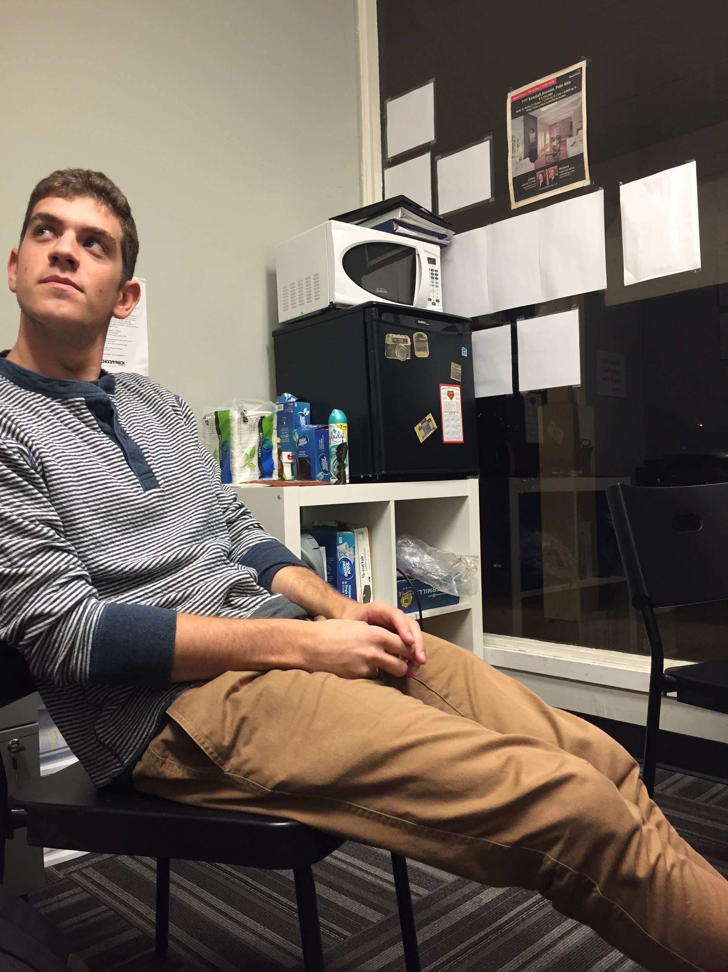
Questions?

