Slide 1
momentous
High-Fi Prototype
Midway Milestone

Slide 2
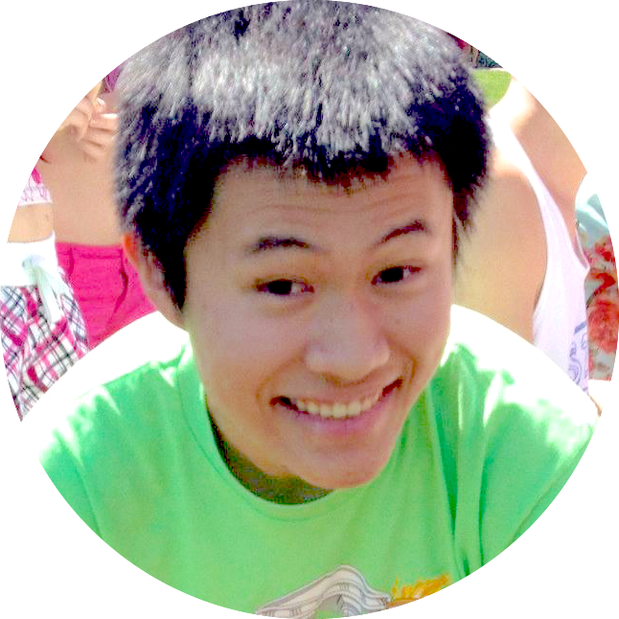
Team Rahim
David E
Pavitra R
Catherine D
Levi J

Slide 3
Saving the Day
Notes:
easily save and write about your day by automatically documenting
Aggregates multiple different types of content
multi-sensory journaling experience
It also shows you relevant entries from the past to rekindle memories and highlight personal growth
We are not making a shiny new app. We are allowing people to save their day and look back.

Slide 4
Heuristic Evaluation Results

Slide 5
4 main issues
1. Trends 2. Landing Page 3. New Post 4. Timing

Slide 6
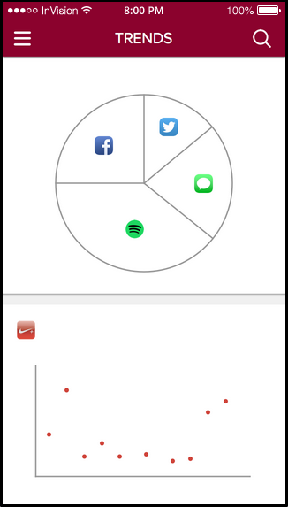
1. Trends 2. Landing Page 3. New Post 4. Timing
Trends page is not labeled
Graphs have no labels
Not many of them
Add pin button to each trend
Search function necessary?

Slide 7
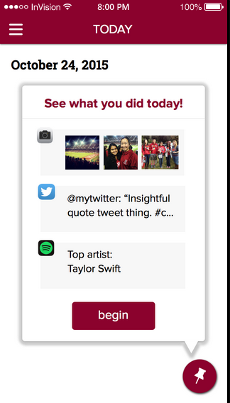
1. Trends 2. Landing Page 3. New Post 4. Timing
“Begin” is a bad call to action
Stuff is misspelled
Activities displays are inconsistent
Pin button
Activities display is un-editable

Slide 8
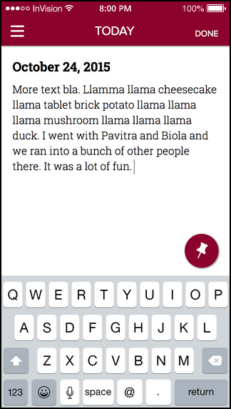
1. Trends 2. Landing Page 3. New Post 4. Timing
Done button?
Re-edit a new post
Is the content saved?
Pin button while typing
Consistency between dates

Slide 9
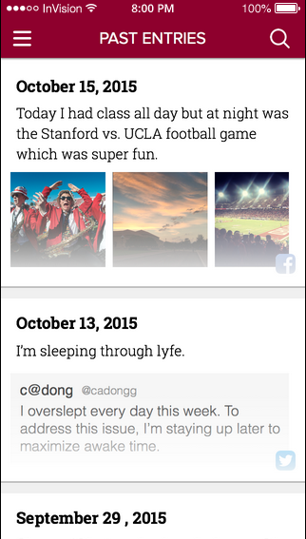
1. Trends 2. Landing Page 3. New Post 4. Timing
Auto-posting
When does a new “day” start?
Editing old posts
How does Trends respond

Slide 10
Overview of Revised Design

Slide 11
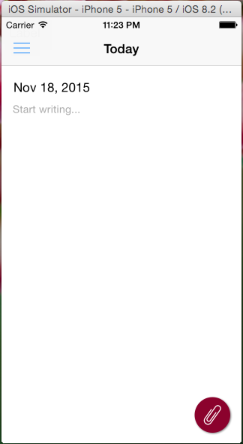
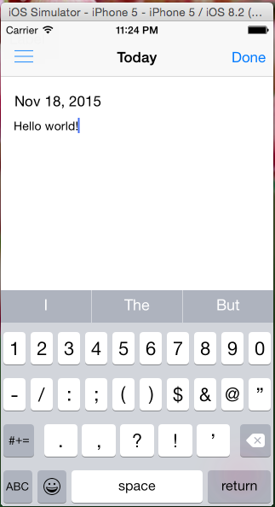
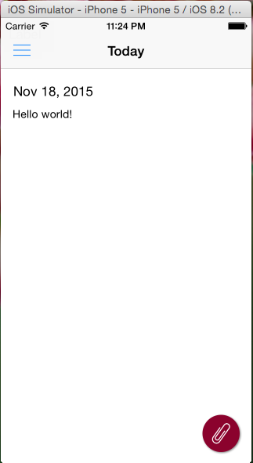
Important changes
Call to action
Done button
NO “save” button
No pin button
pin → paper clip
dynamic content
Notes:
tutorial before was misleading w/ limitations of med-fi

Slide 12
Prototype Implementation Status

Slide 13
tools
Sketch: static assets
Xcode: build the app (iOS)
Swift: Language choice
Notes:
Sketch: icon logos,
xcode: generally used to build iOS apps.
swift: new replacement of objective C (bc it’s a little simpler). No one on the team had any experience with it. Part of the process has been learning the language. We await developer license.

Slide 14
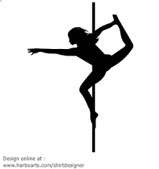
Implemented features
Unimplemented features
Task 1: writing in blank entry
Writing persists/entries saved
Dynamically updated dates
Navigation between screens w/ sandwich menu
Basic scroll view for pinning activities and past entries
Task 2: Pinning activities
Task 3: Looking back
Plan: Thanksgiving break!
Notes:
last implemented features are the foundation for tasks 2, 3

Slide 15
Wizard of Oz Techniques
Hard-coded data
Issues/questions
Assume user has already used app many times (so that old content already exists)
Previous entries Trends
Not sure how to import from other apps…
Notes:
given that primary goal is UI, we’ll create a hard-coded store of information from which the app will pull data to pin/create trends.

Slide 16
Demo

Slide 17
Summary
Task 1 implemented
Tasks 2 and 3… Thanksgiving break
Trends still needs a lot of work
Make users feel comfortable (finishing/saving entries, understandable navigation)
Entries (timing, looking back, re-editing)

