Slide 1
momentous
Interactive
Medium-Fi Prototyping

Slide 2
Team Rahim
David E
Pavitra R
Catherine D
Levi J

Slide 3
Saving the Day
Notes:
Haphazard solutions to importing media
Decentralized means of tracking health and fitness, interactions, expensess

Slide 4
Tasks

Slide 5
Tasks
Write
Review
Reflect
Simple Task
Medium Task
Hard Task

Slide 6
Design Changes

Slide 7
Considerations
Remove redundancy between the “start writing” and “compose” features
Create a clear home screen
Give users a clear call to action from the default view
Give users a way to pin trends to entry
Remove confusion between “today” and “entries” tabs

Slide 8
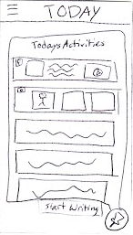
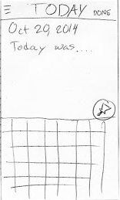
Compose

Slide 9
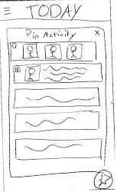
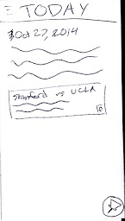
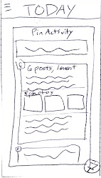
Pin Activity

Slide 10
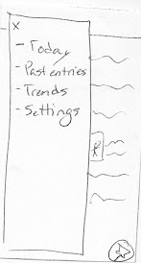
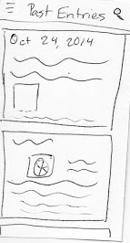
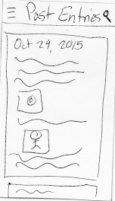
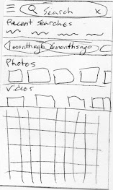
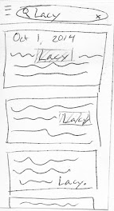
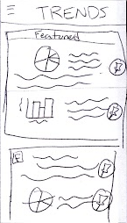
Reflect

Slide 11
Changelog
Replace tabs with sandwich
Home screen is plain text with pin icon
First time pop-up on today’s entry to highlight activity
Scroll view of activities expands to card view
Rename sandwich items: “today”, “past entries”, “trends”, “settings”
Allow users to pin insights to their entry, not just activities
Allow users to search when reflecting on past entries

Slide 12
Medium-Fi
Task Flows

Slide 13
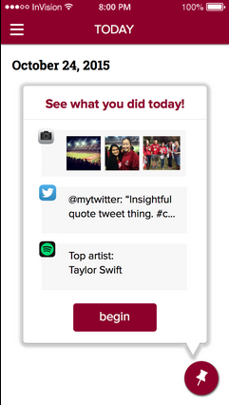
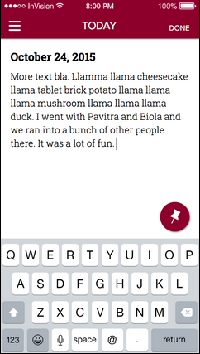
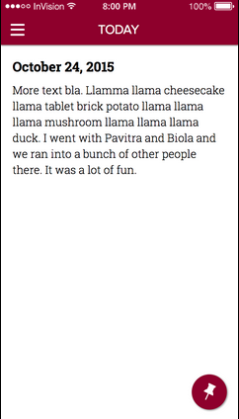
Compose

Slide 14
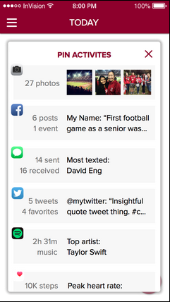
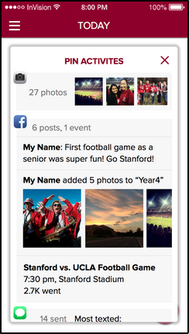
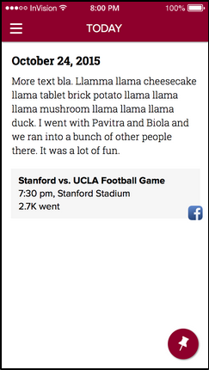
Pin Activity

Slide 15
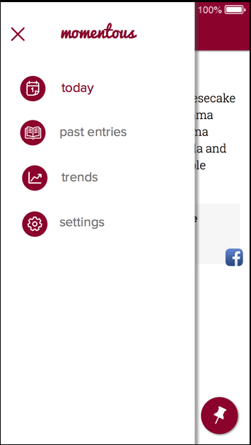
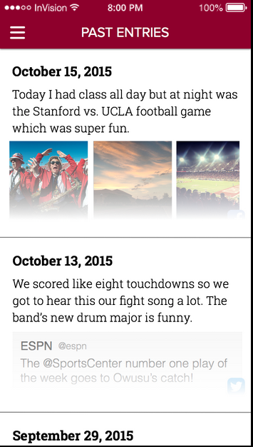
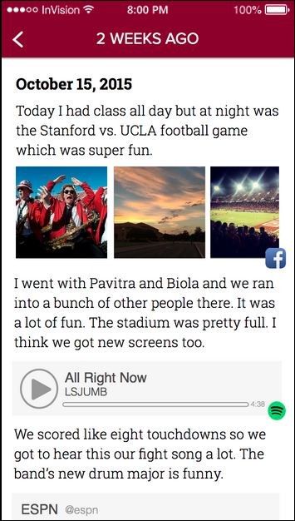
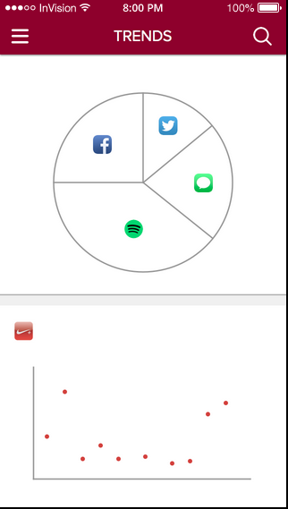
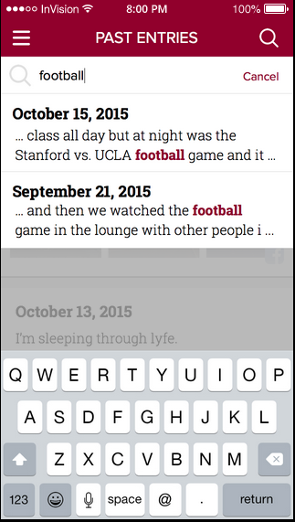
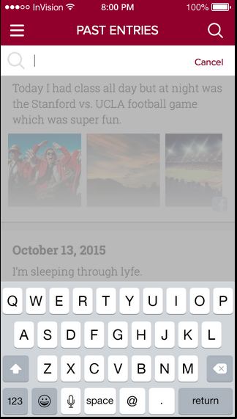
Reflect

Slide 16
Prototype Overview

Slide 17
Prototyping Tools
Sketch
Ease of view creation
Intuitive interface
Difficult for collaboration
Invision
Multiple transitions options
Sync to phone
Inability to scroll on overlay
No dynamic input capabilities
Notes:
No dynamic input capabilities so we hardcoded all entry content.

Slide 18
Limitations and Wizard of Oz techniques
Hardcoded data for all content, trends, and search results
Not much seed data

Slide 19
Appendix

Slide 20
Links
Website: http://web.stanford.edu/class/cs147/projects/creation/team_rahim/
Medium-Fi Prototype and README Overview: http://web.stanford.edu/class/cs147/projects/creation/team_rahim/assignments.html
Medium-Fi Prototype: invis.io/SE4O9TM7

