Slide 1
momentous
Lo-fi Prototyping &
Pilot Usability Testing

Slide 2
Team Rahim
David E
Pavitra R
Catherine D
Levi J

Slide 3
Saving the Day

Slide 4
Interface

Slide 5
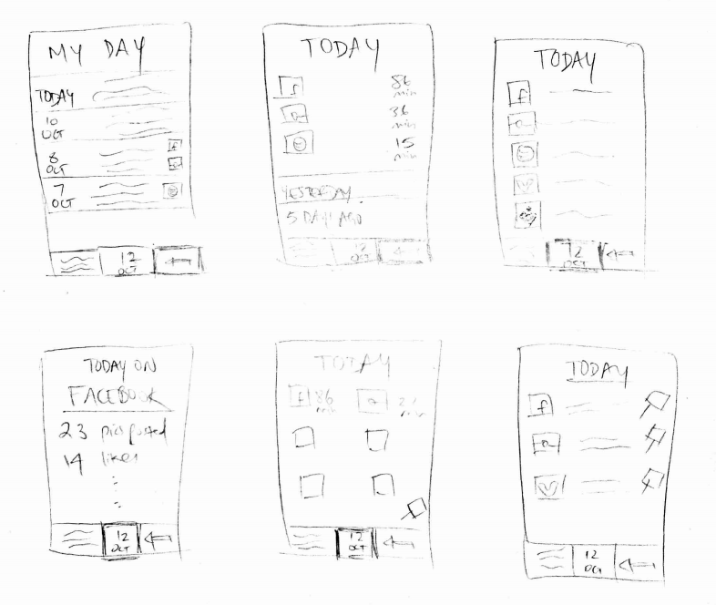
Tabular Structure
Atomicity of the tasks:
Creating an entry
View digital footprint
Reflecting on the past
Feasibility for mobile device

Slide 6
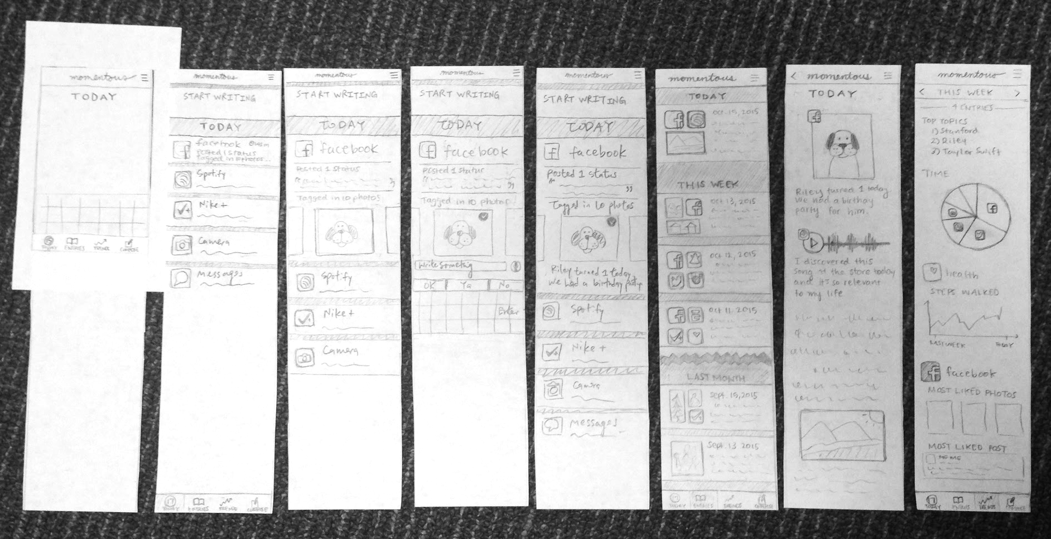
Lo-fi Prototype

Slide 7
Tasks

Slide 8
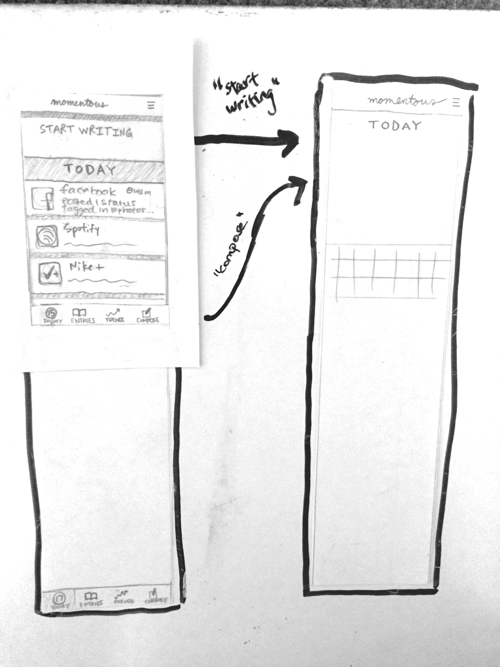
Compose

Slide 9
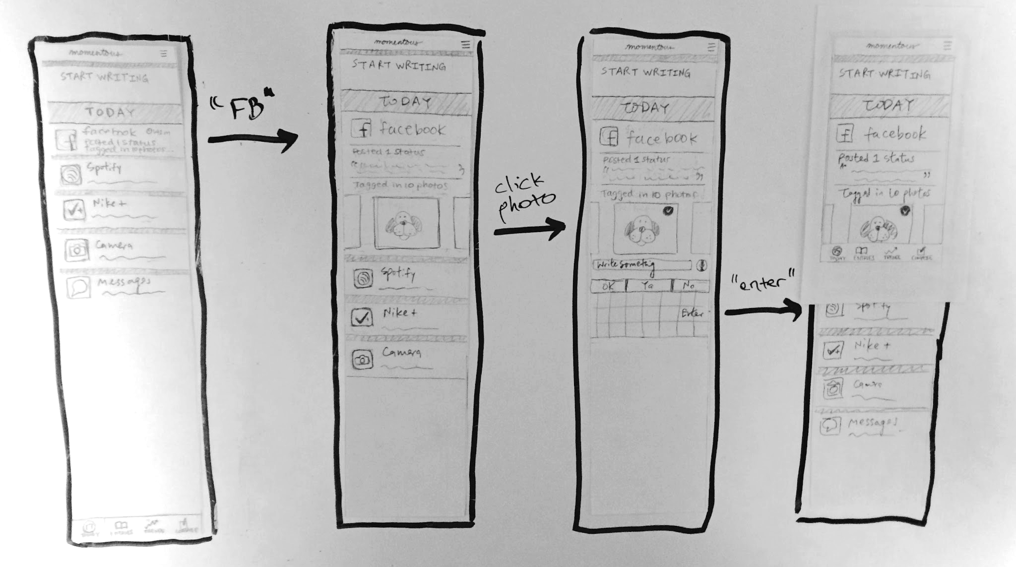
Today

Slide 10
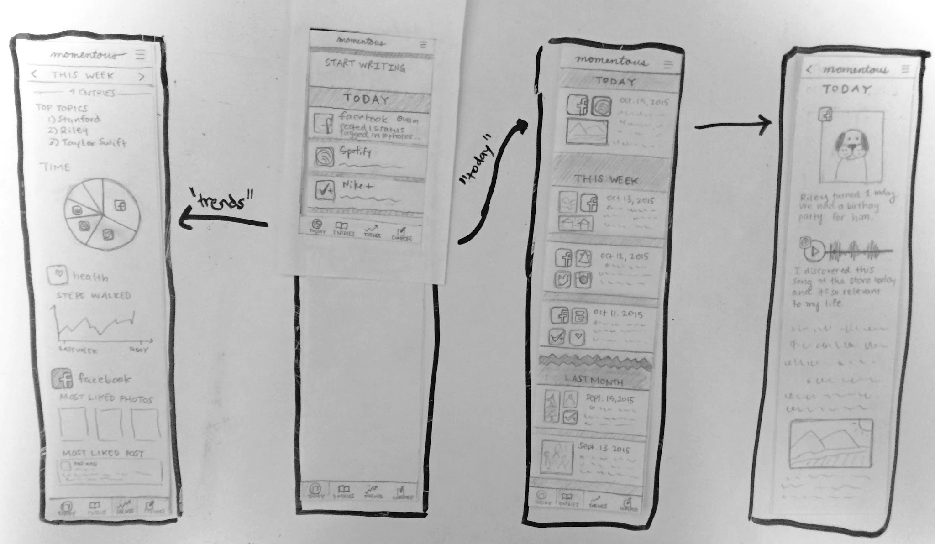
Past Entries & Trends

Slide 11
User Testing
& Results

Slide 12
Method
Developed a testing script
Explained our application’s purpose and capabilities
Asked users to complete the three tasks:
create a simple text entry
create an entry with a Facebook photo (with caption)
look back on old entries
Encouraged users to think aloud
Tested on 6 users, half male & half female, ages 16-30

Slide 13
Results
5 of 6 users somewhat confused about the “start writing” and “compose” features
1 user initially misunderstood the purpose of the app
2 users didn’t know how to get back to the “home screen”
3 users completed all three tasks easily
5 of 6 users enjoyed the app experience and functionality (integration with other apps, looking back, and trends)

Slide 14
Suggested Changes
“Start writing” text field and “compose” tab are redundant → display one clear way of creating or adding to today’s entry
People confused about the home screen → make it clear where users should “start” the experience
People enjoyed looking back and seeing trends → further highlight these capabilities through notifications

