Slide 1
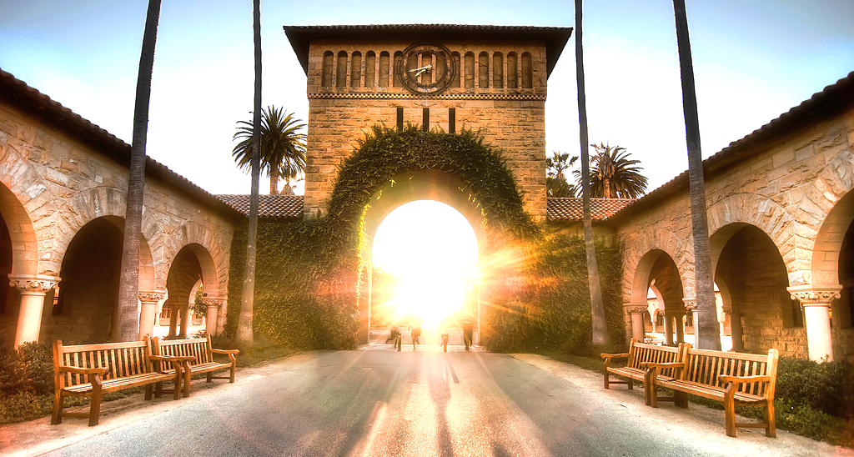
Creating Memories
Concept Video

Slide 2
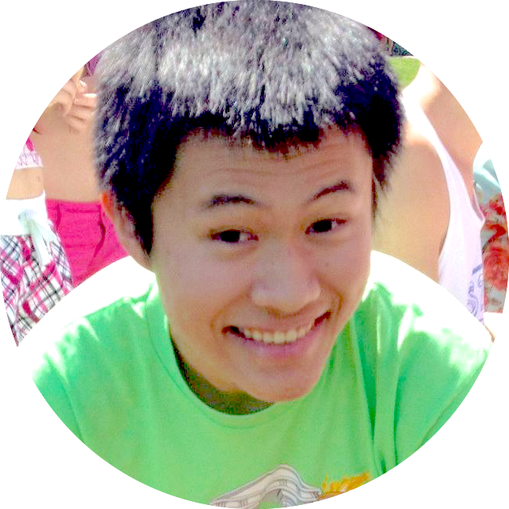
Team Rahim
David E
Pavitra R
Catherine D
Levi J

Slide 3
Value Proposition
momentous
saving the day

Slide 4
Problem/Solution Overview
Many people enjoy journaling and looking back on their memories but have trouble creating and organizing content or simply don’t have the time.
momentous enables you to easily save and write about your day by automatically documenting your digital footprint. It also shows you relevant entries from the past to rekindle memories and highlight personal growth.

Slide 5
Tasks
Easy Writing a basic text journal entry
Medium Adding parts of your day from your “digital footprint” to your journal entry
Hard Looking back on relevant journal entries from the past to reflect and see personal growth

Slide 6
Storyboard

Slide 7
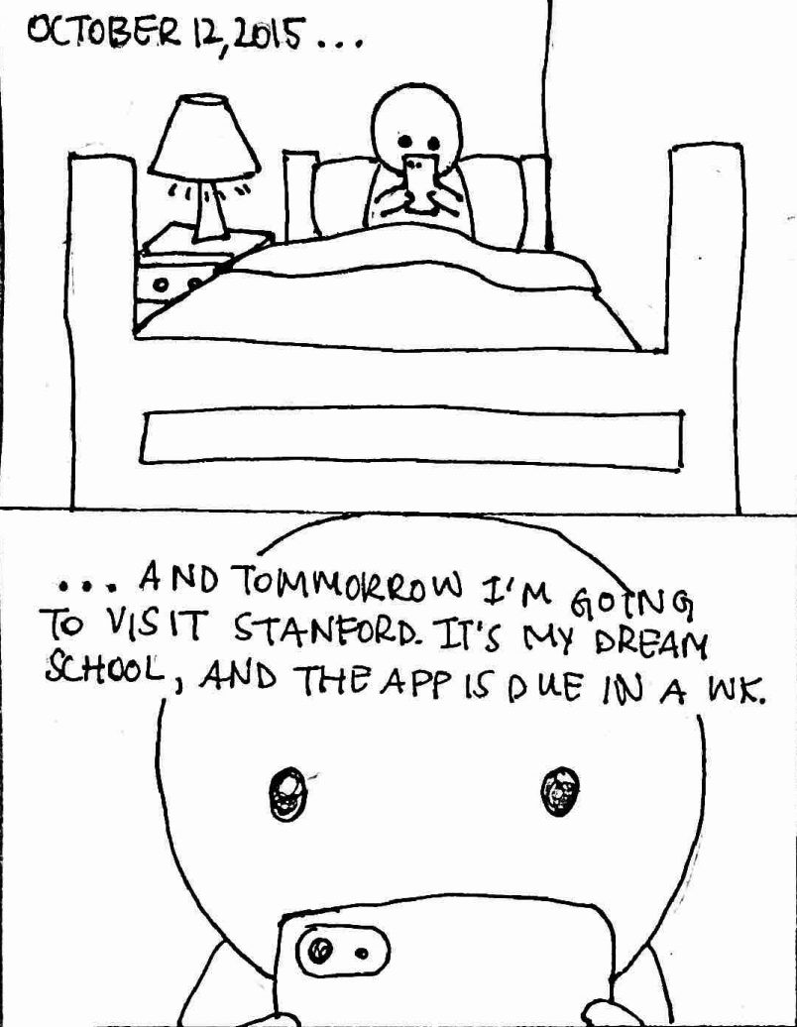
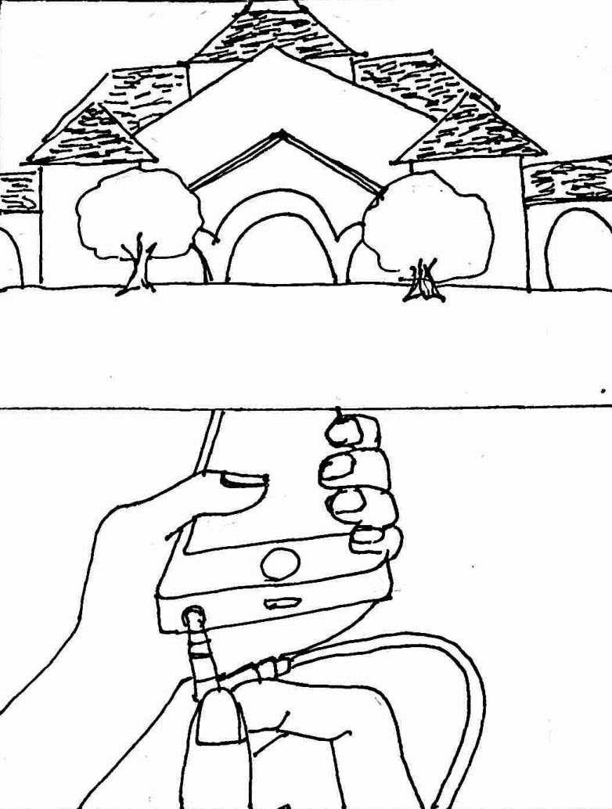
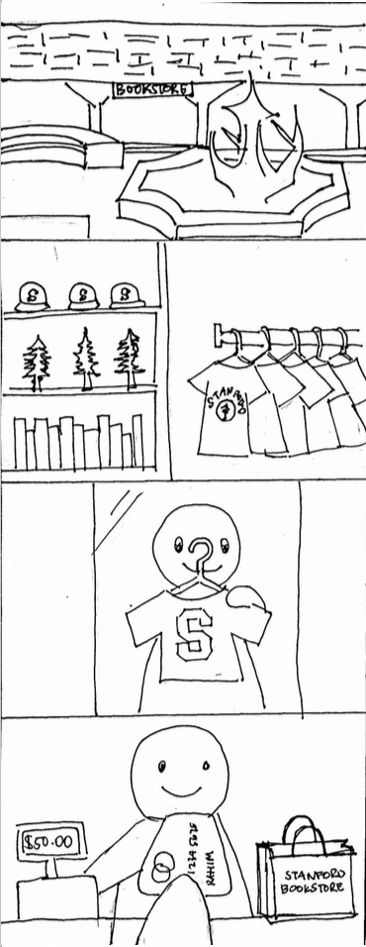
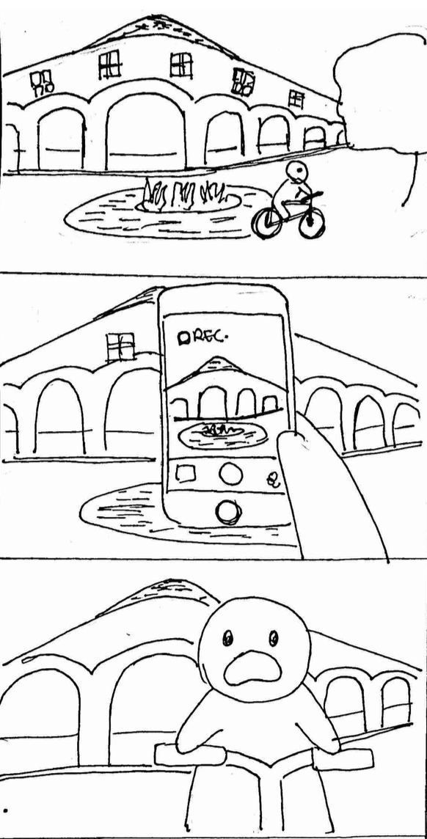
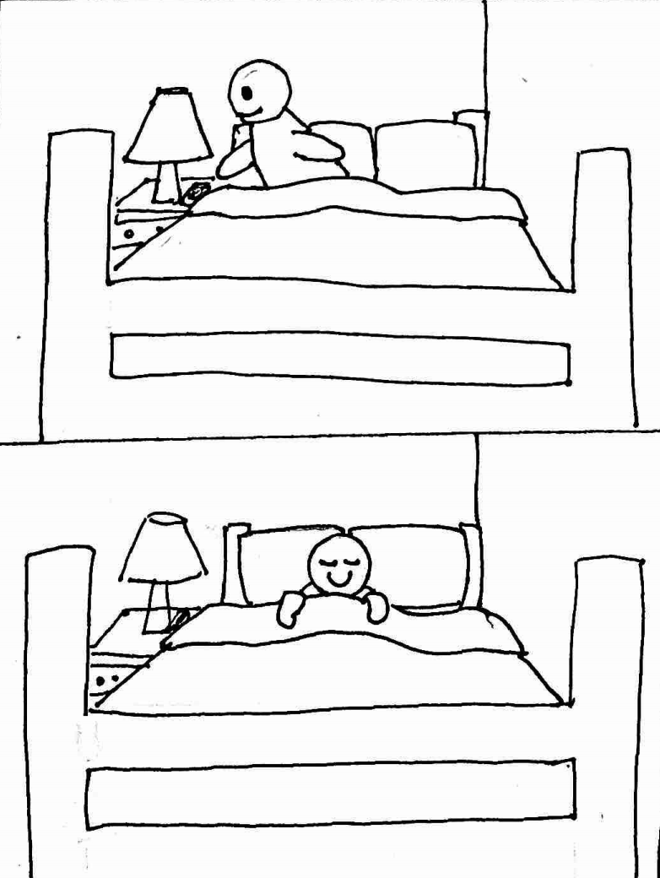
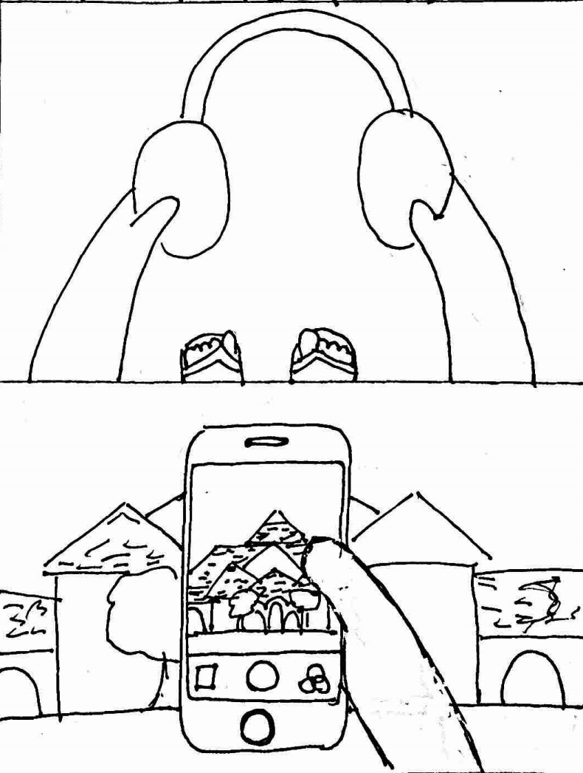

Slide 8
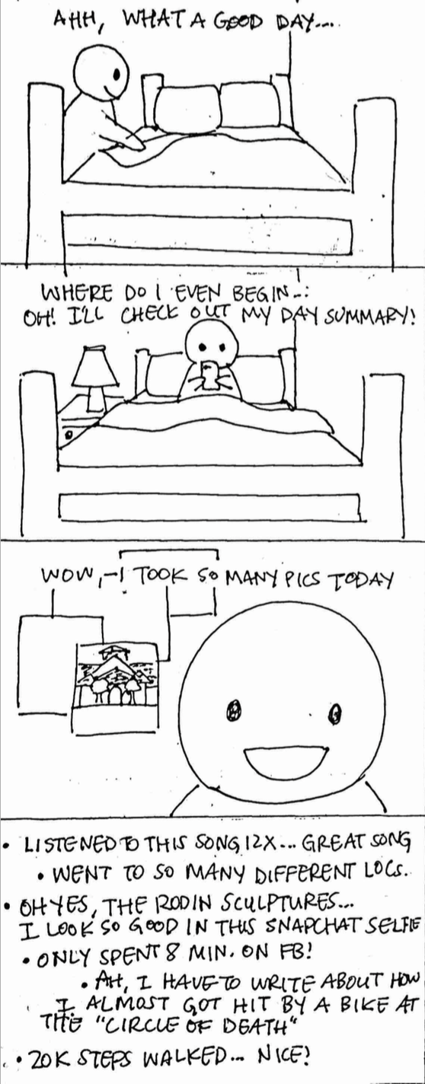
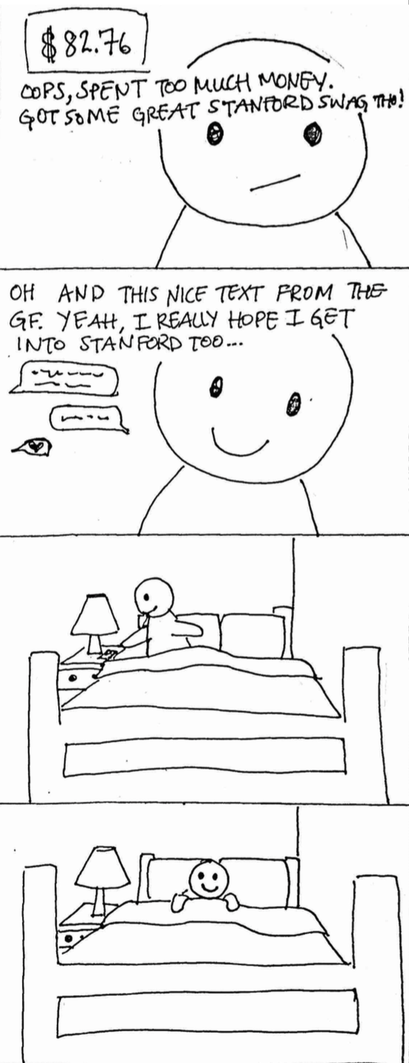
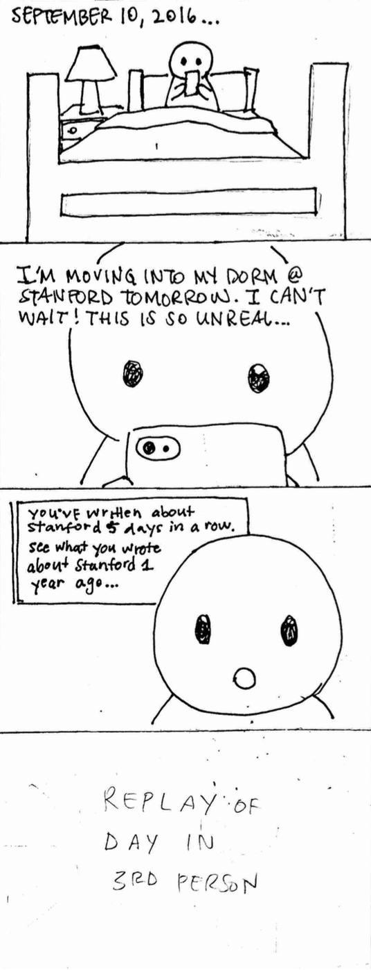
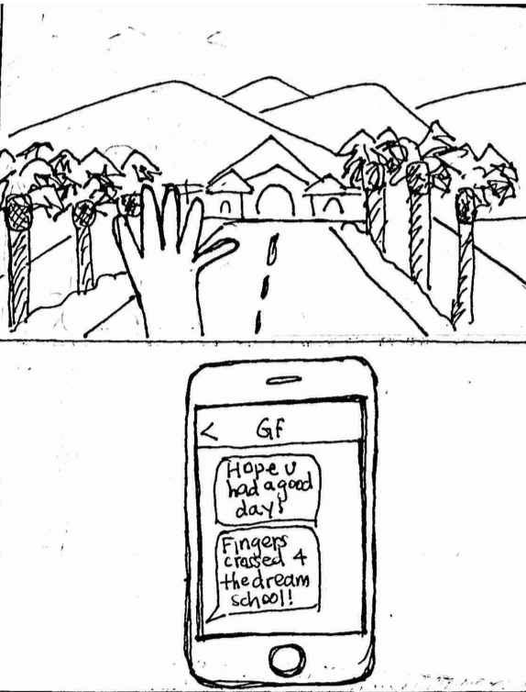

Slide 9
Concept Video

