Slide 1
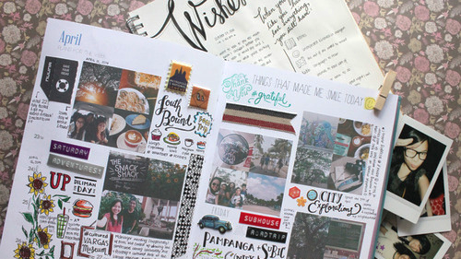
Creating Memories
POV, HMW,
& Experience Prototypes

Slide 2
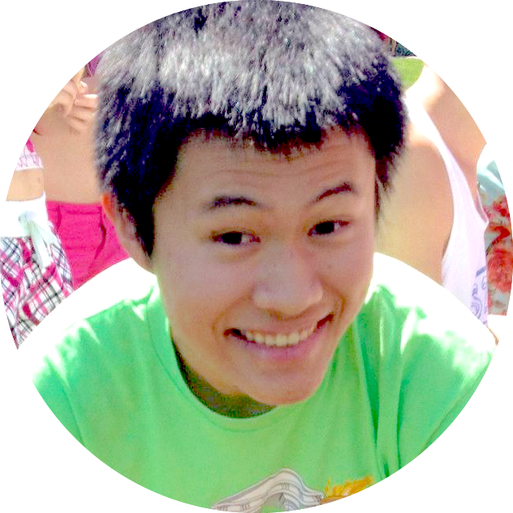
The Team
David E
Pavitra R
Catherine D
Levi J

Slide 3
Problem Domain — Creation
How do people want to record their thoughts, events, and memories?
journaling
photography
electronic history
scrapbooking
social media

Slide 4
Interviews
- round 2 -

Slide 5
Users
Laura (18) Lost two handwritten journals and crashed her computer in high school
Kat (21) Writes letters to her friends and revisits them several times per year
Joyce (22) Video blogs anytime, anywhere
Kim (45) Writes letters to her children but lacks time to journal consistently

Slide 6
Insights & Needs

Slide 7
Positivity & Happiness
put the day in perspective, find & highlight good things, acknowledge & release bad things

Slide 8
Self Understanding & Improvement
solidify thoughts and emotions, understand personal change and progress, learn from the past

Slide 9
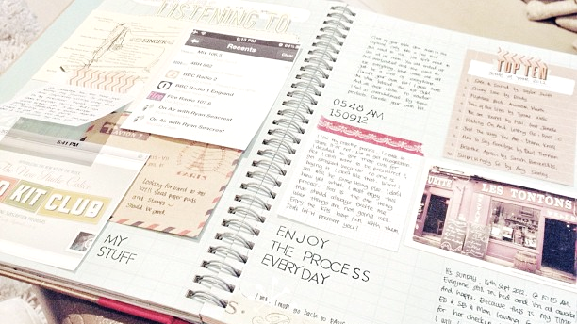
Nostalgia
eternalize memories, reminisce and reflect, feel good

Slide 10
Points of View
- revised -

Slide 11
POV — Rahim
We met Rahim.
We were amazed to realize that he has written more than 1,000 journal entries in one Pages document.
It would be would be game-changing to enable Rahim to eternalize and reflect on his memories with greater organization and ease but still retain the flexibility that his Pages document affords.

Slide 12
POV — Kat
We met Kat.
We were amazed to realize there are implicit aspects of expression (body language, vocal tone, facial expression) that she is unable to convey in written words in her diary/letters
It would be would be game-changing to capture these feelings by creating a more multi-sensory journaling experience.

Slide 13
How might we ... ?

Slide 14
Integration
How might we integrate journaling into various daily habits?
Notes:
POV: Rahim’s
Need: recording memo

Slide 15
Organization
How might we organize and make sense of existing content?
Notes:
POV: Rahim’s
Need: self-improvement

Slide 16
Expression
How might we capture the realness of live expression through a mobile device
Notes:
POV: Kat
Need:

Slide 17
Solutions &
Experience Prototypes
Notes:
How might we organize and make sense of existing content?

Slide 18
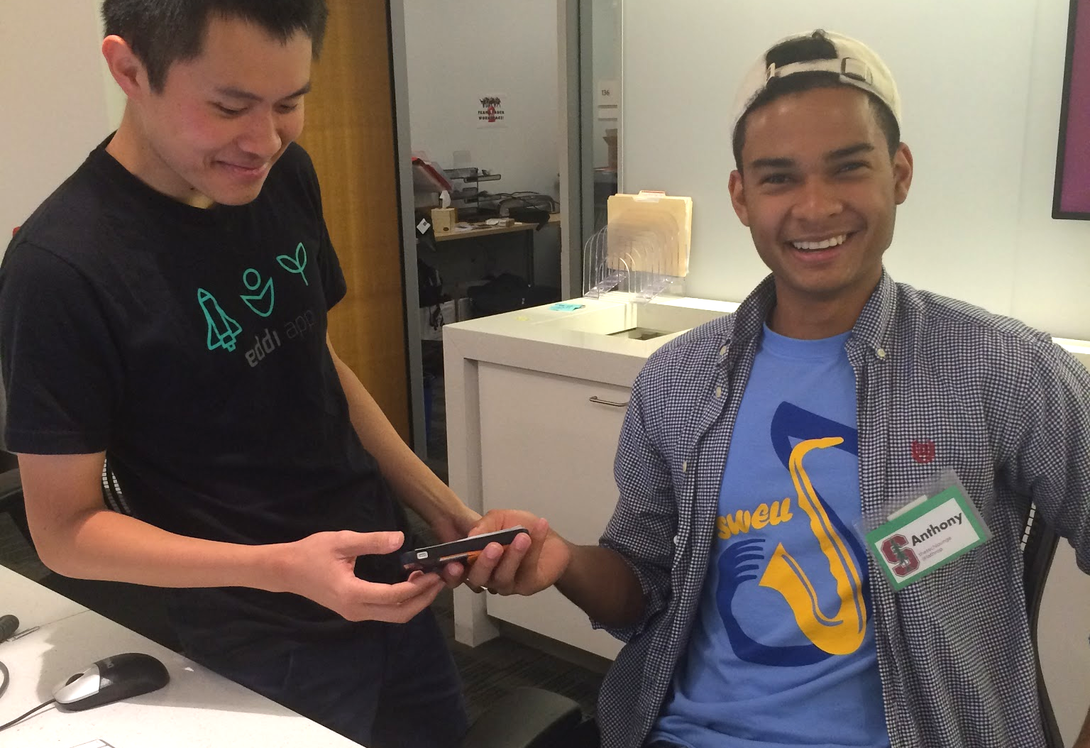
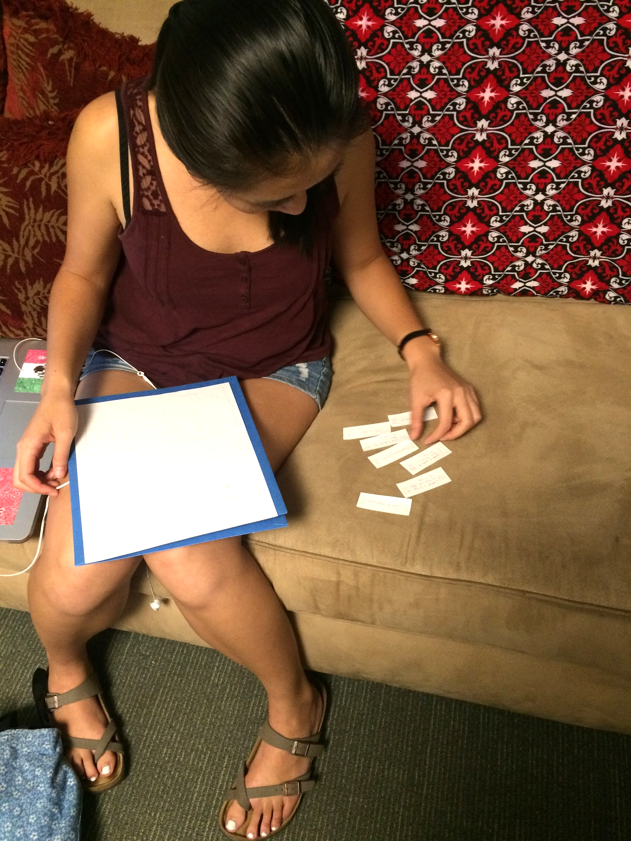
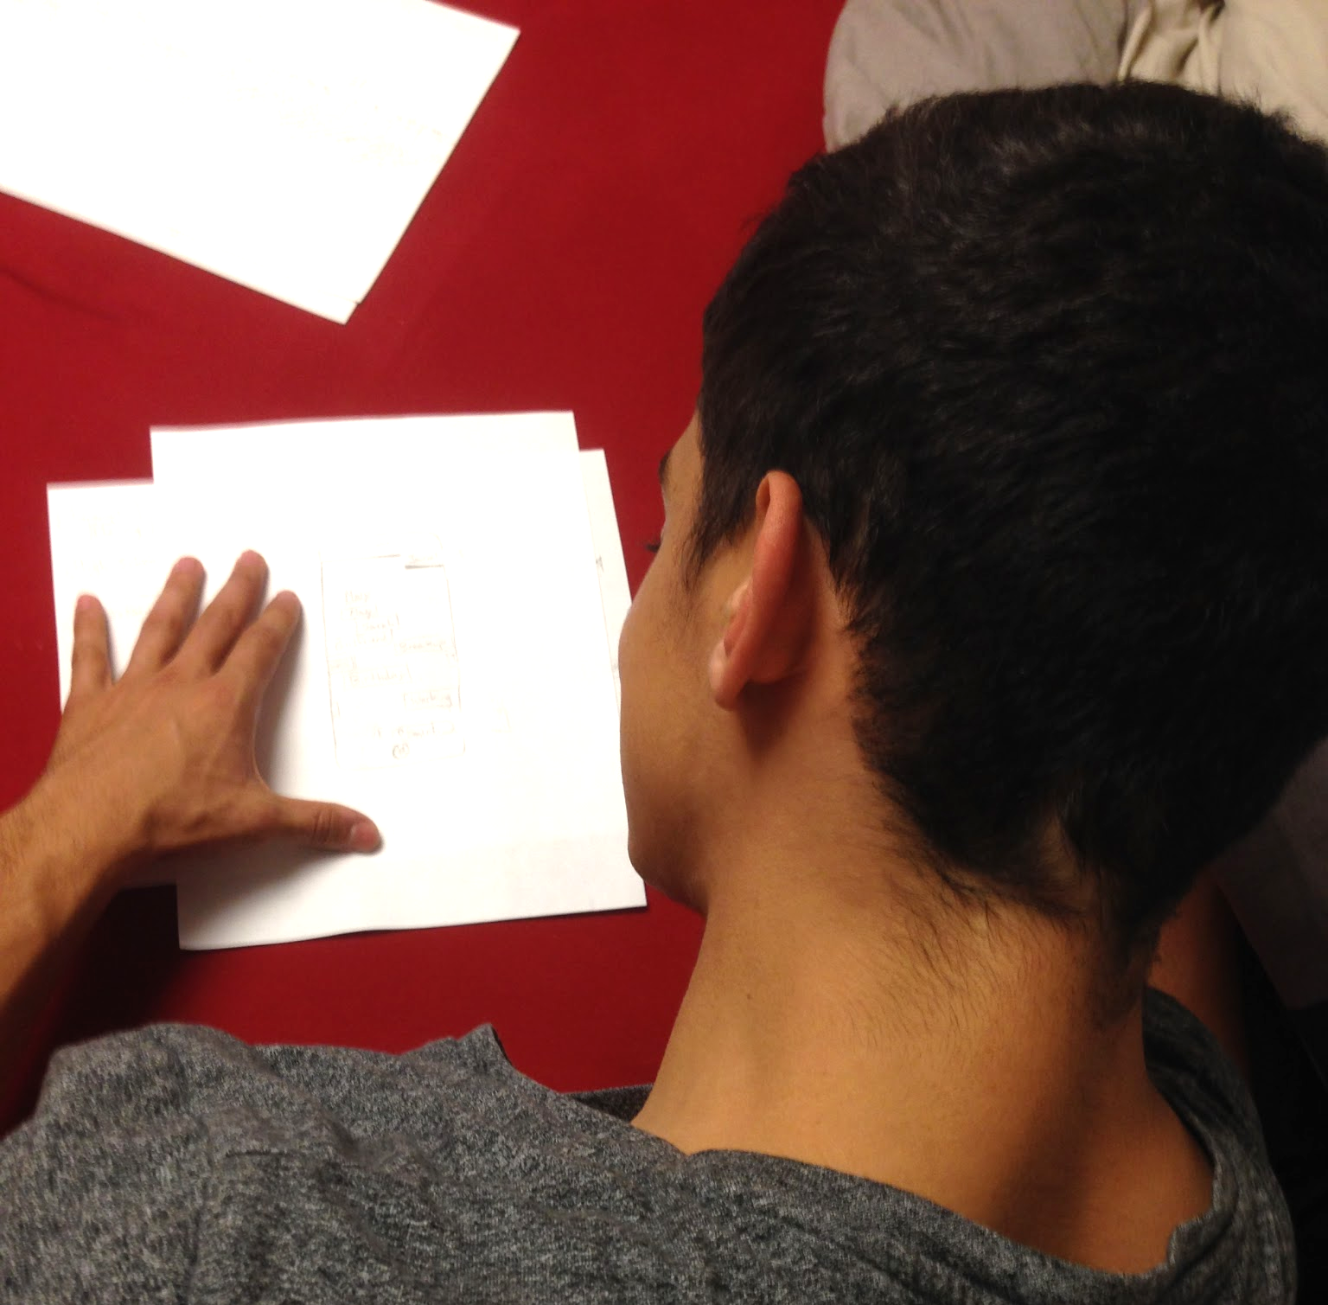

Slide 19
How might we integrate journaling into various daily habits?
Automatic content generation based on the user’s phone usage that day

Slide 20
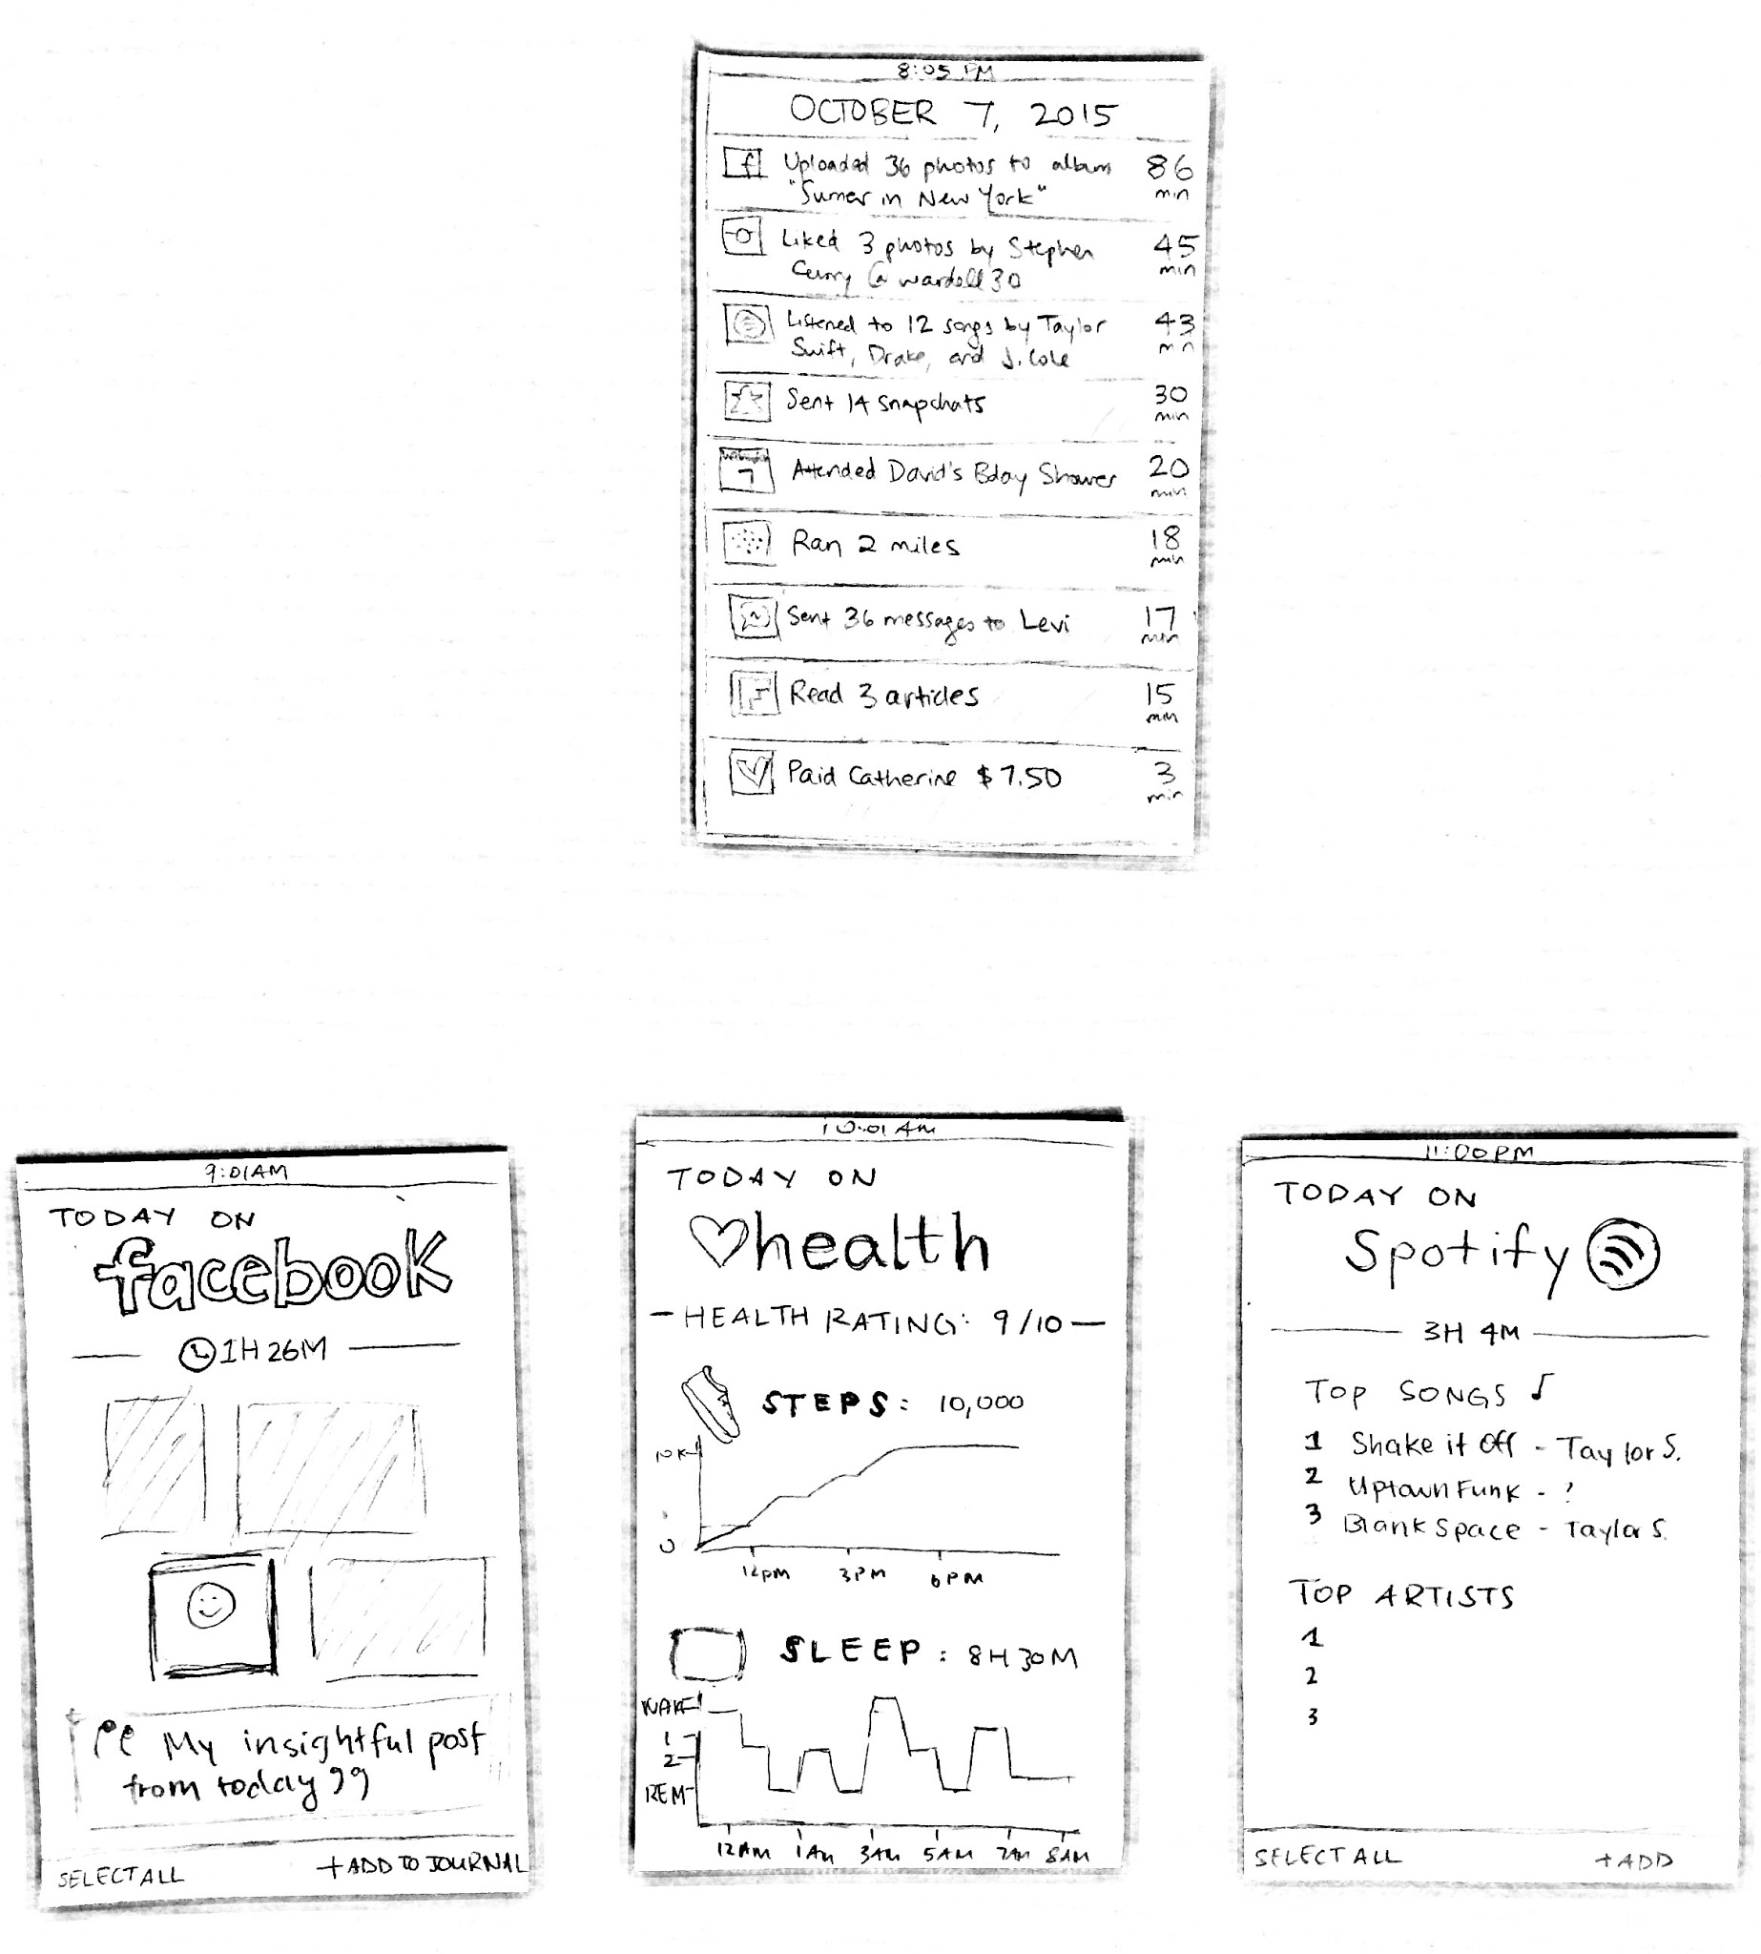
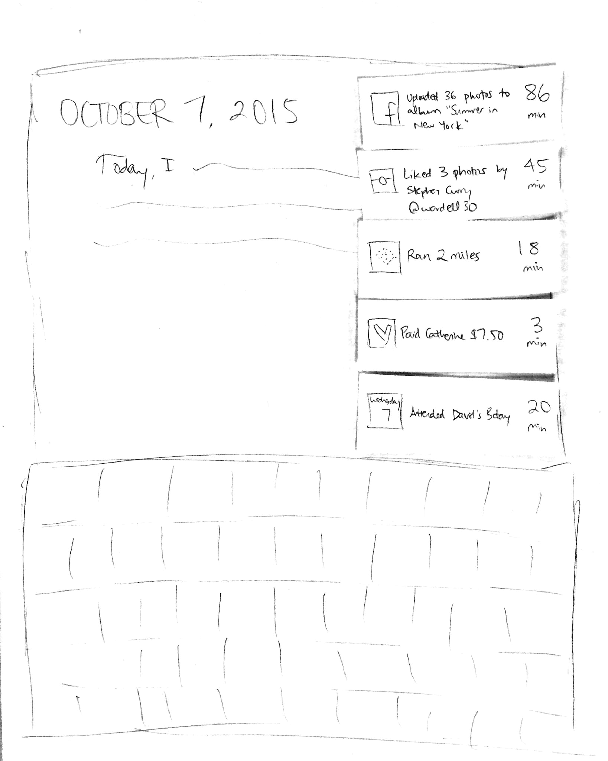
Prototype — Digital Footprint Tracker

Slide 21
Prototype — Digital Footprint
Assumption People want to easily see what their daily activity looks like and how they change over time. Testing the prototype Tested on five people between the ages of 18 and 28 Asked which inputs, if any, they would pin to their journal entry. What worked? People like to see how they spend their time Facebook, diet/fitness apps

Slide 22
Prototype — Digital Footprint
What didn’t work? Adrienne thought journaling was a sanctuary and does not appreciate digital journals
What did we learn? Most people would love a way to track/consolidate/analyze their use of time People would use this as a way to generate content to ease writer’s block
Was the assumption valid? Yes! People seemed really excited about this idea

Slide 23
How might we organize and make sense of existing content?
Automatically analyze trends in the user’s content, sort entries based on content type and sentiment, and display it intuitively.

Slide 24
Prototype — Spatial Journal

Slide 25
Prototype — Spatial Journal

Slide 26
Prototype — Spatial Journal
Assumption A spatial representation is more intuitive and therefore preferable to a written representation Testing the prototype Nico Sanchez (20) Told him that he had a bunch of journal entries with titles and that his task was to look back through them all Then told him to search a keyword he wanted: “Mary”

Slide 27
Prototype — Spatial Journal
What worked? The visualization was fun The Search feature was intuitive
What didn’t work? The chronology structure was less appealing that we expected
What did we learn? Clusters can reveal connections between entries
Was the assumption valid? Seems valid. Nico was engrossed in the “world” of his entries

Slide 28
How might we capture the realness of live expression through a mobile device?
Utilizing physical, visual, and vocal interactions with the device to capture emotions.
Notes:
Kat really enjoyed having a physical journal. She said she like “the weight of the journal in her hands” because it felt more real.
We wanted to create a more visceral, interactive experience for users as a more real, live, and effective outlet for expression

Slide 29
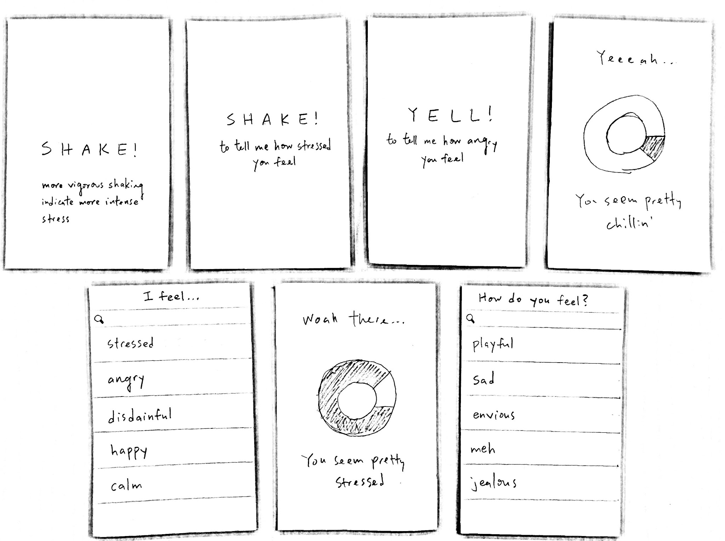
Prototype — [action] for [emotion]

Slide 30
Prototype — [action] for [emotion]
Assumption People want a physical, rather than just textual, means to express their emotions Testing the prototype We interviewed 10+ many people Kenaba (18) and Anthony (20) offered the most valuable insights What worked? Users tested the prototype without guidance Simplicity of the concept made adoption friendly to new users
Notes:
Kenaba: didn’t feel particularly stressed but still shook it because it was fun
Jonasel: didn’t want to shake it because he was stressed, but asking him to shake it made him realize how stressed he was because he was forced to translate it to a physical action, which made him more inclined to journal about how he was feeling

Slide 31
Prototype — [action] for [emotion]
What didn’t work? Different users associate different actions with different emotions
What did we learn? Users would shake again Physical action increases subsequent desire to journal
Was the assumption valid? Yes! Kinesis seems to evoke strong emotional response

Slide 32
Winner:
Digital Footprint

Slide 33
Appendix

Slide 34
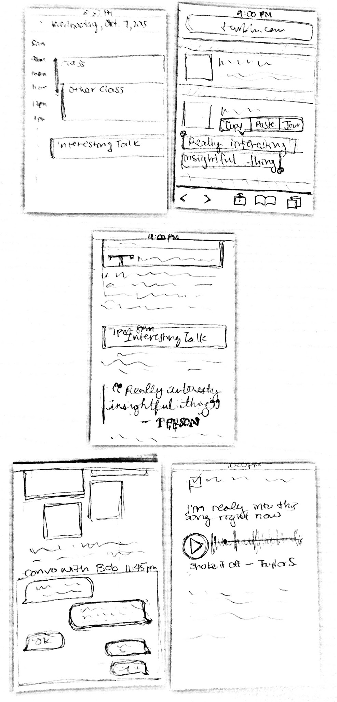
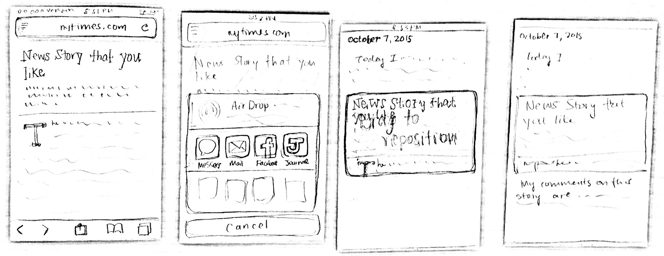
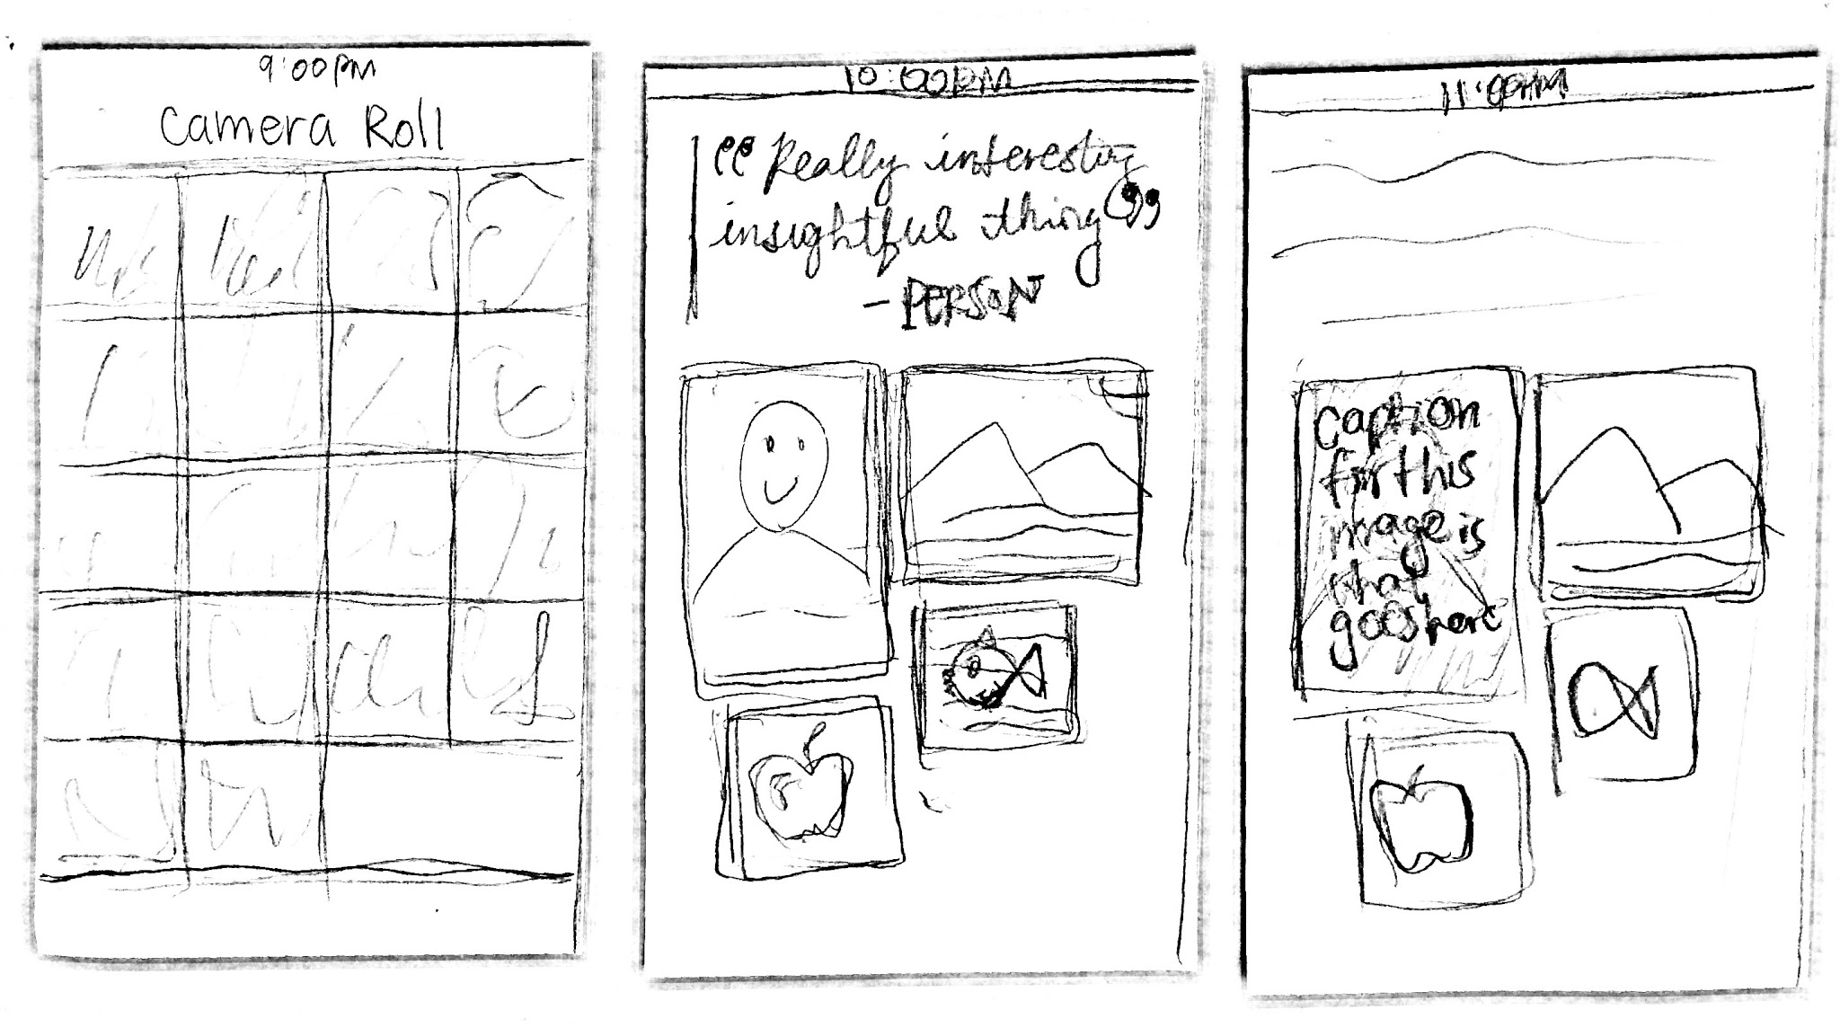
Prototype — [action] for [emotion]

Slide 35
Points of View
- round 1 -

Slide 36
POV — Power Users + Intermediate Users
We met several intermediate users in their 30s-40s.
We were amazed to realize the variety in the types of content they record.
It would be would be game-changing to allow them to easily synthesize all their different types of content in a way that feels cohesive and organized.

Slide 37
POV — Non Users
We met teenage and middle-aged non users.
We were amazed to realize that they thought journaling detracted from their lives.
It would be would be game-changing to change their perception of what journaling entails and the time investment necessary to journal.

