Slide 1
Creating Memories
- needfinding -
Levi Jennings, Pavitra Rengarajan, David Eng, Catherine Dong

Slide 2
Problem Domain
How do people record thoughts, events, and memories?
journaling
photography
social media
scrapbooking
electronic history

Slide 3
Needfinding Methodology

Slide 4
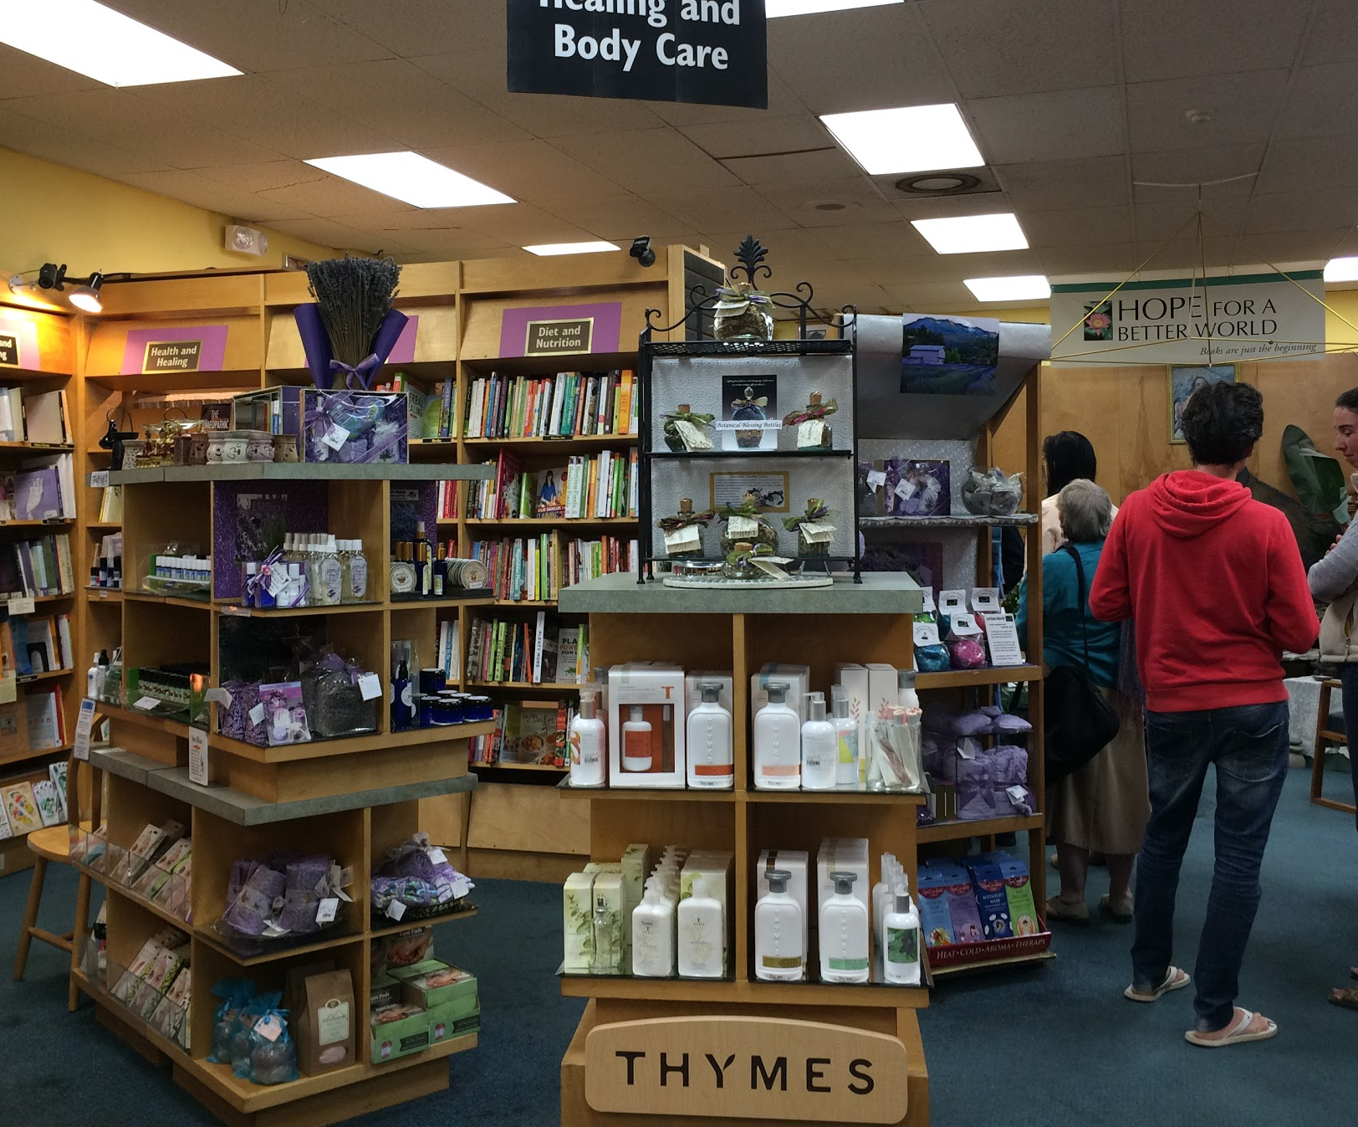
Needfinding Methodology
Approach Variety of ages, journal habits, social media habits
Places Starbucks, Blue Bottle, Palo Alto HS

Slide 5
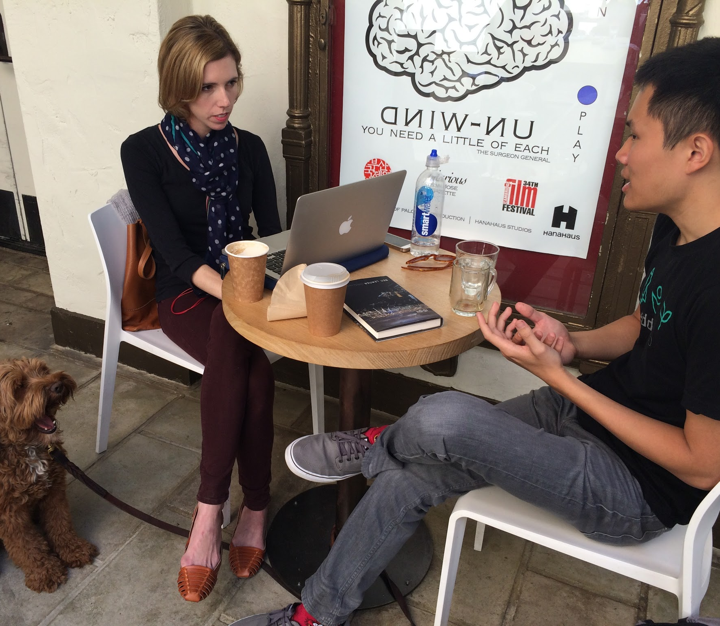
Interview Questions
How do you record your daily life?
How and when do you to look back on your memories?
When was the last time you posted on social media?
Why do you record your life/post on social media?

Slide 6
Interview
Results

Slide 7
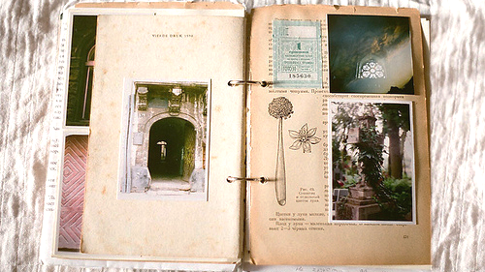
drawings
quotes
notes
conversations
lyrics
prayers
photos
screenshots
poetry
goals
beliefs
bucket lists
reflections
thoughts
letters to future self

Slide 8
Three Users
Power Users
Journal often (4 - 15 times/wk)
Significant part of their lives
Intermediate Users
Journal occasionally
Open to journaling more
Non-Users
Don’t journal
Won’t journal

Slide 9
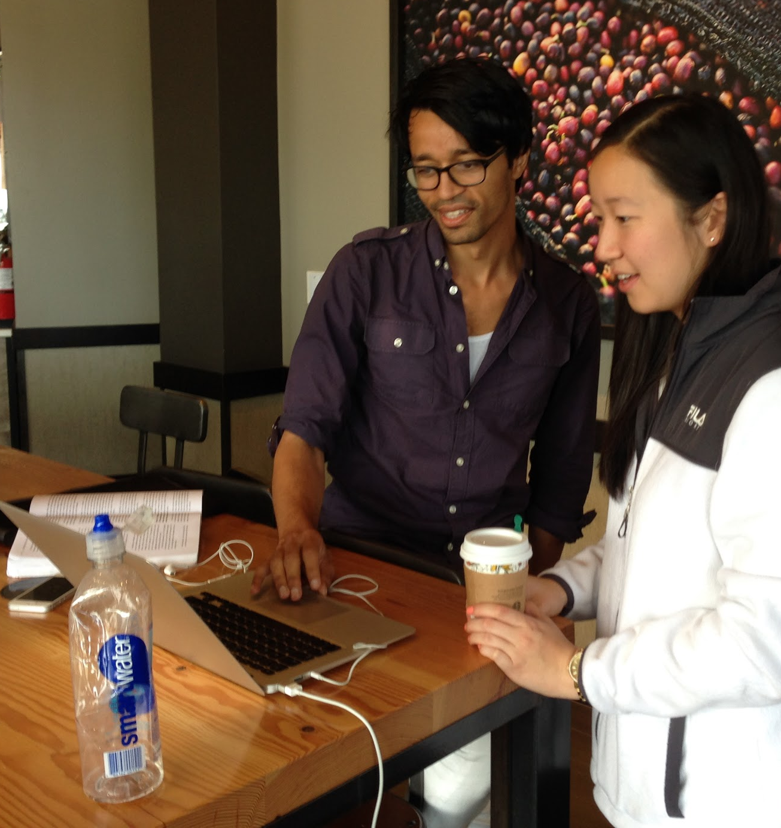
Power Users - Overview
Rahim (28) and Marie (30)
Write 200+ journal entries/yr
Variety of content: photos, messages, text, etc.
Journal for self-expression and reflection

Slide 10
Power Users - Empathy Map
SAY
“it’s all my thoughts in one place”
“journaling is a flow of thoughts, an escape”
THINK
it will be interesting to look back on thoughts
journaling is beneficial
DO
record notes, quotes, things to do, photos, prayers, thankfulness, beliefs, poetry
FEEL
comfortable, natural
insightful, introspective
Notes:
part of how they thought of and about themselves

Slide 11
Power Users - Needs
Self-Expression
Wanting to be heard
Wanting to be in a place free of judgment
Reflection
Wanting to reminisce and remember
Wanting to improve
Wanting to solidify existing thoughts

Slide 12
Intermediate Users - Overview
Lindsay (30), Cameron (14), Isaiah (14)
Important (often difficult) events drive journaling
Occasion, not time, based

Slide 13
Intermediate Users - Empathy Map
SAY
“social media is too public”
“for solidifying thoughts, to get things off my chest, rather than daily events”
THINK
journaling is nice, but it’s hard to be consistent; lack of accountability
too busy and tired to write
DO
tried an app with daily writing prompts
used a physical journal, sometimes inserted tickets
FEEL
unmotivated
disorganized

Slide 14
Intermediate Users - Needs
Observations
Too busy to spend time recording things regularly
Content is disorganized and is not consolidated in one place
Needs
Simple, quick way of organizing thoughts and memories to encourage consistent content creation
Notes:
We wanted to narrow the scope of the focus so we left out non-users.

Slide 15
Analysis

Slide 16
Inferences
People enjoy reminiscing on their pasts
People want to express themselves and organize their thoughts without judgment
Given more organization and structure and an easier way to create content, intermediate users may become more active journalers

Slide 17
Insights
Contradiction
People generally like to look back/reminisce, but don’t want to make the effort to record memories
People respond respond differently to public and private journals

Slide 18
Questions
How will the mobile format impact the types of users we will focus on? What are the most important features for each group of users? How much of a social aspect should be incorporated?

Slide 19
Summary & Conclusions
3 different types of users: power users, intermediate users, non users
Needs of different types of users are too disparate to try to cater to all of them

Slide 20
Appendix

Slide 21
Power Users Empathy Map
SAY “Journaling is lifechanging” ~ Rahim “In my life there is a dichotomy between clearing of thoughts through meditation and flow of thoughts through journaling” ~ Marie “I was bullied in high school and found journaling to be therapeutic, an escape” ~ Marie Rahim wants his thoughts to be in one consolidated place Marie wants her journal to be more organized and searchable | THINK Rahim needs flexibility to write whatever he wants Marie sometimes knows what she wants to write about but sometimes likes to have a prompt Marie needs more organization while maintaining flexibility and creativity Rahim wants to be able to look back later and wants to see connections between posts (people, places, events) and needs flexibility Marie wants a different service at different times Both want more organization
DO Rahim uses coach.me, pages doc (4x a week) which is color-coded but haphazard Rahim writes about notes, things to remember, quotes, goals, pictures, prayers, beliefs, people, screenshots Marie writes about what she’s thankful for, what she learned, shat she was happiest for that day, prayers after meditating, travel log, poetry, screenshots, pictures | FEEL Rahim feels organized/accomplished Rahim feels that diary apps are usually too restrictive Rahim feels improved after journaling Marie feels pensive, calm, reflective, cleansed, content Marie feels that journaling is therapeutic & cathartic Marie finds journaling to not be a chore but rather enjoyable Both feel like it is an integral part of their identity and their life

Slide 22
Intermediate Users Empathy Map
SAY Cameron doesn’t want friends to comment on journal entries Cameron would be willing to post anonymously “I like to just use one platform to reminisce, otherwise there’s too many things to keep track of” ~ Isaiah “At the end of a really long day, you just don’t want to write anymore” ~ Lindsay Lindsay journals to solidify her thoughts not because she likes to remember stuff “I prefer to look to the future, so I have more bucket lists than day chronicling” ~ Isaiah | THINK Lindsay would journal again if more time & had organized tool Cameron doesn’t want to be judged Isaiah doesn’t want photos/memories to be scattered, wants a more organized way to browse Isaiah finds Facebook to not be useful Isaiah has scattered thoughts Robert thinks that most social media is too public and not a good means for posting personal thoughts
DO Cameron uses Facebook occasionally, checks Instagram 3 times a day, occasionally posts pictures of friends Cameron sometimes journaled in the past, when something significant happens, usually negative Isaiah used to use Facebook then switched over to Instagram Lindsay journaled in high school & college, had DIY solutions for journal like Word, Evernote - disorganized & suboptimal Claire journals about her goals, not so much about thoughts Robert has a public blog & a private blog - prefers anonymity | FEEL Cameron feels self-conscious and wants to not be judged Lindsay feels busy and tired and finds the task of journaling to be cumbersome Jared wants to portray a “rose-colored” version of himself Claire feels good to look back at her goals/progress Jared is excited to write to his future self and look back on his past self Robert is very conscious about the publicity of his posts

Slide 23
Non-Users Empathy Map
SAY “Not a thing dudes my age do” ~ Justin “I’m just too lazy. I forget and don’t have time.” ~ Justin “It’s cool to see what other people post but I don’t really post stuff on Facebook or Instagram or any of that.” ~ Justin “I would rather live my life than journal. I look back with my memories or talk to my wife.” ~ Jyrki “I take photos when it’s something I want to look back on something that makes an impression on my heart.” ~ Jyrki “I don’t feel good to sit on couch and update on Facebook.” ~ Jyrki | THINK Justin probably thought it was weird to journal, especially for student athletes Justin probably felt judged by his friends, especially those who were present during the interview Jyrki doesn’t need to journal Jyrki lives life in the moment and says that you will remember the important things Jyrki feels he is not missing out on anything
DO Justin keeps no journal, very rarely posts on social media but enjoys seeing what other people post Justin did enjoy journaling in English class Justin is involved with sports Jyrki doesn’t have time & takes pictures Jyrki spends time with his kids Jyrki kept a diary when he was young | FEEL Justin seemed to feel embarrassed, judged by his friends Justin probably enjoyed the English class journal because it was required and everyone was doing it, so no one would judge him for it Jyrki feels love for his kids Jyrki feels that journaling would take away from being able to live in the moment

Slide 24
responses
Look at people who journal for their career
bolder inferences? (esp for intermediate users)
making intermediate journalors better when they do journal, not just try to make them do it more
---
what about people who didn’t have a group?

