Slide 1
Team Covalence
TED
LI
COURTNEY
NOH
LOGAN
SHORT
EMMA TOWNLEY-SMITH

Slide 2
Studio Theme: Creation

Slide 3
Studio Theme: Creation
Problem Domain:
Making Educational Content

Slide 4
Making Lessons
Review
Highlighting Learning
Notes:
either on student or teacher side

Slide 5
Original POVs: George and Petra
We met George…
We were amazed to realize that students need more visual forms of learning.
It would be game-changing to help guide George toward a more productive form of ‘practice’.
We met Petra…
We were amazed to realize that creation of new lesson content fundamentally comes down to tweaking existing material.
It would be game-changing to help teachers combine and re-use quality components and connect around creating new educational content.

Slide 6
Our Interviewees: Studying Education
Carol Giraudo
High School English Teacher
Petra Dierkes-Thrun
Lecturer in Comparative Literature

Slide 7
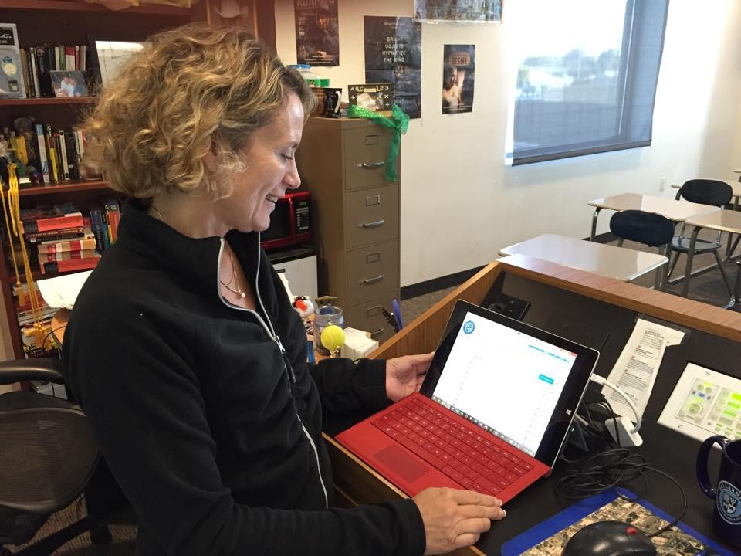
Carol Giraudo
High School English Teacher
“
We do a “Wiki-Project” every year and the kids love it. They work together on their Google Docs and then design the page
Pic Collage, Canvas, and Google Docs are great, but they’re a bit simple - kind of limiting
Ms. Giraudo shows us her Microsoft Surface that she uses to start each class with

Slide 8
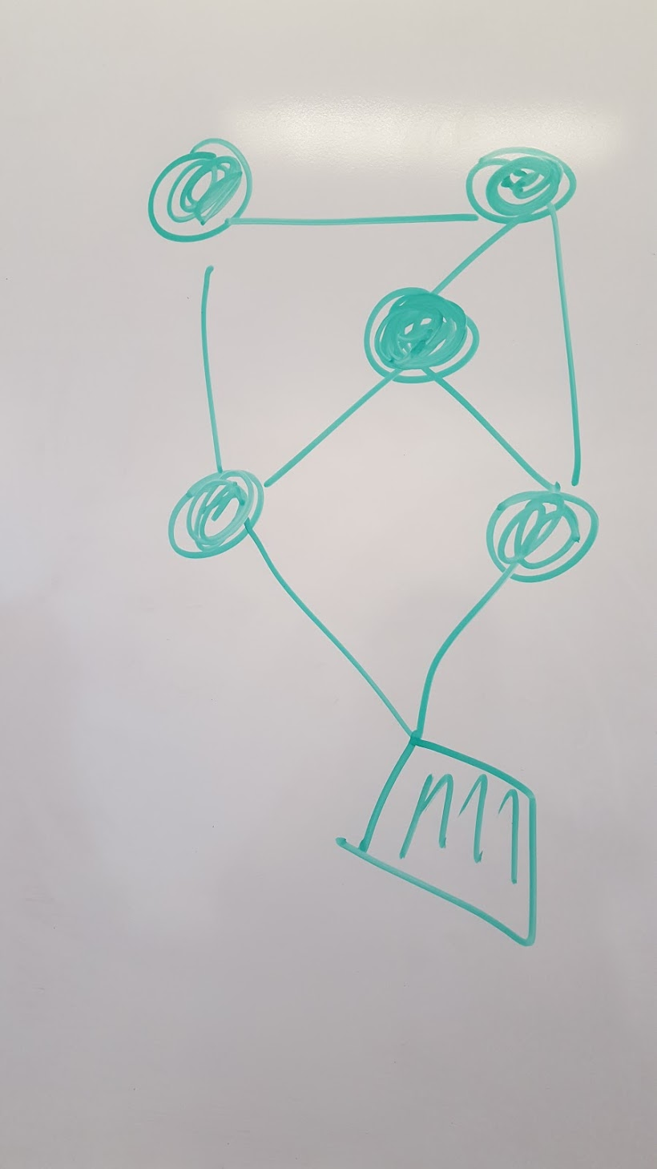
Petra Dierkes-Thrun
Professor of Comparative Literature
“
Think of [the concepts in a class] as pods...the point of a class is to show how they are connected.
When I make my lessons, I take chunks from old ones and number them...I wish these [lesson plans] were more flexible. They feel static.
Petra draws out her idea of how a class should be structured and taught

Slide 9
Inferences & Conclusions
Students learn and work better in a collaborative environment. Having creative projects also helps them be more enthusiastic about their work.
Making lesson plans involves a lot of work and often involves taking content from previous plans. Lesson plans also feel static.

Slide 10
Revised POVs
1
We met George, Tim, and Luke
We were amazed to realize that though these students love visual methods of learning, they take cues from their teachers on what sorts of study habits they should develop
It would be game-changing to help guide them towards more productive assignments that utilize their love for creation.

Slide 11
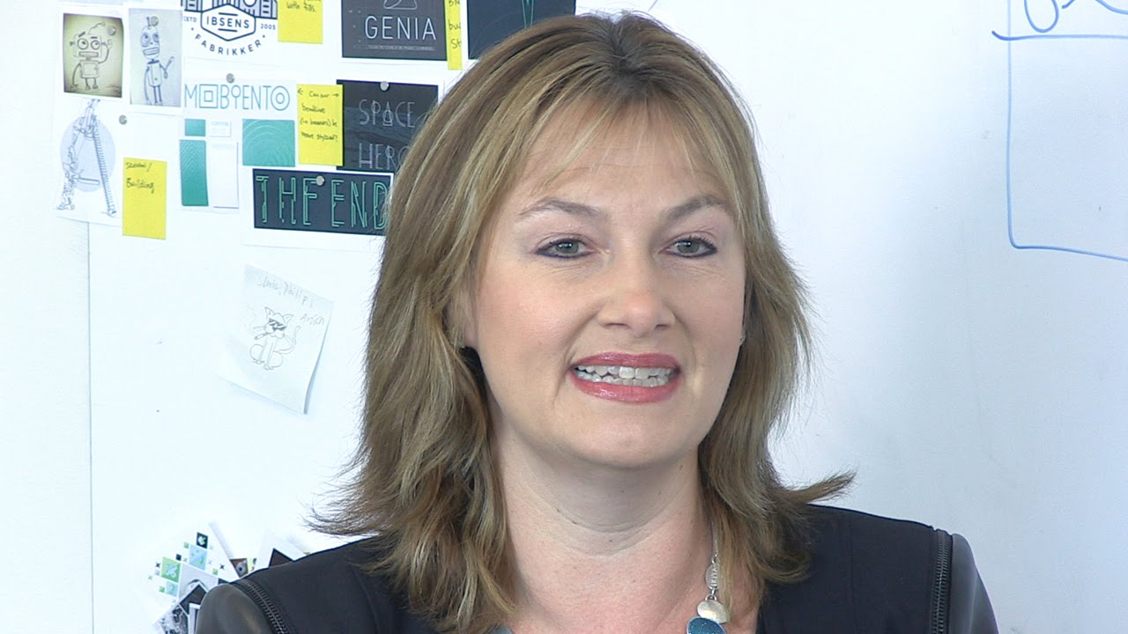
Revised POVs
2
We met Petra
We were amazed to realize that creation of new lesson content comes down to tweaking existing material, often in inflexible forms, such as Word documents.
It would be game-changing to help teachers combine and re-use quality components in more flexible forms

Slide 12
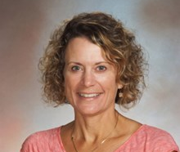
Revised POVs
3
We met Ms. Giraudo
We were amazed to realize how important allowing students to collaborate on assignments were to her classroom style
It would be game-changing to help give teachers more resources to let their students work together creatively

Slide 13
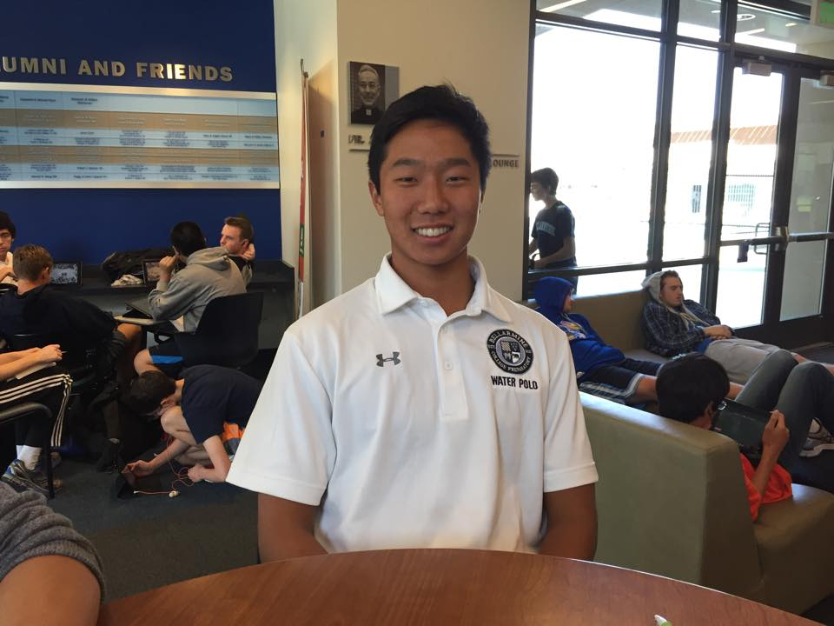
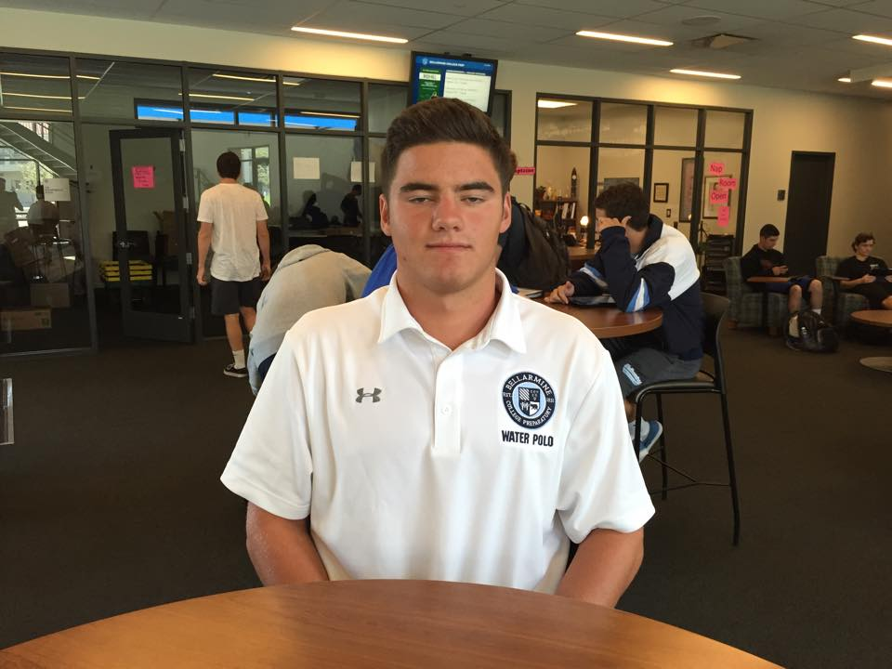
George, Tim, Luke HMW
1
How might we help George, Tim, and Luke...
use their own knowledge and conceptual understandings to teach others?
give feedback to their teachers on what concepts they understand or have trouble with?
find new, easy, and exciting ways of interacting with their notes again to solidify their understanding of concepts?

Slide 14
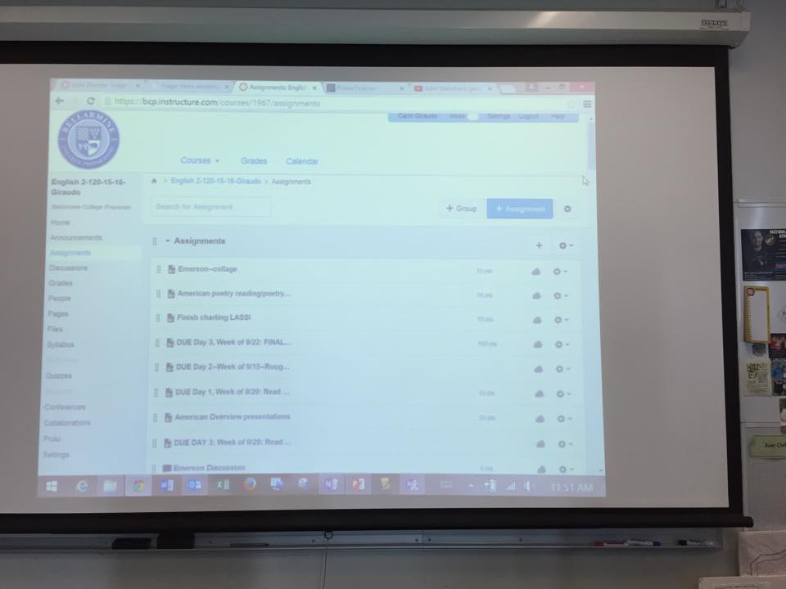
Ms. Giraudo HMW
2
How might we help Ms. Giraudo…
quickly and easily be able to create (and iterate on) new, interesting high-quality educational materials?
facilitate group work in more creative and visual manners?
encourage free creation and creativity through her assignments?

Slide 15
Petra HMW
3
How might we help Petra...
recognize what her students are interested in, and guide/improve the curriculum toward engaging them?
help students create these connections and roadmaps on their own time?
organize her overflowing amount of content in ways that will allow her to make more connections?

Slide 16
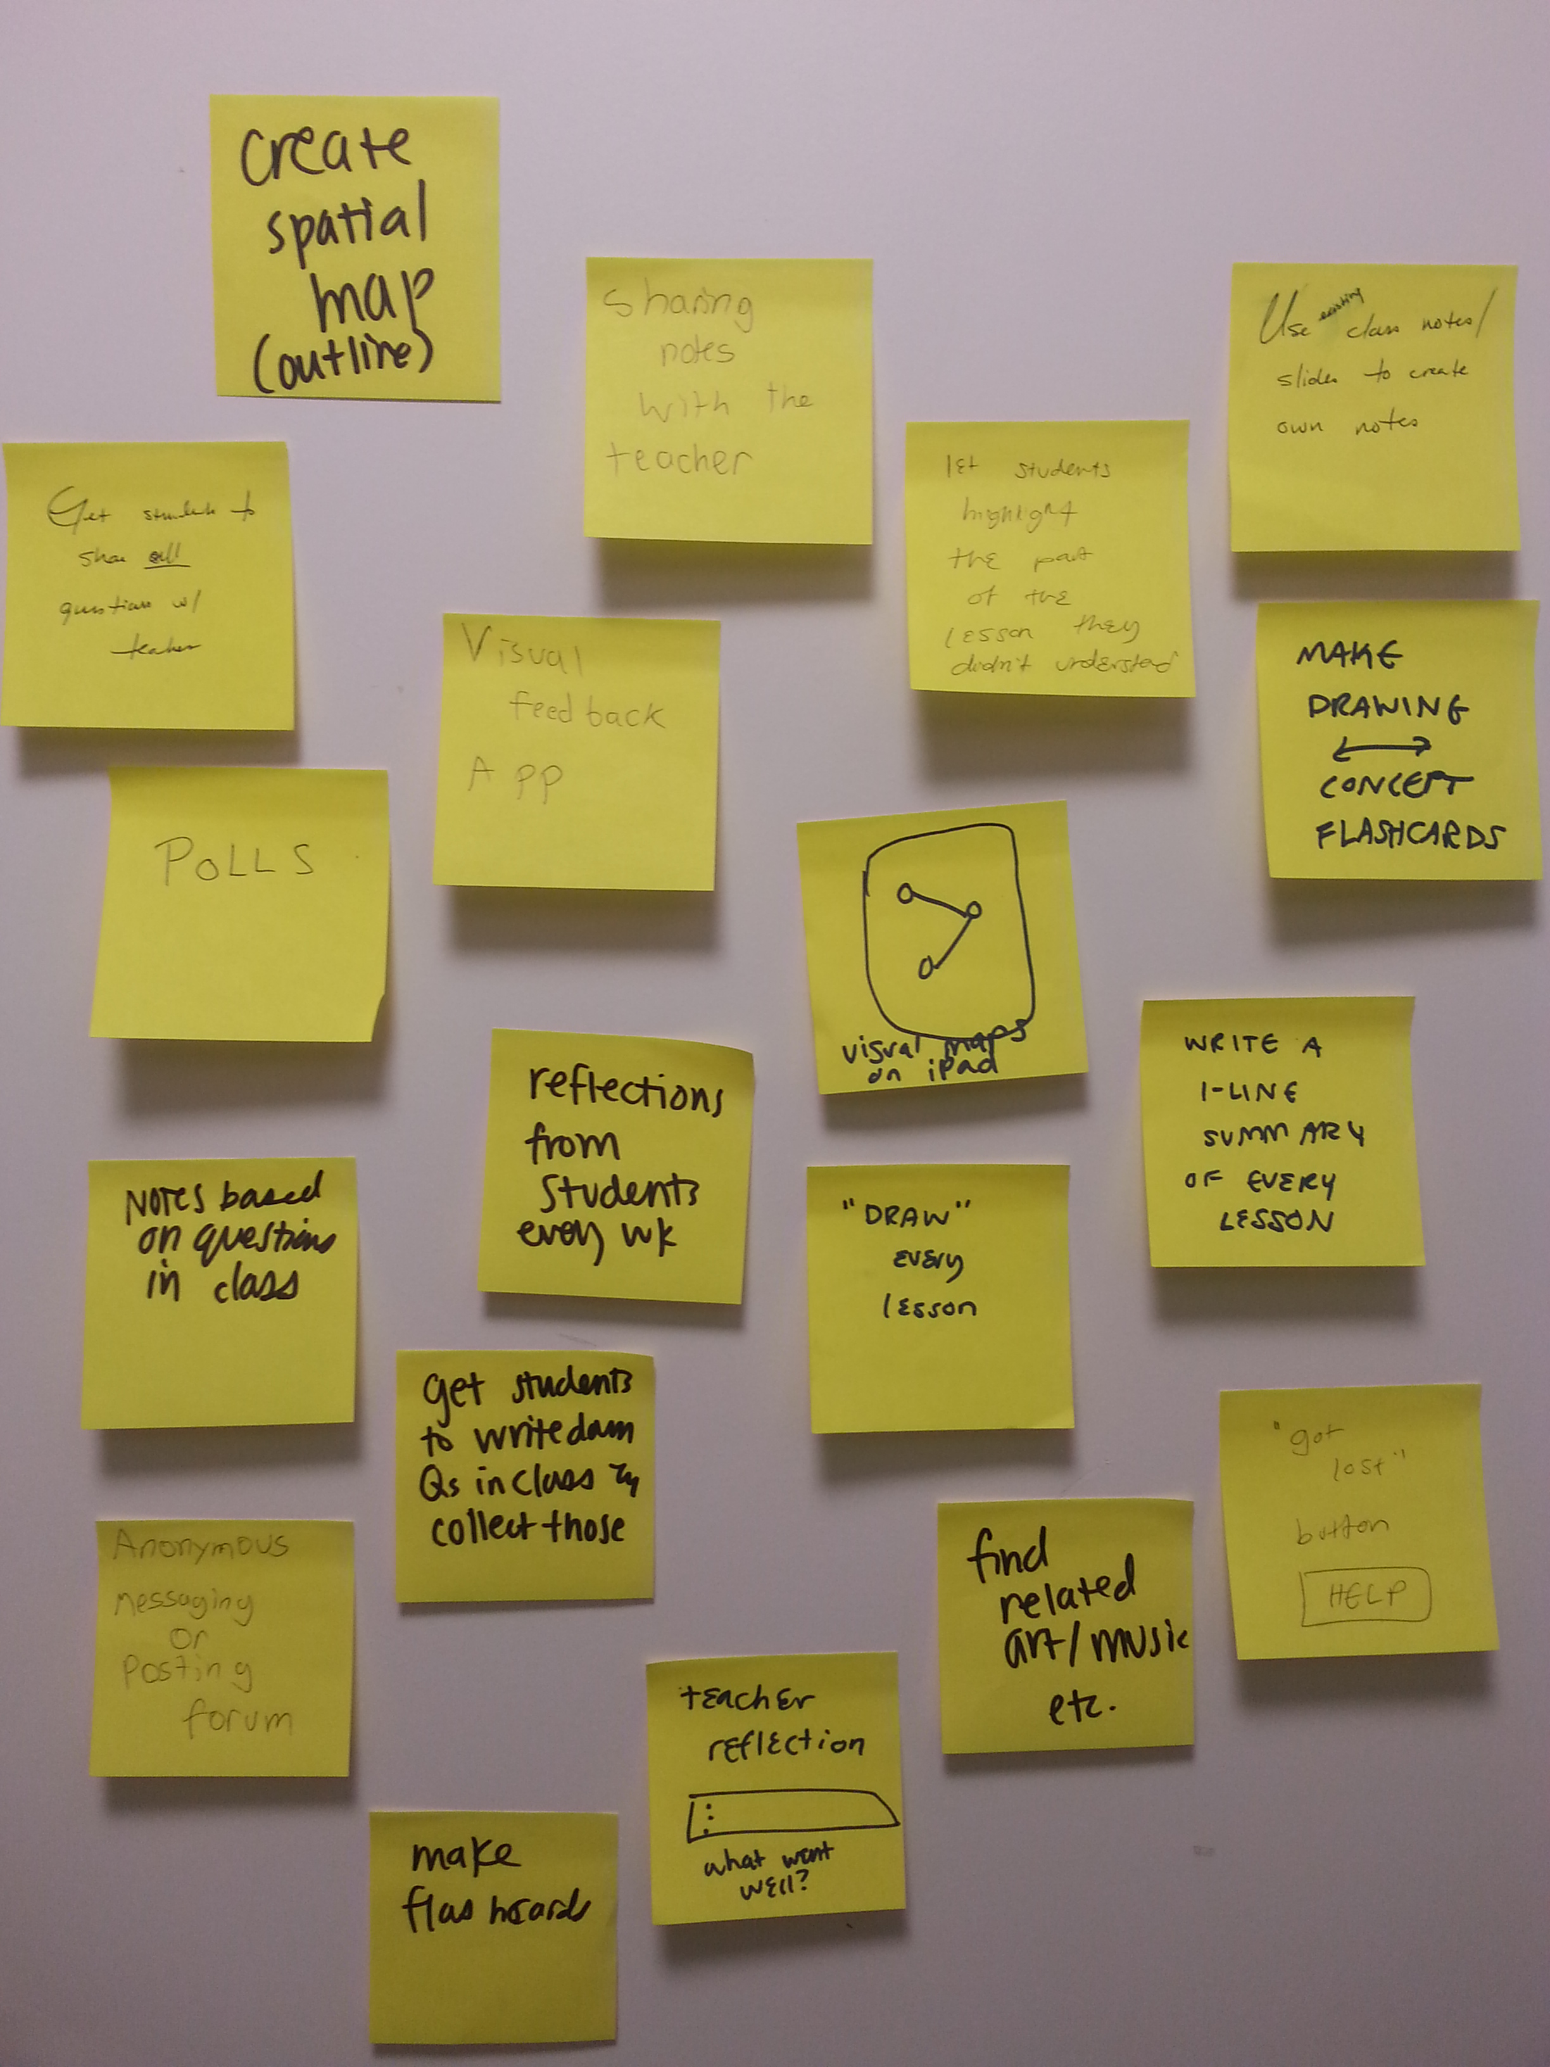
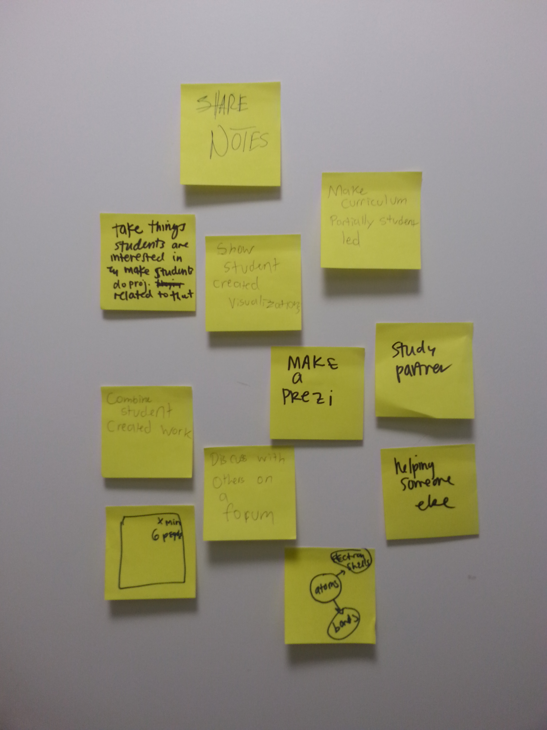
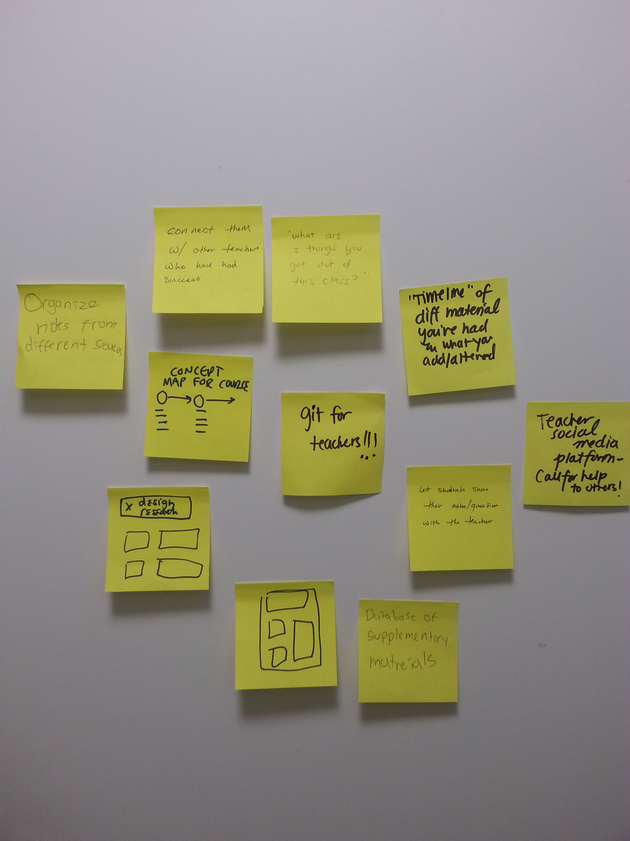
Generating Solutions

Slide 17
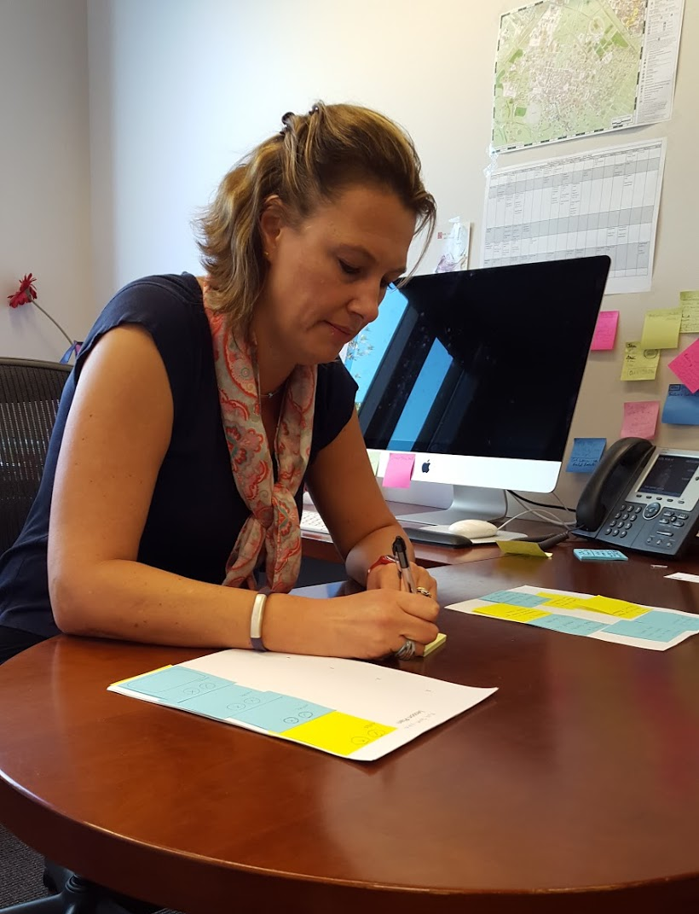
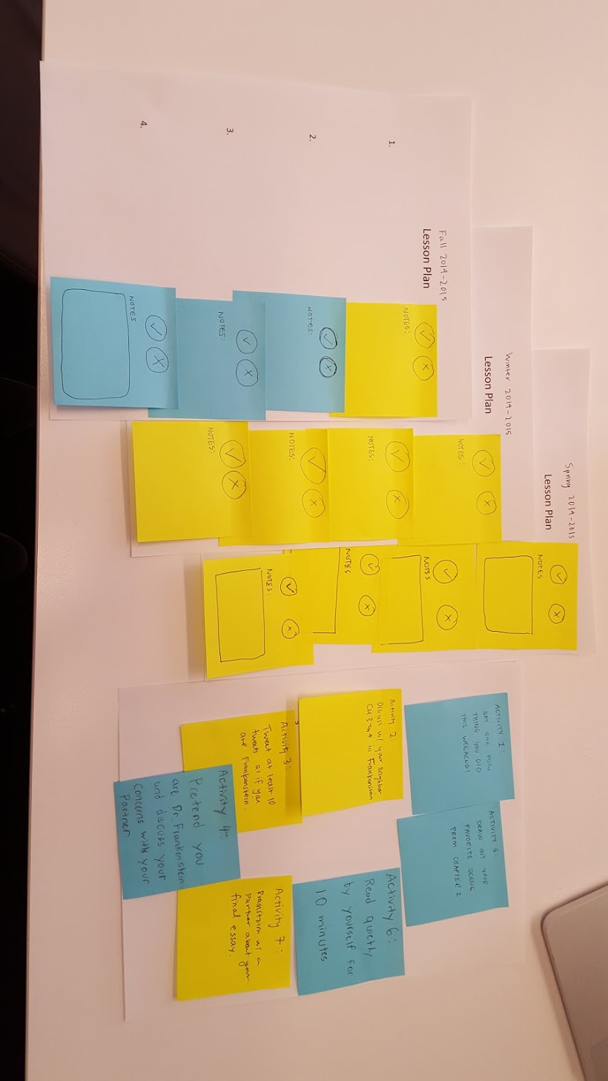
Github for Teachers
Experience Prototype
1
Scene: first class of a new course
Roles: students/teacher in her class
Artifacts: “lesson plans” with activities/comments (on sticky notes)
Notes:
description
method of testing
results (things that worked, things that didn’t, surprises, new learnings)
was assumption valid? why/why not? any new assumptions emerge?

Slide 18
Github for Teachers
Experience Prototype
1
👍 : Lesson plans felt more dynamic – easy to update
👎 : Not enough time to take notes while teaching
❗ : Classes broken down as “pods” of knowledge that teachers then connect
📖 : A ton of detail and time goes into planning each lesson
Notes:
description
method of testing
results (things that worked, things that didn’t, surprises, new learnings)
was assumption valid? why/why not? any new assumptions emerge?

Slide 19
Github for Teachers
Experience Prototype
1
Assumptions:
Teachers would like a way to more quickly make flexible lesson plans that they can go back to
✔
Notes:
description
method of testing
results (things that worked, things that didn’t, surprises, new learnings)
was assumption valid? why/why not? any new assumptions emerge?

Slide 20
Github for Teachers
Experience Prototype
1
Assumptions:
Teachers would like a way to more quickly make flexible lesson plans that they can go back to
✔
Teachers would like to be able to take quick notes on their lesson plans in class
❌
Notes:
description
method of testing
results (things that worked, things that didn’t, surprises, new learnings)
was assumption valid? why/why not? any new assumptions emerge?

Slide 21
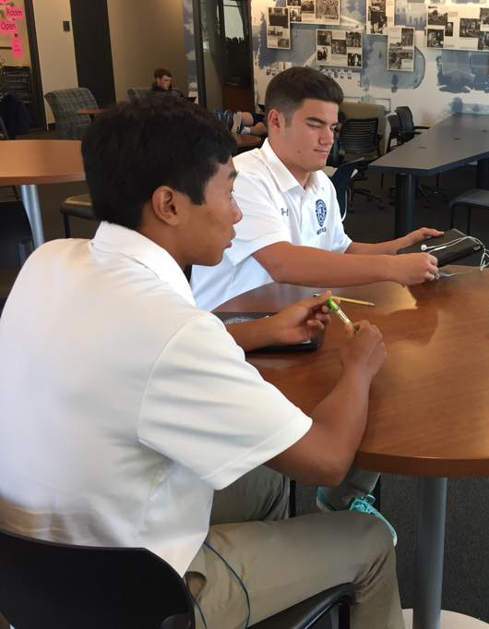
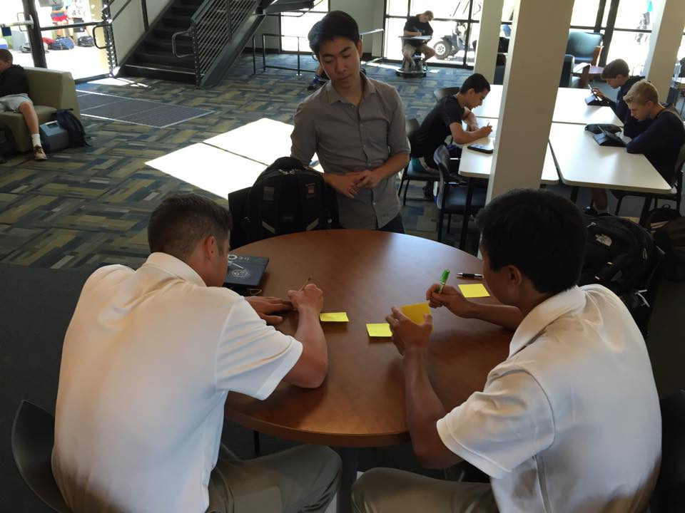
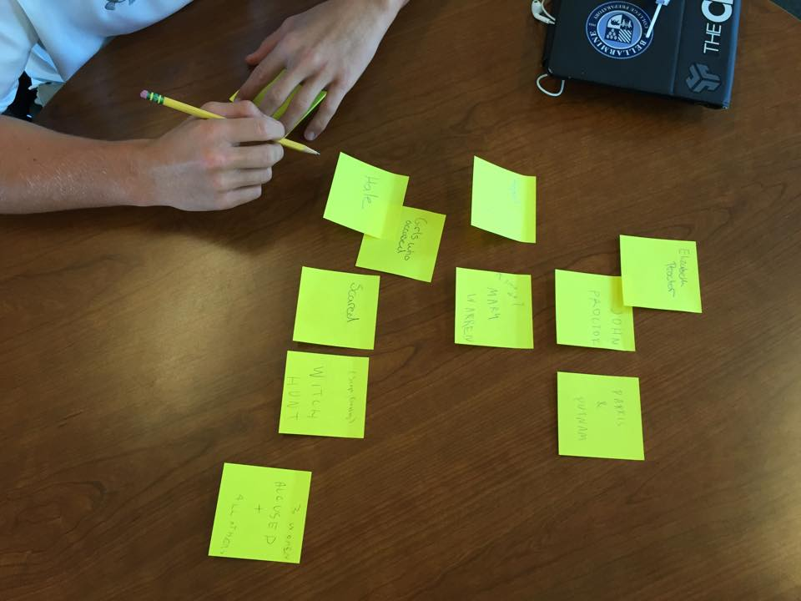
Atom Model
Experience Prototype
2
Scene: creating map for The Crucible
Roles: students in an English class
Artifacts: Post-It notes that represent ideas and a table to map on
Notes:
description
method of testing
results (things that worked, things that didn’t, surprises, new learnings)
was assumption valid? why/why not? any new assumptions emerge?

Slide 22
Atom Model
Experience Prototype
2
👍 : Students were very enthusiastic and felt like it gave them a broader understanding
👎 : Lack of customization and aesthetics
❗ : Proposed the idea of making it online
📖 : Students enjoy working with each other – they talked about every step in constructing the map
Notes:
description
method of testing
results (things that worked, things that didn’t, surprises, new learnings)
was assumption valid? why/why not? any new assumptions emerge?

Slide 23
Atom Model
Experience Prototype
2
Assumptions:
Students enjoy working in a collaborative environment.
✔
Notes:
description
method of testing
results (things that worked, things that didn’t, surprises, new learnings)
was assumption valid? why/why not? any new assumptions emerge?

Slide 24
Atom Model
Experience Prototype
2
Assumptions:
Students enjoy working in a collaborative environment.
✔
Putting your knowledge into a spatial context helps with understanding
✔
Notes:
description
method of testing
results (things that worked, things that didn’t, surprises, new learnings)
was assumption valid? why/why not? any new assumptions emerge?

Slide 25
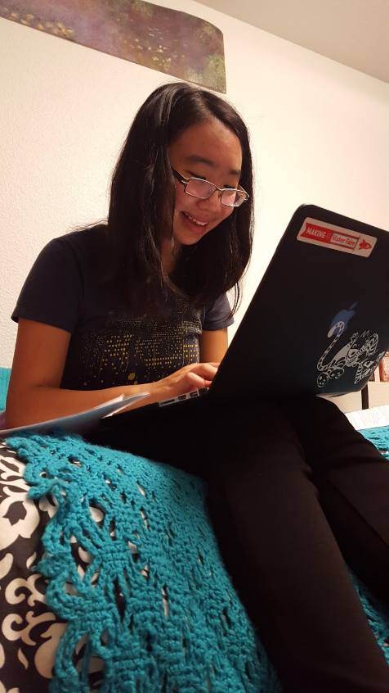
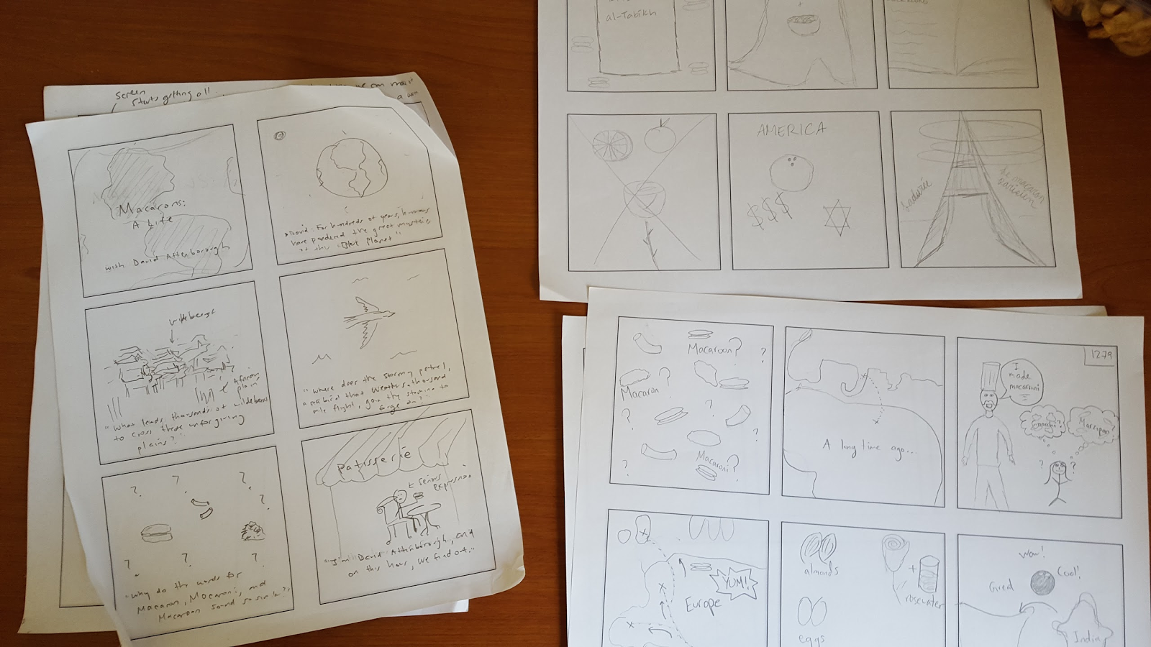
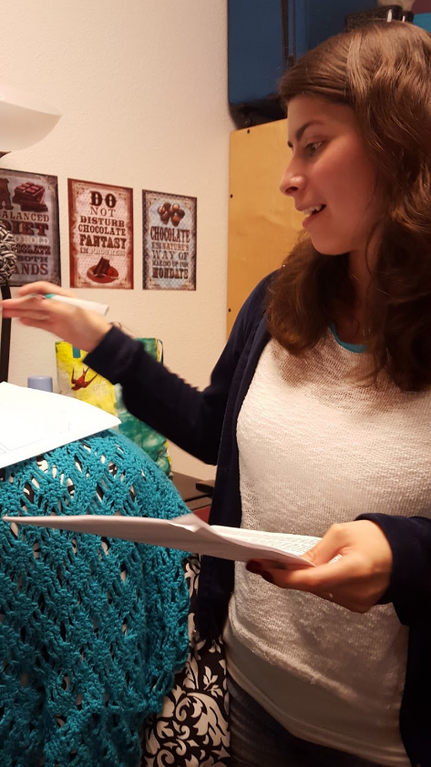
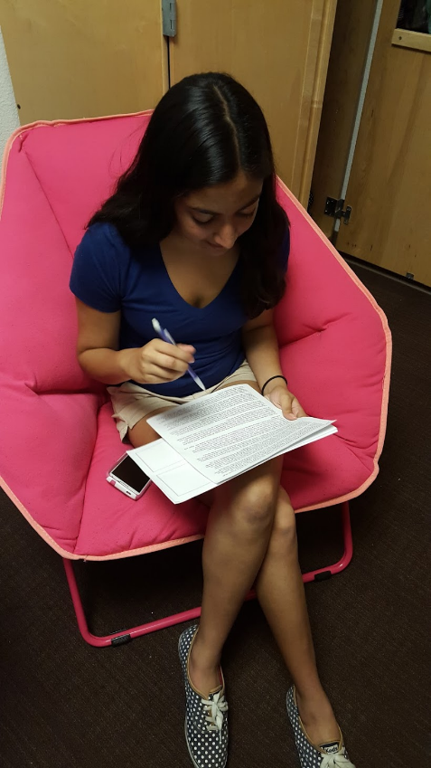
Short Educational Videos
Experience Prototype
3
Scene: making a storyboard for something they just learned
Roles: students/teacher in a class
Artifacts: article to read and paper to storyboard on
Notes:
description
method of testing
results (things that worked, things that didn’t, surprises, new learnings)
was assumption valid? why/why not? any new assumptions emerge?

Slide 26
Short Educational Videos
Experience Prototype
3
👍 : Students said they had to think deeply about the material – fun as well!
👎 : Challenging and time intensive for some
❗ : Everyone had different ideas
📖 : Students are very different in what they enjoy doing, can do well, and how they approach their work
Notes:
description
method of testing
results (things that worked, things that didn’t, surprises, new learnings)
was assumption valid? why/why not? any new assumptions emerge?

Slide 27
Short Educational Videos
Experience Prototype
3
Assumptions:
Making videos can be a fun way to synthesize your learning
✔
Notes:
description
method of testing
results (things that worked, things that didn’t, surprises, new learnings)
was assumption valid? why/why not? any new assumptions emerge?

Slide 28
Short Educational Videos
Experience Prototype
3
Assumptions:
Making videos can be a fun way to synthesize your learning
✔
We can make an app that makes creating videos simple enough for most people to do
❓
Notes:
description
method of testing
results (things that worked, things that didn’t, surprises, new learnings)
was assumption valid? why/why not? any new assumptions emerge?

Slide 29
In summary...
We learned a lot about the creation process for students and teachers through observation
Many of our conversations revolved around two main ideas:
Making learning engaging and collaborative
Connecting different ideas in a map
Of our three prototypes, we are looking to pursue the Atom Model prototype

