Slide 1
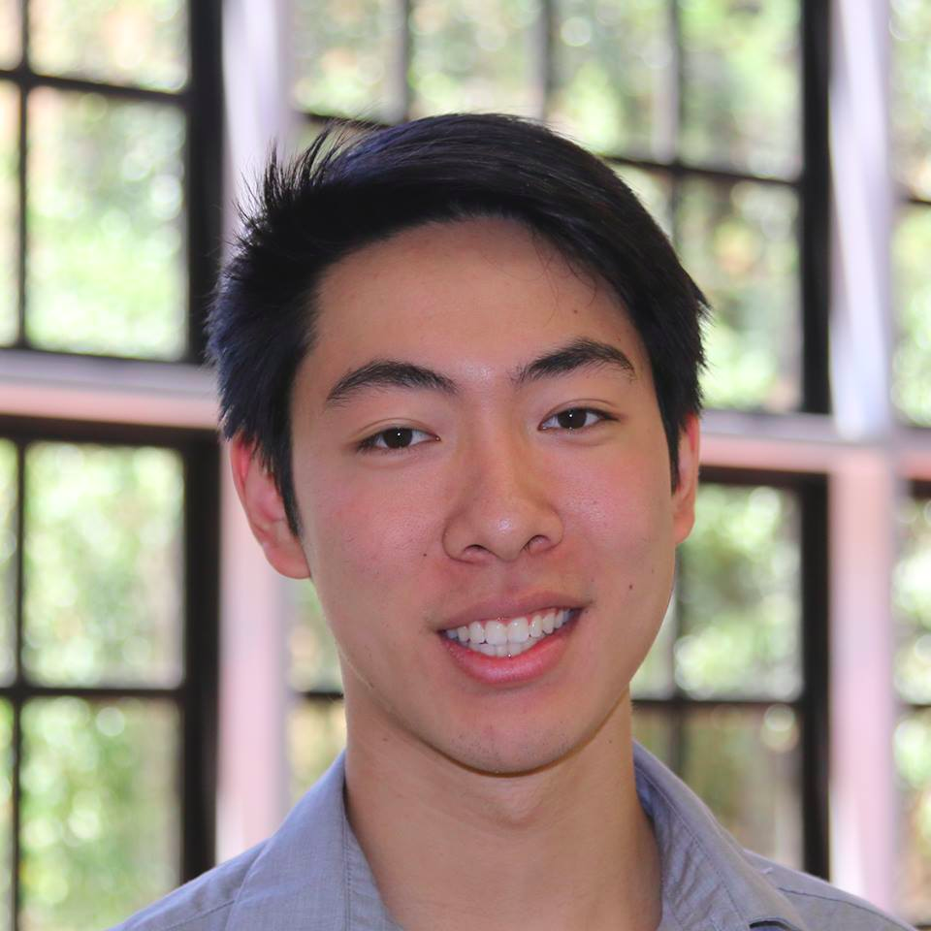
Team XYZ
TED
LI
COURTNEY
NOH
LOGAN
SHORT
EMMA TOWNLEY-SMITH

Slide 2
Studio Theme: Creation

Slide 3
Studio Theme: Creation
Our Theme: Creation
(of educational content)

Slide 4
Learning Process

Slide 5
Learning Process
Creating lessons
Remembering/Recall
Highlighting learning

Slide 6
Teachers + desire to teach
Students + desire to learn
Students
Learning Process
Creating lessons
Remembering/Recall
Highlighting learning

Slide 7
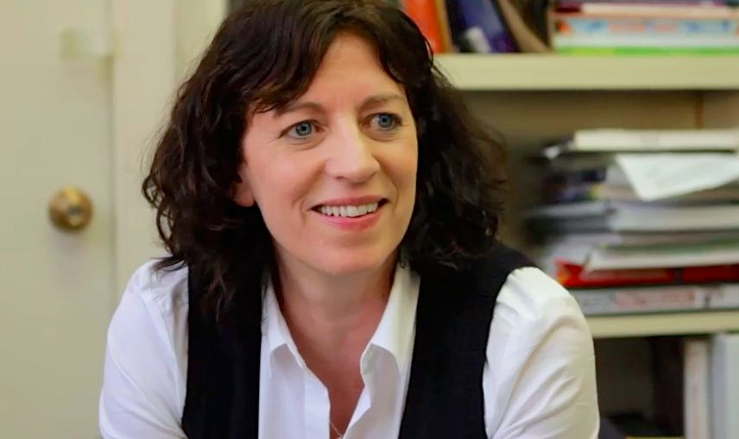
Our Interviewees: Studying Education
Jo Boaler
Professor of Math Education
Glenn ‘Max’ McGee
Superintendent of PAUSD

Slide 8
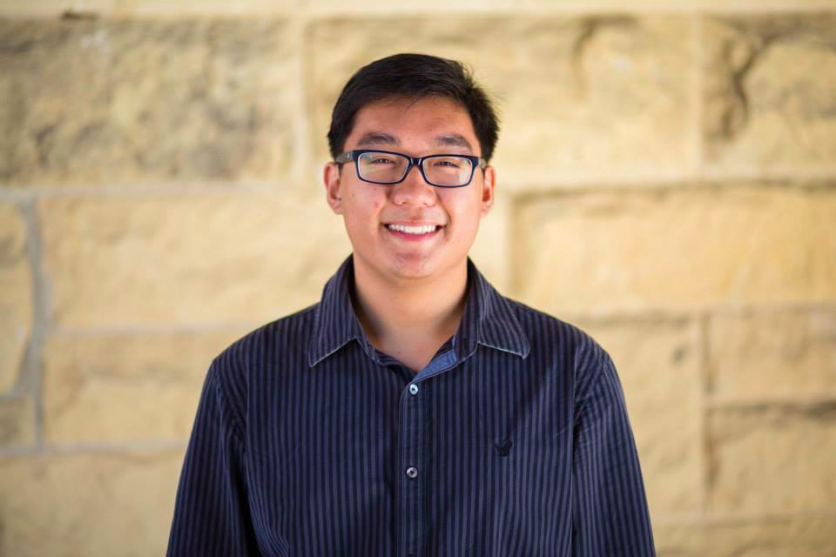
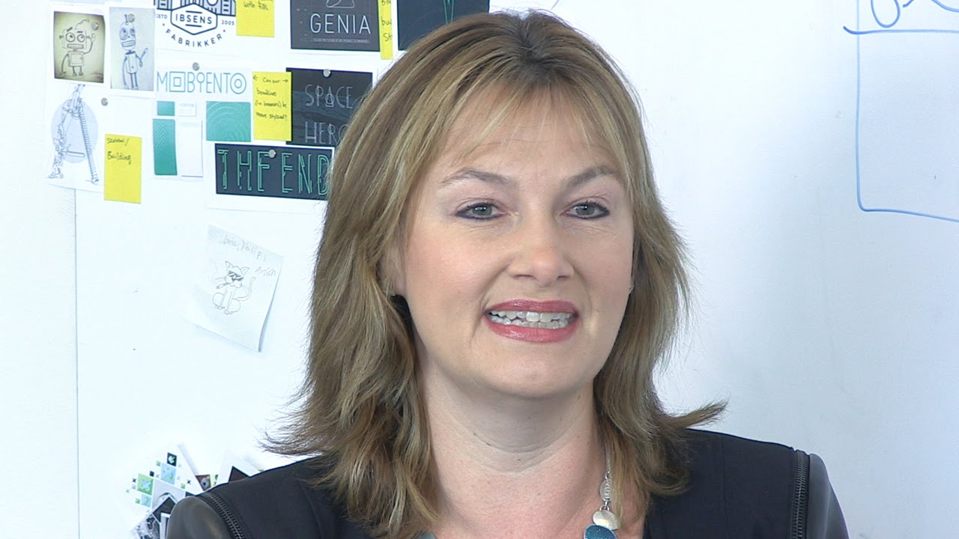
Our Interviewees: Practicing Education
George Fei
Student & Splash Teacher
Petra Dierkes-Thrun
Professor of Comparative Literature
Jennifer Short
Middle School Chinese Teacher

Slide 9
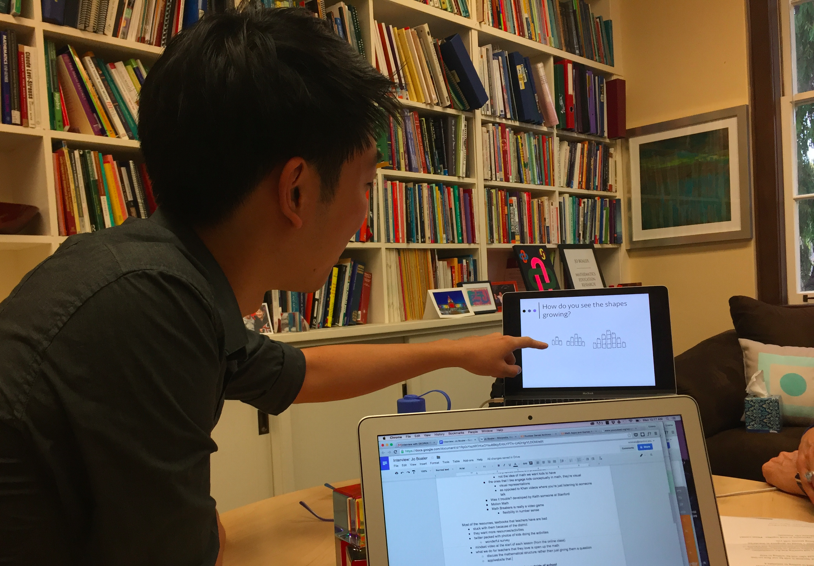
Jo Boaler
Professor of Math Education
“
[For teachers], the problem isn’t that the resources aren’t there… it’s hard to sift through and find quality work.”
We want to open up the learning process, and let the students learn for themselves.”
Ted tries one of Boaler’s ‘opening math’ exercises: visualizing (n+1)² growth.
… a lot of ed-tech has tried to go around teachers, like Khan Academy.”

Slide 10
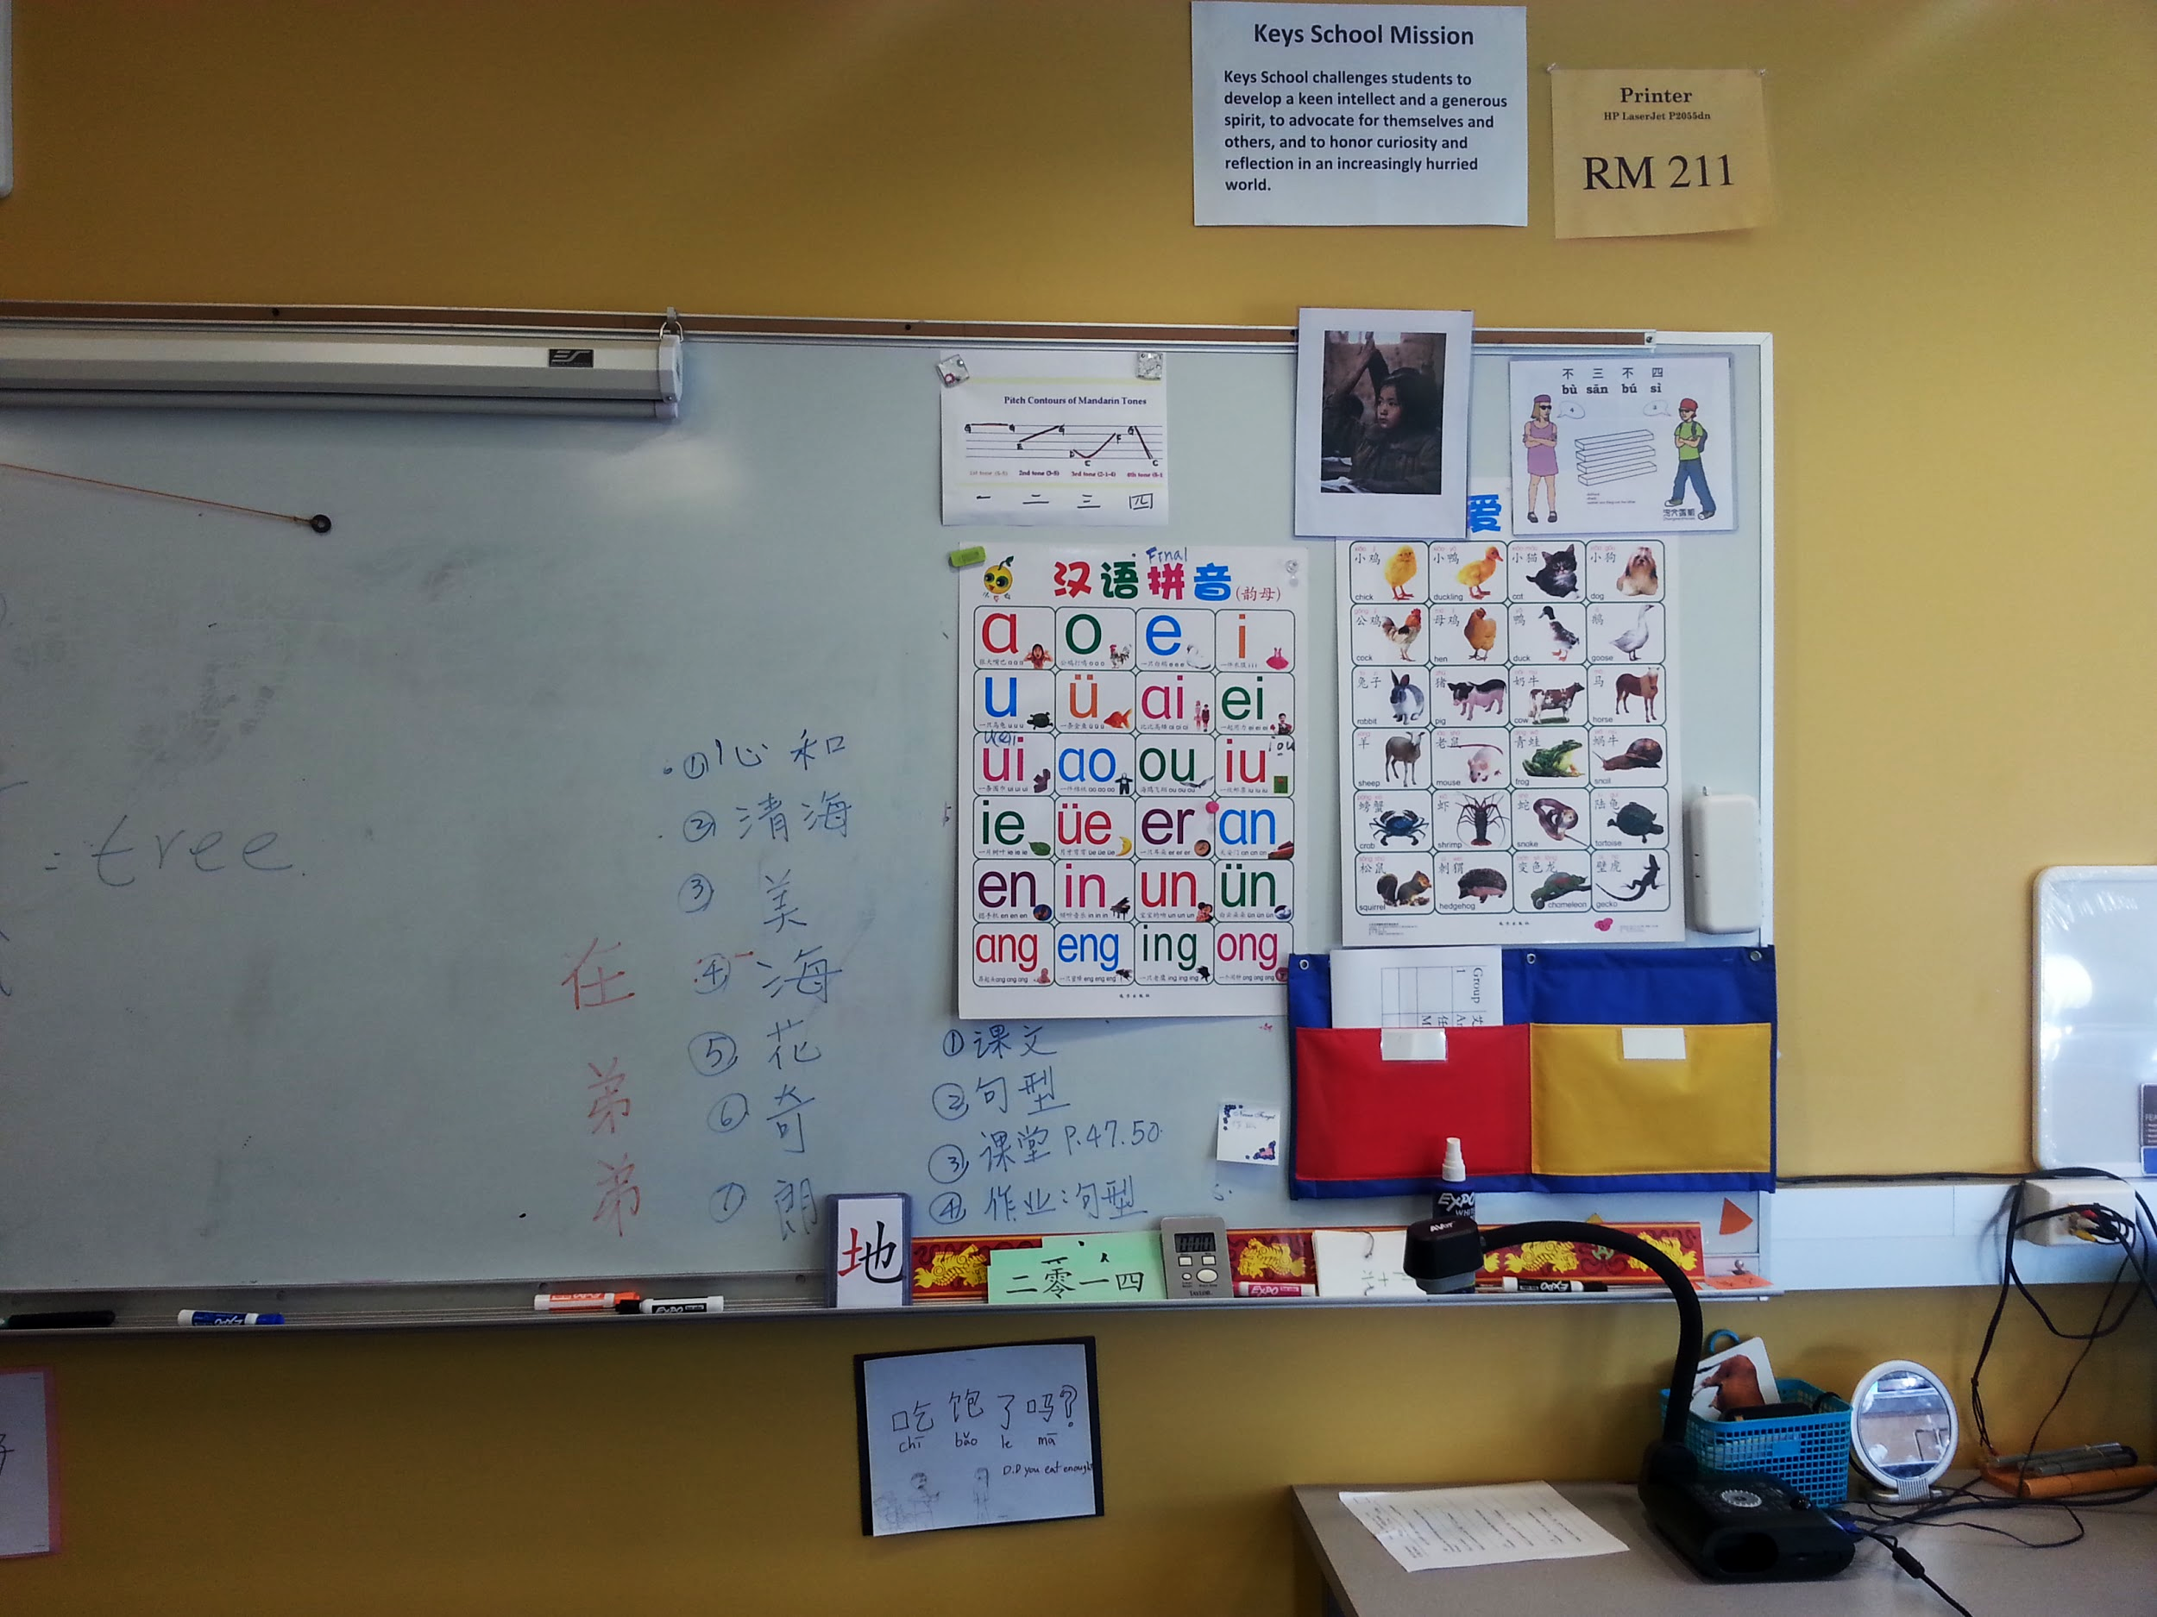
Jennifer Short
Middle School Chinese Teacher
“
"Teachers just don't have enough time."
"A lot of teachers have great ideas for activities to reinforce learning, but finding the time and resources to make them a reality just isn't possible while teaching."
"Games help, but sometimes they're so boring, but I can't do anything about them."

Slide 11
Petra Dierkes-Thrun
Professor of Comparative Literature
“
there’s this guy at the law school who teaches abstract concepts in law by bringing in visual materials (photographs, and sculptures, etc)... giving teachers a repository of other ways of describing something really complex or illustrating it”
[For teachers] there’s a sharing economy going on behind the scenes. I look at their stuff and realize it’s too specific for my needs… but it actually helps me BRAINSTORM THINGS!”

Slide 12
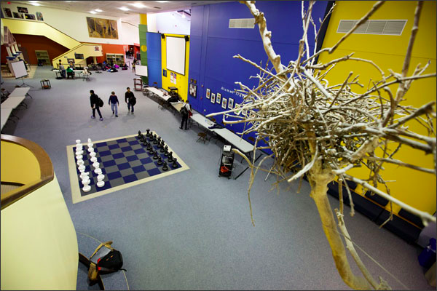
Max McGee
Superintendent of PAUSD
“
...the important piece is allowing time for that conversation, and organizational space for that.”
...students have to generate a work product that ideally generates new knowledge.
...[teachers] brought with them knowledge and network much beyond the high school community.”
Notes:
people are trying to go around teachers

Slide 13
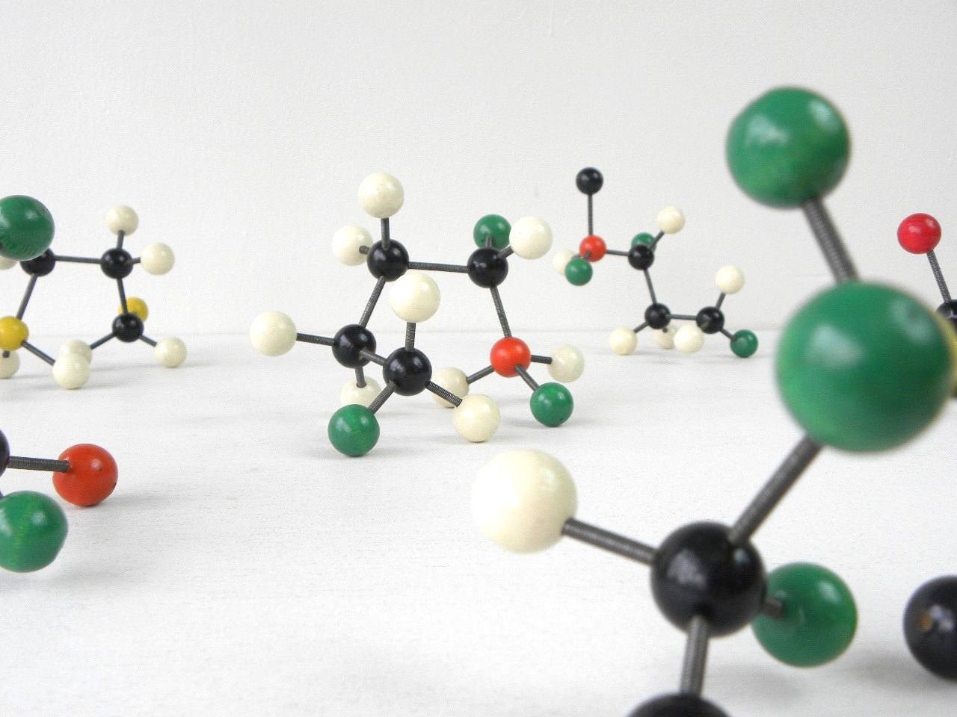
George Fei
Student and Splash teacher
“
Learning python: “It’s very difficult to understand what’s important and what’s not -- very difficult to distinguish the fundamentals from the details.”
“When writing my notes, I create a spatial relationship!... literally doing SOMETHING that makes you interact with it to a certain degree.

Slide 15
Tension: teachers feeling excited and frustrated about trying new things because of the lack of quality control.

Slide 16
Contradiction: Teachers think that students learn best when they make connections for themselves… but the student approach is often going to textbooks, etc.

Slide 17
Surprise: The creation of good educational content has more to do with tailoring for your circumstances than ‘reinventing the wheel’

Slide 18
Inferences & Conclusions
Teachers’ access to creative resources and a peer community affects how empowered they feel to make change in the classroom.
Teachers’ creative process isn’t independent -- it’s frequently reliant on inspiration from peers and tailoring + curating existing content for new practical circumstances.

Slide 19
Inferences & Conclusions
Teachers’ access to creative resources and a peer community affects how empowered they feel to make change in the classroom.
Teachers’ creative process isn’t independent -- it’s heavily reliant on inspiration from peers and tailoring + curating existing content for new practical circumstances.

Slide 20
Inferences & Conclusions
Students’ learning struggles seem to center around relationships between abstract concepts.
How important are concepts relative to each other?
How are certain concepts related?
How do these concepts apply?

Slide 21
Inferences & Conclusions
FOR TEACHERS
FOR STUDENTS
NEED
NEED
INSIGHT
INSIGHT

Slide 22
Inferences & Conclusions
FOR TEACHERS
FOR STUDENTS
PROBLEM
Feel empowered through access to creative peer feedback and resources
NEED
INSIGHT
INSIGHT

Slide 23
Inferences & Conclusions
FOR TEACHERS
FOR STUDENTS
PROBLEM
Time and knowledge constraints make it difficult to find quality, creative work
Feel empowered through access to creative peer feedback and resources
NEED
OPPORTUNITY
‘Creating’ is about tweaking, modifying, personalizing
INSIGHT

Slide 24
Inferences & Conclusions
FOR TEACHERS
FOR TEACHERS
FOR STUDENTS
PROBLEM
Time and knowledge constraints make it difficult to find quality, creative work
PROBLEM
Time and knowledge constraints make it difficult to find quality, creative work
Feel empowered through access to creative peer feedback and resources
NEED
OPPORTUNITY
CREATING
Visual, hands-on educational content
OPPORTUNITY
‘Creating’ is about tweaking, modifying, personalizing
INSIGHT

Slide 25
Inferences & Conclusions
FOR TEACHERS
FOR TEACHERS
FOR STUDENTS
PROBLEM
Time and knowledge constraints make it difficult to find quality, creative work
PROBLEM
Time and knowledge constraints make it difficult to find quality, creative work
Feel empowered through access to creative peer feedback and resources
PROBLEM
Feel confident in understanding relationships between new, abstract concepts
OPPORTUNITY
CREATING
Visual, hands-on educational content
OPPORTUNITY
‘Creating’ is about tweaking, modifying, personalizing
INSIGHT

Slide 26
Inferences & Conclusions
FOR TEACHERS
FOR TEACHERS
FOR STUDENTS
PROBLEM
Time and knowledge constraints make it difficult to find quality, creative work
PROBLEM
Time and knowledge constraints make it difficult to find quality, creative work
Feel empowered through access to creative peer feedback and resources
PROBLEM
Understanding the relationships between new concepts
Understand relationships between new, abstract concepts
Feel confident in understanding relationships between new, abstract concepts
OPPORTUNITY
CREATING
Visual, hands-on educational content
OPPORTUNITY
‘Creating’ is about tweaking, modifying, personalizing
OPPORTUNITY
Organization of material is where teachers are needed most

Slide 27
In summary...
We’ve identified two ‘creation’ moments that we’re excited to explore:
Teachers creating visual or hands-on activities to accompany their lessons
Students creating visuals in order to interact with abstract concepts

