Slide 1
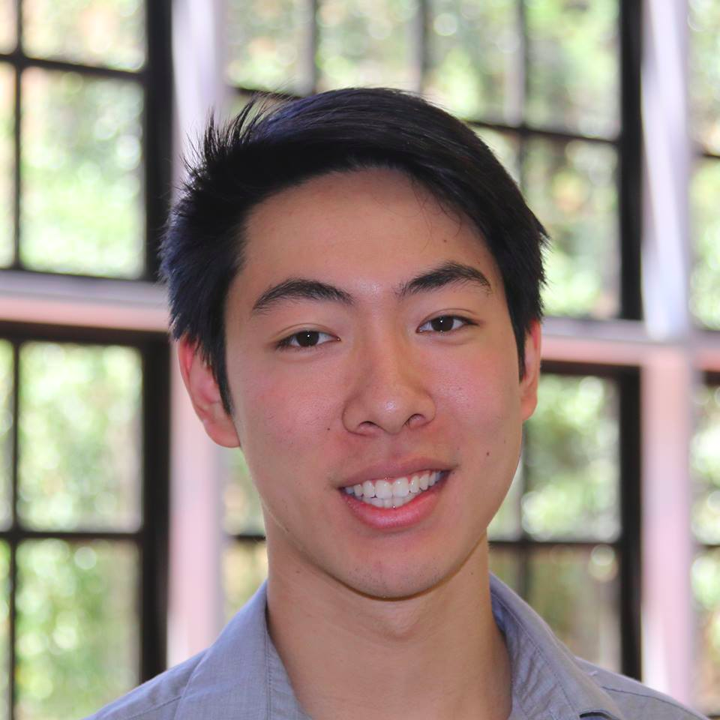
Team Covalence
TED
LI
COURTNEY
NOH
LOGAN
SHORT
EMMA TOWNLEY-SMITH

Slide 2
Problem: interacting meaningfully with material
Notes:
target audience: STUDENTS
meaningfully collaborate, spatially organize and interact with material
and CREATE!!!!!

Slide 3
Covalence
Problem: interacting meaningfully with material
Solution:
Notes:
value proposition/team mission
******** Problem and Solution Overview *********

Slide 4
Covalence
Organize your thoughts, share your ideas, connect your world
Notes:
value proposition/team mission
******** Problem and Solution Overview *********
(main value prop) Covalence is a visual, mobile workspace for concept maps. Use writing, images, drawings, and other resources to share your ideas and connect your world.
(key features) Covalence is content agnostic -- learning today is scattered across PDFs, course websites, handwritten notes, and Powerpoints, and we want you to be able to utilize whatever tools help you learn best. (key features) Covalence was built for collaboration -- easily map ideas with others in real-time.

Slide 5
TASKS:
COMPLEX: create your own map
MEDIUM: explore maps from other users
SIMPLE: share a map you’ve created or found
Notes:
None of these tasks were changed from last week!!

Slide 6
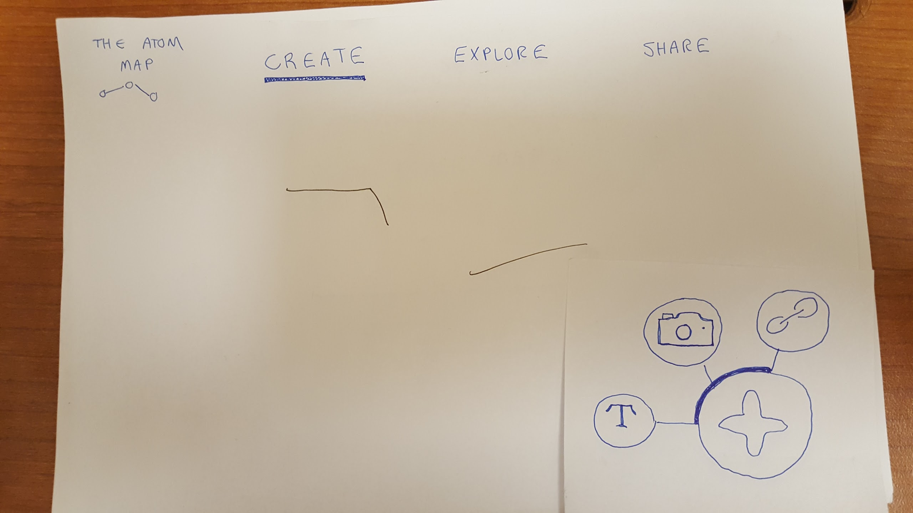
CHANGE #1: replacing “link” with “draw”
Notes:
Present the 3 biggest changes between your low-fi sketches (from last week) and the new sketches of your updated interface. Show the before​ and after sketches and explain your rationale​ for making those changes!!!!!!!!!!

Slide 7
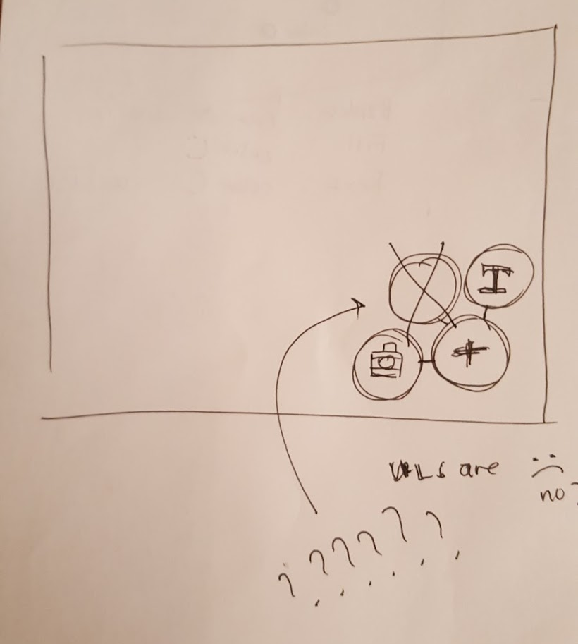
CHANGE #1: replacing “link” with “draw”
Notes:
Present the 3 biggest changes between your low-fi sketches (from last week) and the new sketches of your updated interface. Show the before​ and after sketches and explain your rationale​ for making those changes!!!!!!!!!!

Slide 8
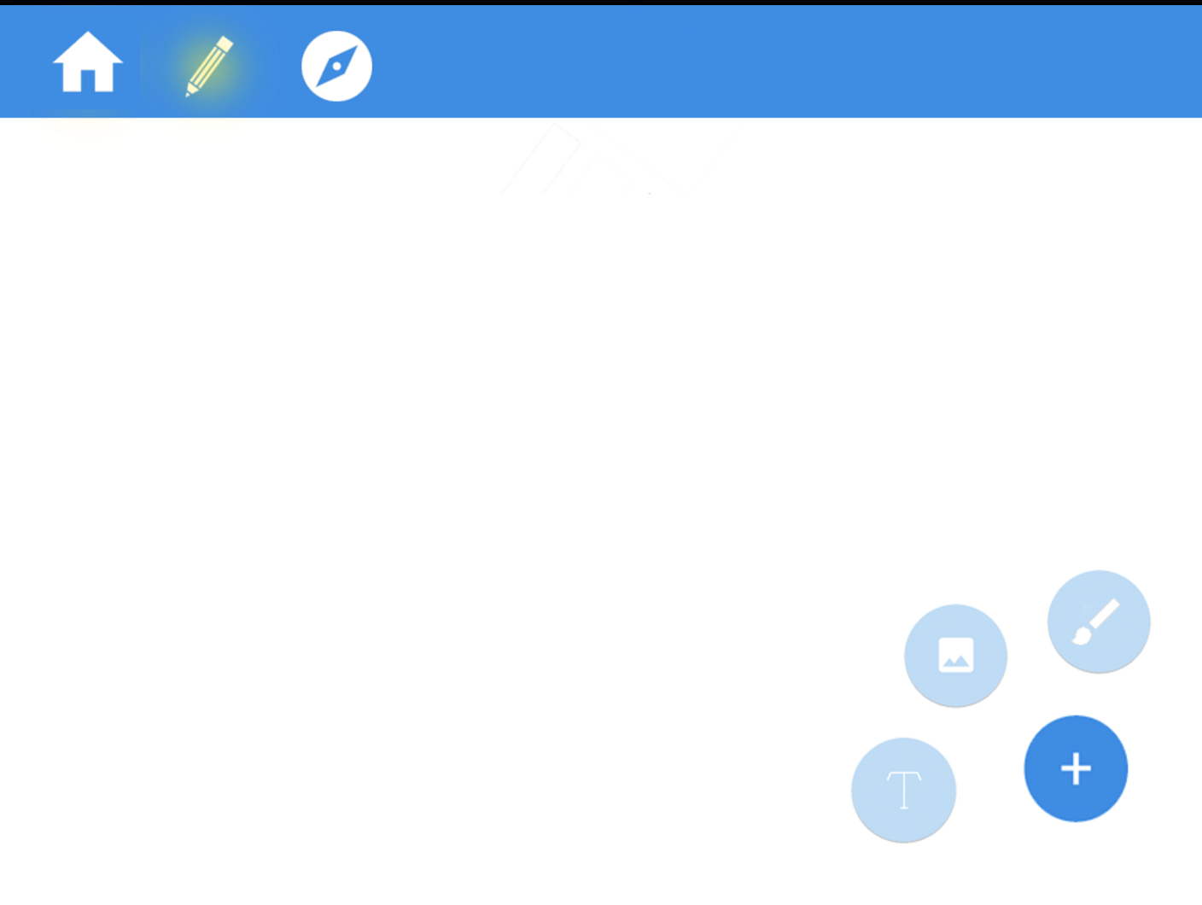
CHANGE #1: replacing “link” with “draw”
Notes:
Present the 3 biggest changes between your low-fi sketches (from last week) and the new sketches of your updated interface. Show the before​ and after sketches and explain your rationale​ for making those changes!!!!!!!!!!

Slide 9
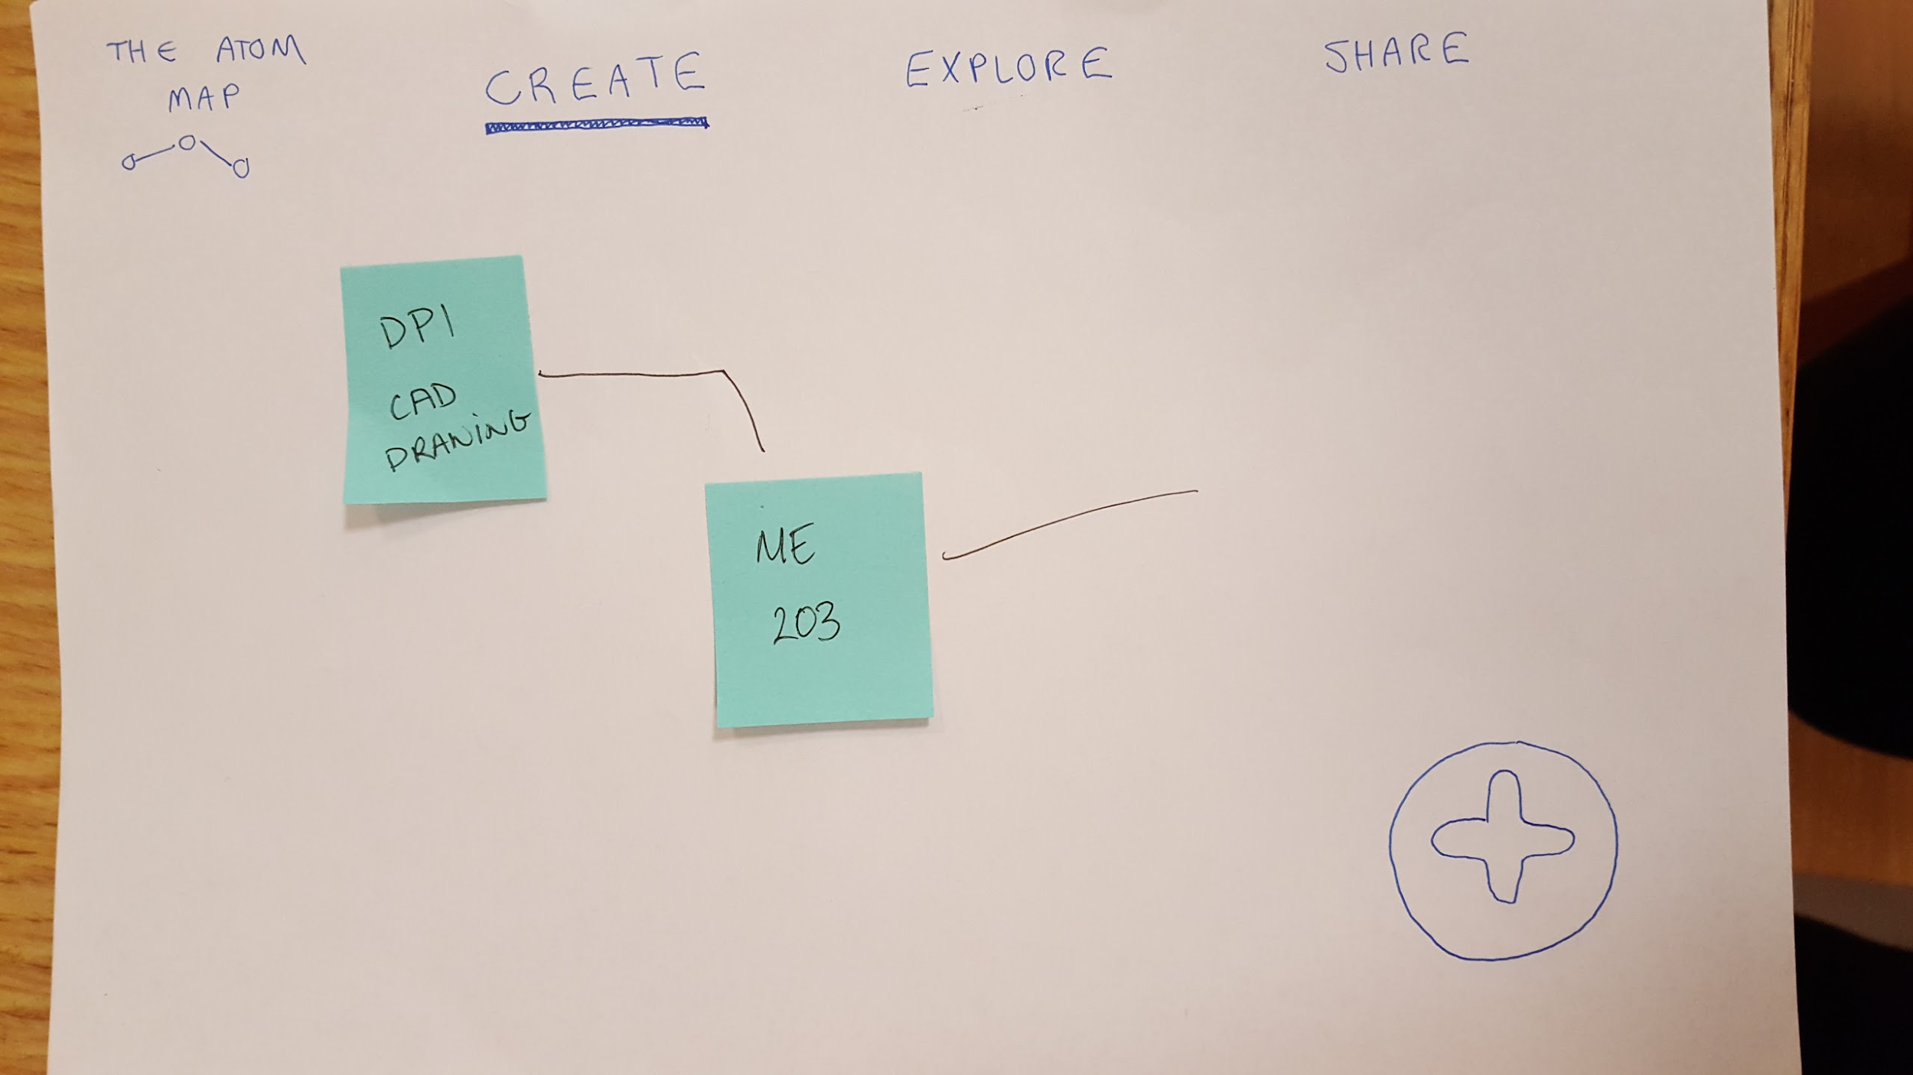
CHANGE #2: making content more robust
Notes:
Present the 3 biggest changes between your low-fi sketches (from last week) and the new sketches of your updated interface. Show the before​ and after sketches and explain your rationale​ for making those changes!!!!!!!!!!

Slide 10
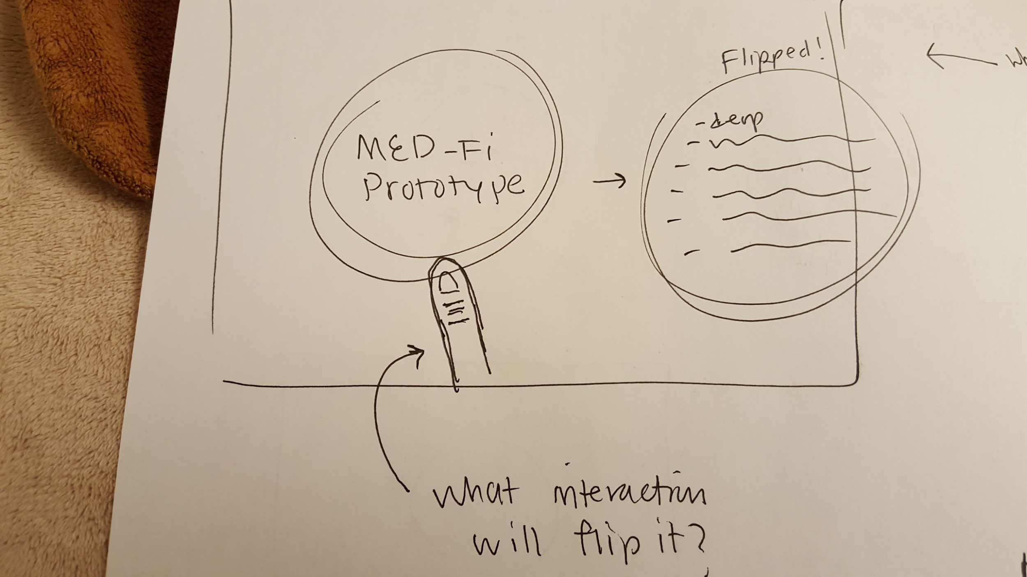
CHANGE #2: making content more robust
Notes:
Present the 3 biggest changes between your low-fi sketches (from last week) and the new sketches of your updated interface. Show the before​ and after sketches and explain your rationale​ for making those changes!!!!!!!!!!

Slide 11
CHANGE #2: making content more robust
Notes:
Present the 3 biggest changes between your low-fi sketches (from last week) and the new sketches of your updated interface. Show the before​ and after sketches and explain your rationale​ for making those changes!!!!!!!!!!

Slide 12
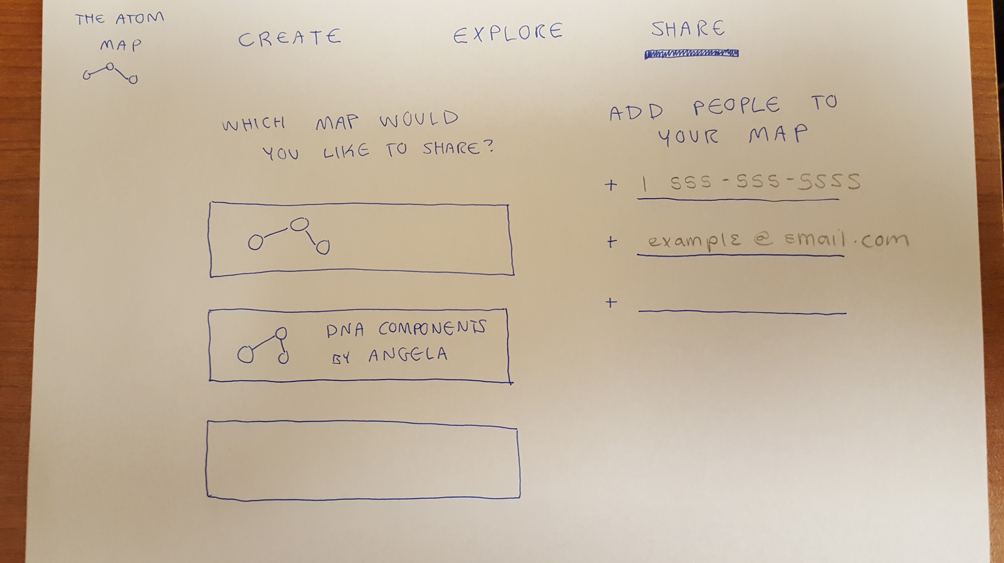
CHANGE #3: Making share a pop up // adding “home”
Notes:
Present the 3 biggest changes between your low-fi sketches (from last week) and the new sketches of your updated interface. Show the before​ and after sketches and explain your rationale​ for making those changes!!!!!!!!!!

Slide 13
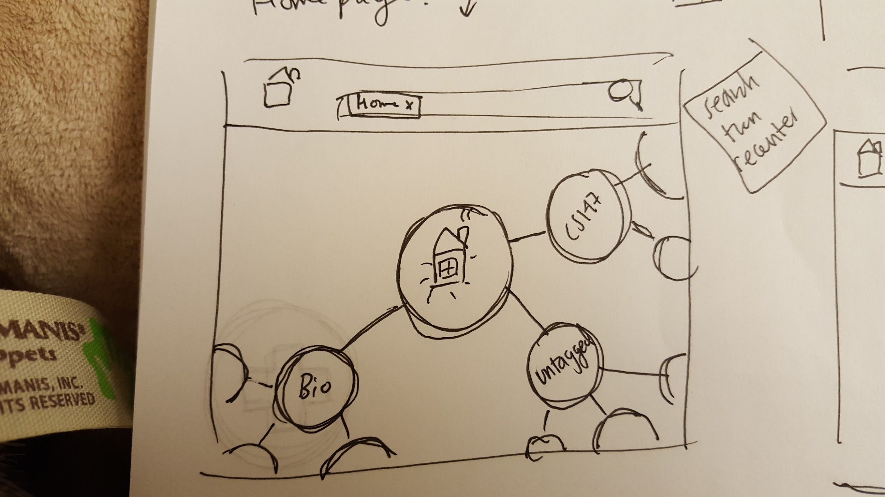
CHANGE #3: Making share a pop up // adding “home”
Notes:
Present the 3 biggest changes between your low-fi sketches (from last week) and the new sketches of your updated interface. Show the before​ and after sketches and explain your rationale​ for making those changes!!!!!!!!!!
we’re removing a lot of unnecessary steps
also have other changes we made that we weren’t able to implement

Slide 14
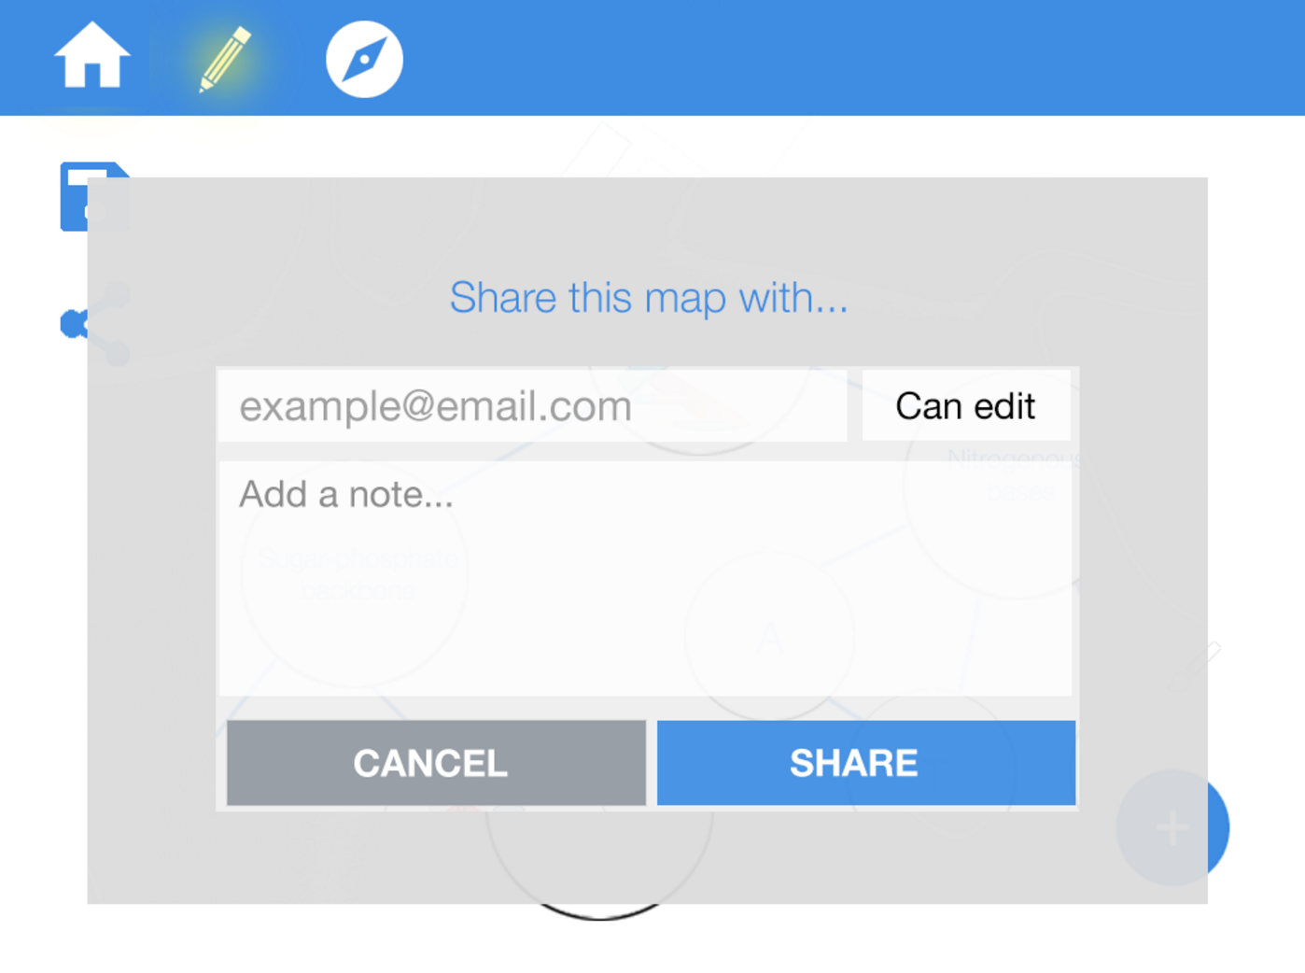
CHANGE #3: Making share a pop up // adding “home”
Notes:
Present the 3 biggest changes between your low-fi sketches (from last week) and the new sketches of your updated interface. Show the before​ and after sketches and explain your rationale​ for making those changes!!!!!!!!!!
we’re removing a lot of unnecessary steps
also have other changes we made that we weren’t able to implement

Slide 15
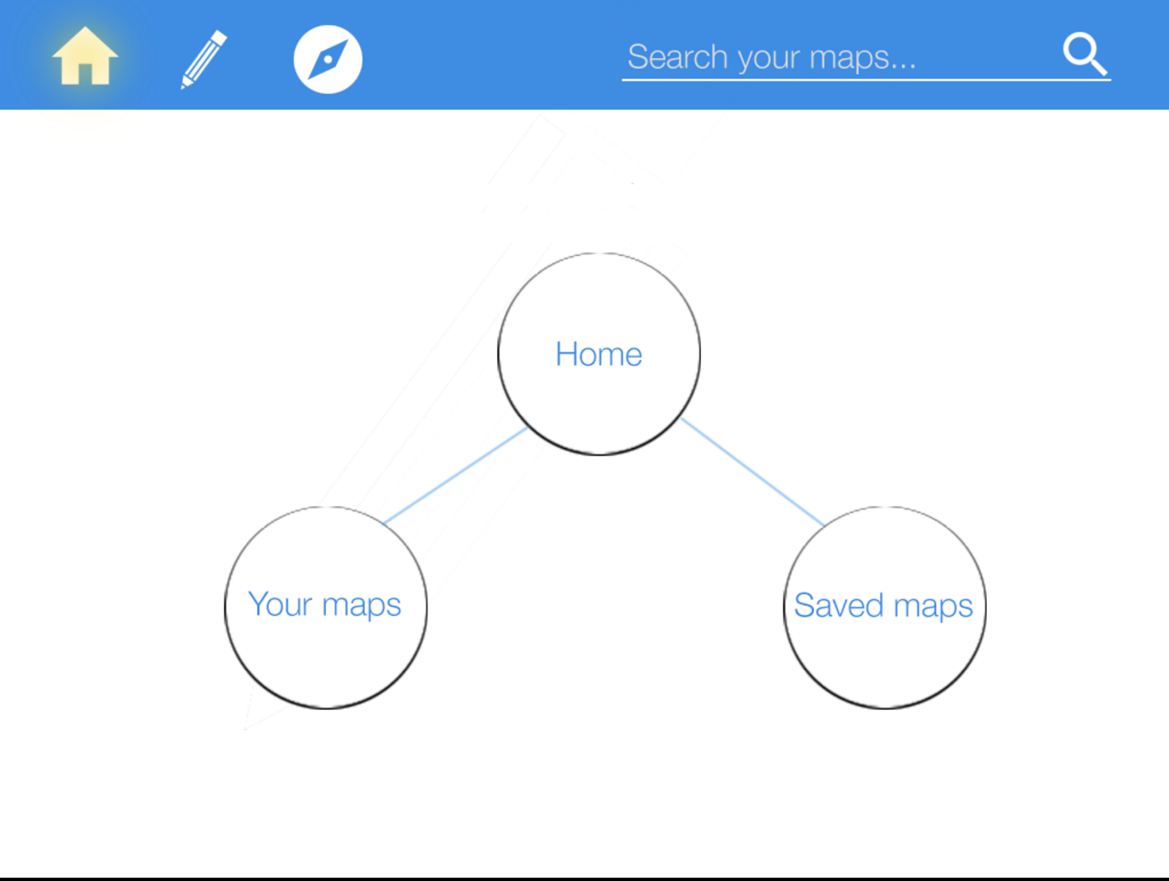
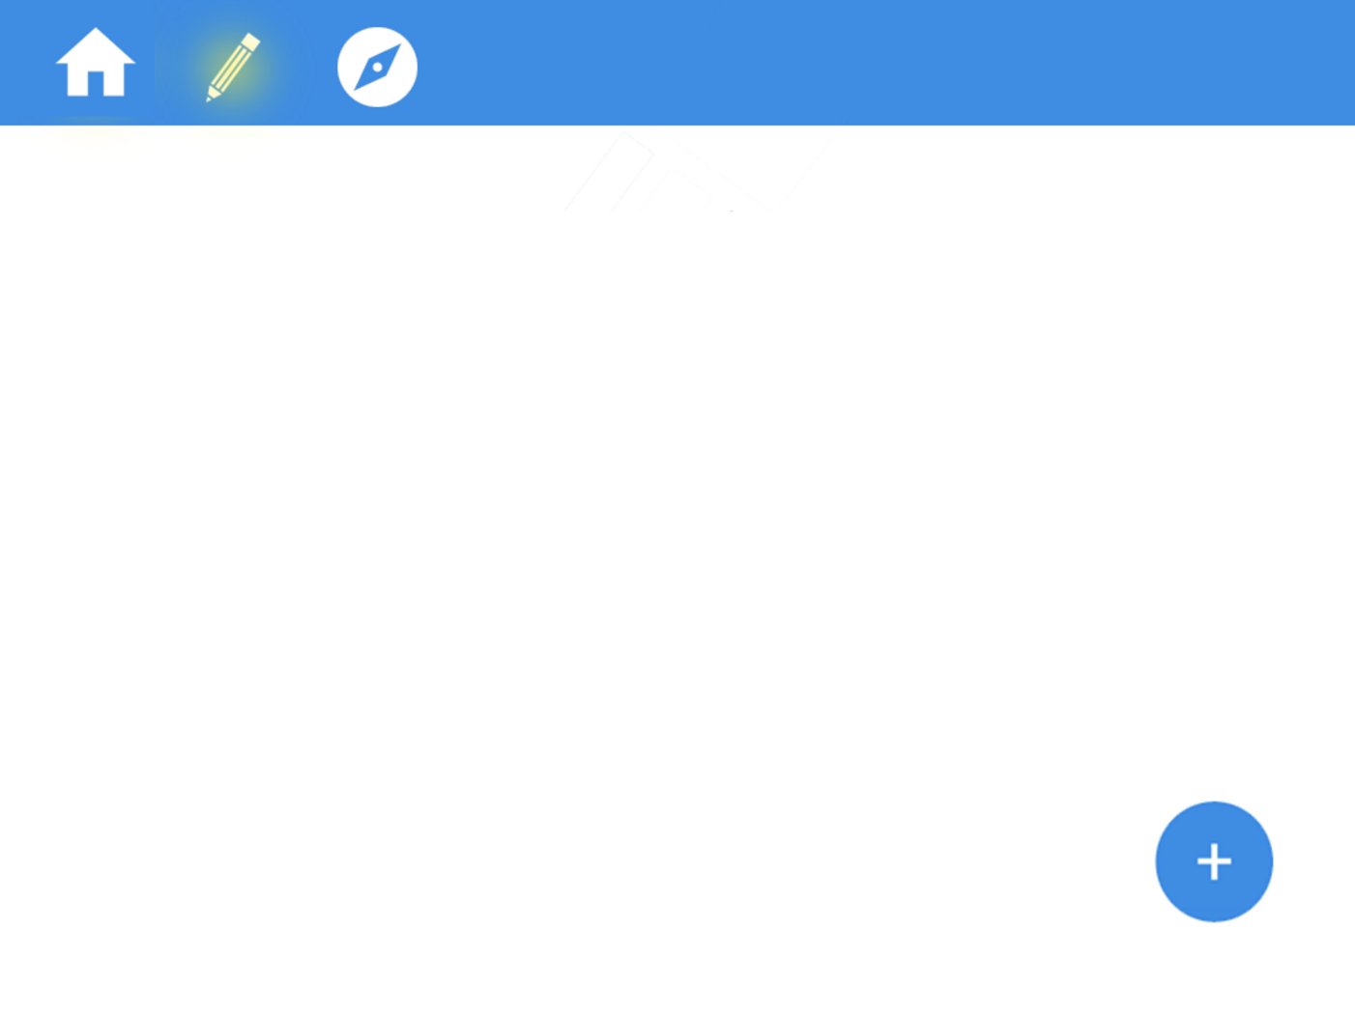
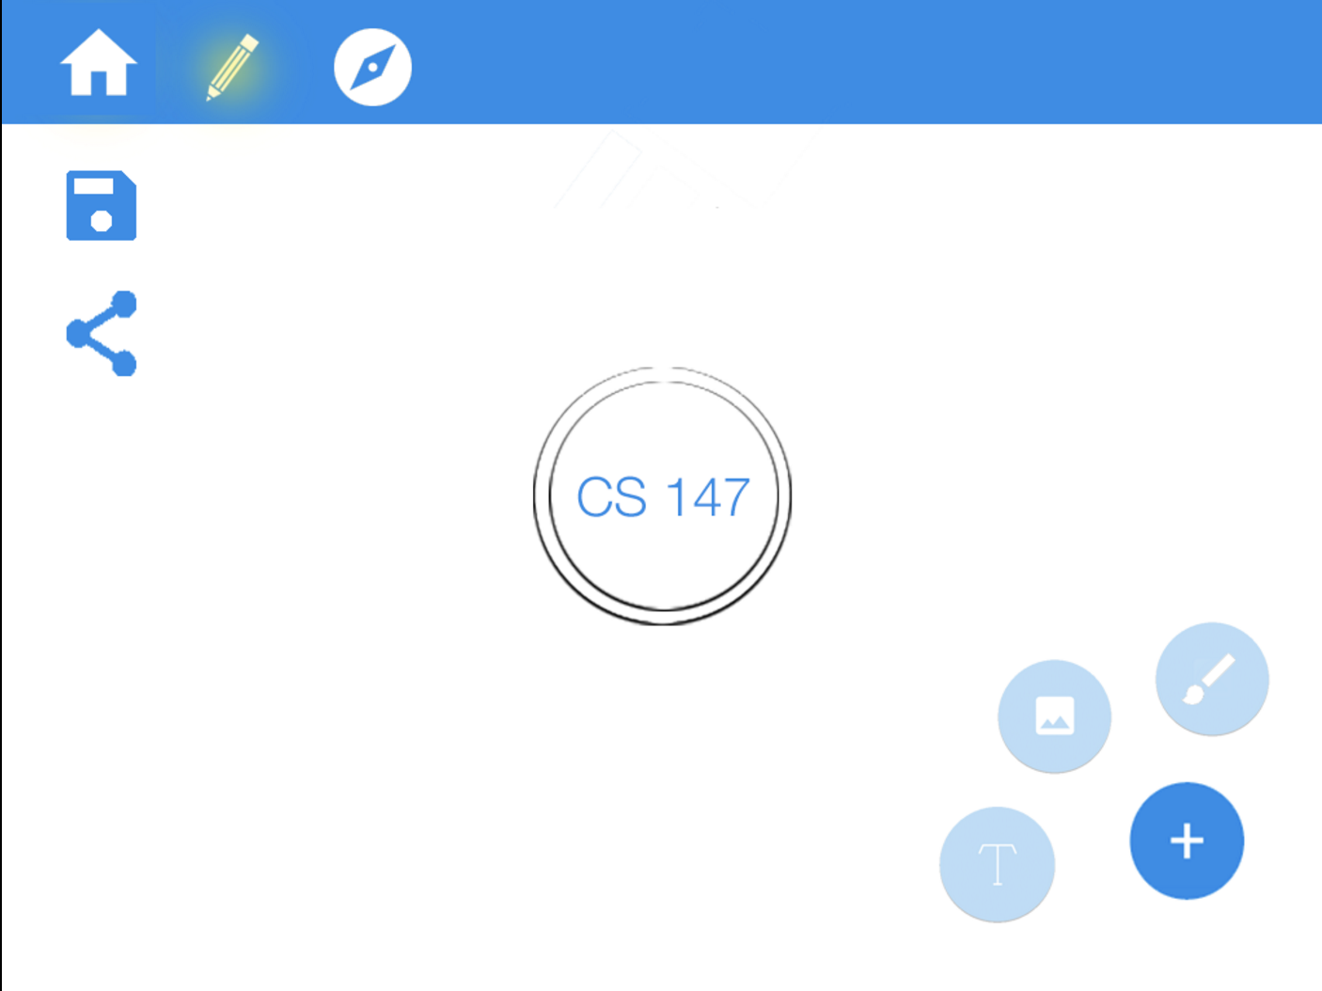
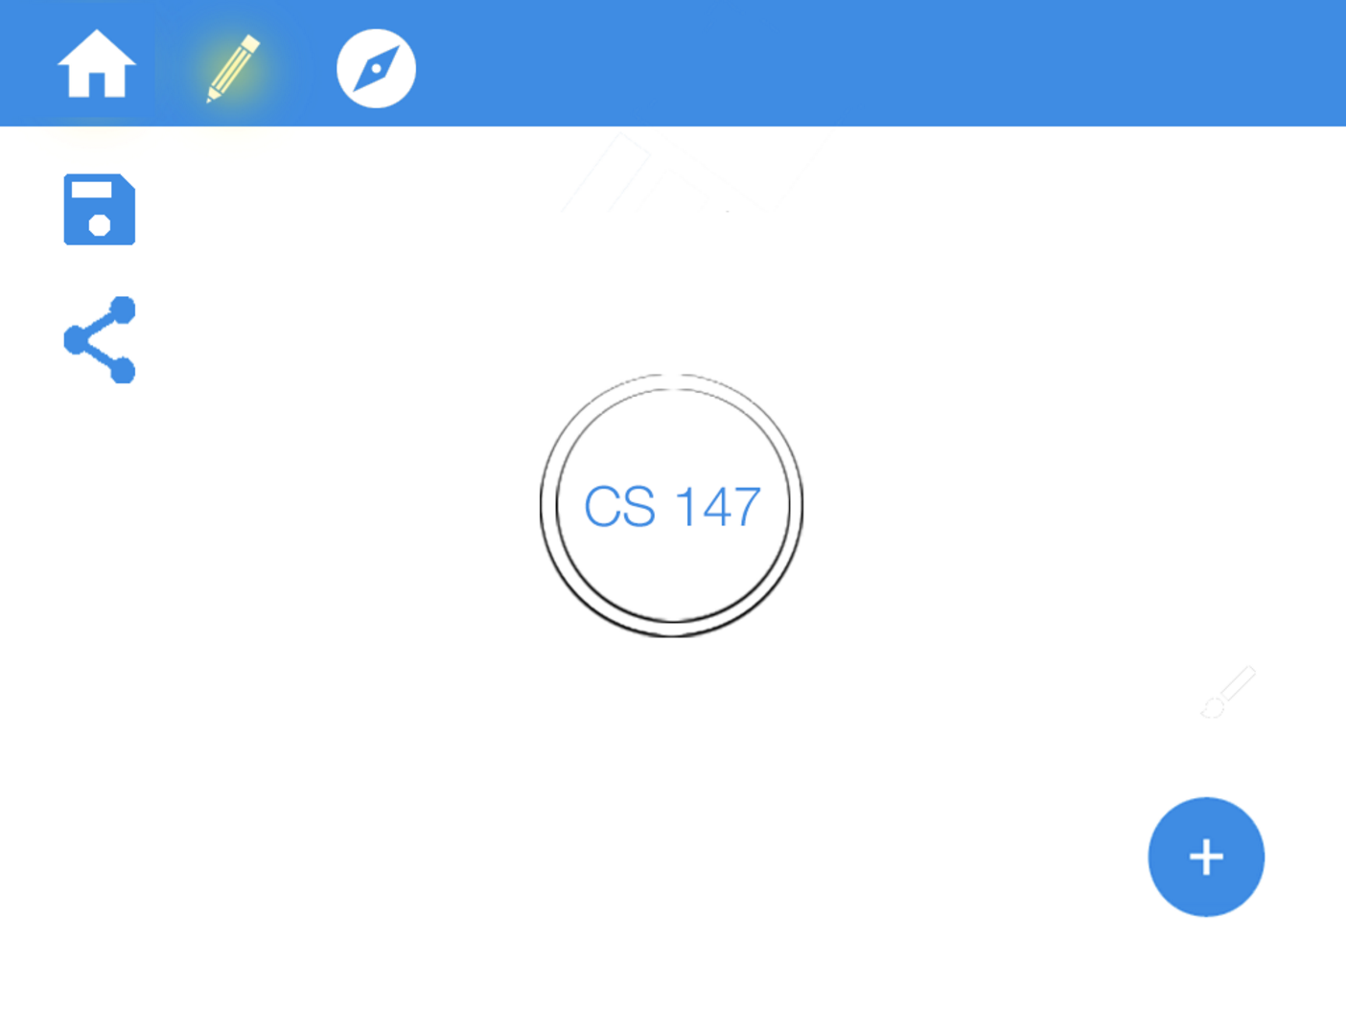
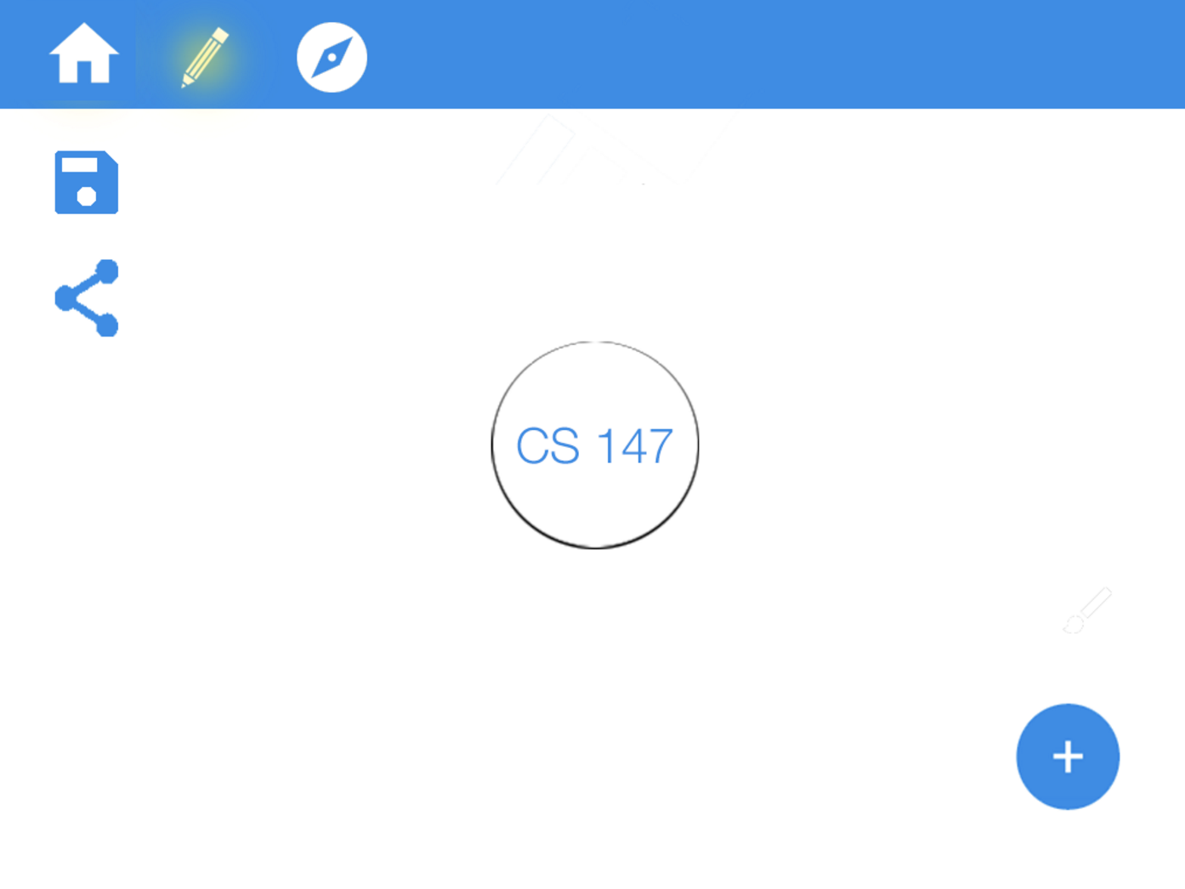
COMPLEX: create your own map
storyboard
Click on Create
Click on the “text” button
Click on “add”
Click on “photo” button
Tap on the central bubble
Notes:
​- Present your 3 tasks as a series of storyboards of task flows (annotated screenshots from your medium-fi prototype, arrows between screens, etc.)

Slide 16
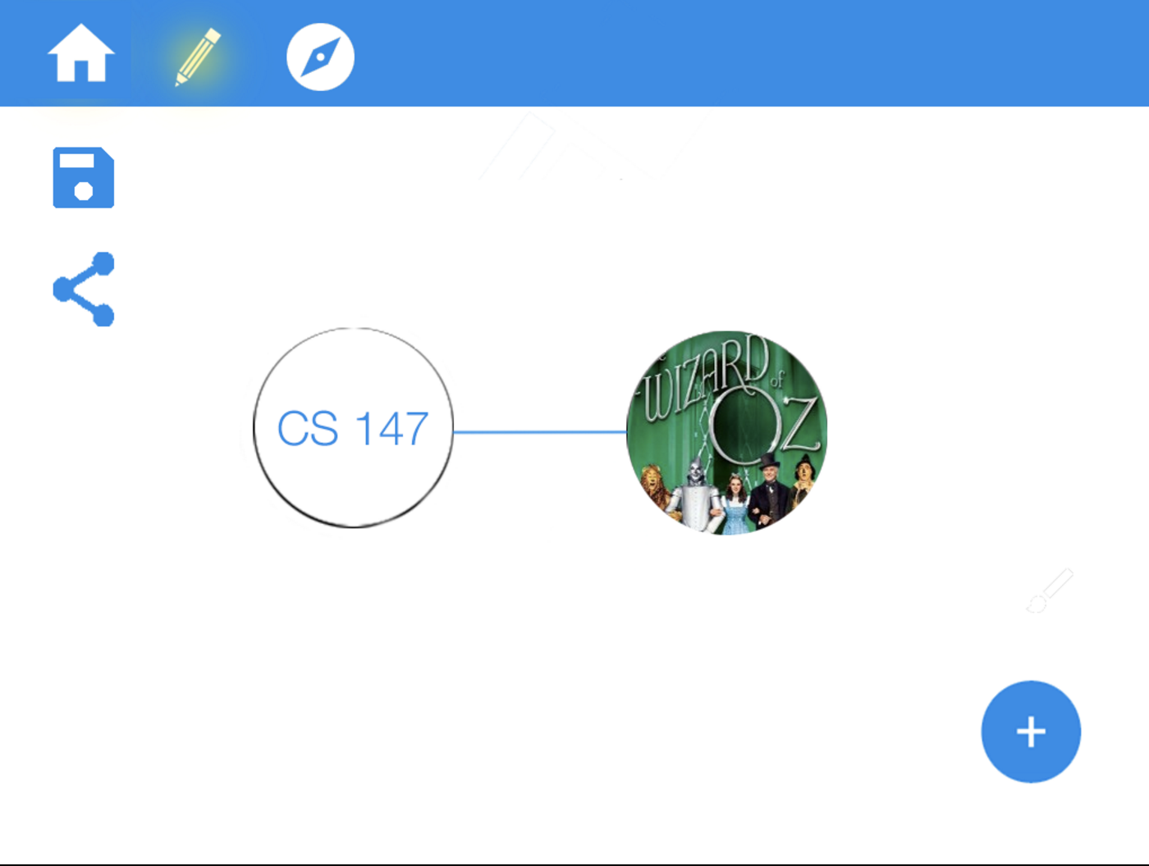
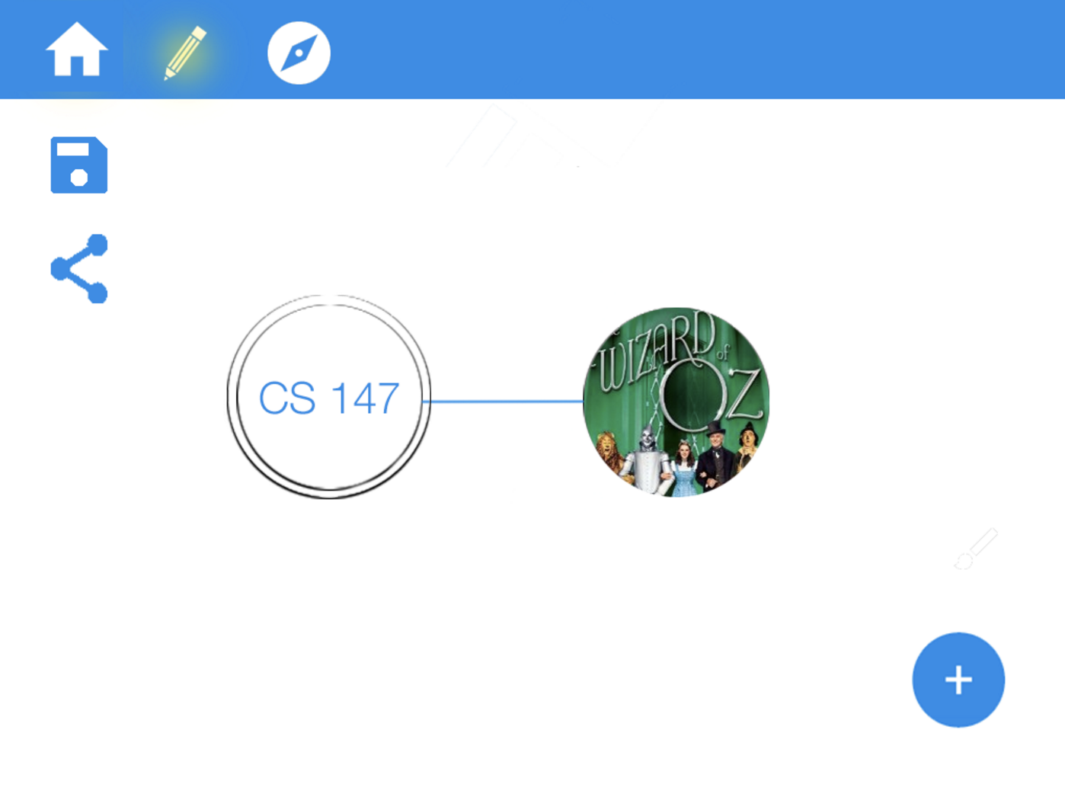
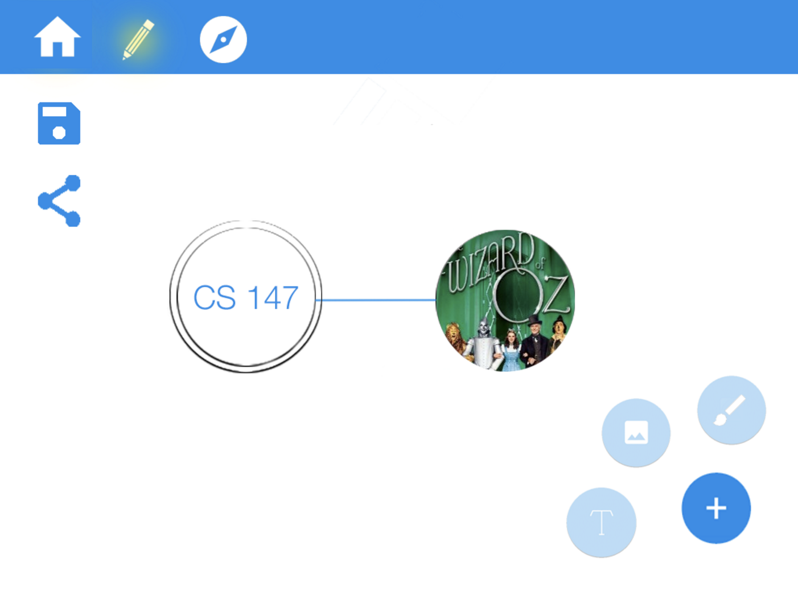
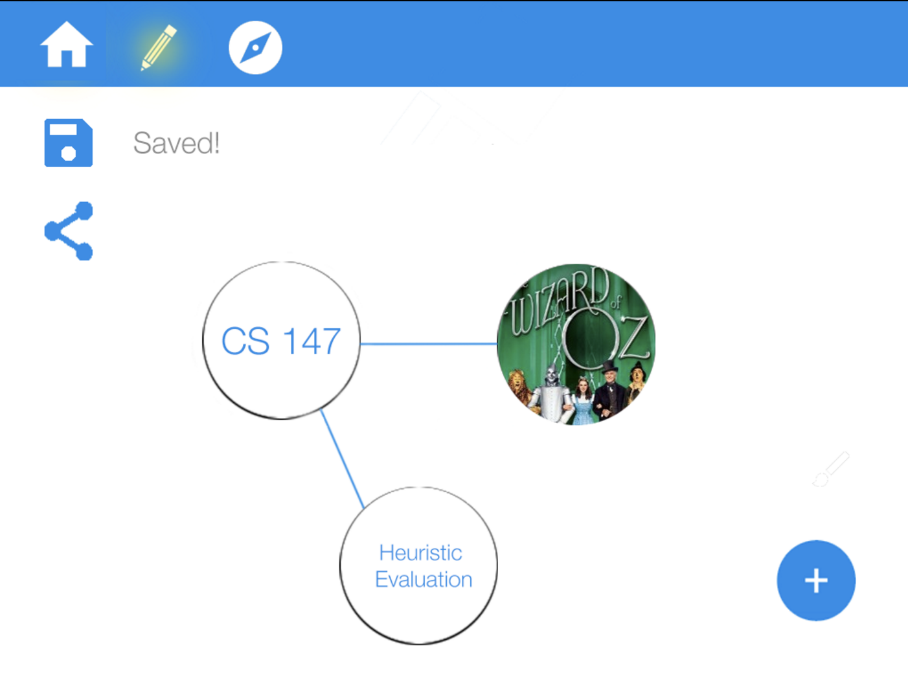
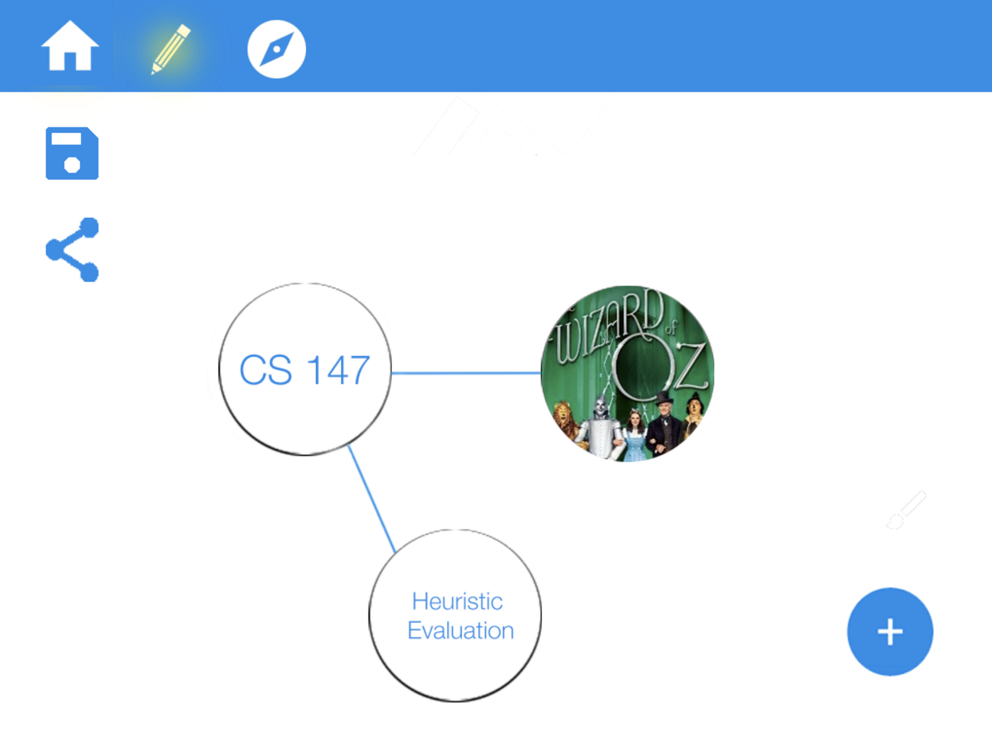
COMPLEX: create your own map
storyboard
Click on the “text” button
Tap on the central bubble
Click on save
double
tap on
Notes:
​- Present your 3 tasks as a series of storyboards of task flows (annotated screenshots from your medium-fi prototype, arrows between screens, etc.)

Slide 17
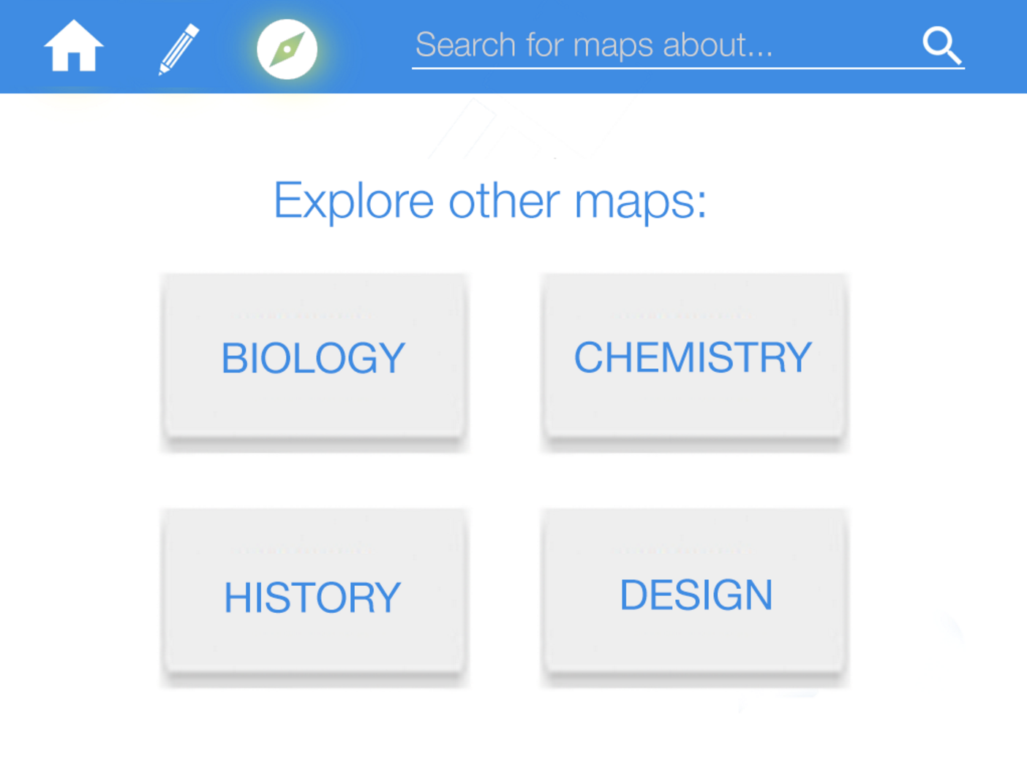
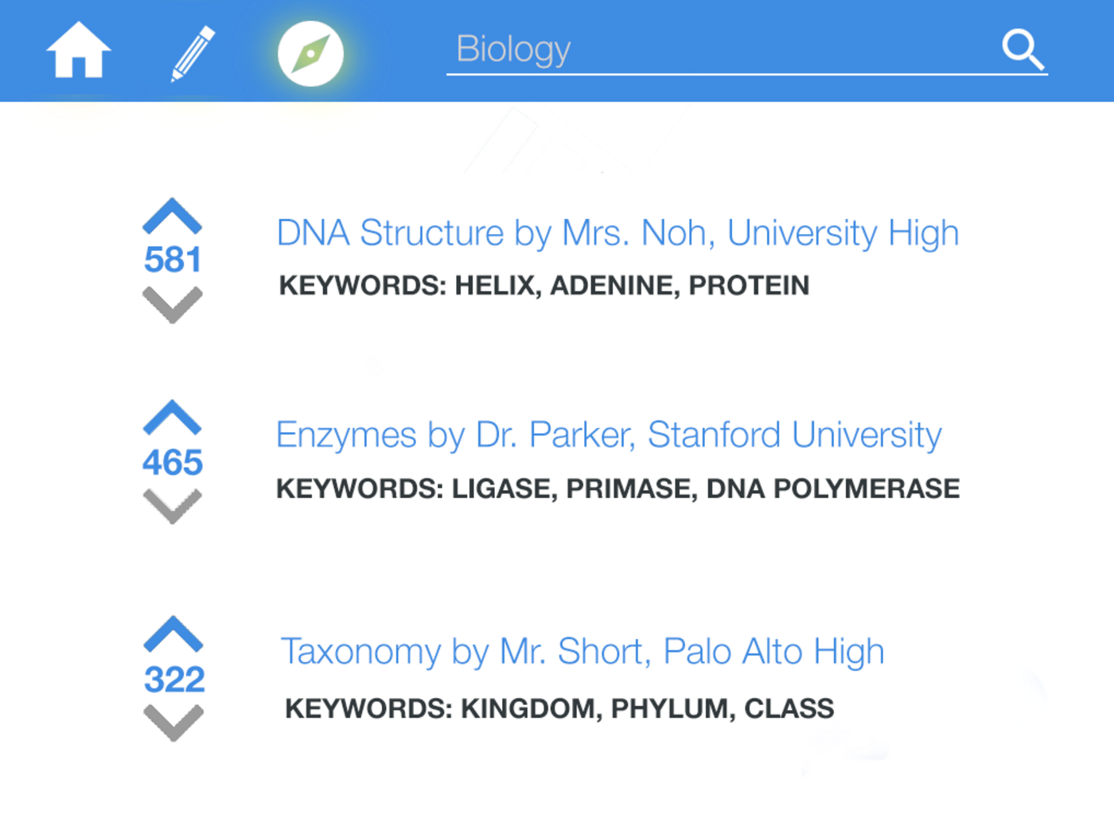
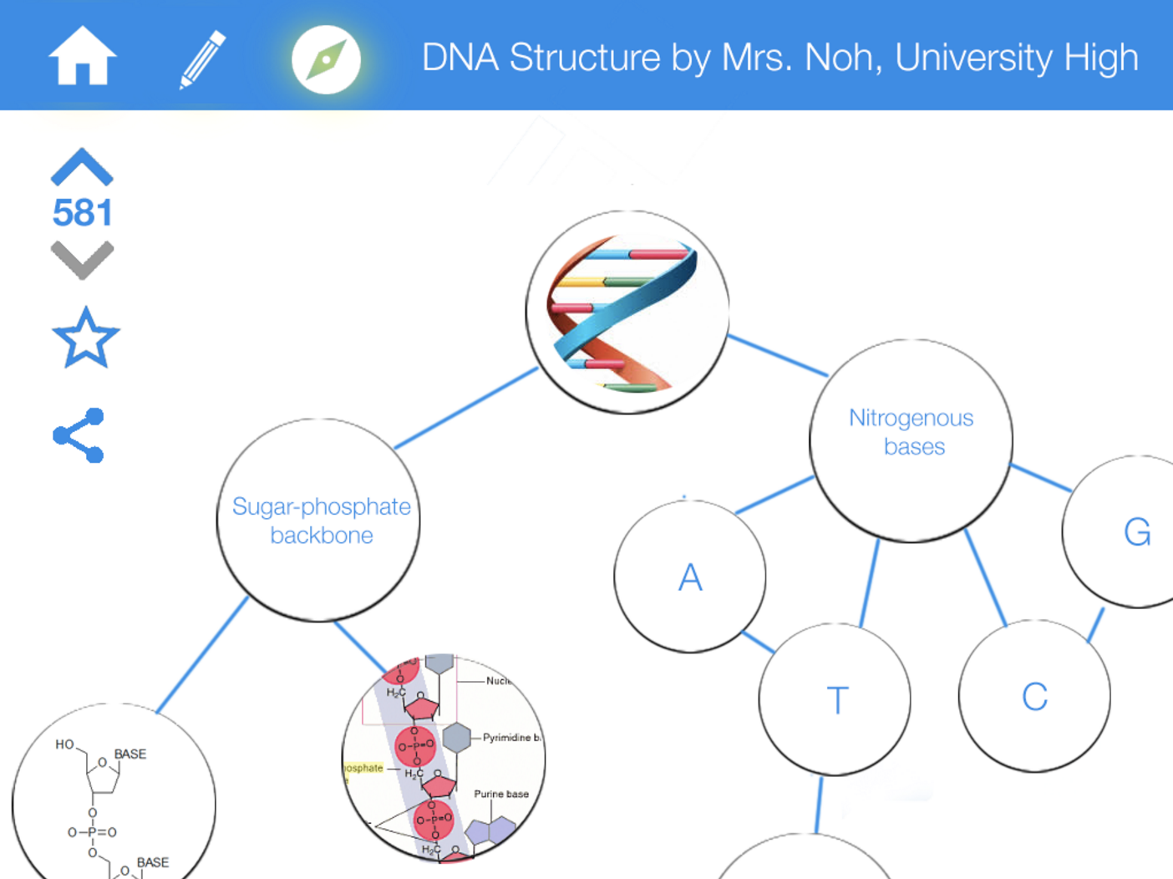
MEDIUM: explore others’ maps
storyboard
click on biology
click on first result
click on star
Notes:
​- Present your 3 tasks as a series of storyboards of task flows (annotated screenshots from your medium-fi prototype, arrows between screens, etc.)

Slide 18
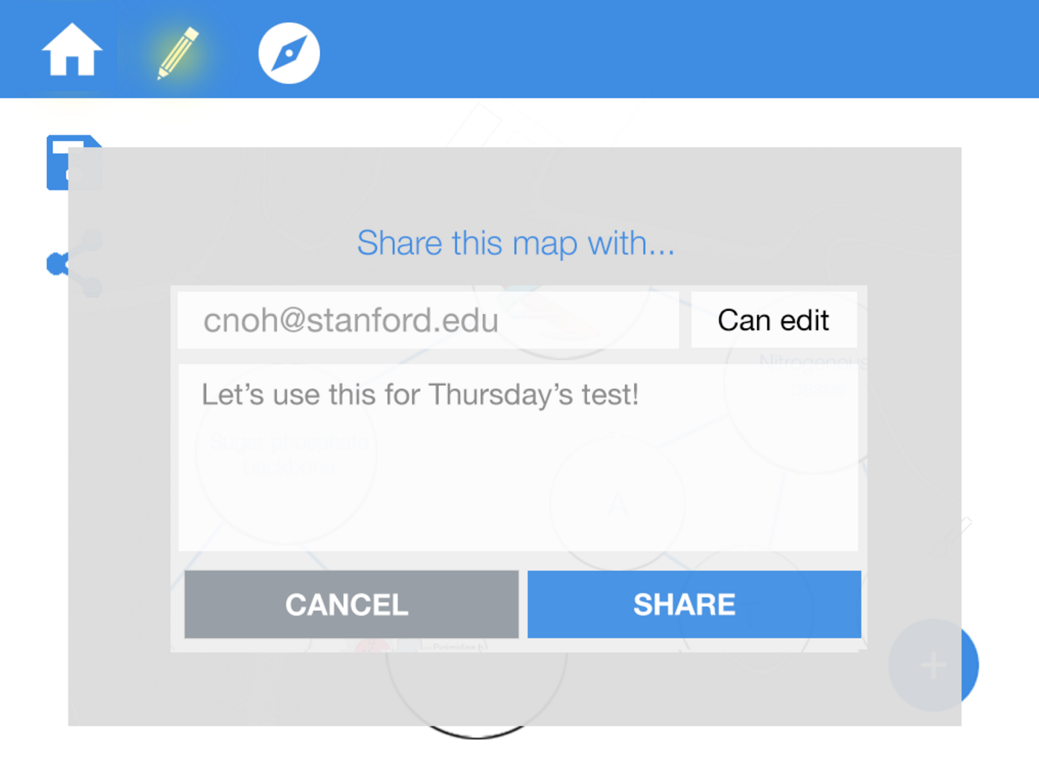
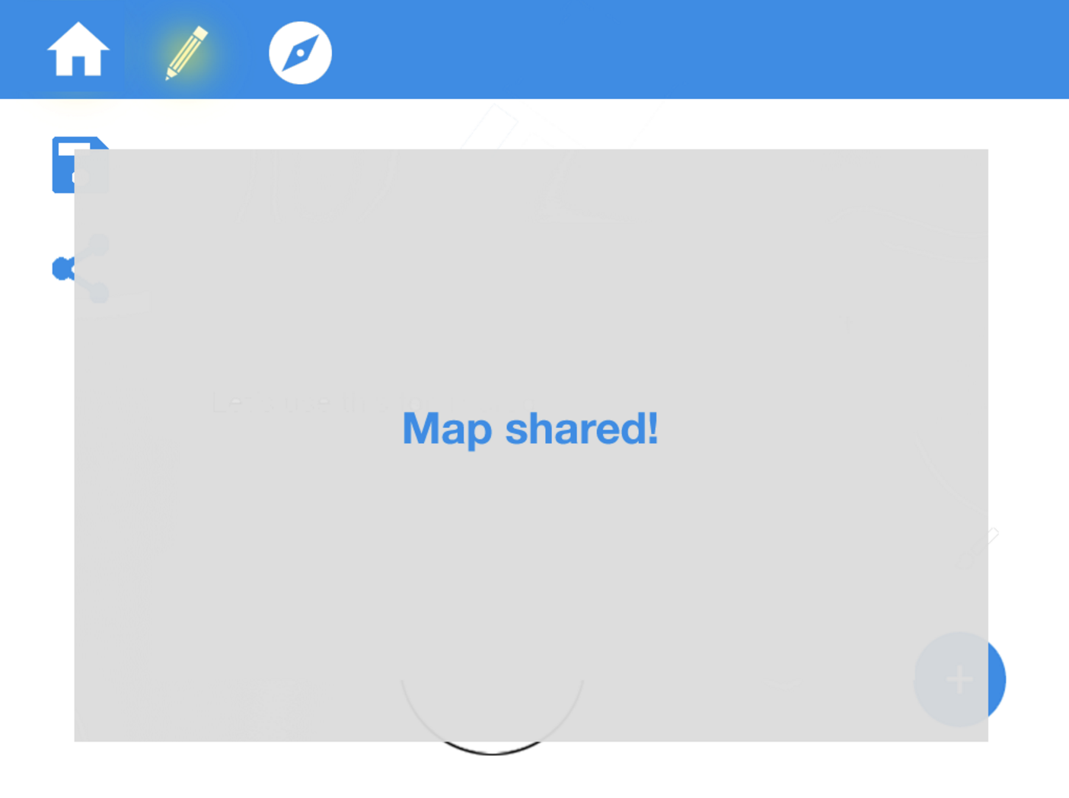
SIMPLE: share a map // 2 flows
storyboard
Click on Share
Notes:
​- Present your 3 tasks as a series of storyboards of task flows (annotated screenshots from your medium-fi prototype, arrows between screens, etc.)

Slide 19
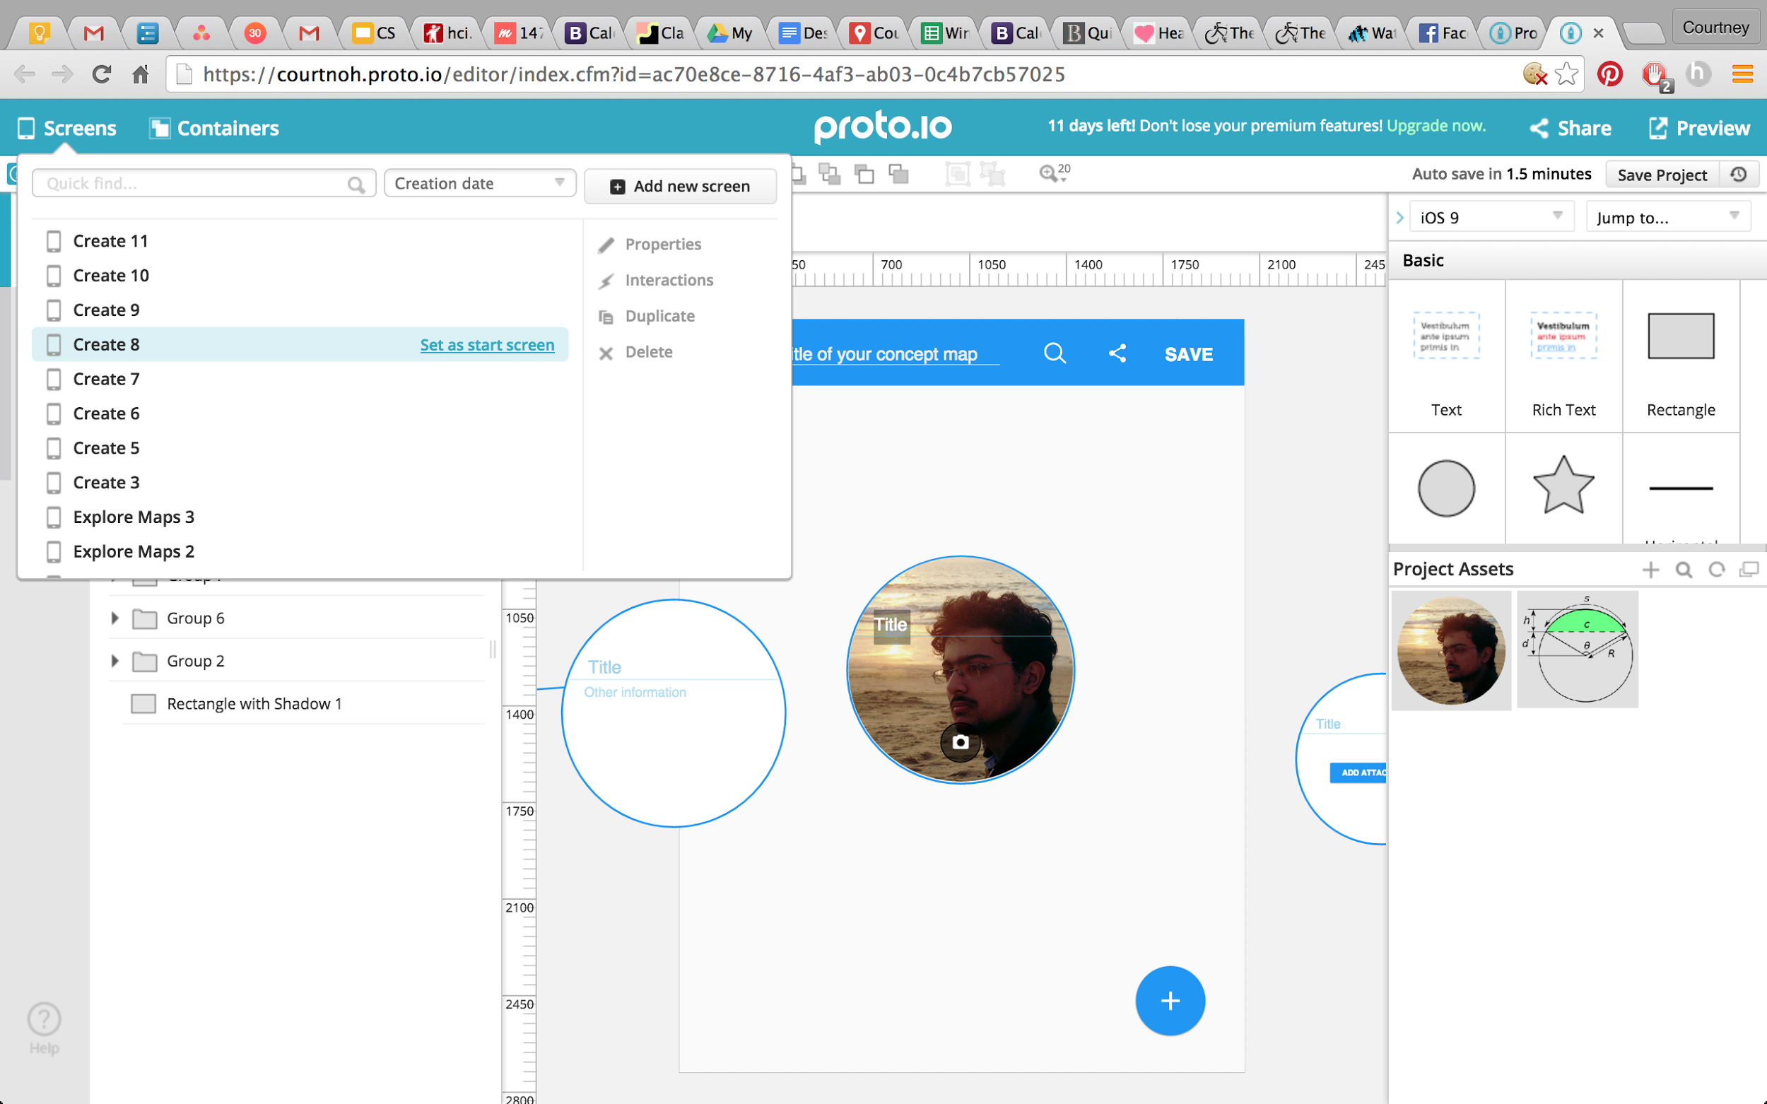
Prototyping: proto.io
Notes:
Quite conducive to teamwork

Slide 20
Prototyping: proto.io
collaboration!
“smart” interactions
not intuitive
$$$ after 15 days!
preview vs. edit screen
Notes:
Quite conducive to teamwork

Slide 21
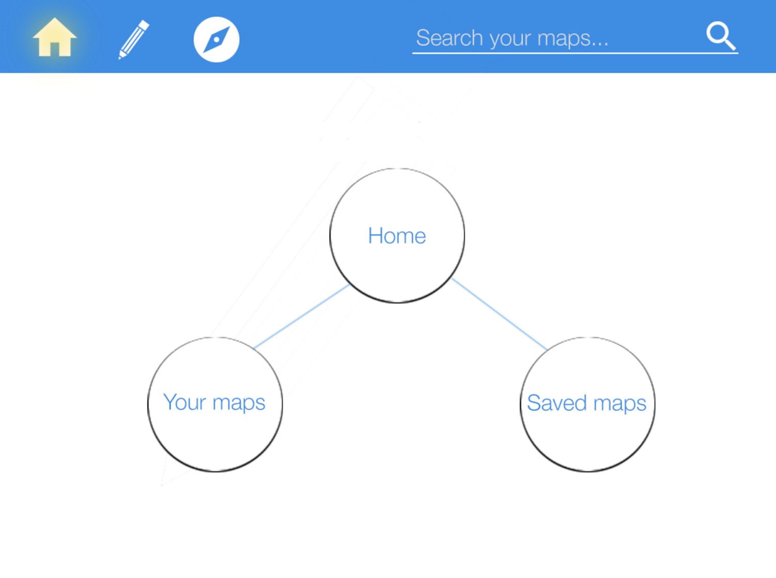
Prototyping: proto.io marvel
Notes:
Prototyping Tools ■ What did you use? ■ How the tool helped ■ How the tool did not help b. Limitations/tradeoffs of the current prototype (What was left out and why) c. Any Wizard of Oz techniques required to make it work d. Hand-coded features and why required

Slide 22
Prototyping: proto.io marvel
helped us simplify
helped us see things we missed
doesn’t allow for “smart” interactions i.e. touch screen
not really “creating” your own map
Notes:
simplify from editing bar, ALL the action buttons (attaching a file) etc. since we have to make all the screens!!!!!
we need a home screen!
more restrictions (
Prototyping Tools ■ What did you use? ■ How the tool helped ■ How the tool did not help b. Limitations/tradeoffs of the current prototype (What was left out and why) c. Any Wizard of Oz techniques required to make it work d. Hand-coded features and why required

Slide 23
Current Prototype: limitations/tradeoffs
editing of nodes (color, shape, content)
ability to “free form” connect
actually draw/take pictures/upload
creation of own map
No Wizard of Oz/hand-coded features
Notes:
Prototyping Tools ■ What did you use? ■ How the tool helped ■ How the tool did not help b. Limitations/tradeoffs of the current prototype (What was left out and why) c. Any Wizard of Oz techniques required to make it work d. Hand-coded features and why required
What was left out:
back button
actually showing stuff in the home screen
privacy settings
ability to “free form add”
actually take pictures/upload (not clear)
can’t DRAW on the node!!!!!!!!
editing
not really CREATING own map lol

Slide 24
Team Covalence
TED
LI
COURTNEY
NOH
LOGAN
SHORT
EMMA TOWNLEY-SMITH

