Slide 1

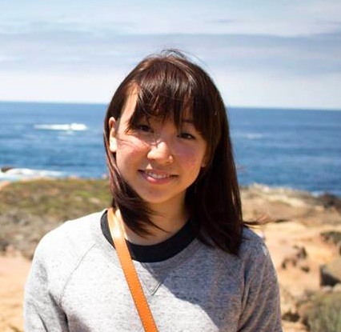
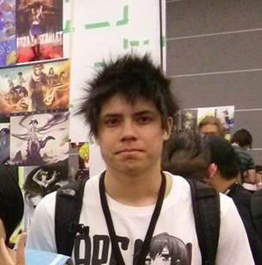

Team Covalence
TED
LI
COURTNEY
NOH
LOGAN
SHORT
EMMA TOWNLEY-SMITH

Slide 2
The Atom Map
a visual, mobile workspace
Notes:
value proposition/team mission

Slide 3
The Atom Map
Organize your thoughts, share your ideas, connect your world
Notes:
value proposition/team mission

Slide 4
Interface Designs
Read View
Node View
Notes:
selected interface rationale

Slide 5
Read View
Focus on structure and quality of content

Slide 6
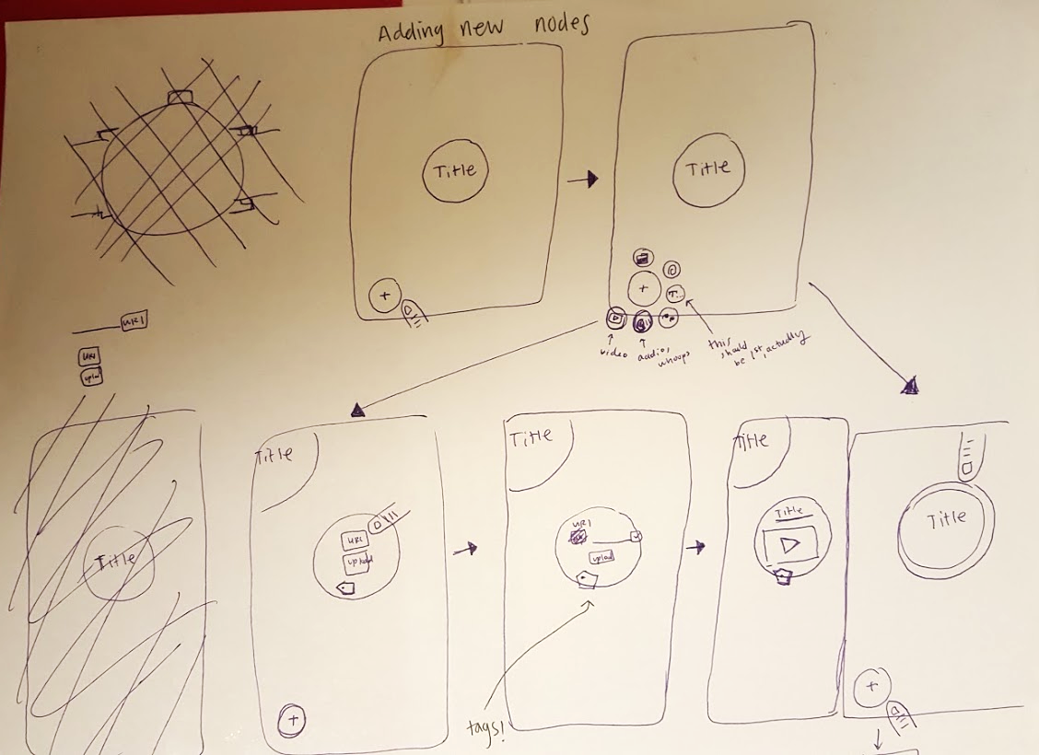
Node View
Focus on flexibility and speed

Slide 7
Selected Interface Design: Node View
“Read View” feels static
“Node View” can freely move around on a small screen
Easy to combine many sub-categories
Flexibility, Speed, and Collaboration

Slide 8
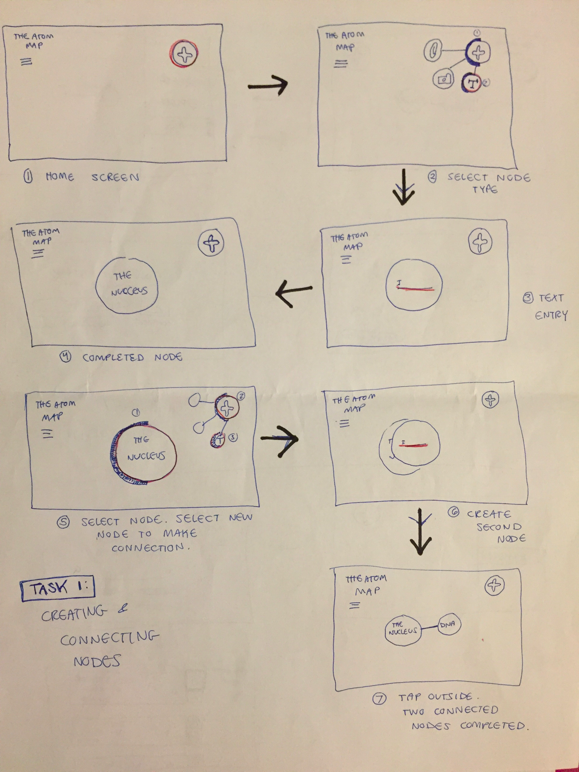
Task: Create a Map for User’s Class

Slide 9
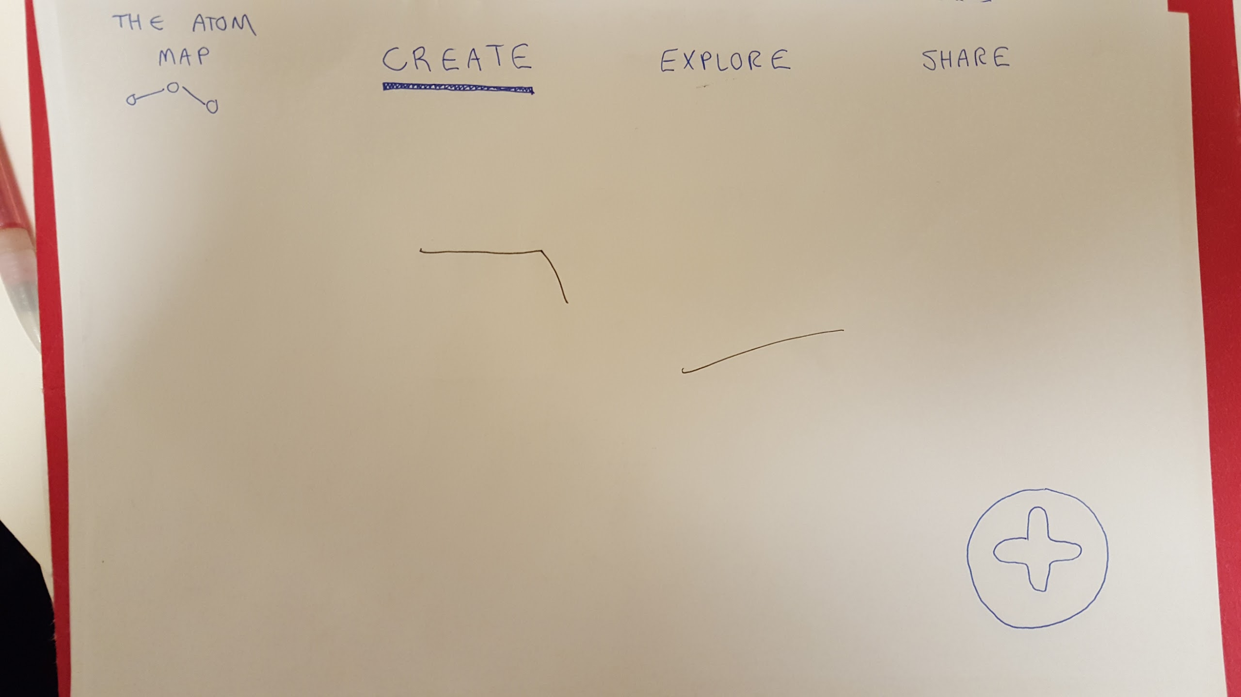
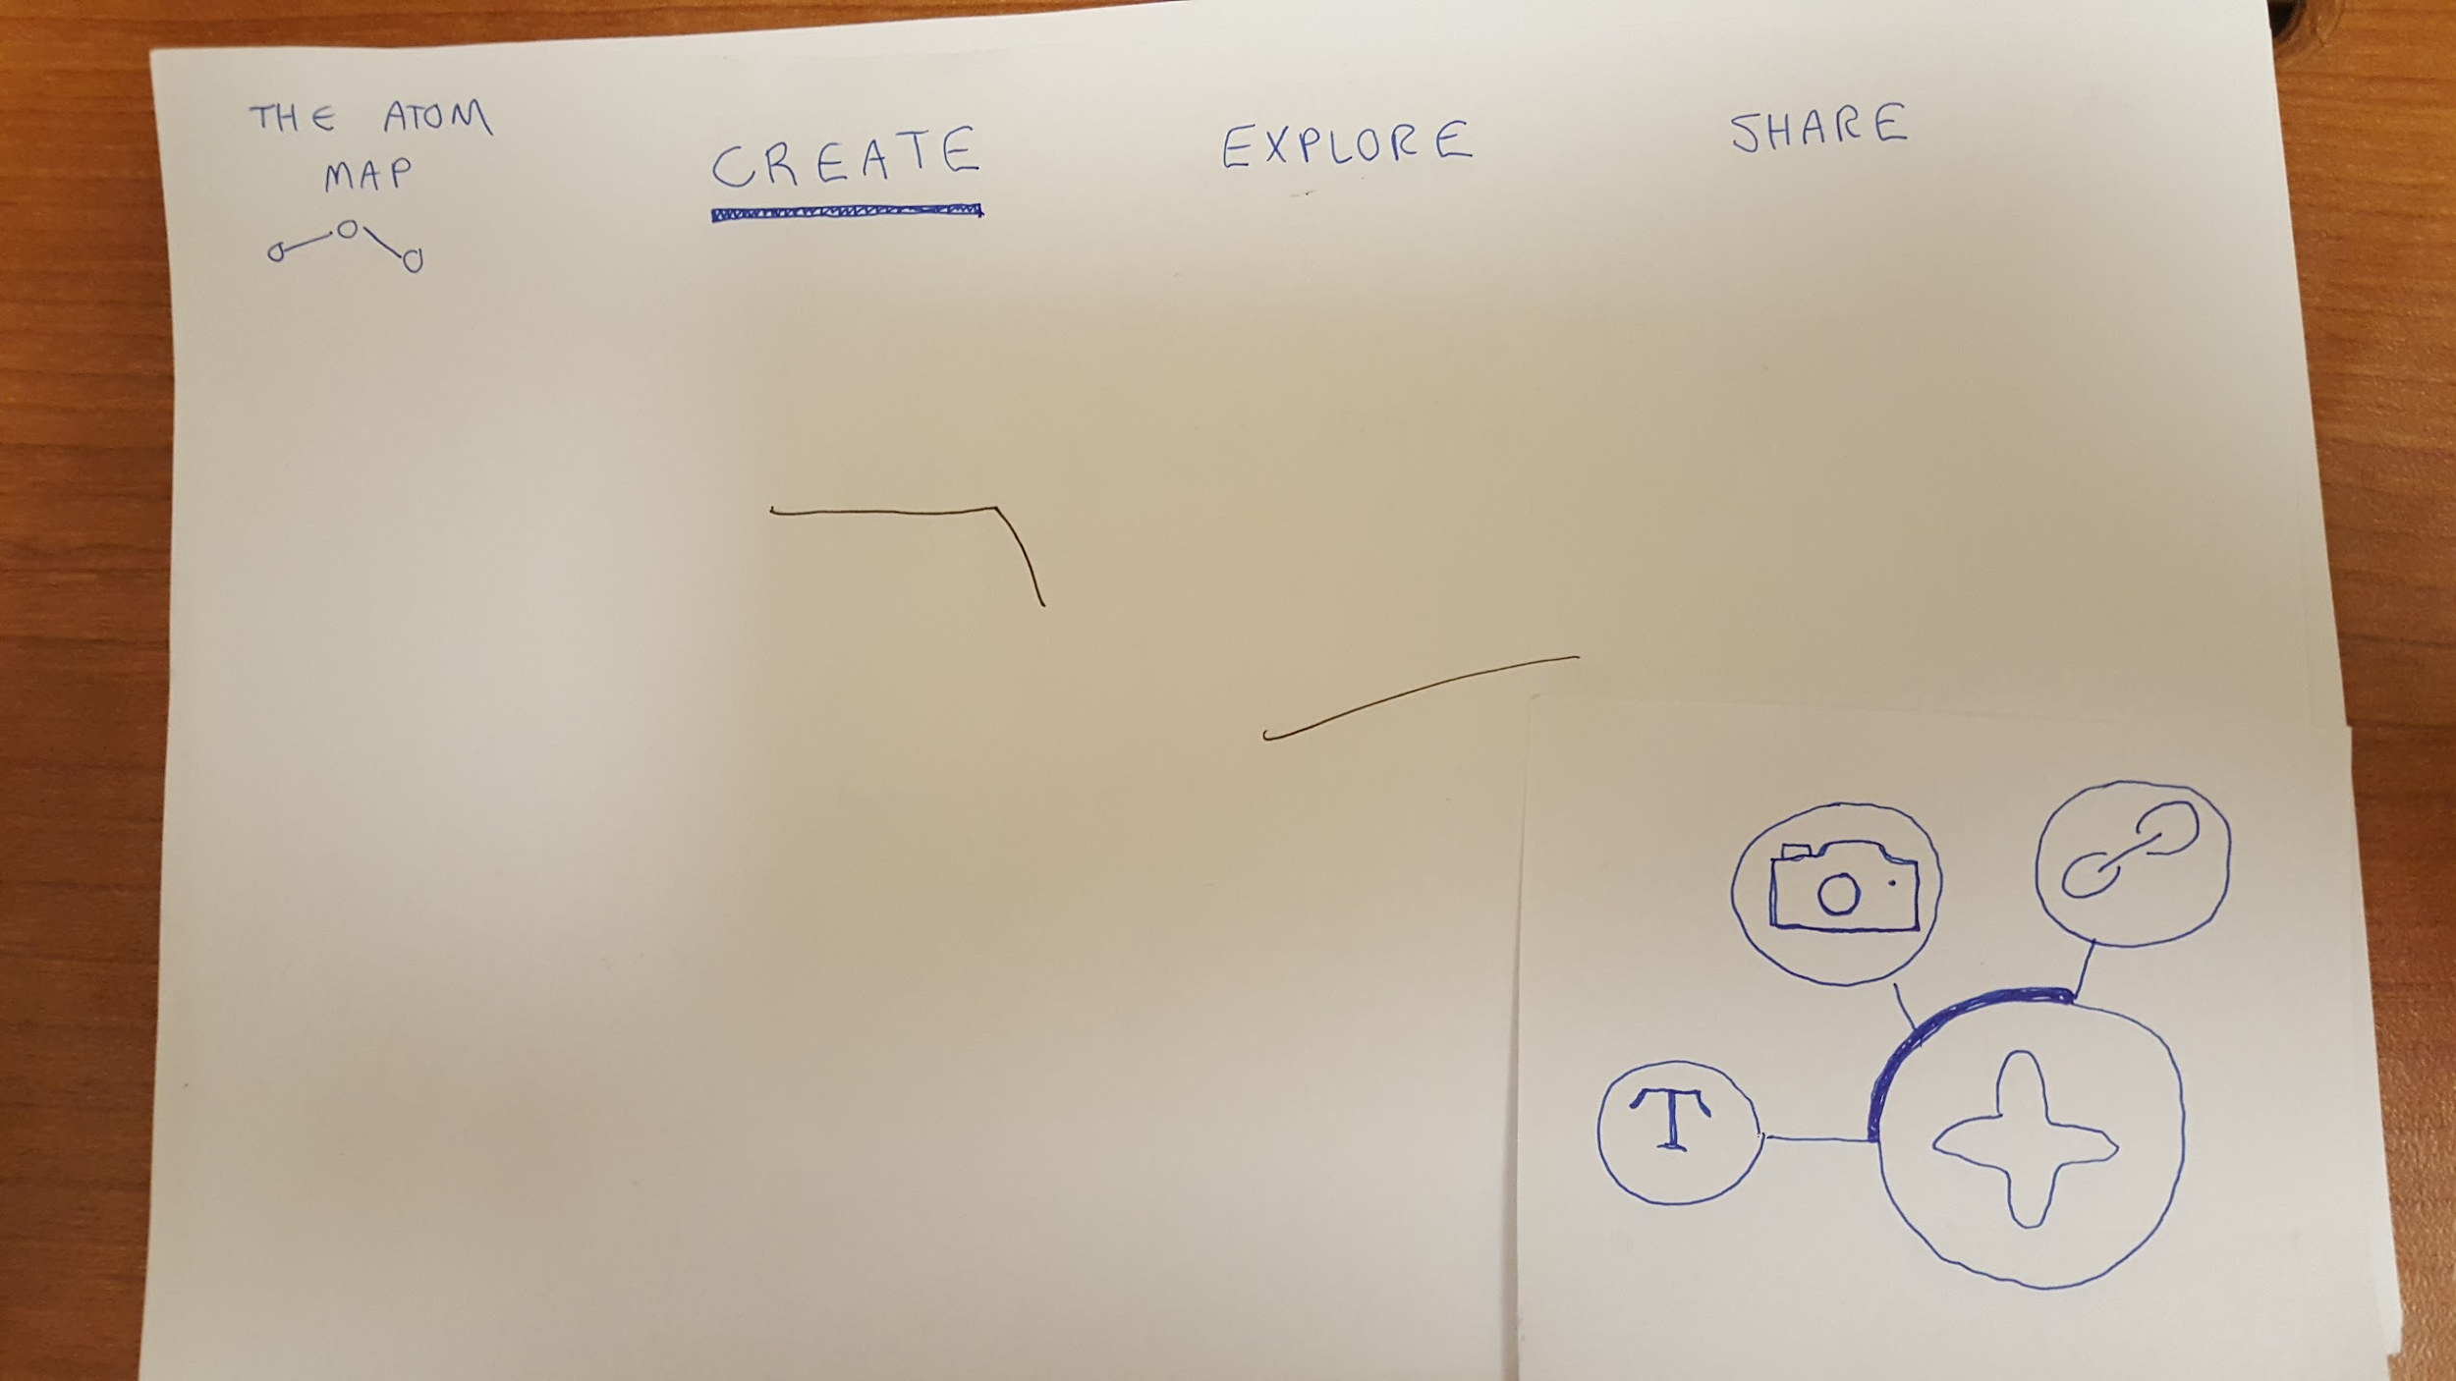
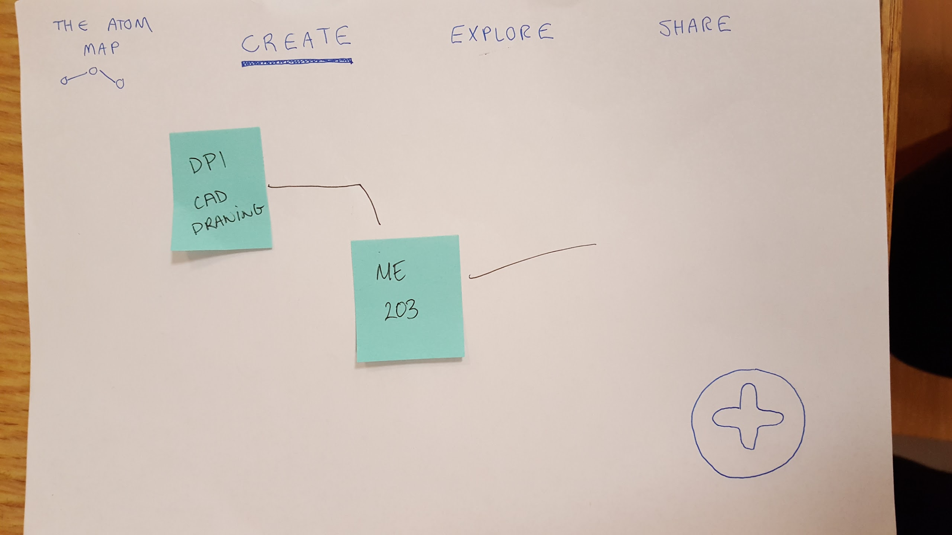
Prototype: Create a Map for User’s Class

Slide 10
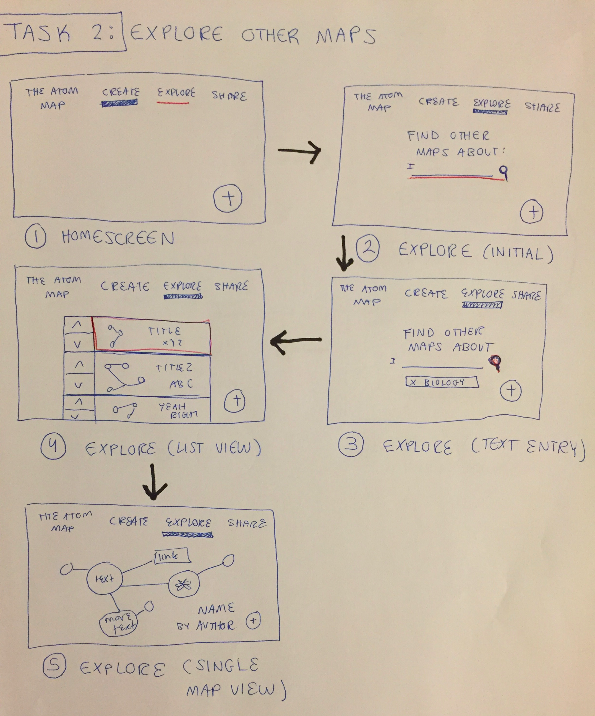
Task: Explore Other Maps For Biology

Slide 11
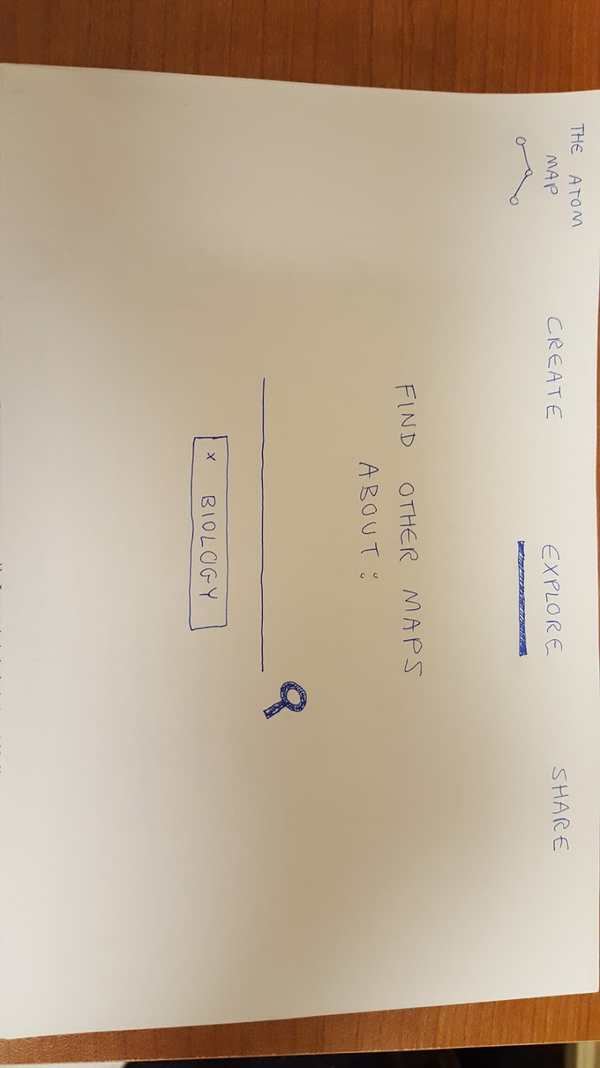
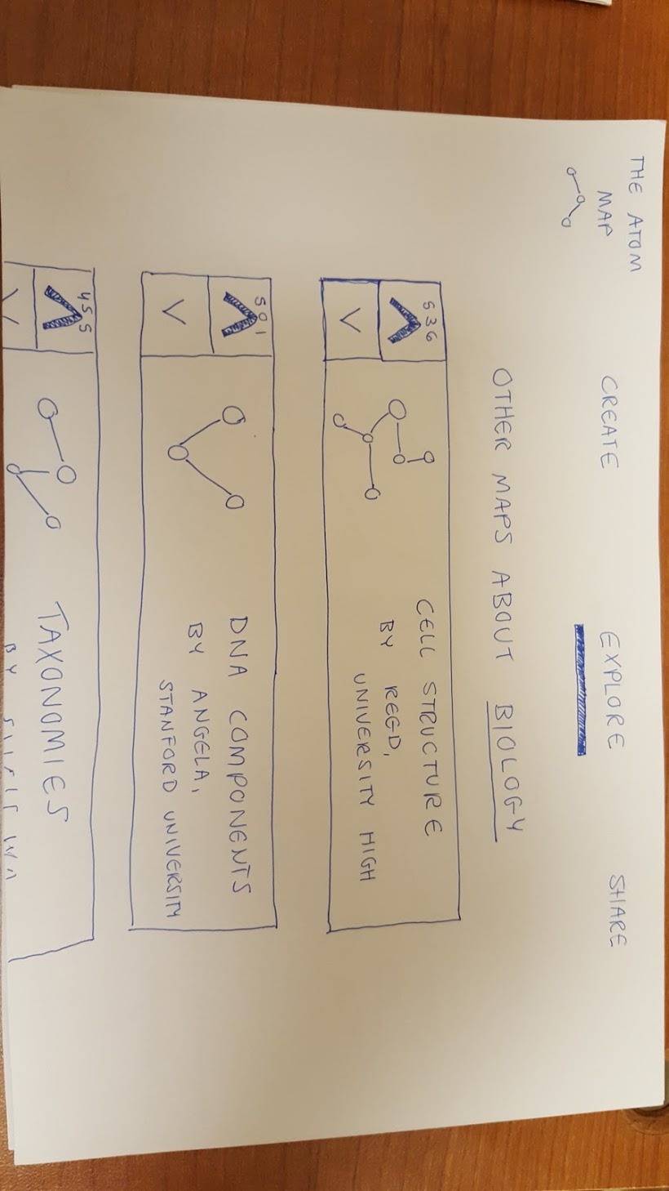
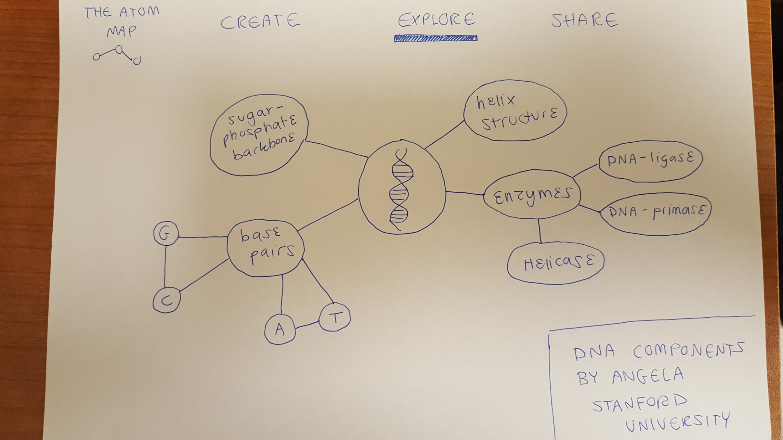
Prototype: Explore Other Maps For Biology

Slide 12
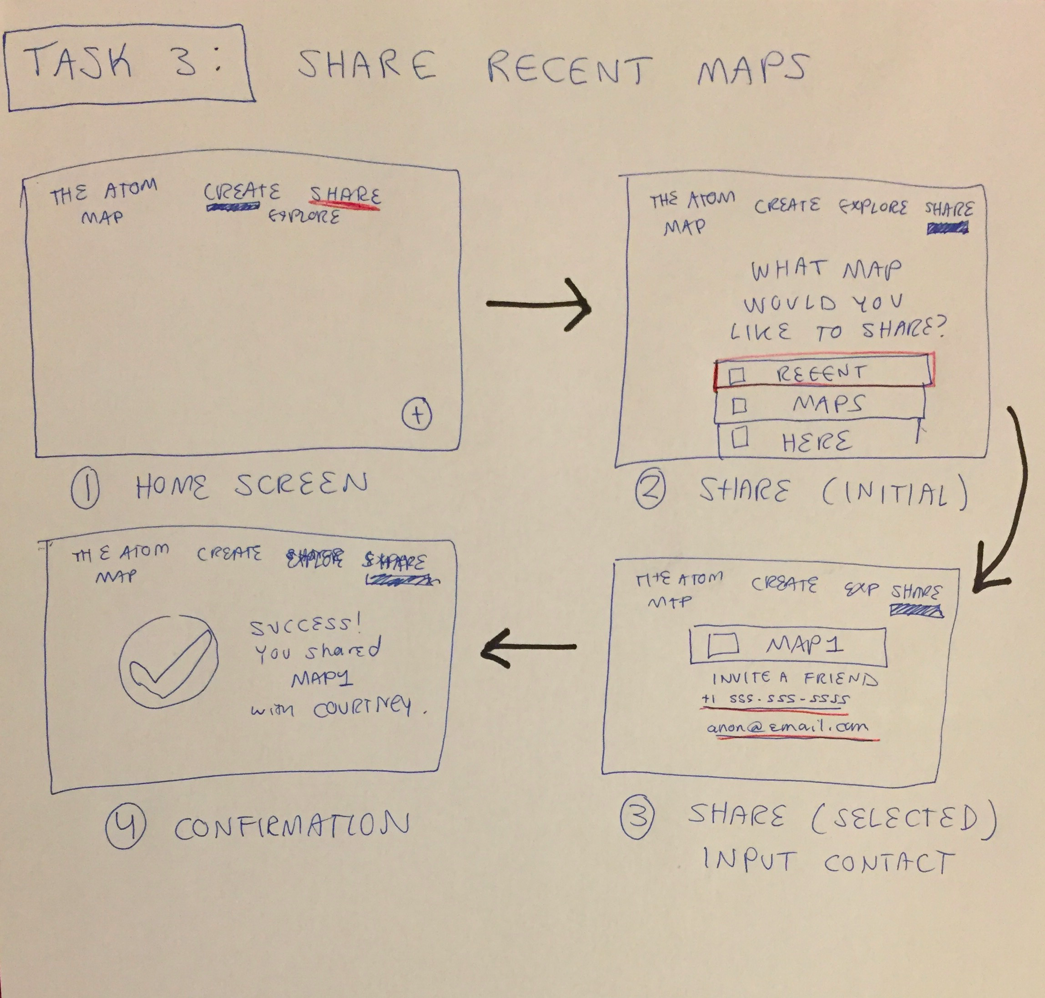
Task: Share a Map You’ve Found or Created

Slide 13
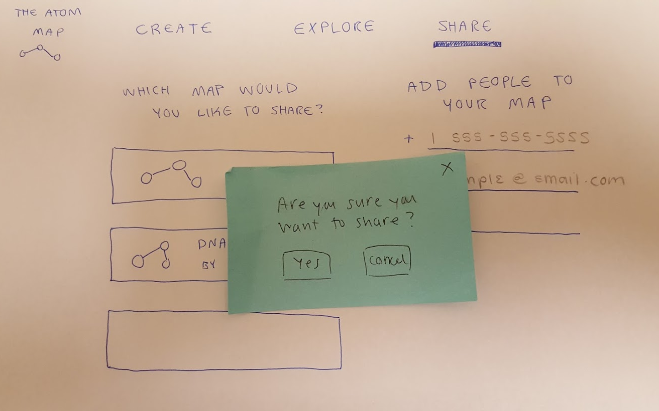
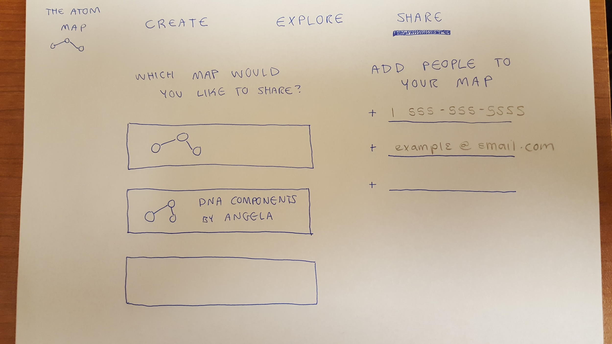
Prototype: Share a Map You’ve Found or Created

Slide 14
Experiment Method
Participants: Students from different backgrounds
Locations: Common studying or working areas
Incentive: Cherry Turnovers
Notes:
experiment method

Slide 15
Experiment Method
Introduce the app
Obtain consent form
Frame testing using subject’s class
Describe the task
Have subject think aloud through the task
Number of errors, attempts to perform new actions
Notes:
experiment method

Slide 16
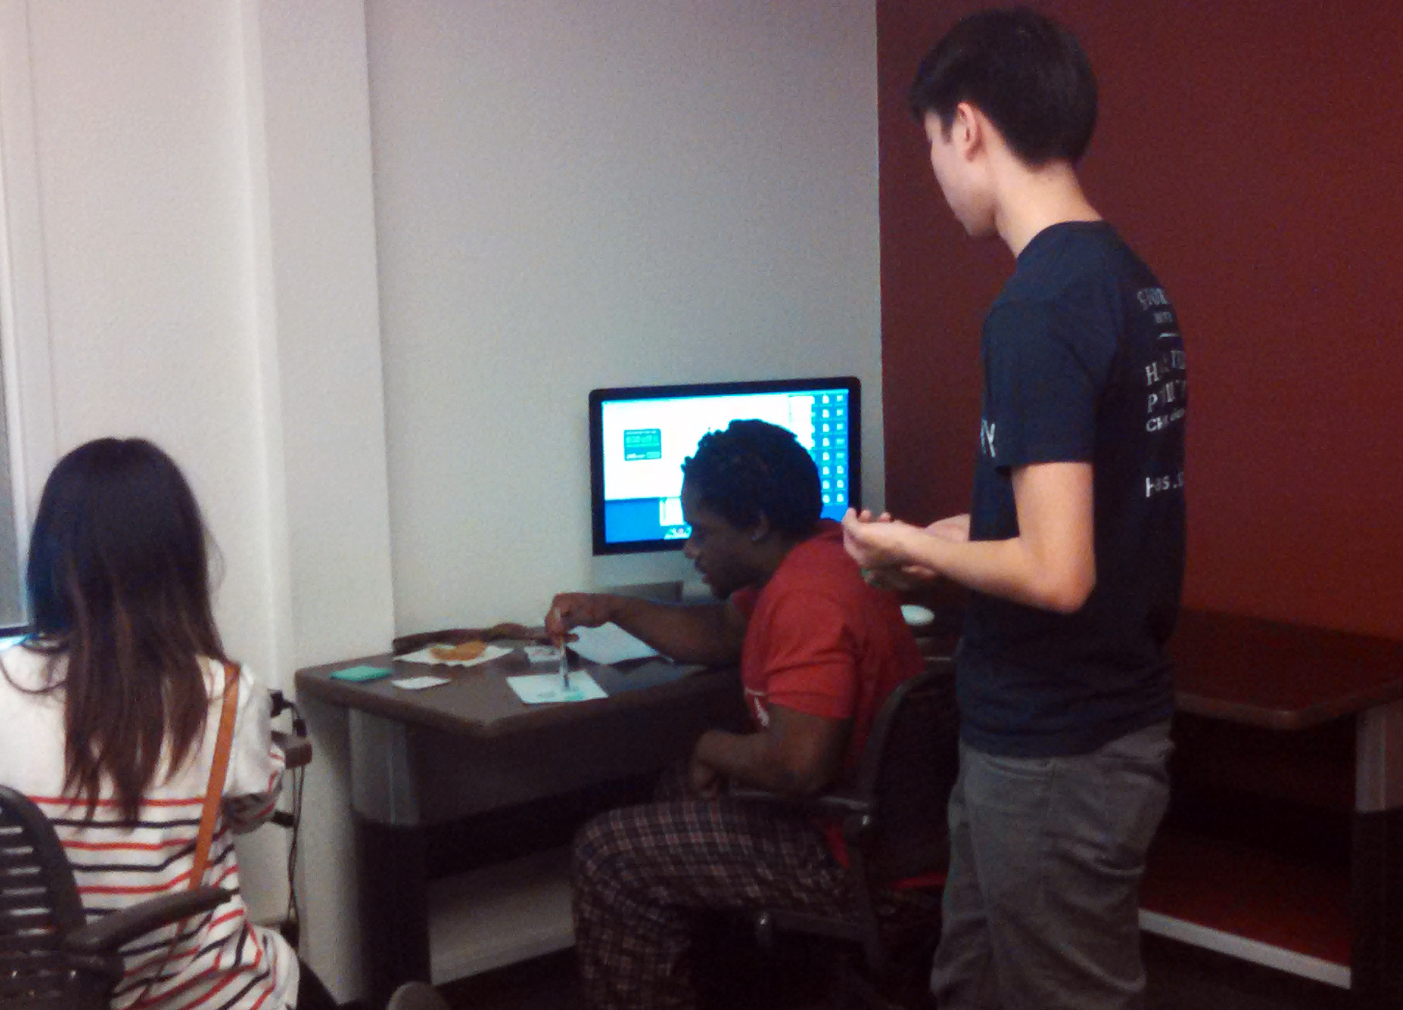
Subject 1
Chemistry Student
“
Does this button make a link between nodes? I’m not really sure...
It’d be cool to be able to edit these maps...drag to rearrange nodes or something.
Subject 1 explains the map he has created
Notes:
subject 1

Slide 17
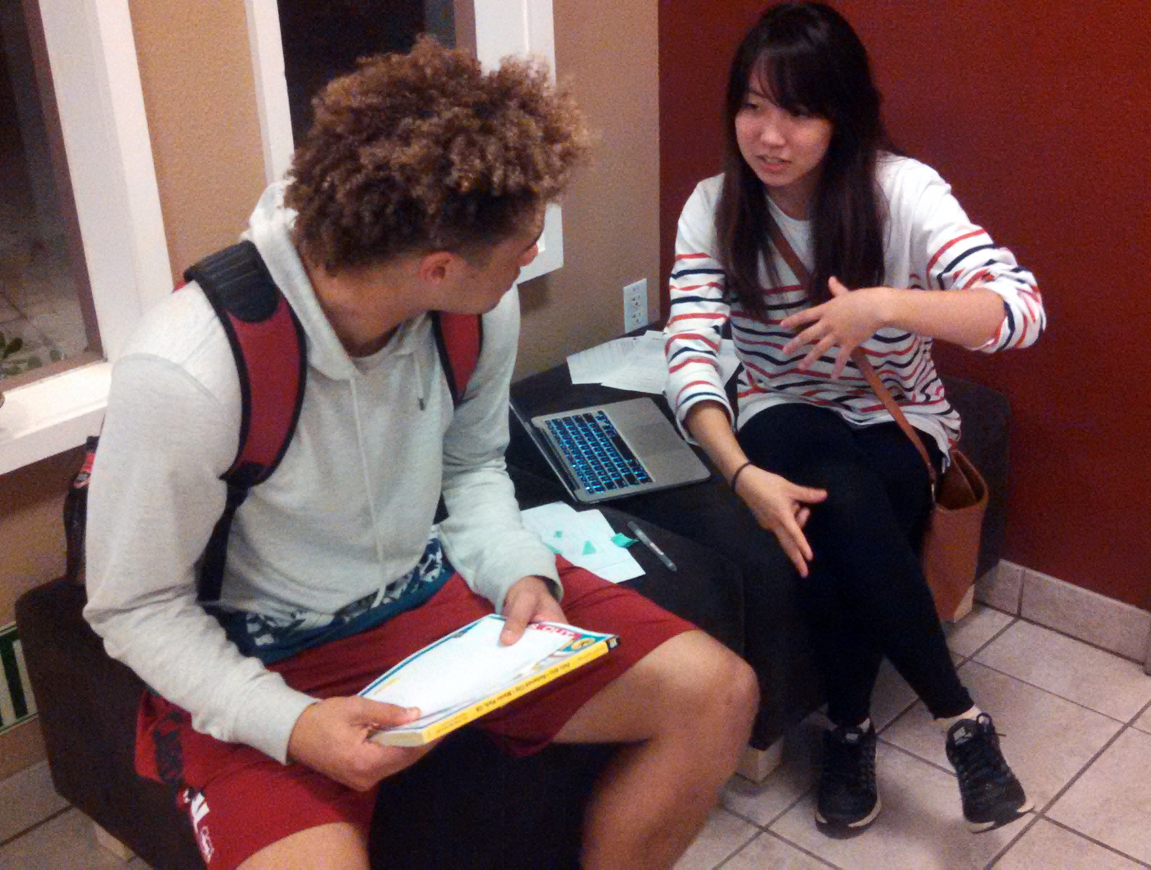
Subject 2
Human Biology Student
“
I’m not really sure where to start...is this button to move around?
I guess you could pinch to zoom in and out...and maybe click on nodes to get information.
Subject 2 listens to an introduction of the app
Notes:
subject 1

Slide 18
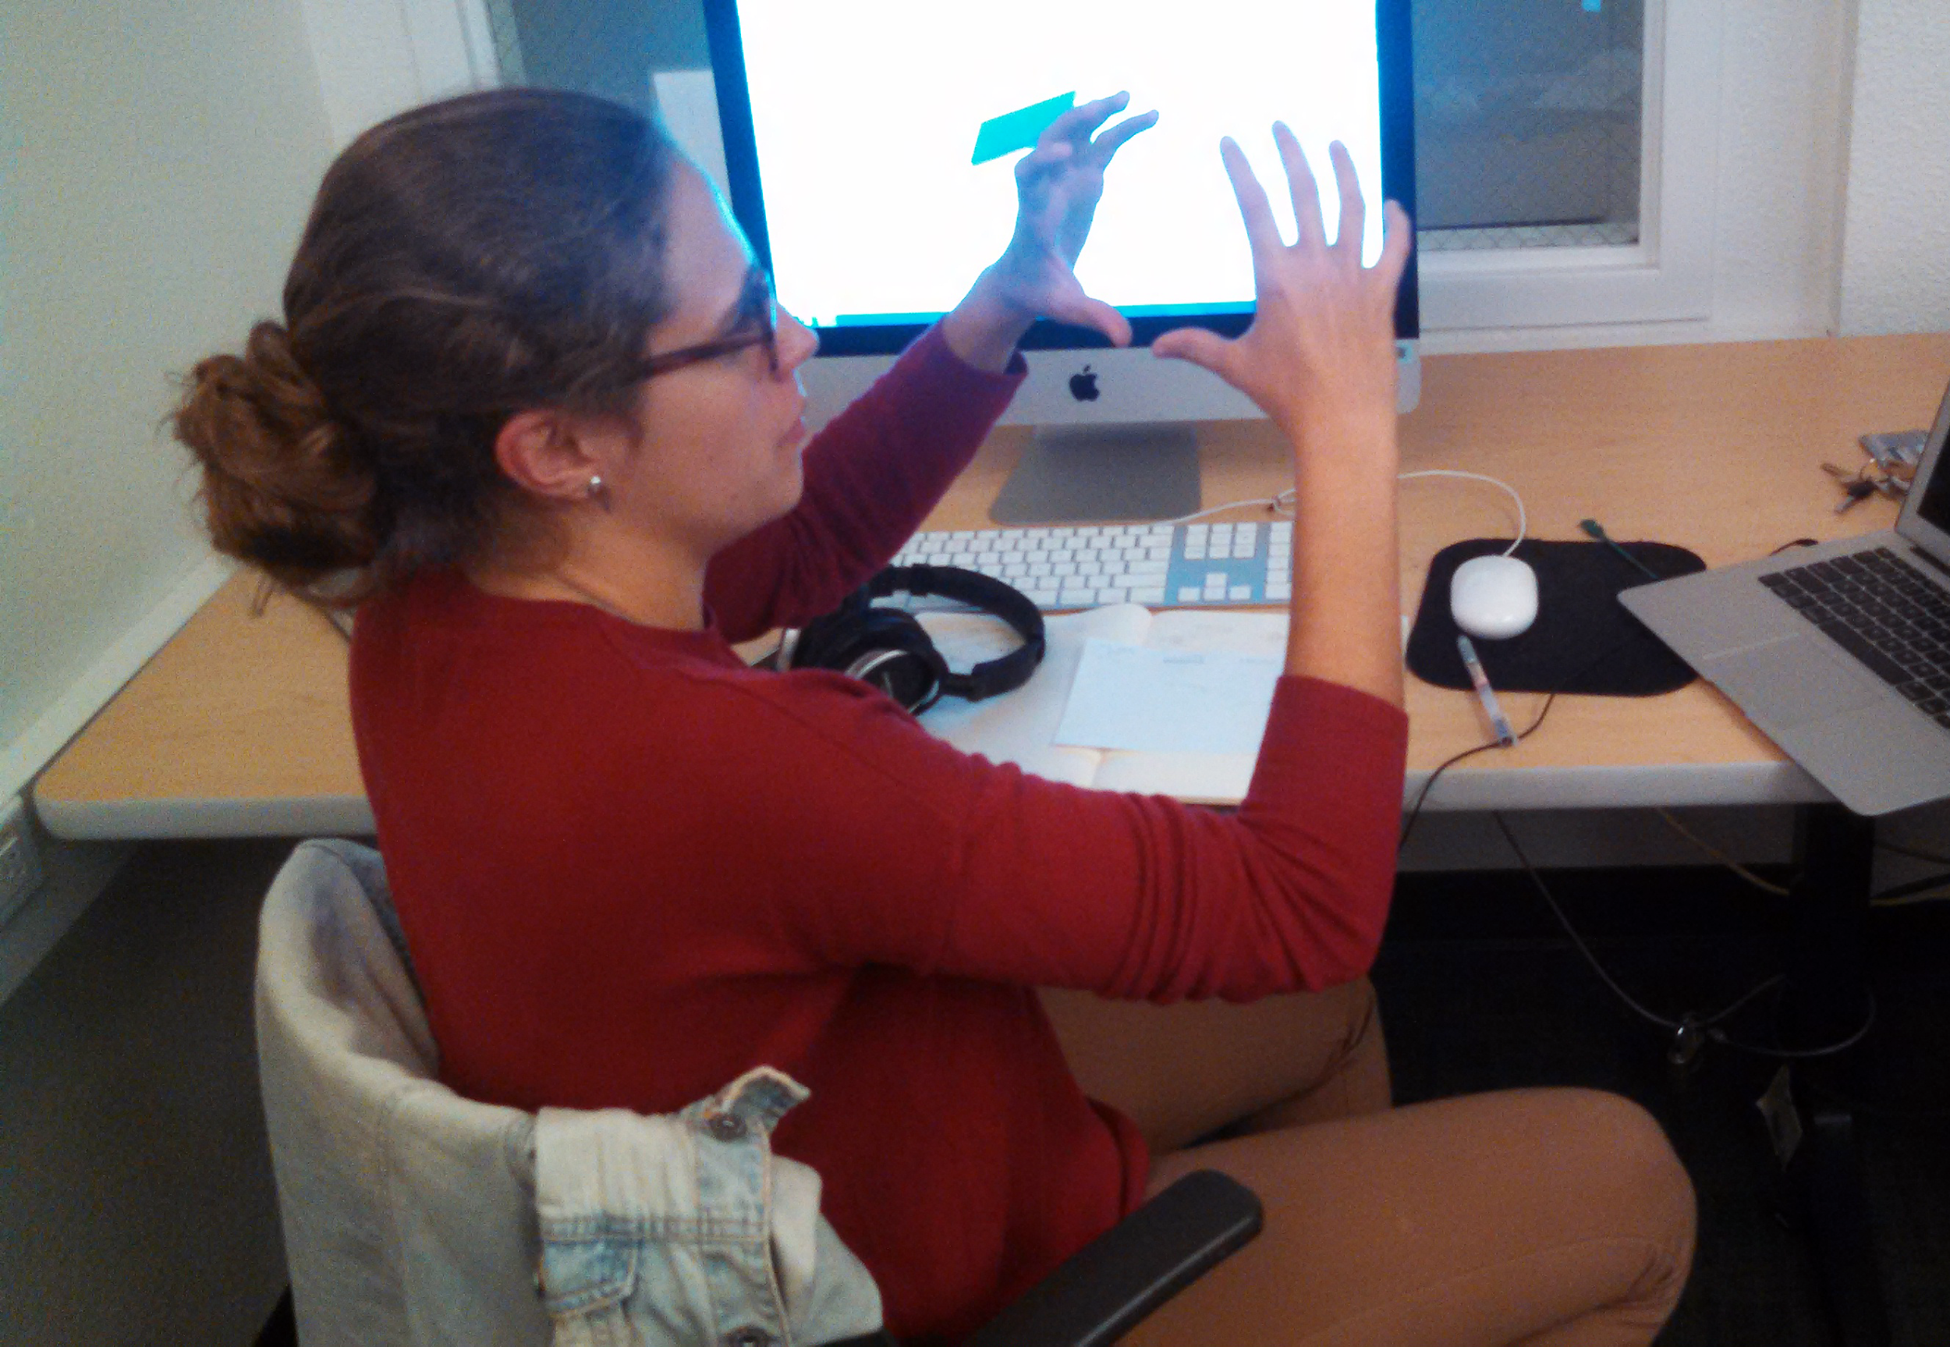
Subject 3
Product Design Student
“
I always go with the one with the most votes, so I’ll go with the first one.
I like having my own handwriting on things...the whole point of my making maps is seeing my handwriting.
Subject 3 explains an idea for map exploration
Notes:
subject 1

Slide 19
Suggested UI Changes
Subjects were unsure how to connect nodes
Notes:
summary of ui changes

Slide 20
Suggested UI Changes
Subjects were unsure how to connect nodes
Tutorial or onboarding process for basic map creation
Notes:
summary of ui changes

Slide 21
Suggested UI Changes
Subjects wanted to zoom in and out to explore maps
Notes:
summary of ui changes

Slide 22
Suggested UI Changes
Subjects wanted to zoom in and out to explore maps
Pinch to zoom in the “Exploration” tab
Notes:
summary of ui changes

Slide 23
Suggested UI Changes
Subjects want to freely interact with maps found through exploration
Notes:
summary of ui changes

Slide 24
Suggested UI Changes
Subjects want to freely interact with maps found through exploration
Allow users to download local copies of maps
Notes:
summary of ui changes

Slide 25
Suggested UI Changes
Subjects would like to be able to handwrite on or around maps
Notes:
summary of ui changes

Slide 26
Suggested UI Changes
Subjects would like to be able to handwrite on or around maps
Allow users to make handwritten notes and comments on maps
Notes:
summary of ui changes

Slide 27
In summary...
Users felt that the “Node View” design was an intuitive way to interact with maps
Added functionality to exploration could improve the experience of collaborating
Some onboarding may be required

