Slide 1
Team Covalence
TED
LI
COURTNEY
NOH
LOGAN
SHORT
EMMA TOWNLEY-SMITH

Slide 2
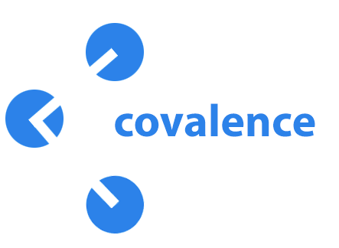
Covalence is a visual, mobile workspace for concept maps.
Use text, images, drawings, and other resources to share your ideas and connect your world.
Connect your world.
Notes:
product, logo, tagline, value prop

Slide 3
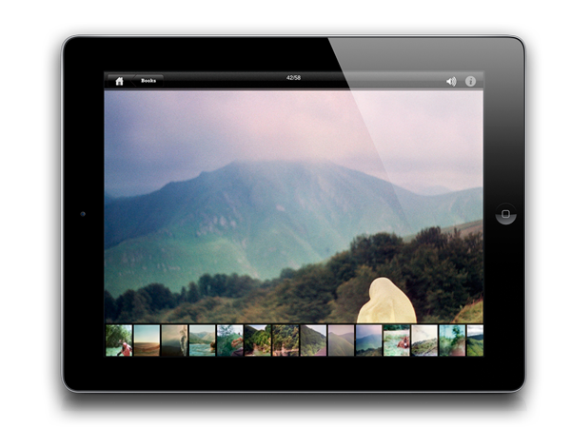
Problem: learning happens everywhere.
Notes:
problem and solution

Slide 4
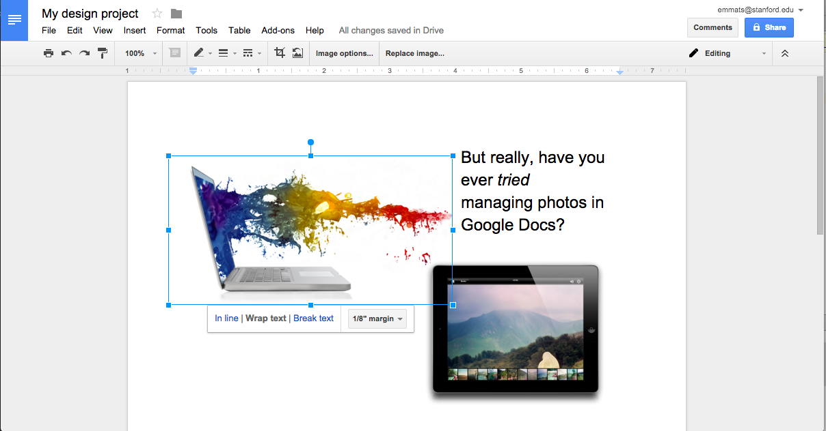
Problem: current tools hamper collaboration and visual learning.
Notes:
problem and solution

Slide 5
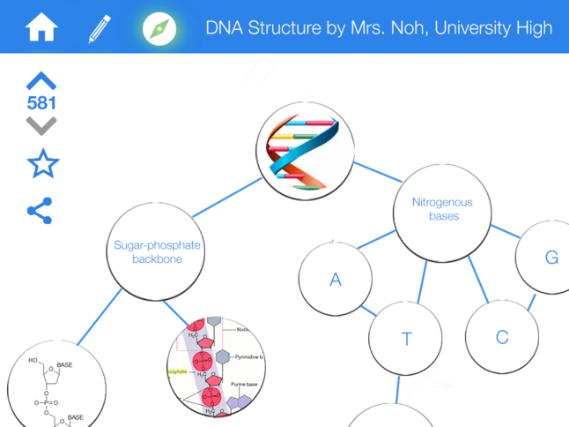
Our solution: Covalence.
Notes:
problem and solution (note: we’ll want to update these screenshots)

Slide 6
Today we’re covering...
HE Results & Revised Design
Prototype thus far
The road ahead
Notes:
talk outline

Slide 7
HE RESULTS & REVISED DESIGN
Notes:
HE results w/ focus on level 3-4 issues

Slide 8
Results: Heuristic Evaluation
Three big changes:
UX flow for linking nodes
“Modes of operation” -- edit and view
Model for how maps are stored
Notes:
HE results w/ focus on level 3-4 issues

Slide 9
Results: Heuristic Evaluation
UX flow for linking nodes
[H2-1: Visibility of Status] (Severity 2)
After creating the “CS147” node, a second tap on the node creates a double outline but nothing else seems to have changed; it is thus unclear what double-tapping does...
Following this, perhaps make the “add node” button grayed out such that a user will know they can’t click it before clicking the node they just made/the node they want to extend another node from or connect with.
Notes:
HE results w/ focus on level 3-4 issues

Slide 10
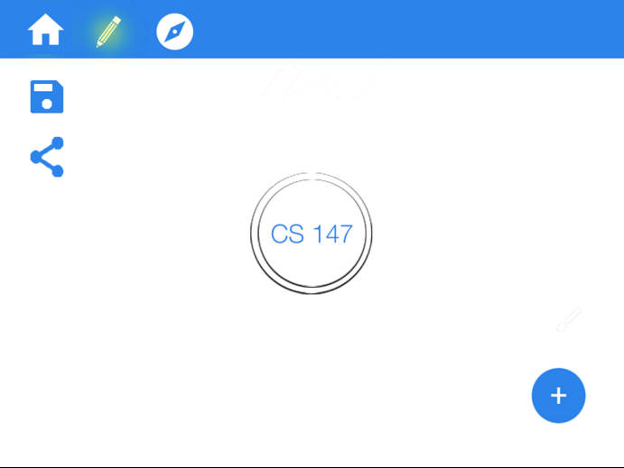
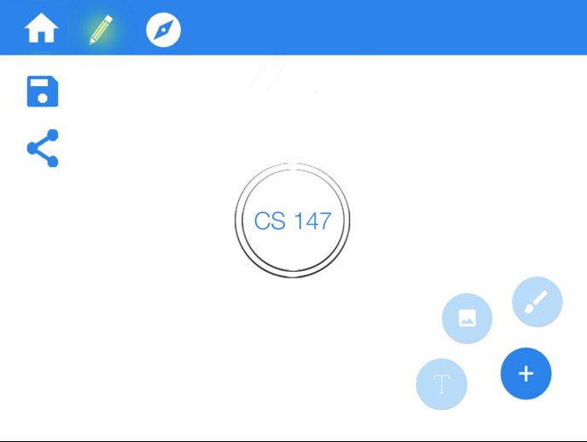
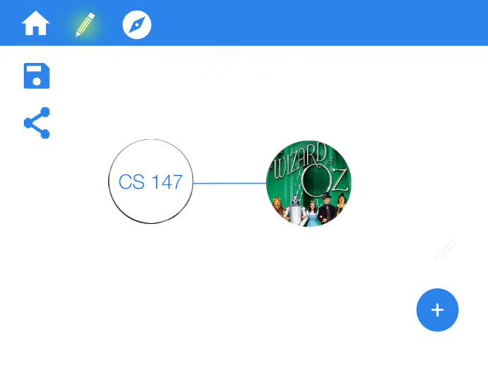
Results: Heuristic Evaluation
UX flow for linking nodes: before
2. Add the new node through the ‘plus’ button.
3. Connections between nodes are drawn automatically.
1. Tap on the node(s) your next node should be connected to.
1.
3.
2.
Notes:
DISCUSS: CHANGES AND WHY WE MADE THEM

Slide 11
Results: Heuristic Evaluation
UX flow for linking nodes: after
Draw a line between the centers of two nodes to connect them.
Notes:
DISCUSS: CHANGES AND WHY WE MADE THEM

Slide 12
Results: Heuristic Evaluation
Modes of Operation -- Edit and View
[H2-3: User Control] (Severity 3)
How do you edit an existing map? The editor only allows you to create new maps - I don’t see any edit button when I’m viewing a finished map - this seems like an an important oversight especially since editing/creating maps is one of your main tasks. There should at least be an edit button somewhere in your prototype to represent this.
Notes:
HE results w/ focus on level 3-4 issues

Slide 13
Results: Heuristic Evaluation
Edit and view modes: before
2. How do you edit someone else’s map?
1. How do you view (not edit) your own maps?
Notes:
DISCUSS: CHANGES AND WHY WE MADE THEM

Slide 14
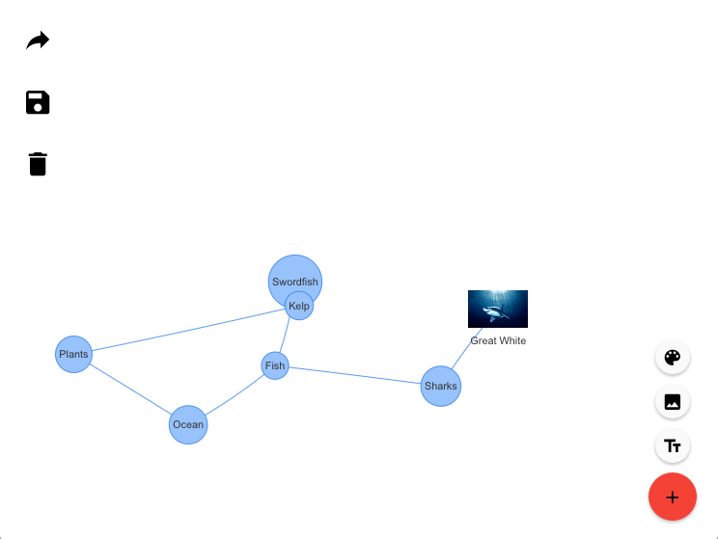
Results: Heuristic Evaluation
Edit and view modes: after
EDIT
View
Explicit UI buttons for edit vs. view
Notes:
DISCUSS: CHANGES AND WHY WE MADE THEM

Slide 15
Results: Heuristic Evaluation
Model for how maps are stored
[H2-3: User Control] (Severity 3)
...How do you import/save a public map into your local storage so that you can edit it, or see it later? (I see a “saved maps” section in the “Home” section, but there’s no corresponding save button when you look at a specific map under the “Explore maps” section)
Notes:
HE results w/ focus on level 3-4 issues

Slide 16
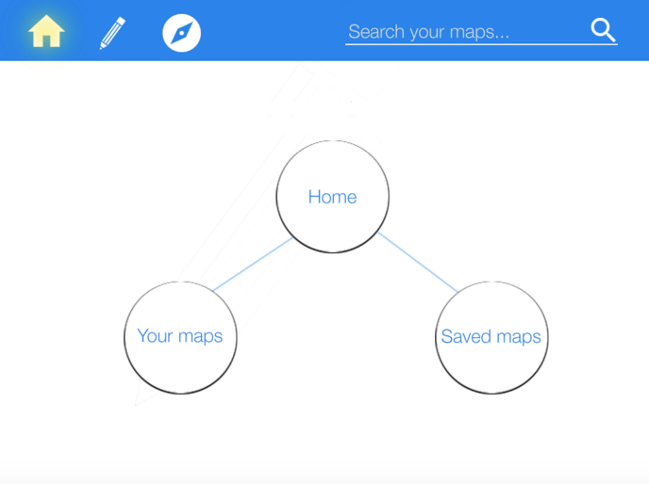
Results: Heuristic Evaluation
How are maps stored? (before)
Notes:
DISCUSS: CHANGES AND WHY WE MADE THEM

Slide 17
Results: Heuristic Evaluation
How are maps stored? (after)
Explicit save button on any map
Home page list view of your saved maps
Your Maps
DNA STRUCTURE by Courtney
PALO ALTO STORES by Ted
CS103 MIDTERM by Logan
Notes:
DISCUSS: CHANGES AND WHY WE MADE THEM

Slide 18
Backburner
Automatic crediting when you’re copying someone else’s map
A way to view recent searches and recently viewed maps
Think more about visual contrast between nodes and background
Notes:
DISCUSS: CHANGES AND WHY WE MADE THEM

Slide 19
THE PROTOTYPE
Notes:
HE results w/ focus on level 3-4 issues

Slide 20
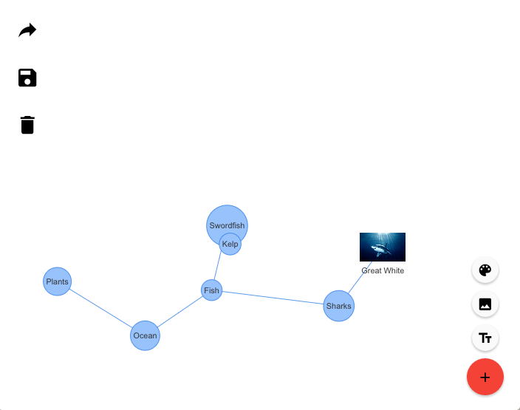
The Prototype
Android with embedded AngularJS web app + vis.js library
Current implementation:
add text nodes
add image nodes
connect nodes
move nodes and background
‘flip over’ nodes to see more content
Notes:
HE results w/ focus on level 3-4 issues

Slide 21
The Prototype
No Wizard of Oz techniques
Hard-coded data
For ‘Explore’ task -- hard-coded community maps
Notes:
HE results w/ focus on level 3-4 issues

Slide 22
DEMO
Notes:
HE results w/ focus on level 3-4 issues

Slide 24
THE ROAD AHEAD
Notes:
HE results w/ focus on level 3-4 issues

Slide 25
Issues/Challenges
Building a very flexible yet structured GUI heavy application
Make automatic node sizing more aesthetic
Figuring out how we are going to save/store maps
Work on and find quicker/more intuitive motions
Notes:
HE results w/ focus on level 3-4 issues

Slide 26
Still to implement...
Saving maps to your homescreen
list view of recently saved maps
Exploring other maps
search and view
Sharing maps
share link to covalence through email
Notes:
HE results w/ focus on level 3-4 issues

Slide 27
Summary
Covalence: a mobile workspace for concept maps.
Our HE taught us…
Intuitive gestures are better!
Think carefully about the user mindset (edit vs. view)
Think through conceptual model for map storage
We implemented our ‘hardest’ task! Now we just have the build the system around these concept maps that will make them useful.
Notes:
HE results w/ focus on level 3-4 issues

Slide 28
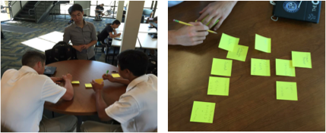
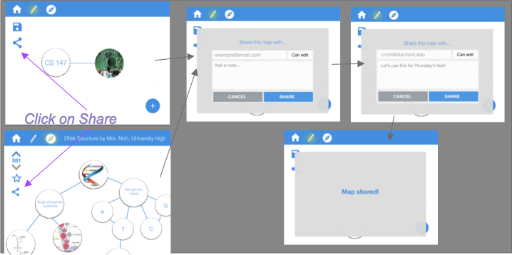
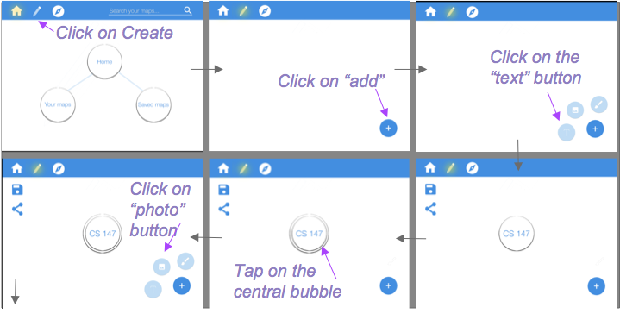
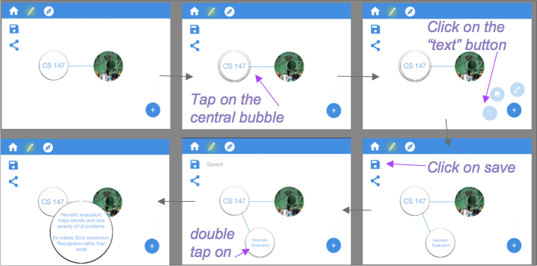
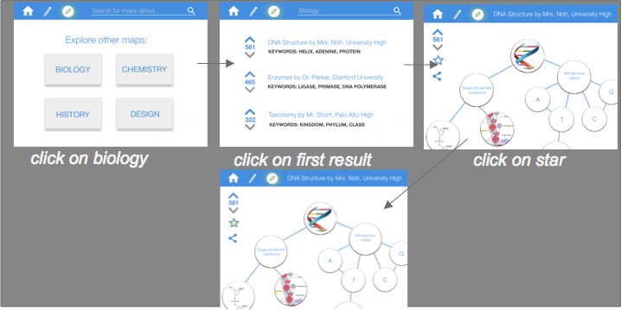
INSIGHT random stuff that can help
How might we help George, Tim, and Luke...
• use their own knowledge and conceptual understandings to teach others?
•give feedback to their teachers on what concepts they understand or have trouble with?
•find new, easy, and exciting ways of interacting with their notes again to solidify their understanding of concepts?
How might we help Ms. Giraudo…
•quickly and easily be able to create (and iterate on) new, interesting high-quality educational materials?
•facilitate group work in more creative and visual manners?
•encourage free creation and creativity through her assignments?
EXPERIENCE PROTOTYPING PICS:

