Slide 1
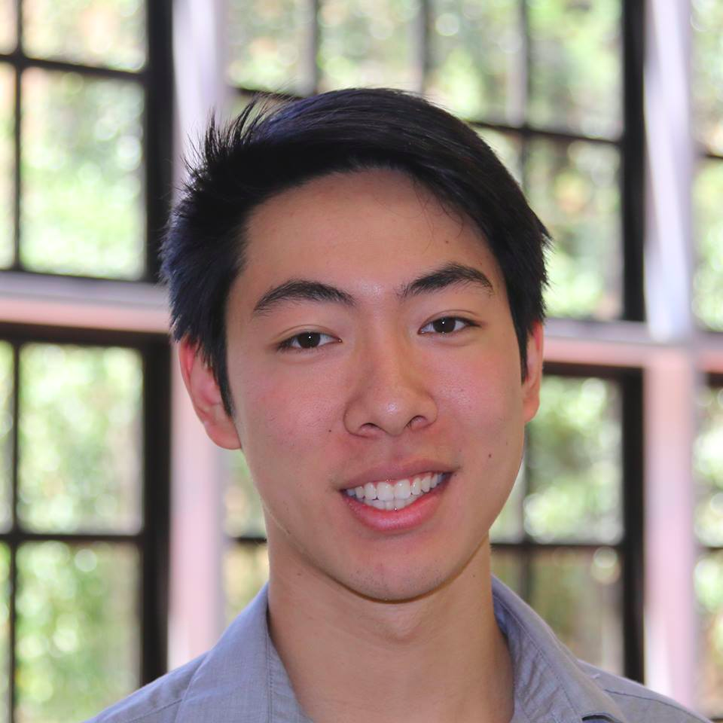
Team Covalence
TED
LI
COURTNEY
NOH
LOGAN
SHORT
EMMA TOWNLEY-SMITH

Slide 2
Value Proposition
Organize your thoughts, share your ideas, connect your world
In an ever busier world, we hardly have time to collect our thoughts and express them as well as we'd like, whether it's studying for classes, sharing your favorite restaurants, or collecting all of your selfies. We've got the capability to keep all of this info on our phones and tablets, but how do we quickly go through all of it - and share it? With Covalence, we hope to provide a mobile app that allows you to link your memories in a map on the go, optimized for quick use and versatility so that you can express yourself more openly, organize your ideas better, and connect with others more.

Slide 3
Tasks
Simple Task: Create a node based on an idea
Moderate Task: Connect nodes to create a map
Complex Task: Collaborate on and share maps with others

Slide 4
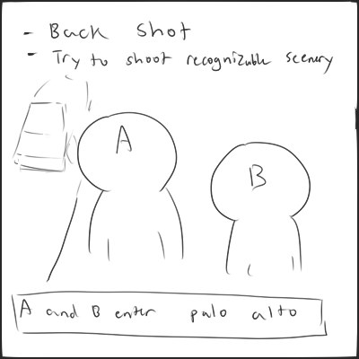
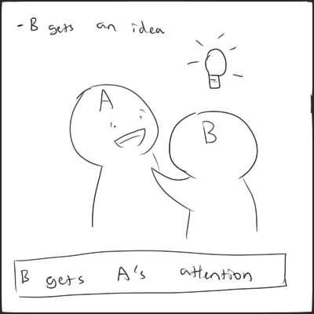
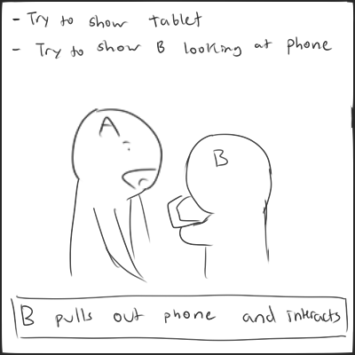
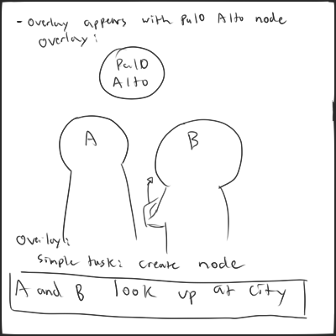
Simple Task: Storyboard

Slide 5
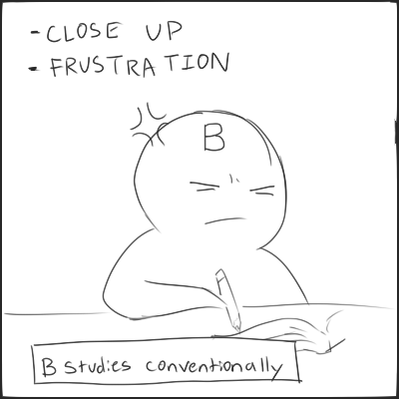
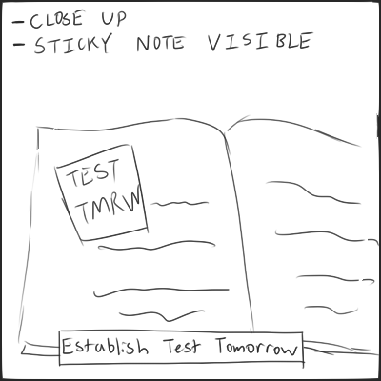
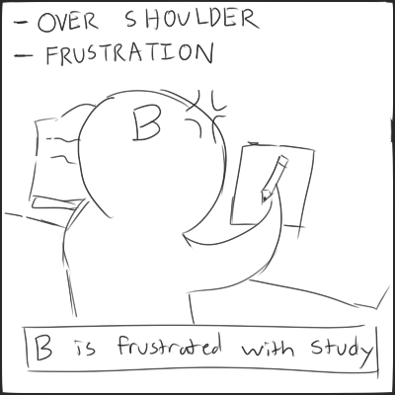
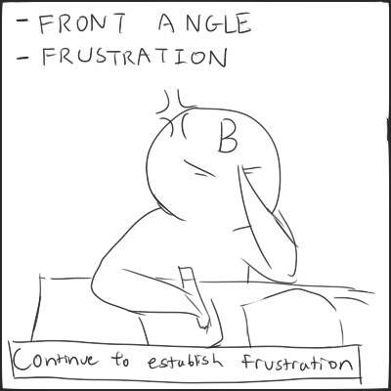
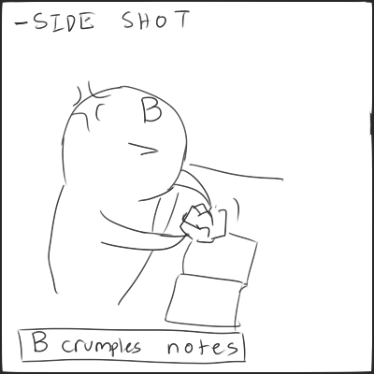
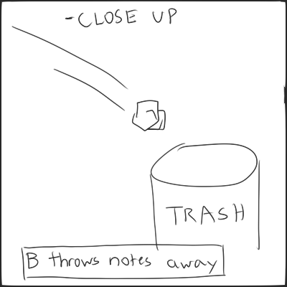
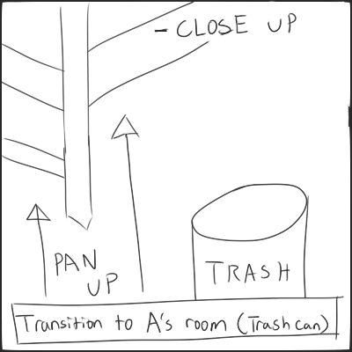
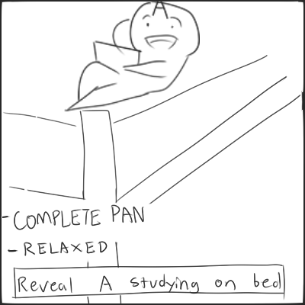
Moderate Task: Storyboard

Slide 6
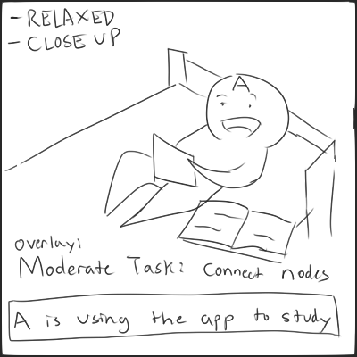
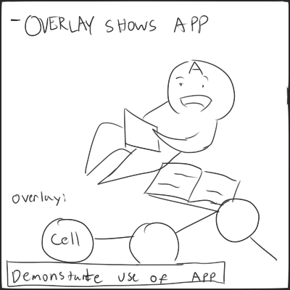
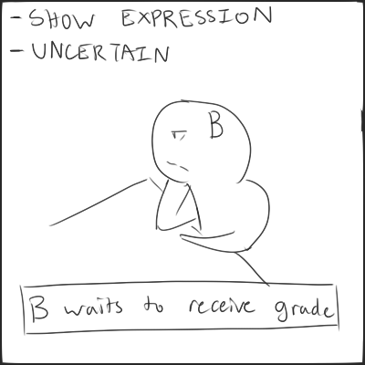
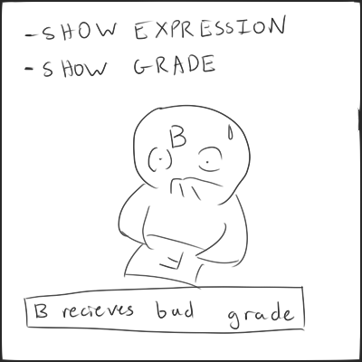
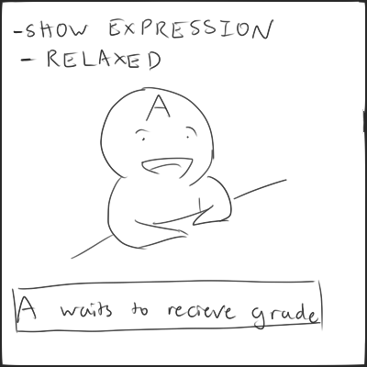
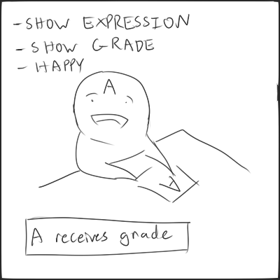
Moderate Task: Storyboard (cont.)

Slide 7
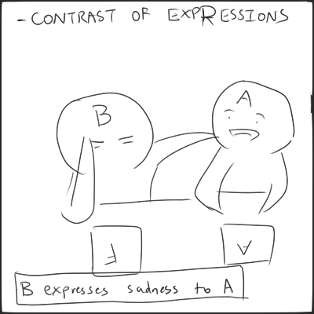
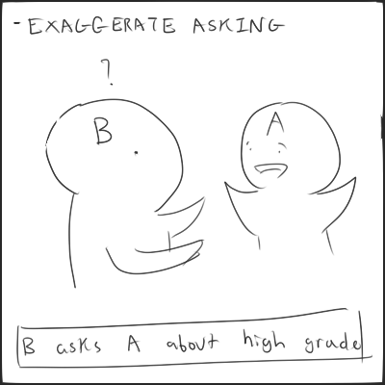
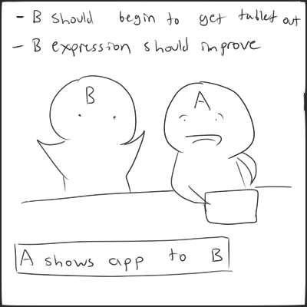
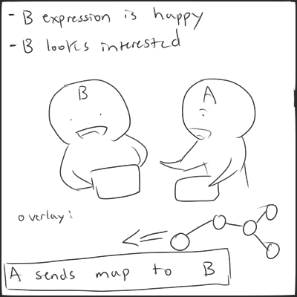
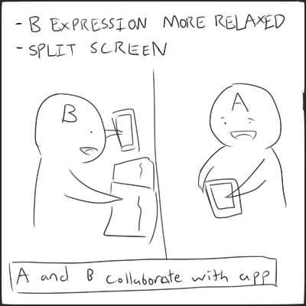
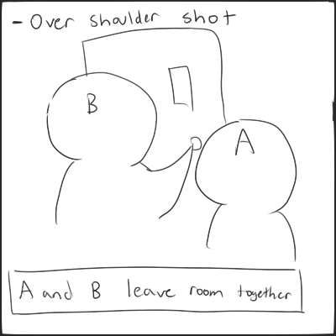
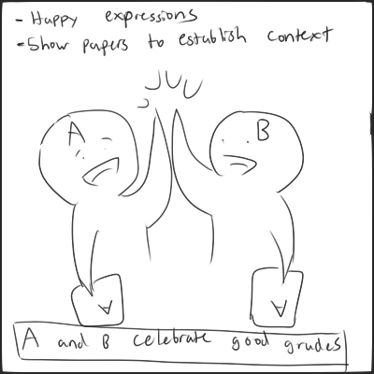
Complex Task: Storyboard

Slide 8
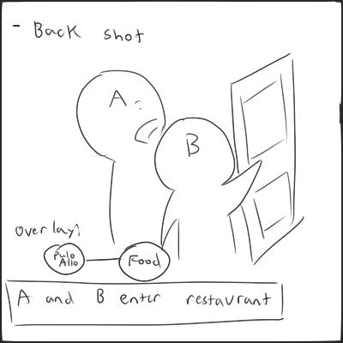
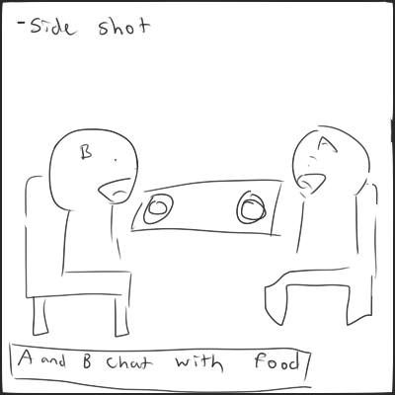
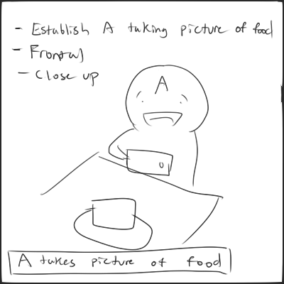
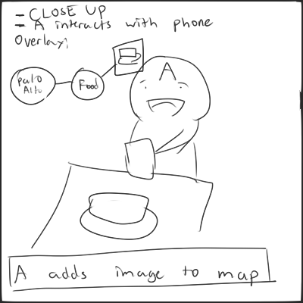
Complex Task 2: Storyboard

Slide 9
Concept Video
https://youtu.be/D54G55RFSxM
https://vimeo.com/142689888

