Slide 1
Facilitating Creativity
Mike Yu, Darby Schumacher, April Yu, Alex Lin

Slide 2
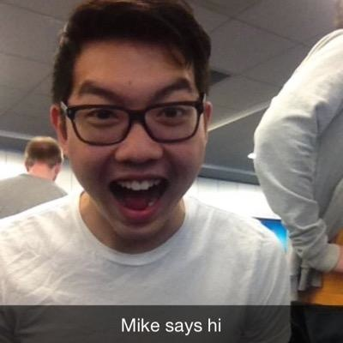
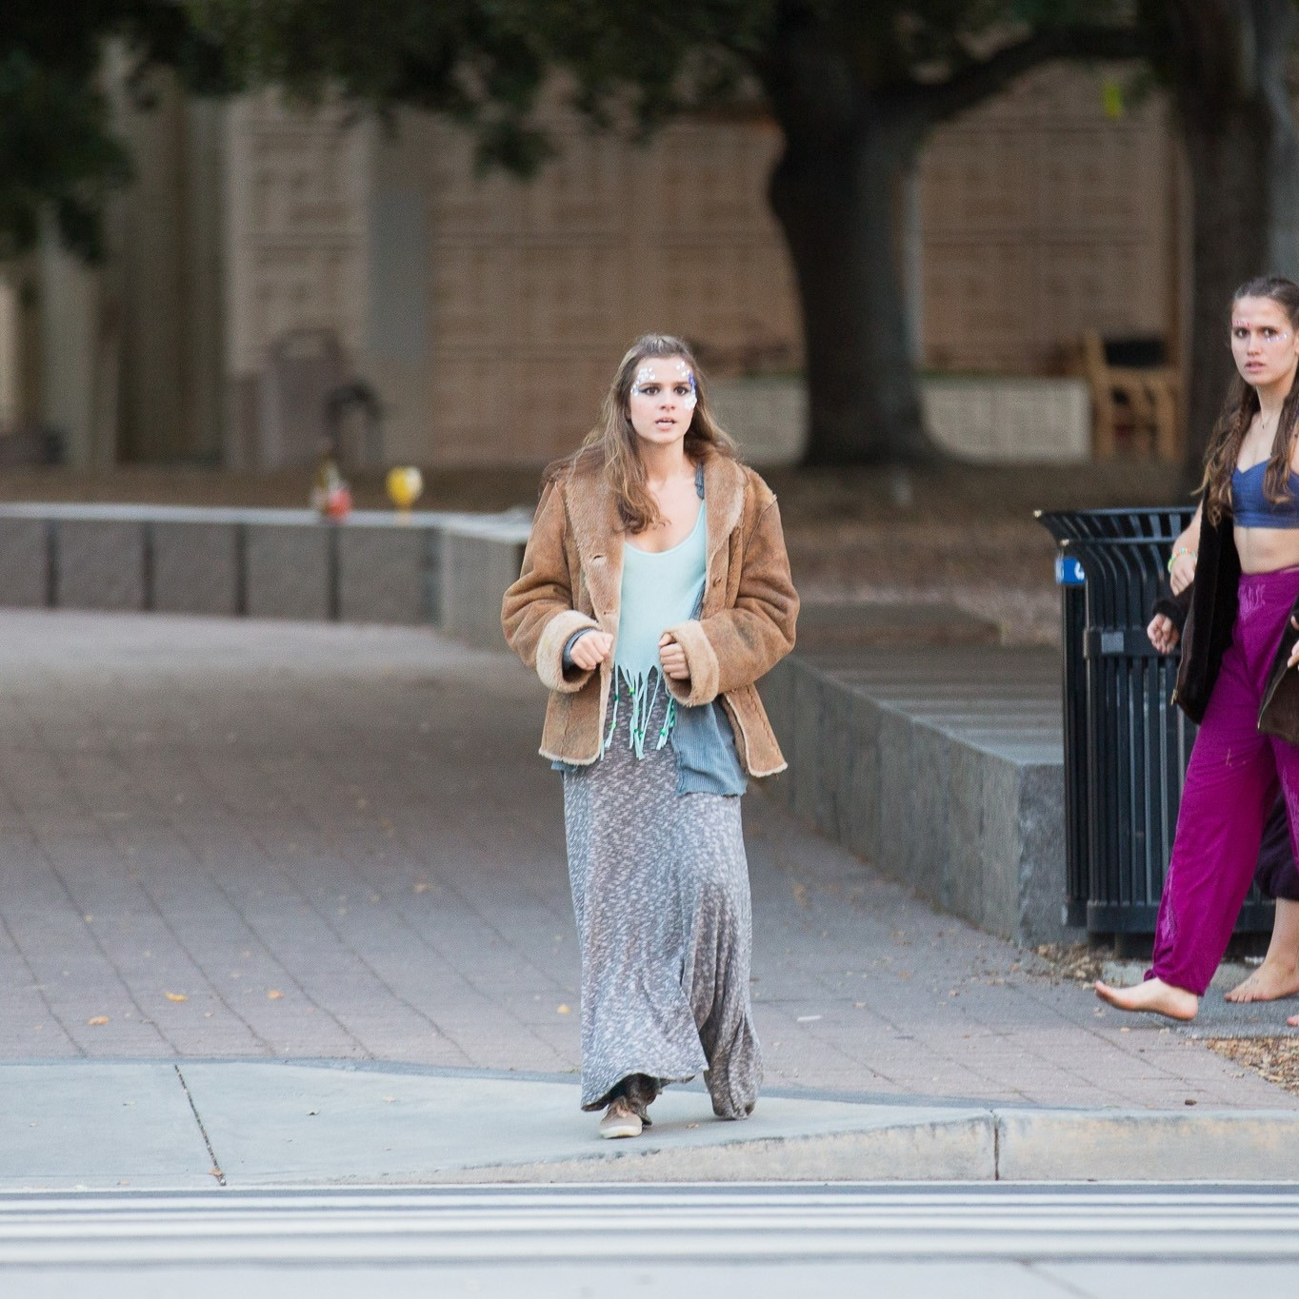
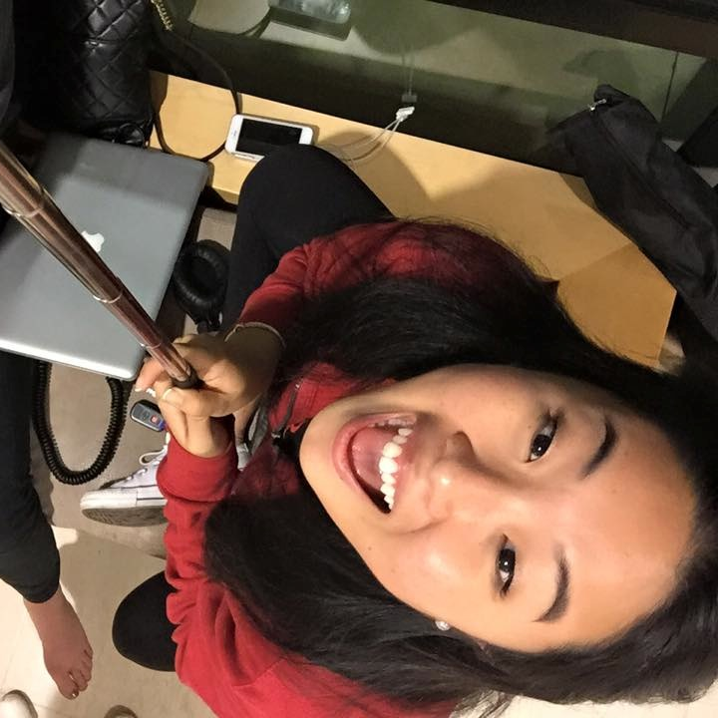
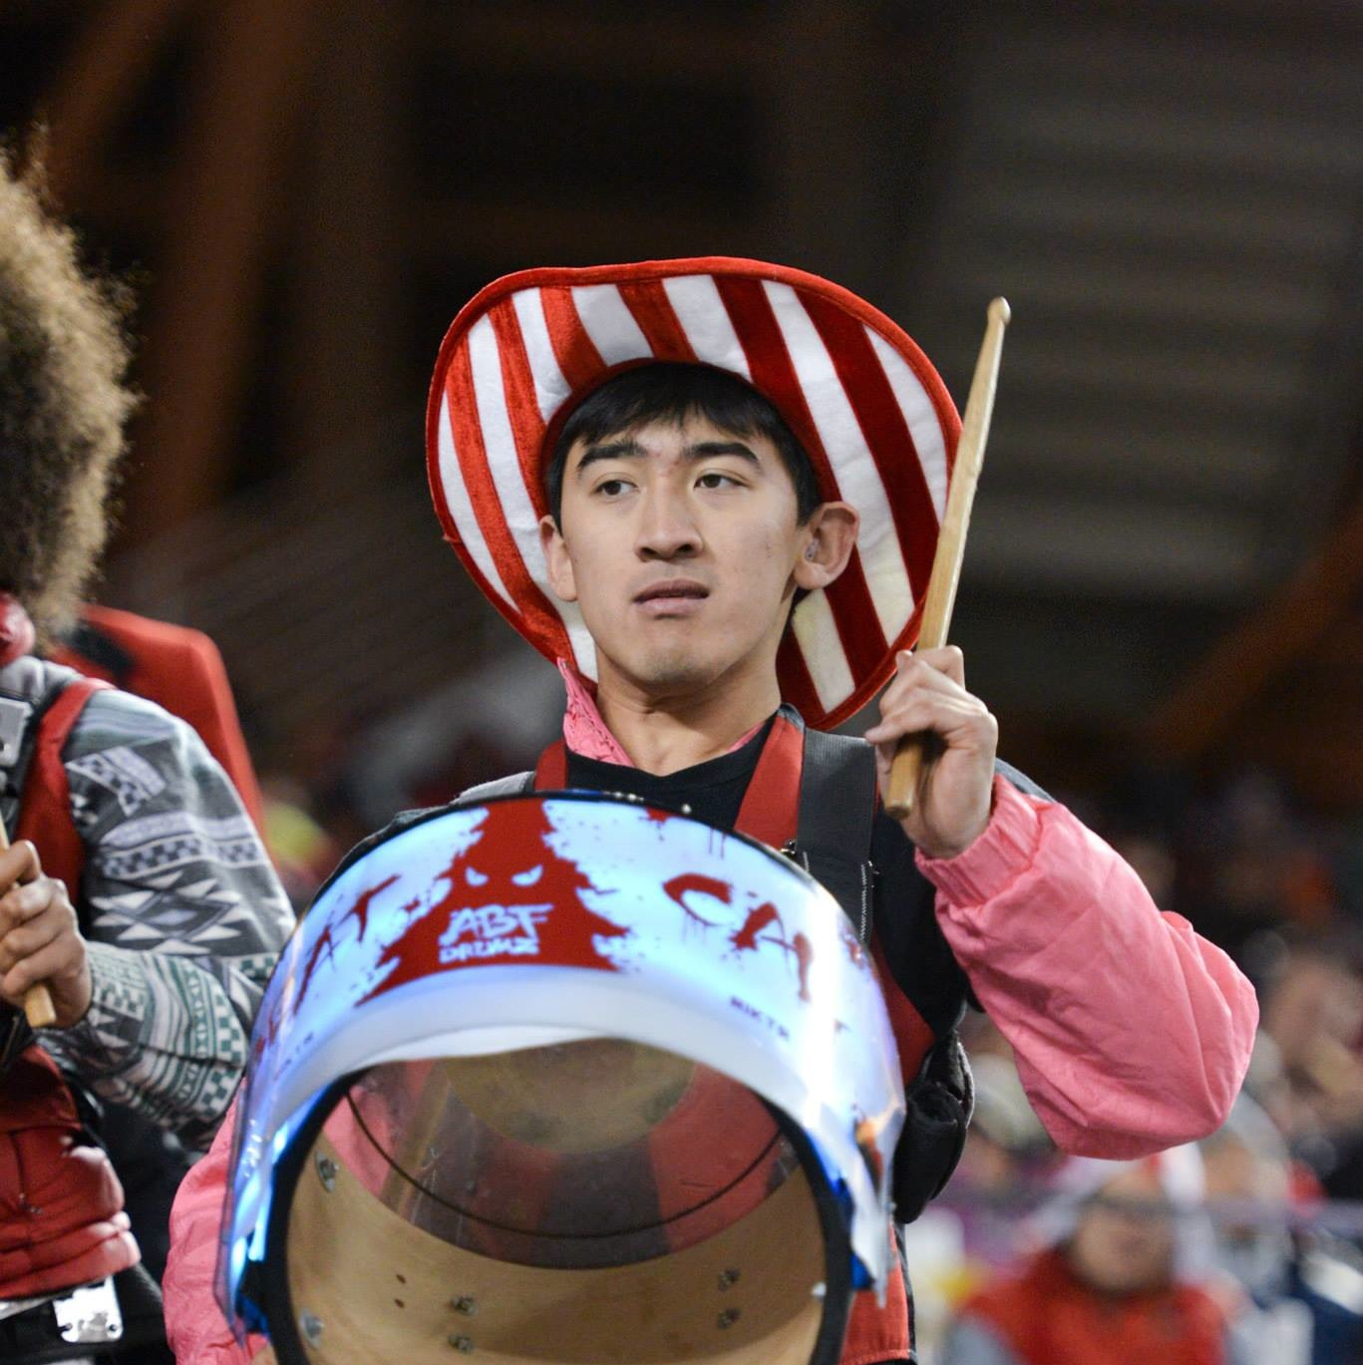
Team:
Mike Yu
Darby Schumacher
April Yu
Alex Lin

Slide 3
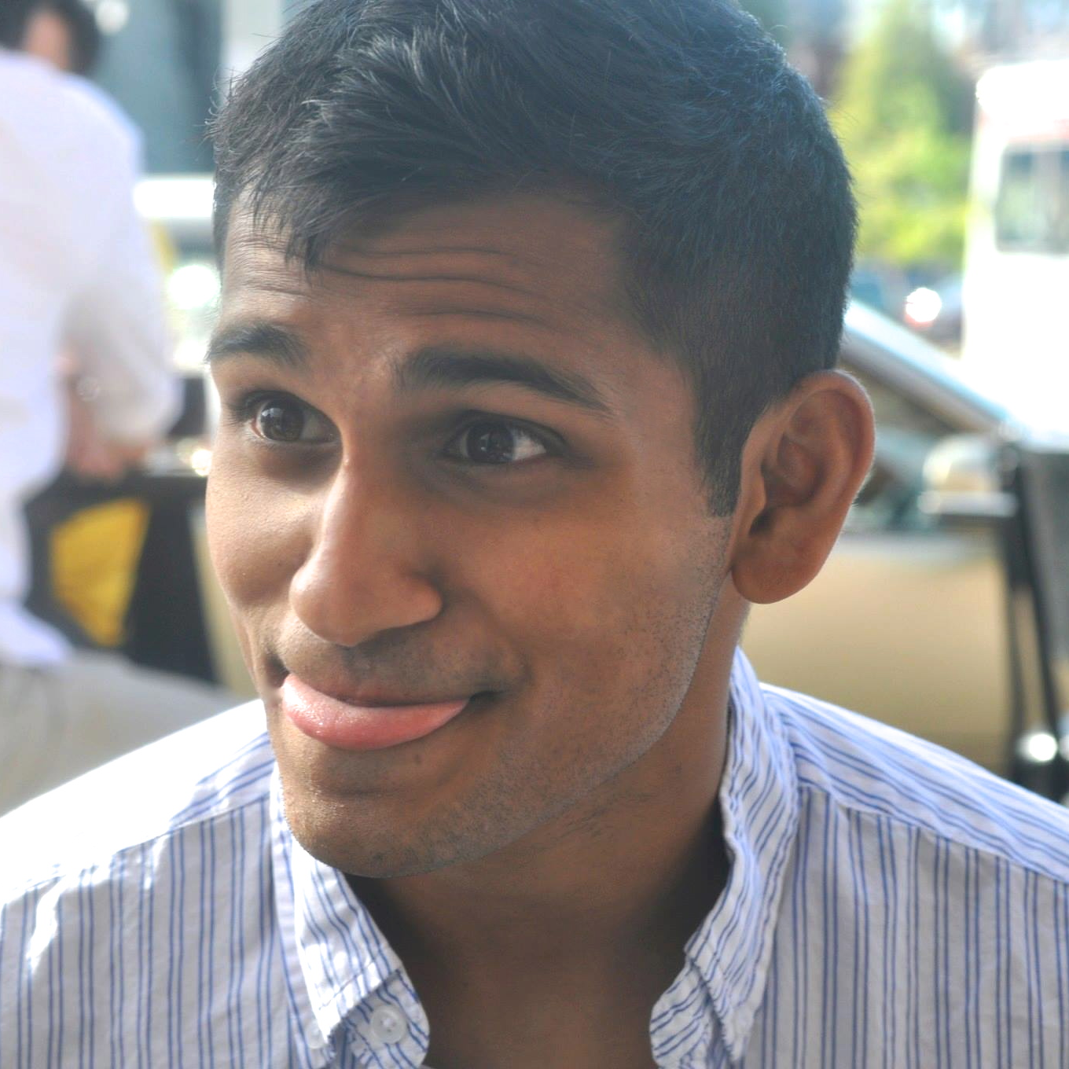
Ankit Shah
Age: 24
Founder, Tea with Strangers
“the most important thing about creative ideas is remembering a few key context points about where they came from.”

Slide 4
We Met…
An entrepreneur who finds inspiration organically
We were amazed to discover…
He believes that context is a huge part of an idea and accordingly has to record a lot
We wonder if this means…
He has a hard time staying excited about an idea when he’s out of context that led to it
It would be game-changing if…
He could create in the moment, while the idea is still fresh

Slide 5
How might we…
Create “moments” of inspiration in his creative workspace?
Leverage his surroundings to enable him to be creative?
Build him a toolkit to carry with him to create on the go?
Introduce him to communities that inspire him while he is working?
Remove the need for inspiration to be creative?
Make creative work more mobile and natural, like email?
Enable him to keep ideas “fresh” longer?
Help him sustain excitement about new ideas?
Create a platform where he can document his scribbles and doodles and categorize them?
Foster an environment in which ideas are easily solidified into plans?

Slide 6
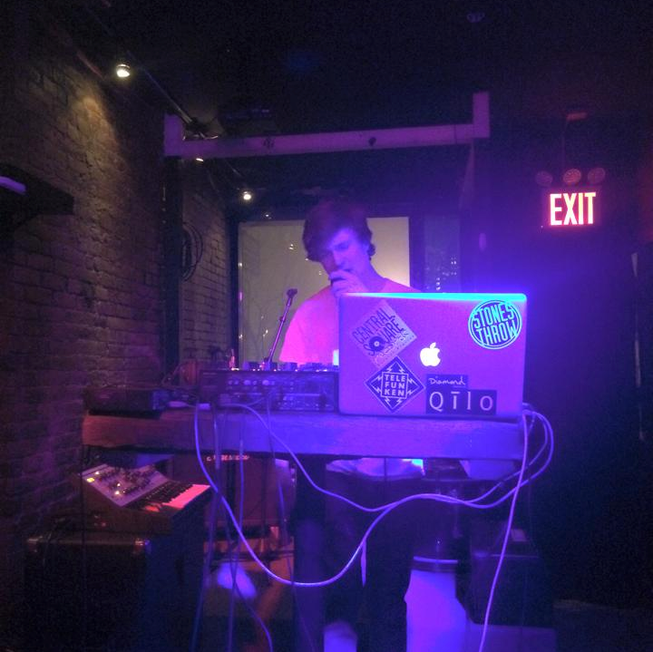
Harrison Holmes
Age: 19
Music Producer and DJ
“I used to use voice memos to record a tune or something… a friend found them in a folder and remixed them into songs and it was super embarrassing.”

Slide 7
We Met…
A DJ who prefers to write instrumentation before lyrics
We were amazed to discover…
He tries to memorize his tunes because singing them into a voice memo is too embarrassing
We wonder if this means…
It’s very important that each step of a process is professional and production quality
It would be game-changing if…
He was able to be proud of each stage of his work

Slide 8
How might we…
Streamline his process so that each step is professional?
Celebrate the rough drafts that come with creating something great?
Teach him not to fear failure?
Free him from concern about what others think?
Build tools that make each step of the process beautiful?
Make his intermediate work the most rewarding work to reflect on?
Introduce him to communities that value incomplete work?
Encourage audiences to listen to and value incomplete music?
Give him a platform to share and be proud of the work that is incomplete?
Leverage his fear of embarrassment to improve his work?

Slide 9
Cathlyn Jones
Age: 19
Vine Superstar
“Business videos get ten days, but personal videos only get twenty minutes max.”

Slide 10
We Met…
An avid social media user with over 250 thousand vine followers
We were amazed to discover…
She spends orders of magnitude more time on sponsored/professional content vs personal
We wonder if this means…
She values her professional and paid work more than her creative and spontaneous
It would be game-changing if…
She was empowered to have creative direction and freedom in professional content

Slide 11
How might we…
free her from commercial obligations?
use her creativity and short development cycles as an opportunity for sponsorship?
make her professional process about authenticity rather than polish?
Remove the pressure to produce “professional” content
Leverage professional sources to improve her creativity?
Celebrate her creative work more than her sponsored work?
Connect her with sponsors who value her personality of work?
Provide her with tools to create professional content more easily?
Enable her to be her own sponsor?
Encourage her community to demand more authentic and organic work?

Slide 12
How might we make creative work more mobile and natural, like email?
Parse writing and sketch it
Ability to pull up color swatches based on language
Parse sound and transcribe to notes
Palette creator based on pictures
Automatic font generator for photos
Ability to automatically pull inspiring features out of photos
Color and fonts generated based on music
Random chord/color/word generator
Carry mobile 3D printers
Scan surroundings and recreate virtual reality space

Slide 13
How might we give him a platform to share and be proud of the work that is incomplete?
Artists-only social application
Archives of rough drafts of great work
Constant life video stream
Community service that promotes “rough” content
App that forces artists to record something rough daily and post
Instruments/Recording sets that broadcast everything he does
System that stores “progressions” of the same work
Create music platform that only lets you work on a piece for ten minutes
Improv concerts
Private paparazzi everywhere

Slide 14
How might we provide her with tools to create professional content more easily?
Artificial intelligence to edit videos
High quality mobile camera
“Video filters”
Audio filters
Gyroscope app that works in tandem with camera to keep level
Better phone flash
Mobile video editing
Self-editing editing program
Computer vision to scan videos and make sure fulfills sponsorship
Sharing for videos to enable professionals to edit while she is filming

Slide 15
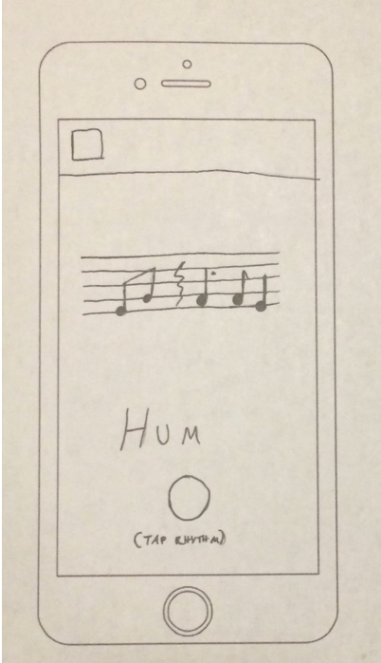
Prototype 1: Hum
We designed an application where a user could hum a tune and tap out a beat on an iPhone screen and it would be transcribed into sheet music with an attached mp3 file of the hummed tune.

Slide 16
Prototype 1: Hum
Things that Worked:
Things that Didn’t:
Tool to record inspiration on the go
Lyric Transcription not desirable
Surprises:
New Learnings:
Professionalism very important
Beats important to record as well!

Slide 17
Prototype 1: Hum
important to let the user record the beat first and then the melody
Transcription of lyrics was not as much of a “want” as we expected

Slide 18
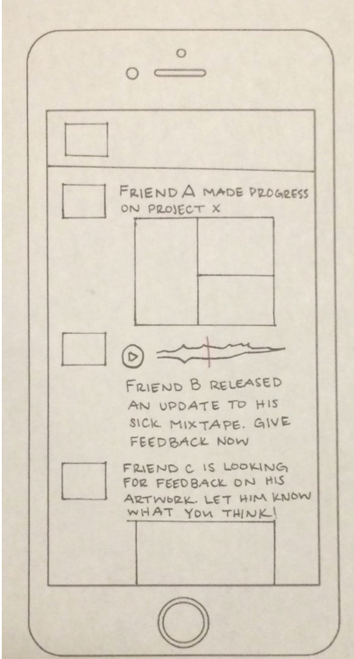
Prototype 2: Version Control
We essentially designed a version control-like platform for creatives that allows for other artists/creatives to comment feedback during the creation process.

Slide 19
Prototype 2: Version Control
Things that Worked:
Things that Didn’t:
Could help amateurs
Artists don’t want to expose vulnerability
Surprises:
New Learnings:
People want to hide their creative process
Art is currently not seen as iterative - why?

Slide 20
Prototype 2: Version Control
“art is binary. It’s either finished or it’s not”
“This exposes an artist’s vulnerability, and I’m not sure they would be comfortable with doing that.”

Slide 21
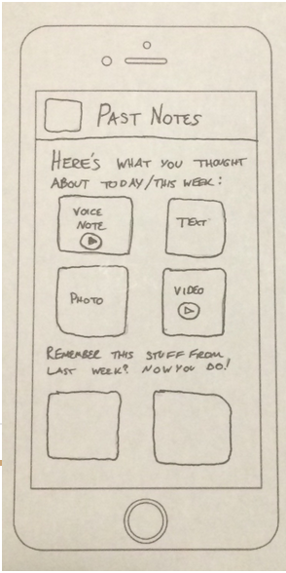
Prototype 3: Organic Documentation
We designed an app that is a platform for documenting memories, thoughts, and ideas, and allows for a chronological time view of all logged “momentos” and allows for users to decide when they will be reminded of the idea — time-based, activity-based, or location-based.

Slide 22
Prototype 3: Organic Documentation
Things that Worked:
Things that Didn’t:
Users loved smart reminders
Not game-changing on a storage level
Surprises:
New Learnings:
People often forget things they want to do
Behavioral triggers very valuable in process

Slide 23
Prototype 3: Organic Documentation
liked the idea of getting a push notification to return back to idea so that it doesn’t get lost in the abyss
“I always say I will go back and read my notes, but I often don’t. I check my e-mail every day though, so this would be a great fit for my daily schedule.”

Slide 24
ORGANIC DOCUMENTATION
Winner:
(with reminders!)

