Slide 1
10 Lines
Hi-Fi Prototype Midway Milestone
Selina Her
Nyasha Smith
Ben-Han Sung
Sarah Wymer

Slide 2
Heuristic Eval Summary
Lots of great feedback, thanks guys!
Severity 4 | 5
Severity 3 | 5
Severity 2 | 12
Severity 1 | 11
Notes:
So, I wanted to start off with the results of the heuristic eval from last week. Here’s a chart of all the violations you guys found...and uh, thanks for all the great feedback. We had a few more severity 4 points than we would have liked,

Slide 3
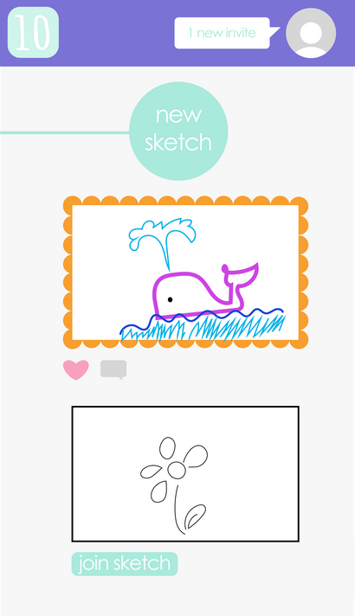
Anticipated (Visual) Changes
Consistency: Always your profile here
Show # of upvotes,
# of comments
Add Sketch titles
Indicate # of lines left. Possibly add sketch caption?
Notes:
So...based on your feedback, here are some changes that we’re planning to make. So, starting the with the home screen slash news-feed…
First...sketch titles
Second…# lines left
Third…ACTUAL # of upvotes..# of comments - will make purpose of these buttons clearer

Slide 4
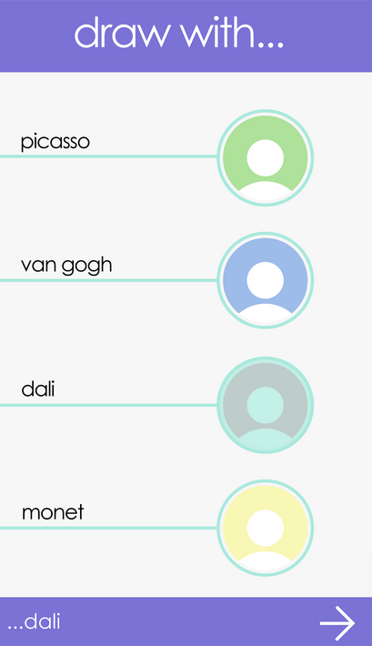
Anticipated (Visual) Changes
Organize names by friends you frequently draw with
Make it more obvious this is a multiple-select list

Slide 5
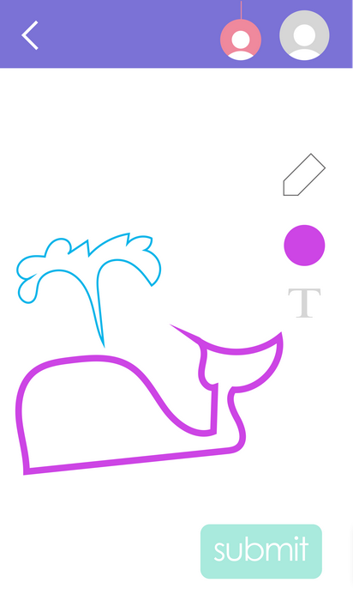
Anticipated (Visual) Changes
Back button warns user about losing unsubmitted changes
Consistency: Always you here
Show sketch title
Show remaining line count

Slide 6
Implementation: Tech Stack
Developing native iOS app with Xcode/Swift
Thanks Louis!
CS193P (iPhone and iPad Application Programming) lecture videos on iTunes U
UI assets created in Adobe Illustrator
Notes:
So...moving forward. We’re implementing our hi-fi prototype as a native iOS app. We’re using Xcode 7, Swift 2, and reading online tutorials and other things to get up to speed with iOS development. We went to Louis’ boot camp, and we’re also watching some of the lectures from Stanford’s iOS programming class, which is available on iTunes U.
We’re also making as many of our UI assets in Adobe Illustrator as possible, since we two really experienced designers on the team, in Selina and Sarah.

Slide 7
Notes:
So when we started coding….we realized this is pretty hard

Slide 8
Implementation: Challenges
Lots to learn, little development time.
Scaled down expectations?
Getting up and running with GitHub
New to most of the team
Collaborative iOS coding is hard
Storyboard files conflict all the time and have to be resolved manually

Slide 9
{ Insert Awesome Demo }

Slide 10
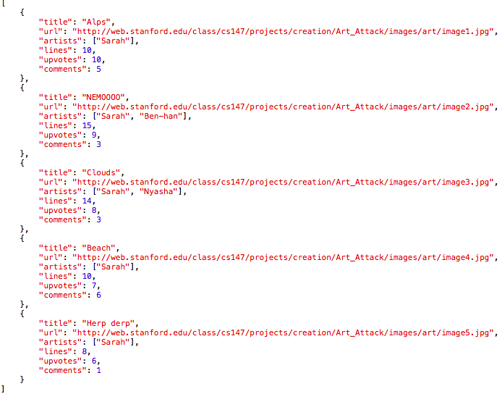
Milestone Task: Browse Art
Implemented features
Newsfeed
Pull-to-refresh
Upvoting
Commenting
JSON support

Slide 11
Next Up
Public/Friend invitation system (mock, at least)
Actual drawing interface
“Whiteboard”
Brushes (at minimum, a pen tool)
If there is time: real backend web services with node.js?
else, Wizard of Oz’ing your “friends” lines

