Slide 1
10 Lines
Medium-fi Prototype
by: Team Art Attack!
Selina Her
Nyasha Smith
Ben-Han Sung
Sarah Wymer
10/29/2015

Slide 2
Problem & Solution Overview
Value proposition:
Collaborative drawing for kickstarting creativity.

Slide 3
Tasks
Simple: Browse art
was: Look at other people’s art (for fun or inspiration)
Medium: Draw with a friend
was: Draw pictures with another person without being in the same place
Complex: Create with the public
was: Start visual dialogue with creative community

Slide 4
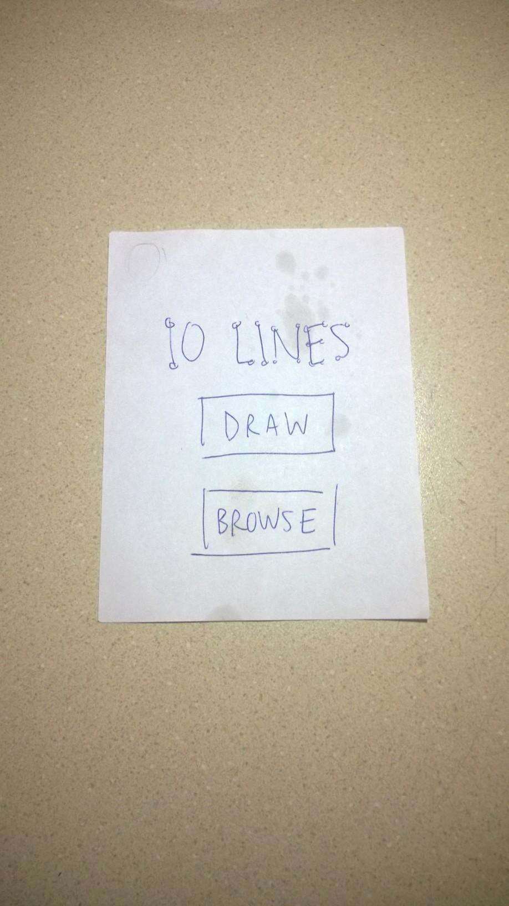
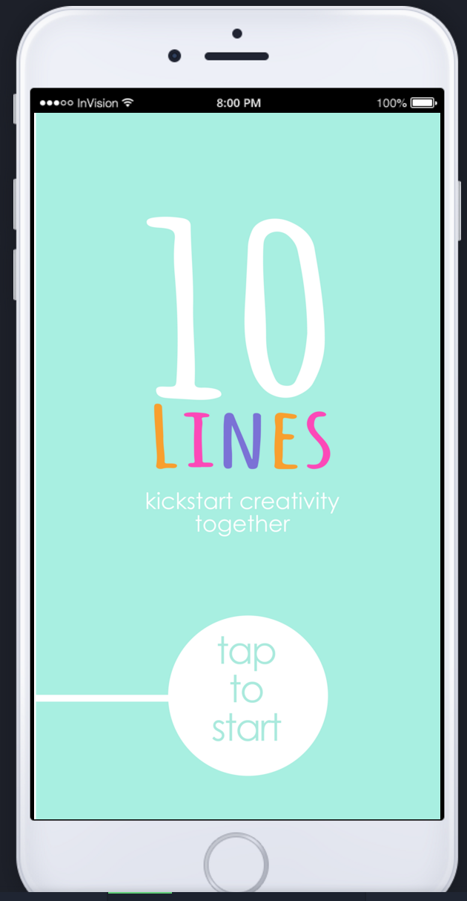
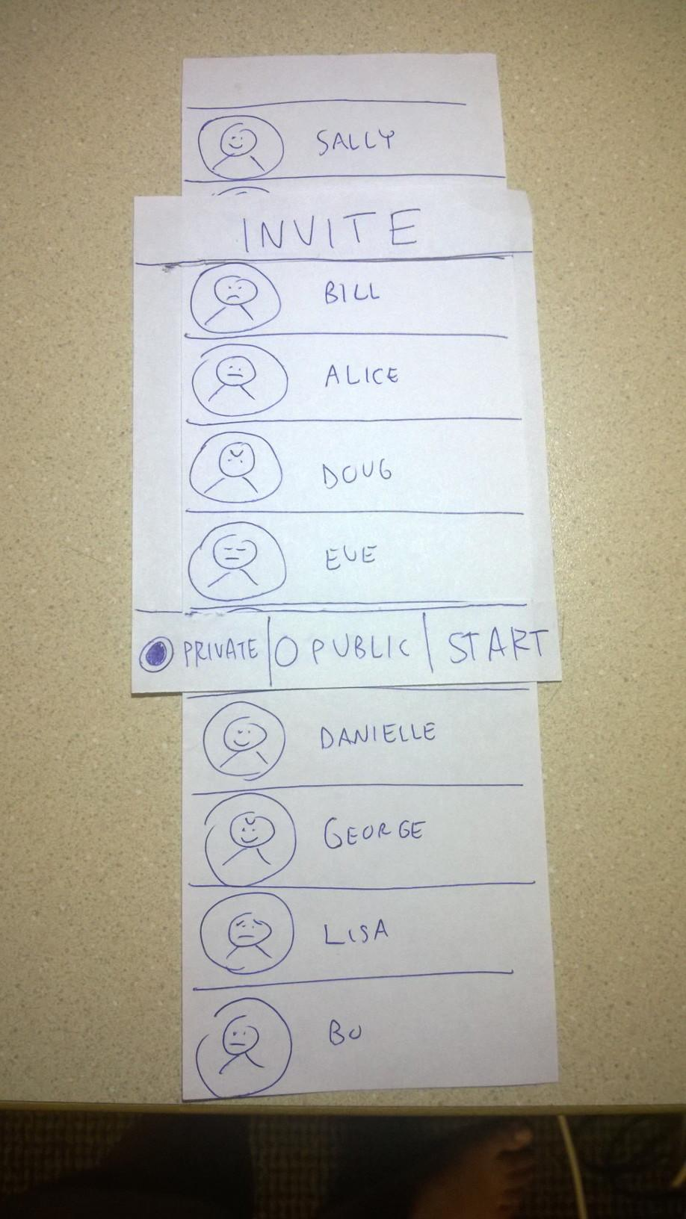
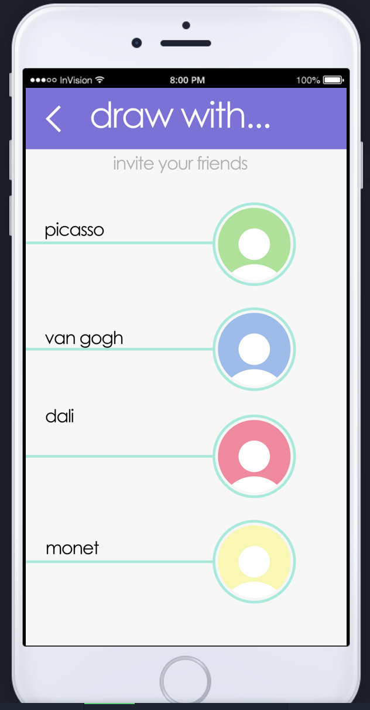
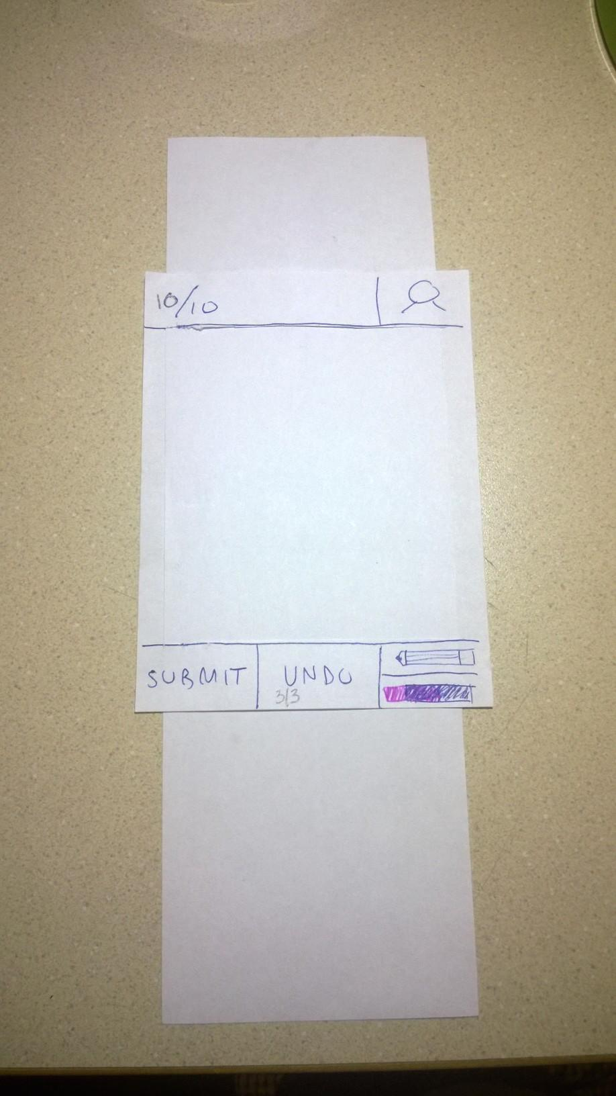
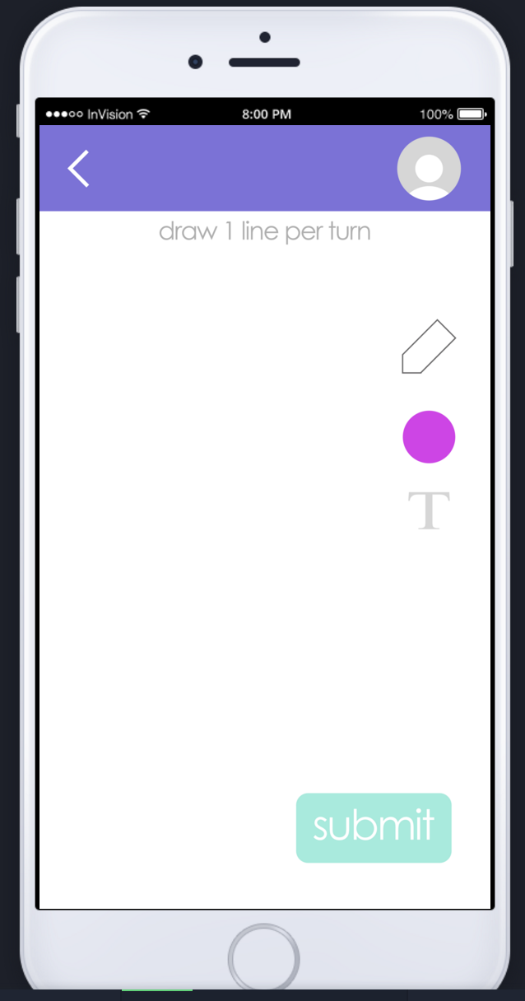
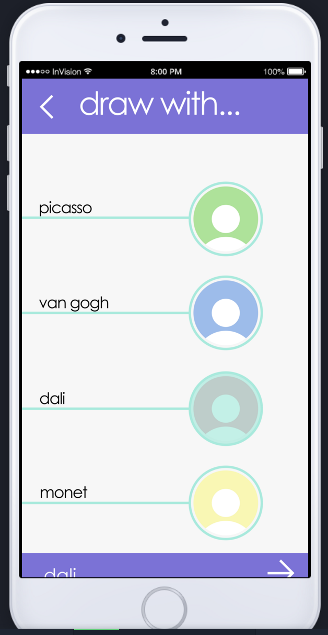
Revised Interface Design: Refined Ideas

Slide 5
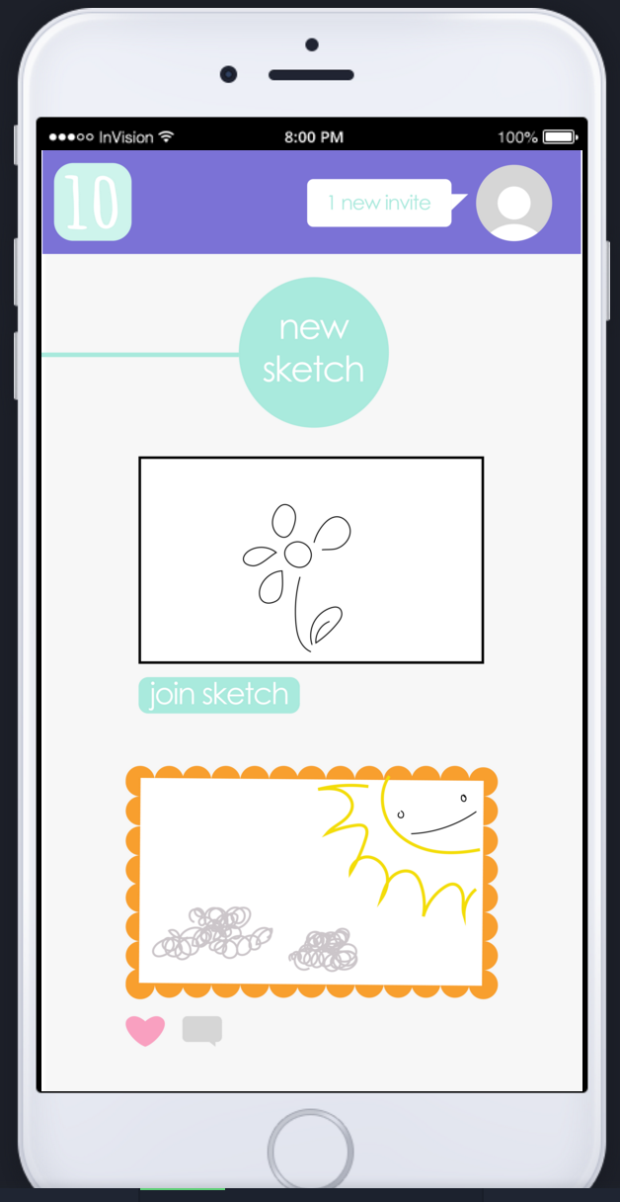
Revised Interface: Major Developments
Combo newsfeed/new sketch feature
Lots of streamlined task flows
screens eliminated
1 line per turn; 10 lines total
Creation of visual language
Circular buttons
Instructions in gray
Appropriate color use for emphasis
Golden frames vs black border

Slide 6
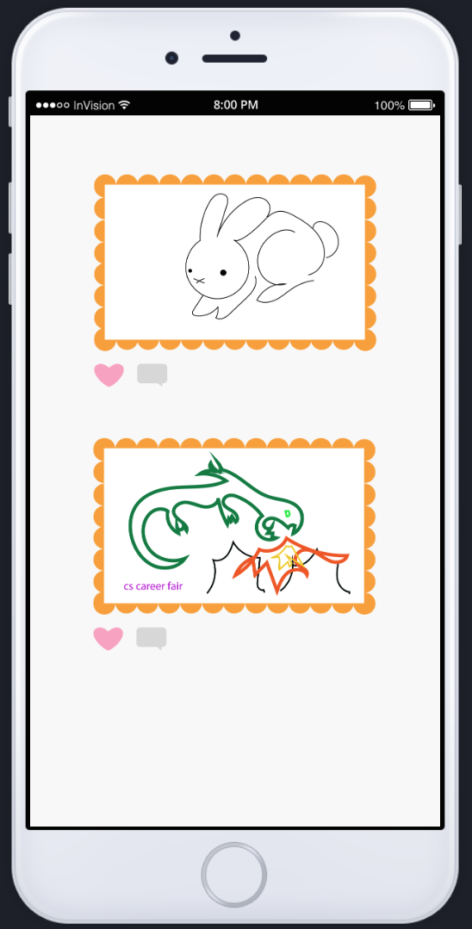
Task 1
Browse others’ work for inspiration
*example of current events commentary use case

Slide 7
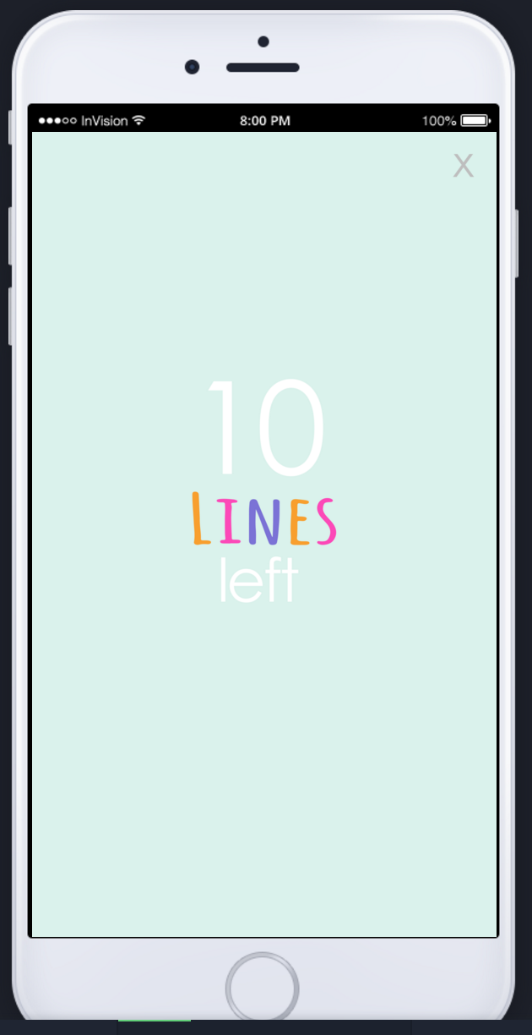
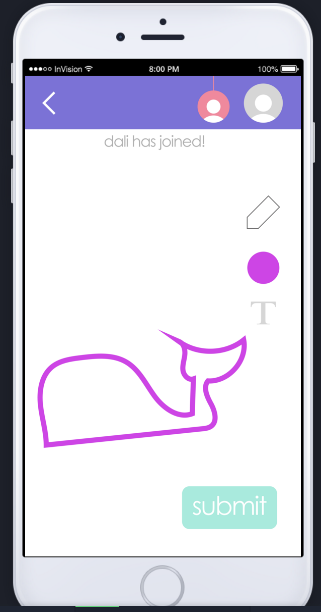
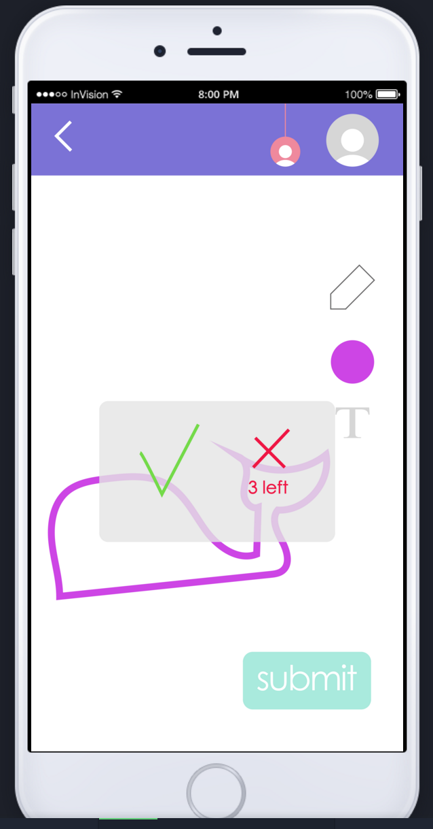
Task 2
Draw with
a friend

Slide 8
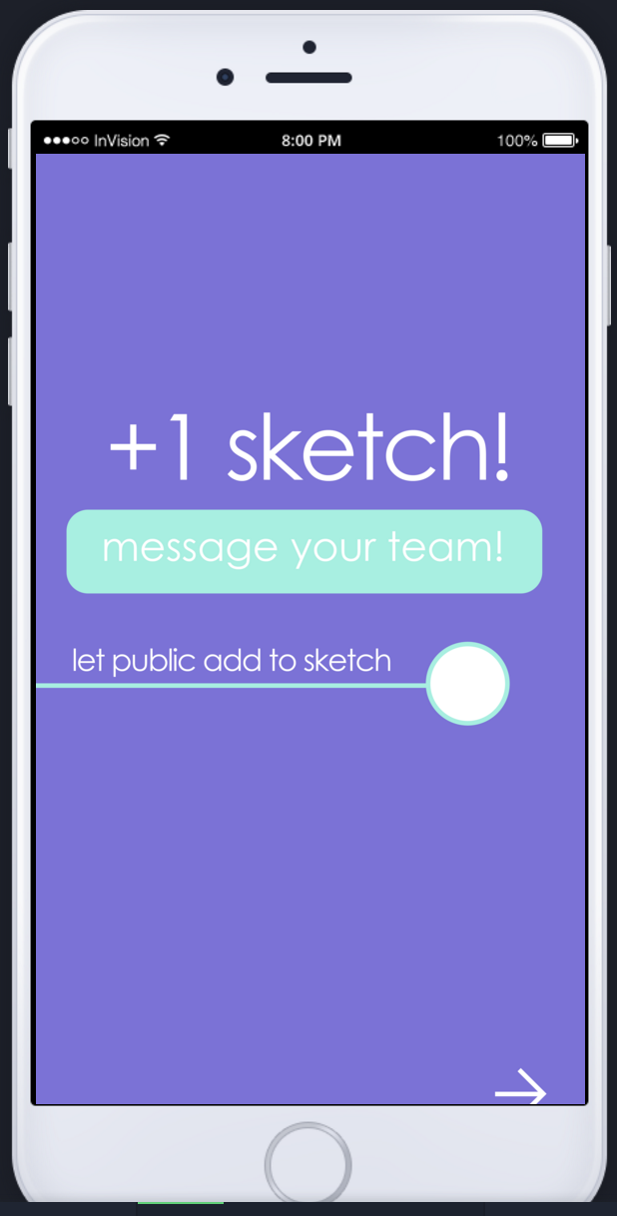
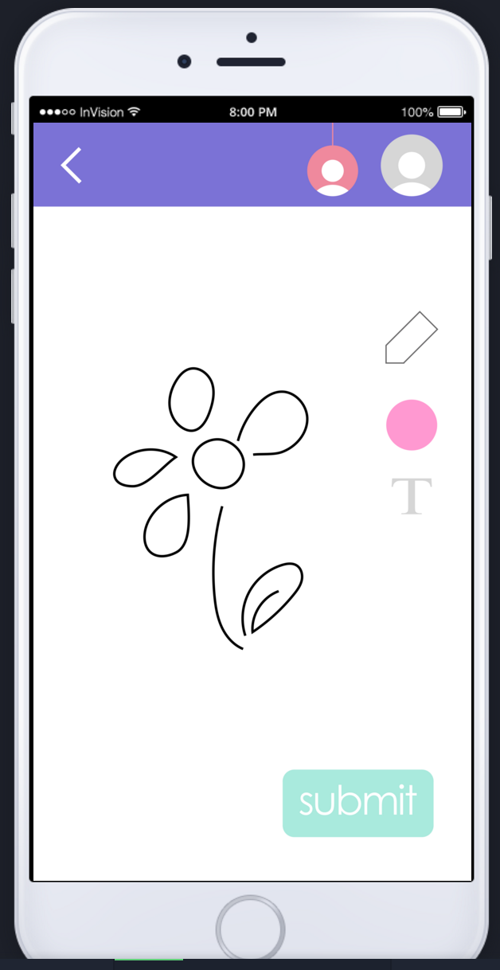
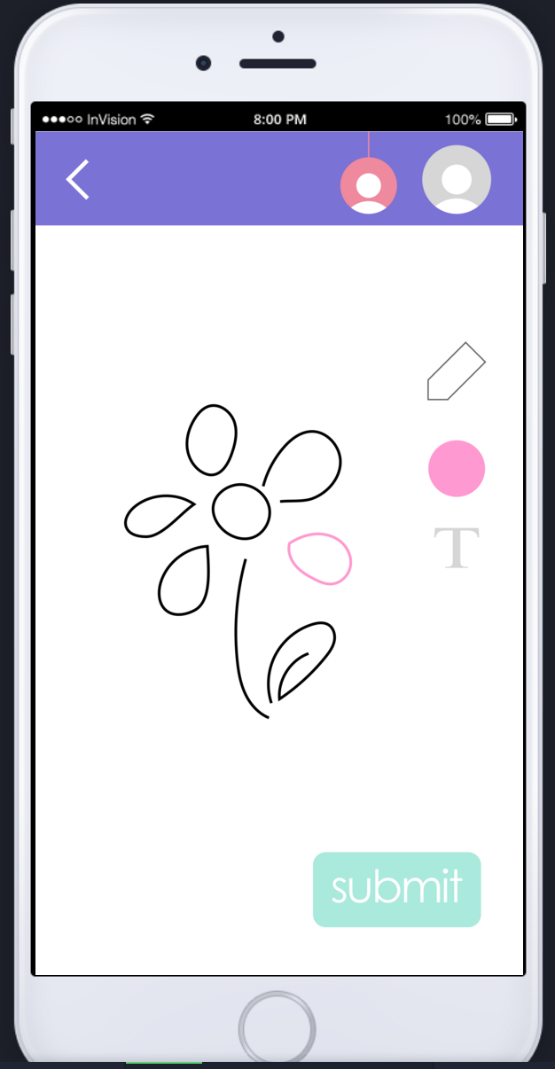
Task 3 Create with the public: 2 options

Slide 9
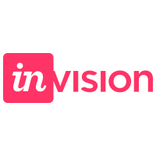
Prototype Overview
Our tools:
Illustrator

Slide 10
Prototype Overview
Benefit
better feel for the task flow, the vibe of the app
Wizard of Oz Techniques
real-time collaboration
simulated drawings
Limitations
InVision bugs
limited screens/
multi-purpose screens

Slide 11
Prototype Overview
Hand-coded features:
Message to friend*
Friend
list
Line
drawings
*see next slide

Slide 12
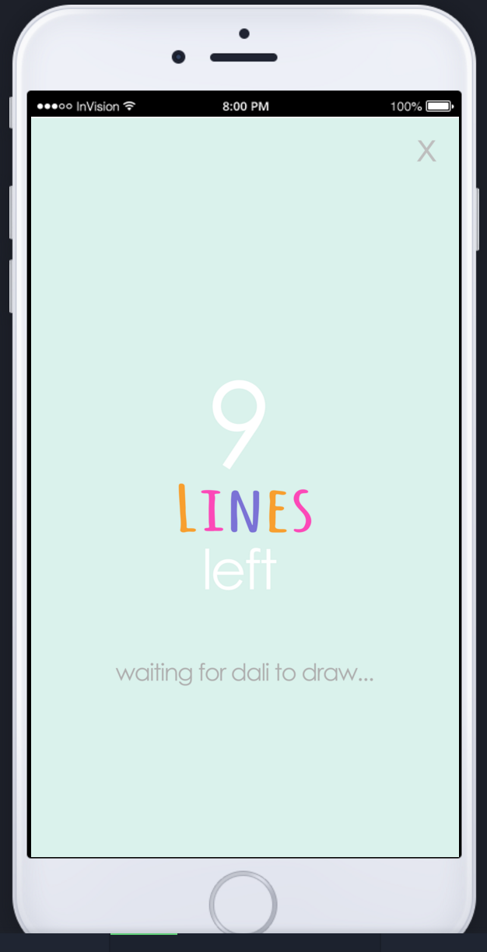
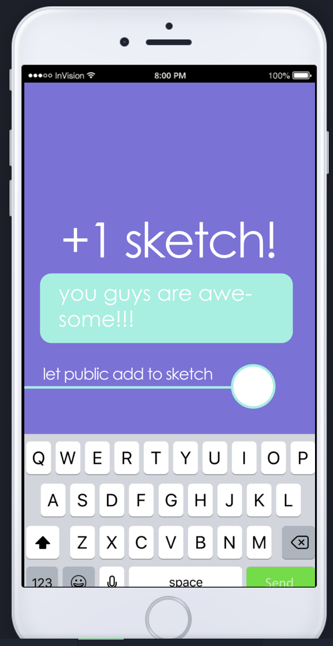
Additional Prototype Screenshots

Slide 13
Website+Prototype
http://web.stanford.edu/class/cs147/projects/creation/Art_Attack/

