Slide 1


Slide 2
Time Well Spent.
Phocus helps individuals and groups spend their times without the distraction of electronic devices.
We achieve this through a platform where people share their focusing successes and failures.

Slide 3

Task 1: Simple Task
An individual wants to focus on his or her work

Slide 4

Task 2: Medium Task
An individual wants a group to put away their phones and focus

Slide 5

Task 3: Complex Task
An individual fails to focus and must rise to the “dare” challenge
Notes:
based on use feedback we modified this task and I will touch on this soon

Slide 6
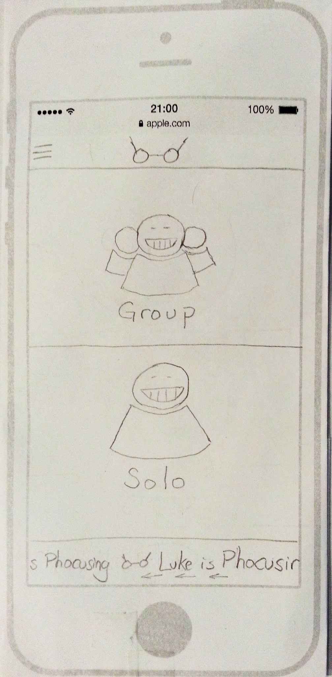
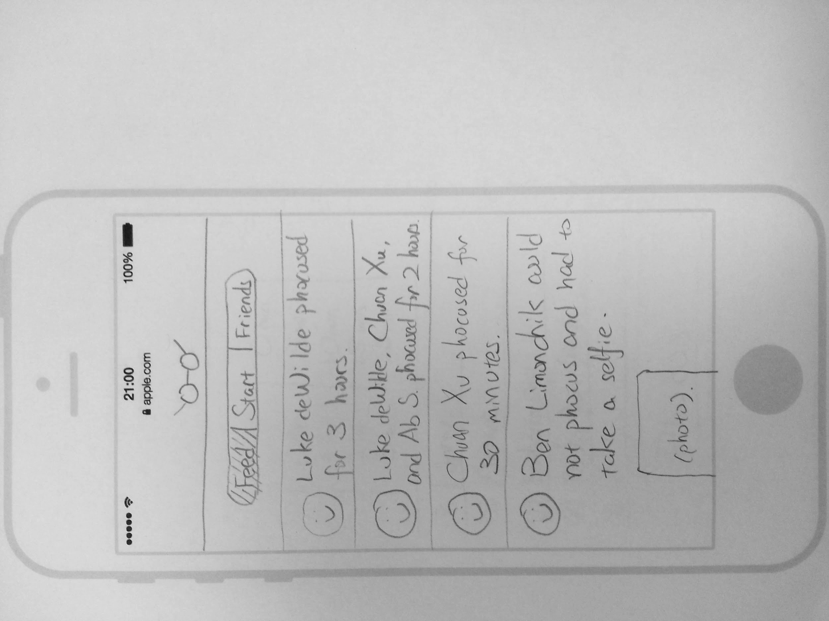
Major Design Change #1
Refashioned the Home Screen; Inserted the split display
Notes:
Rationale for change:
Users were confused about the home screen and spent a lot of time figuring out what is going on.
It seemed a little like choosing a mode in a game
We looked at a bunch of other apps to see what is the starting point and realized we should start with a split screen Starting from the news feed

Slide 7
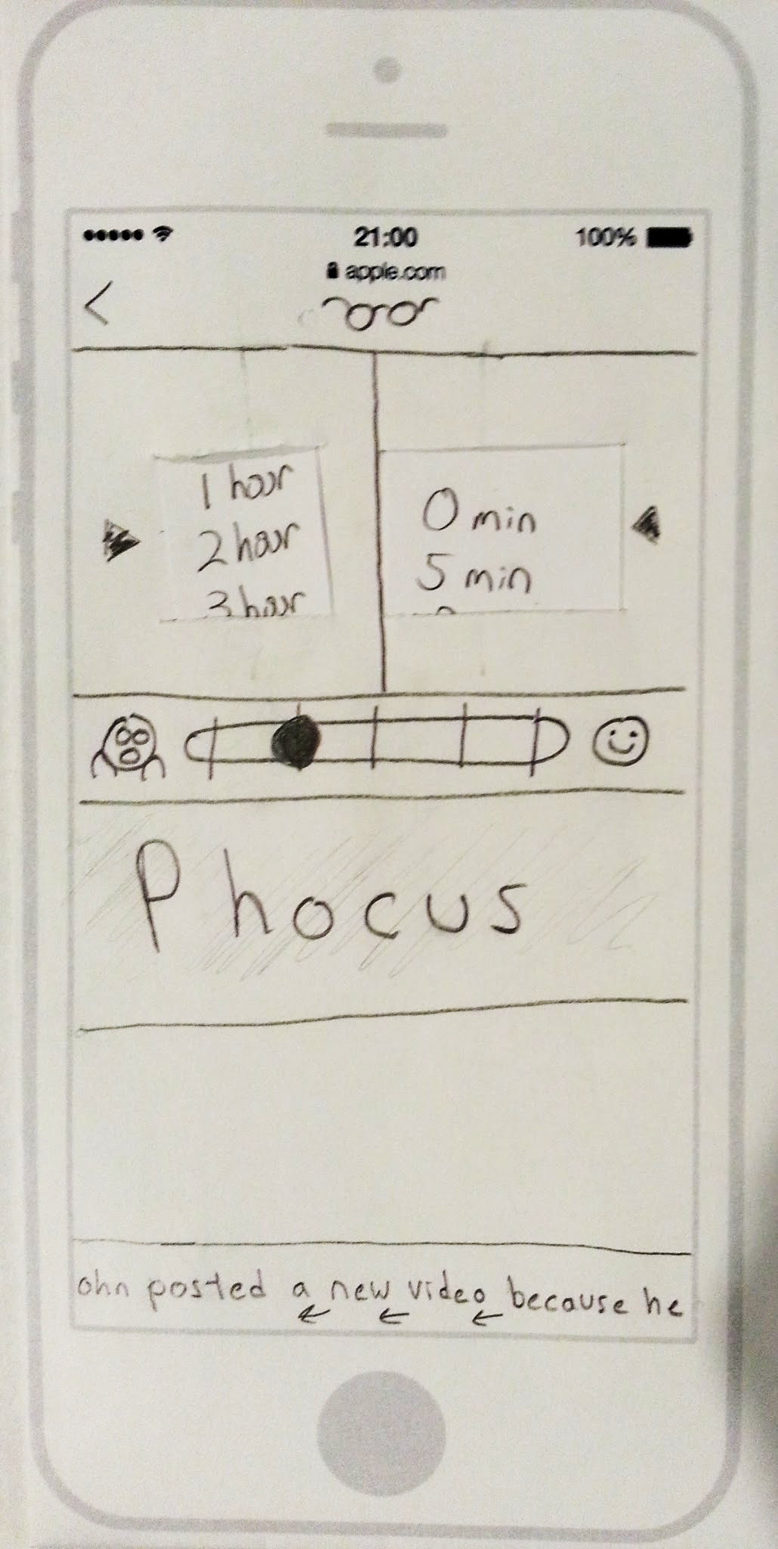
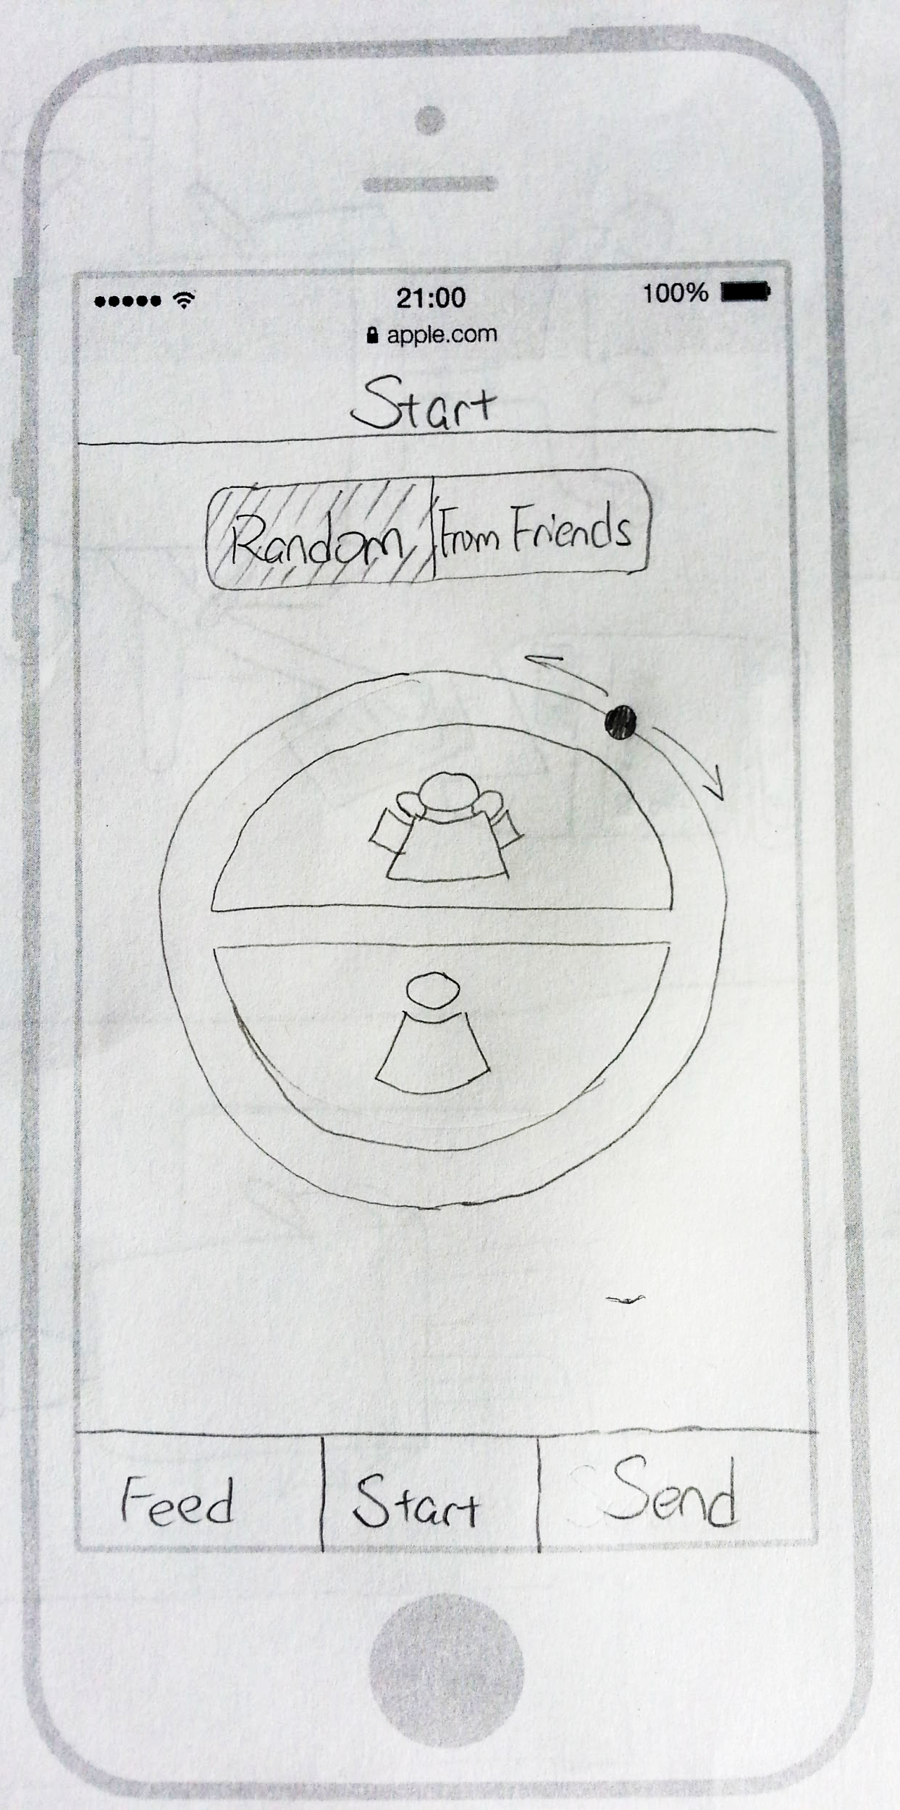
Major Design Change #2
Refashioned the Phocus session creation screen; create the dial
Notes:
Rationale for change:

Slide 8
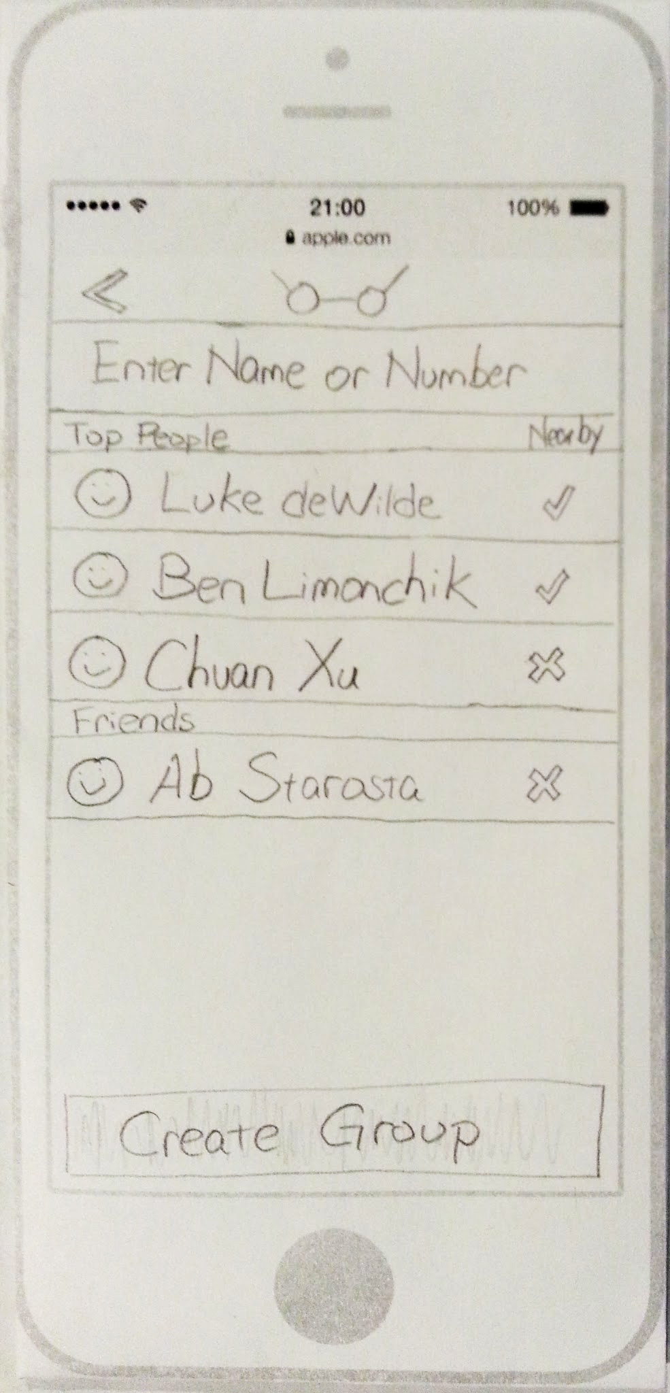
Major Design Change #3
Rearranged the order: set the group Phocus parameters before selecting members
Notes:
Rationale for change:

Slide 10
Medium-Fi Task #2

Slide 11
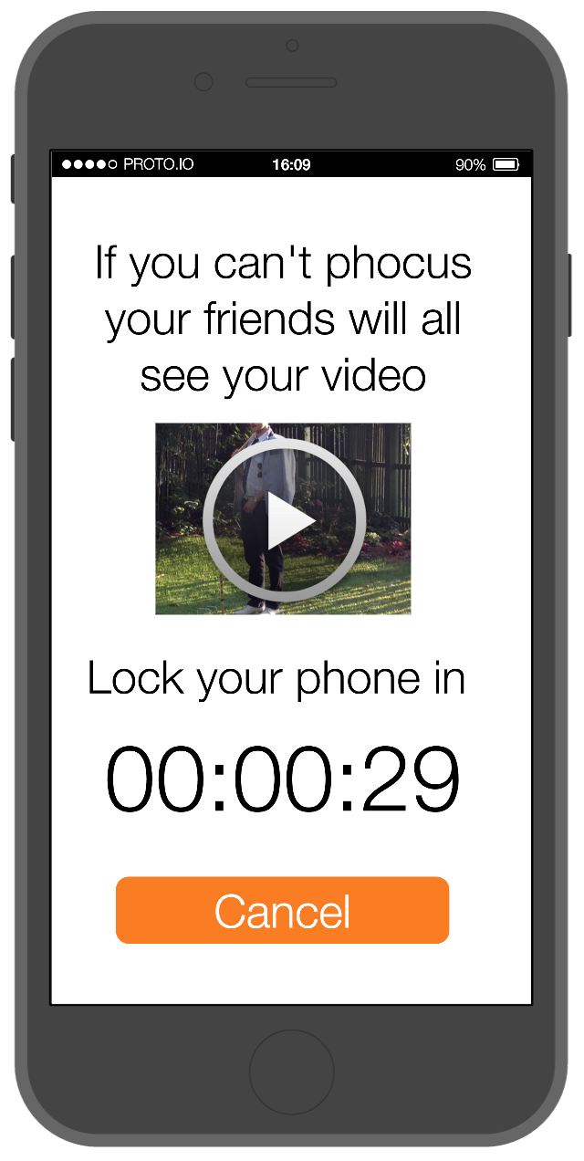
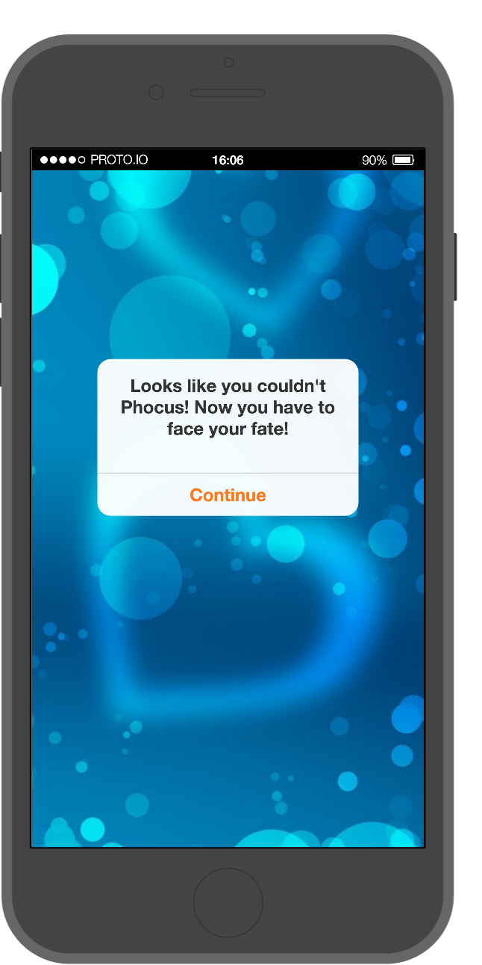
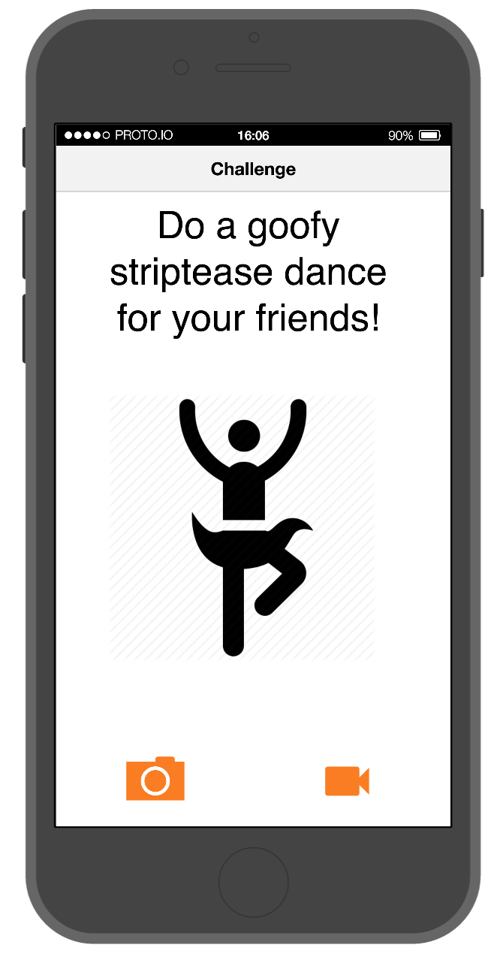
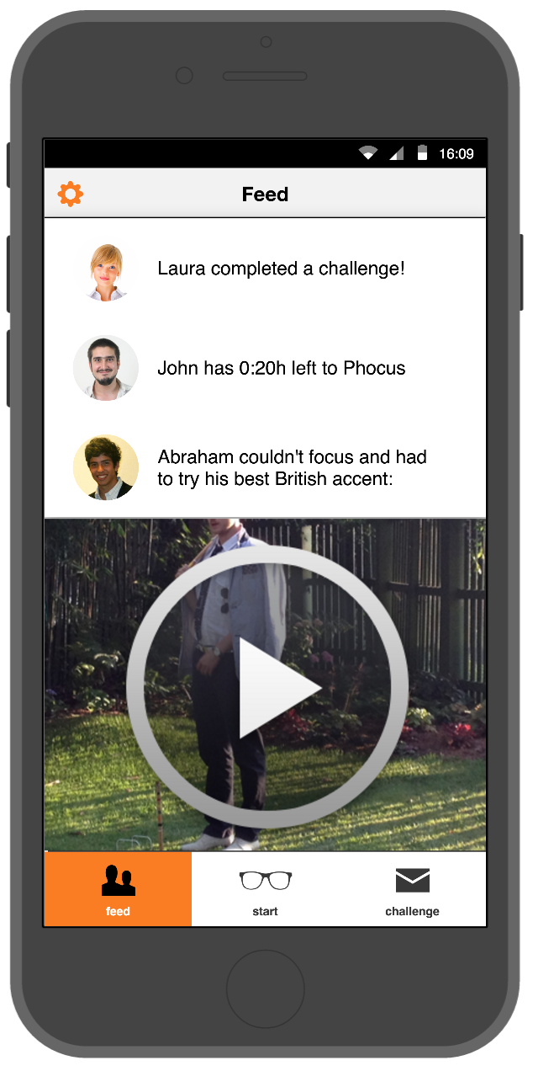
Medium-Fi Task #3

Slide 12
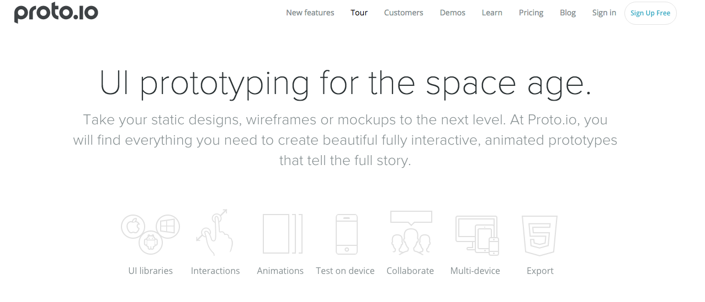
Prototype Tool

Slide 13


Prototype Tool
Environment highly similar to iPhone 6
Clean design
Difficult to create new buttons (e.g., the dial)
Time based transitions do not exist
Some app features are missing
Cannot edit simultaneously

Slide 14


Limitations and Tradeoffs
Left out
Wizard of Oz
Notes:
We took out setting due to low prioritization
WOO - we hand you the task

Slide 15
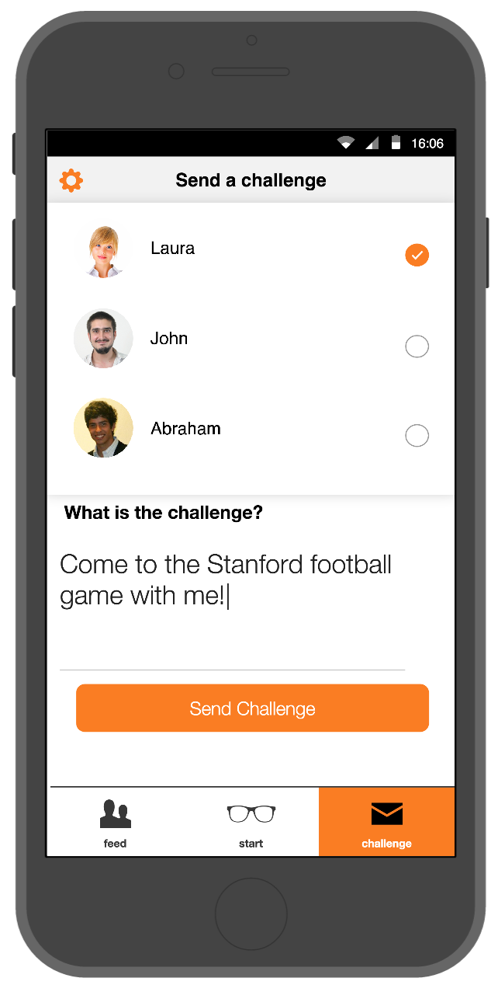
Prototype Screenshots
Notes:
based on user feedback we added an additional feature to customize the tasks someone gets when they fail to Phocus

Slide 17
http://web.stanford.edu/class/cs147/projects/behavior/Laser_Phocus/cs147website.html

