Slide 1


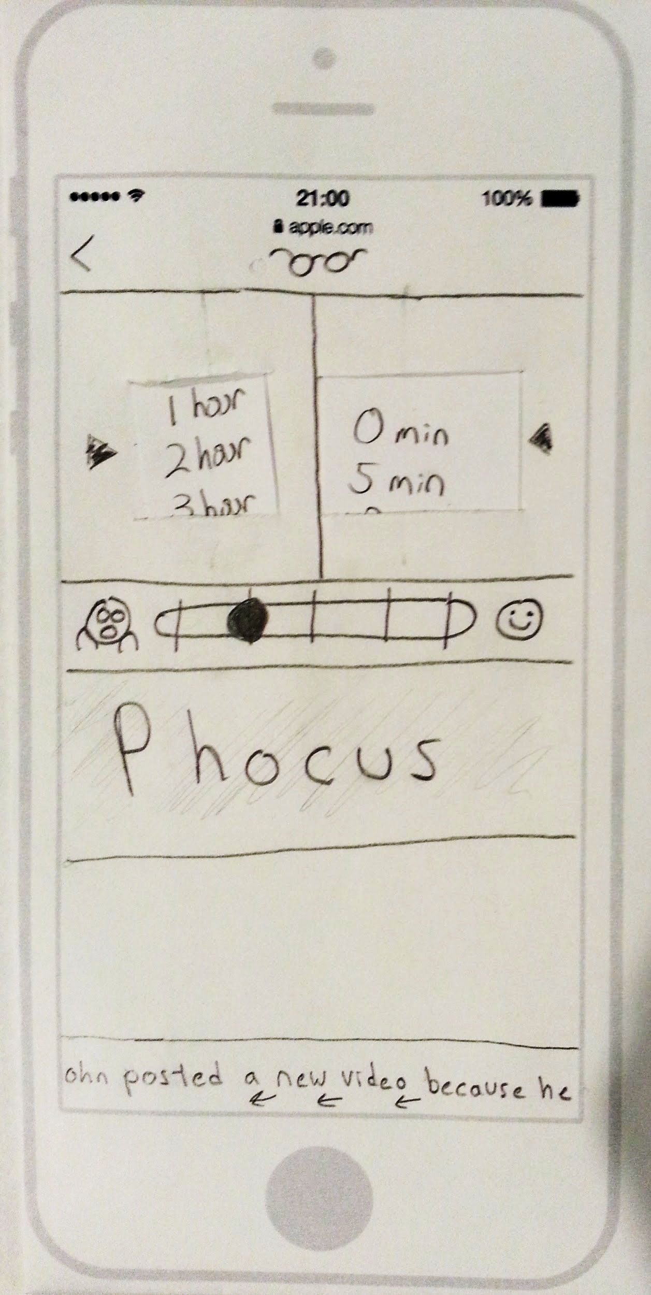
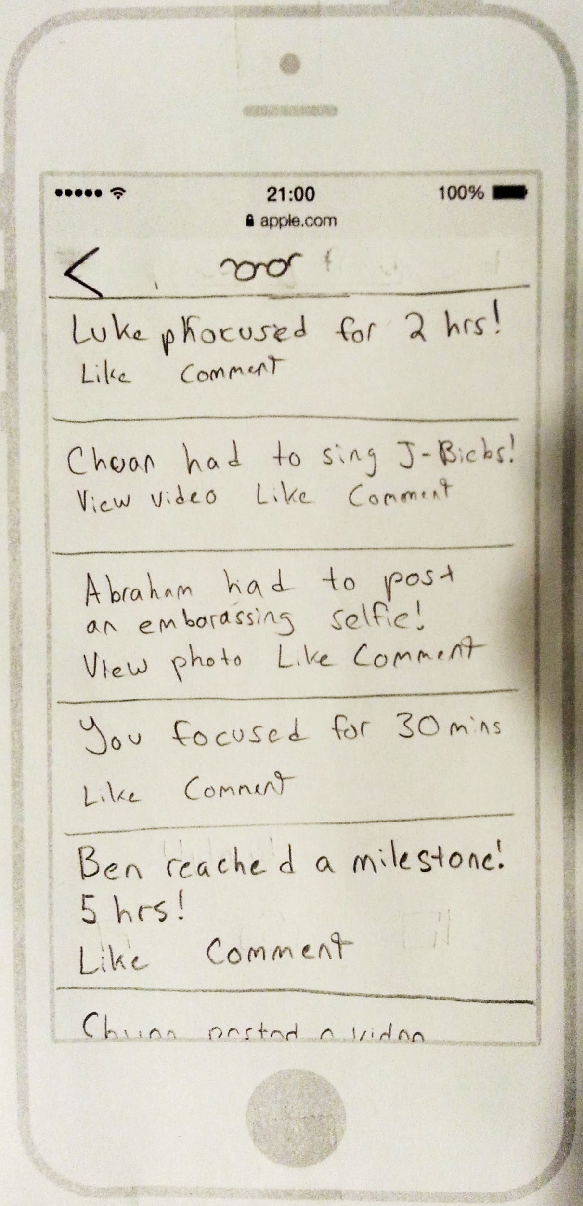
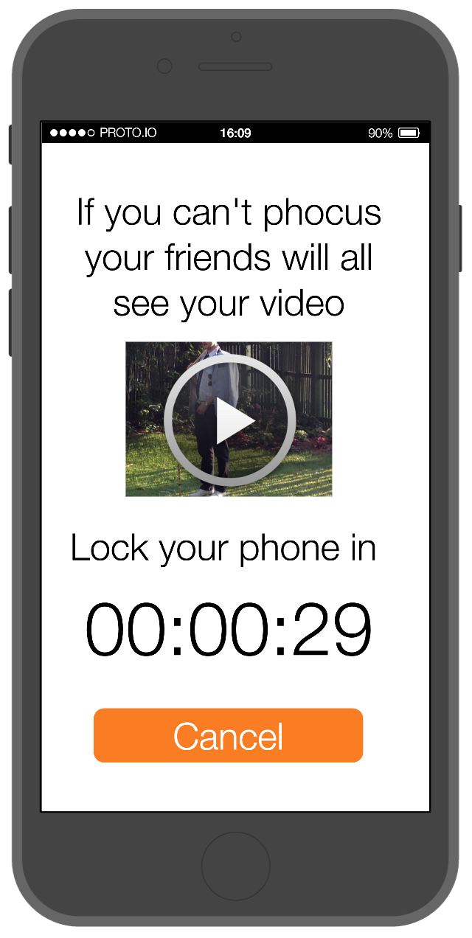
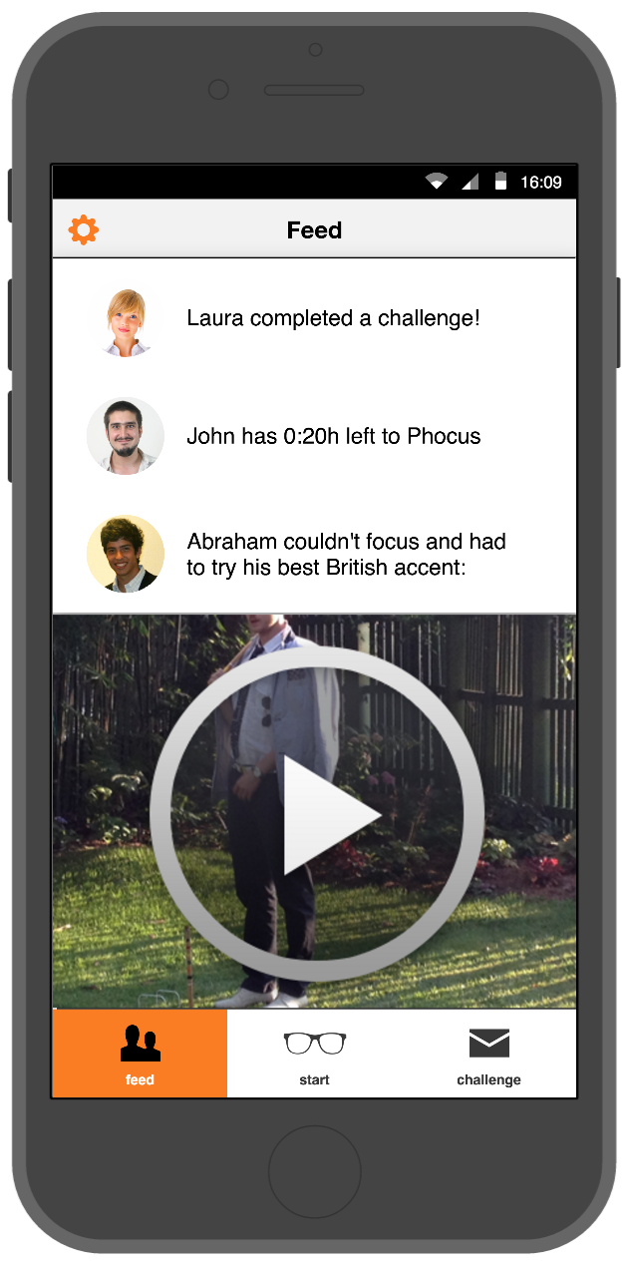
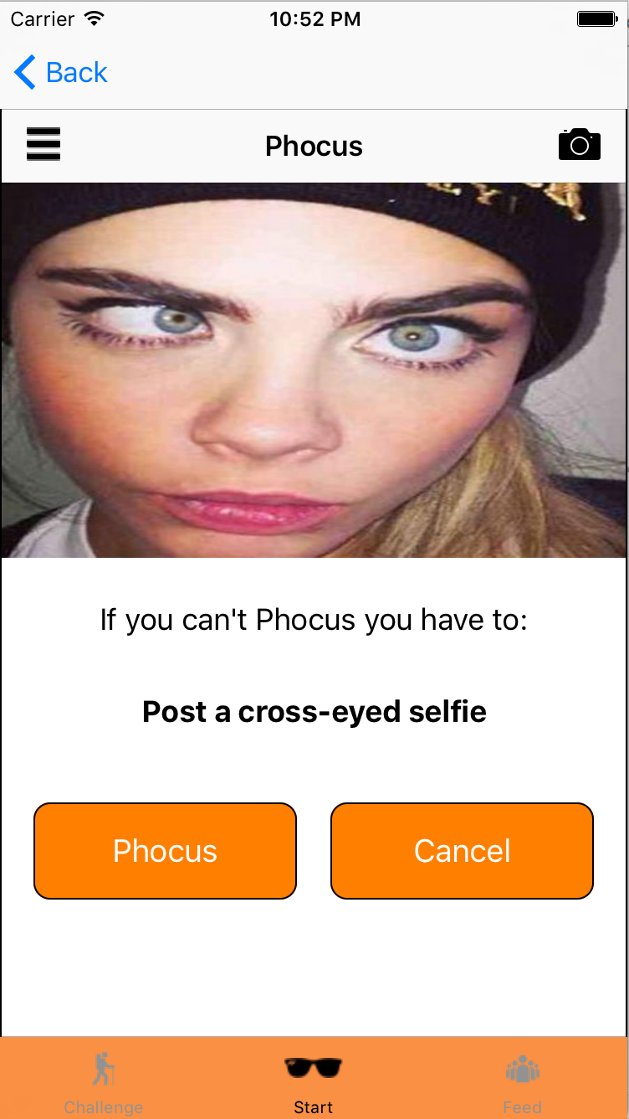
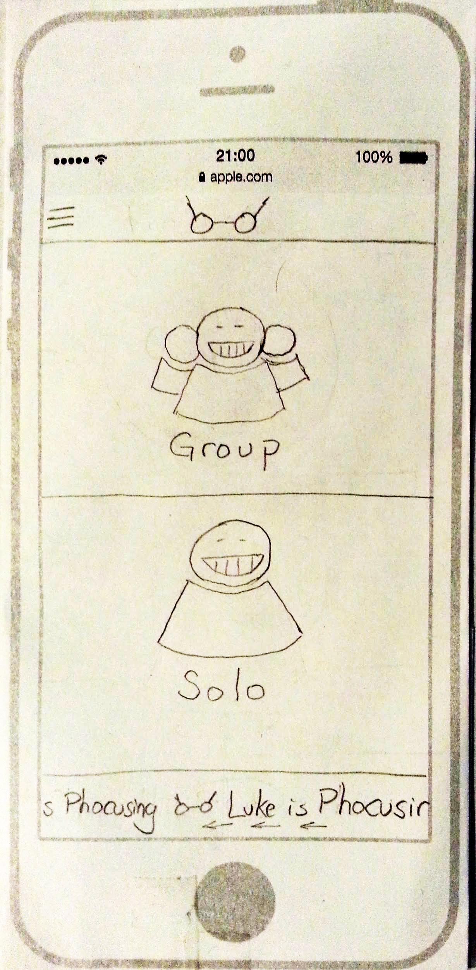
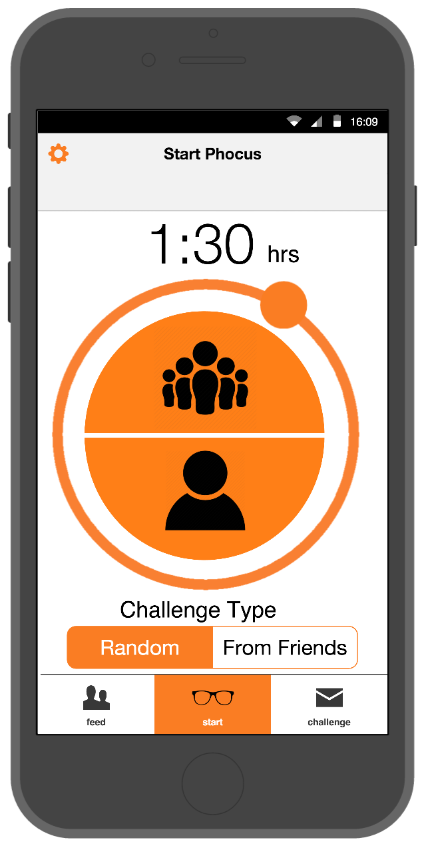
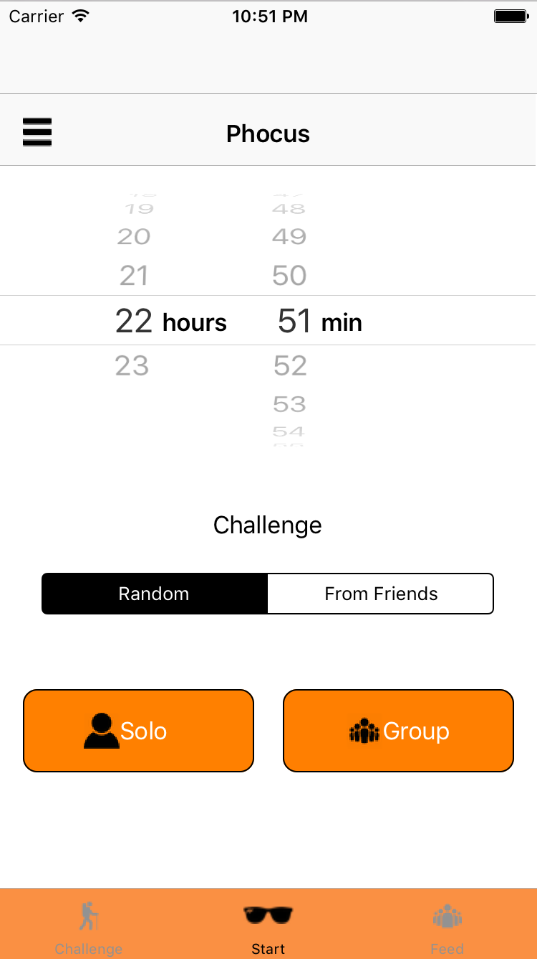




Time Well Spent.
Helping us pay attention to what we’re doing and who we’re with...
...not what’s happening on our phones
The Problem
Design Iteration
We are easily distracted by our devices
It can be hard to work when our phones provide so much opportunity for procrastination
It can be hard to talk to friends and family at meal times
Lo-fi
Medium-Fi
High-Fi
Our Solution
Key Features
Phocus dares us to put away our phones. Phocus provides a platform that gives users bragging rights when they do focus and gives them funny or productive challenges when they can’t.
Solo and group modes
Successes and failures shared with your friends
Quick, hilarious challenges
Luke deWilde | Abraham Starosta | Ben Limonchik | hci.stanford.edu/courses/cs147/2015/au/projects/behavior/phocus | CS 147 Autumn 2015

