Slide 1



Slide 2
Time Well Spent.
Phocus helps individuals and groups spend their times without the distraction of electronic devices.
We achieve this through a platform where people share their focusing successes and failures.

Slide 3
The Talk
1. Heuristic Evaluation Results

Slide 4
The Talk
Heuristic Evaluation Results
Revisions

Slide 5
The Talk
Heuristic Evaluation Results
Revisions
High-Fi Prototype Status
  Tools
  Plan
  Looking Ahead
  Wizard of Oz/Hard-coded elements
  Issues

Slide 6
The Talk
Heuristic Evaluation Results
Revisions
High-Fi Prototype Status
  Tools
  Plan
  Looking Ahead
  Wizard of Oz/Hard-coded elements
  Issues
Demo

Slide 7
The Talk
Heuristic Evaluation Results
Revisions
High-Fi Prototype Status
  Tools
  Plan
  Looking Ahead
  Wizard of Oz/Hard-coded elements
  Issues
Demo
Summary

Slide 8
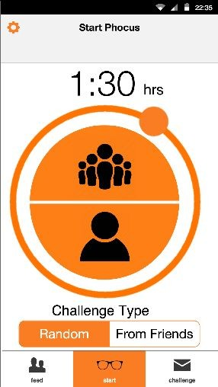
HE Result #1: Redo the Start Screen
Change the clock to a conventional iOS time picker

Slide 9
HE Result #1: Redo the Start Screen
Change the clock to a conventional iOS time picker
Add a tabbed “more” browser for other features instead of the settings gear

Slide 10
HE Result #1: Redo the Start Screen
Change the clock to a conventional iOS time picker
Add a tabbed “more” browser for other features instead of the settings gear
Rearrange components on the start screen

Slide 11
HE Result #1: Redo the Start Screen
Change the clock to a conventional iOS time picker
Add a tabbed “more” browser for other features instead of the settings gear
Rearrange components on the start screen
Change the challenge icon

Slide 12
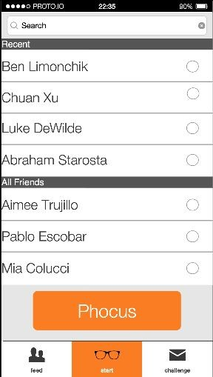
HE Result #2: Redo the Group Screen
Label the screen and provide instructions

Slide 13
HE Result #2: Redo the Group Screen
Label the screen and provide instructions
Make the whole row clickable

Slide 14
HE Result #2: Redo the Group Screen
Label the screen and provide instructions
Make the whole row clickable
Change the text to say “Invite to Phocus”

Slide 15
HE Result #2: Redo the Group Screen
Label the screen and provide instructions
Make the whole row clickable
Change the text to say “Invite to Phocus”
Ensure that the user invites at least one person

Slide 16
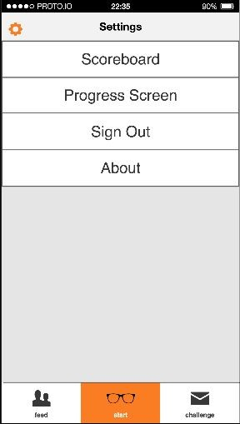
HE Result #3: Rearrange the Settings
Use a tabbed system that comes out from the side

Slide 17
HE Result #3: Rearrange the Settings
Use a tabbed system that comes out from the side
Rearrange order

Slide 18
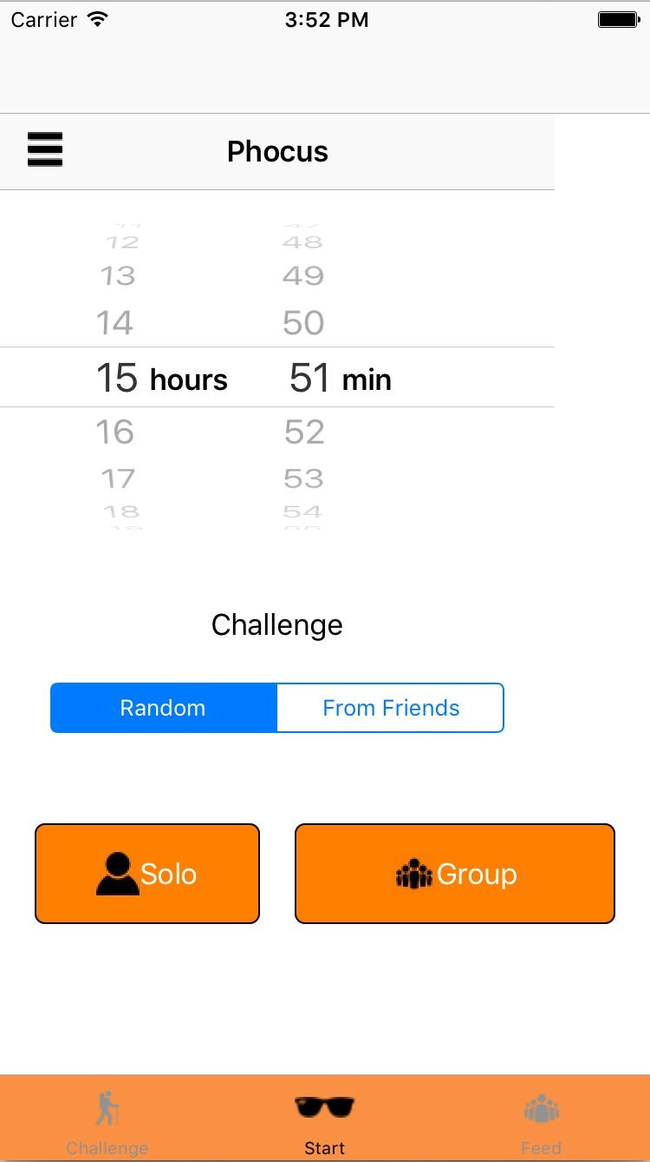
Start Screen Revision

Slide 19
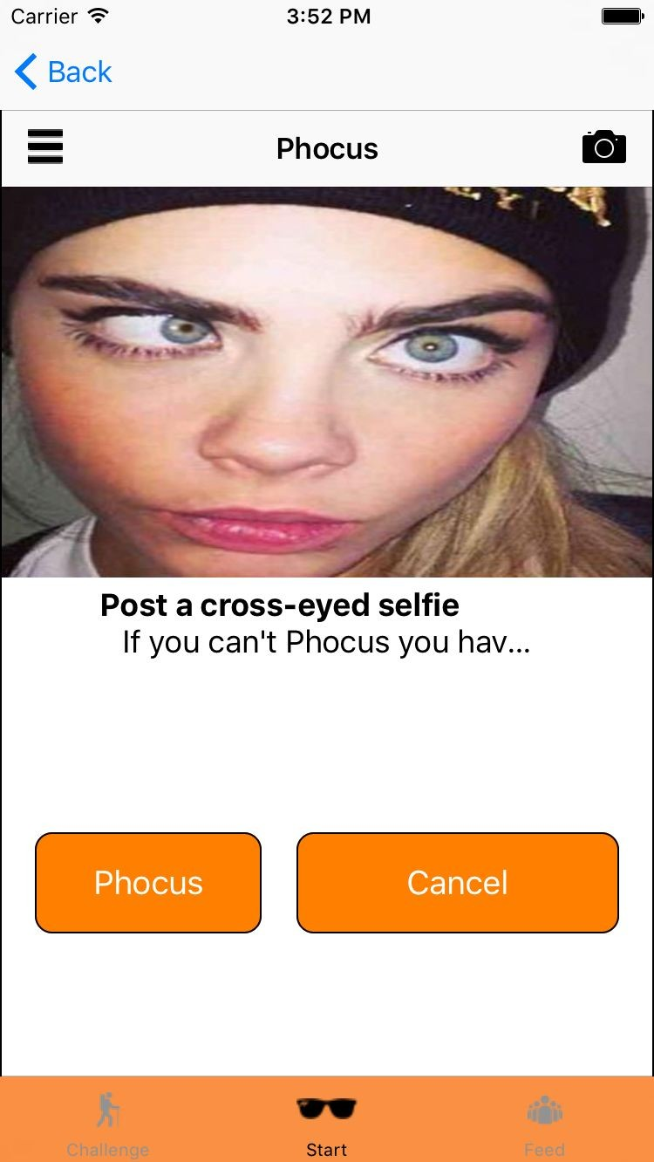
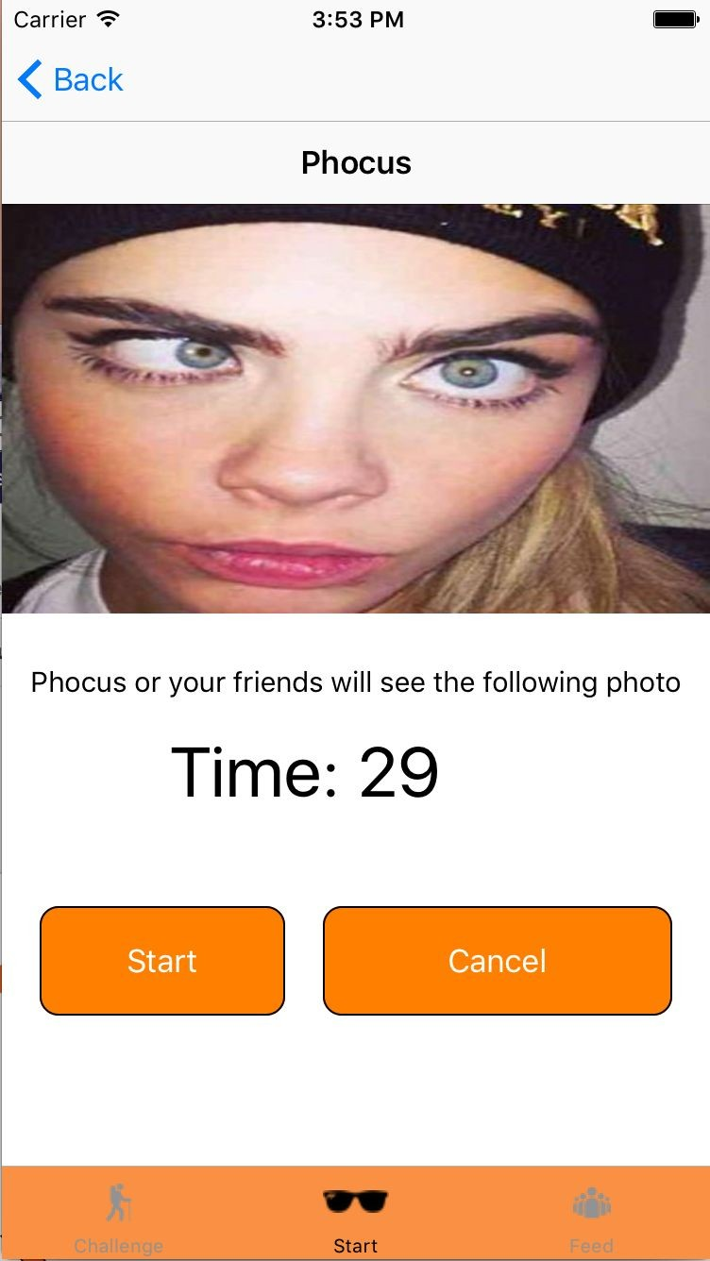
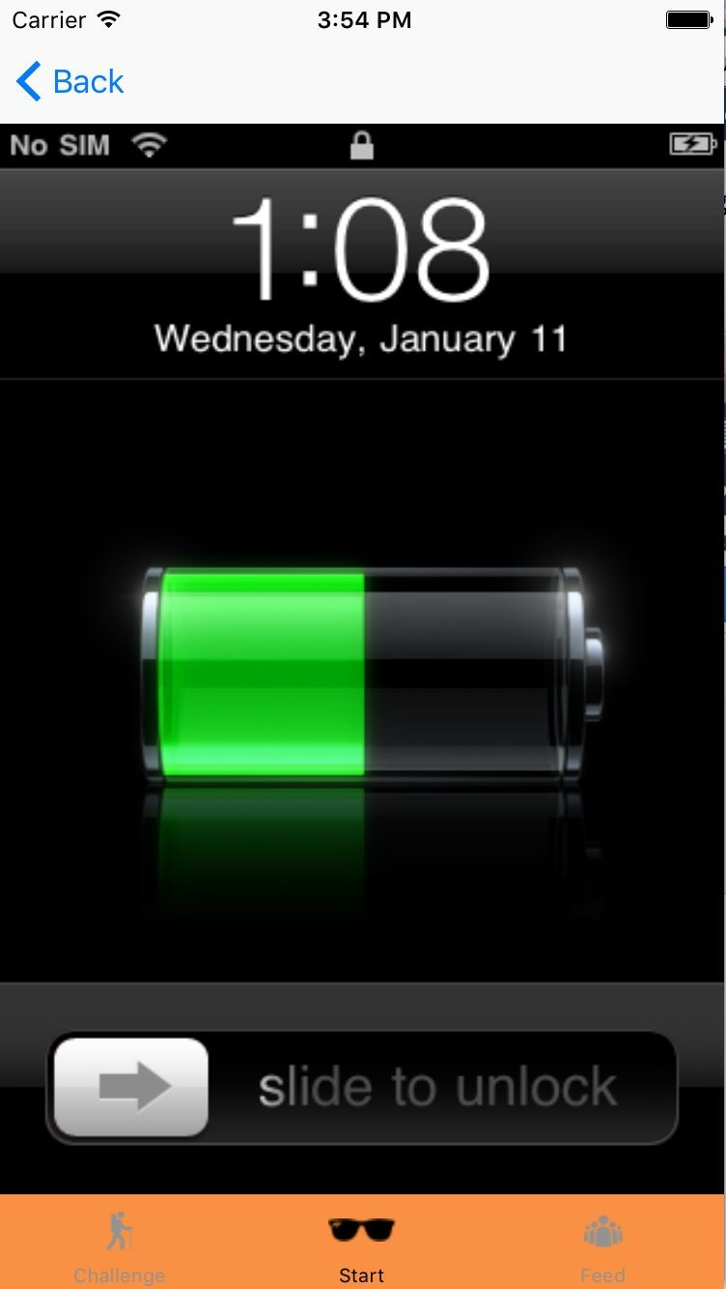
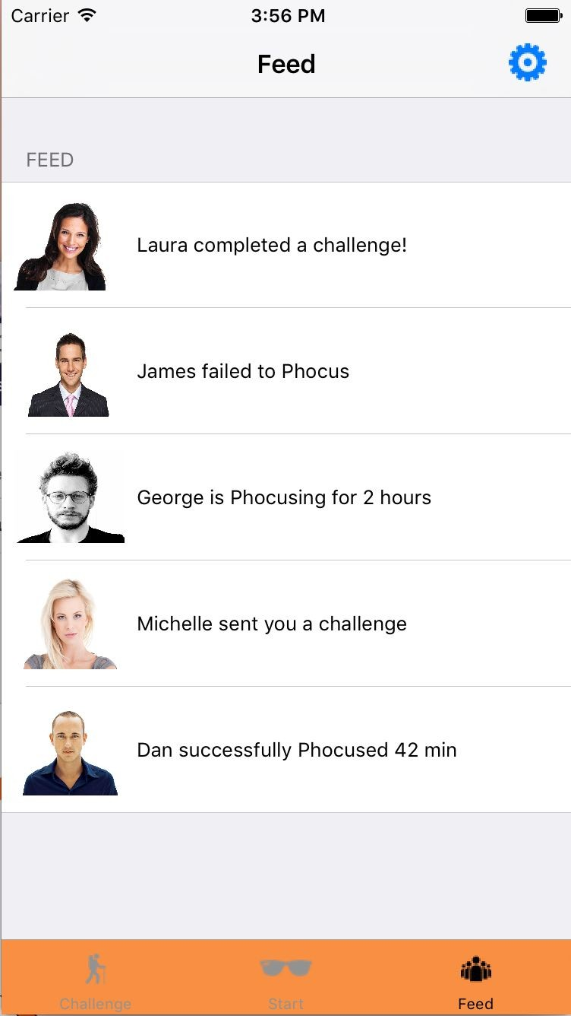
Task One Revision

Slide 20

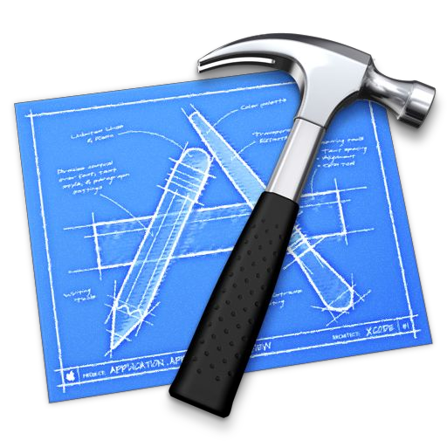

High-Fi Prototype: Tools
Dynamic, powerful
User control
Steep learning curve
Bugs

Slide 21
High-Fi Prototype: Plan
Funcitonality
  Simple task: Solo - Done
  Medium Task: Group - Not done
  Complex Task: Failure & Challenge - In progress

Slide 22
High-Fi Prototype: Plan
Funcitonality
  Simple task: Solo - Done
  Medium Task: Group - Not done
  Complex Task: Failure & Challenge - In progress
Aesthetics
  Heuristic suggestions
  Minimalism

Slide 23
High-Fi Prototype: Plan
Funcitonality
  Simple task: Solo - Done
  Medium Task: Group - Not done
  Complex Task: Failure & Challenge - In progress
Aesthetics
  Heuristic suggestions
  Minimalism
Extras
  Heuristic suggestions
  Bells & whistles

Slide 24

High-Fi Prototype: Wizard of Oz and Hard Code
Wizard of Oz
  Failure to Phocus
  Camera

Slide 25
High-Fi Prototype: Wizard of Oz and Hard Code
Wizard of Oz
  Failure to Phocus
  Camera
Hard-coded
  Friends list
  Feed
  Challenges

Slide 26
High-Fi Prototype: Issues
Loss of a group member
Layout & other bugs

Slide 27
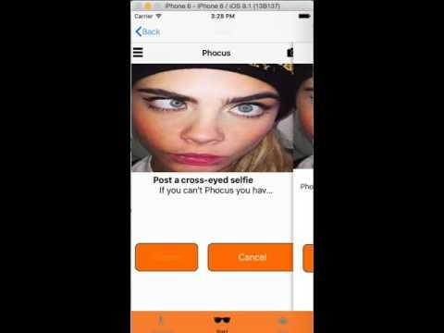
Demonstration
https://www.youtube.com/watch?v=Tvosy5gAVDg

Slide 28
Summary
1. Valuable and implementable heuristics feedback

Slide 29
Summary
Valuable and implementable heuristics feedback
Completed start screen and task one revisions

Slide 30
Summary
Valuable and implementable heuristics feedback
Completed start screen and task one revisions
Work, work, work

