Slide 1
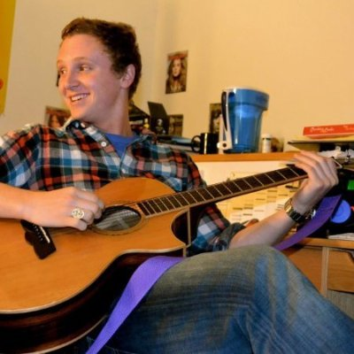
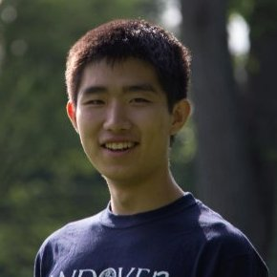
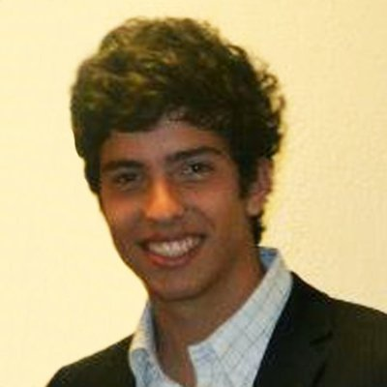
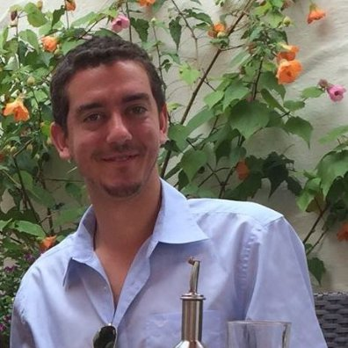
Luke,
Chuan,
Abraham,
and Ben
Studio Theme: Behavioral Change
----------
Domain: Moderate Consumption

Slide 2
Our Questions
Day-to-day routines and habits
Tell us about your last weekend
Tell us about the last time you or someone you know overindulged
What did you do in that situation?
(If applicable)
What support do you provide?
What advice do you give those in need?

Slide 3
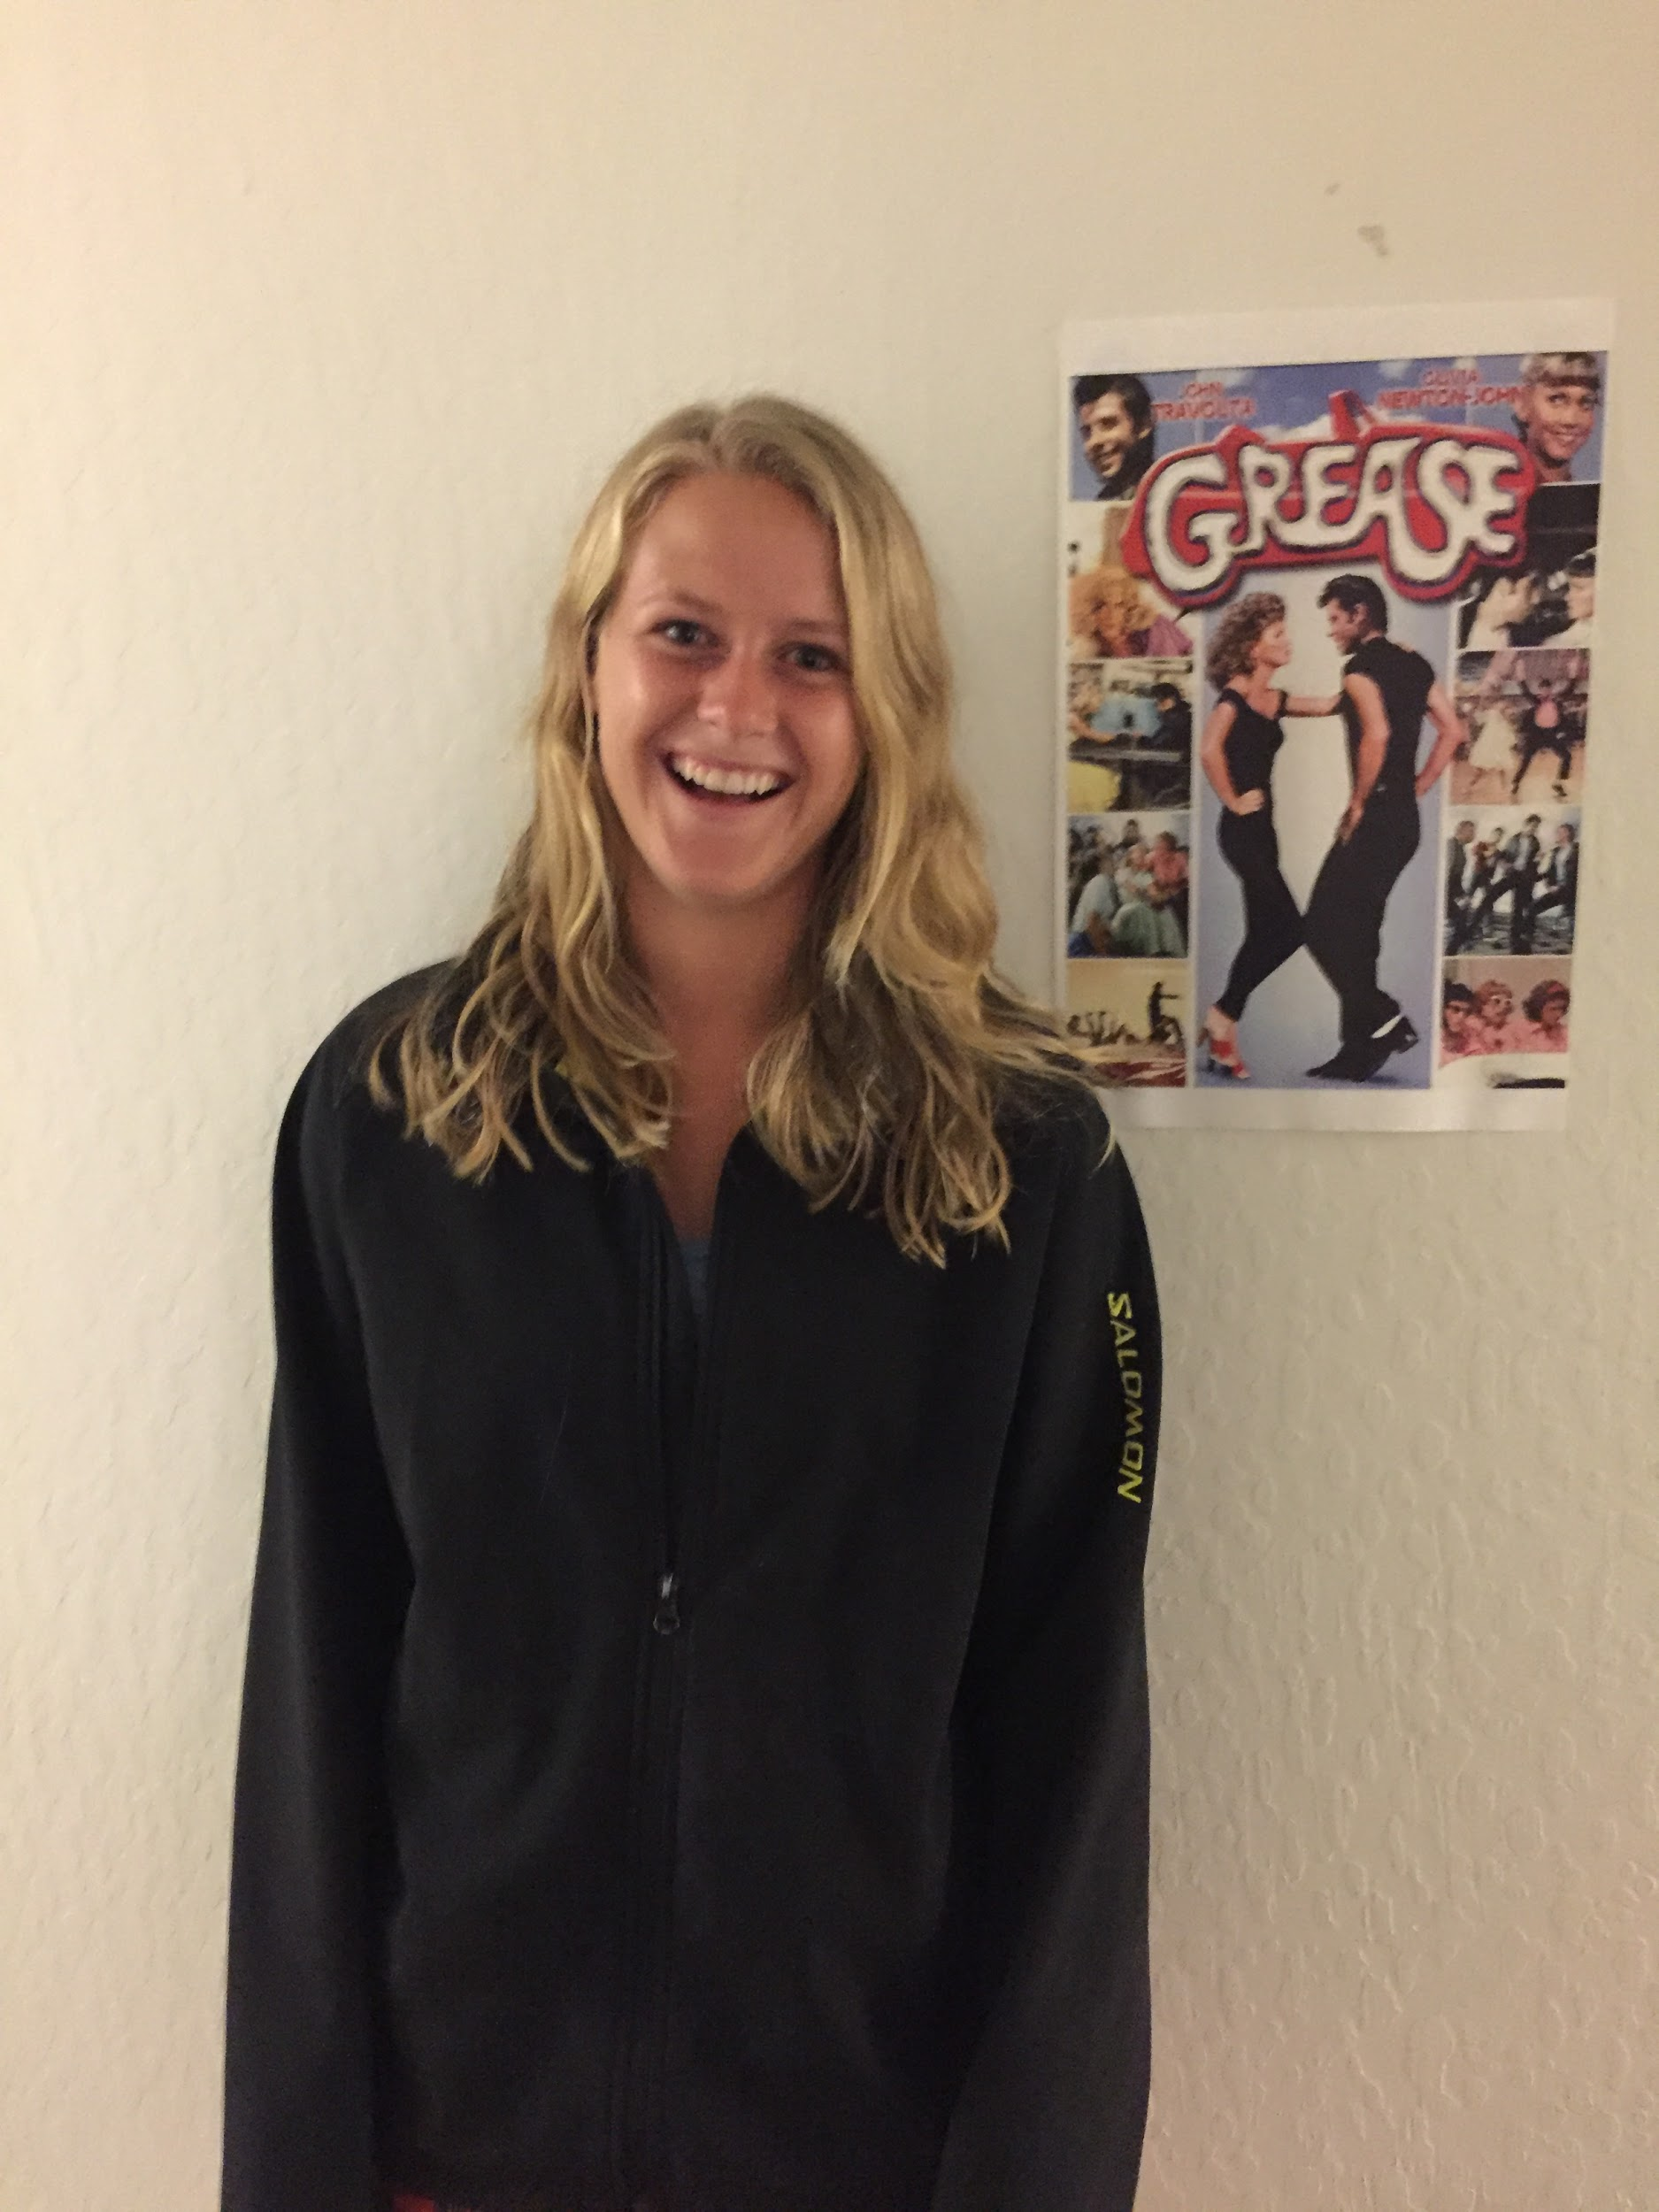
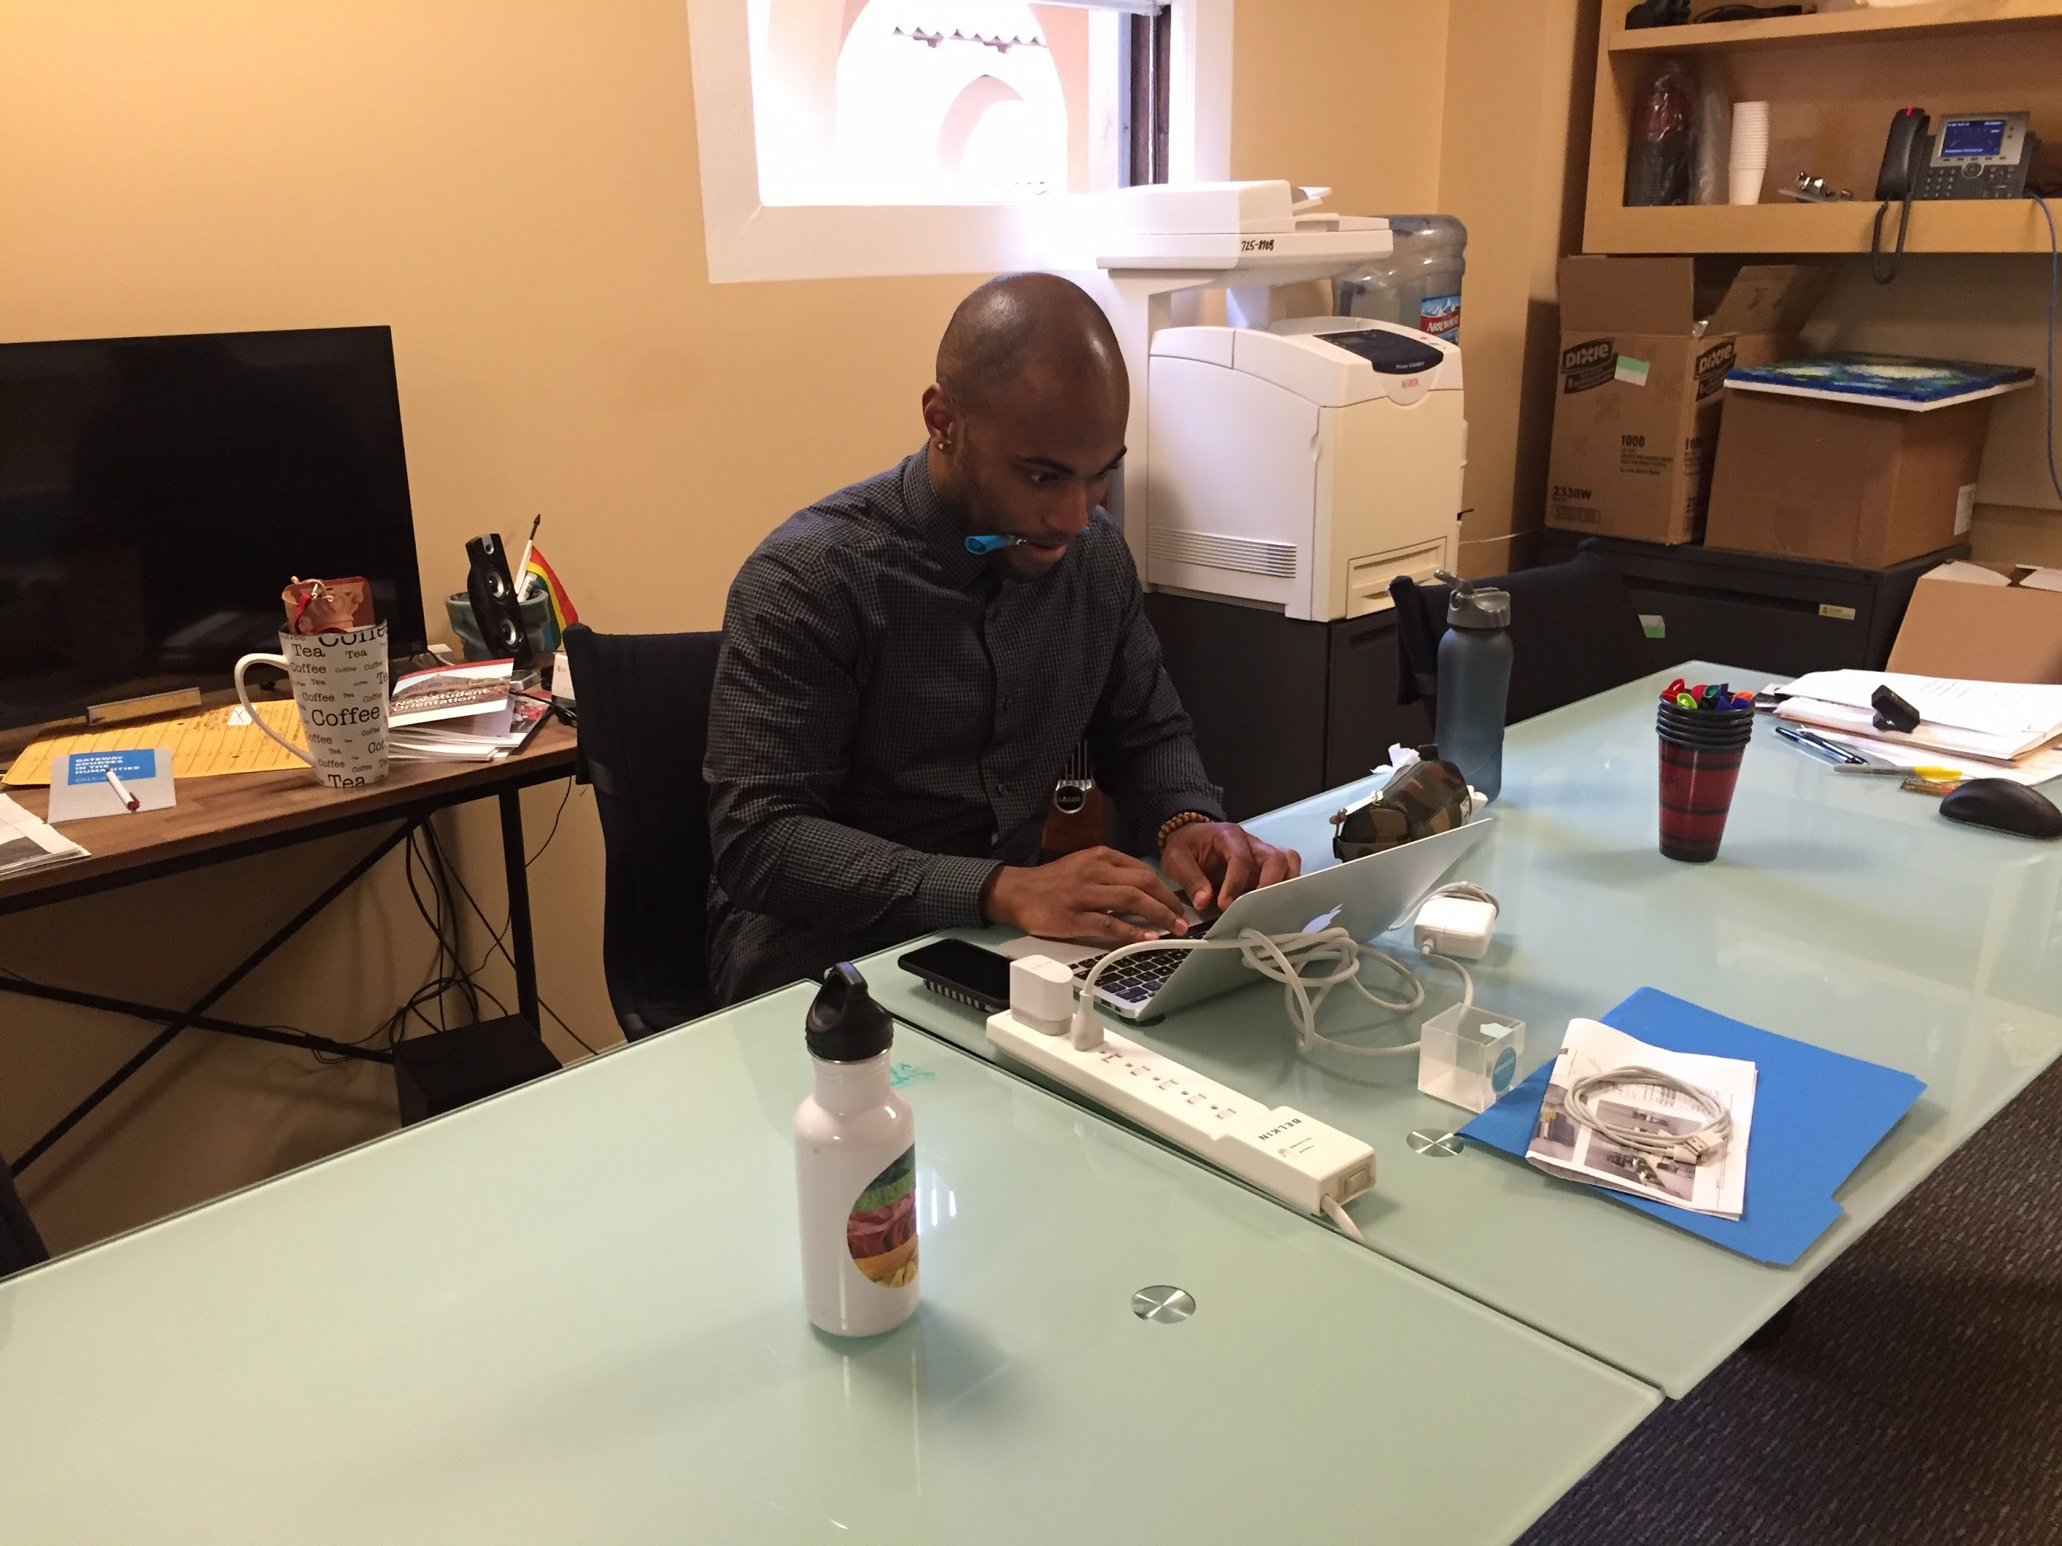
Kira & Jarreau - Office of Alcohol Policy and Education
Kira - Senior Events Coordinator
Jarreau - Assistant Dean of Students and Associate Director
Location: OAPE
Location: Phi Sig (no Cardinal Nights Events planned during fall quarter)
Plans fun alcohol-free events on campus
Offers support, training, referrals, and consultations about alcohol for students, staff, faculty and groups

Slide 4
What We Found
Kira
Said: “It’s the ability to provide an option for people who don’t want to drink, an alternative.”
Did: Paced when talking about developing programming.
Thought: How do we bring everyone, even drinkers to our events?
Felt: Responsibility for binge-drinking episodes on campus.
Jarreau
Said: - “Our successful drinkers set a plan before going out.” - “Stress, fear, anxiety, and boredom”
Did: Explained strategies for educating students, helping to set plans, and providing help and referrals.
Thought: I feel comfortable being used as a resource for anyone.
Felt: Relaxed, enthusiastic, and confident.

Slide 5
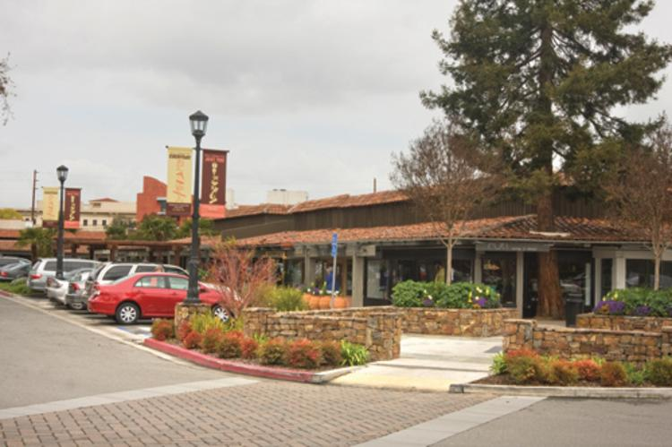
John
John: 23-yr-old, recent college grad, working in car dealer in SJ

Slide 6
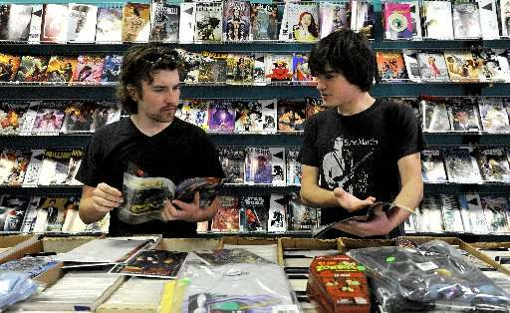
What We Found
John:
SAY: “It is impossible to stop once I start.”
DO: Looked elsewhere when he was talking about his indulgence
THINK: I regret indulging so much.
FEEL: I lost control of myself.

Slide 7
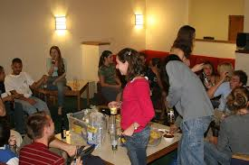
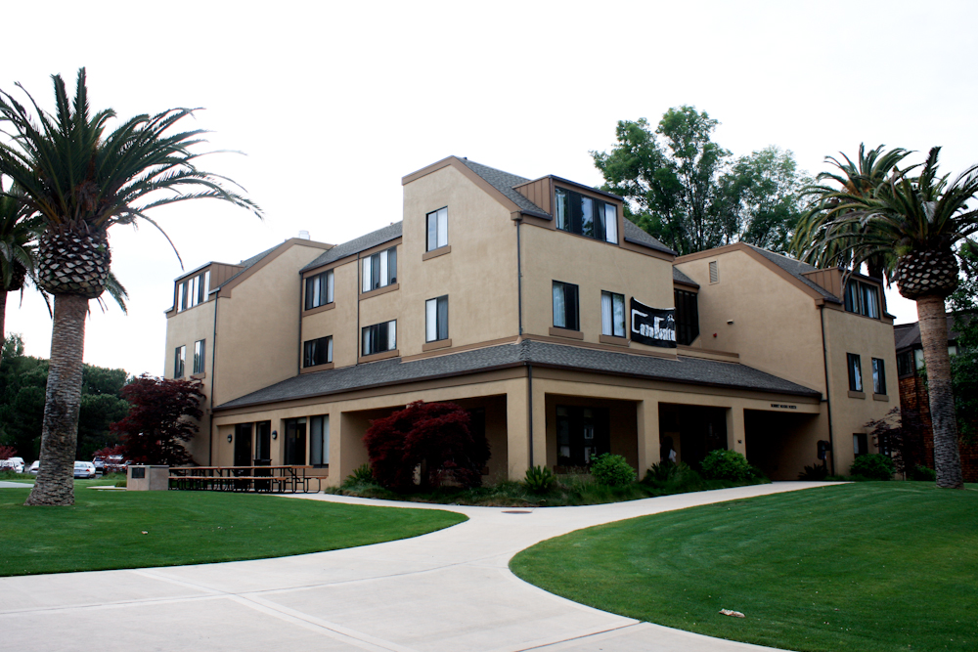
Anonymous - Stanford ‘15 Female
College student with experience handling alcohol (or not) in alcoholic environments

Slide 8
What We Found
SAY: “I thought she could have choked and died”
DO: Cried for her sister
THINK: Her sister is in danger
FEEL: Terrified that her sister could have died that night

Slide 9
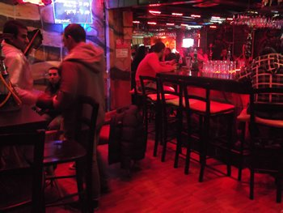
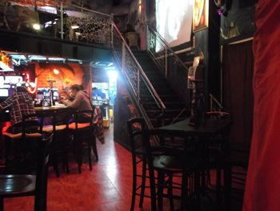
Guy - Israeli Bartender
An ex-Israeli soldier who worked part time as a bartender
Chosen for his familiarity with local population’s drinking habits
Questions (interviewed over the phone):
What type of people come to the bar?
What is common to those who consume large amount of alcohol?

Slide 10
What We Found
Guy
Said: “It’s the ability for soldiers to release steam after a tough week and Run away.”
Did: Explained how tough their lives are, behaved as if they were drunk before getting to the bar.
Thought: I am stressed I need to relax so that I can speak with women.
Felt: a climax to their week, excited and thrilled

Slide 11
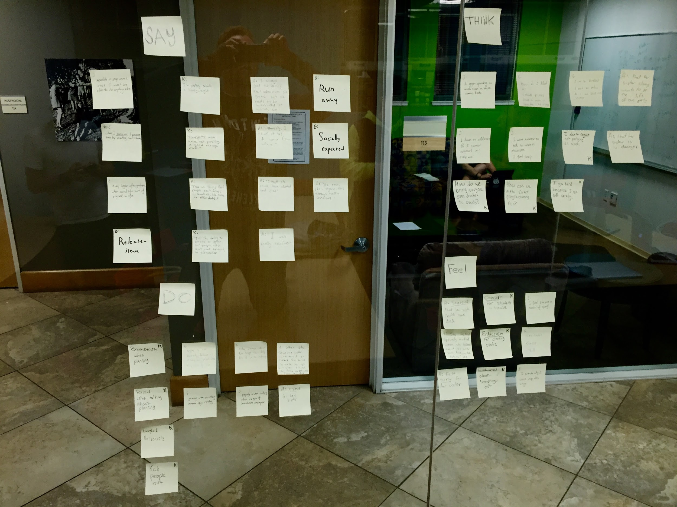
Analysis - Empathy Map

Slide 12
Analysis - Empathy Map
SAY: John: “It was impossible for me to stop.” Jarraeu: “Successful drinkers set a plan before going out.” Anonymous: “She could have choked and died” Guy: “It’s the ability for soldiers to release steam after a tough week and Run away.” | THINK: John: I regret indulging so much Kira: How do we bring everyone, even drinkers to our events? Anonymous: Her sister is in danger Guy: I am stressed I need to relax so that I can speak with women.
DO: John: Looked elsewhere when he was talking about his indulgence Kira: Paced when talking about programming. Anonymous: Cried for her sister | FEEL: John: I lost control of myself Kira: Responsible for binge-drinking episodes Anonymous: Terrified that her sister could have died Guy: a climax to their week, excited and thrilled

Slide 13
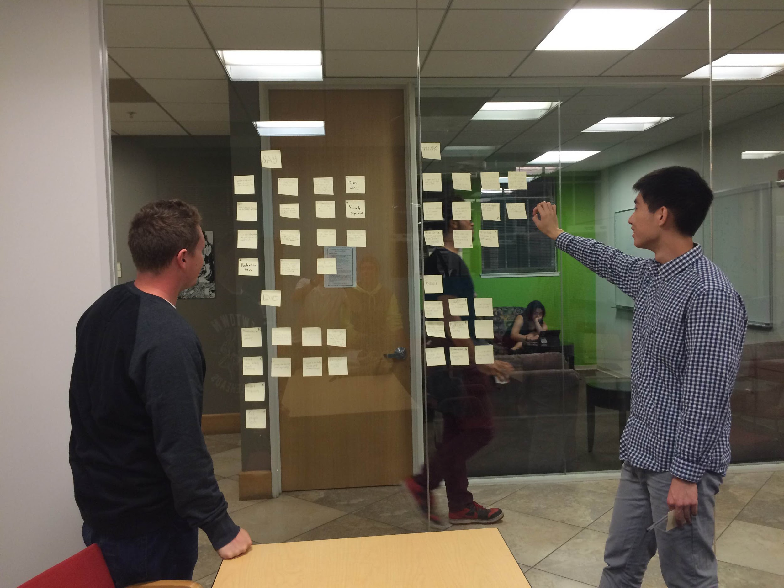
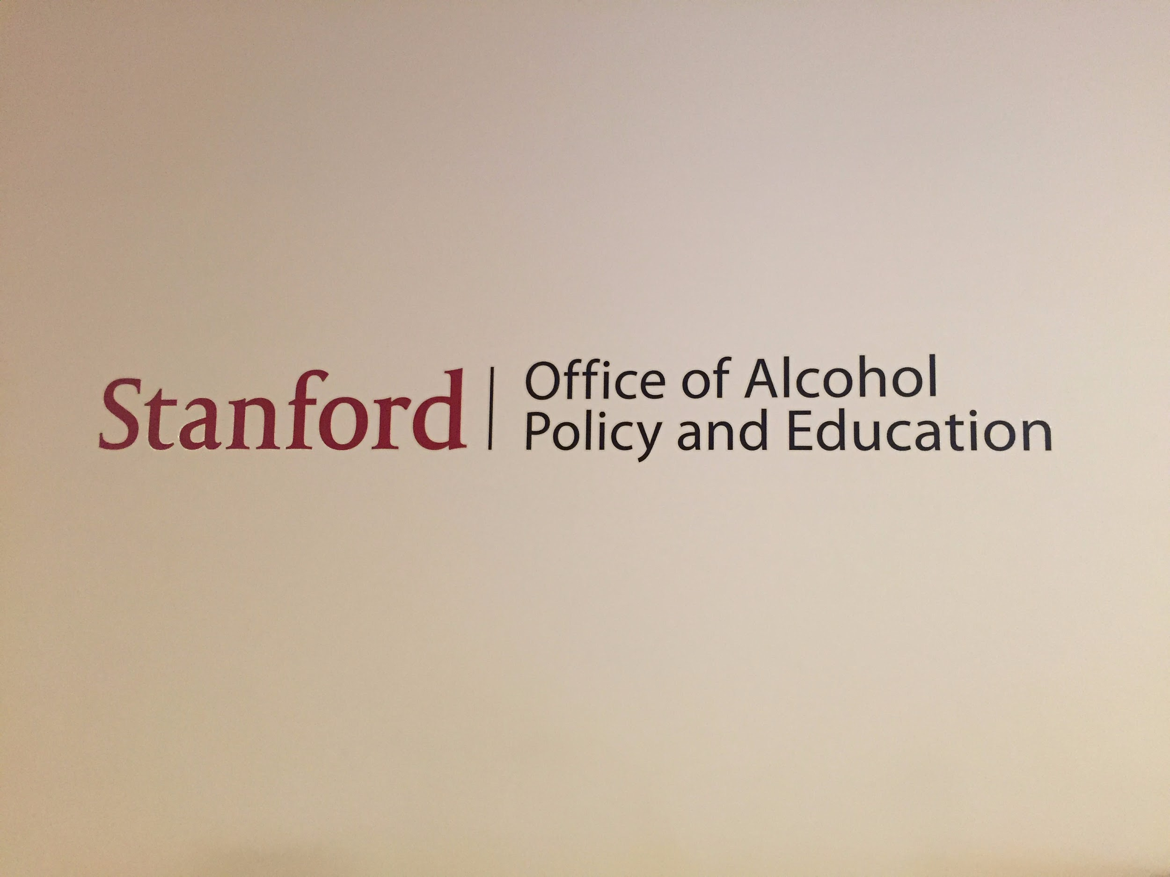
Analysis
The Insights:
People want those they love to moderate their consumption.
Self-control collapses due to stress, fear, anxiety, and boredom.
Once you start binging, it can be hard to stop.
The need: Help people identify binge-triggering emotions such as stress, anxiety, fear, and boredom, and encourage healthy consumption habits during these times.

Slide 14
Summary
Domain: Moderate Consumption
Interviewed Kira, Jarreau, John, Guy, and Anonymous Alumna
Discovered: People exhibit binging behaviors due to stress, anxiety, fear, and boredom
Expert analysis from Jarreau: Healthy consumption is reliant on crafting a plan.
Our Goal:
Encourage healthy consumption habits during times of stress, anxiety, fear, and boredom.

