Slide 1
Understanding Meeting Behavior
Targeted Needfinding, POVs, and Experience Prototypes

Slide 2
WHO WE ARE
THEO C.
DERIN D.
TOMMY F.
LIZA G.

Slide 3
PROBLEM DOMAIN
BEHAVIORAL CHANGE

Slide 4
PROBLEM DOMAIN
BEHAVIORAL CHANGE
IN THE MEETING SPACE.

Slide 5
SOLUTION APPROACH
TARGETED NEEDFINDING
EXPERIENCE PROTOTYPES
DEVELOPED
POINTS
OF VIEW
KEY TAKEAWAYS
FOUNDATION

Slide 6
SOLUTION APPROACH
TARGETED NEEDFINDING
EXPERIENCE PROTOTYPES
DEVELOPED
POINTS
OF VIEW
KEY TAKEAWAYS
FOUNDATION

Slide 7
FOUNDATION
We talked to Baiju, a co-founder of Robinhood.

Slide 8
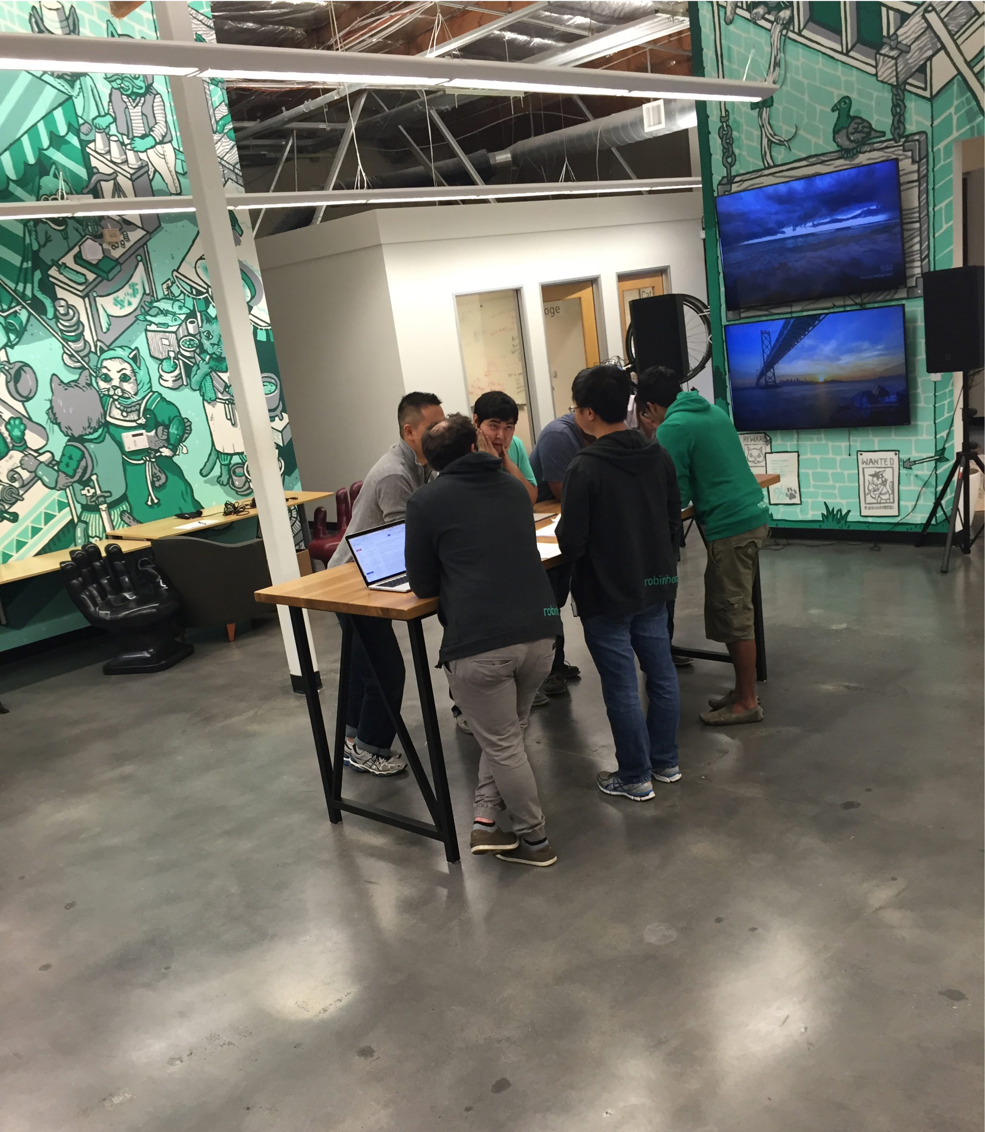
FOUNDATION
We talked to Baiju, a co-founder of Robinhood.
We were amazed to learn that organizational structure can have a noteworthy impact on meeting dynamics and productivity.

Slide 9
FOUNDATION
We talked to Baiju, a co-founder of Robinhood.
We were amazed to learn that organizational structure can have a noteworthy impact on meeting dynamics and productivity.
It would be game changing if we could break down organizational barriers to create a level playing field for all individuals attending meetings.

Slide 10
SOLUTION APPROACH
TARGETED NEEDFINDING
PROPOSED
SOLUTIONS
DEVELOPED
POINTS
OF VIEW
KEY TAKEAWAYS
FOUNDATION

Slide 11
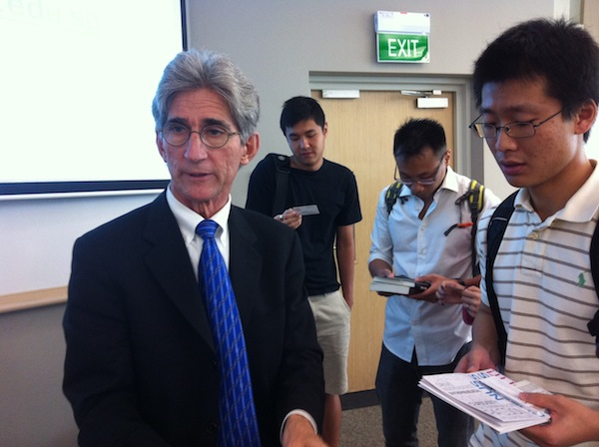
TARGETED NEEDFINDING
KAY L.
GRANT G.
TOM K.
“Because people are volunteering their time, priorities are in different places. Our meetings manifest themselves as social gatherings, which can be frustrating for the leadership team.”
“There is always a group of people sitting in the back on their computers that clearly do not need to be in the room. You’ve been there, I’ve been there. It just happens.”
“I schedule weekly because it seems that having the meeting is better than not having the meeting. Wait… that doesn’t make sense when I say it out loud.”
VOLUNTEER - WORDS ALIVE
PRODUCT MANAGER - CBS
PROFESSOR - STANFORD

Slide 12
TARGETED NEEDFINDING
KAY L.
GRANT G.
TOM K.
“Because people are volunteering their time, priorities are in different places. Our meetings manifest themselves as social gatherings, which can be frustrating for the leadership team.”
“There is always a group of people sitting in the back on their computers that clearly do not need to be in the room. You’ve been there, I’ve been there. It just happens.”
“I schedule weekly because it seems that having the meeting is better than not having the meeting. Wait… that doesn’t make sense when I say it out loud.”
VOLUNTEER - WORDS ALIVE
PRODUCT MANAGER - CBS
PROFESSOR - STANFORD

Slide 13
TARGETED NEEDFINDING
KAY L.
GRANT G.
TOM K.
“Because people are volunteering their time, priorities are in different places. Our meetings manifest themselves as social gatherings, which can be frustrating for the leadership team.”
“There is always a group of people sitting in the back on their computers that clearly do not need to be in the room. You’ve been there, I’ve been there. It just happens.”
“I schedule weekly because it seems that having the meeting is better than not having the meeting. Wait… that doesn’t make sense when I say it out loud.”
VOLUNTEER - WORDS ALIVE
PRODUCT MANAGER - CBS
PROFESSOR - STANFORD

Slide 14
SOLUTION APPROACH
TARGETED NEEDFINDING
PROPOSED
SOLUTIONS
DEVELOPED
POINTS
OF VIEW
KEY TAKEAWAYS
FOUNDATION

Slide 15
POV #1

Slide 16
POV #1
ASSUMPTIONS
INDIVIDUALS MEET FOR THE SAKE OF MEETING.
PEOPLE DON’T KNOW WHY THEY ARE INVITED TO MEETINGS.
THERE IS NOT A MUTUAL UNDERSTANDING OF THE MEETING AGENDA.

Slide 17
POV #1
ASSUMPTIONS
INDIVIDUALS MEET FOR THE SAKE OF MEETING.
PEOPLE DON’T KNOW WHY THEY ARE INVITED TO MEETINGS.
THERE IS NOT A MUTUAL UNDERSTANDING OF THE MEETING AGENDA.

Slide 18
POV #1
ASSUMPTIONS
INDIVIDUALS MEET FOR THE SAKE OF MEETING.
PEOPLE DON’T KNOW WHY THEY ARE INVITED TO MEETINGS.
THERE IS NOT A MUTUAL UNDERSTANDING OF THE MEETING AGENDA.

Slide 19
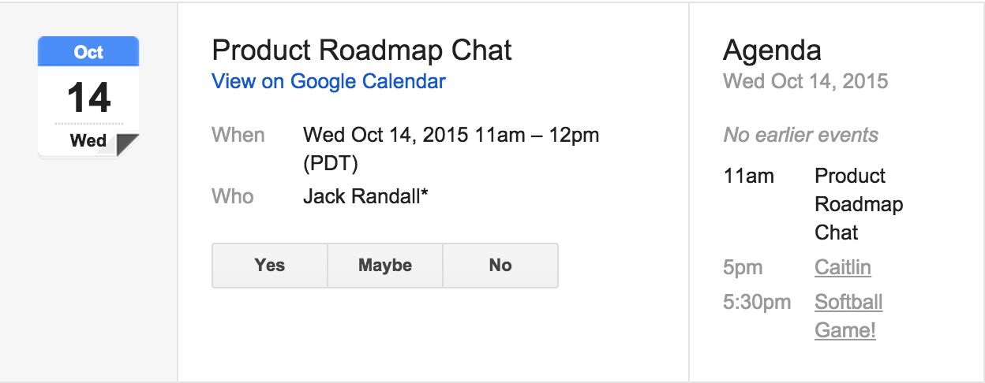
POV #1
EXAMPLE

Slide 20
POV #1
STATEMENT
We met Grant, a project manager who needs to know when and why he should go to a meeting. It would be game changing if Grant knew the purpose of a meeting in more detail than “Data Pipeline Chat” so he could know if he should attend.

Slide 21
POV #1
HOW MIGHT WE
ensure that only relevant people are in meetings?
ensure that people don’t feel obligated to attend if they don’t add value?
ensure people know the agenda?

Slide 22
POV #2

Slide 23
POV #2
ASSUMPTIONS
INDIVIDUALS DO NOT KNOW WHEN IT IS APPROPRIATE TO INTERRUPT.
CERTAIN VOICES ARE HEARD TOO MUCH.
MEETING TOPICS ARE CHANGED TOO QUICKLY.

Slide 24
POV #2
ASSUMPTIONS
INDIVIDUALS DO NOT KNOW WHEN IT IS APPROPRIATE TO INTERRUPT.
CERTAIN VOICES ARE HEARD TOO MUCH.
MEETING TOPICS ARE CHANGED TOO QUICKLY.

Slide 25
POV #2
ASSUMPTIONS
INDIVIDUALS DO NOT KNOW WHEN IT IS APPROPRIATE TO INTERRUPT.
CERTAIN VOICES ARE HEARD TOO MUCH.
MEETING TOPICS ARE CHANGED TOO QUICKLY.

Slide 26
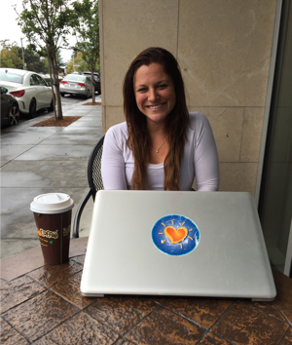
POV #2
STATEMENT
We met Jane who needs to learn to speak up because she feels that only those with loud voices and superior titles are heard. It would be game changing if everyone’s ideas were heard to the same degree and people felt compelled to interact with others’ ideas in the meeting room.

Slide 27
POV #2
HOW MIGHT WE
ensure productive speaking during meetings?
ensure that certain individuals do not overshare?
stop people from cutting others off?

Slide 28
POV #3

Slide 29
POV #3
ASSUMPTIONS
THERE IS OFTEN NOT A STRONG REASON FOR A MEETING.
PEOPLE DO NOT KNOW WHEN MEETINGS ARE PRODUCTIVE.
IT IS ASSUMED THAT HAVING MEETINGS IS NECESSARY.

Slide 30
POV #3
ASSUMPTIONS
THERE IS OFTEN NOT A STRONG REASON FOR A MEETING.
PEOPLE DO NOT KNOW WHEN MEETINGS ARE PRODUCTIVE.
IT IS ASSUMED THAT HAVING MEETINGS IS NECESSARY.

Slide 31
POV #3
ASSUMPTIONS
THERE IS OFTEN NOT A STRONG REASON FOR A MEETING.
PEOPLE DO NOT KNOW WHEN MEETINGS ARE PRODUCTIVE.
IT IS ASSUMED THAT HAVING MEETINGS IS NECESSARY.

Slide 32
POV #3
STATEMENT
We met Tom, who needs to know when meetings should happen because he currently schedules meetings on a weekly basis, as opposed to in accordance with their necessity. It would be game changing if he could understand how having a meeting fit into the long term goal of a project's lifecycle.

Slide 33
POV #3
HOW MIGHT WE
visualize the productivity of meetings in a project lifecycle?
ensure meetings only happen when they need to?
change the culture around meetings?

Slide 34
SOLUTION APPROACH
TARGETED NEEDFINDING
EXPERIENCE PROTOTYPES
DEVELOPED
POINTS
OF VIEW
KEY TAKEAWAYS
FOUNDATION

Slide 35
EXPERIENCE PROTOTYPE #1
GOAL: TO IMPACT PLANNING BEHAVIOR SO MEETINGS ONLY HAPPEN WHEN NECESSARY WITH ESSENTIAL PARTIES IN ATTENDENCE.

Slide 36
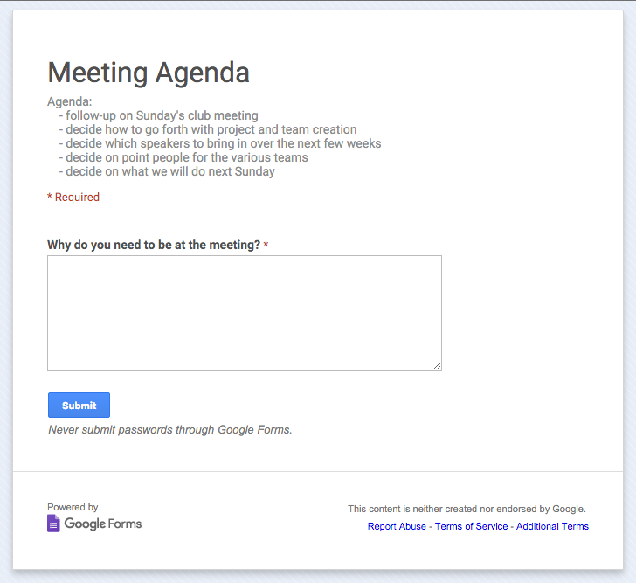
EXPERIENCE PROTOTYPE #1
Version 1
Organizer has control
Creates agenda and explains why each attendee is invited
Version 2
Attendance is crowd sourced
Organizer sends out a google form with a tentative agenda
Respondents explain why they need to attend.

Slide 37
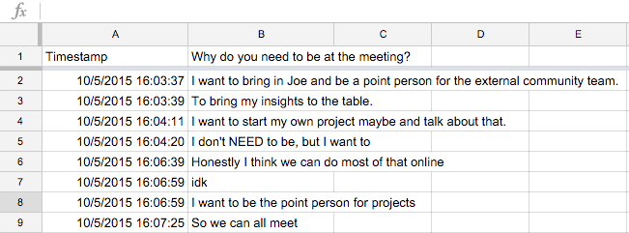
EXPERIENCE PROTOTYPE #1

Slide 38
EXPERIENCE PROTOTYPE #1

Slide 39
EXPERIENCE PROTOTYPE #1

Slide 40
THINGS THAT WORKED
Prevented 2 people from coming to original meeting
The survey moved second meetings offline
Agenda distributed beforehand
THINGS THAT DIDN’T WORK
Individuals feelings were hurt when they weren’t invited to the meetings
People provided filler responses
EXPERIENCE PROTOTYPE #1
RESULTS
SURPRISES AND NEW LEARNINGS
People like to be included in meetings even if they don’t need to be there
People enjoy meeting for the sake of meeting

Slide 41
THINGS THAT WORKED
Prevented 2 people from coming to original meeting
The survey moved second meetings offline
Agenda distributed beforehand
THINGS THAT DIDN’T WORK
Individuals feelings were hurt when they weren’t invited to the meetings
People provided filler responses
EXPERIENCE PROTOTYPE #1
RESULTS
SURPRISES AND NEW LEARNINGS
People like to be included in meetings even if they don’t need to be there
People enjoy meeting for the sake of meeting

Slide 42
THINGS THAT WORKED
Prevented 2 people from coming to original meeting
The survey moved second meetings offline
Agenda distributed beforehand
THINGS THAT DIDN’T WORK
Individuals feelings were hurt when they weren’t invited to the meetings
People provided filler responses
EXPERIENCE PROTOTYPE #1
RESULTS
SURPRISES AND NEW LEARNINGS
People like to be included in meetings even if they don’t need to be there
People enjoy meeting for the sake of meeting

Slide 43
EXPERIENCE PROTOTYPE #2
GOAL: TO IMPACT BEHAVIOR DURING MEETINGS TO ENSURE EVERYONE’S VOICES ARE HEARD, BY MODERATING TOPICS AND INPUTS.

Slide 44
EXPERIENCE PROTOTYPE #2
8 people planning a trip to Thailand
Two cards
X for current topic
O for new topic
Only one person can speak at a time
You can only speak when it is your turn in queue

Slide 45
EXPERIENCE PROTOTYPE #2

Slide 46
THINGS THAT WORKED
People were more aware of when they spoke
THINGS THAT DIDN’T WORK
Meeting was incredibly inefficient
There were times when it made sense for someone to jump in and give their opinion
People were frustrated with this type of moderation
EXPERIENCE PROTOTYPE #2
RESULTS
SURPRISES AND NEW LEARNINGS
Interruptions can be productive in some meeting environments
This type of solution would have to be incredibly subtle as to not be a distraction

Slide 47
THINGS THAT WORKED
People were more aware of when they spoke
THINGS THAT DIDN’T WORK
Meeting was incredibly inefficient
There were times when it made sense for someone to jump in and give their opinion
People were frustrated with this type of moderation
EXPERIENCE PROTOTYPE #2
RESULTS
SURPRISES AND NEW LEARNINGS
Interruptions can be productive in some meeting environments
This type of solution would have to be incredibly subtle as to not be a distraction

Slide 48
THINGS THAT WORKED
People were more aware of when they spoke
THINGS THAT DIDN’T WORK
Meeting was incredibly inefficient
There were times when it made sense for someone to jump in and give their opinion
People were frustrated with this type of moderation
EXPERIENCE PROTOTYPE #2
RESULTS
SURPRISES AND NEW LEARNINGS
Interruptions can be productive in some meeting environments
This type of solution would have to be incredibly subtle as to not be a distraction

Slide 49
EXPERIENCE PROTOTYPE #3
GOAL: HELP CREATE A MORE POSITIVE CULTURE AROUND MEETINGS BY HELPING GROUPS TO UNDERSTAND THEIR PRODUCTIVITY IN A GREATER PROJECT LIFECYCLE.

Slide 50
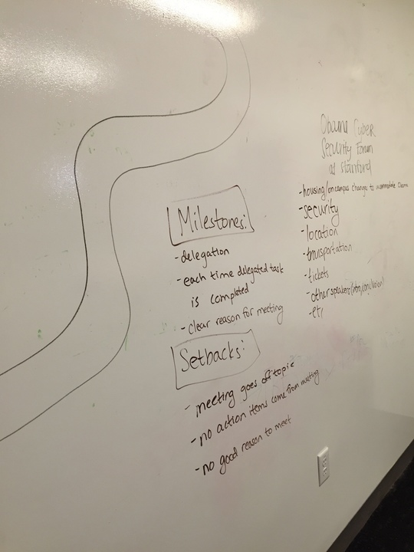
EXPERIENCE PROTOTYPE #3
Outlined project and milestones
Visualized project progress on a roadmap
Completed milestones moves forward
Setbacks push the team back

Slide 51
EXPERIENCE PROTOTYPE #3

Slide 52
THINGS THAT WORKED
Outline of tasks
Responding to changes
THINGS THAT DIDN’T WORK
Because or two subjects were friends they joked around quite a bit during the experiment
Difficult to make decisions about how a project is progressing
Hard to recreate this in a short time-frame
EXPERIENCE PROTOTYPE #3
RESULTS
SURPRISES AND NEW LEARNINGS
Task delegation is a big problem – meetings occurred because responsibility was not assigned well from the start
Visualization only influences the project lead

Slide 53
THINGS THAT WORKED
Outline of tasks
Responding to changes
THINGS THAT DIDN’T WORK
Because or two subjects were friends they joked around quite a bit during the experiment
Difficult to make decisions about how a project is progressing
Hard to recreate this in a short time-frame
EXPERIENCE PROTOTYPE #3
RESULTS
SURPRISES AND NEW LEARNINGS
Task delegation is a big problem – meetings occurred because responsibility was not assigned well from the start
Visualization only influences the project lead

Slide 54
THINGS THAT WORKED
Outline of tasks
Responding to changes
THINGS THAT DIDN’T WORK
Because or two subjects were friends they joked around quite a bit during the experiment
Difficult to make decisions about how a project is progressing
Hard to recreate this in a short time-frame
EXPERIENCE PROTOTYPE #3
RESULTS
SURPRISES AND NEW LEARNINGS
Task delegation is a big problem – meetings occurred because responsibility was not assigned well from the start
Visualization only influences the project lead

Slide 55
SOLUTION APPROACH
TARGETED NEEDFINDING
EXPERIENCE PROTOTYPES
DEVELOPED
POINTS
OF VIEW
KEY TAKEAWAYS
FOUNDATION

Slide 56
KEY TAKEAWAYS
NATURAL CONVERSATION
CLEAR DELEGATION
WHO CARES?

Slide 57
KEY TAKEAWAYS
NATURAL CONVERSATION
CLEAR DELEGATION
WHO CARES?

Slide 58
KEY TAKEAWAYS
NATURAL CONVERSATION
CLEAR DELEGATION
WHO CARES?
Notes:
Talk about scheduling with who cares

Slide 59
KEY TAKEAWAYS
MOVING FORWARD
Notes:
Talk about scheduling with who cares

Slide 60
THANK YOU!
Notes:
Talk about scheduling with who cares

