Slide 2
Group Travel is hard
Invites and Confirmation
Lodging
Group vs. Individual Activities
Document Tracking
Payments
Social Loafing

Slide 3
Instagator makes it better
One platform for every stage of the trip
Group involvement increases engagement
Planner and Participant Reminders
In-app cost tracking
Lowered barriers to future group travel

Slide 4
Instagator makes it better
One platform for every stage of the trip
Group involvement increases engagement
Planner and Participant Reminders
In-app cost tracking
Lowered barriers to future group travel

Slide 5
Agenda
Heuristic Evaluation Overview
Design Revisions
Development Techniques
Prototype Status and Demo

Slide 6
Heuristic Evaluation
“If there is no struggle, there is no progress.” - Frederick Douglass

Slide 7
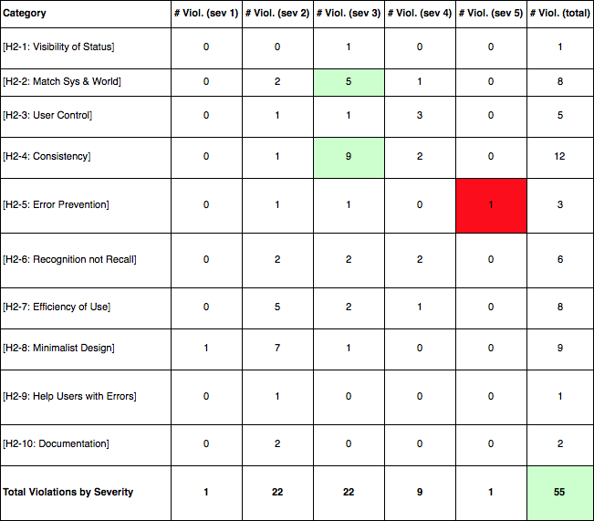
Heuristic Evaluation
Highlights
Issues with med-fi logic flow and implementation
Ease of use fixes: quick returns to home, fewer screens
One severity 5 issue due to lack of error handling given the dummy data of med-fi

Slide 8
Heuristic Evaluation
Highlights
Issues with med-fi logic flow and implementation
Ease of use fixes: quick returns to home, fewer screens
One severity 5 issue due to lack of error handling given the dummy data of med-fi

Slide 9
Heuristic Evaluation
Highlights
Issues with med-fi logic flow and implementation
Ease of use fixes: quick returns to home, fewer screens
One severity 5 issue due to lack of error handling given the dummy data of med-fi

Slide 10
Heuristic Evaluation - Key Fixes
Level 3
Level 4
Consistent Back, Cancel, and Save interactions
Denser information: 8/8 confirmed, reservation status
New ways to enter a poll - currently next to “save” in itinerary
Process and flow cleanup (med-fi problems, not design)
General font, icon, alignment work (redesigned full UI)

Slide 11
Heuristic Evaluation - Key Fixes
Level 3
Level 4
Consistent Back, Cancel, and Save interactions
Denser information: 8/8 confirmed, reservation status
New ways to enter a poll - currently next to “save” in itinerary
Process and flow cleanup (med-fi problems, not design)
General font, icon, alignment work (redesigned full UI)
Icons, consistency, and communication
Inter-user communications - poll reminders, payment updates, general inbox
Fully-fleshed feature set (delete trips, admin privileges, error handling)

Slide 12
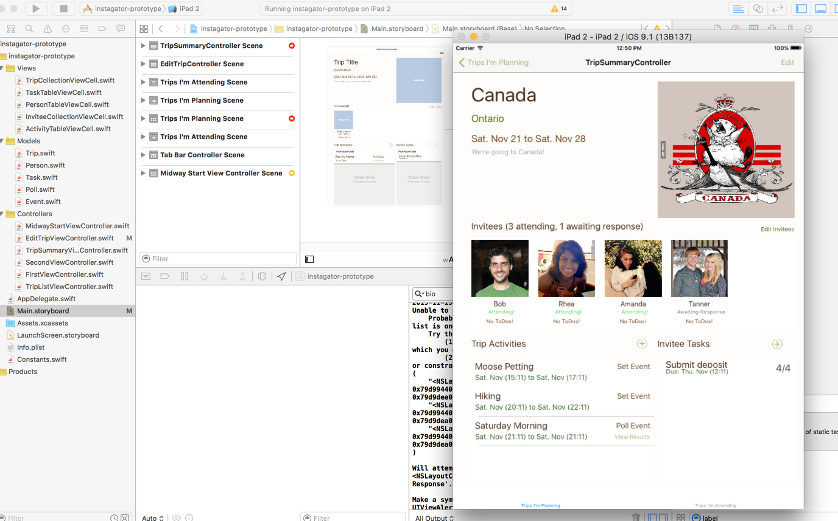
Redesign and Prototype Implementation

Slide 13
Old Design

Slide 14
Redesign Themes
Utilize familiar iOS buttons, habits
Utilize real estate to simplify flow
Dashboard approach
Improve overall aesthetics

Slide 15
Redesign Themes
Utilize familiar iOS buttons, habits
Utilize real estate to simplify flow
Dashboard approach
Improve overall aesthetics

Slide 16
Redesign Themes
Utilize familiar iOS buttons, habits
Utilize real estate to simplify flow
Dashboard approach
Improve overall aesthetics

Slide 17
New Design

Slide 18
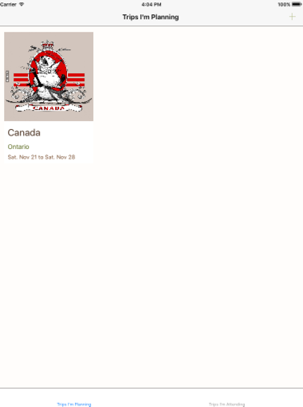
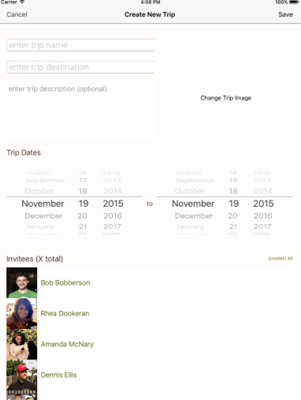
New Design

Slide 19
New Design

Slide 20
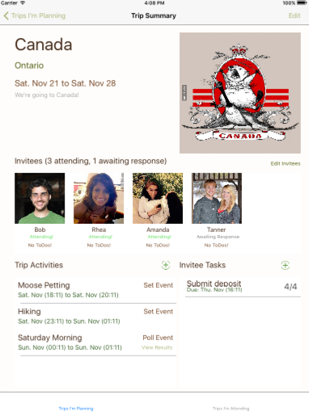
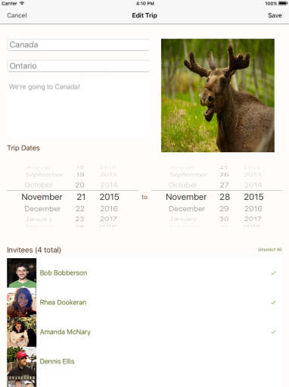
New Design

Slide 21
New Design

Slide 22
Tools Used

Slide 23
Tools Used
Benefits:
Native Application
Good Dev Environment
Built-in emulator
Storyboard
Drawbacks:
We didn’t know Swift
Custom built for each platform

Slide 24
Tools Used
Benefits:
Native Application
Good Dev Environment
Built-in emulator
Storyboard
Drawbacks:
We didn’t know Swift
Custom built for each platform

Slide 25
Tools Used
Benefits:
Web dev tools
(we know these!)
Built-in emulator
Drawbacks:
No native capabilities
More code required
New tool
Lacks pre-made objects, use HTML

Slide 26
Tools Used
Benefits:
Web dev tools
(we know these!)
Built-in emulator
Drawbacks:
No native capabilities
More code required
New tool
Lacks pre-made objects, use HTML

Slide 27
Tools Used

Slide 28
Hard-coded Data
Options
Databases - difficult set-up and interfacing
Local storage - local
Global vars - Perfect!
Data
People
Trips
Tasks
Polls
Events
Images

Slide 29
Hard-coded Data
Options
Databases - difficult set-up and interfacing
Local storage - local
Global vars - Perfect!
Data
People
Trips
Tasks
Polls
Events
Images

Slide 30
Other Tricks and Techniques
Notifications instead of messages
Straight up lying
Of COURSE Tanner is now an admin…
Of COURSE I just sent a reminder to everyone...

Slide 31
Future Features
Task interface
Sending reminders
Poll interface
Creation by admin
Participation by members
New Task 3!
Results for admin
User privileges

Slide 32
Future Features
Task interface
Sending reminders
Poll interface
Creation by admin
Participation by members
New Task 3!
Results for admin
User privileges

Slide 33
Future Features
Task interface
Sending reminders
Poll interface
Creation by admin
Participation by members
New Task 3!
Results for admin
User privileges, small UI fixes and extensions

Slide 34
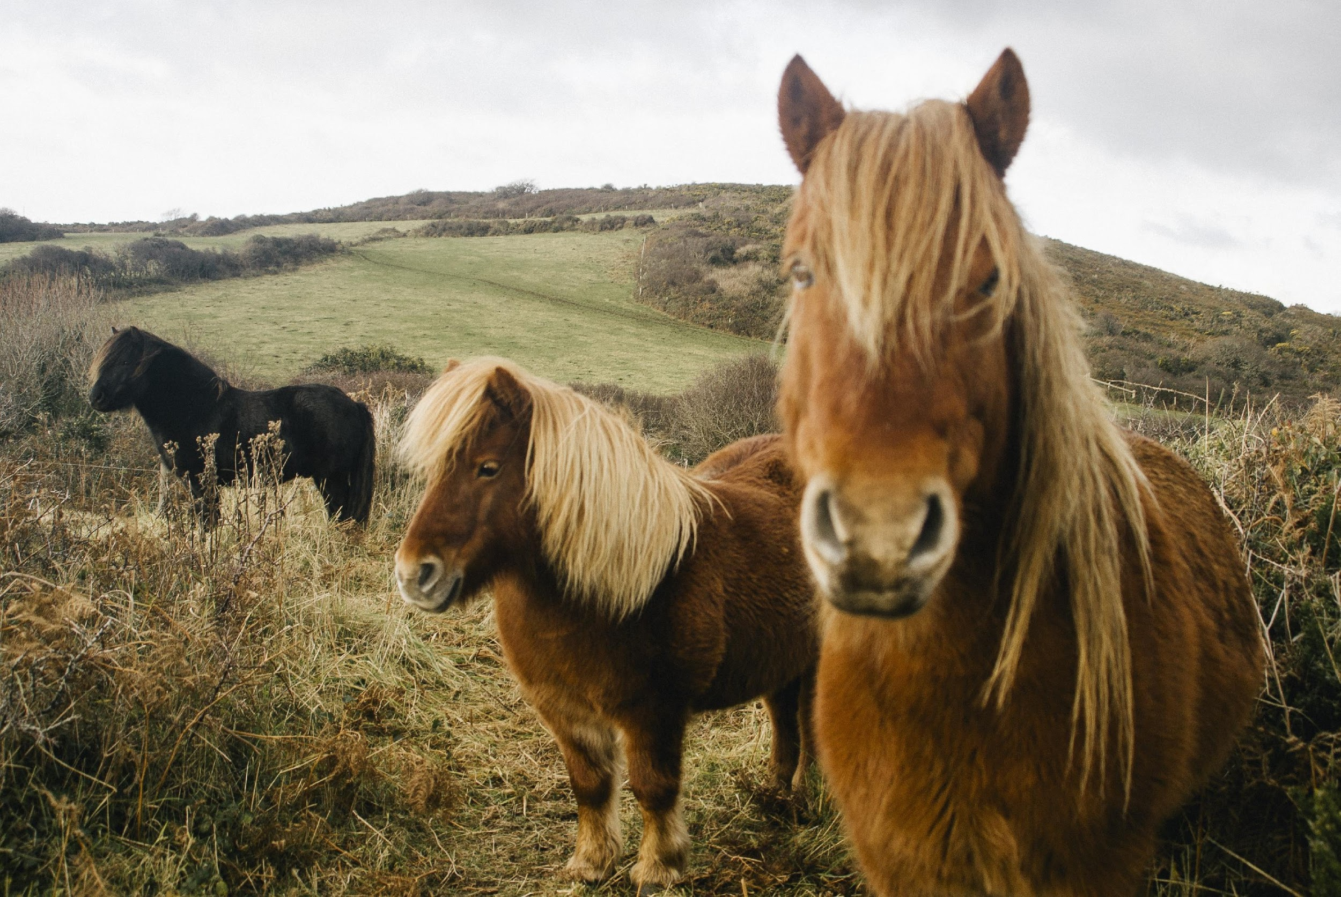
Wrap
“A journey is best measured in friends rather than miles” - Tim Cahill

