Slide 1
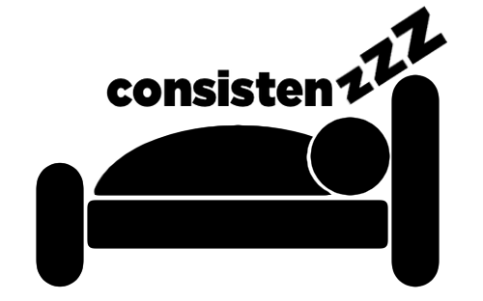
Hi-Fi Midway Milestone
The Dream Team

Slide 2
sleep more, live better.

Slide 3
People lose countless hours of quality sleep to homework and technological distractions, such as late-night use of their computers or phones.
We aim to change this by inspiring users to consistently set and reach their sleep goals, tracking users’ sleep debt, and helping users leverage sleep to improve their lives overall.

Slide 4
TD;LR
Problem: People don’t get enough sleep
Solution: Set bedtime goals and hit them

Slide 5
Roadmap
Tasks
Heuristic Eval Results
Design Revisions
Current Status
Gameplan
Demo

Slide 6
Roadmap
Tasks
Heuristic Eval Results
Design Revisions
Current Status
Gameplan
Demo

Slide 7
Tasks
Simple: Go to bed at bedtime goal
Moderate: Set a schedule and goals
Complex: See your progress and adjust

Slide 8
Roadmap
Tasks
Heuristic Eval Results
Design Revisions
Current Status
Gameplan
Demo

Slide 9
Heuristic Eval Results
(1) Home Screen
(2) Clock Logic
(3) Navigation
(4) Fix Me
(5) Progress Screens
Notes:
(1) Home Screen
> comments in final recommendations
> too much unused space
> graphic was too big and didnt do anything (not clickable)
(2) Clock Logic
> 7 level 4-5 severity issues
> not all minutes are available - clock in 30 min increments
> no distinction between AM / PM
> time selection scroller was not visible or intuitive
> lack of flexibility for adjusting bed/wake times (i.e. after bed time has passed)
> handful of level 1-3 severity issues
(3) Navigation
> 2 level 4-5 severity issues
> changing set up settings later on
> confusing back/home buttons
> handful of level 1-3 severity issues
> comments in final recommendations
(4) fix me
> 4 level 4-5 severity issues
> laborious task to set weekly
> some design problems
> redefine its purpose
(5) progress
> 2 level 4-5 severity issues
> more design problems
> redefining purpose of these screens

Slide 10
Heuristic Eval Results
(1) Home Screen
(2) Clock Logic
(3) Navigation
(4) Fix Me
(5) Progress Screens
Notes:
(1) Home Screen
> comments in final recommendations
> too much unused space
> graphic was too big and didnt do anything (not clickable)

Slide 11
Heuristic Eval Results
(1) Home Screen
(2) Clock Logic
(3) Navigation
(4) Fix Me
(5) Progress Screens
Notes:
(2) Clock Logic
> 7 level 4-5 severity issues
> not all minutes are available - clock in 30 min increments
> no distinction between AM / PM
> time selection scroller was not visible or intuitive
> lack of flexibility for adjusting bed/wake times (i.e. after bed time has passed)
> handful of level 1-3 severity issues

Slide 12
Heuristic Eval Results
(1) Home Screen
(2) Clock Logic
(3) Navigation
(4) Fix Me
(5) Progress Screens
Notes:
(3) Navigation
> 2 level 4-5 severity issues
> changing set up settings later on
> confusing back/home buttons
> handful of level 1-3 severity issues
> comments in final recommendations

Slide 13
Heuristic Eval Results
(1) Home Screen
(2) Clock Logic
(3) Navigation
(4) Fix Me
(5) Progress Screens
Notes:
(4) fix me
> 4 level 4-5 severity issues
> laborious task to set weekly
> some design problems
> redefine its purpose

Slide 14
Heuristic Eval Results
(1) Home Screen
(2) Clock Logic
(3) Navigation
(4) Fix Me
(5) Progress Screens
Notes:
(5) progress
> 2 level 4-5 severity issues
> more design problems
> redefining purpose of these screens

Slide 15
Roadmap
Tasks
Heuristic Eval Results
Design Revisions
Current Status
Gameplan
Demo
Notes:
focus on 1-3 of heuristic eval - related to task #1
GOAL = calculate sleep debt, display it, set bed/wake times, and get alerts

Slide 16
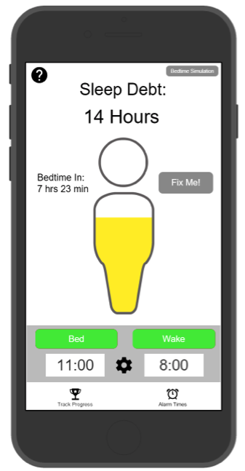
Design Revision: Home Screen
Notes:
> sleep debt graphic
> graphic will serve as a fix me button
> improved coloring schematics
> complemented by “Functioning at %”

Slide 17
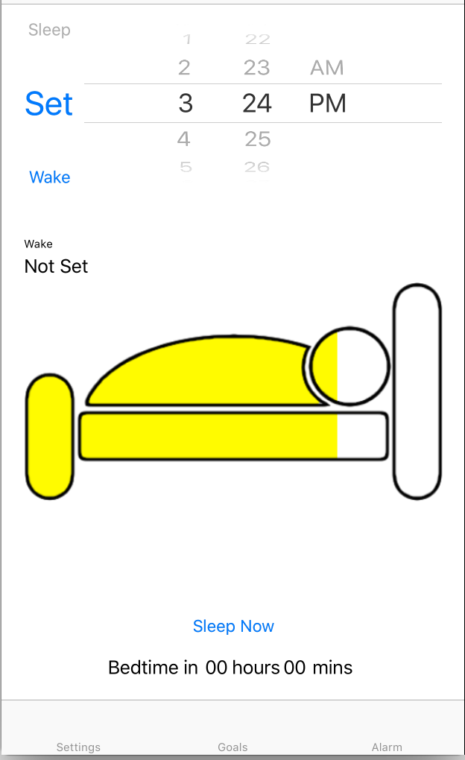
Design Revision: Home Screen
Notes:
> sleep debt graphic
> graphic will serve as a fix me button
> improved coloring schematics
** > will be complemented by “Functioning at %” & # value of sleep debt

Slide 18
Design Revision: Home Screen
Notes:
> use of space
> focal point is setting alarms
> bedtime countdown w/ sleep now button
> still improvements on maximizing use of space

Slide 19
Design Revision: Home Screen
Notes:
> use of space
> focal point is setting alarms
> bedtime countdown w/ sleep now button
> still improvements on maximizing use of space

Slide 20
Design Revision: Home Screen
Notes:
> use of space
> focal point is setting alarms
> bedtime countdown w/ sleep now button
> still improvements on maximizing use of space

Slide 21
Design Revision: Home Screen
Notes:
> centered around bed & wake times + ability to adjust times
> countdown till bedtime + sleep now button
> focus more on setting your daily / nightly schedule as we know that people’s schedules are constantly changing so scheduling a week of wake/bed times is a lot to ask

Slide 22
Design Revision: Home Screen
Notes:
> centered around bed & wake times + ability to adjust times
> countdown till bedtime + sleep now button
> focus more on setting your daily / nightly schedule as we know that people’s schedules are constantly changing so scheduling a week of wake/bed times is a lot to ask

Slide 23
Design Revision: Clock Logic
Notes:
> intuitive bed/wake time alarm set up + more flexibility with adjusting alarms
> improved visibility of time scroller because there is 1 not 2
> toggle between setting wake and bed

Slide 24
Design Revision: Clock Logic
Notes:
> intuitive bed/wake time alarm set up + more flexibility with adjusting alarms
> improved visibility of time scroller because there is 1 not 2
> toggle between setting wake and bed

Slide 25
Design Revision: Clock Logic
Notes:
> intuitive bed/wake time alarm set up + more flexibility with adjusting alarms
> improved visibility of time scroller because there is 1 not 2
> toggle between setting wake and bed

Slide 26
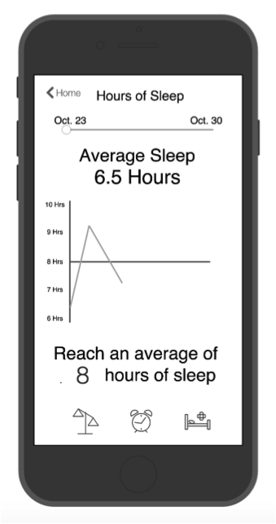
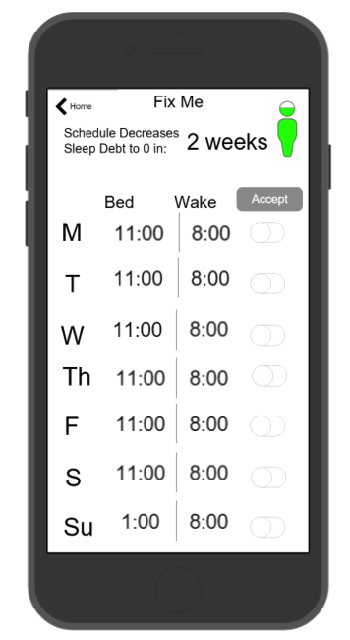
Design Revision: Navigation
Home Nav Bar
Progress Nav Bar
No Nav Bar
Notes:
> static navigation bar on all screens
> improved ease & flow of user interaction
> more intuitive & less confusing
> eliminated “<Home” buttons

Slide 27
Design Revision: Navigation
Home Nav Bar
Progress Nav Bar
No Nav Bar
STATIC Nav Bar
Notes:
> static navigation bar on all screens
> improved ease & flow of user interaction
> more intuitive & less confusing
> eliminated “<Home” buttons

Slide 28
Design Revision: Navigation
STATIC Nav Bar
Notes:
> static navigation bar on all screens
> improved ease & flow of user interaction
> more intuitive & less confusing
> eliminated “<Home” buttons
** < BACK WONT BE THERE - ONLY FOR TESTING PURPOSES

Slide 29
Roadmap
Tasks
Heuristic Eval Results
Design Revisions
Current Status
Gameplan
Demo

Slide 30
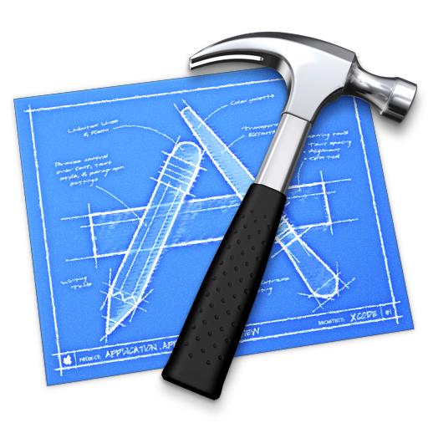
Current Status: Tools
Notes:
>XCode
** version control issues have affected production of prototype
>Github (collaboration)

Slide 31
Current Status: Task #1 Features
setting bed & wake time alarms
bedtime countdown
“Sleep Now” button
sleep debt tracking
receiving alerts
static navigation bar

Slide 32
Current Status: Task #1 Features
setting bed & wake time alarms
bedtime countdown
“Sleep Now” button
sleep debt tracking
receiving alerts
static navigation bar

Slide 33
Current Status: Task #1 Features
setting bed & wake time alarms
bedtime countdown
“Sleep Now” button
sleep debt tracking
receiving alerts
static navigation bar

Slide 34
Current Status: Task #1 Features
setting bed & wake time alarms
bedtime countdown
“Sleep Now” button
sleep debt tracking
receiving alerts
static navigation bar

Slide 35
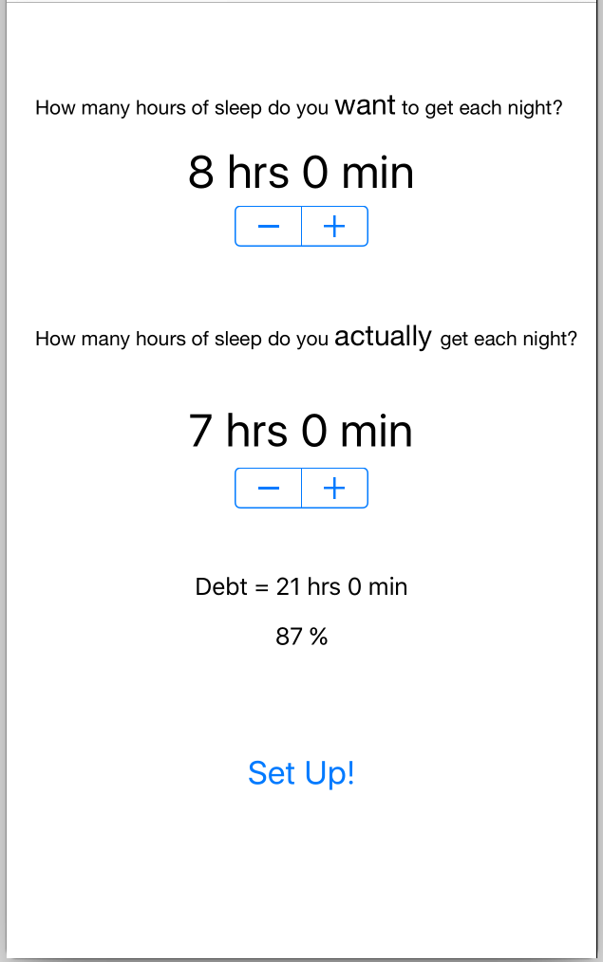
Current Status: Task #1 Features
setting bed & wake time alarms
bedtime countdown
“Sleep Now” button
sleep debt tracking
receiving alerts
static navigation bar

Slide 36
Current Status: Task #1 Features
setting bed & wake time alarms
bedtime countdown
“Sleep Now” button
sleep debt tracking
receiving alerts
static navigation bar

Slide 37
Current Status: Task #1 Features
setting bed & wake time alarms
bedtime countdown
“Sleep Now” button
sleep debt tracking
receiving alerts
static navigation bar
Notes:
ADD IN GRAPHIC

Slide 38
Roadmap
Tasks
Heuristic Eval Results
Design Revisions
Current Status
Gameplan
Demo

Slide 39
Game Plan
refine navigation bar
Task #2 & #3 features
educational component
NO hard coding data or Wizard of Oz
user testing
consistency in design
Notes:
new focus = focus less full week calendars and more on nightly sleep/setting one alarm
revamp Task #2/3 features
> redefine “Fix me” function
> implement easier weekly schedule planning
> allow user to save alarms
> redefine “Progress” screens
incorporate educational component (learn why sleep in important and where sleep debt comes from and other interesting sleep related info/articles)
avoid hard coding data & Wizard of Oz
user functionality & design testing
improve overall consistency in design / branding

Slide 40
Game Plan
refine navigation bar
Task #2 & #3 features
educational component
NO hard coding data or Wizard of Oz
user testing
consistency in design
Notes:
refine nav bar w/ icons & 5 components
> learn
> alarms
> home/sleep
> progress
> settings

Slide 41
Game Plan
refine navigation bar
Task #2 & #3 features
educational component
NO hard coding data or Wizard of Oz
user testing
consistency in design
Notes:
new focus = focus less full week calendars and more on nightly sleep/setting one alarm
revamp Task #2/3 features
> redefine “Fix me” function
> implement easier weekly schedule planning
> allow user to save alarms
> redefine “Progress” screens

Slide 42
Game Plan
refine navigation bar
Task #2 & #3 features
educational component
NO hard coding data or Wizard of Oz
user testing
consistency in design
Notes:
incorporate educational component (learn why sleep in important and where sleep debt comes from and other interesting sleep related info/articles)

Slide 43
Game Plan
refine navigation bar
Task #2 & #3 features
educational component
NO hard coding data or Wizard of Oz
user testing
consistency in design
Notes:
avoid hard coding data & Wizard of Oz >> implement FB SDK and parse for saving user input and settings etc

Slide 44
Game Plan
refine navigation bar
Task #2 & #3 features
educational component
NO hard coding data or Wizard of Oz
user testing
consistency in design
Notes:
user functionality & design testing
> feedback on usability and design choices

Slide 45
Game Plan
refine navigation bar
Task #2 & #3 features
educational component
NO hard coding data or Wizard of Oz
user testing
consistency in design
Notes:
maintain strong overall consistency in design / branding

Slide 46
Roadmap
Tasks
Heuristic Eval Results
Design Revisions
Current Status
Gameplan
Demo

Slide 47
Demo: Task #1

Slide 48
questions?

