Slide 1
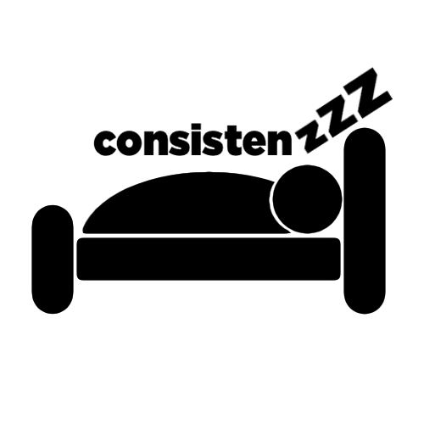
Medium-fi Prototype
The Dream Team

Slide 2
sleep more, live better
Notes:
sleeping has spillover to other poritons of your life

Slide 3
People lose countless hours of quality sleep to homework and
technological distractions, such as late-night use of their
computers or phones.
We aim to change this by inspiring users to consistently set
and reach their sleep goals, tracking users’ sleep debt, and
helping users leverage sleep to improve their lives overall.

Slide 4
TL;DR
Problem: People don’t get enough sleep
Solution: Set bedtime goals and hit them

Slide 5
Tasks
Design Changes
Task Flows
How we did it

Slide 6
Tasks
Design Changes
Task Flows
How we did it

Slide 7
Tasks
Simple: Get to bed on time
Notes:
this is the same

Slide 8
Tasks
Simple: Get to bed on time
Moderate: Set a schedule and goals
Notes:
We changed this one
It used to be “feel more awake during the day”
We think that pretty much all of our tasks help you do this
Our 2nd and 3rd task weren’t distinct enough in user testing
Make the task flow more continuous

Slide 9
Tasks
Simple: Go to bed at bedtime goal
Moderate: Set a schedule and goals
Complex: See your progress and adjust
Notes:
This is a parametrization
It used to be “use sleep to be healthier”
This is also kind of inherent in getting more sleep
This gives more specific feedback to users and helps them better understand what they’re doing right and wrong
This is over the furthest length of time / most devoted user

Slide 10
Tasks
Design Changes
Task Flows
How we did it

Slide 11
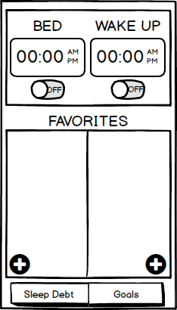
Design Changes - Home Screen
Notes:
Entire purpose of our app was sleep debt
Problem:
users felt like current Sleep Debt screen was not intuitive
unclear why they would click at all
Solution:
this is the best way to give feedback
this way the experience they get everytime they use the app is about what
their current debt is and how they can fix it
a little bit more interactive
educational component - some of our users knew what sleep debt was, others less clear
fix me - user demanded this (probably a user need)

Slide 12
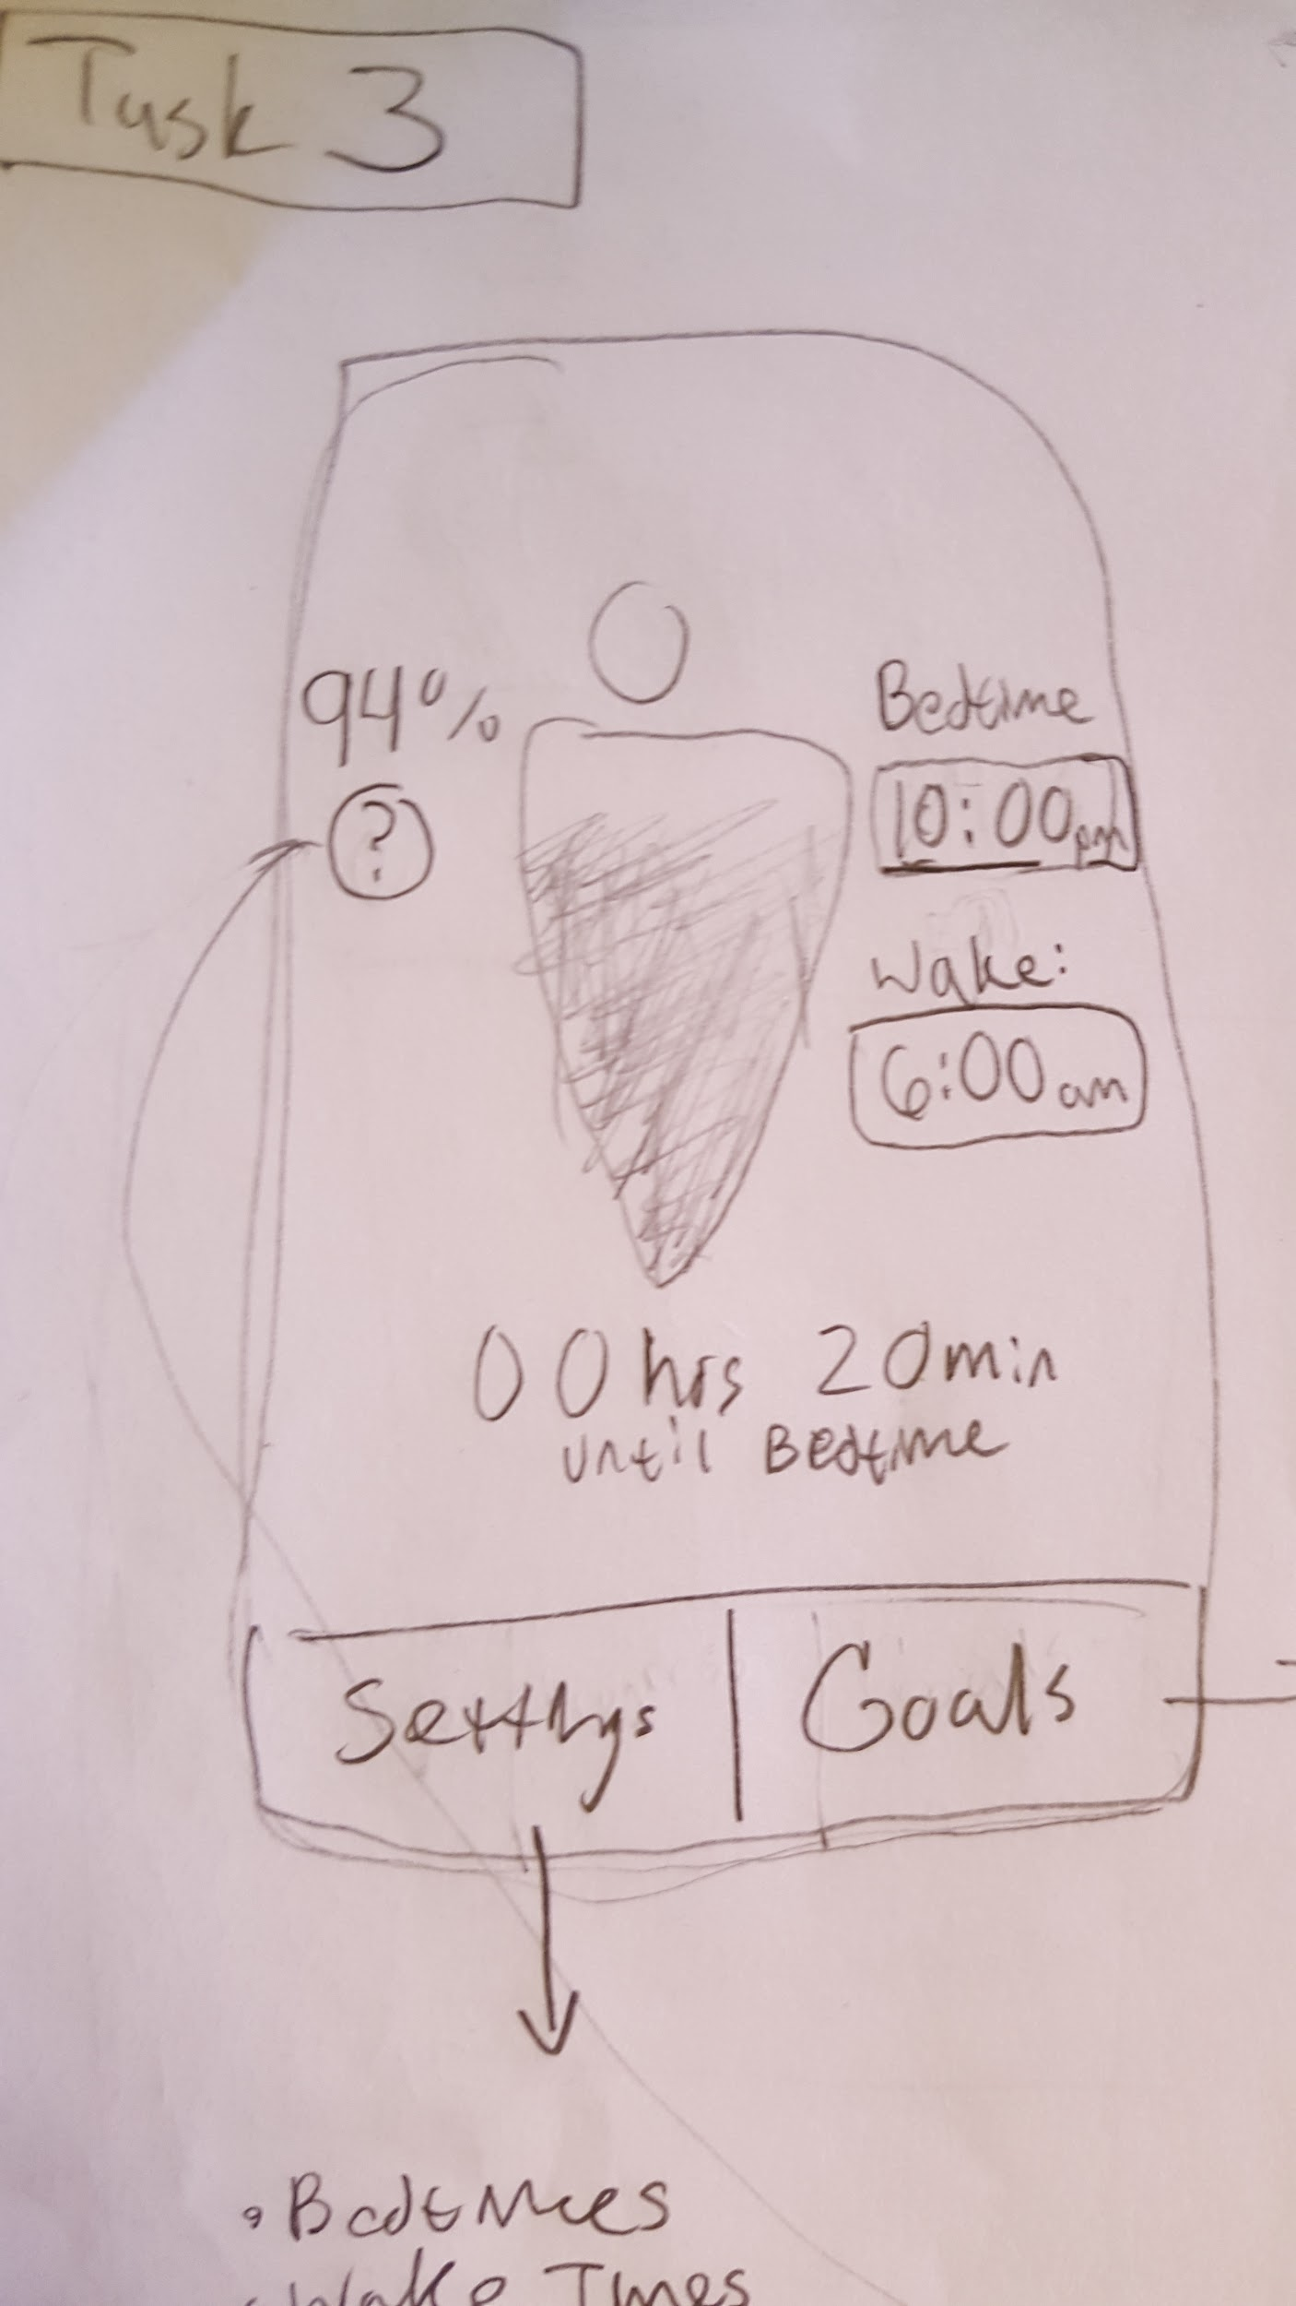
Design Changes - Home Screen
Notes:
Entire purpose of our app was sleep debt
Problem:
users felt like current Sleep Debt screen was not intuitive
unclear why they would click at all
Solution:
this is the best way to give feedback
this way the experience they get everytime they use the app is about what
their current debt is and how they can fix it
a little bit more interactive
educational component - some of our users knew what sleep debt was, others less clear
fix me - user demanded this (probably a user need)

Slide 13
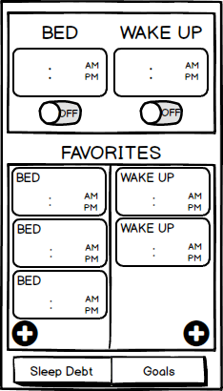
Design Changes - Setting times
Notes:
Users had issues using preset bedtimes and wake up times
2 user camps
Weekly schedules
Tweak nightly
How could we design for both?
we needed a better compromise

Slide 14
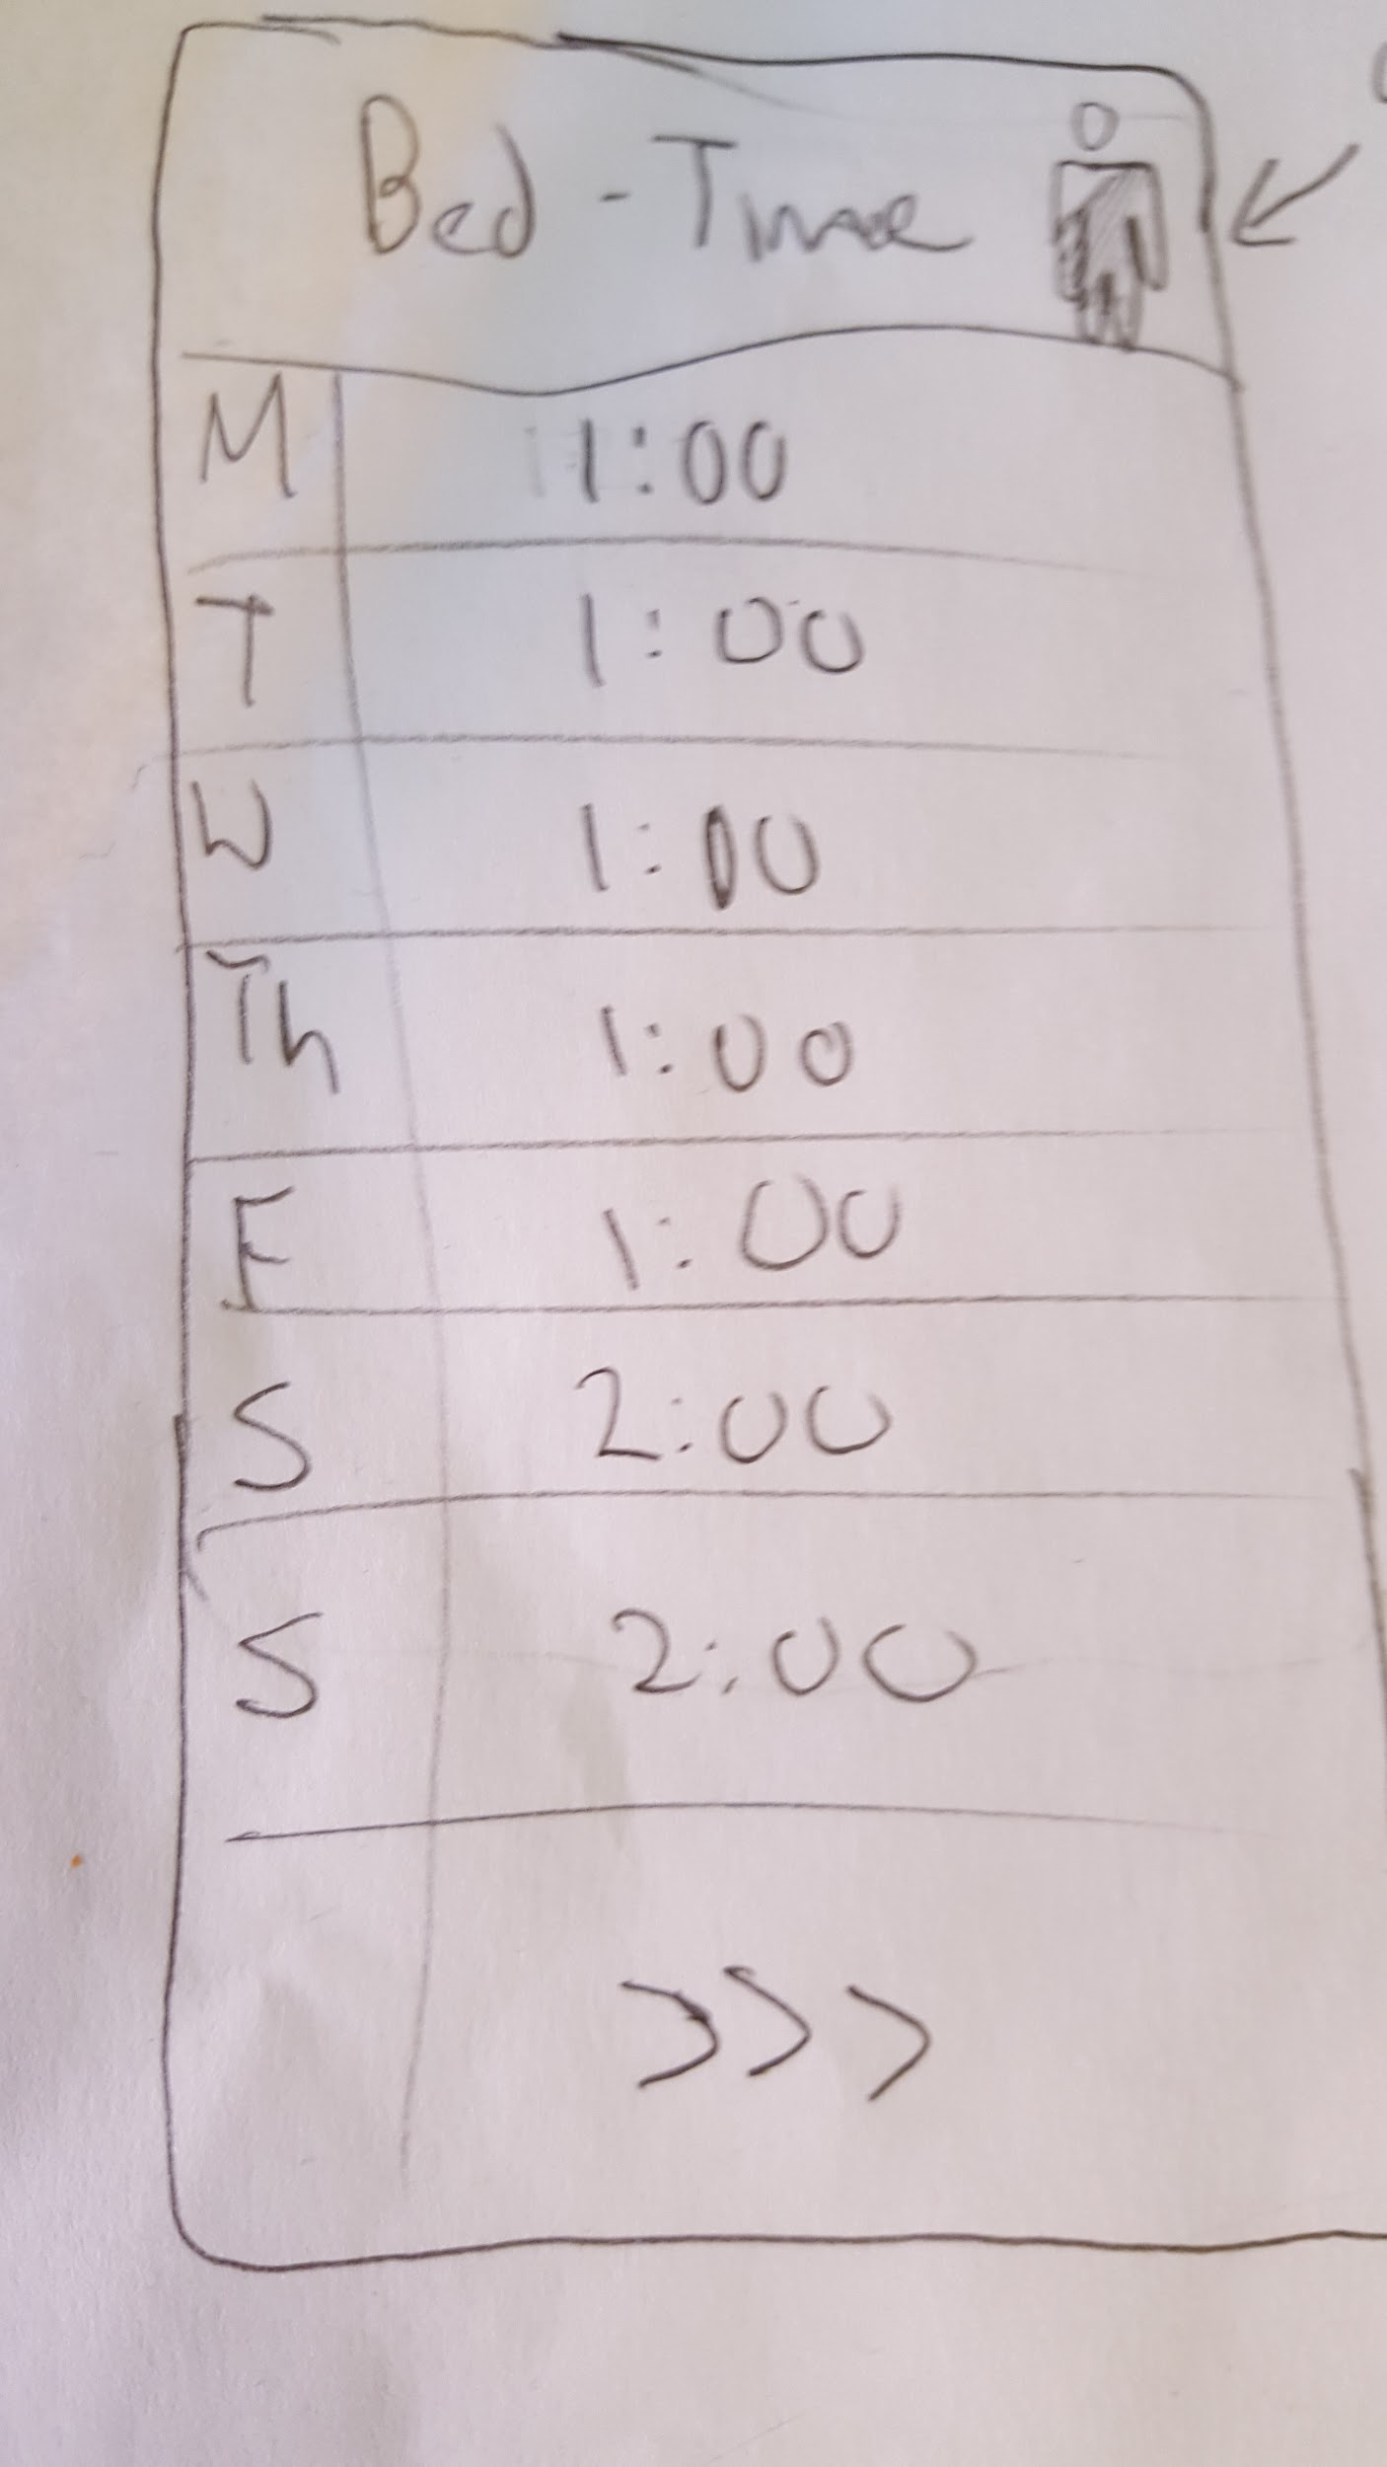
Design Changes - Setting times
Notes:
Problem: Users had issues using preset bedtimes and wake up times
2 user camps
Weekly schedules
Tweak nightly
How could we design for both?
we needed a better compromise

Slide 15
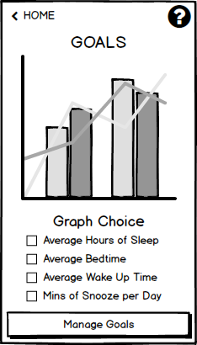
Design Changes - Goals
Notes:
Problem:
Goals weren’t meaningful enough
Graphs were too generic
Management wasn’t very intuitive / helpful - didn’t create the experience of a goal

Slide 16
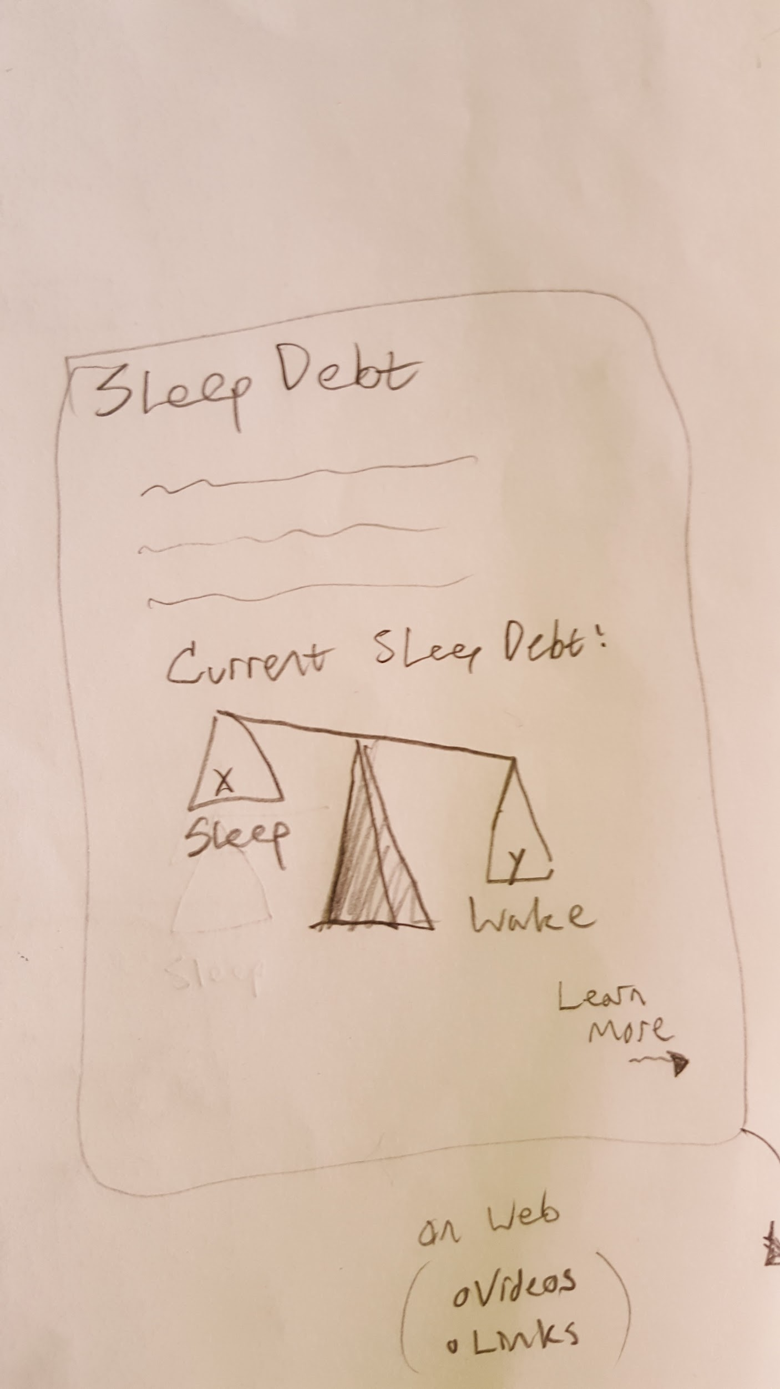
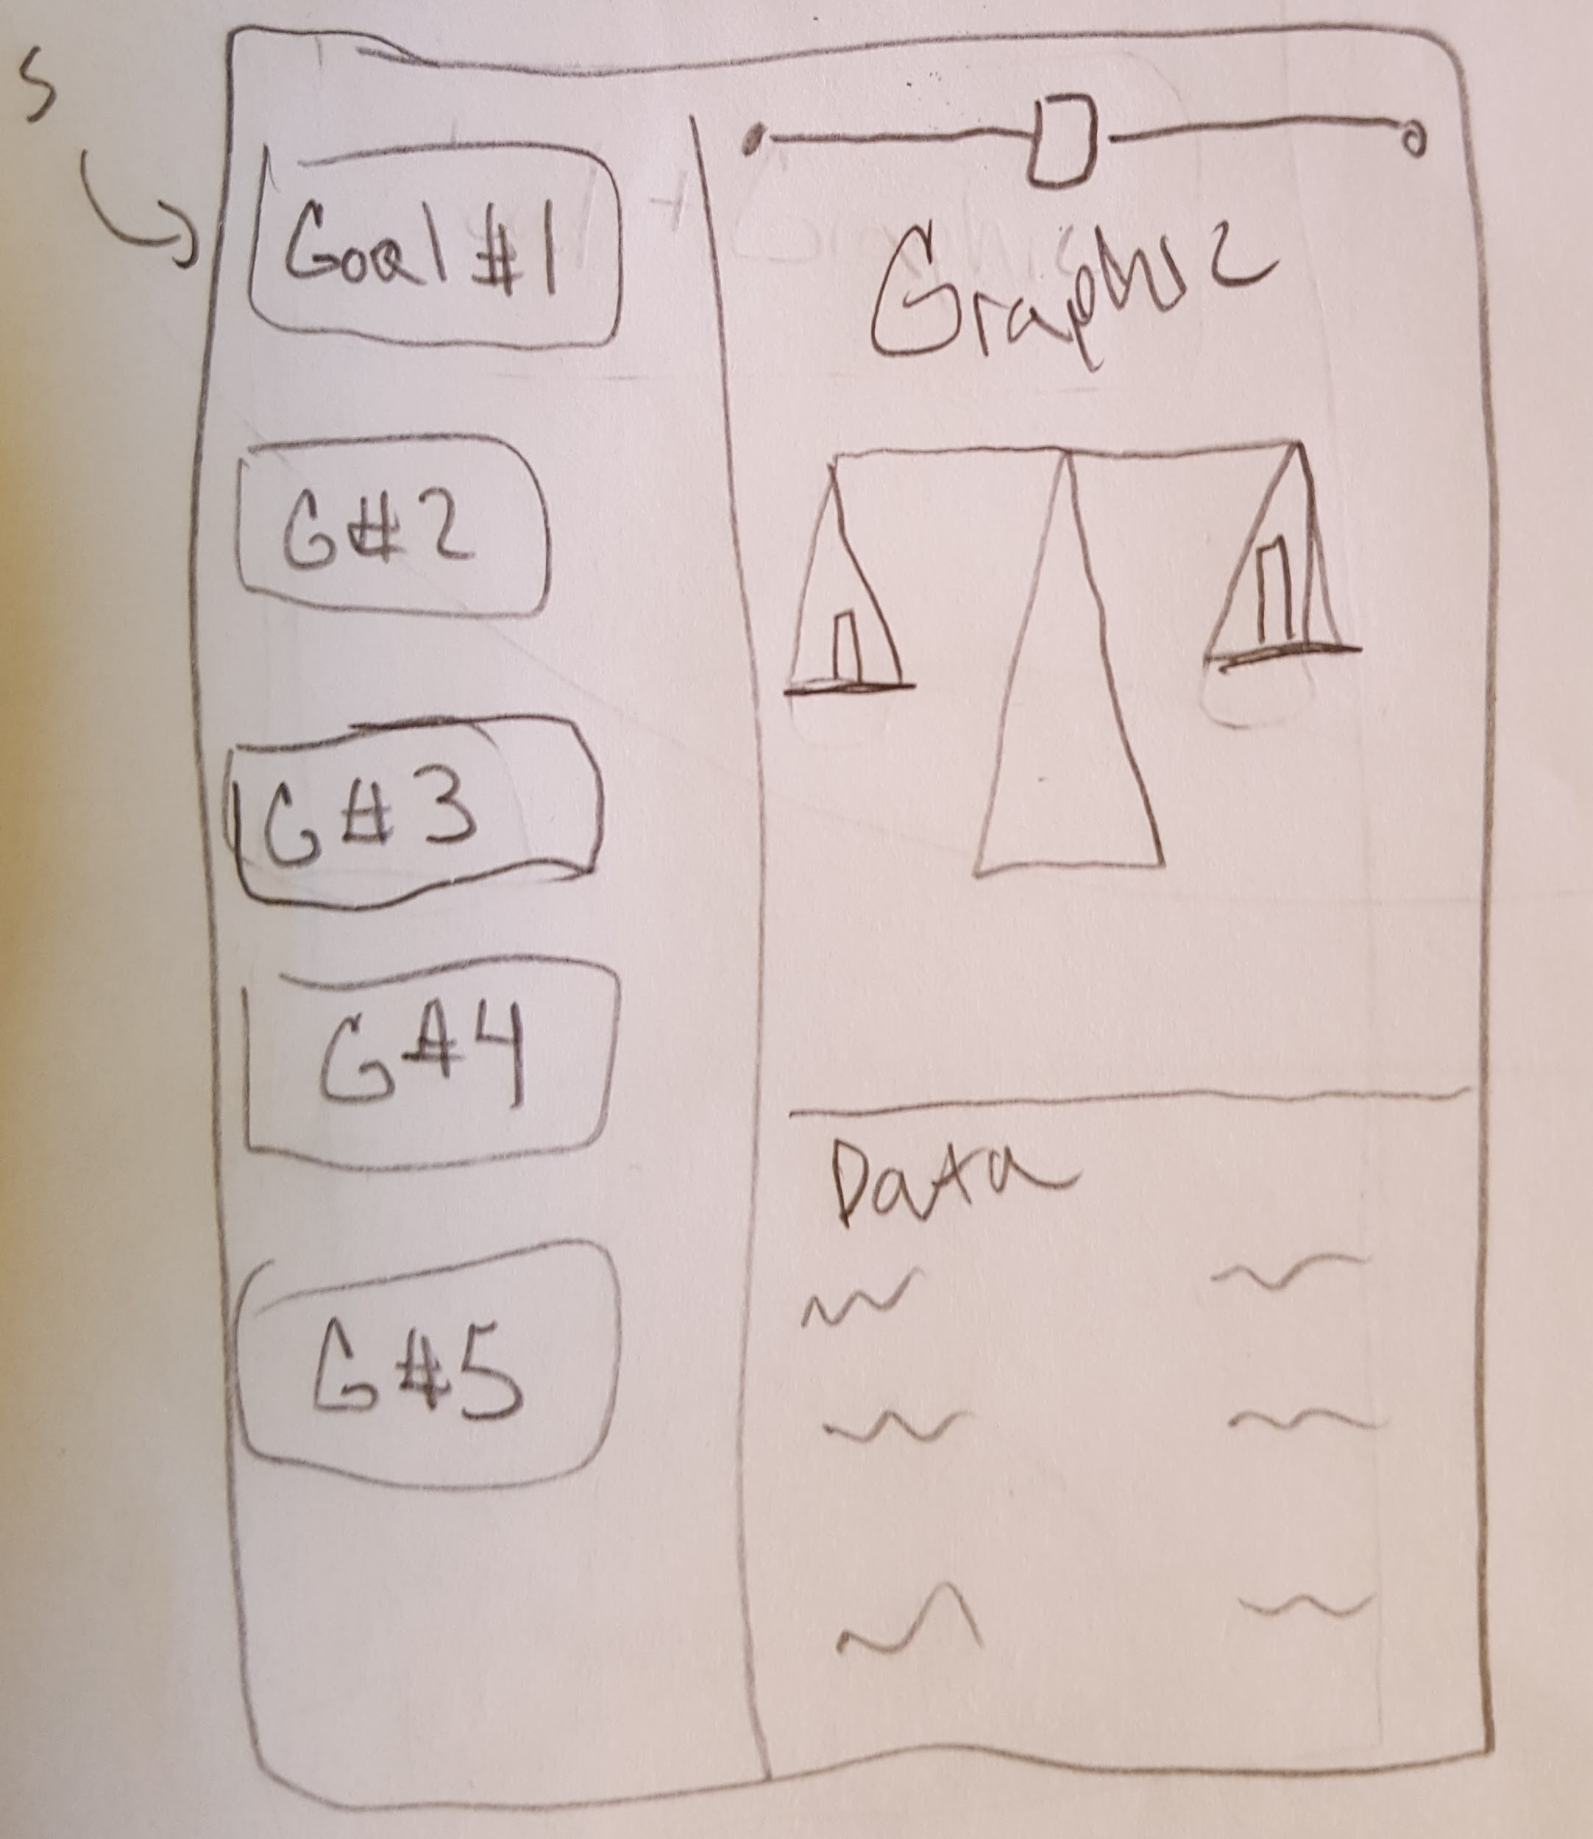
Design Changes - Goals
Notes:
Solution:
Different visualizations which appropriately match different goals
Given standard goals and then modify them as you wish
generally there’s a baseline for good sleep habits - lets help you at least hit that

Slide 17
Tasks
Design Changes
Task Flows
How we did it

Slide 18
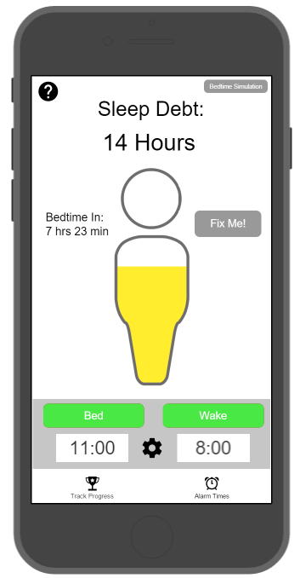
Task Flow 1 - Get to bed on time
User slides up / down to adjust bedtime

Slide 19
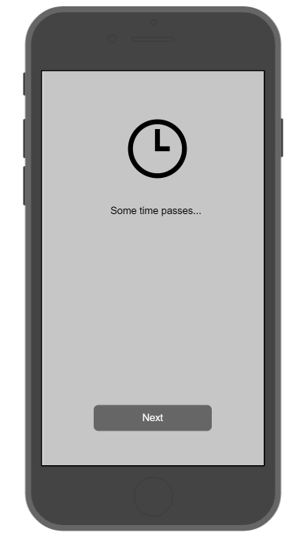
Task Flow 1 - Get to bed on time
User slides up / down to adjust bedtime

Slide 20
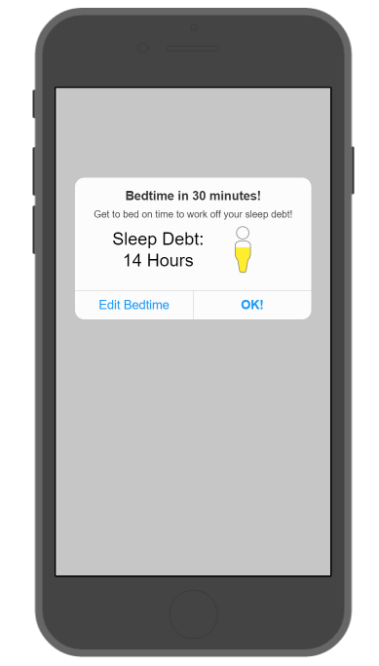
Task Flow 1 - Get to bed on time
User slides up / down to adjust bedtime
For simulation, click accept

Slide 21
Task Flow 1 - Get to bed on time
Tap OK!

Slide 22
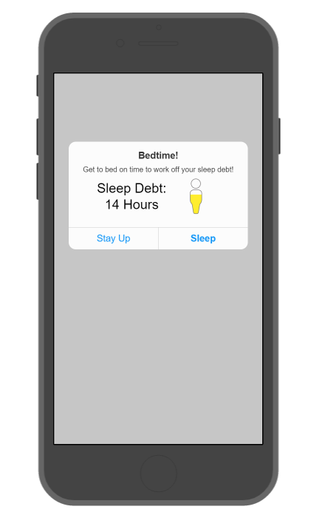
Task Flow 1 - Get to bed on time
Tap OK!
Tap Next

Slide 23
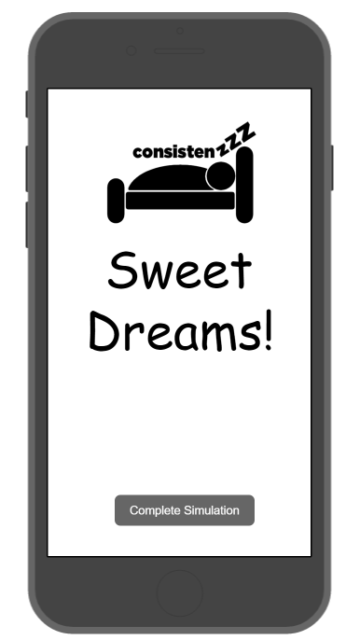
Task Flow 1 - Get to bed on time
Notes:
Why this is an important part of experience
could also be on the wearable

Slide 24
Task Flow 2 - Weekly Schedule
Fix me!

Slide 25
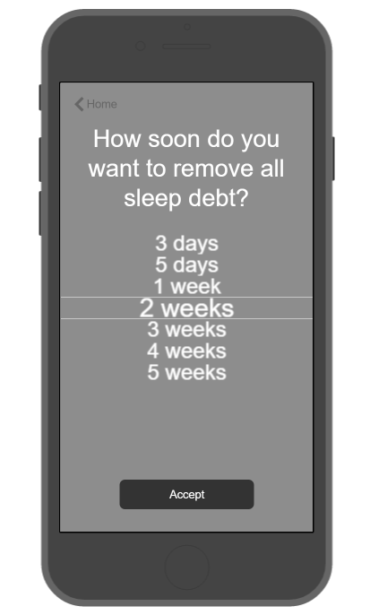
Task Flow 2 - Weekly Schedule
Select a time scale, tap accept
Fix me!

Slide 26
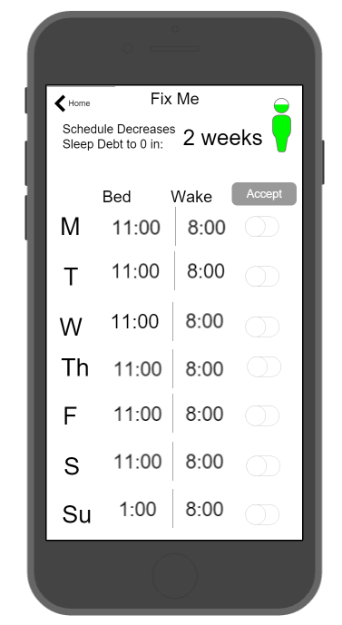
Task Flow 2 - Weekly Schedule
Select a time scale, tap accept
Fix me!

Slide 27
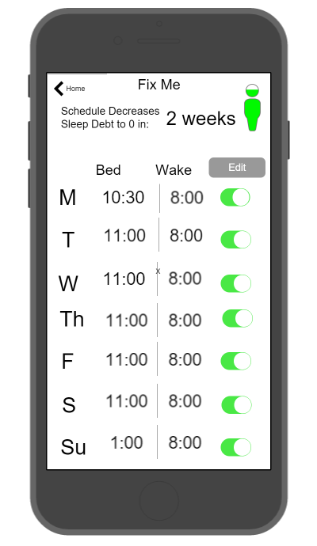
Task Flow 2 - Weekly Schedule
Can tailor, or click accept to turn all on

Slide 28
Task Flow 3 - See your progress and adjust
See progress

Slide 29
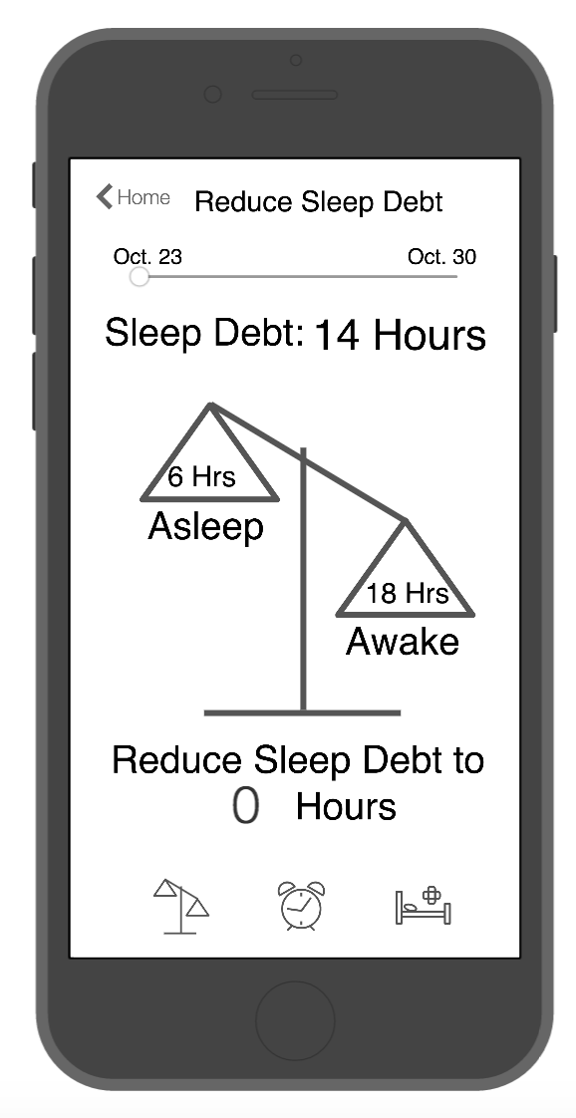
Task Flow 3 - See your progress and adjust
Check out other goals!
See progress

Slide 30
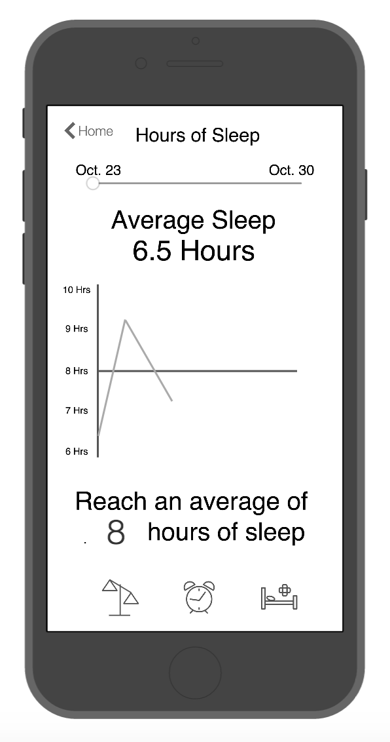
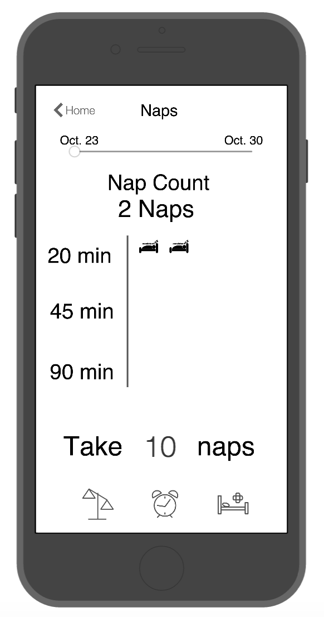
Task Flow 3 - See your progress and adjust
Notes:
View goals, edit goals, etc

Slide 31
Task Flow 3 - See your progress and adjust

Slide 32
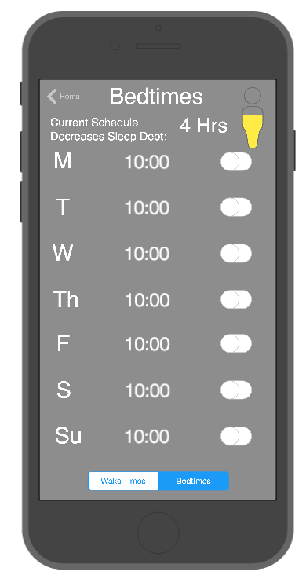
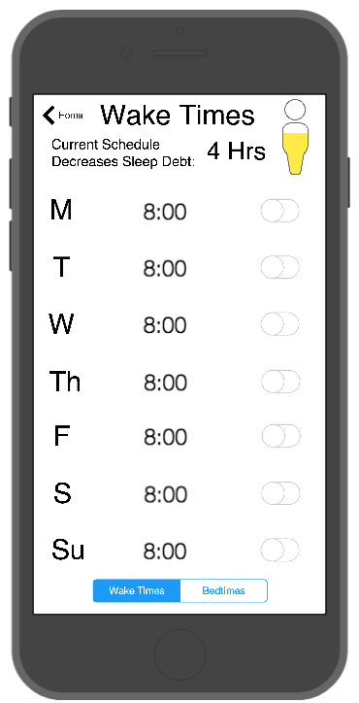
Task Flow 3 - See your progress and adjust

Slide 33
Tasks
Design Changes
Task Flows
How we did it

Slide 34
Proto.io

Slide 35
Proto.io
Pros
Interactions
Grouping
Multiple Designers
Notes:
Interactions
screens vs states, objects
Grouping
throw a bunch of objects together and modify them all at once

Slide 36
Proto.io
Pros
Interactions
Grouping
Multiple designers
Cons
Learning Curve
Limited data input methods
Can’t be working at once
Notes:
Learning Curve
Non intuitive editing
state screens
Data input
couldn’t figure out some functionality we wanted
key pad,

Slide 37
Limitations & Workarounds

Slide 38
Limitations & Workarounds
Limited data
goals screen
sleep debt

Slide 39
Limitations & Workarounds
Limited data
goals screen
sleep debt
Time Passage

Slide 40
prototype
website

