Slide 1
consistenZZZ’s Low Fidelity Prototype Testing
The Dream Team
Gabriella | Nate | Brian | John

Slide 2
Sleep More, Live Better

Slide 3
Selected Interface Design
Prototype Creation
User Tests
Results
Next Steps

Slide 4
Selected Interface Design
Prototype Creation
User Tests
Results
Next Steps

Slide 5
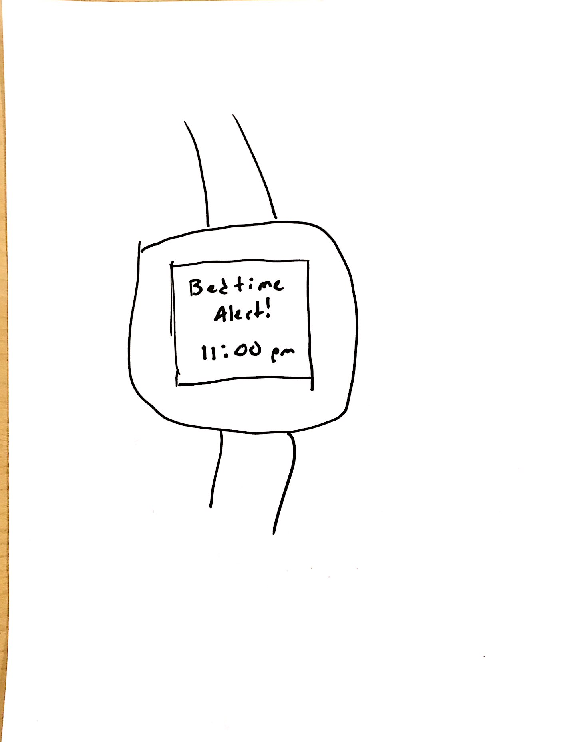
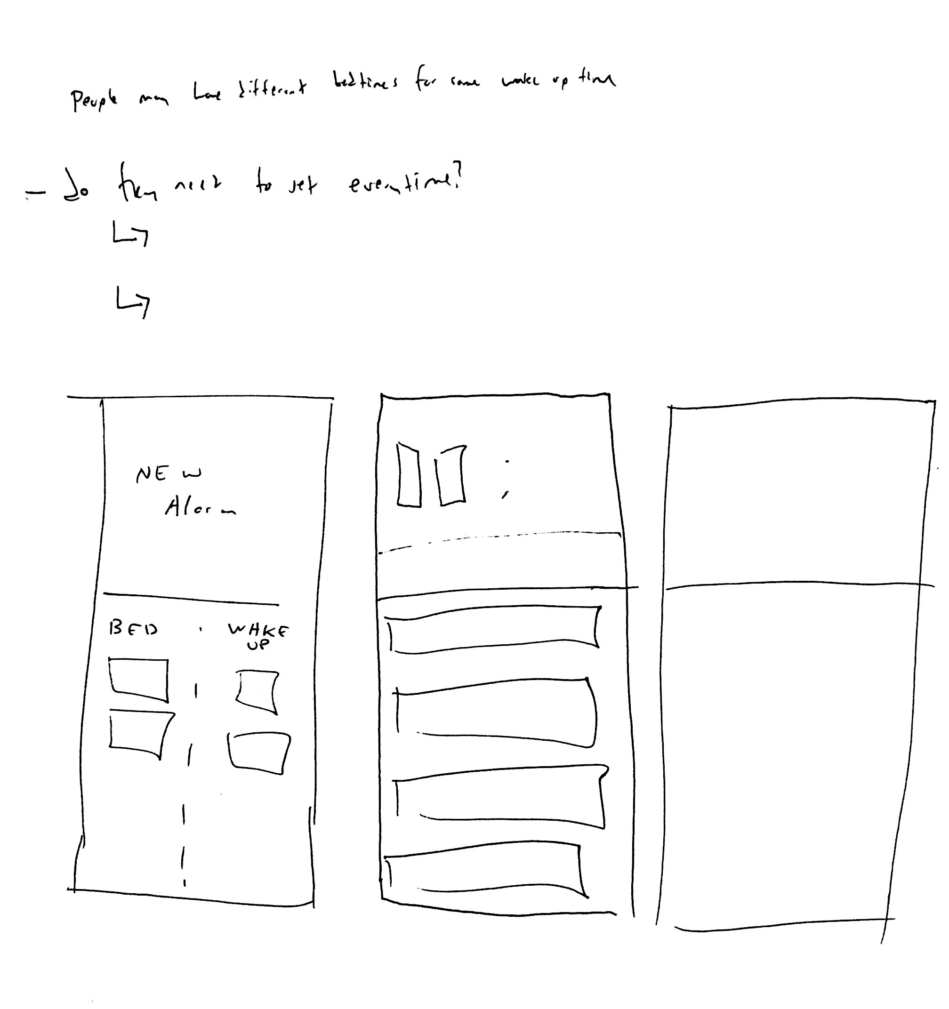
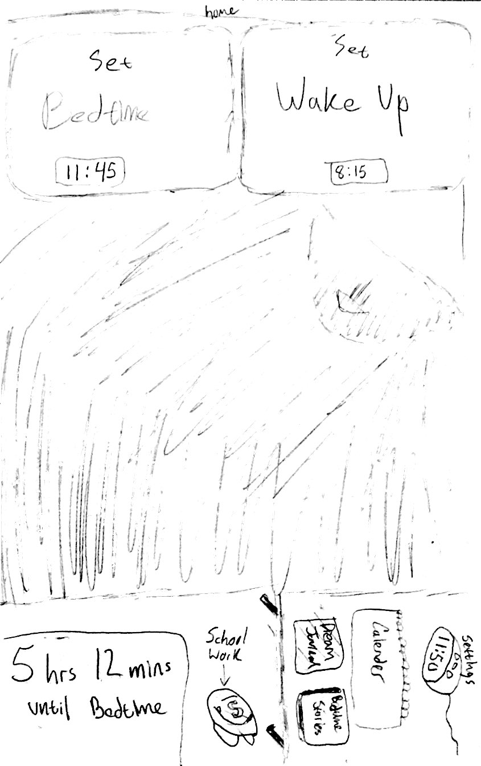
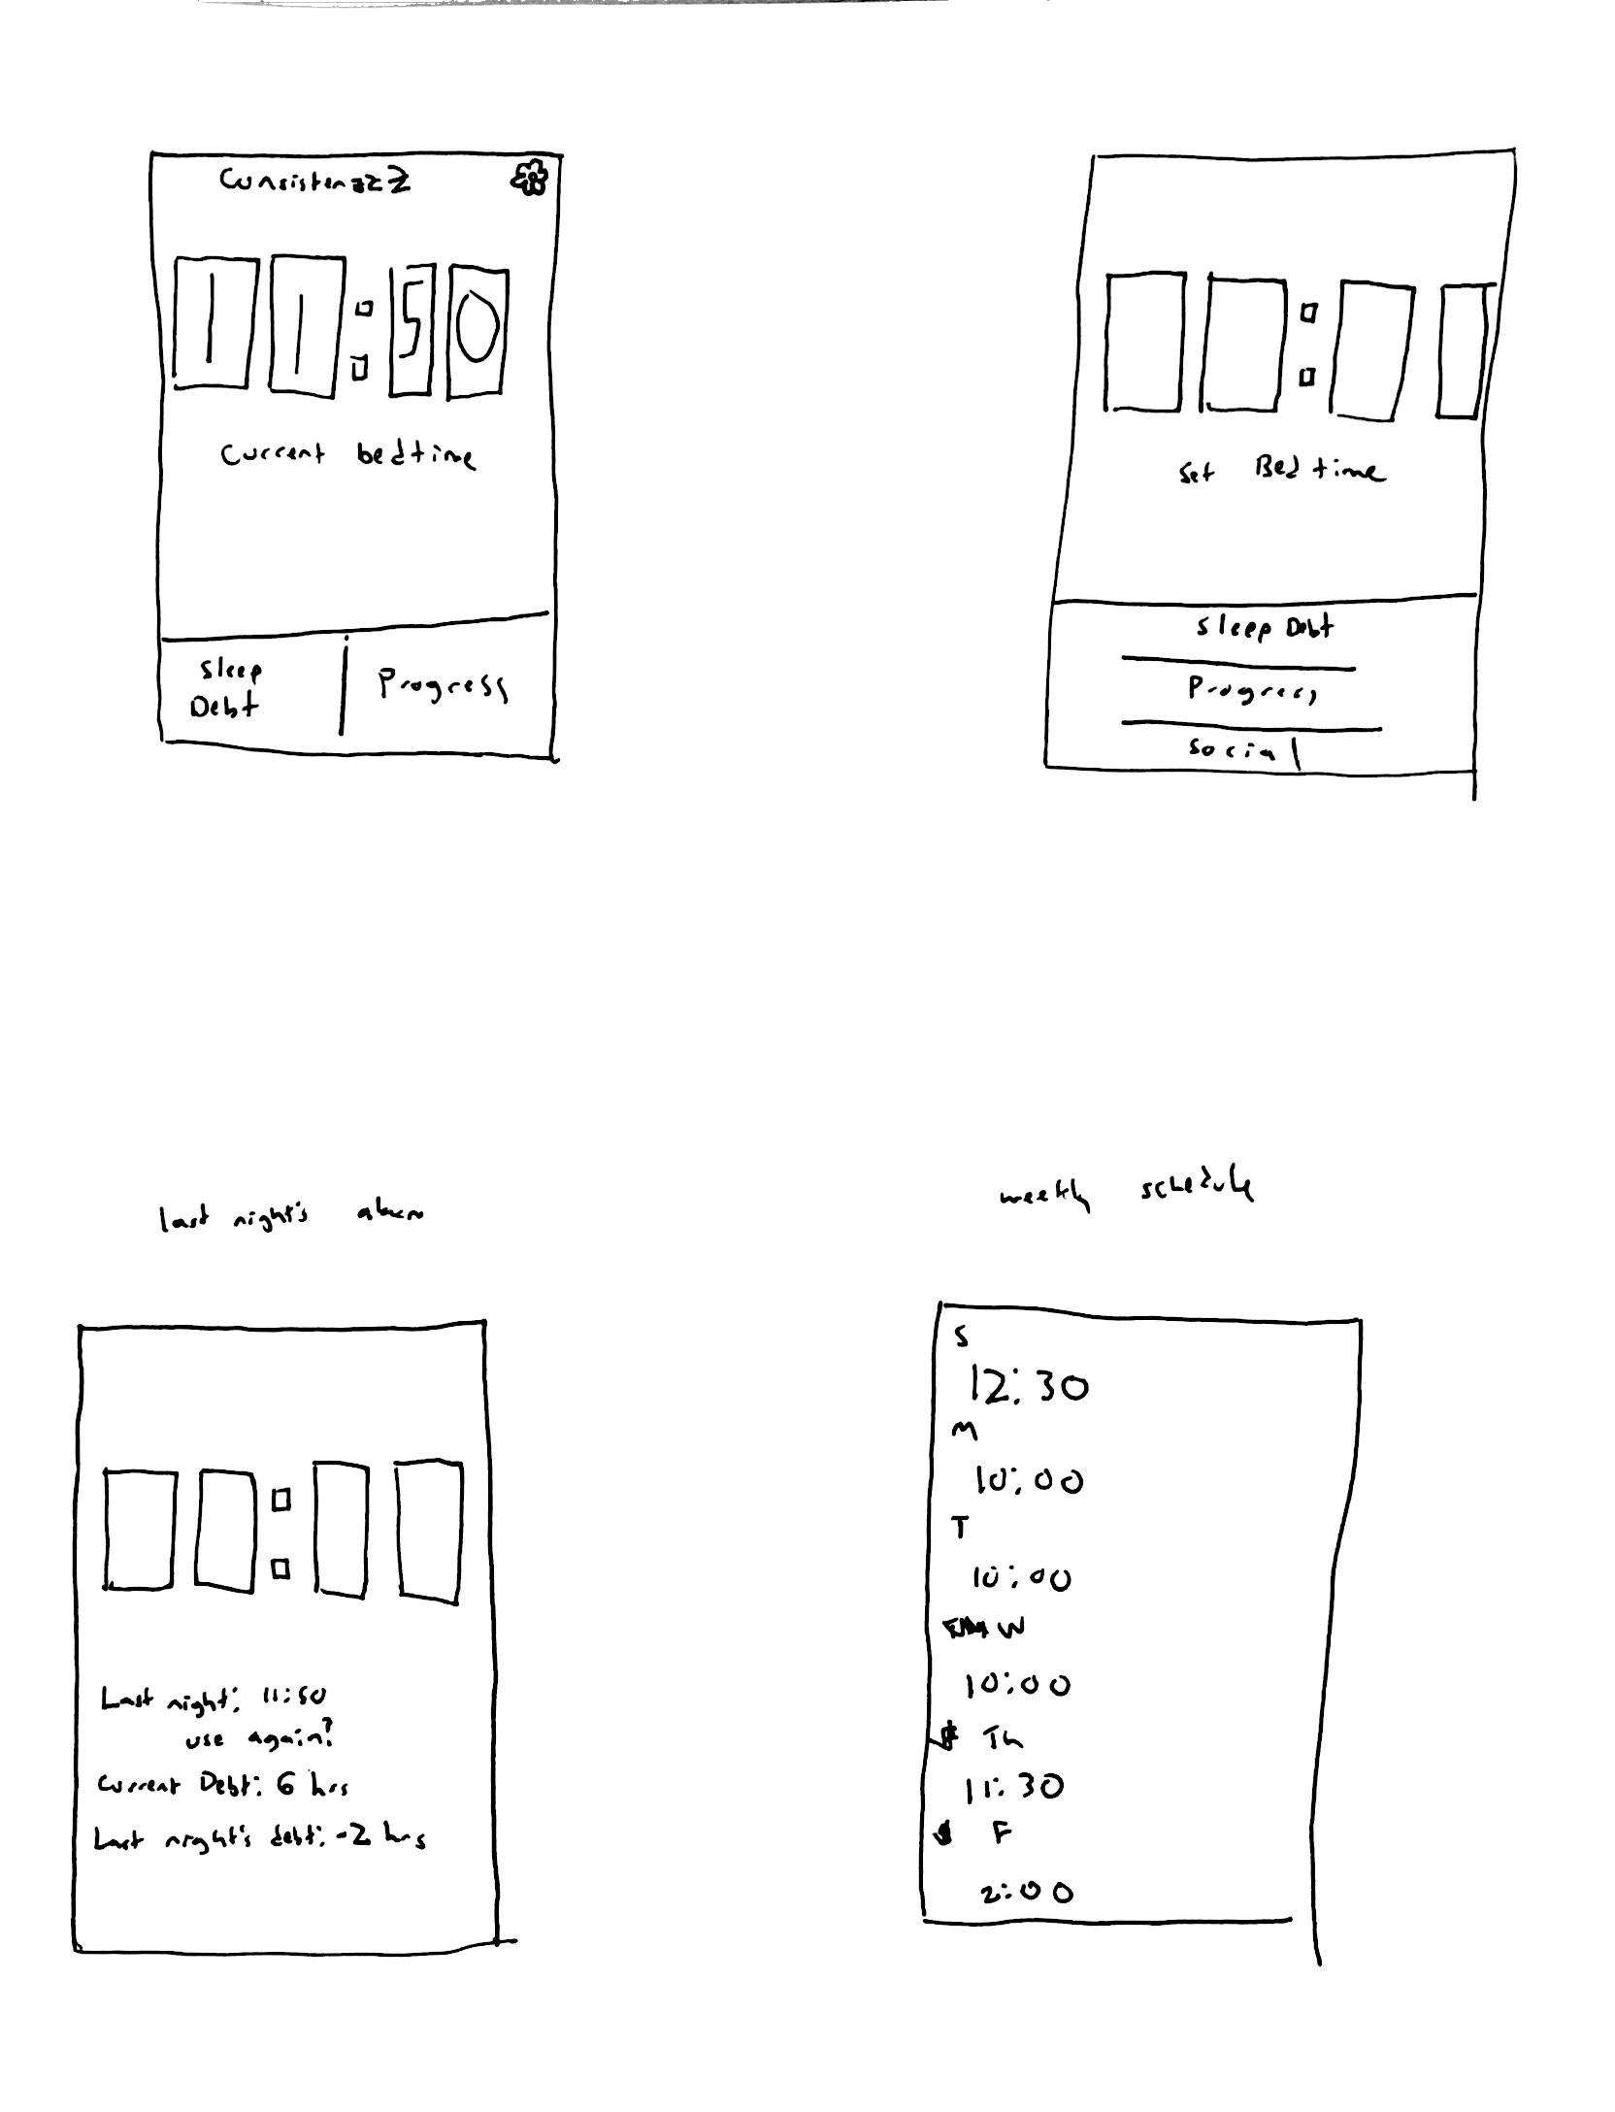
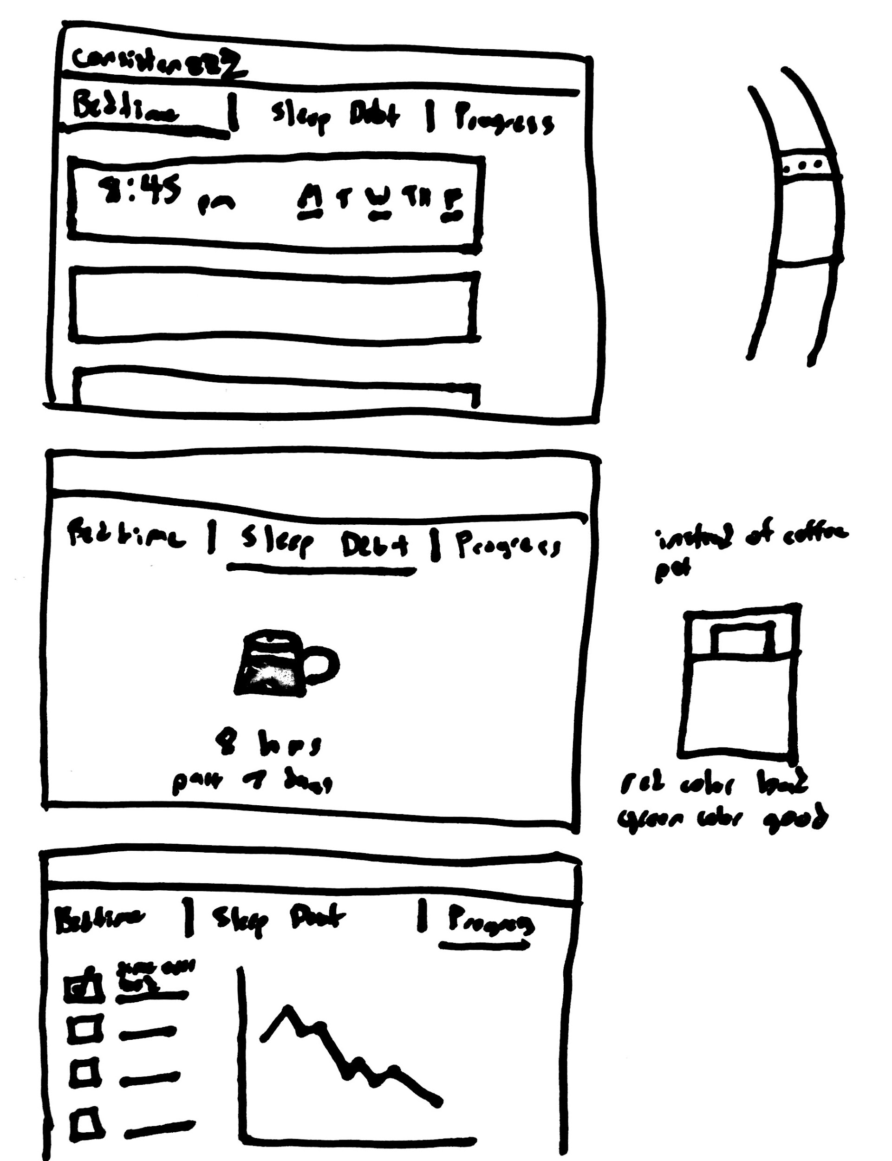
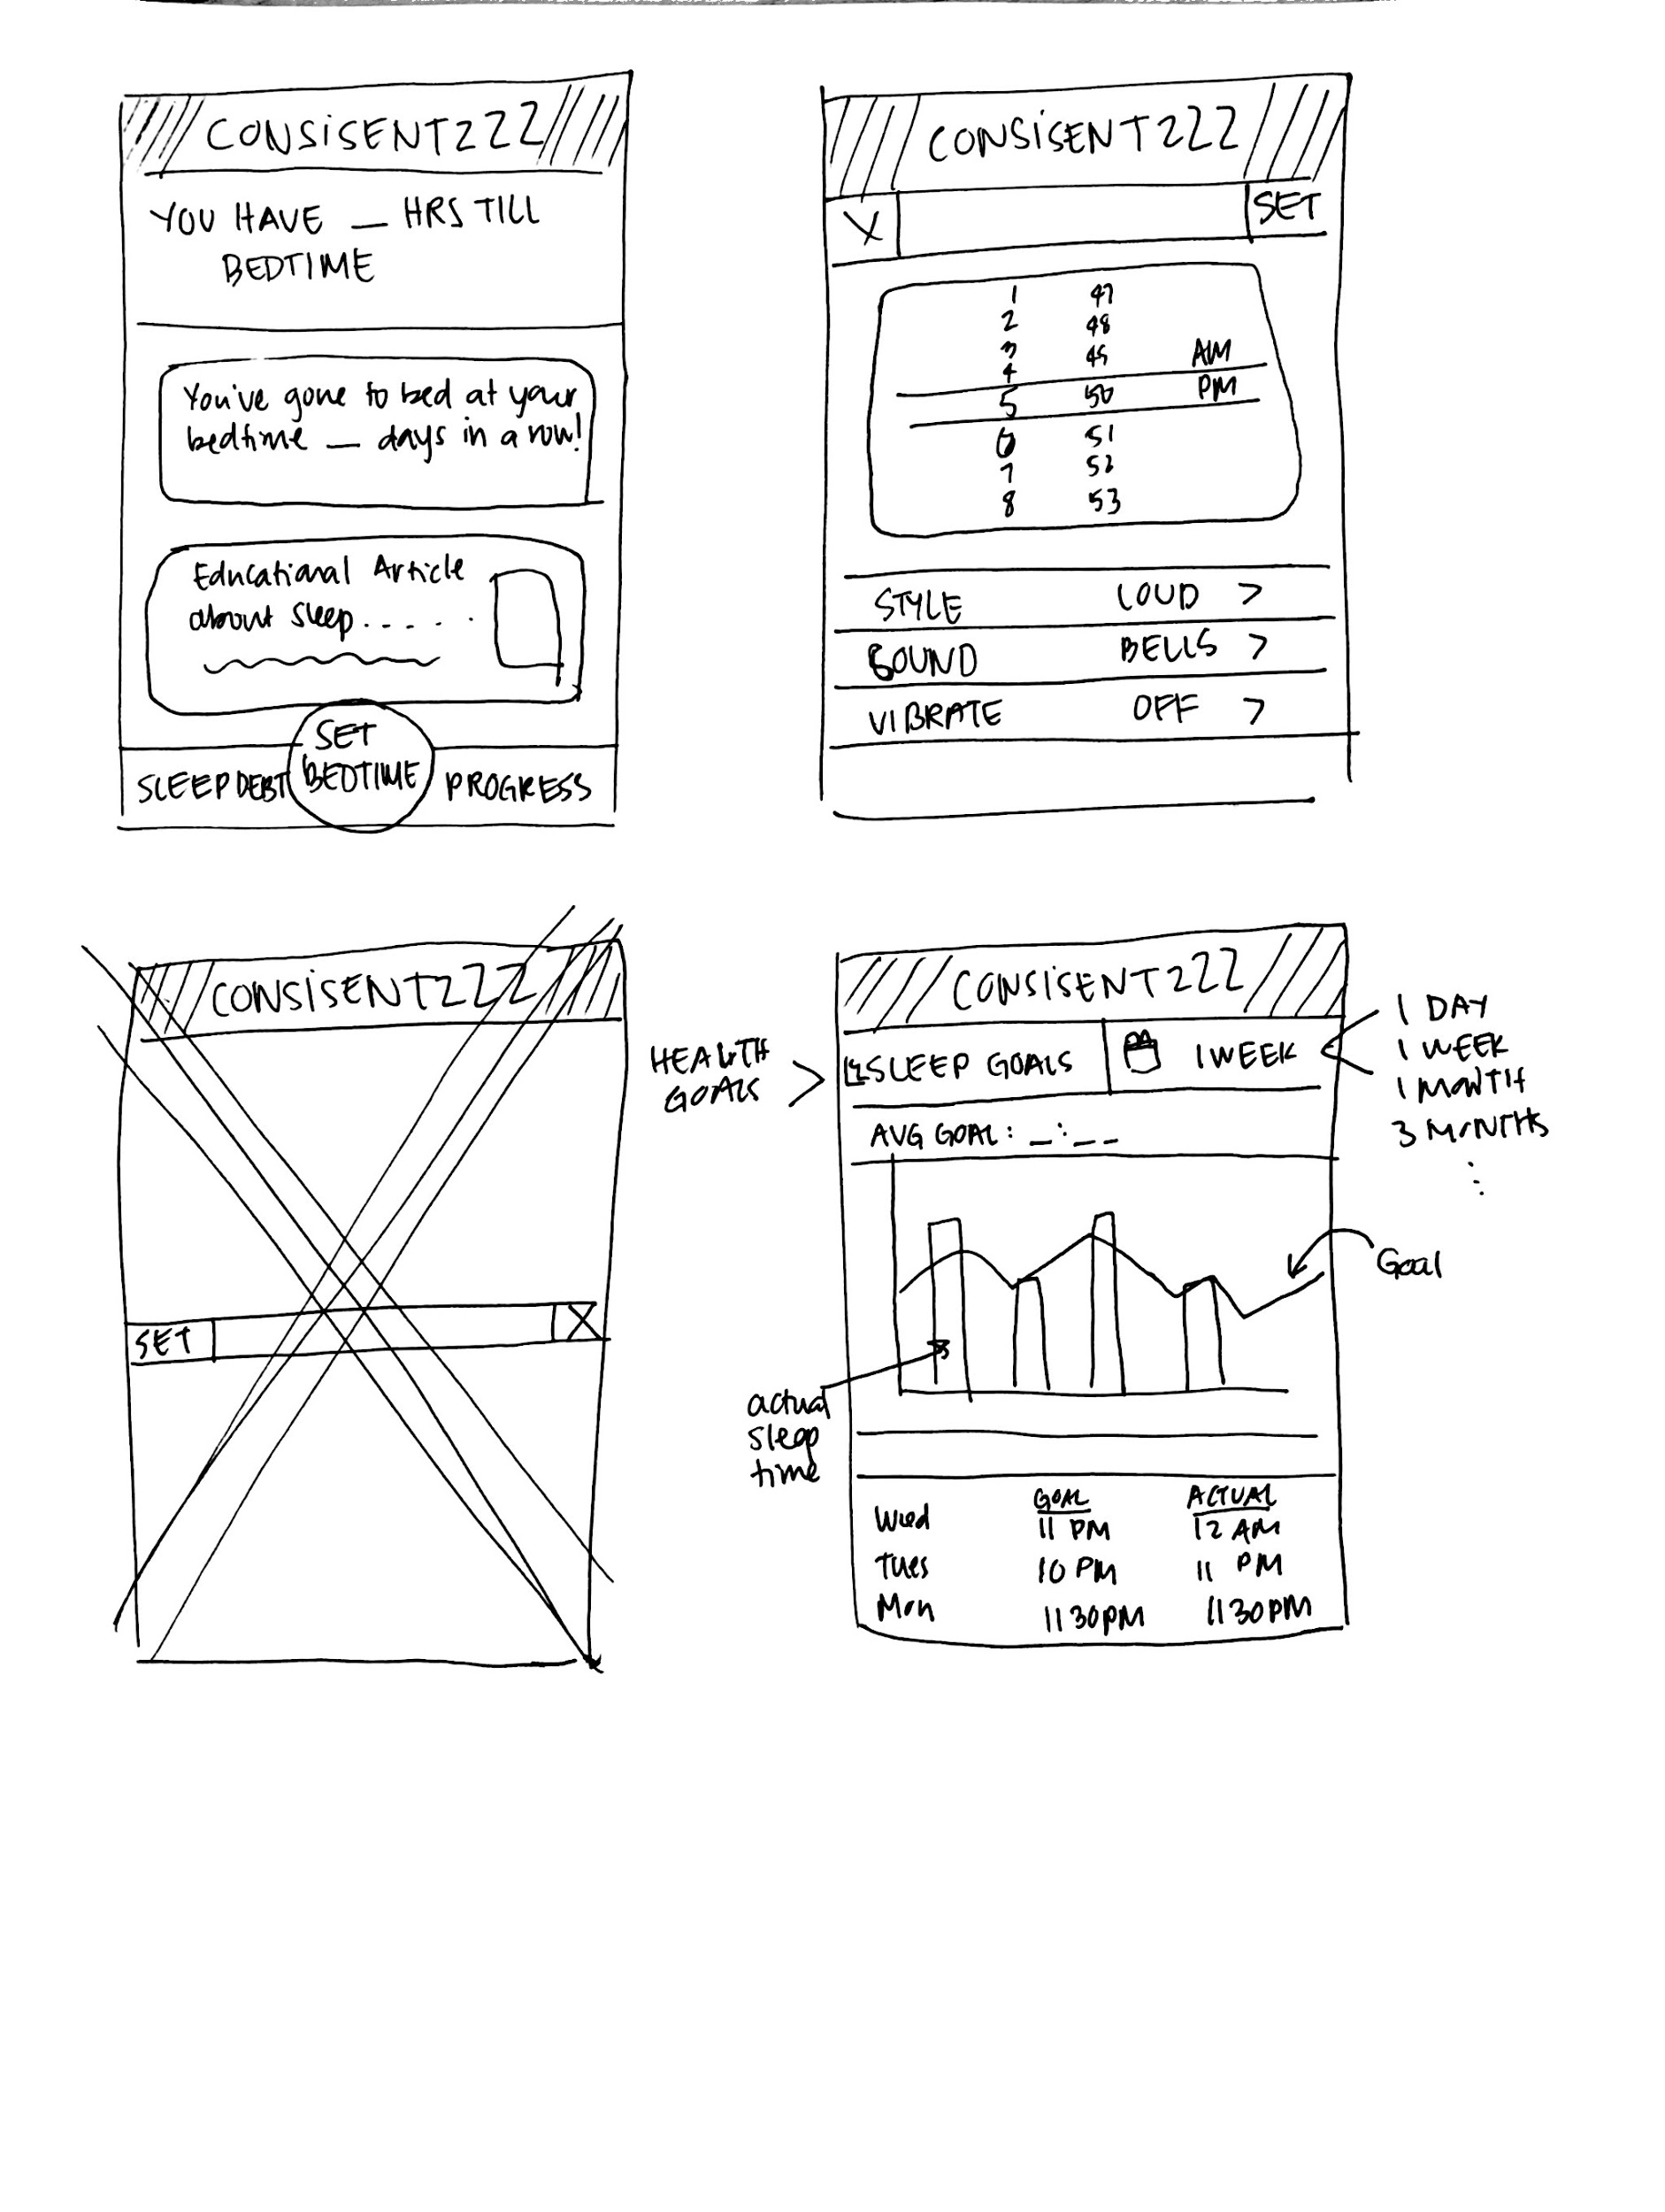
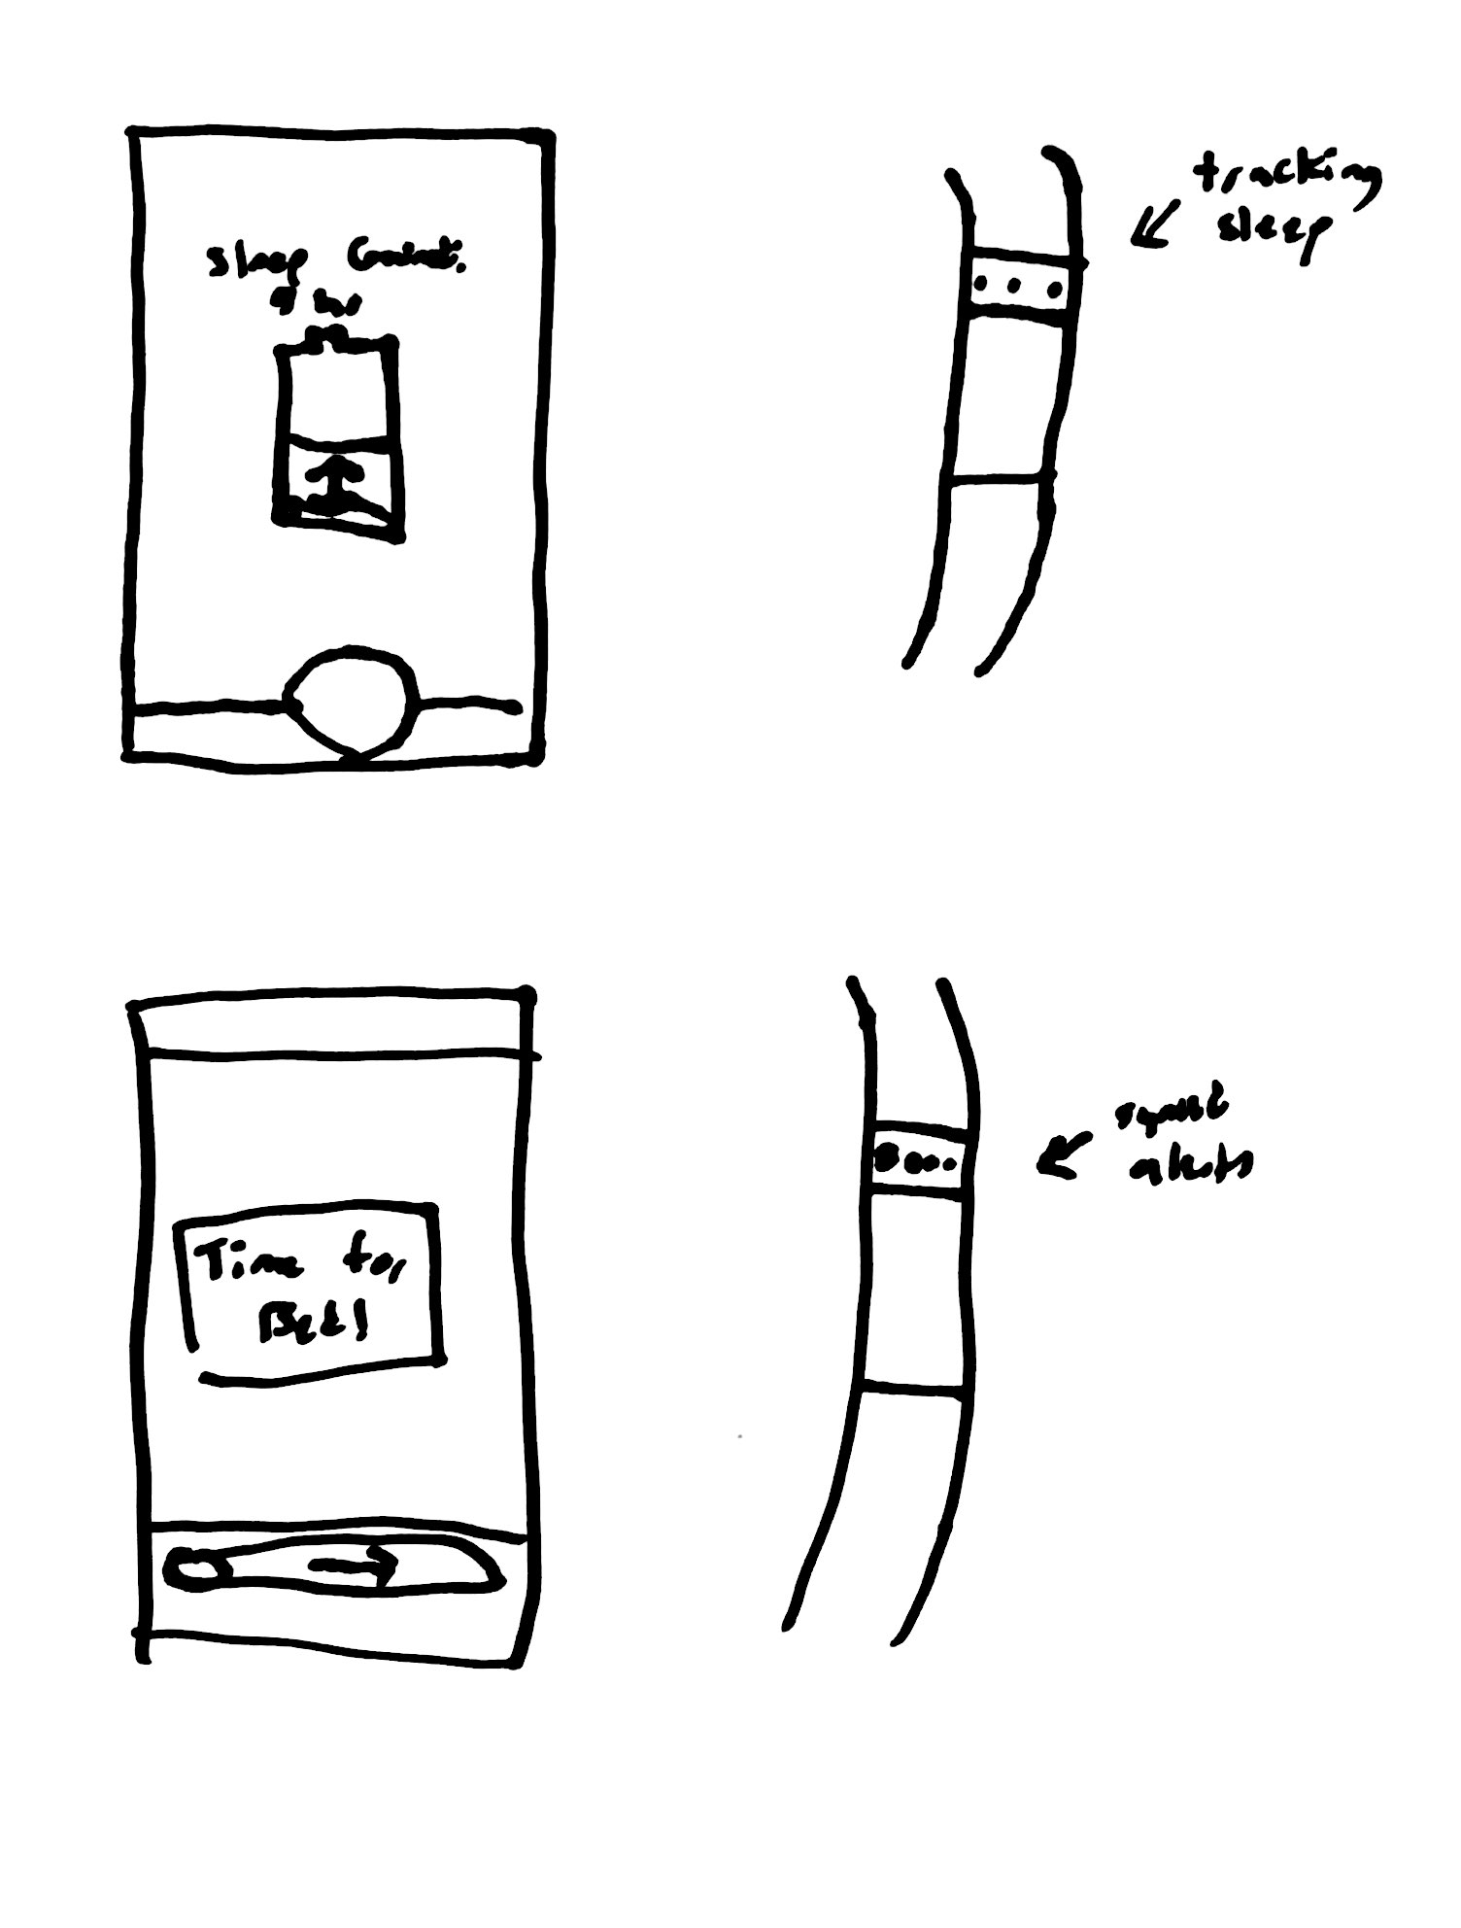
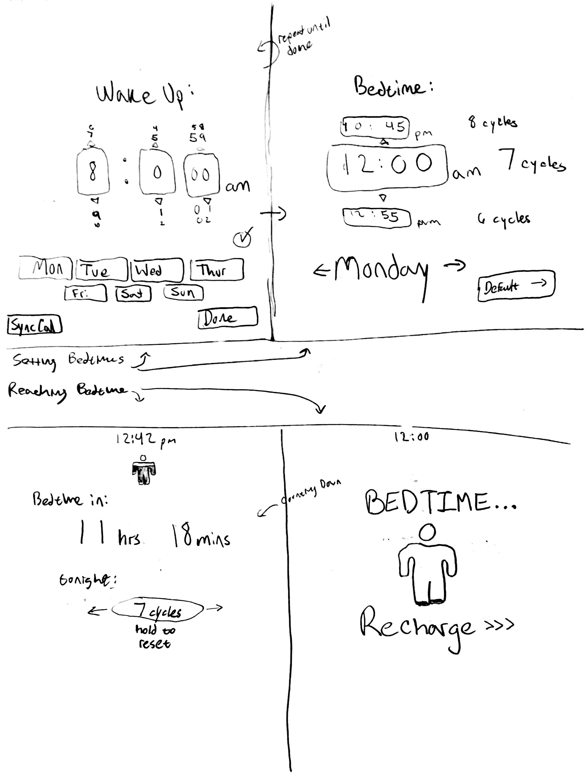
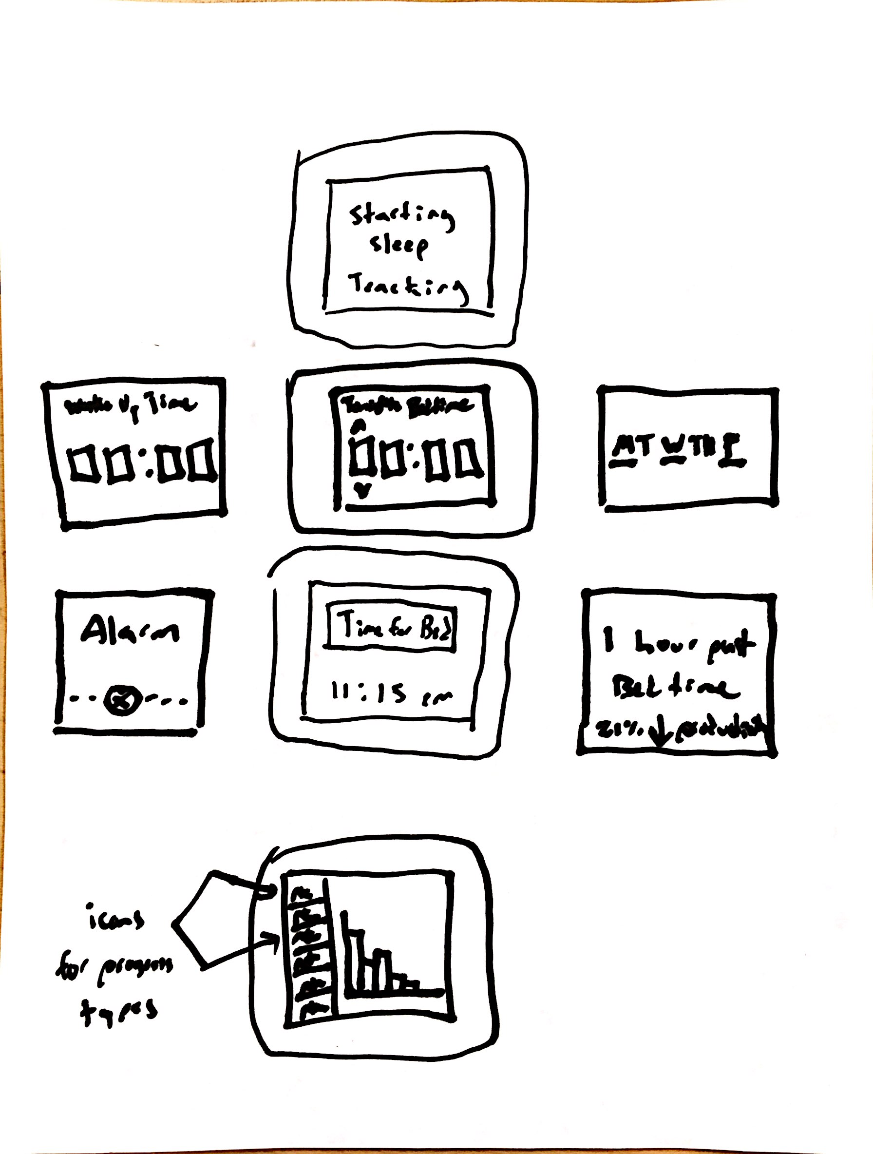
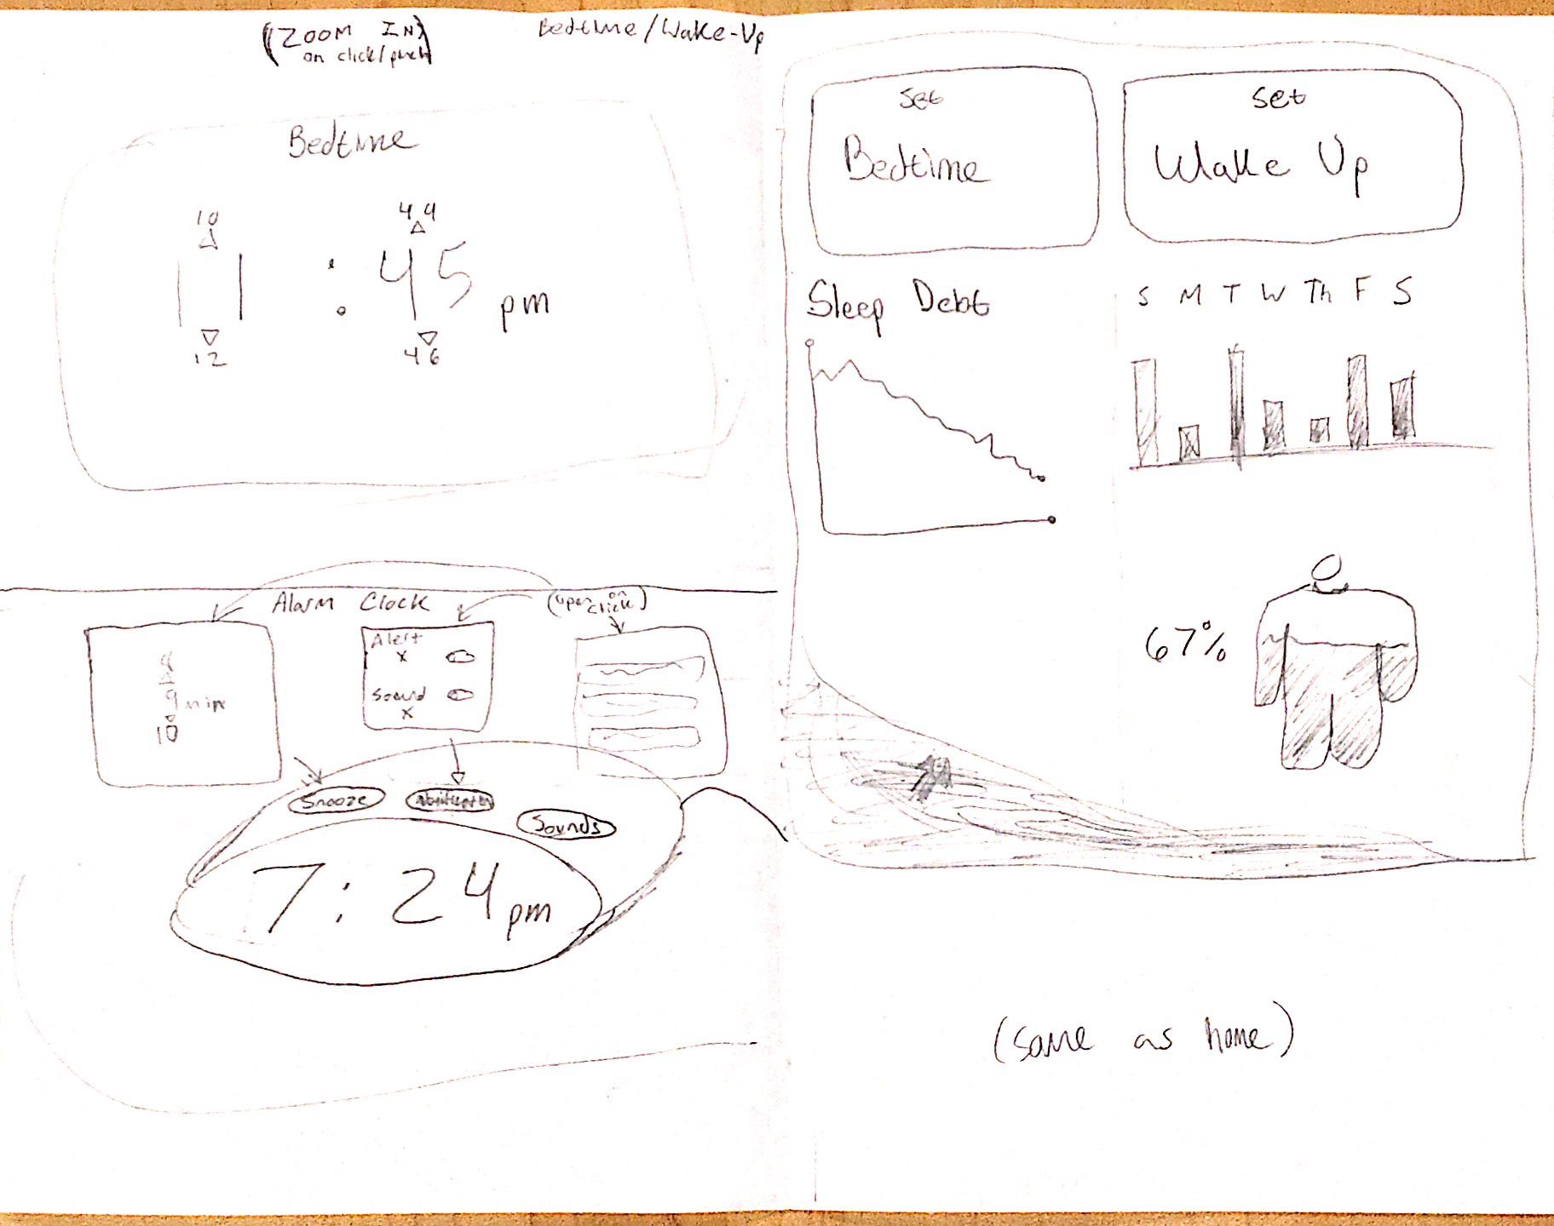
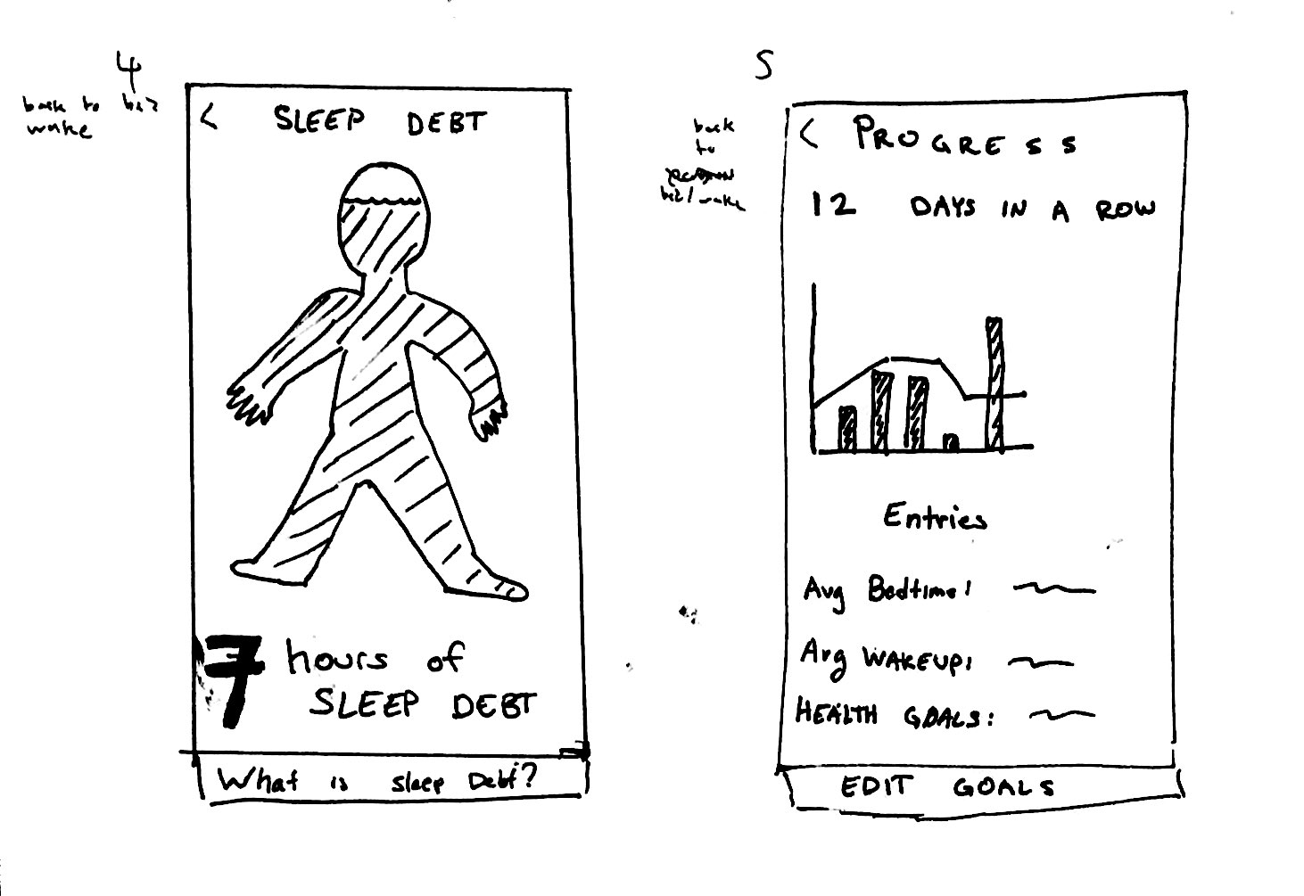
Design Sketches

Slide 6
Skeuomorphic vs Traditional
Ease of use
Small screen issue
More Familiar

Slide 7
Selected Interface Design
Prototype Creation
User Tests
Results
Next Steps

Slide 8
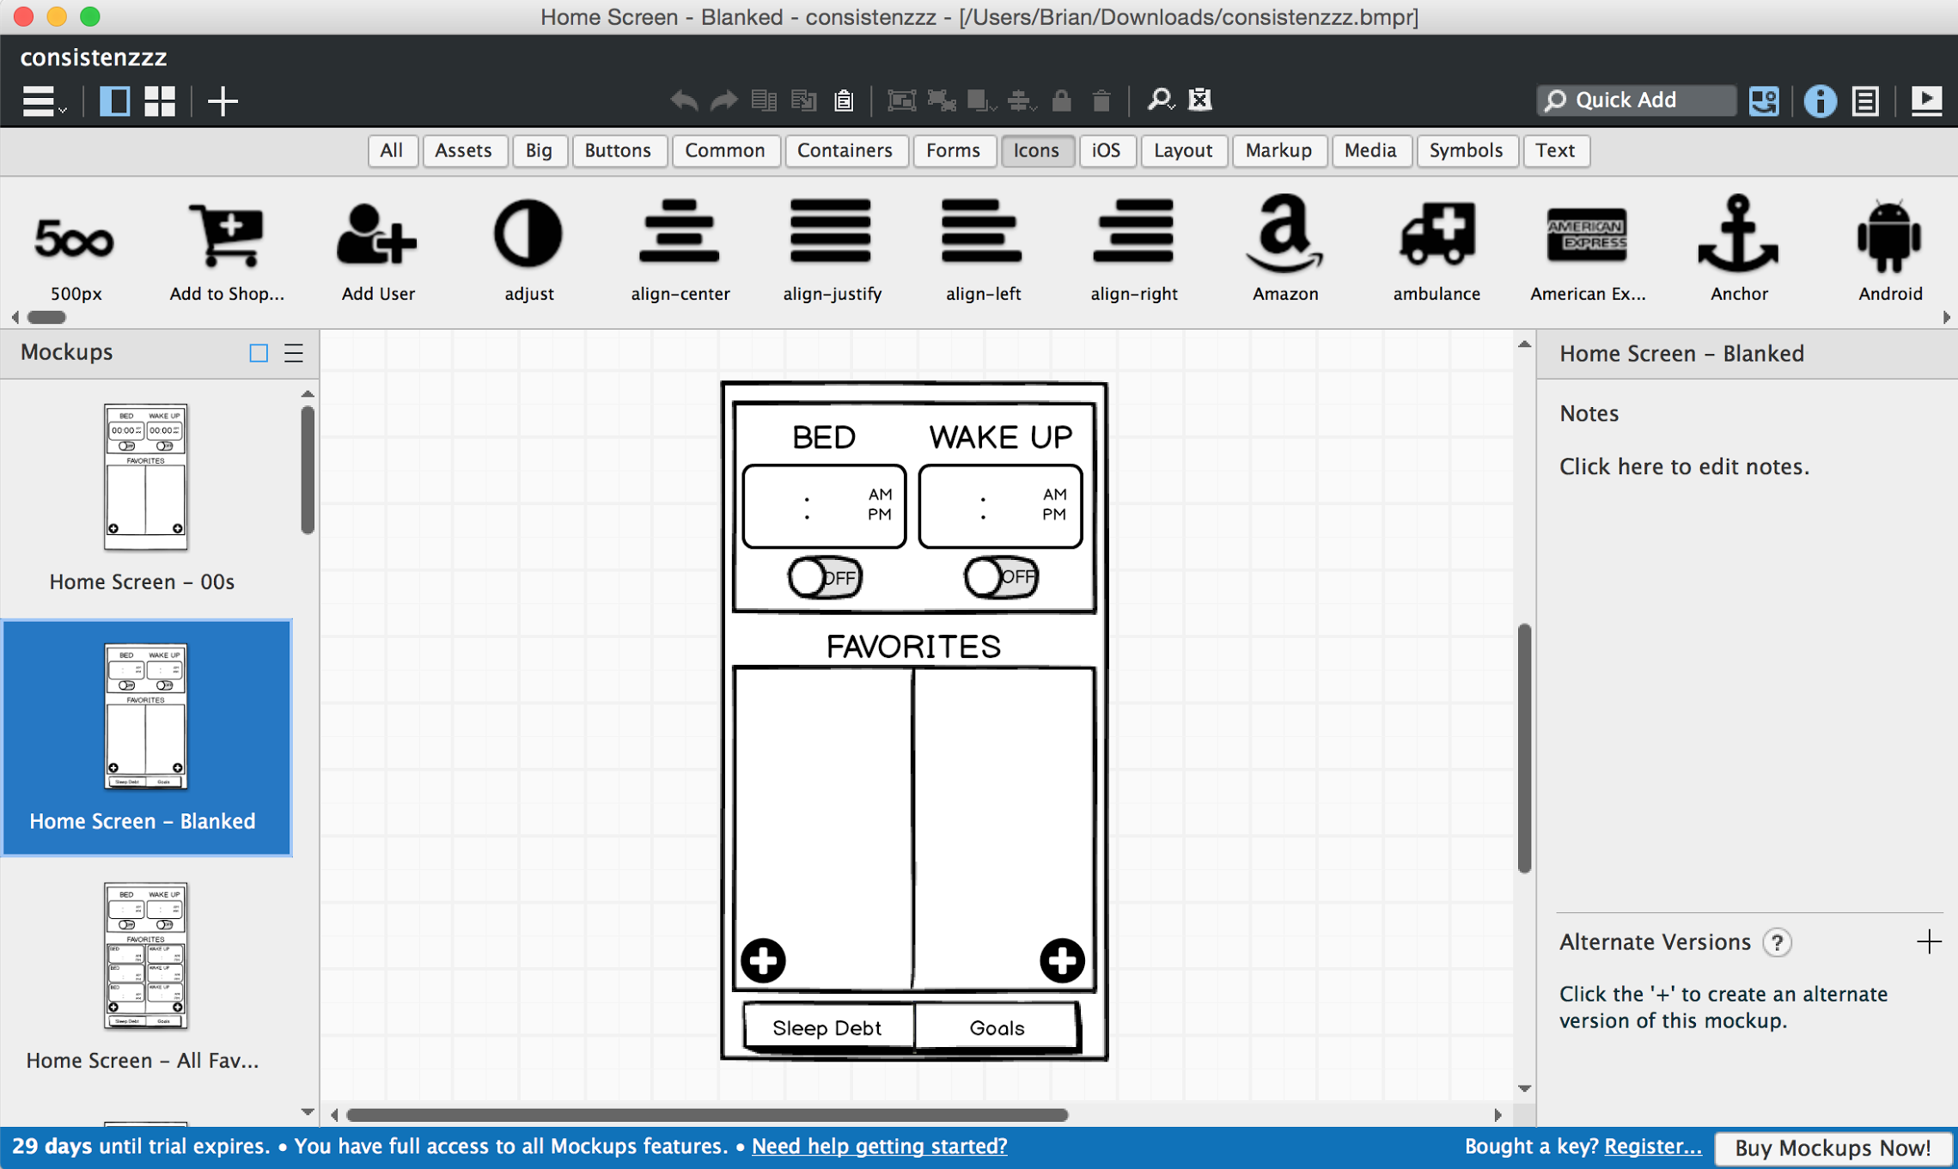
Prototype Creation
Balsalmiq
Black & White
Transparencies

Slide 9
Prototype Creation

Slide 10
Selected Interface Design
Prototype Creation
User Tests
Results
Next Steps

Slide 11
Simple Task
Task 1:
Go to bed at your bedtime goal

Slide 12
Medium Task
Task 2:
Feel more alert throughout the day.

Slide 13
Complex Task
Task 3:
Maintain better and healthier habits using sleep

Slide 14
Experimental Method

Slide 15
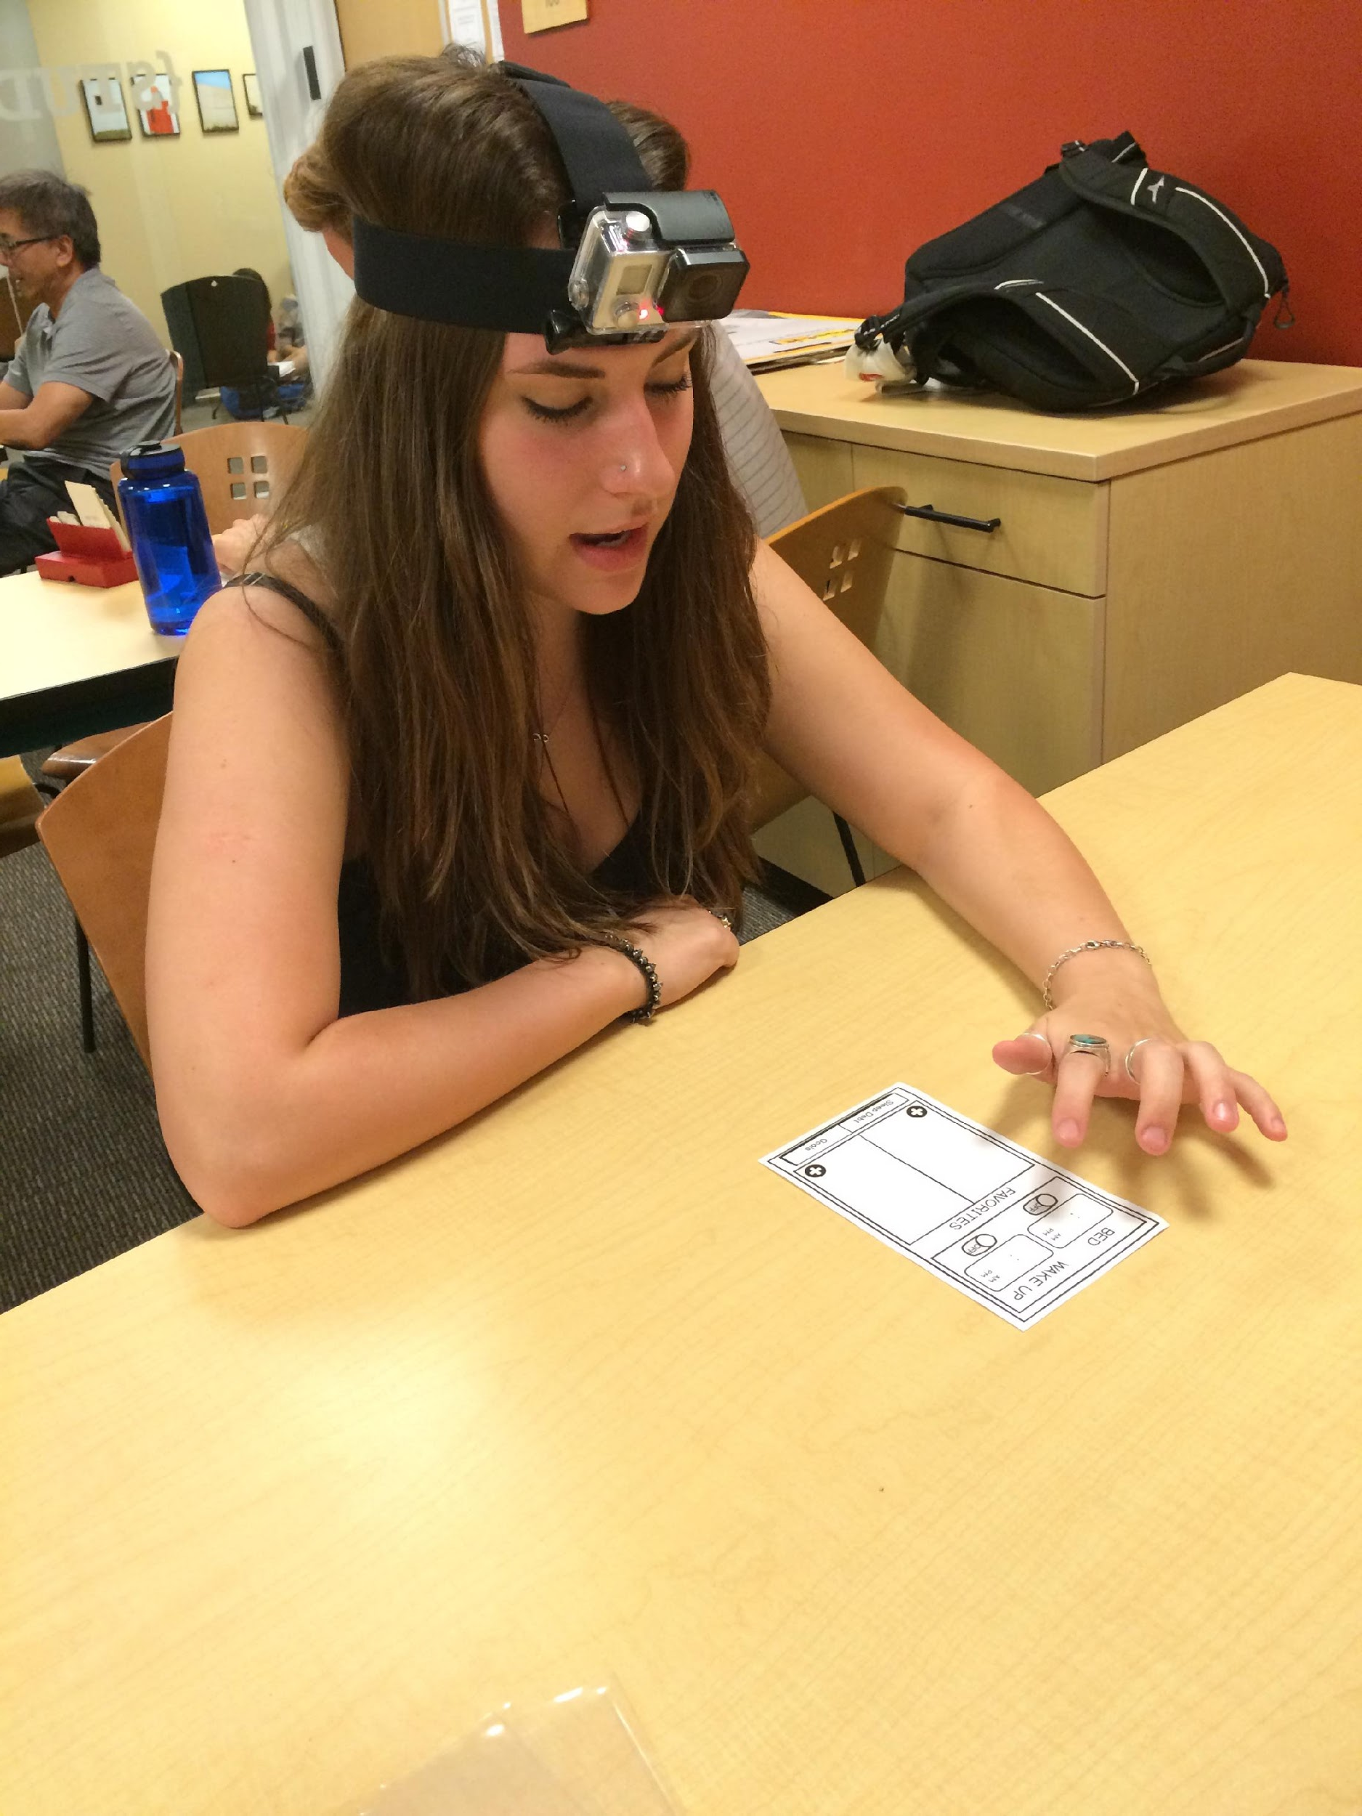
Experimental Results
Setting and editing bed/wake-up time was intuitive

Slide 16
Experimental Results
Users didn’t know what to do after learning their sleep debt

Slide 17
Experimental Results
The goals page wasn’t well understood

Slide 18
Selected Interface Design
Prototype Creation
User Tests
Results
Next Steps

Slide 19
Suggested Changes
Intuitive data visualizations
Incorporate educational component
Improve alerts with personalized messages
Recommendations for bedtime/wake-up goals

Slide 20
Questions?

