Slide 2
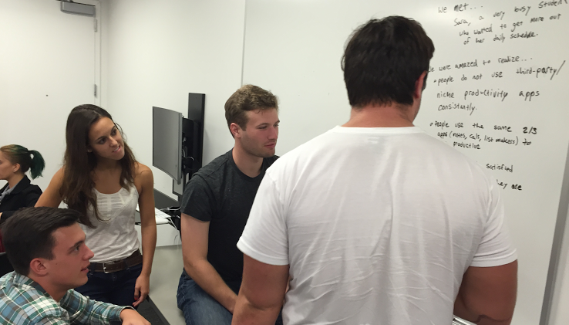
CS 147: Assignment 2
POVs & Experience Prototypes
John M, Gabriella B, Brian H, Nate L
Notes:
Don’t worry! I’m going to make these look pretty. This is just an outline.

Slide 3
Habits
Productivity
Sleep

Slide 4
Needfinding
POVs & HMWs
Experience Prototypes

Slide 5
Needfinding
POVs & HMWs
Experience Prototypes
Notes:
Edit: Font/Add aimations

Slide 6
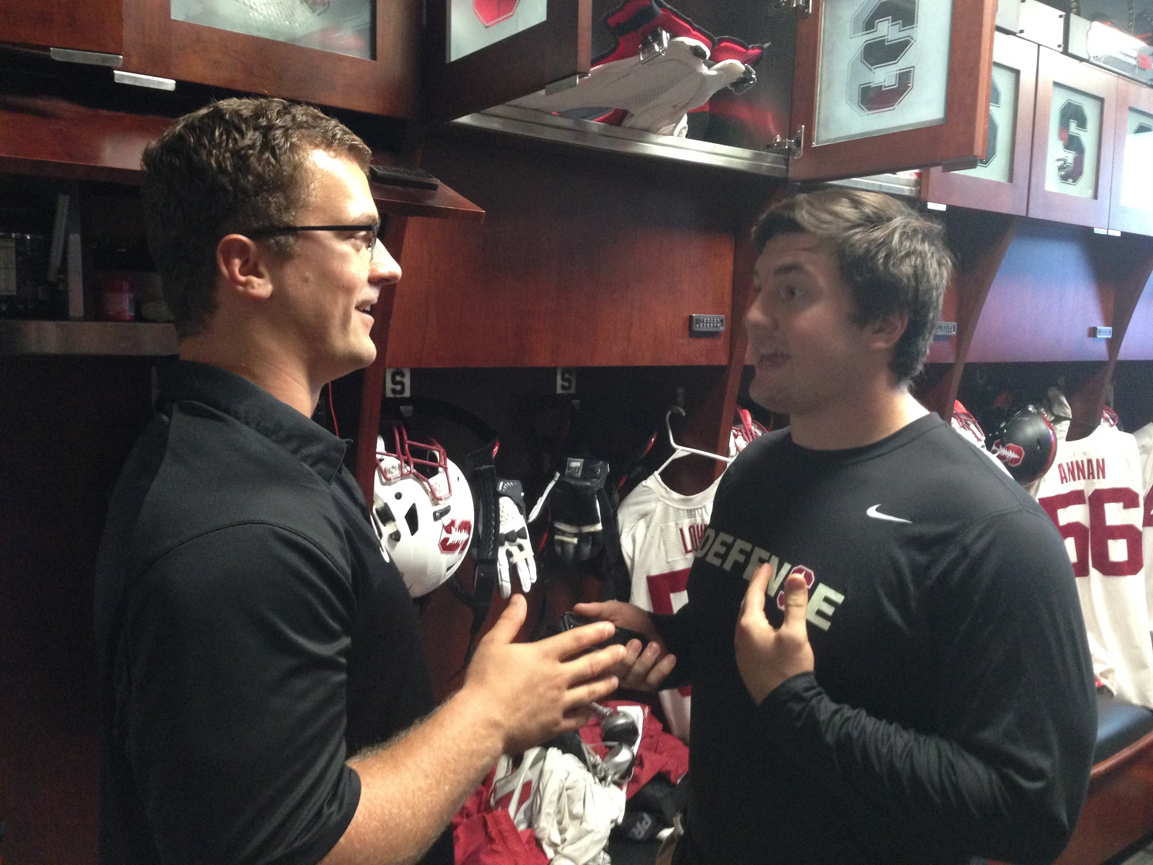
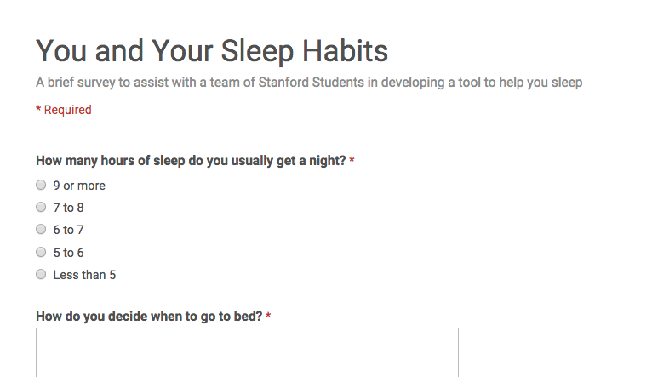
Survey
Interviews

Slide 7
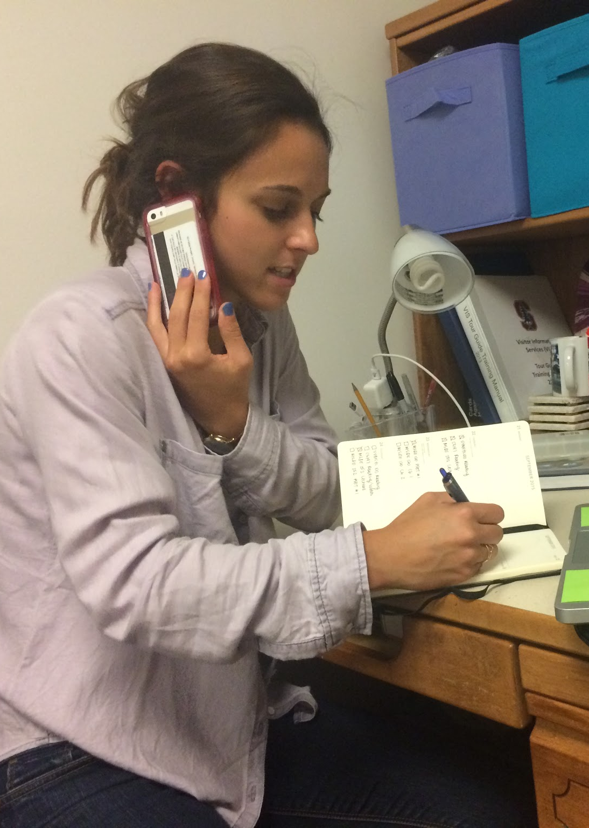
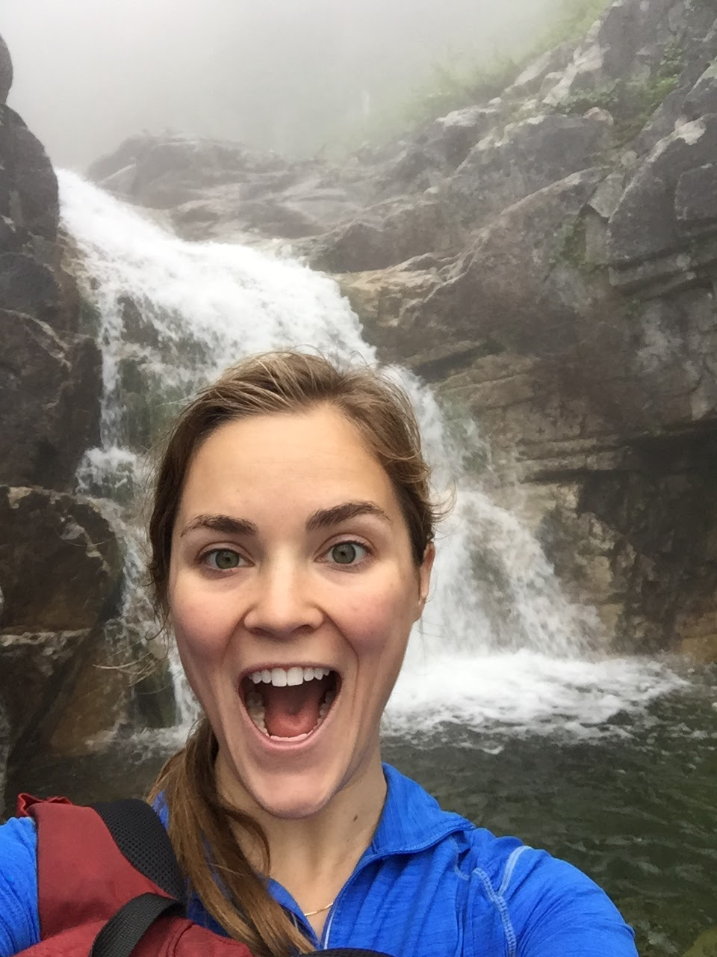
Camryn
Rotto
Tara

Slide 8



High School Student
College Student
Young Professional

Slide 9
Needfinding
POVs & HMWs
Experience Prototypes

Slide 10
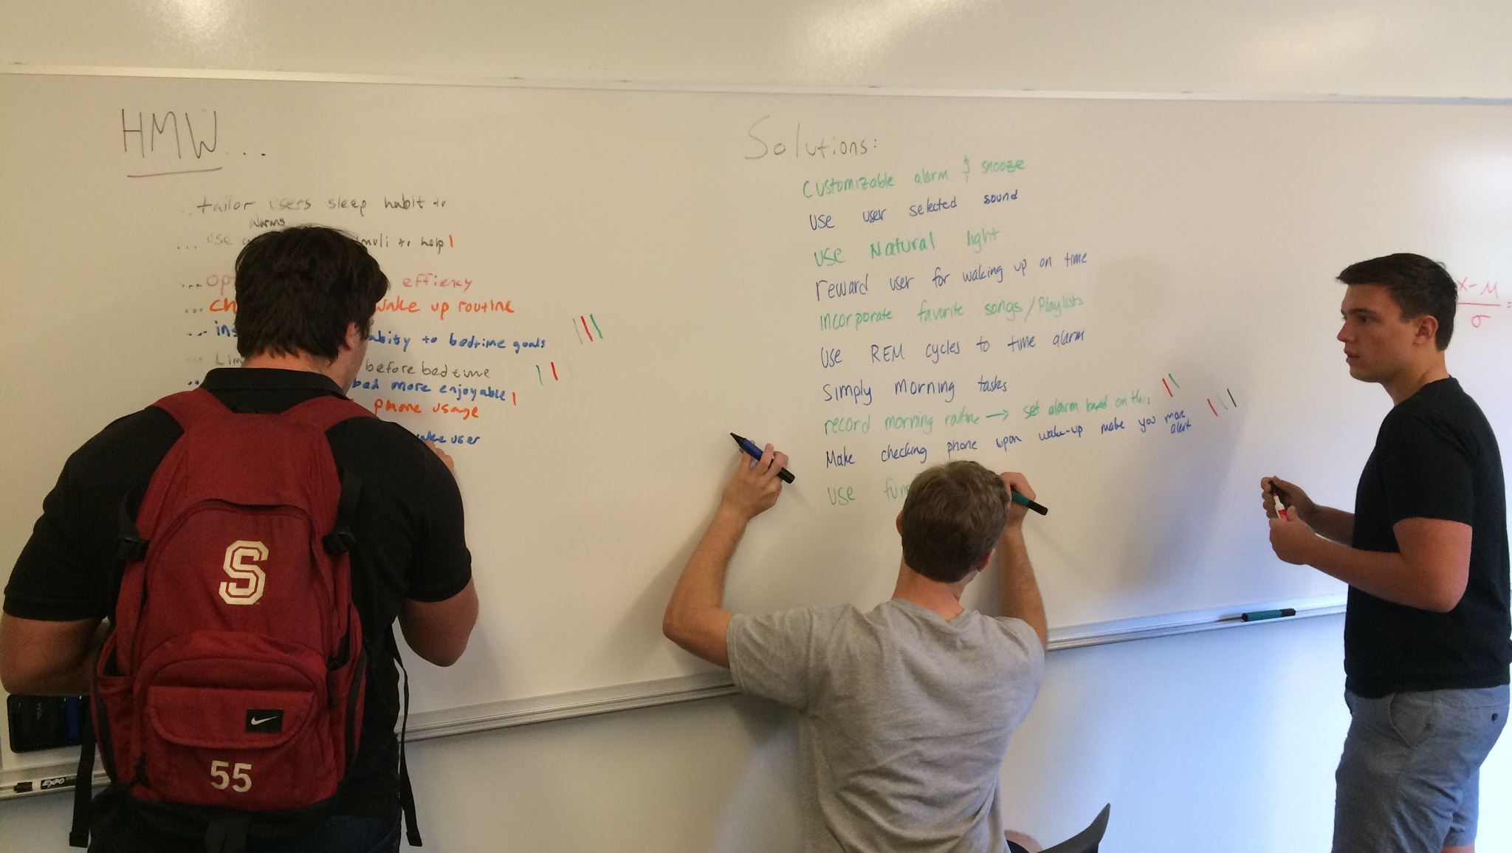

Slide 11
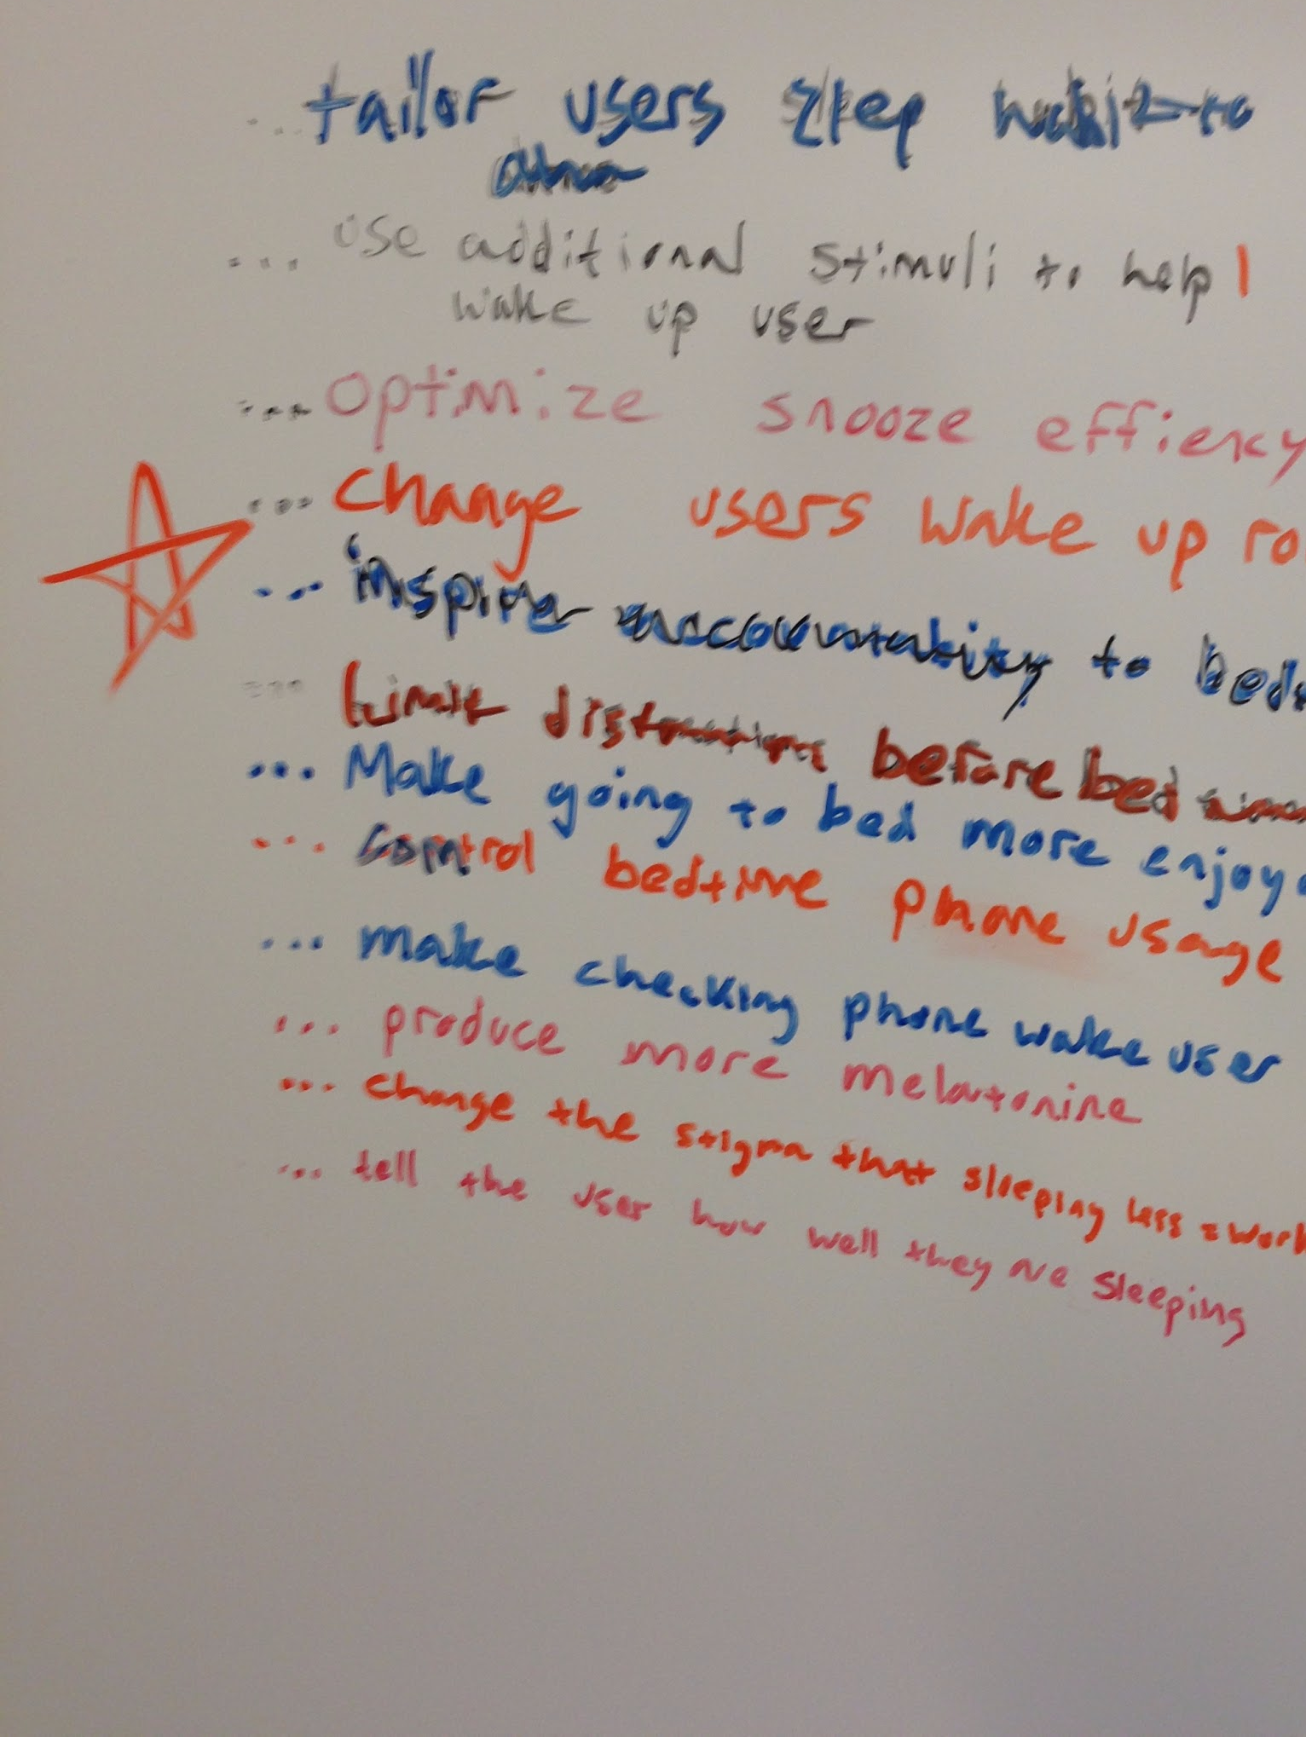
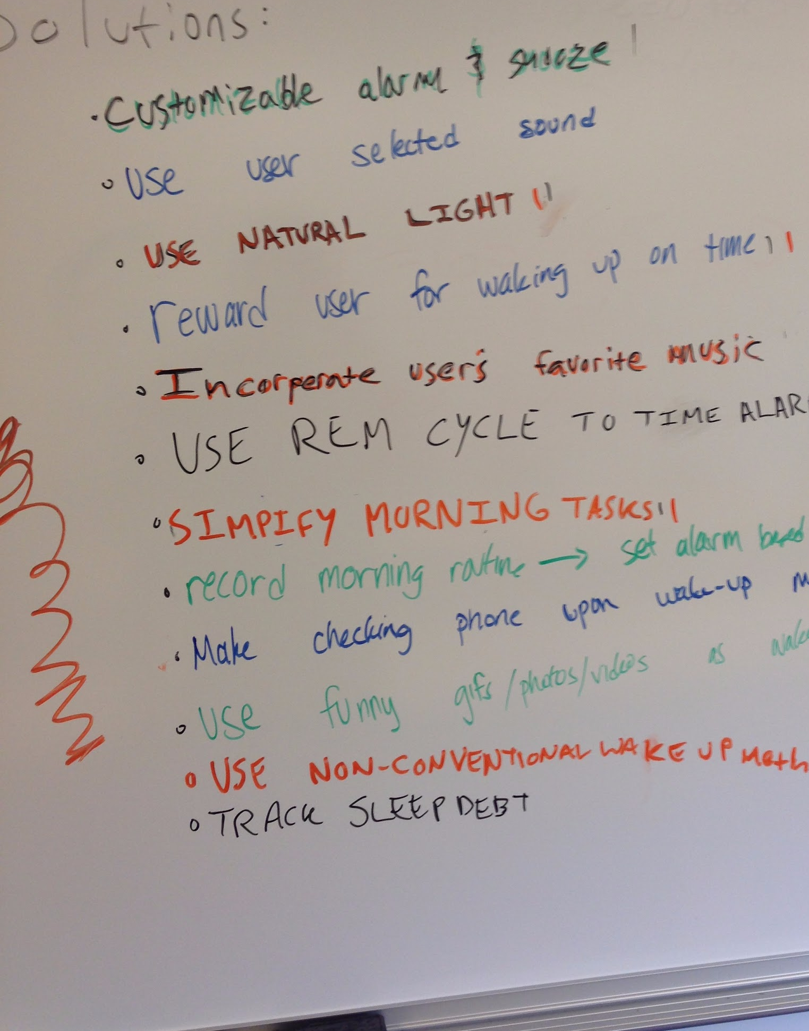
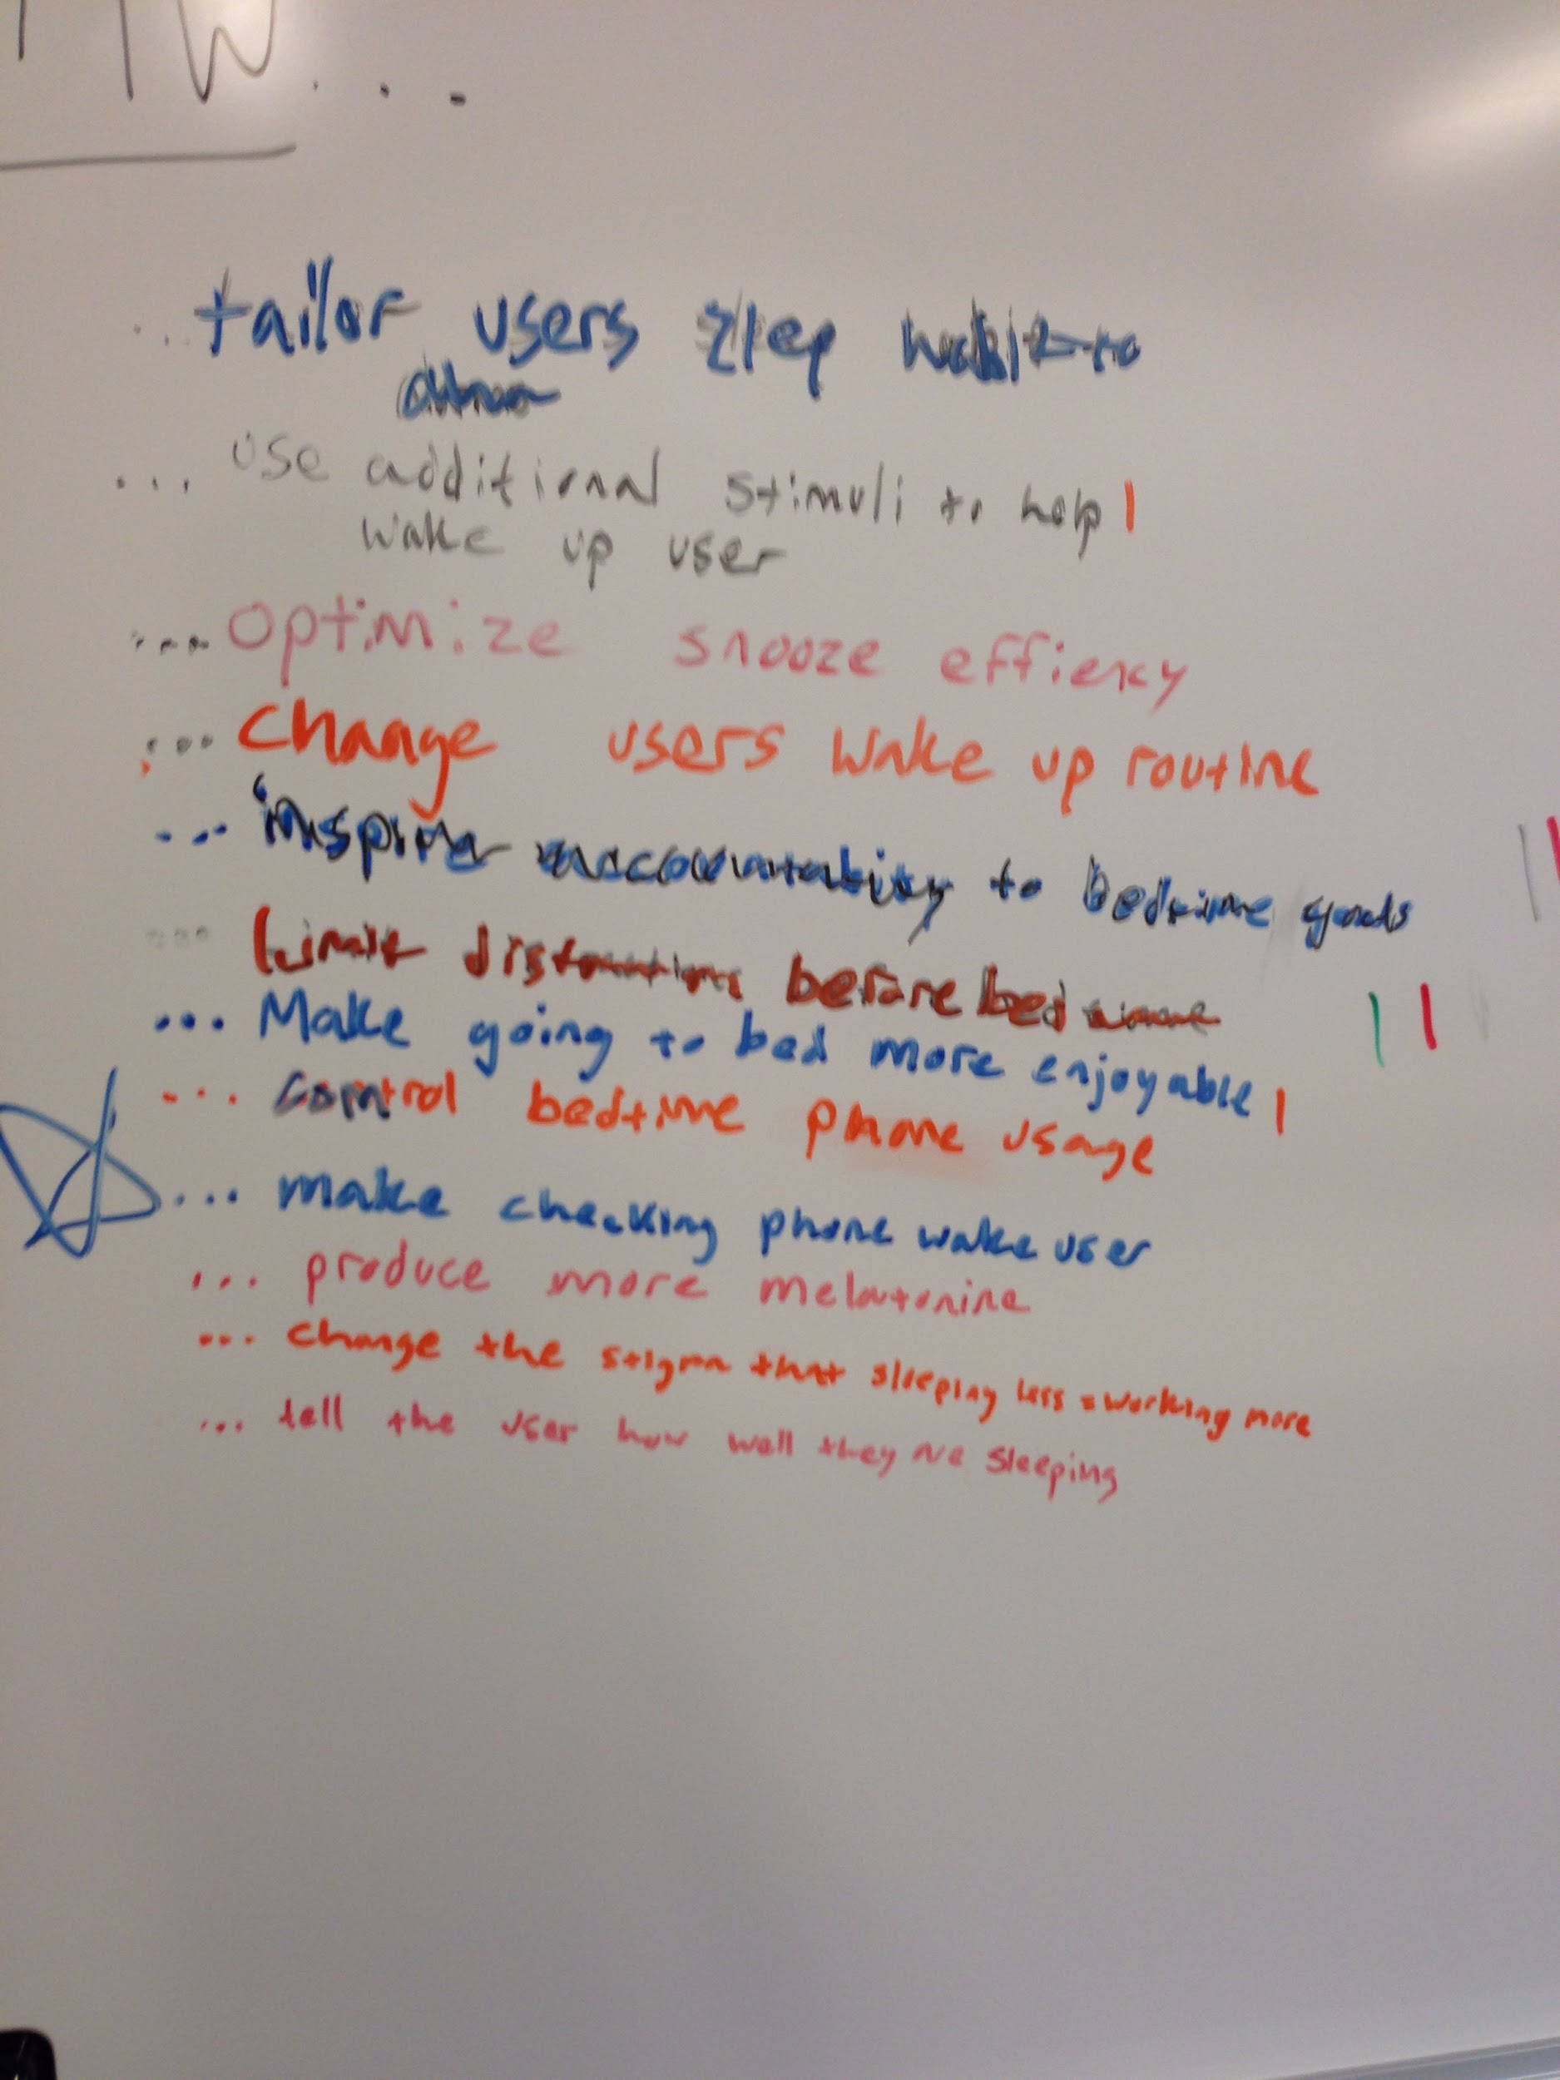
How might we...
High School Student:
College Student:
Young Professional:

Slide 12
How might we...
High School Student:
College Student:
Young Professional:
... make waking up more enjoyable for the user?
...inspire accountability to set and accomplish bedtime goals?
... help users feel more alert when they wake up?

Slide 13
Solutions for...
Enjoyable Wake Ups:
Inspiring Accountability:
Alert Wake Ups:

Slide 14
Solution for...
Enjoyable Wake Ups:
Inspiring Accountability:
Alert Wake Ups:
Customize morning routine with a wearable watch
Change the sleep environment when it’s time to wake up
Track sleep debt and give recommend sleep goals using schedule

Slide 15
Needfinding
POVs & HMWs
Experience Prototypes

Slide 16
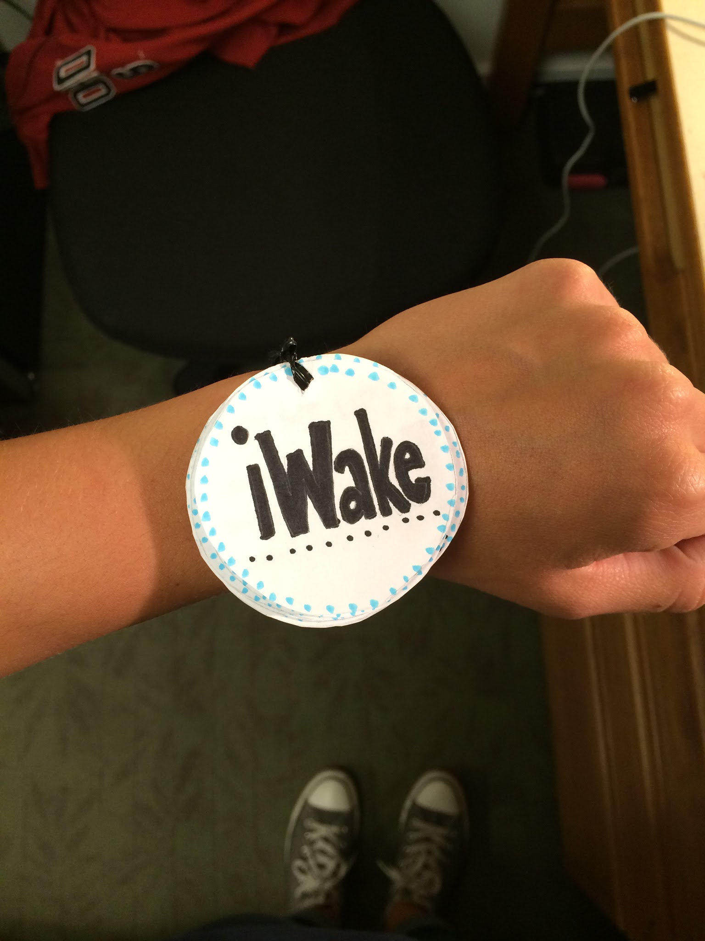
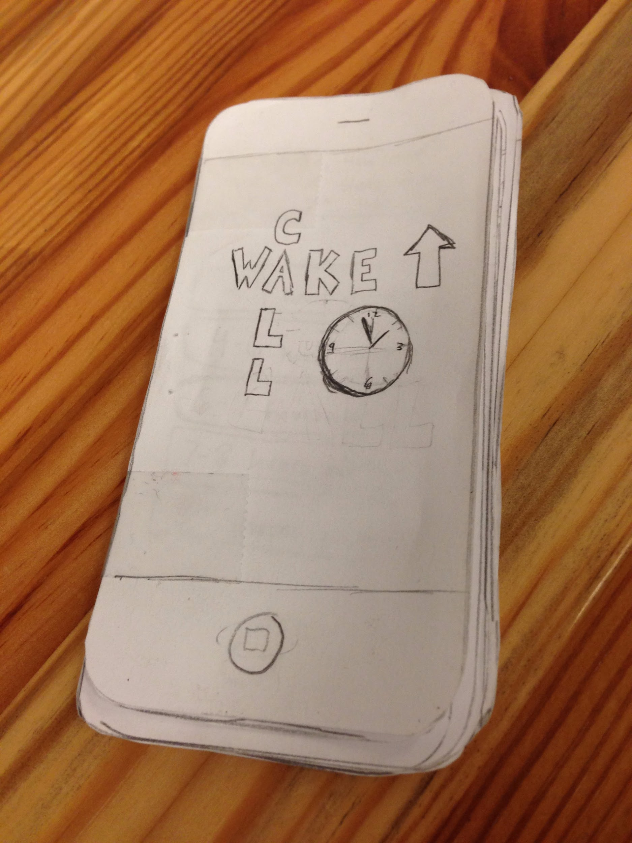
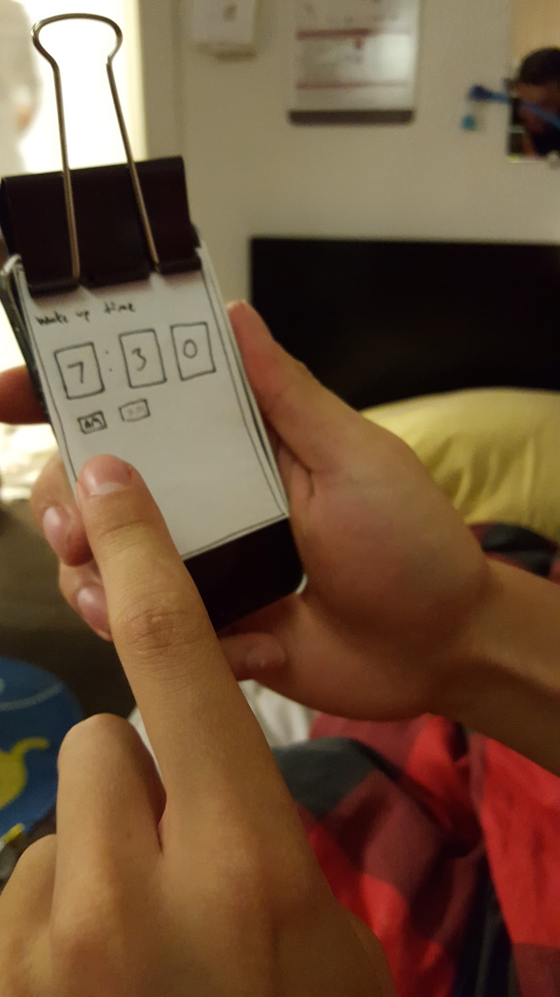
Experience Prototypes
iWake
Wake Up Call
Rise & Shine

Slide 17
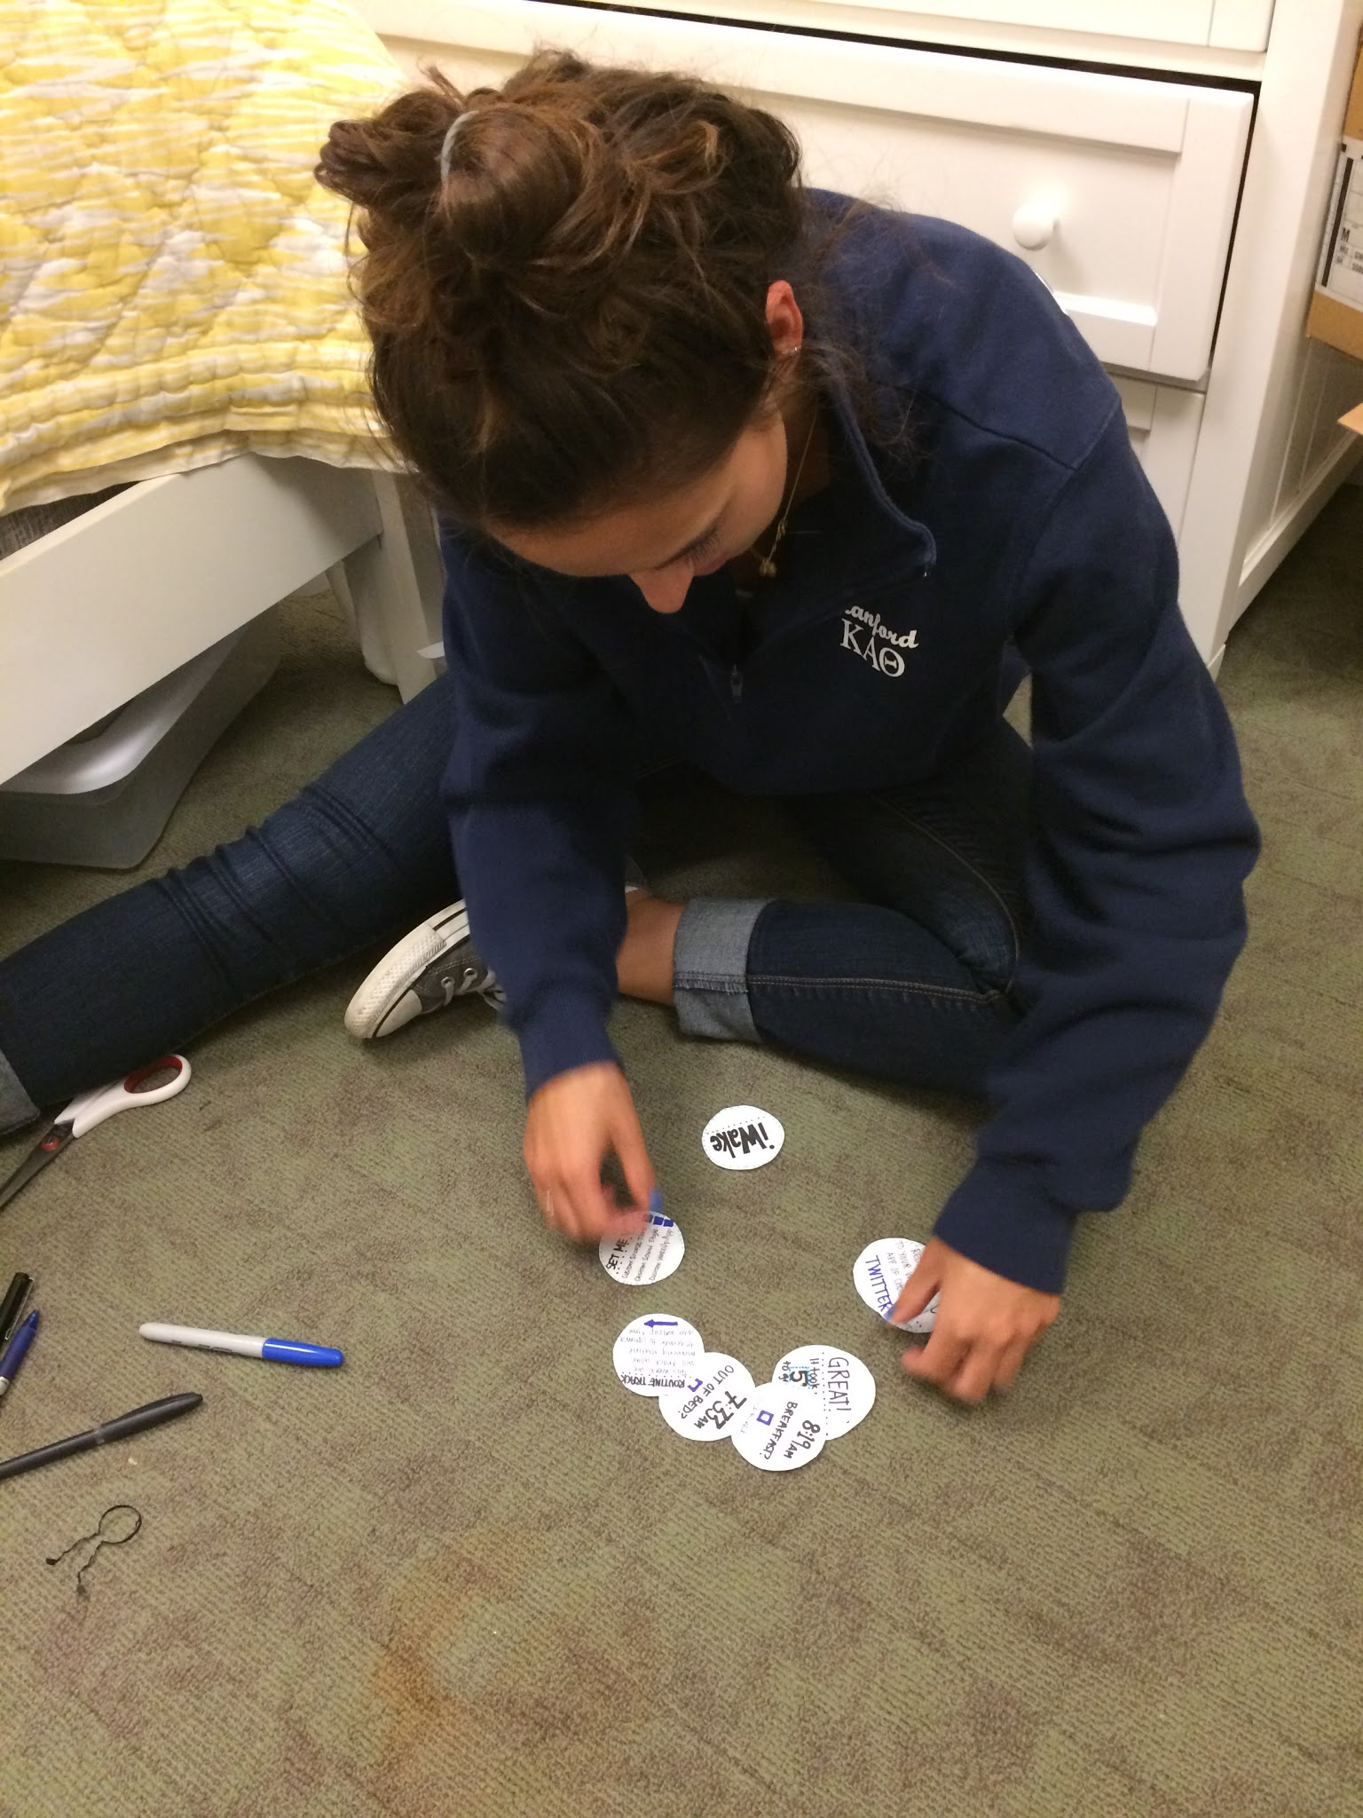
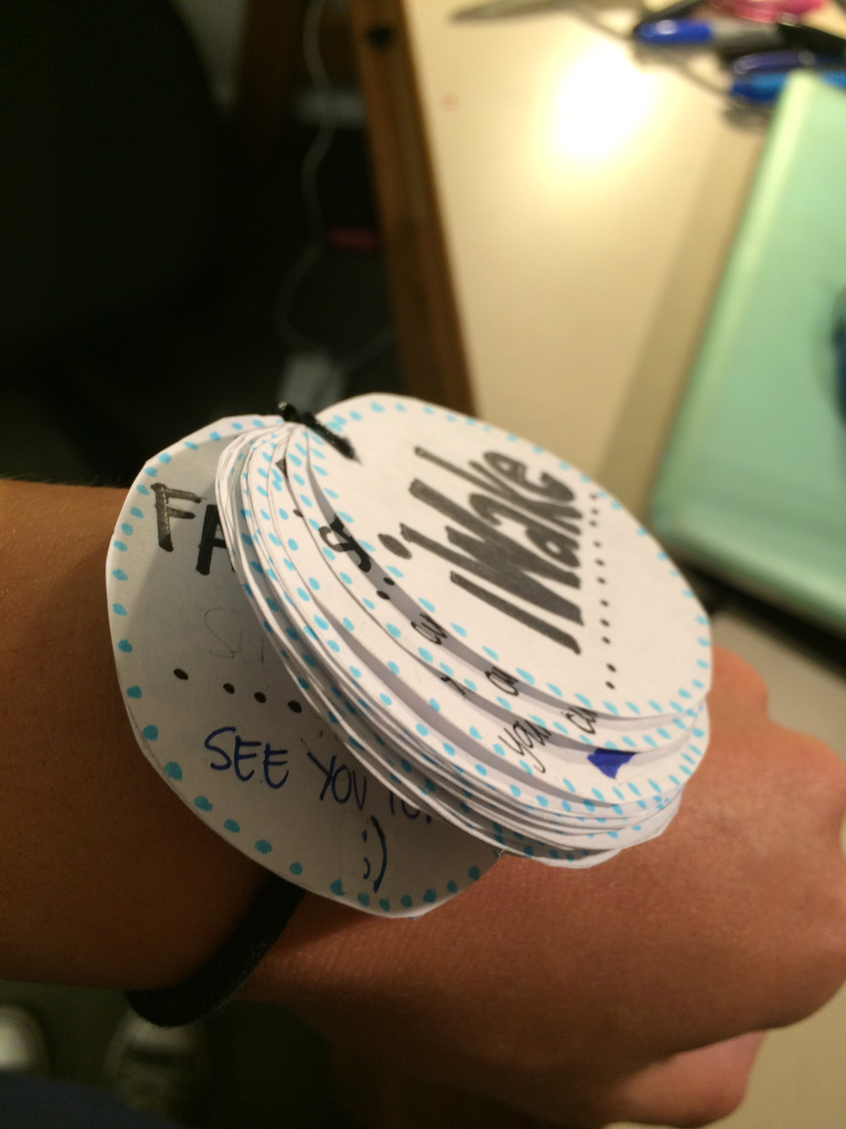
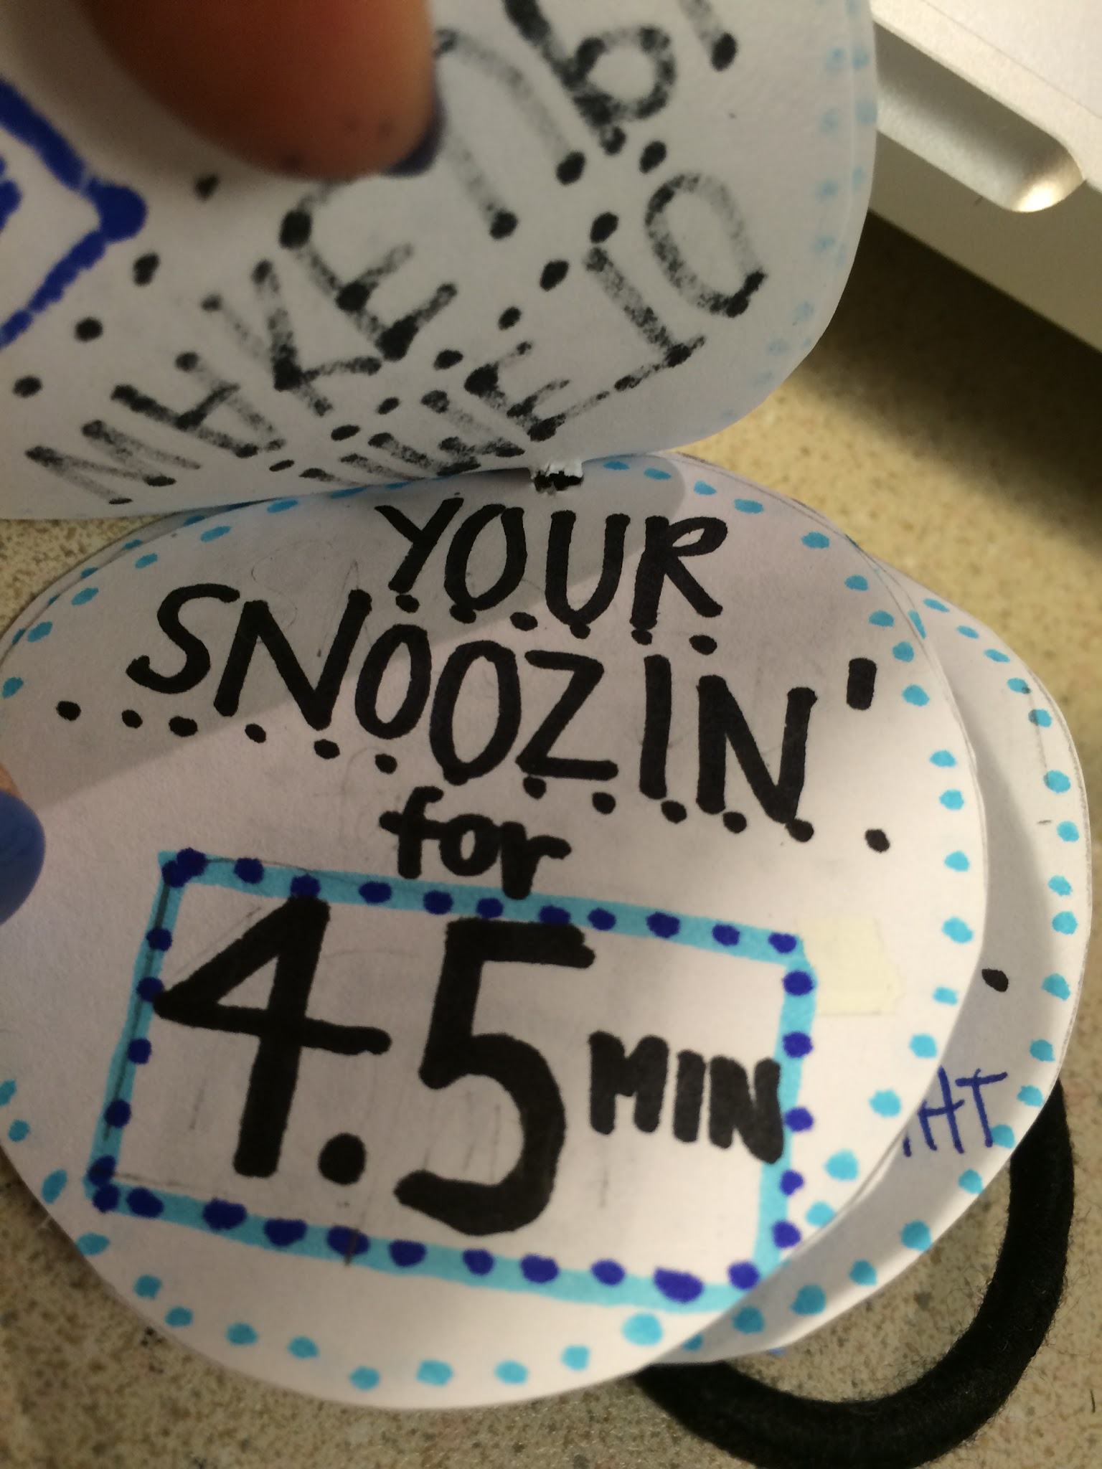
iWake: Development

Slide 18
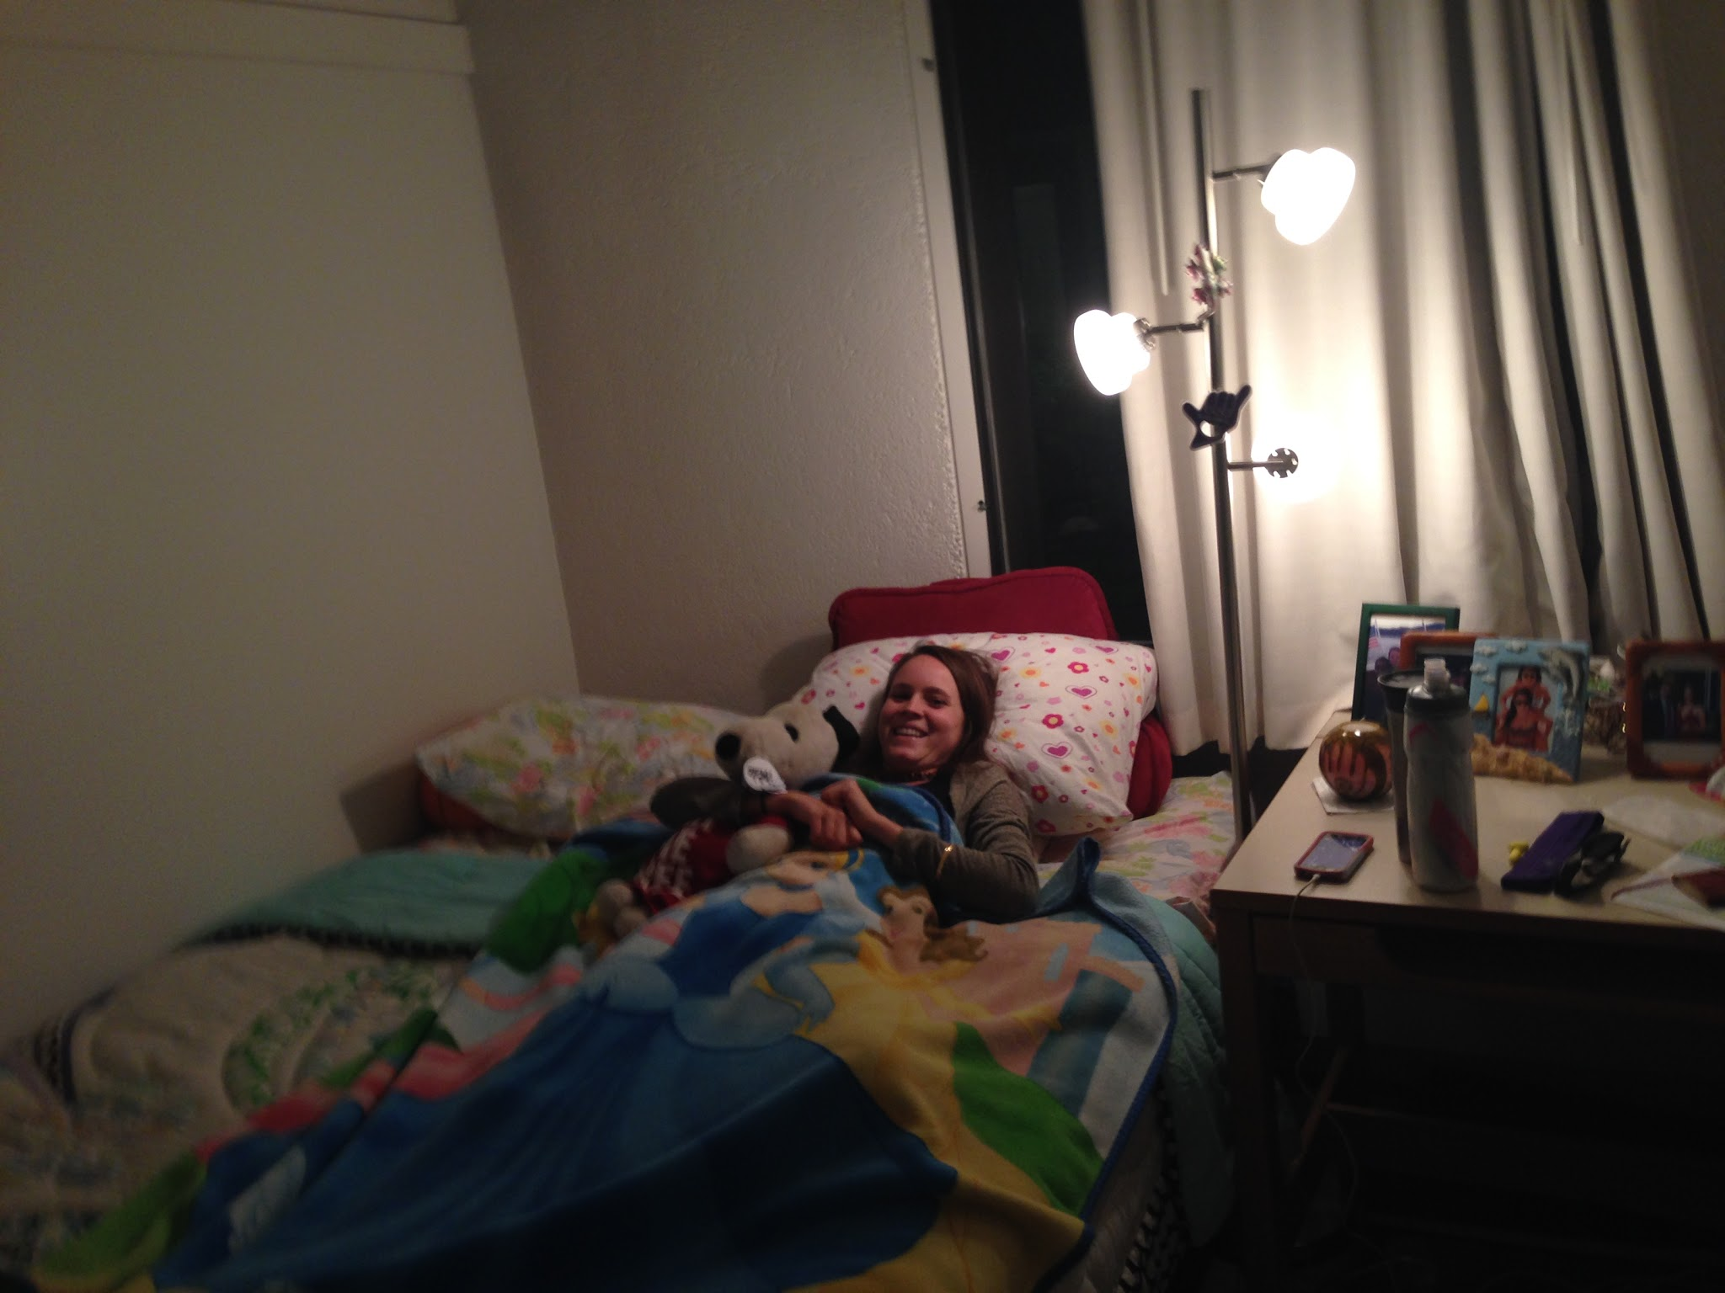
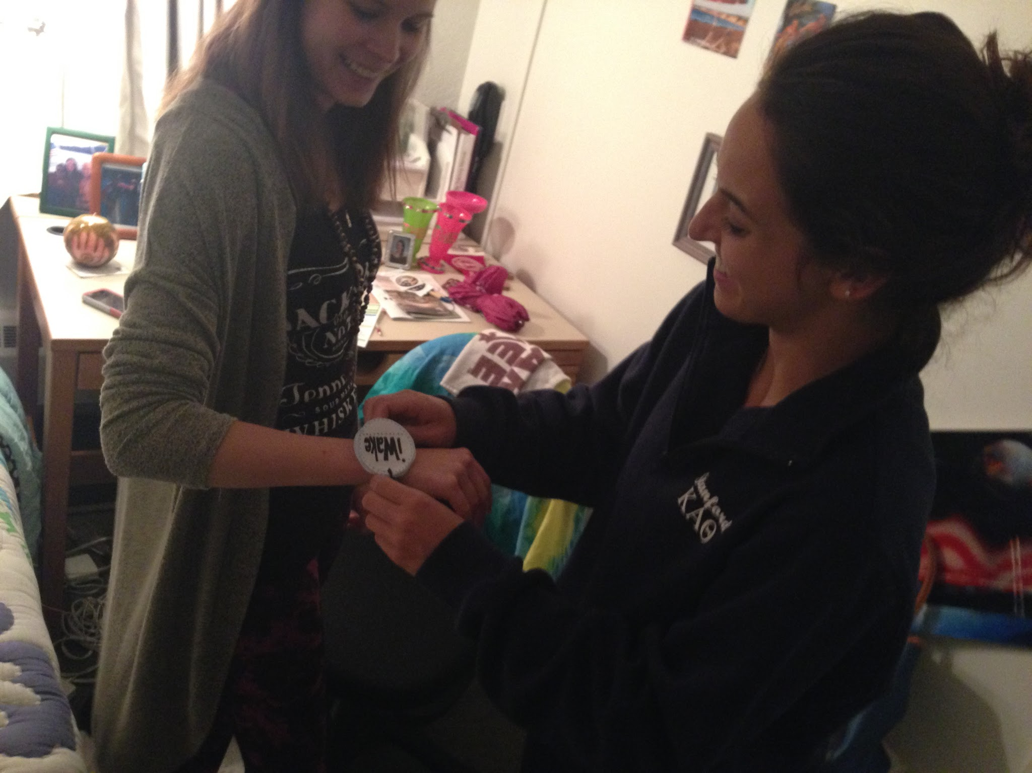
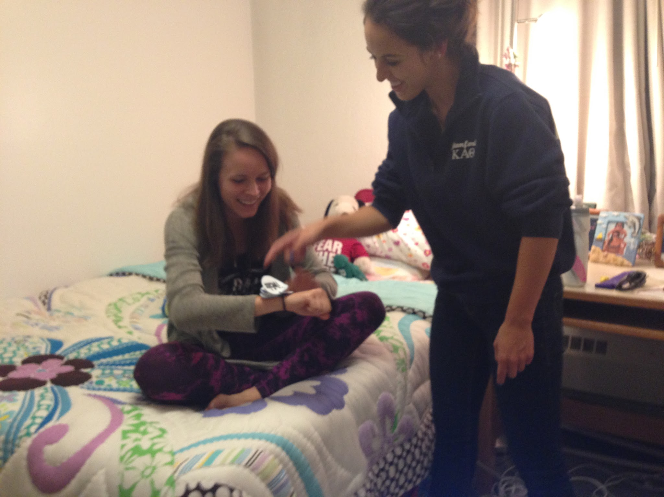
iWake: Testing
Set Nightly Alarm
Input Desired Settings
Wake Up and Complete Morning Routine

Slide 19
iWake: Results
“I try to count backwards, it takes way too long”
“Can I wake up to the sound of my wind chimes?”
“It took me only 20 minutes to get out the door!”

Slide 20
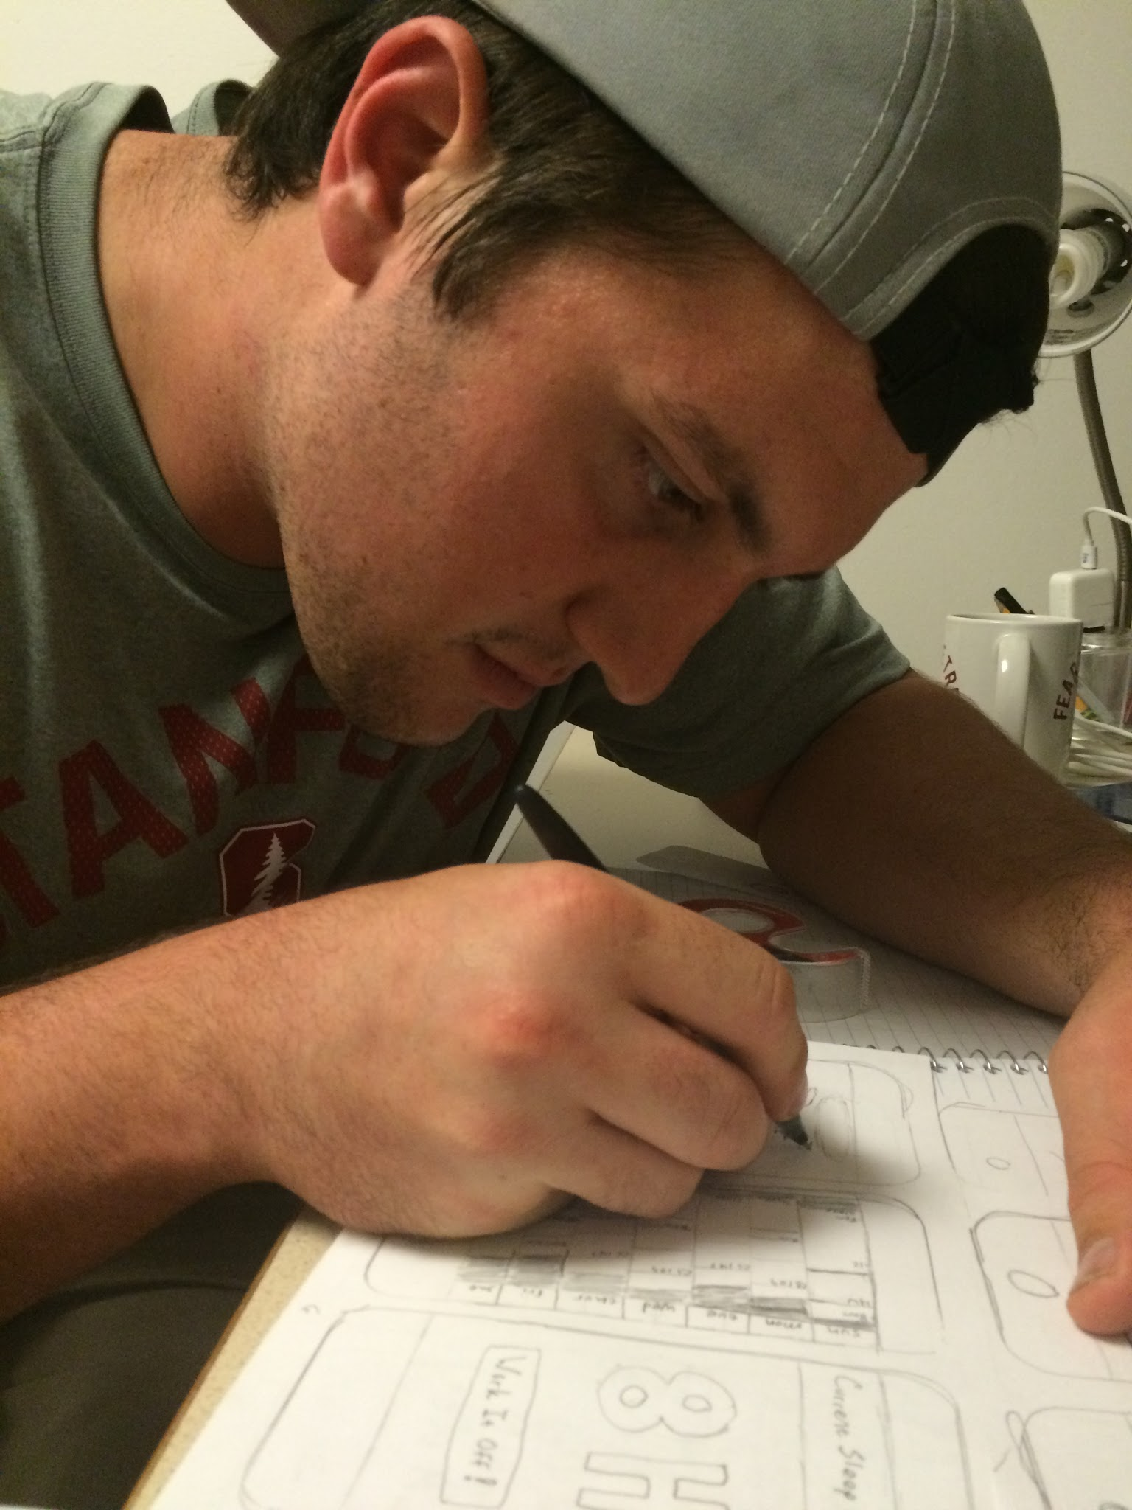
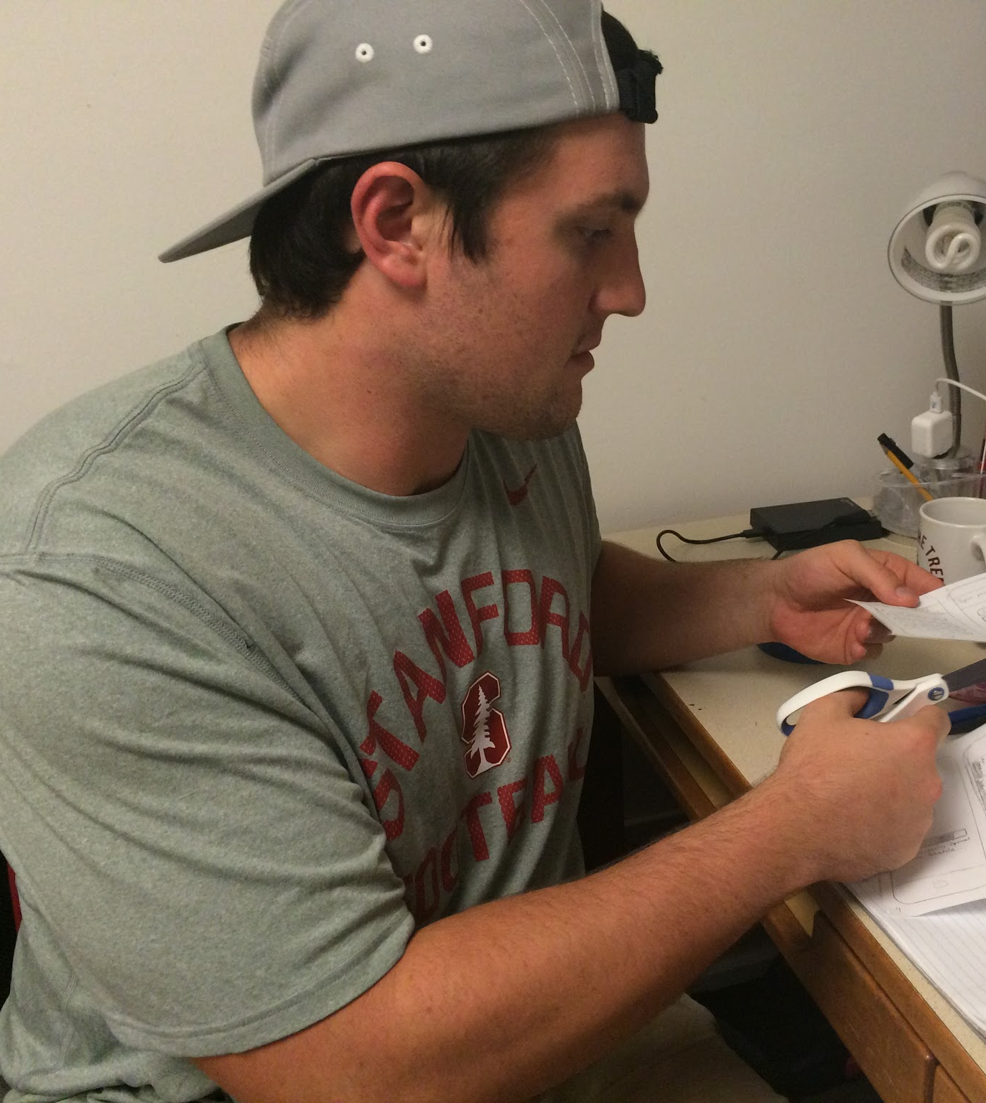
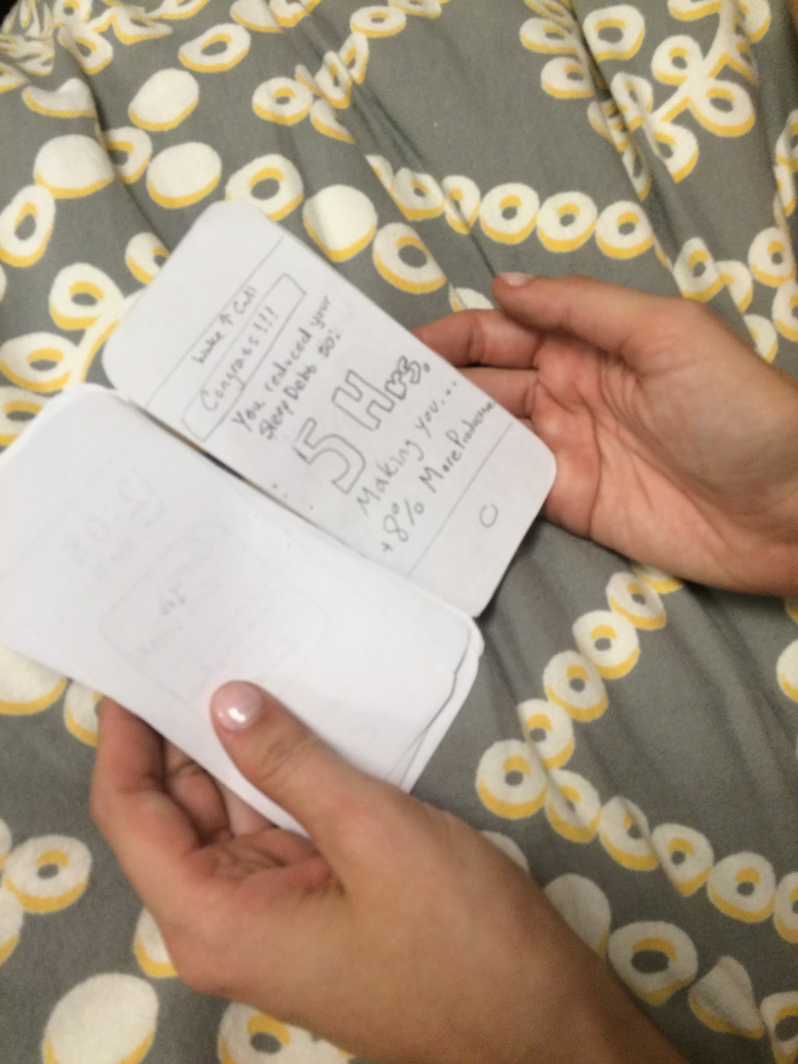
Wake Up Call: Development

Slide 21
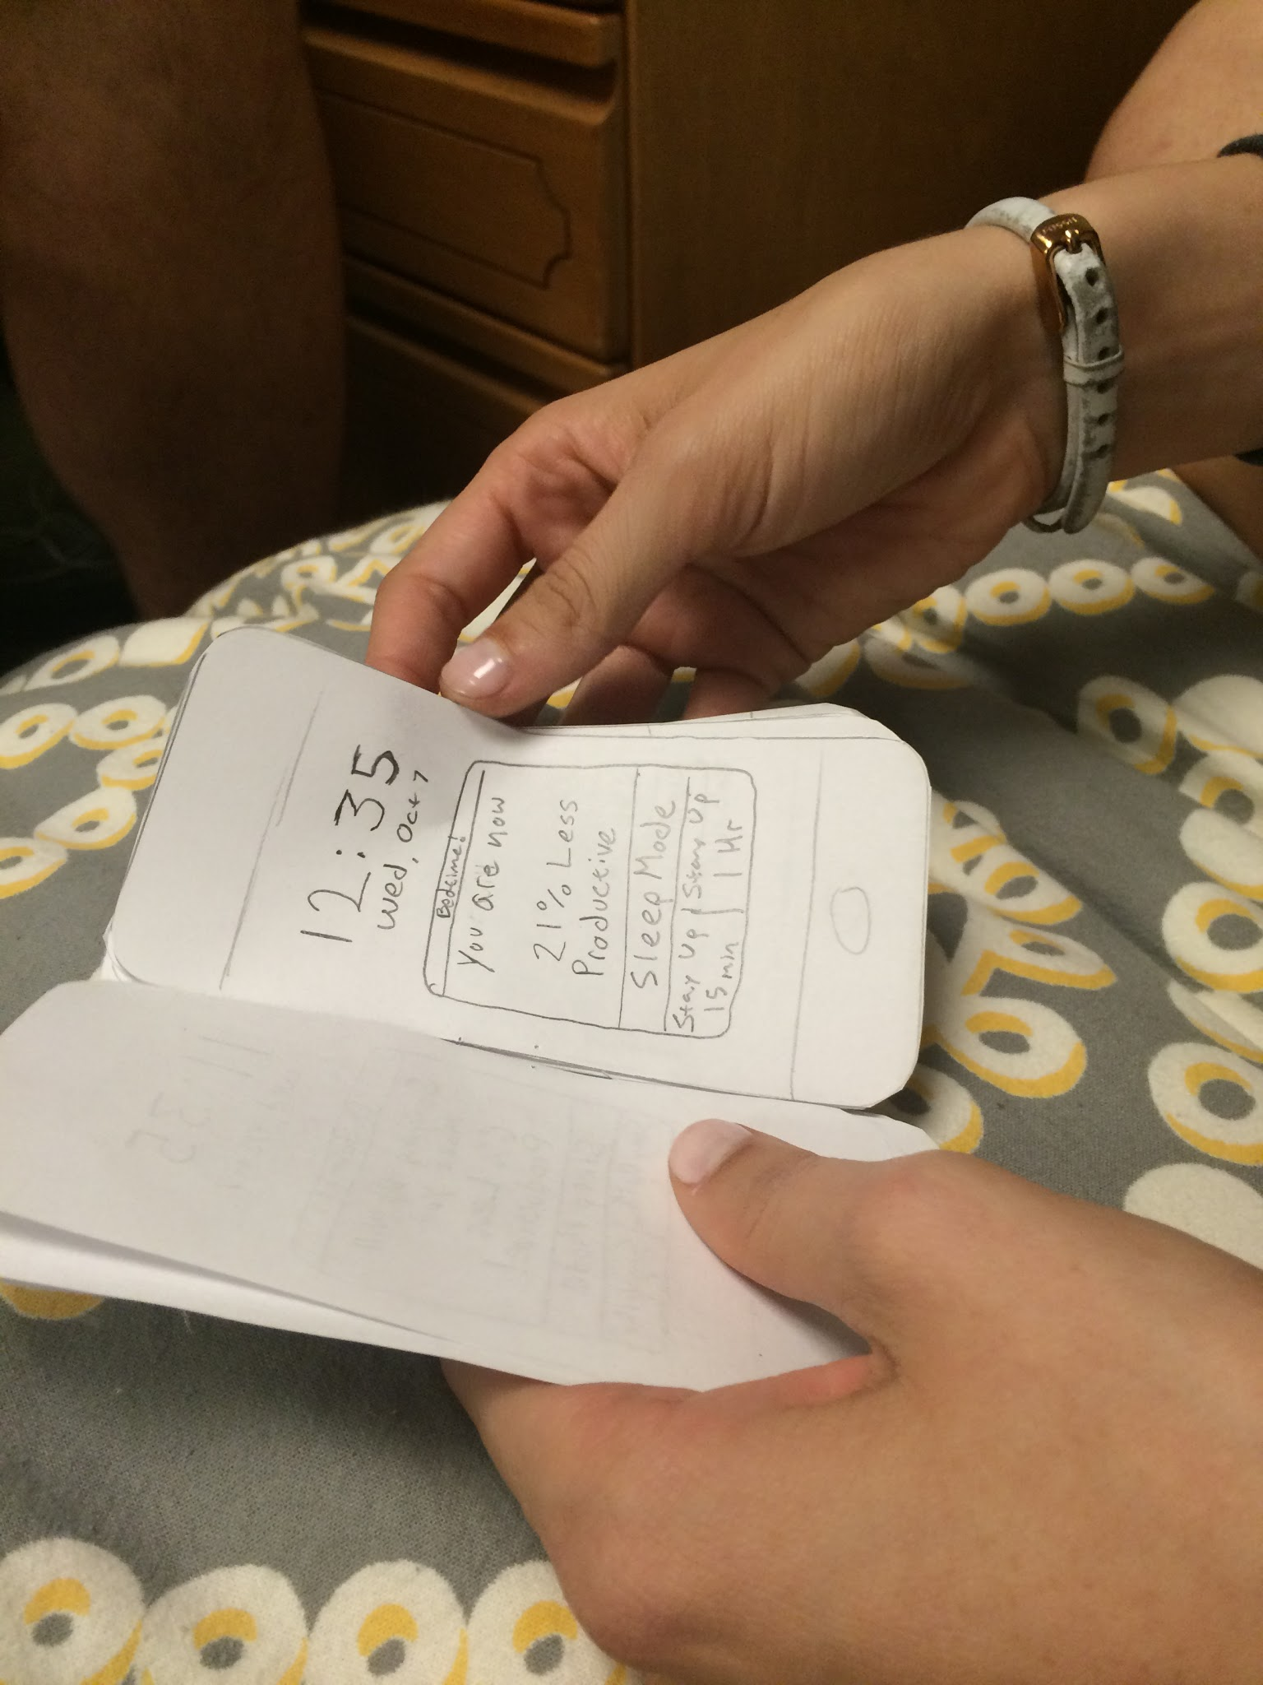
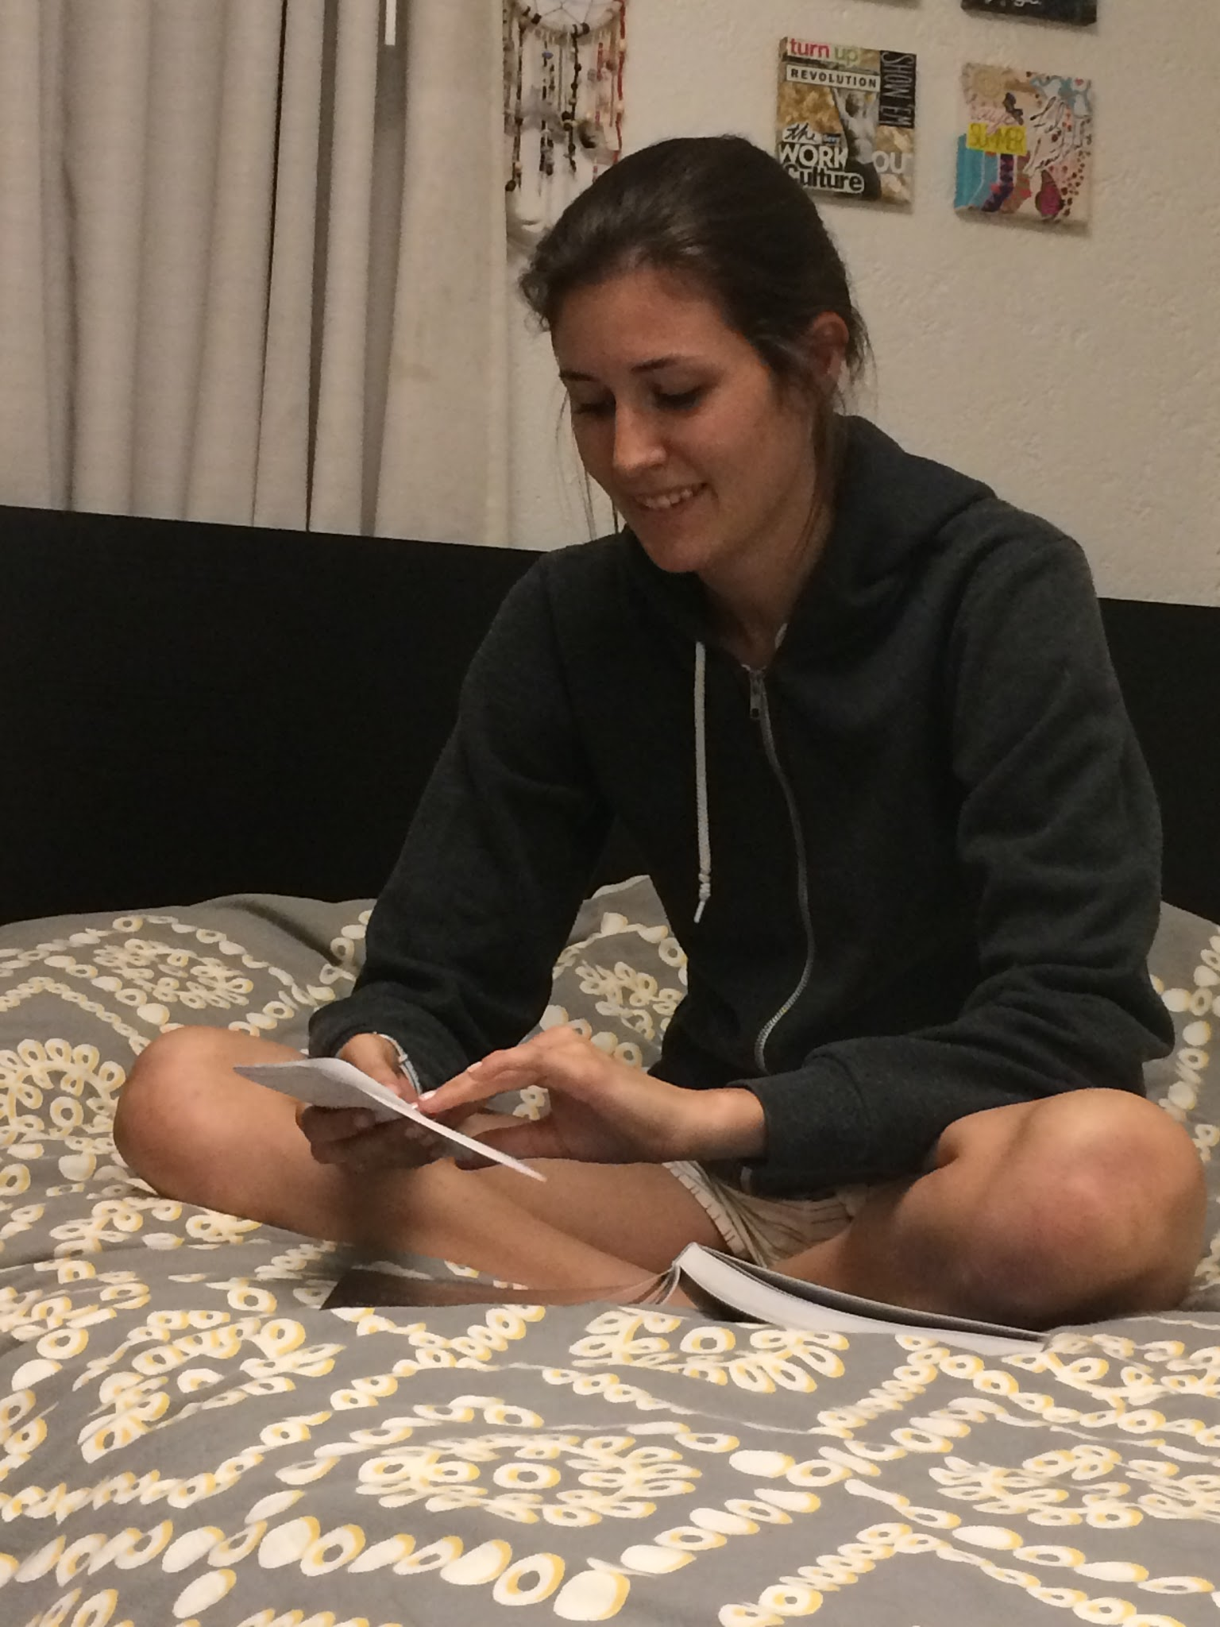
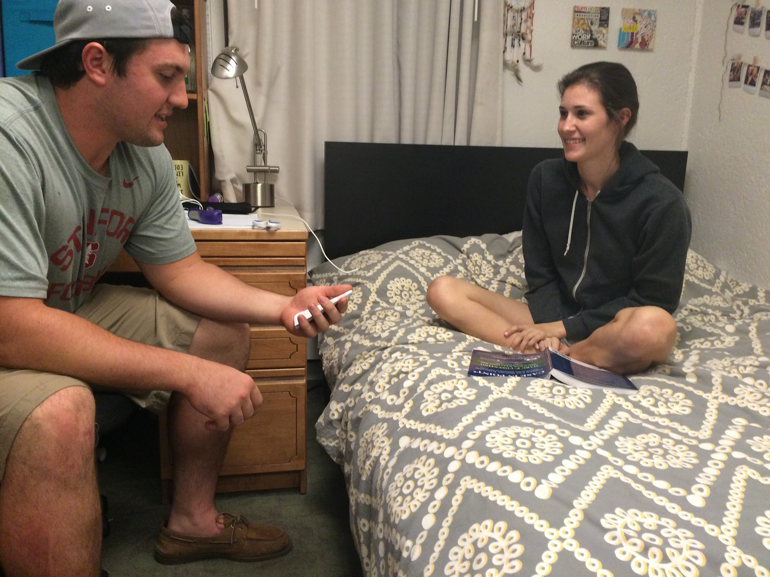
Wake Up Call: Testing
Alerts regarding loss of productivity before bedtime
See your “Optimal” Sleep Schedule
Chose to stay up and work or go to bed

Slide 22
Wake Up Call: Results
“6% is not that much less productive. I think I would still stay up to get my work done. I would want to just crank it out”
“Oh, now I get it. The shaded parts are when I sleep.”
“hmm.. now i’m going to be 21% less productive. that’s a lot. maybe i’ll just go to sleep.”

Slide 23
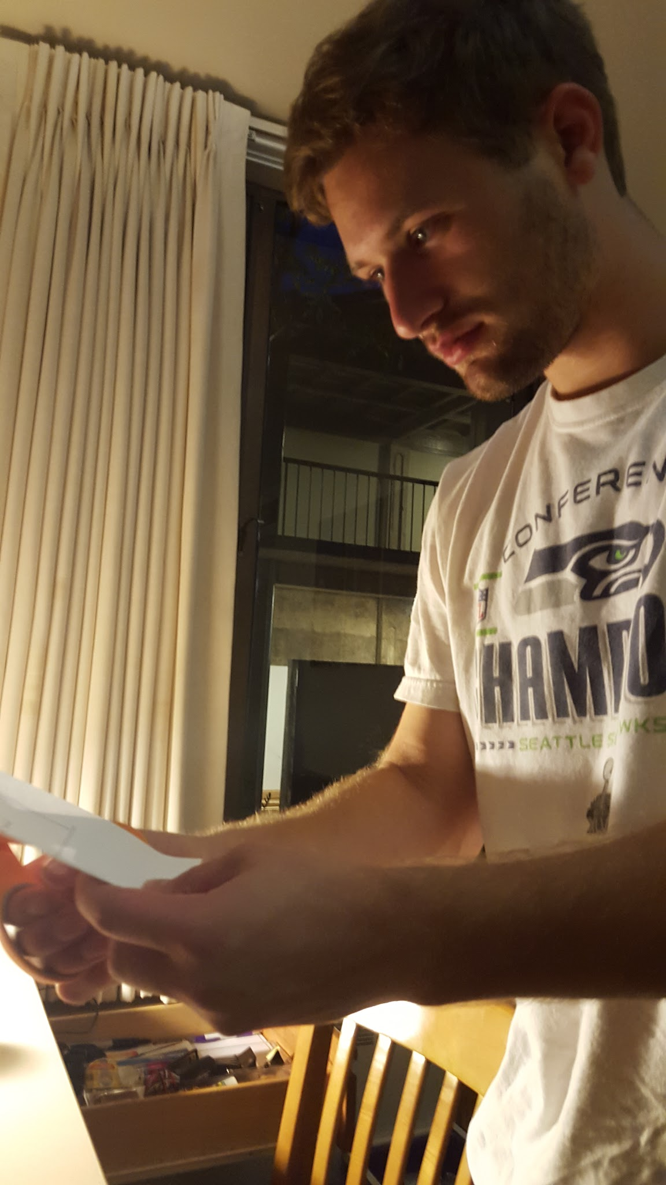
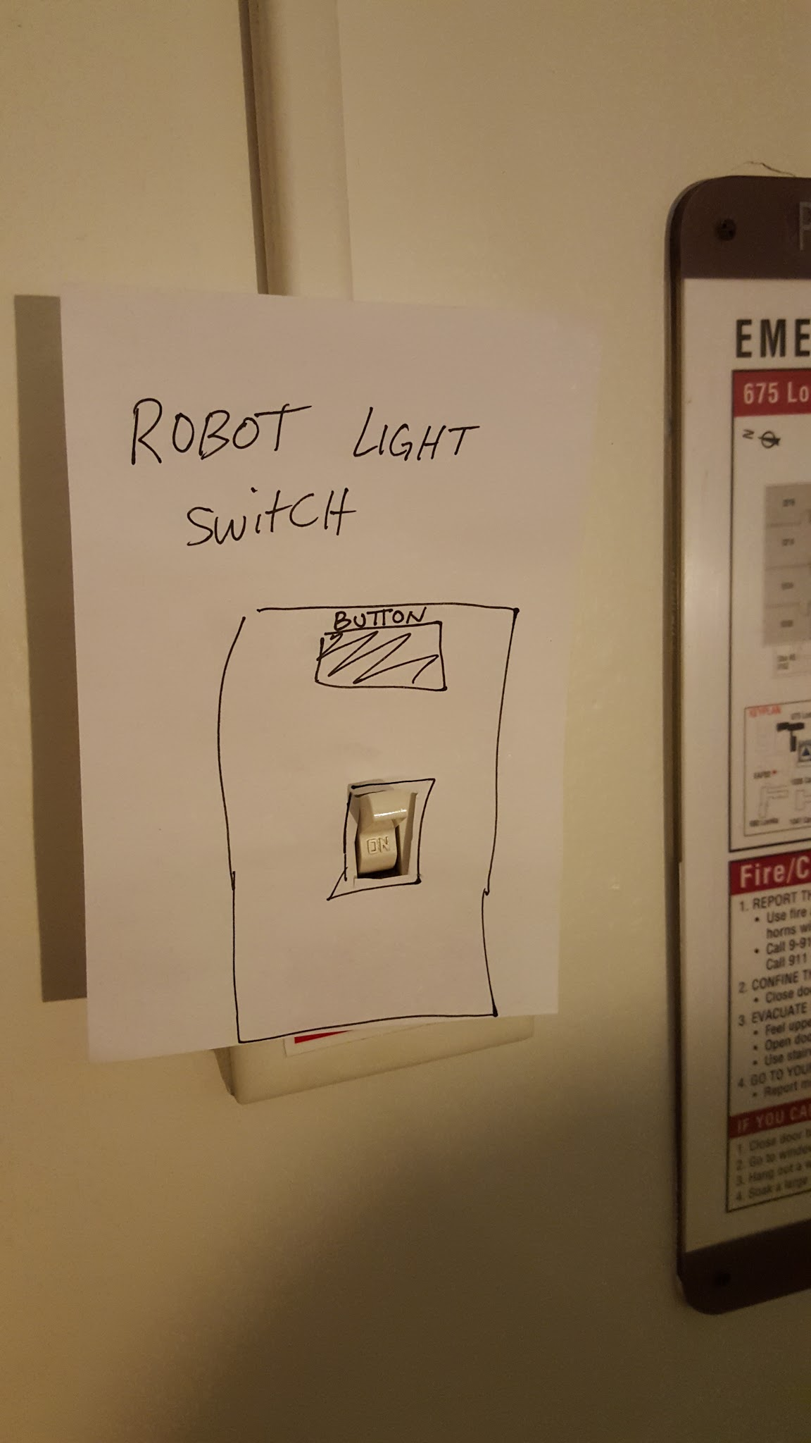
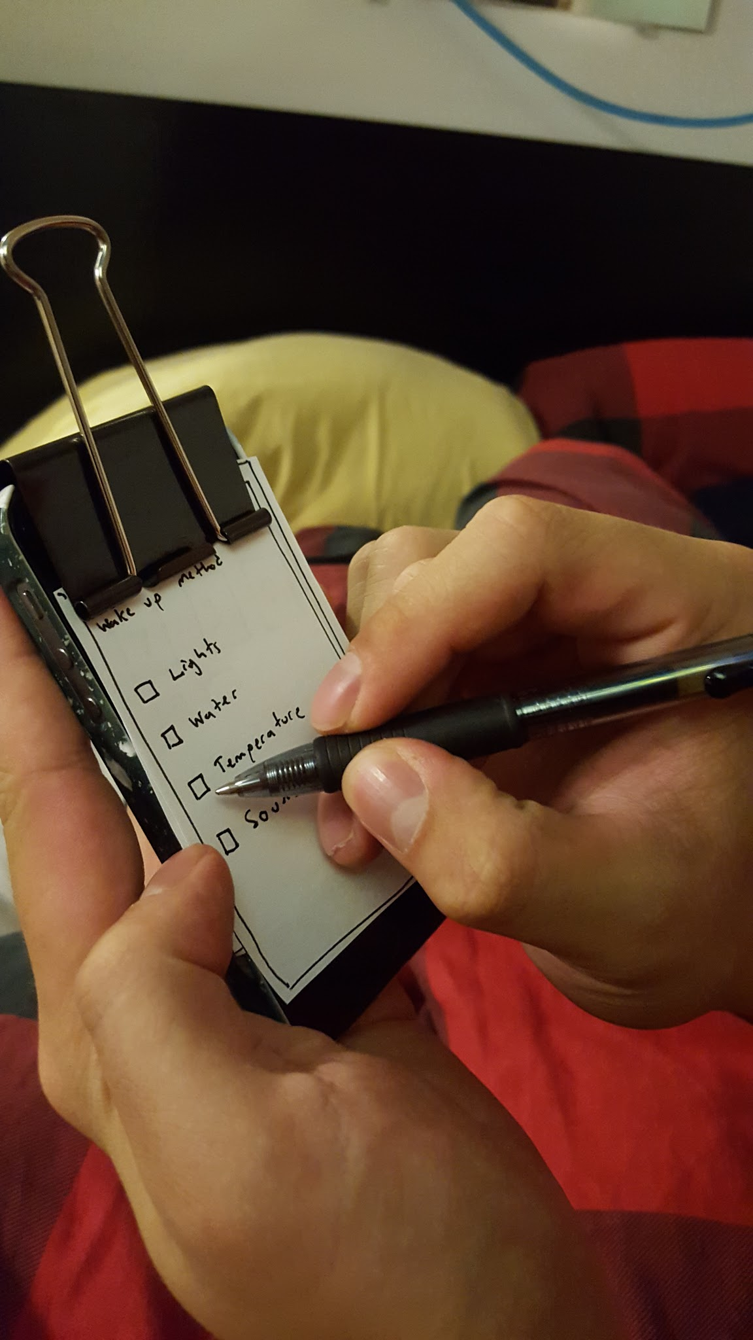
Rise & Shine : Development

Slide 24
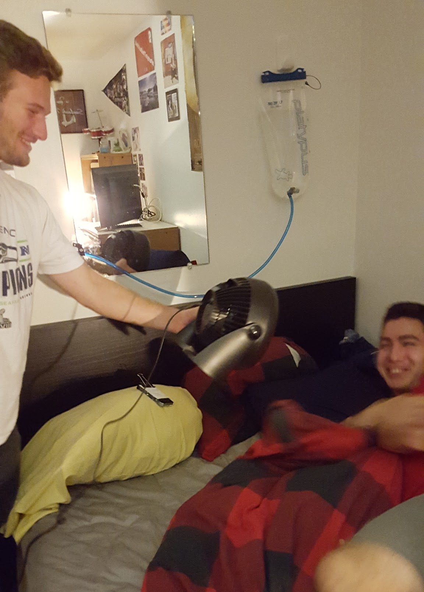
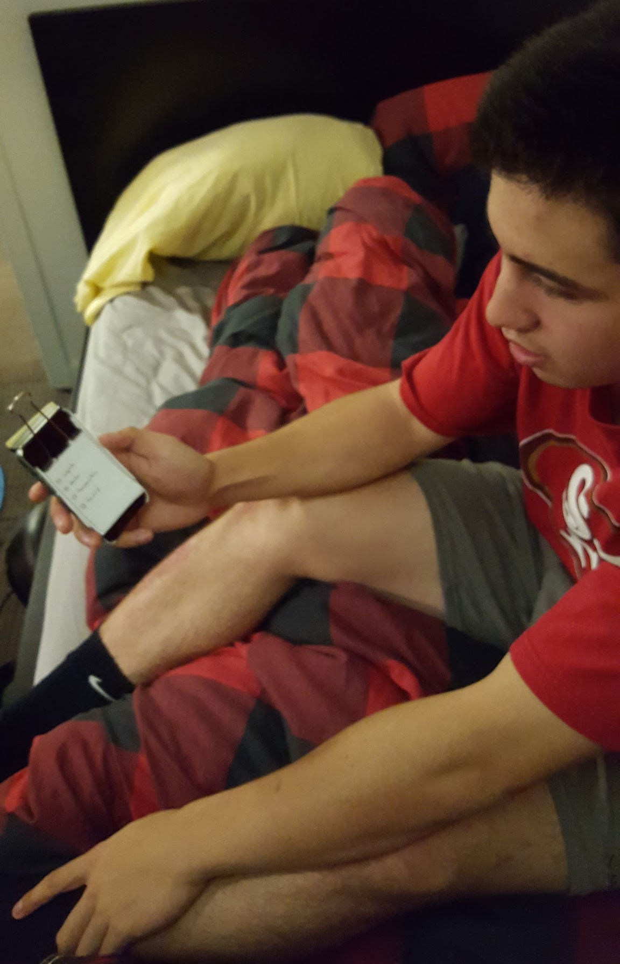
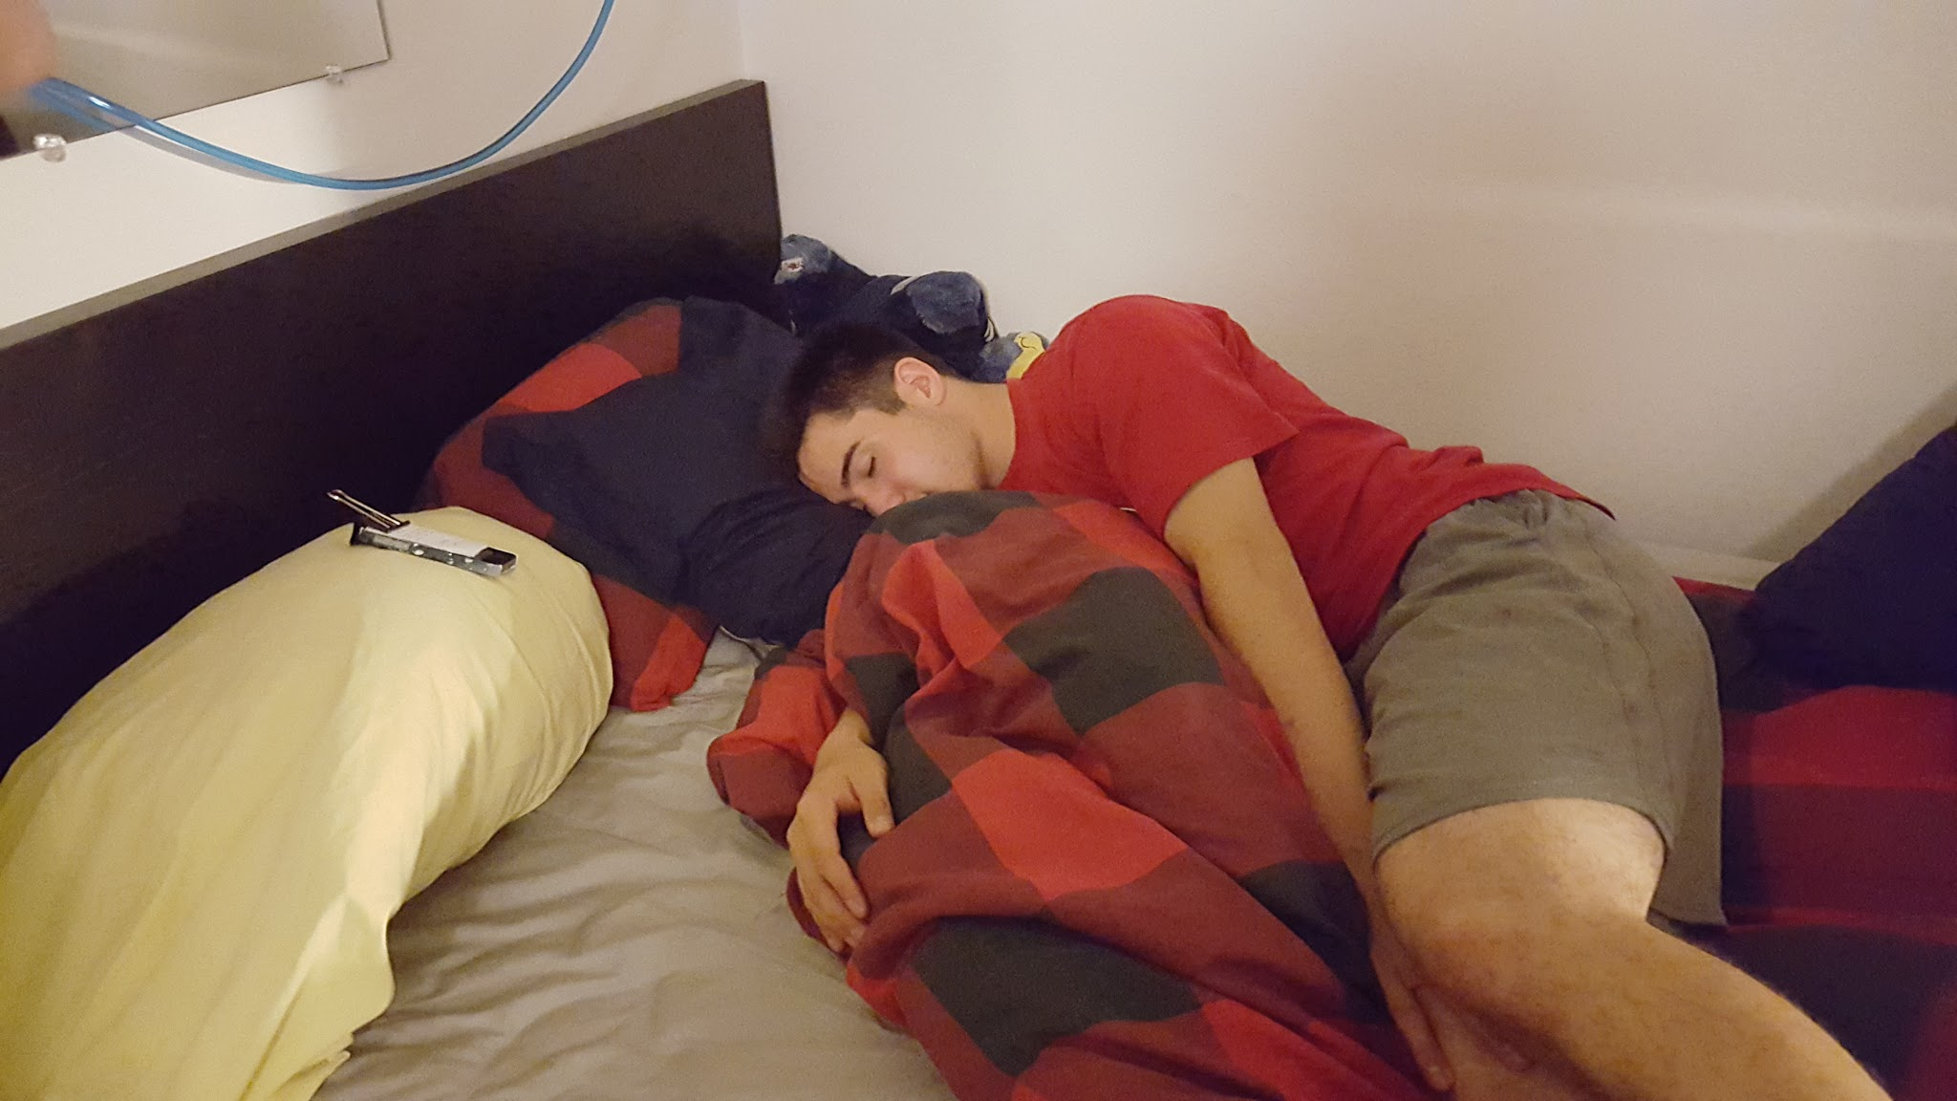
Rise & Shine: Testing
Meditate to reach a point of restfulness
WAKE UP!
Select desired wake up method

Slide 25
Rise & Shine: Testing
“I would definitely use this if I HAD to be up”
“Ah! I’m up, I’m up!”
“I’d either use the water or make my bed cold, or both”

Slide 26
Findings:
IWake:
Wake Up Call:
Rise and Shine:
Custom snooze
Custom alarm
Unaware of the time it takes
Enjoy knowing time it takes
x Favorite app helps
Sleep work conflict
“Sleep mode”
Loss in productivity encourages sleep
Schedule sleep is Rare
x Alerts before bedtime
Water
Cold bed
Sounds
Lights flashing
Non-Traditional methods are prefered to alarms
Tracking movement would help with getting out of bed.
Alerts must be made minimally and at key times.
Users want this when sleeping in is not an option.

Slide 27
Needfinding
POVs & HMWs
Experience Prototypes

Slide 29
Questions?

