Slide 1
CS 147 Overview
Design Thinking for UX Design, Prototyping & Evaluation

Slide 2
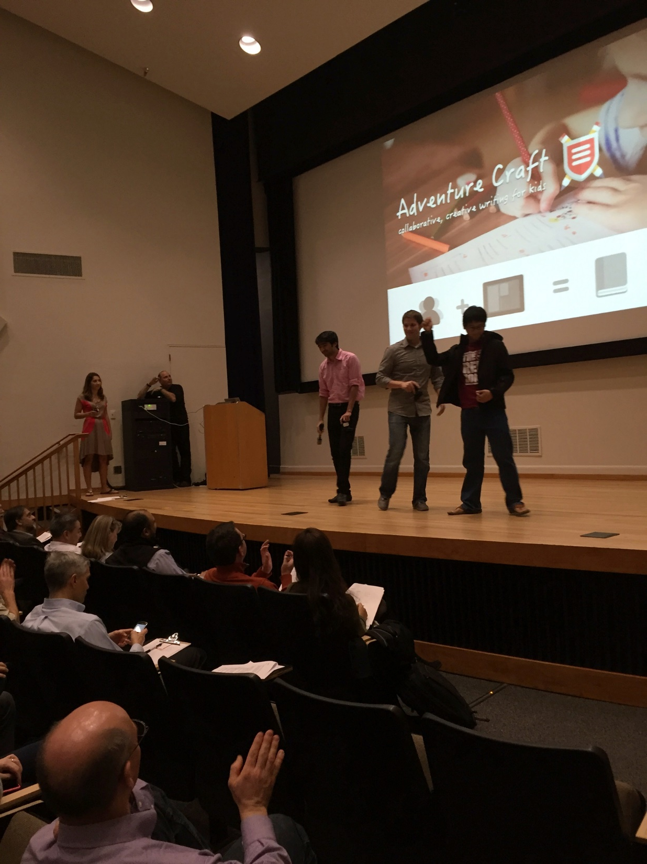
Outline
Course overview 6:00-6:15
Project presentations 6:15-6:50
Poster session/demos 6:50-8:45
Awards 8:45-9:00

Slide 3

balance
design
technology
Notes:
You need to find a balance between:
design & technology, human-centered approaches & CS approaches
Especially now HCI needs to find a balance between careful controlled experiments of existing technologies or minor tweaks on technology and building major new systems that can solve important world problems.

Slide 4





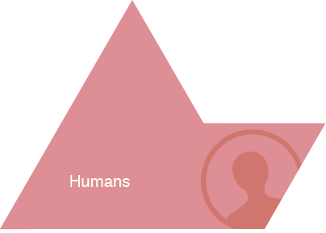
HCI Approach to UX Design
Notes:
Examples of Tasks/Activities:
activity:
learning history
high level task:
- writing a paper
- drawing a picture
low level task (operation):
- copying a word from one paragraph to another
- coloring a line

Slide 5
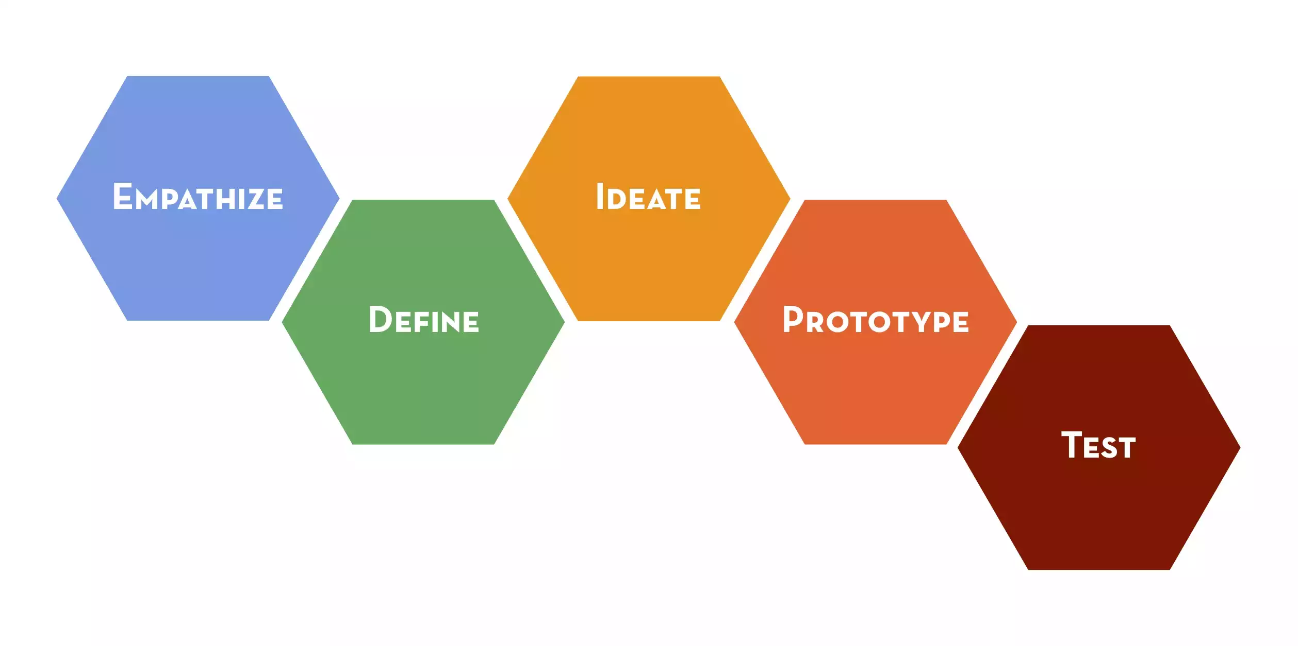
Design Thinking Process

Slide 6
Iterative Design
Driven by the variability in human performance
Design
Prototype
Evaluate

Slide 7
Goals of CS 147
Learn to design, prototype, & evaluate UIs
  tasks, activities & practices of prospective users
  cognitive/perceptual constraints affecting design
  techniques for brainstorming, ideation & prototyping
  methods for evaluating UI designs
  importance of iterative design for usability
  technology used to prototype UIs
  how to work together as a team
  communicating results to a group

Slide 8
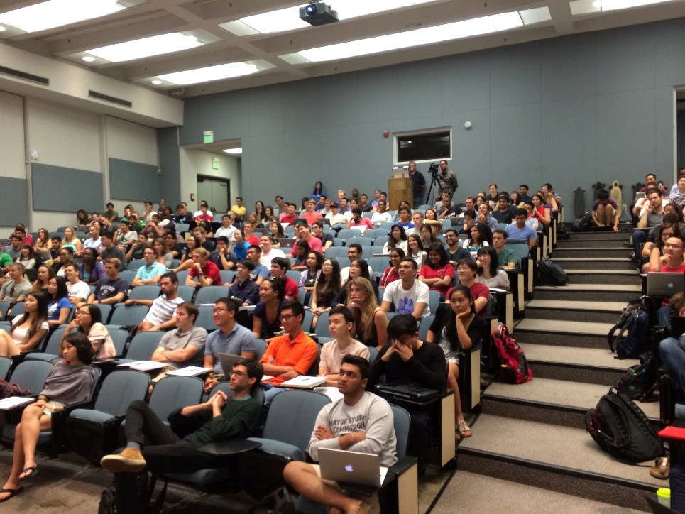
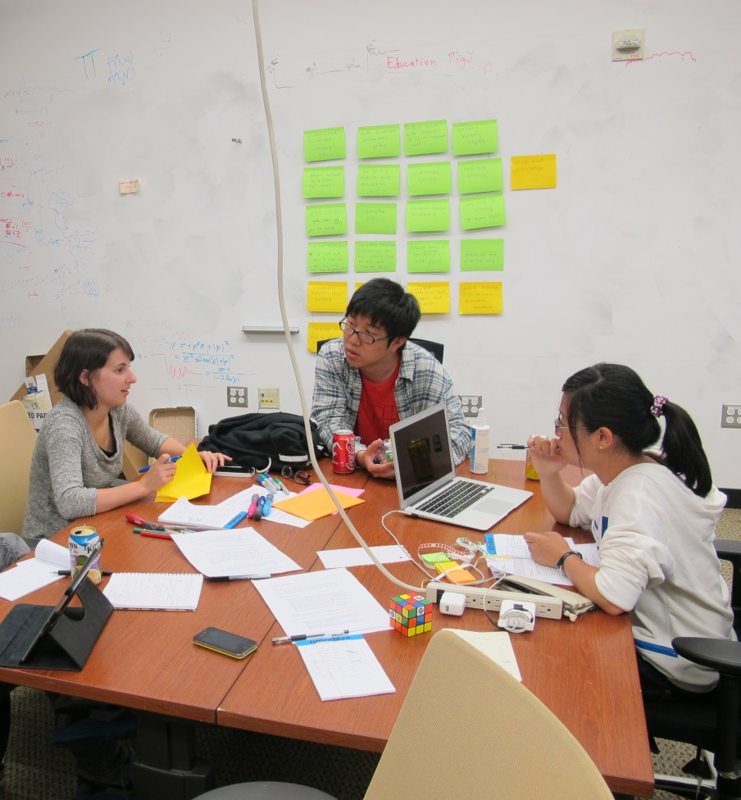
Project Based Course
Iterative design of a real UI
Theme: mobile computing
Quarter long projects
Students
  223 across CS, Symbolic Systems …
62 Teams
  3-4 members
10 major group assignments
  group work is 60% of course grade
Four presentations
  every team member presents
Notes:
click to animate image after [STUDENTS]

Slide 9
Project Process Timeline
Needfinding
Concept
Video
Medium-fi
Prototype
High-fi
Prototype
Experience
Prototypes &
Testing
Low-fi
Prototype
Heuristic
Evaluation
Project Fair
Week 2
Week 4
Week 5
Week 6
Week 7
…
Week 10
Week 3
Week 8

Slide 10
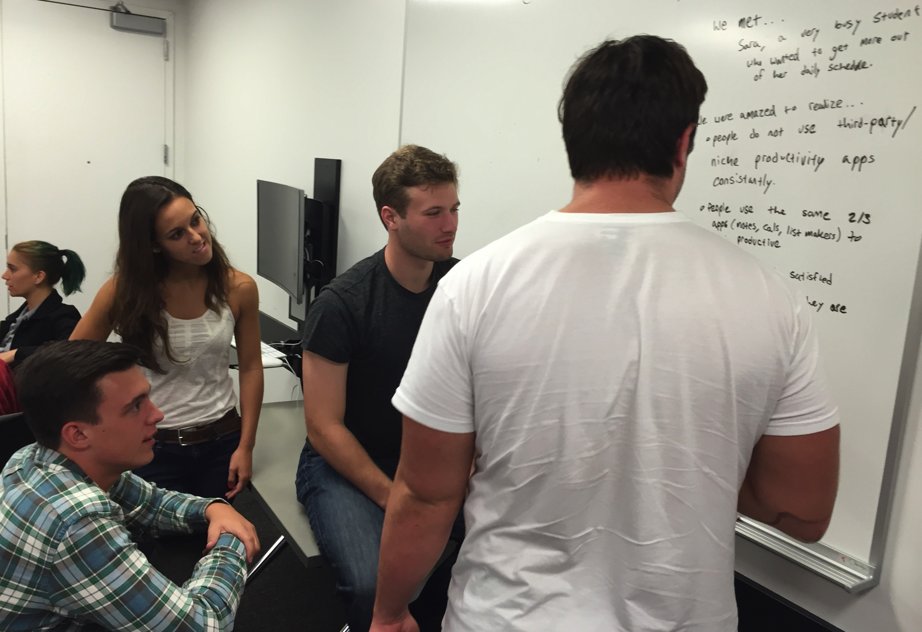
Design Studios
Teams attend small weekly studio (8-16 students)
  critique/feedback in more intimate environment
  start work on next project assignment

Slide 11
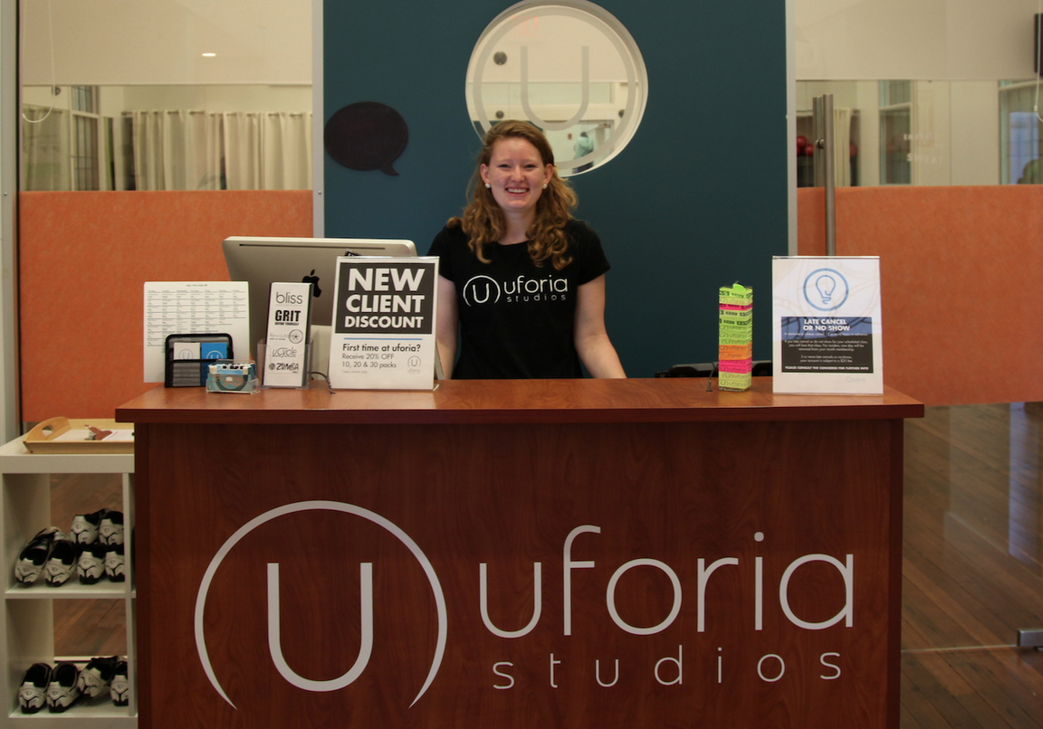
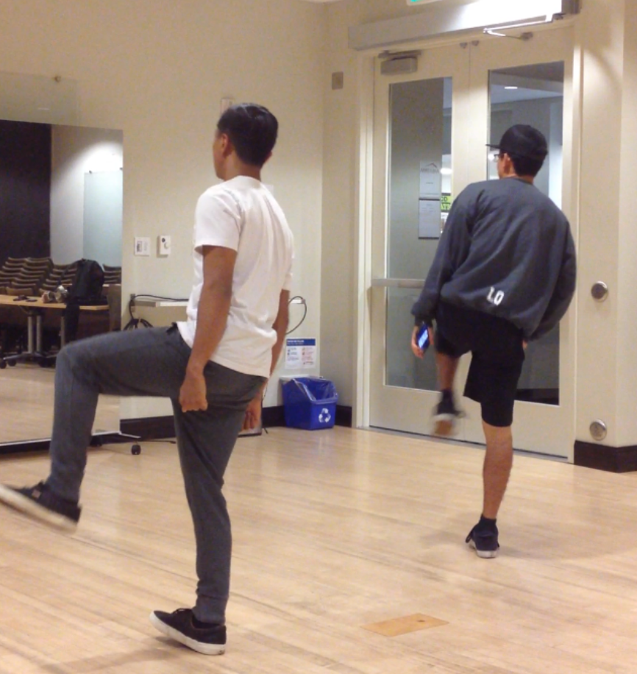
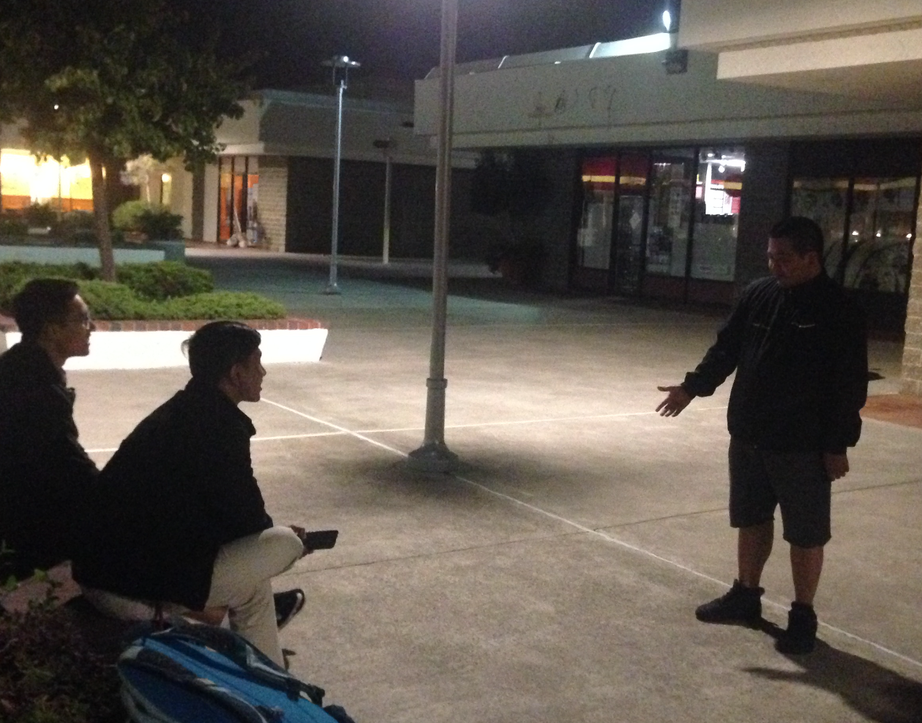
User-centered Design: Needfinding
Fieldwork
  observe existing practices & interview potential users
  make sure key questions answered
ChoreoLab observed/interviewed dancers in studios…. and out in the streets ... (or maybe Berkeley)

Slide 12
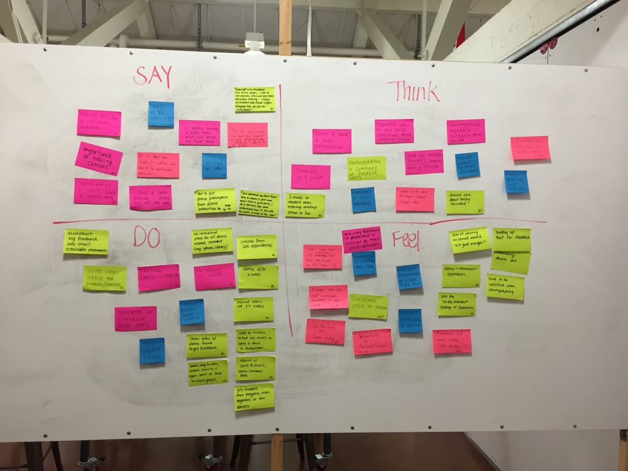
Unpacking the Needfinding
ChoreoLab
Notes:
Start with this CI design sketch, but required many examples (over 30 on 1st assignment) on each subsequent assignment from different folks on the team

Slide 13
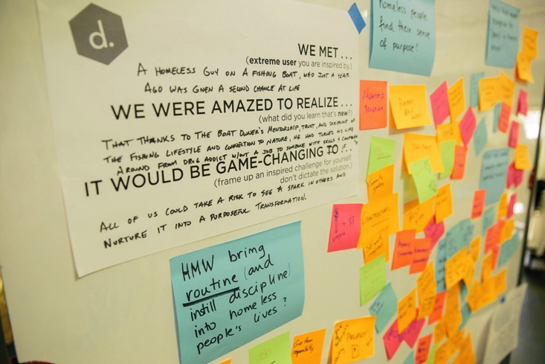
Develop Point of Views
(Person + Insight + Challenge)
Brainstorm on How Might We Solve
Notes:
We met a homeless guy on a fishing boat, who just a year ago was given a second chance at life
We were amazed to realize that thanks to the boat owner’s mentorship, trust, and display of the fishing lifestyle and connection to nature, he has turned around his life from drug addict without a job to someone with success and compassion
It would be game-changing if all of us could take a risk to see a spark in others and nurture it into a purposeful transformation.

Slide 14
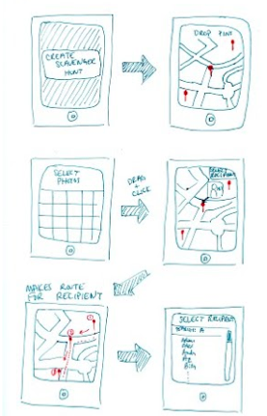

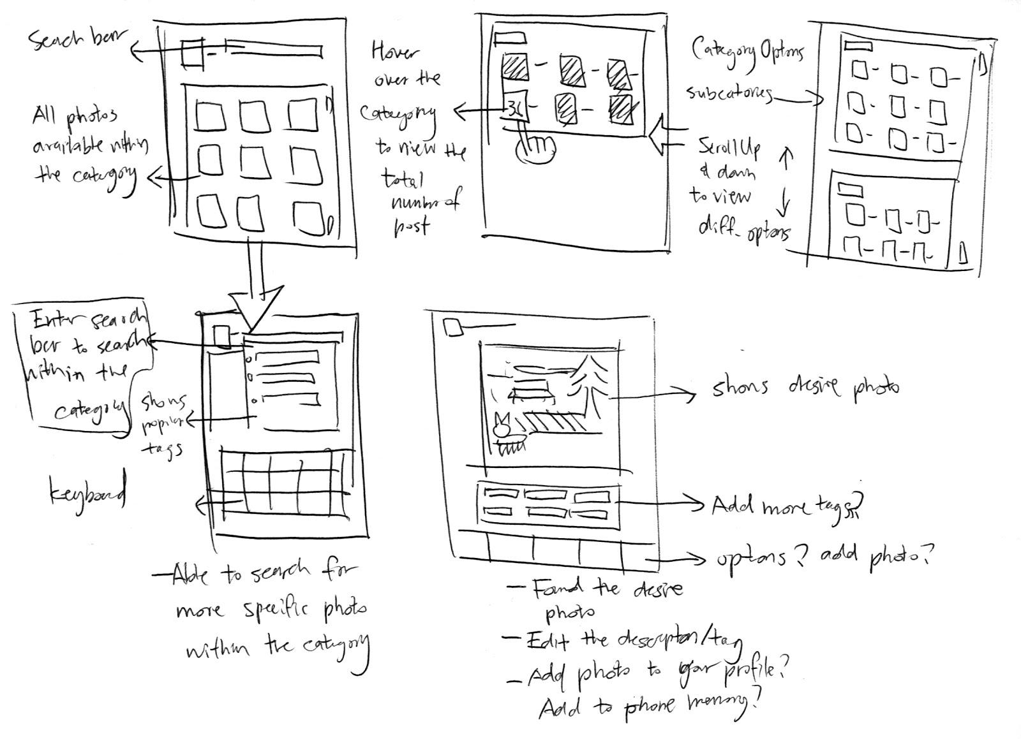
Sketching & Storyboarding
Parcel
tagbuster
Phocus
Notes:
1. Idea generation, Pick 3 or 4… and show in depth

Slide 15
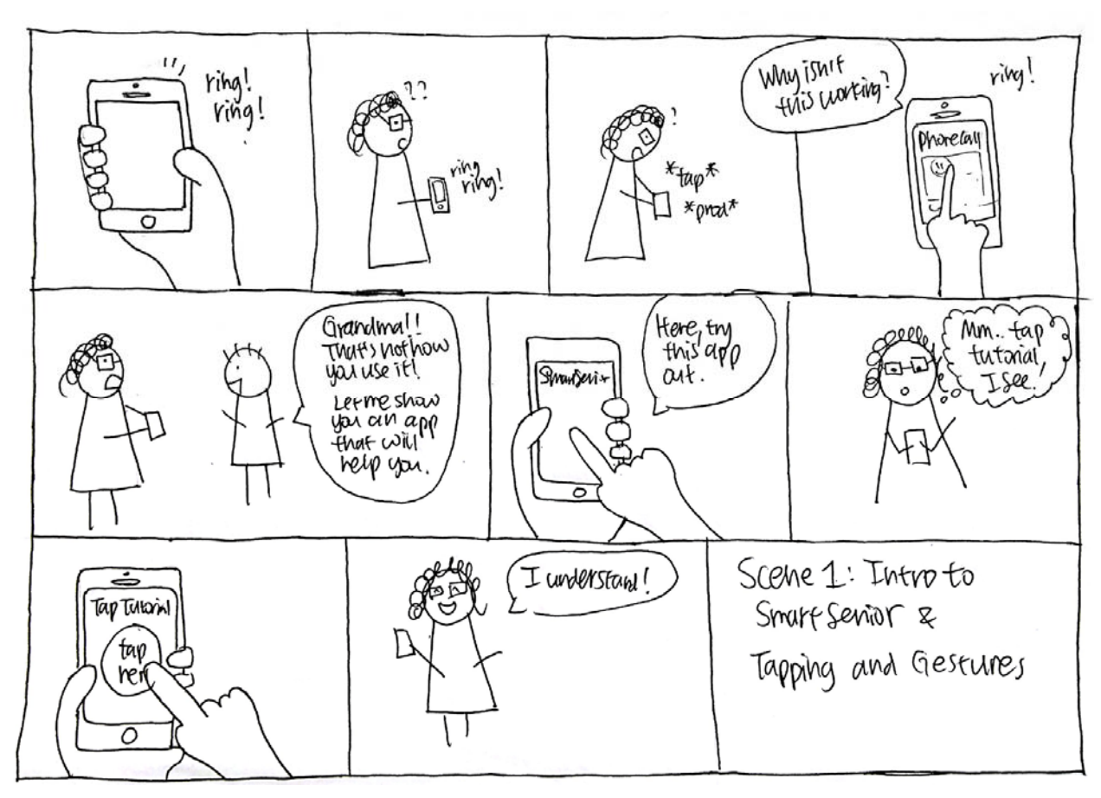
Concept Videos: Planning Storyboards
SmartSenior
Notes:
1. Idea generation, Pick 3 or 4… and show in depth

Slide 16
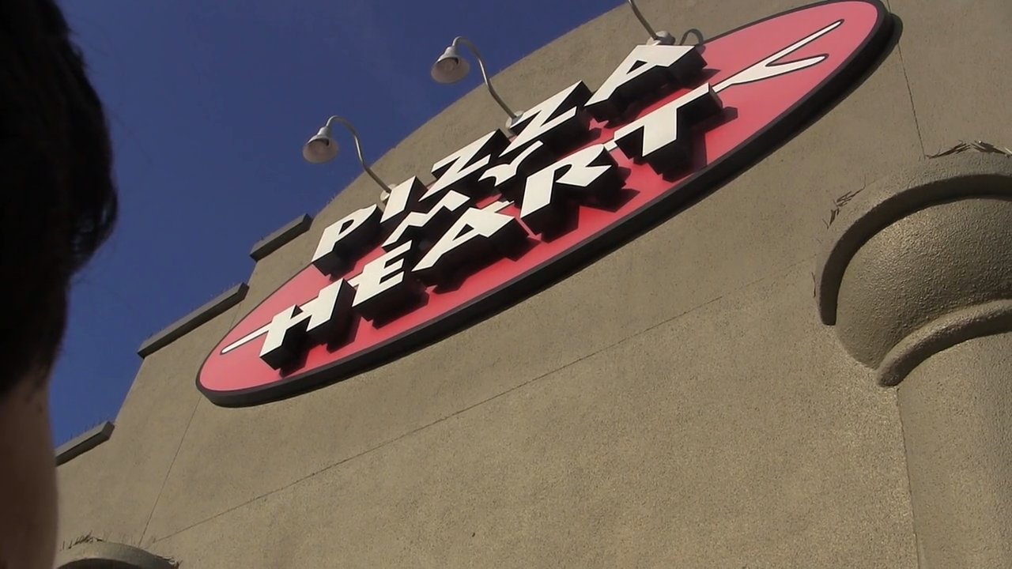
Concept Videos
Munch
Notes:
1. Idea generation, Pick 3 or 4… and show in depth

Slide 17
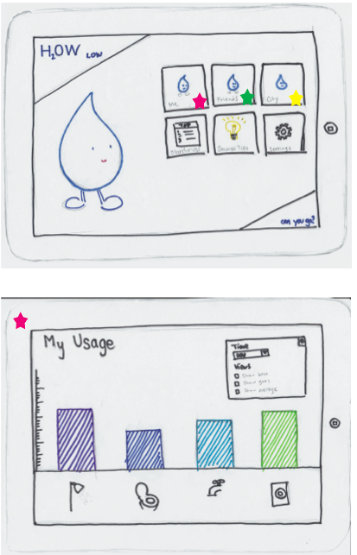
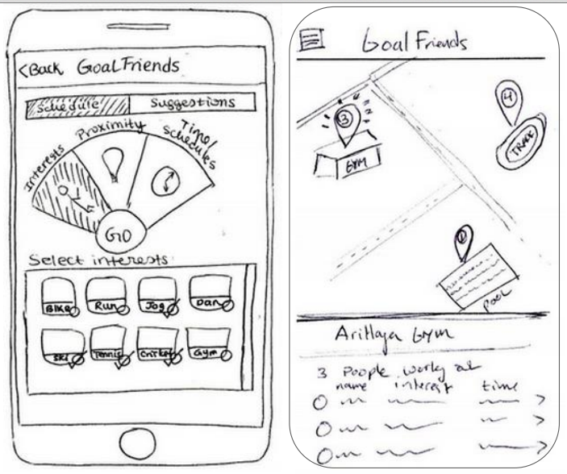
Low-fi Prototyping & Testing
How Low
Goal Friends

Slide 18
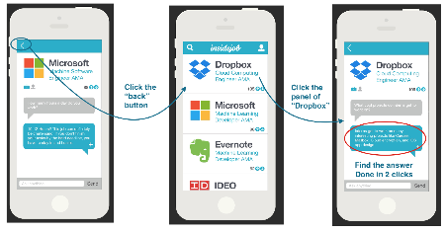
Interactive Prototypes
Medium Fidelity
Insidejob

Slide 19
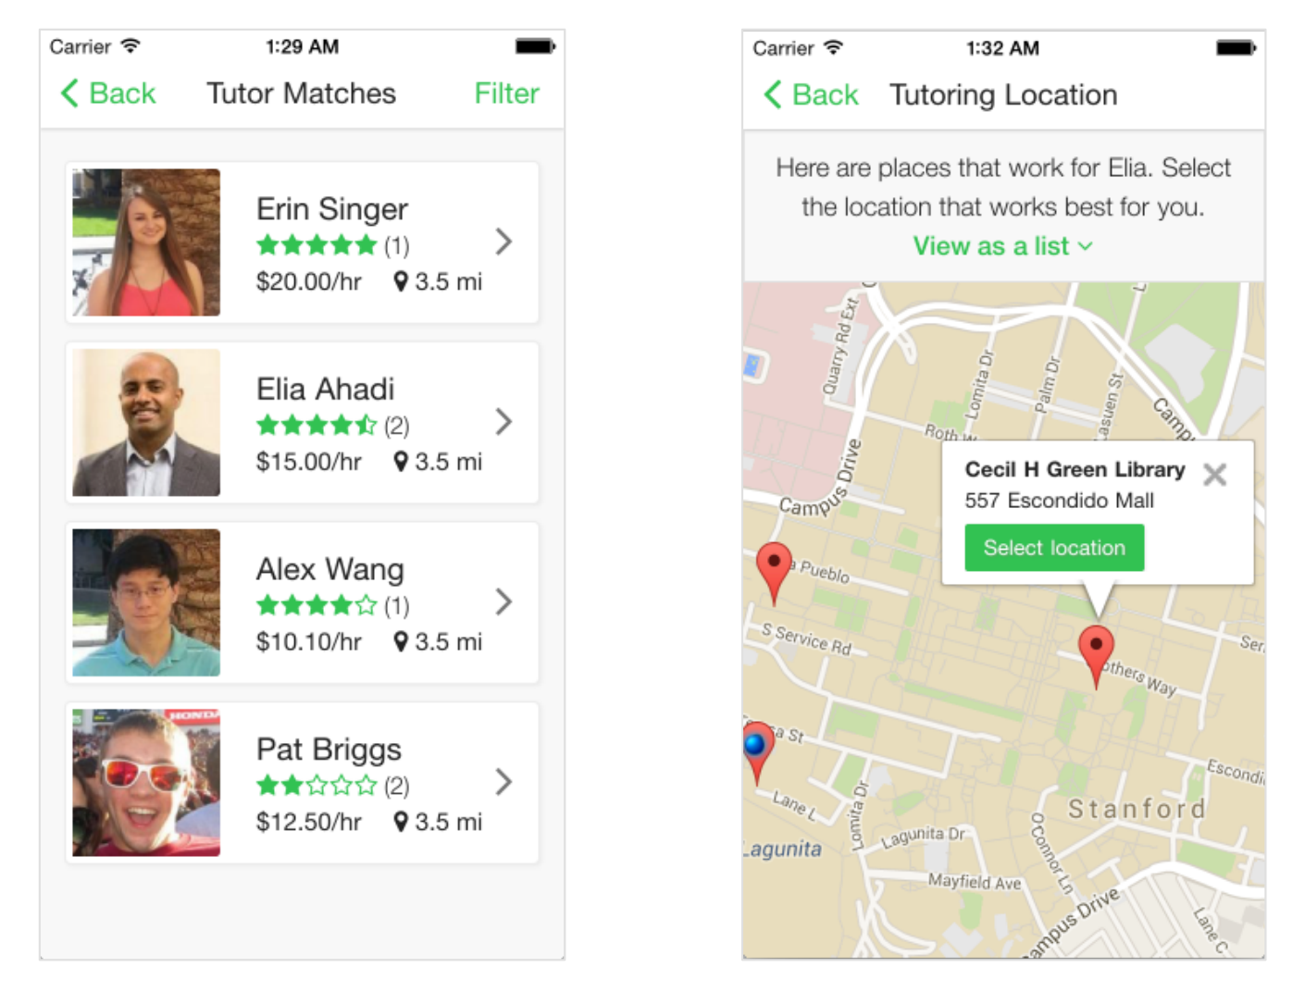
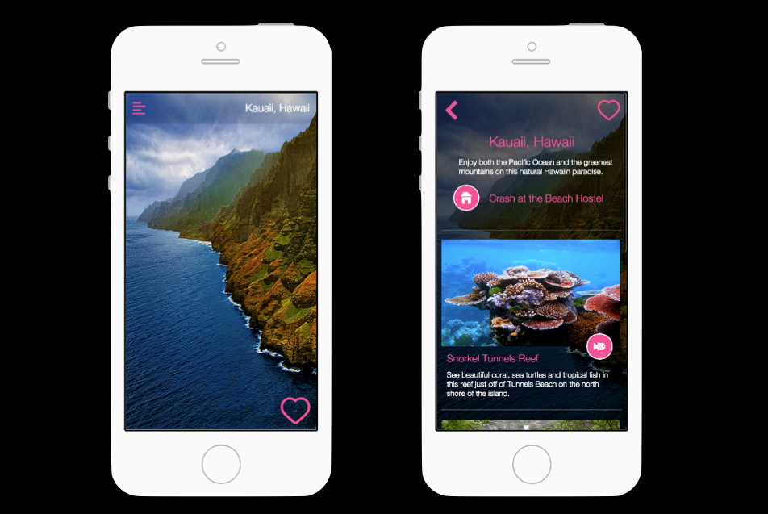
Interactive Prototypes
Hi-Fidelity
Tutera
Uncharted

Slide 20
Evaluation
Test with real users (participants)
Low-cost techniques
  expert evaluation (HE)

Slide 21
http://cs147.stanford.edu
Project web sites w/ all materials
Lecture topics, slides, & video
Homework assignments

Slide 22
The Projects
20 Judges will be picking the best projects (announced at 8:50 PM)
You too will have a say by voting for
The People’s Choice Award
http://bit.ly/CS147-peopleschoice
Student’s Choice Awards for
Best Project/Team Name & Best Pitch
http://bit.ly/147-student-choice

Slide 23
The Judges
Dave Baggeroer, Stanford d.School
Francesca Barrientos, Cisco
Victoria Bellotti, PARC
Bay Chang, Tynker
Paul Fu, Alibaba
Katherine Isbister, UCSC
Manu Kumar, K9 Ventures
Paul Moody, Google
Donal Mountain, Google
Pedro Nakazato Andrade, IDEO
Peter Norvig, Google
Melissa Powel, Google
David Ayman Shamma, Yahoo
Anoop Sinha, Self
Mirjana Spasojevic, HP
John Tang, Microsoft Research
Alex Tibbetts, stealth mode start-up
Vivek Wadhwa, Stanford & Singularity University
Luke Wroblewski, Google
Shumin Zhai, Google

Slide 24
Thanks! Get Involved!
Team mentors in CS 194H (Winter Quarter)
Co-teach Stanford HCI/Design courses
  studio faculty in CS 247 (Winter)
  dt+UX for Global Challenges in d.School (Spring)
Hire students and interns
Support HCI+Design research at Stanford

Slide 25
The Projects
The People’s Choice Award
http://bit.ly/CS147-peopleschoice
Student’s Choice Awards for
Best Project/Team Name & Best Pitch
http://bit.ly/147-student-choice

Slide 27
FALL 2015
CS 147 – dt+UX
AWARDS

Slide 28
Best Project or Team Name
1st Runner Up
Efangelist
The Winner
ChoreoLab

Slide 29
Best Pitch
2nd Runner Up
Efangelist
1st Runner Up
Chapter
The Winner
ChoreoLab

Slide 30
Best Poster
2nd Runner Up
InstaGator
1st Runner Up
Buckets
The Winner
Muncher

Slide 31
Best at Engaging Underserved Populations
2nd Runner Up
Connect
1st Runner Up
Clean Plate
The Winner
Compass

Slide 32
Best Demo Winners (3)
Muncher
ChoreoLab
Spiel / Herd

Slide 33
Best Startup Idea (3)
usense
InCharge
ClickEd

Slide 34
Best Visual Design (3)
Meet
FoodBack
Mango

Slide 35
TA’s Choice
2nd Runner Up
NightOwl
1st Runner Up
NutriGood
The Winner
Munch

Slide 36
The People’s Choice
2nd Runner Up
ChillZone
1st Runner Up
FoodBack
The Winner
Efangelist

Slide 37
Best Overall Project
2nd Runner Up
Mango
1st Runner Up
10 Lines
The Grand Prize Winner
Meet

