Slide 1
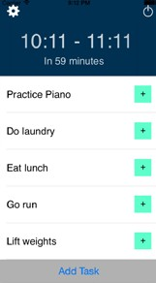
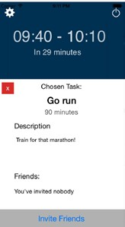
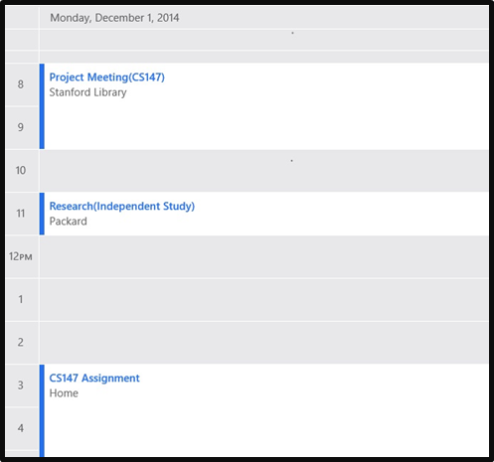
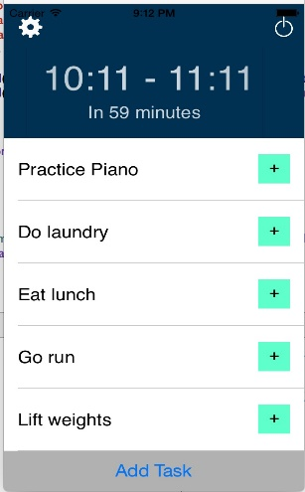
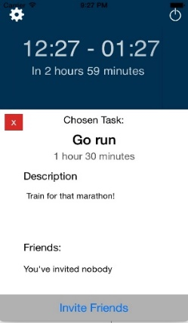
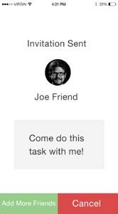
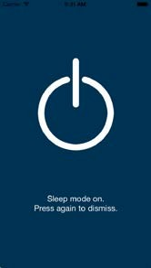
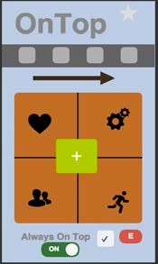
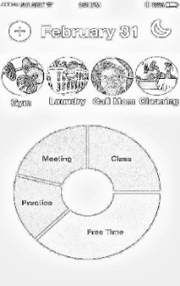
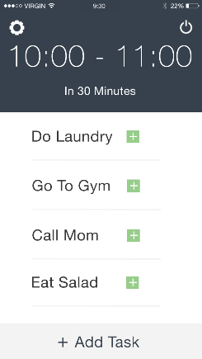
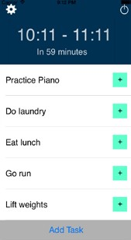
OVERVIEW
Traditional to-do lists are hard. You have to actively check them and your calendar to see when you’re free. OnTop takes care of this for you, allowing you to use pockets of free time in your day to accomplish these tasks.
Add new tasks
Finds your free time for you
Invite friends Turn it off
Free time
Free Time
Optimize your free time!
DESIGN ITERATION
We used contextual inquiry to find out what people wanted in a scheduling app. We then iterated through several designs in the process, progressing from initial Photoshop mockups to a high-fidelity prototype.
CS 147
AUTUMN 2014
Matthew Millett . Pallabi Ghosh .
http://stanford.edu/class/cs147/projects/motivation/ontop/
Alec Douglas .
Pascal Odek
STANFORD UNIVERSITY

