Slide 1
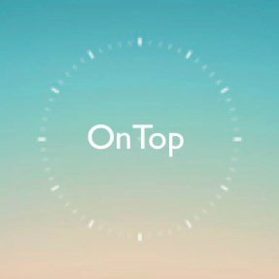
Hi-Fi Prototype
Use your time. Get more done. Be OnTop.
Matthew Millett, Pallabi Ghosh, Alec Douglas, Pascal Odek

Slide 2
The Problem
Many have goals they want to accomplish
Often, busy people don’t know how to fit goals into schedule
Results in endless procrastination, goals never accomplished

Slide 3
The Solution
App which helps people fit goals into their day
Uses data from calendar to determine when user has free time
Alerts user when they have time to accomplish one of their goals

Slide 4
Presentation Overview
The Heuristic Evaluation (HE) results
Our new design
Our progress
A demo of the new design

Slide 5
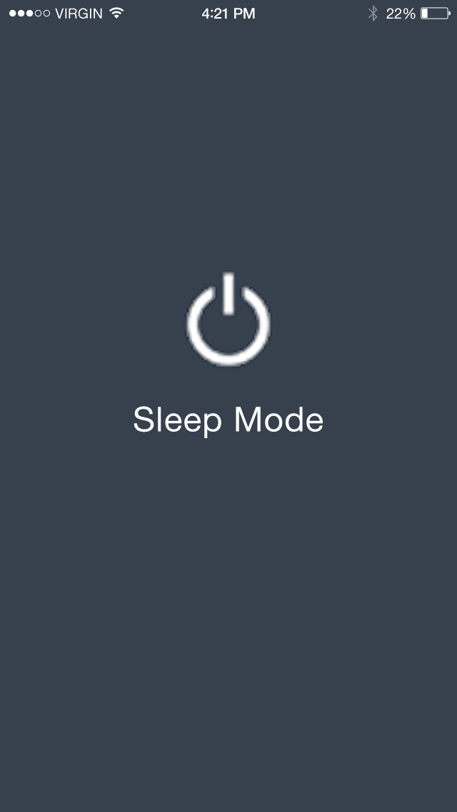
Results from HE
Evaluators found bug in flow of prototype
We found the bug and fixed it.
Sleep button should be moved to settings.
We considered this but decided sleep function is too important.
Evaluators confused by task removal
Task removal has singular function
Task list should have more functionality
We will improve this functionality as prototype progresses
The sleep function should have a timer so user’s don’t forget it’s on
We added a timer function to the sleep mode screen

Slide 6
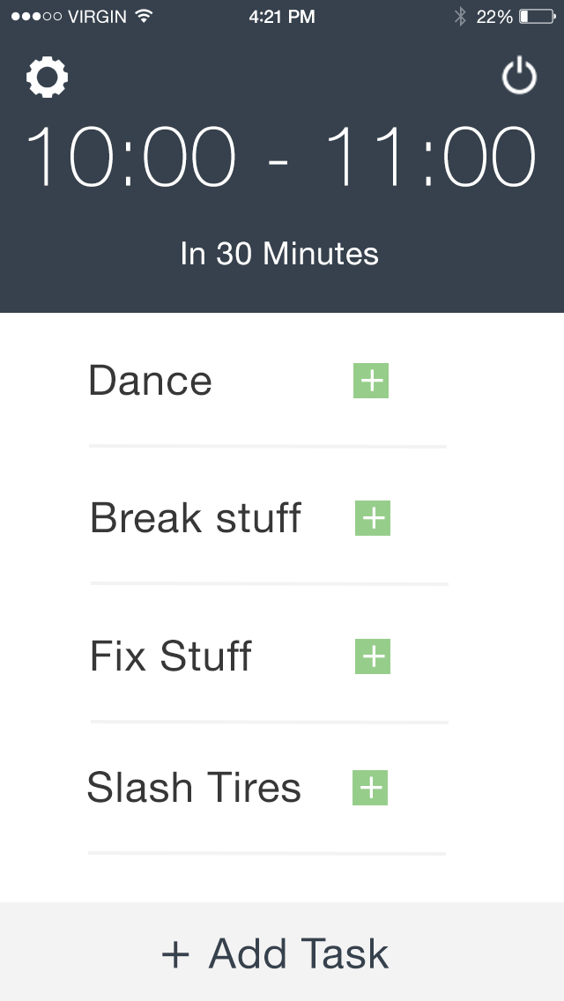
Results from HE (cont.)
User should be able to view all current goals
Eventually, user will be able to scroll through all tasks that fit time period
User should be able to pick free time slots
Eventually, time slots will be determined based on existing calendars
App not compatible with screen readers/assistive technology
Eventually, metadata will be added to all icons/images to accommodate
After adding task, does not show up
Eventually, this functionality will be improved

Slide 7
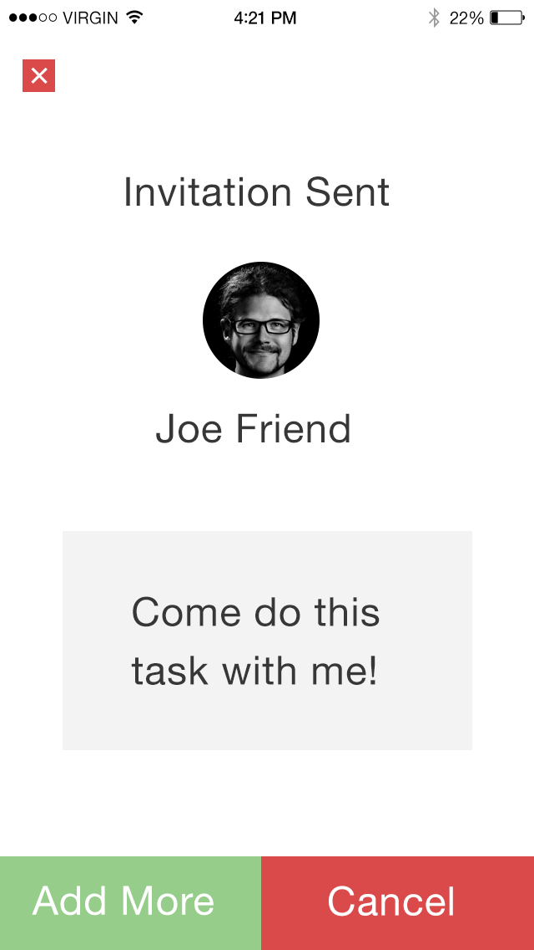
Results from HE (cont.)
Current method of choosing time for task may cause problems
Functionality not fully fleshed out yet
After adding friend to task, two cancel buttons appear
we removed the x button in top left corner
After adding friend to task, “add” button has unclear function
we clarified the text on this button

Slide 8
Our New Design
Users can choose how long the app will stay in sleep mode.

Slide 9
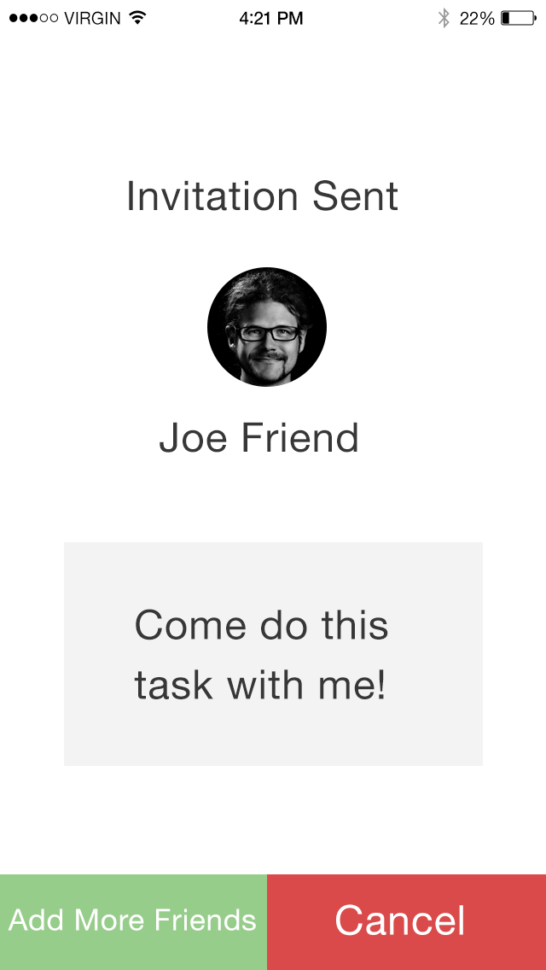
Our New Design (cont.)
On the “invitation sent” screen, the label on the “add button” is much more clear, and the x button in the top left corner has been removed

Slide 10
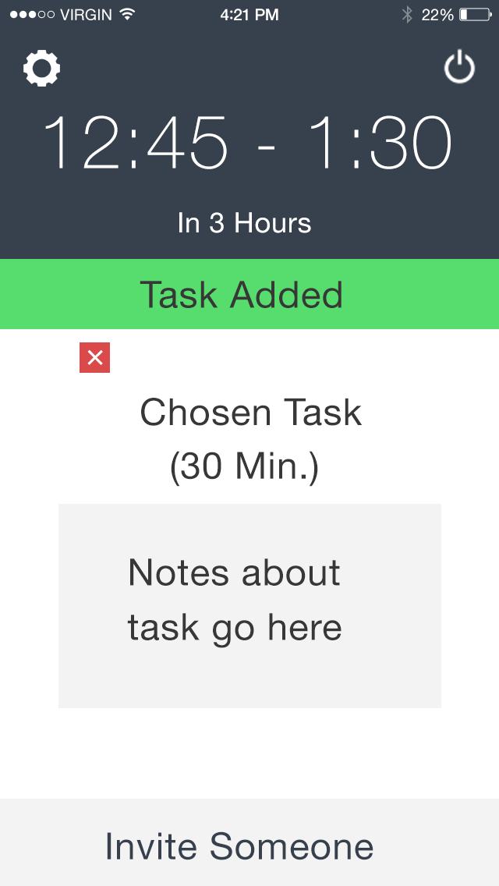
Our New Design (cont.)
When a task is added, a notification appears on the home screen to alert the user

Slide 11
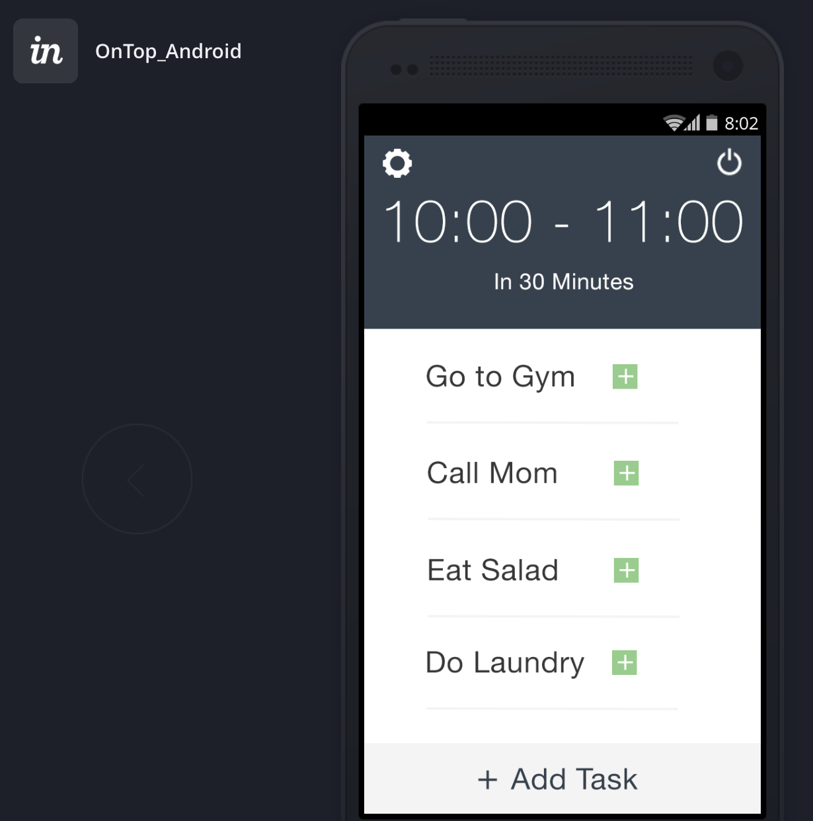
Our Progress
Current prototype developed with InVision

Slide 12
Our Progress (cont.)
Allows for fast implementation of design changes
But limited functionality

Slide 13
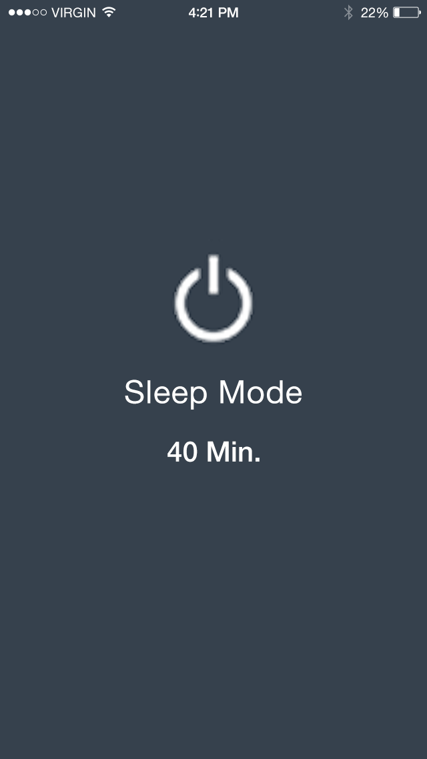
Our Progress (cont.)
Currently, all data is hardcoded

Slide 14
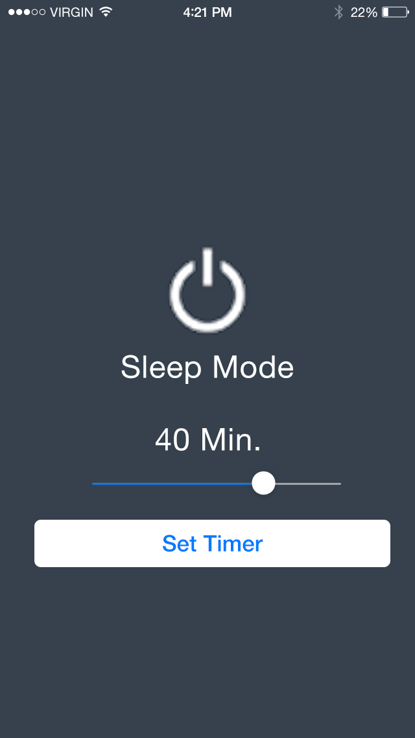
Our Progress(cont.)
Our plan: transition from InVision to iOS app

Slide 15
Our Progress (cont.)
Still deciding between straight Objective C or Javascript to Objective C

Slide 16
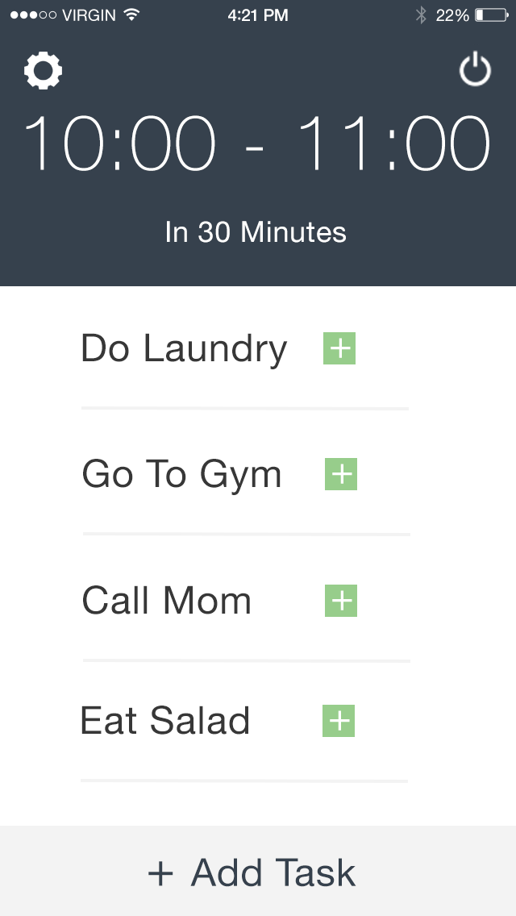
Demonstration
https://projects.invisionapp.com/share/PW1M2QTDF#/screens

