Slide 1
OnTop
Always on top

Slide 2
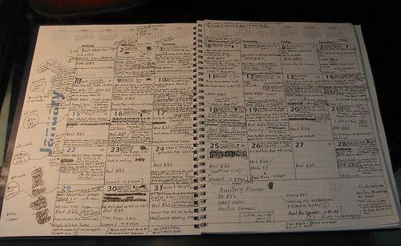
Fit more into your day :)

Slide 3
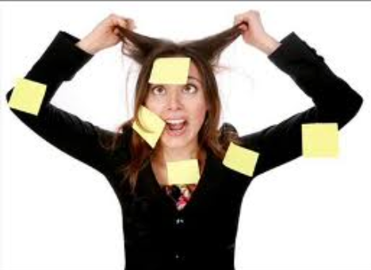
PROBLEM
I’m SO BUSY!! I don’t have time for anything :(

Slide 4
SOLUTION
Guess who’s OnTop of things?

Slide 5
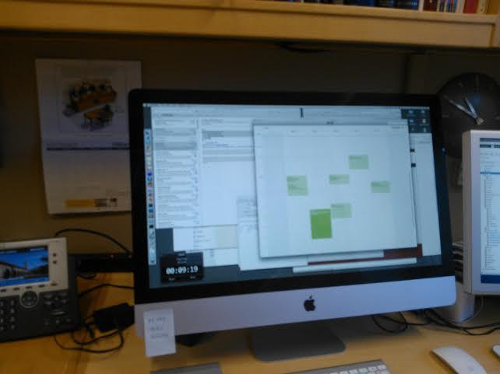
Contextual Inquiry: J.G.
Professor
Busy, non-student
Office Hours interview (in office)
Uses software/post-its to track time
Calendar for formal meetings
Personal events on post-its
Has hourly alarm for stretch/short walk
Updates calendar on-the-fly

Slide 6
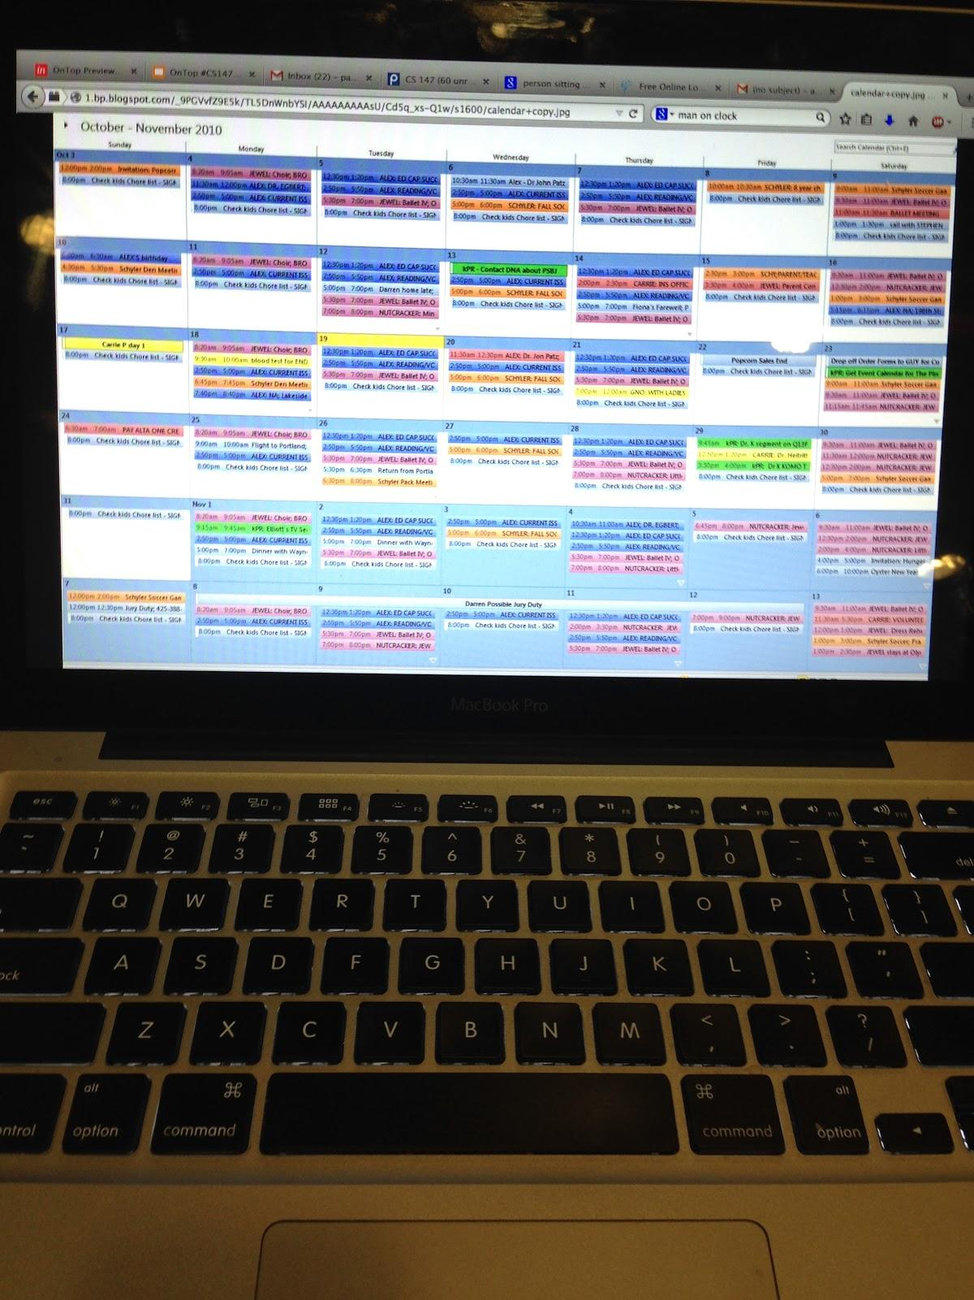
Contextual Inquiry: P.I.
Research Assistant/Coterm , House staff
Interview at residence
Heavily dependent on google calendar (including for micro tasks)
Updates calendar in real time
Dissatisfied with other apps
Inadequate time for exercise,
sleep and social life

Slide 7
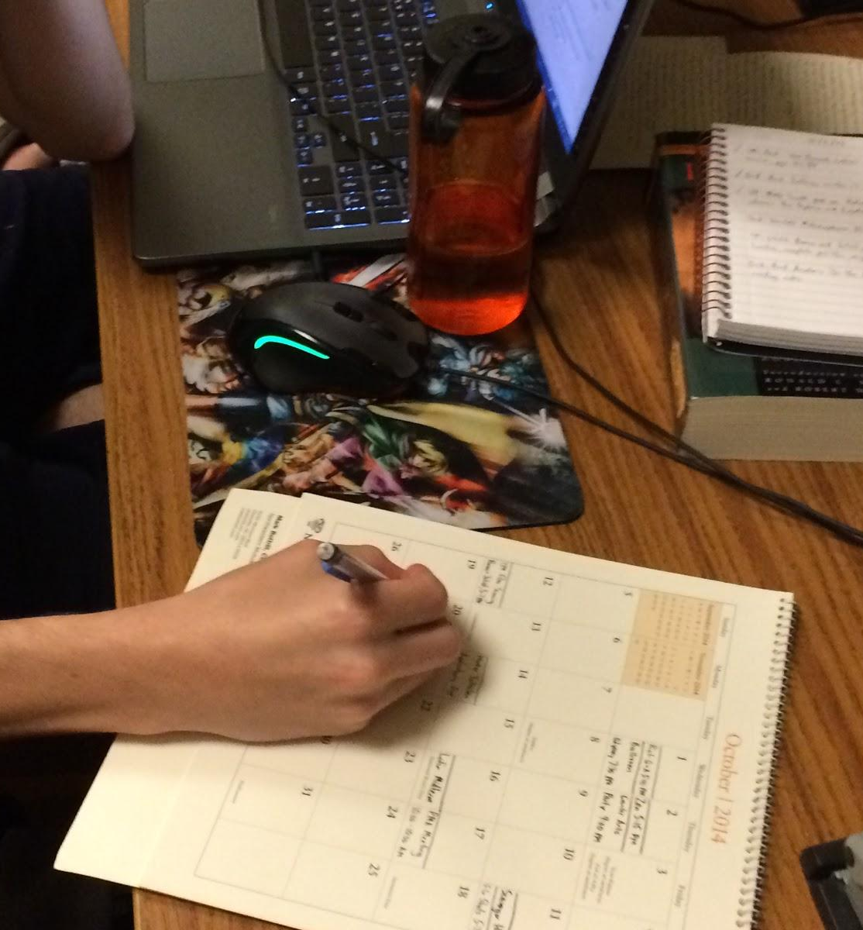
Contextual Inquiry: D.F.
Student in dorm, recruited via email
has busy schedule, minimal time for smaller activities
Uses wall mount calendar for larger events, a smaller weekly calendar for smaller events
Inserts calendar events from desk only (not mobile)
Feels he has inadequate time for exercise, reading

Slide 8
Task Analysis
Efficiency
Needed for on-the-fly event creation
Less data entry
Parse info, put in calendar
Fewer clicks
Should be intuitive
Easy to learn

Slide 9
Task Analysis (cont.)
Intelligence
Figures out sleep-cycle/routines
Remind before leaving home: e.g. “bring library book!”
Learning to handle emergencies/stop-time
Extending a “Do-not-disturb” period
Learning routines from everyday schedule

Slide 10
Task Analysis (cont.)
Location Services
Location access OK!
But only prompt with desired preset tasks
E.g. if “gym” is not in desired tasks, don’t nag user

Slide 11
Task 1: Make/Track/Remind Tasks
Simple front-end input, powerful back-end
Generalized: “Improve my health!”
Custom task creation -> quick access
Location/context-based reminders

Slide 12
Task 2: Allow flexibility in user’s plan
Adapts to everyday schedule changes
Notices if you’re wasting time, prompts with task
In case of unforeseen circumstances, an option to keep task in a ‘sanebox’ is handy
Allows user to re-add undone tasks from the ‘sanebox’.

Slide 13
Task 3: Find Emergency Free Time
“Life happened”: an end to the madness
Turn off tasks for a set period
“Crunch time”: find all pockets of free time.
For emergencies: impending deadline
Could be priority-based

Slide 14
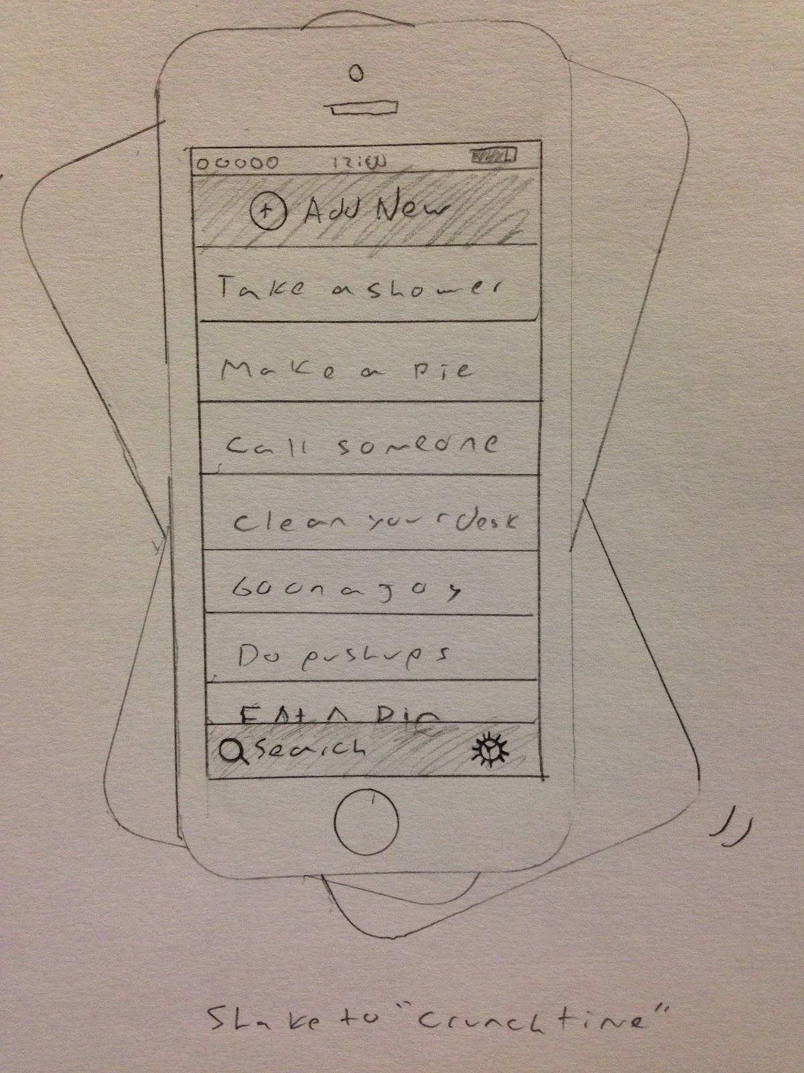
App Idea 1: Cloud-integrated calendar
Integrates everything from all calendars
All data stored/synced online
Shared on phone

Slide 15
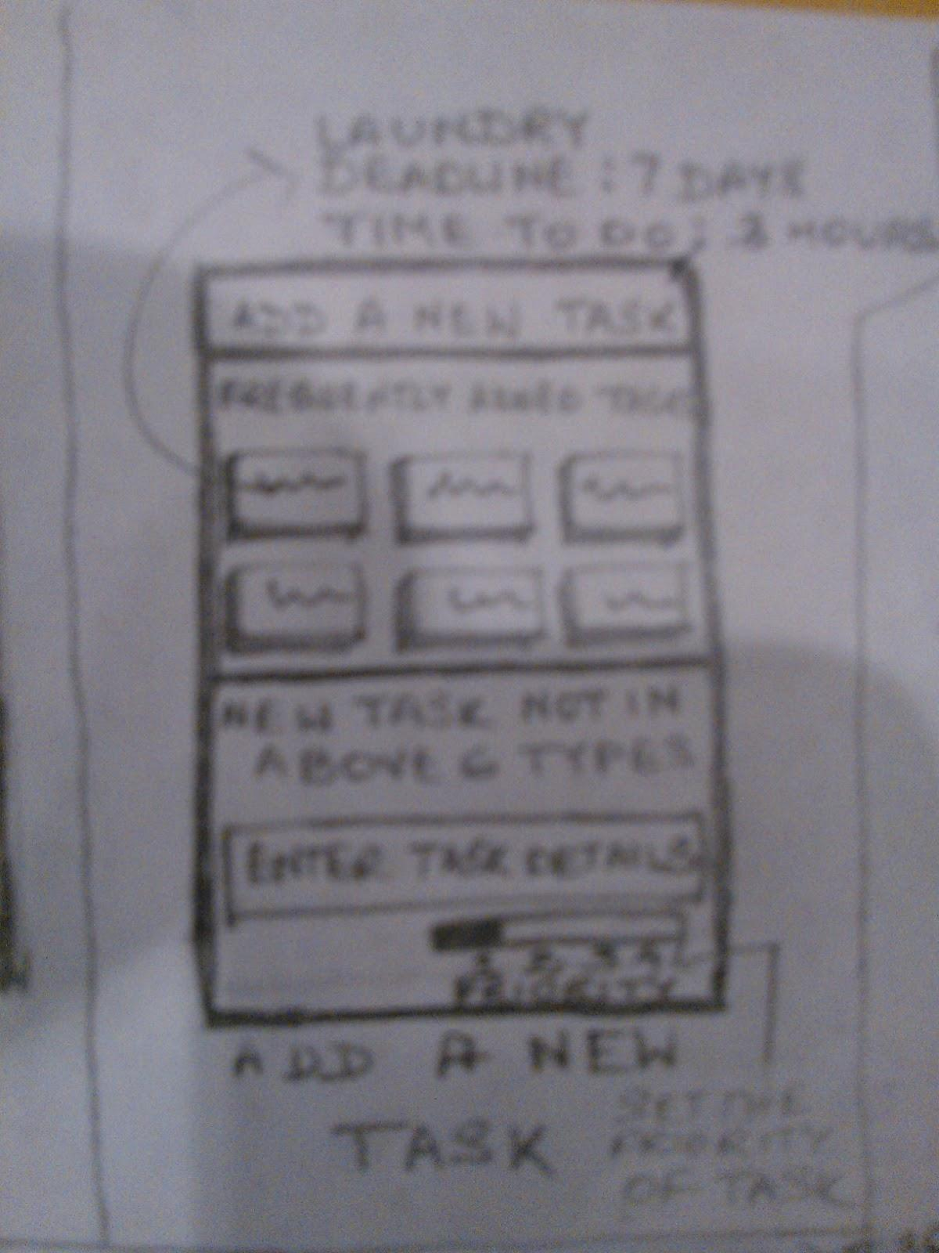
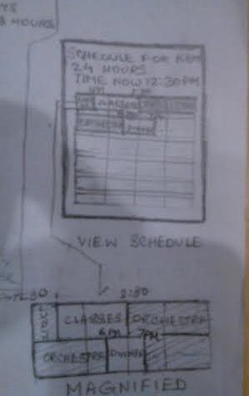
Application Idea #2: Home Calendar
Wall-projected calendar
User can make changes with gestures/stylus/etc.
No app to open!

Slide 16
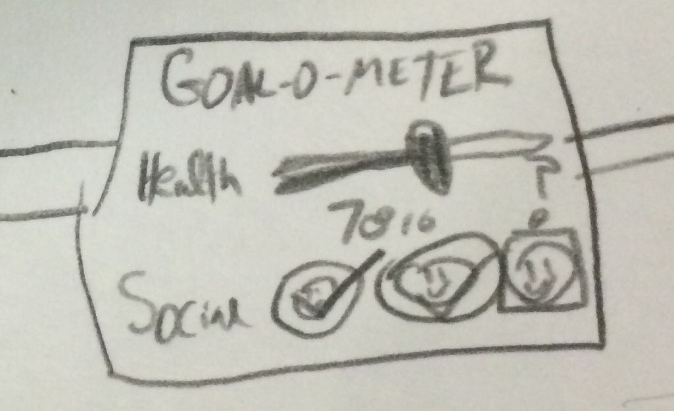
App Idea 3: Wearables
Vibration notifications
Many more contextual clues
User has simple entry methods

Slide 17
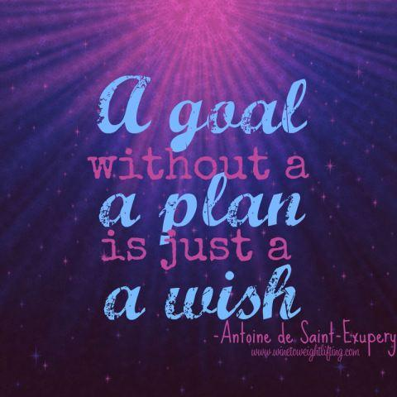
Summary
Mission Statement:
Productivity.
Done better.

