Slide 1
Making diabetes management fun and easy for kids
Henry Tran, Janette Cheng, Harshitha Ramesh

Slide 2
Introduction to
Problem and Solution
Managing diabetes scary and daunting for children
Self-administering insulin shots, pricking and testing blood, visiting the doctor
Current Personal Diabetes Managers not very user-friendly, let alone kid friendly
Notes:
15 sec

Slide 3
Introduction to
Problem and Solution
Our hypothesis: Minimized fears = relaxed and better able to manage diabetes
A way to do minimize fears by gamifying
kid-friendly interface
integrates reminders, metrics, educational games, and positive reinforcement
Notes:
30 sec

Slide 4
Overview of Talk
Heuristic Evaluation Results
Overview of Revised Design
Prototype state
Notes:
45 sec
Prototype state: What we’ve done, haven’t done, and what data is baked into the app

Slide 5
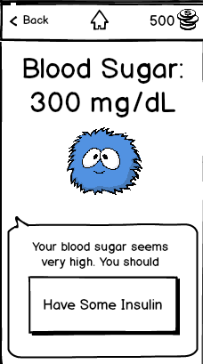
Heuristic Evaluation Results
[H2-2. Match between system and the real world] [Severity 3]
Meaning of "current blood sugar"
How long ago was the reading?
[H2-6. Recognition rather than recall] [Severity 3]
Not intuitive to look for trends under “Check Blood Sugar”
[H2-1. Visibility of system status] [Severity 4]
Having “high blood sugar” more visible
Notes:
1:30

Slide 6
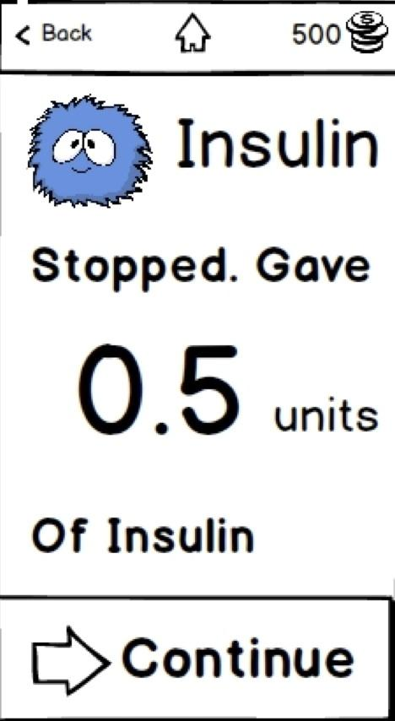
Heuristic Evaluation Results
[H2-1. Visibility of system status] [Severity 3]
Understanding trends and visualizations
[H2-4. Consistency and standards] [3]
Connection between manual and picture carb count unclear
[H2-9. Help users recognize, diagnose, and recover from errors] [4]
No way to continue bolus after you hit “Stop”
Continue brings you back to home
Notes:
2:30

Slide 7
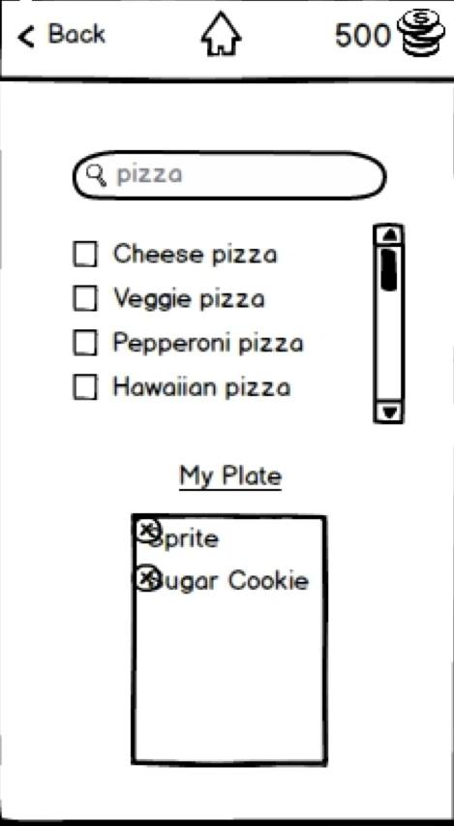
Heuristic Evaluation Results
[H2-1. Visibility of system status] [Severity 4]
Misunderstood limitations of InVision
[H2-7. Flexibility and efficiency of use.] [3]
Carb counter should store previous meals of user
[H2-10. Help and documentation.] [2]
Purpose of the Buddy is unclear
[H2-7. Flexibility/efficiency of use]
Evaluators didn’t know the background knowledge behind insulin units
Notes:
3:30

Slide 8
Overview of Revised Design
Added color! Go for kid-friendly design, but will play around with this.
Lots of wording:
Fixed “current” blood sugar wording & time since CGM check
Trends button under general “Blood Sugar” label now
Made high blood sugar message orange, bold, and visible
Standardized manual entry text to “I’ll change it”
Users can edit their food settings after exercise settings in insulin view
Notes:
4:30

Slide 9
Overview of Revised Design
Allow users to continue insulin dose after stopping it
Have more visual indicators of good or bad values for blood sugar (check)
Instructions for how to use the blood sugar testing
Remember what users entered recently in manual carb counter
Notes:
5:30

Slide 10
Prototype Implementation Status
Tools Used:
Art: Photoshop
App: XCode
Notes:
5:45

Slide 11
Implemented Features
Essential Blood Sugar Task complete
Automatic picture portion of carb counter complete
Insulin process flow complete
Navigation bar for all screens that need one
Notes:
6:30

Slide 12
Unimplemented Features
Still have to make trends work
Still have to make trends understandable
Still have to add in manual entry modes into prototype
Still need to implement “Buddy Central” and a preview of the games possible
Make the purpose of the buddy more clear
Notes:
7:30

Slide 13
WofOz / Hard-Coded Data
Insulin numbers are currently hard-coded
If time permits, then flexible numbers/formula
Carb counter manual input will be hardcoded values instead of full database
Automatic carb counting ala “MealSnap” assumed to work
Blood sugar data will be hard-coded since we can’t get hardware
Notes:
8:30

Slide 14
Demonstration of Prototype
On XCode

