Slide 1


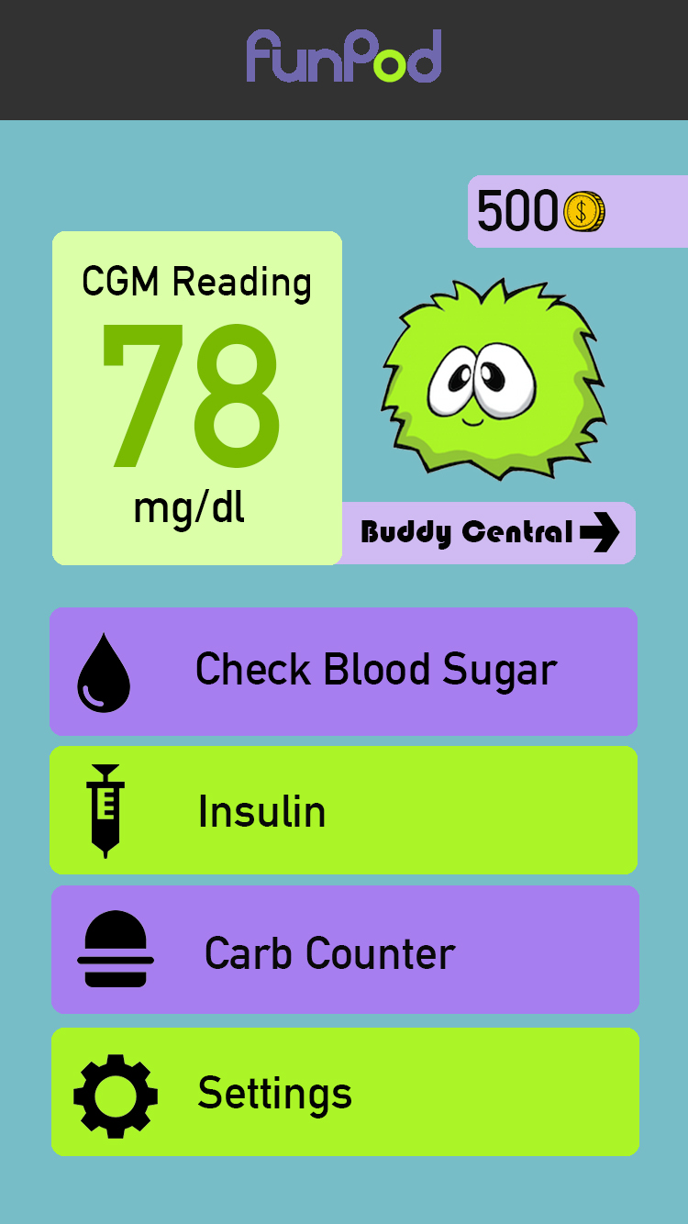
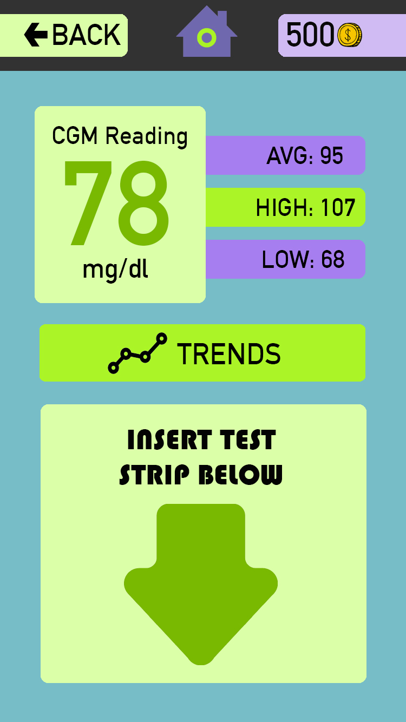
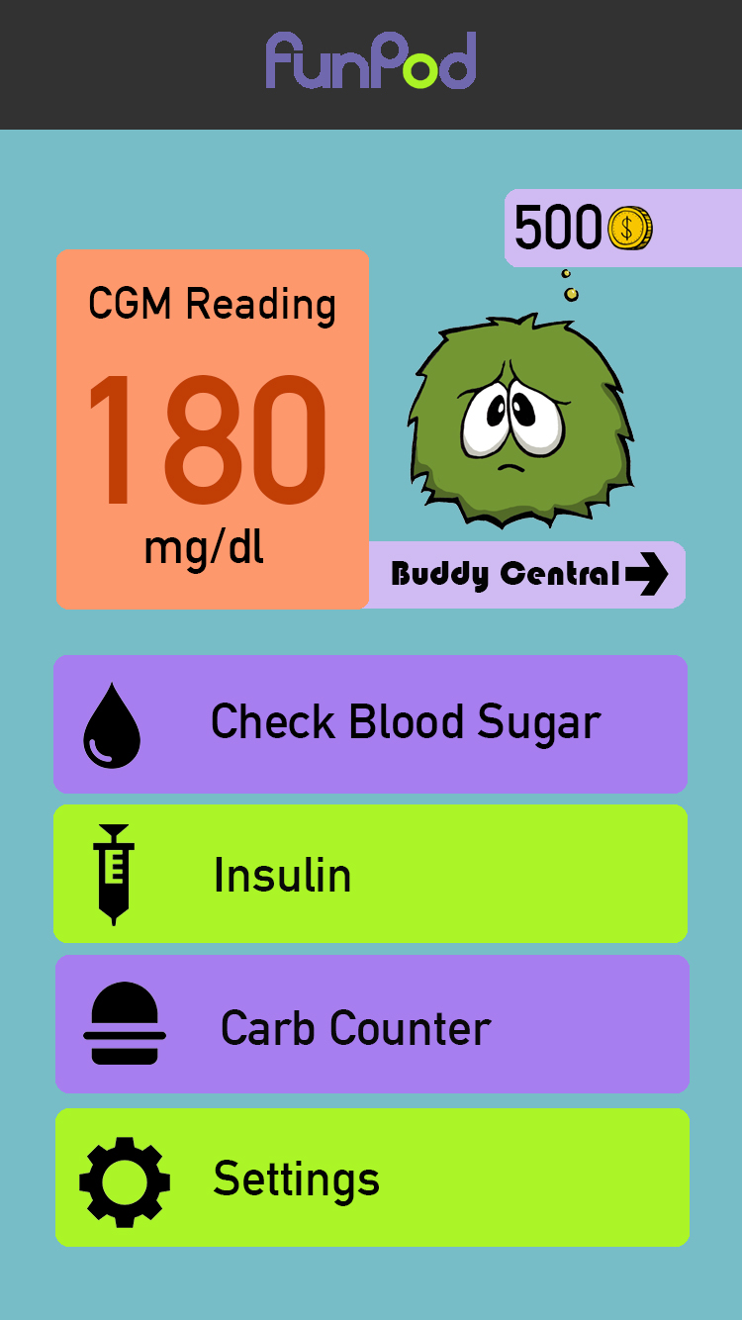
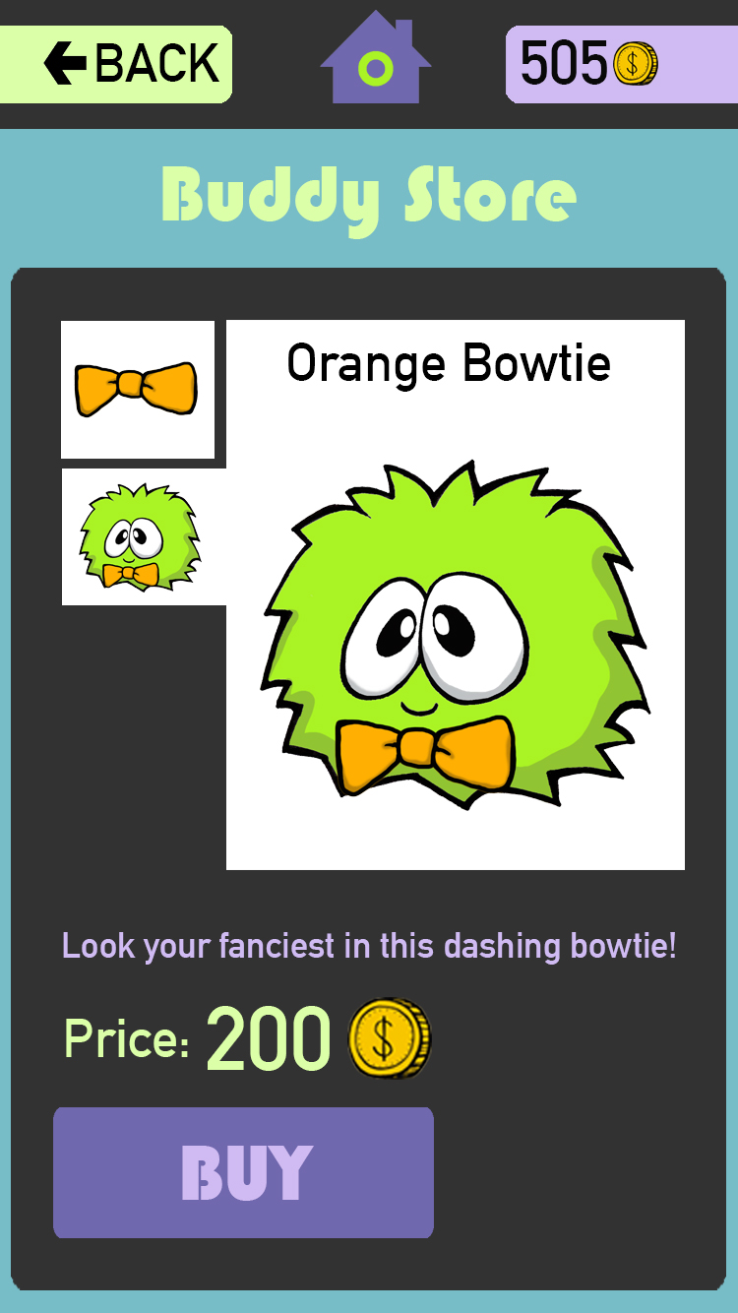
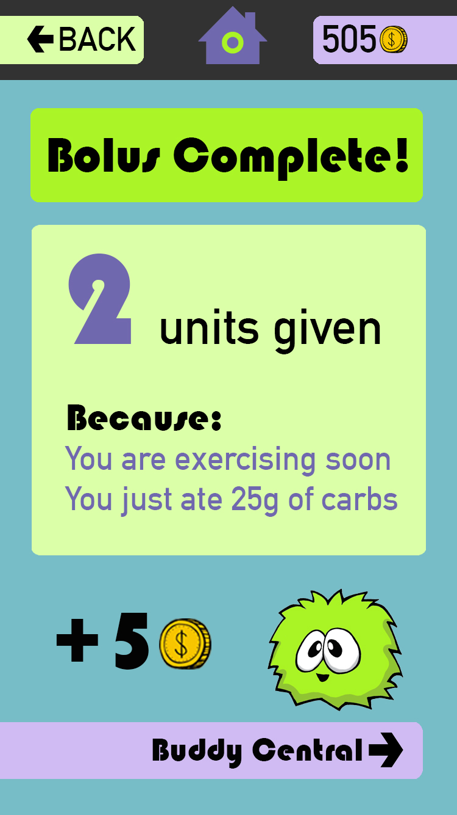
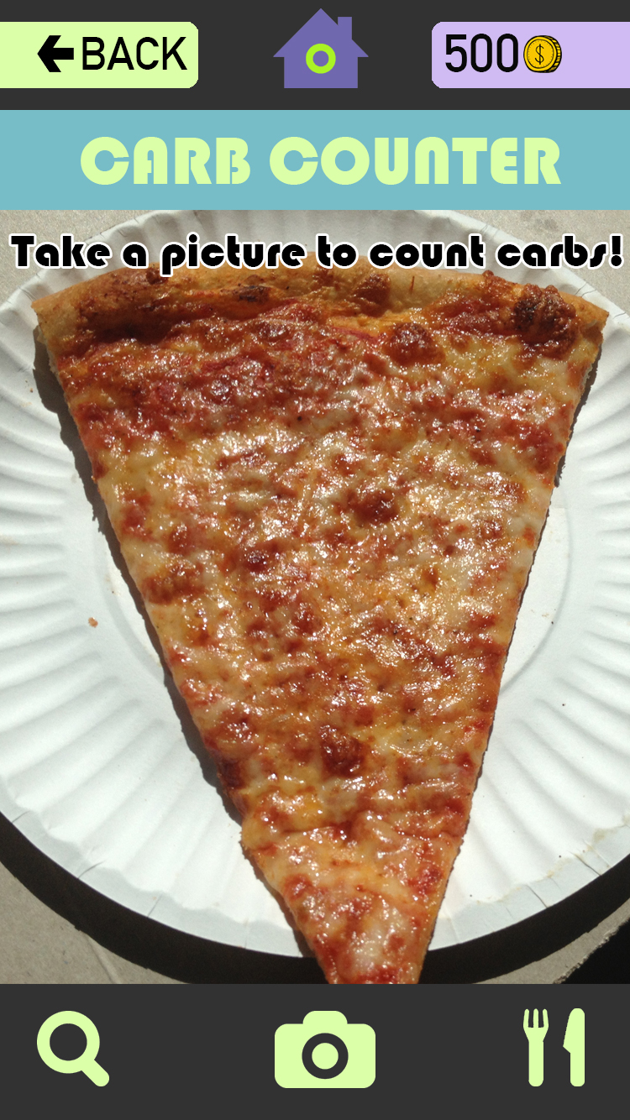
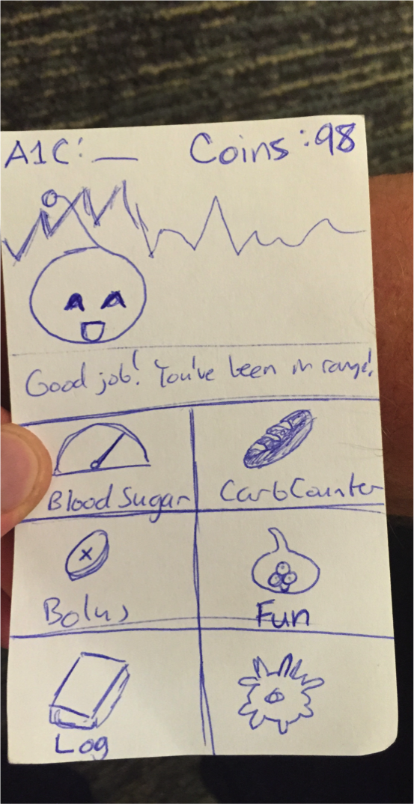
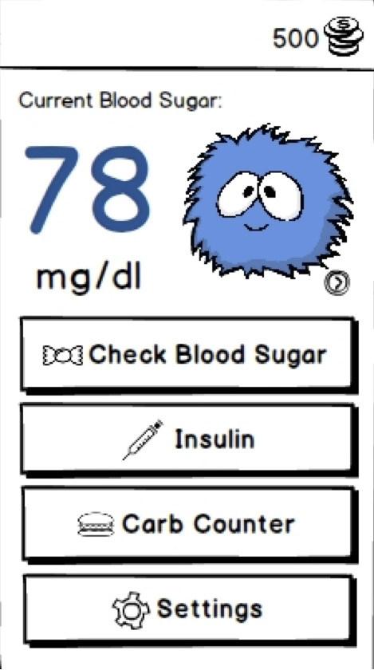
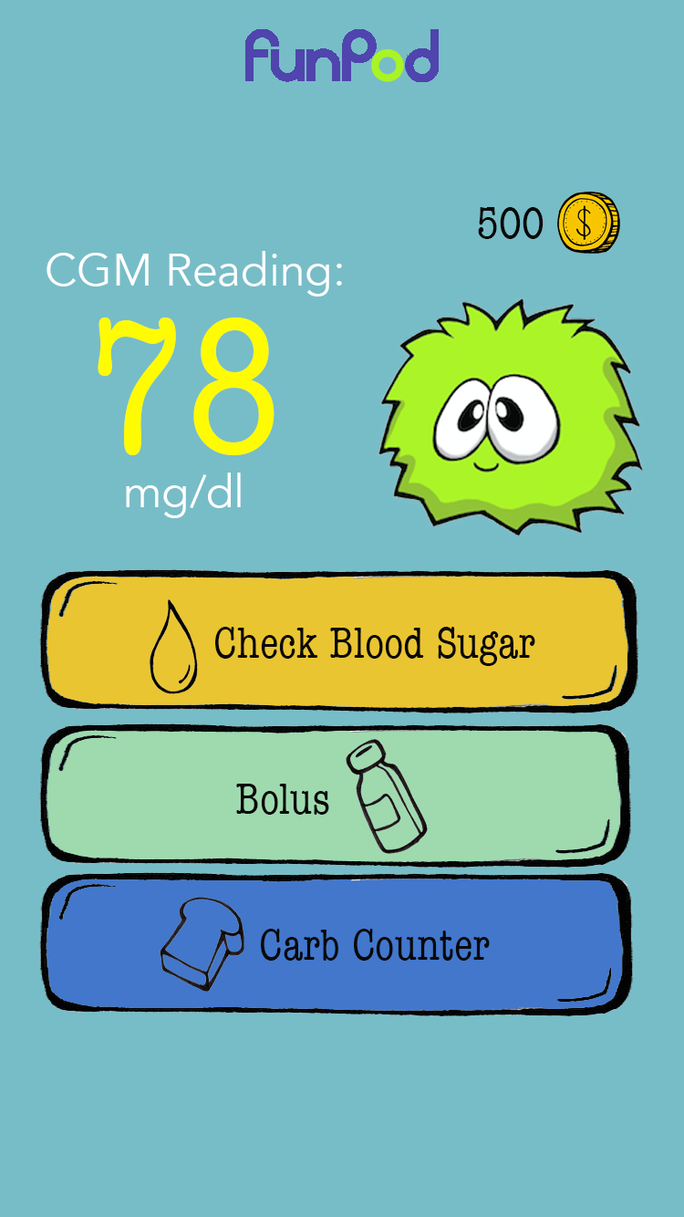
Making diabetes management fun and easy for kids
Overview
Managing type 1 diabetes can be daunting and stressful for children. Diabetics of all ages have to prick themselves to test blood glucose levels, self-administer insulin via injections or insulin pumps, and visit their doctors often to monitor progress.
Main screen with
in-range blood sugar
Checking blood sugar
Main screen with
out-of-range blood sugar
Our Solution
Earn coins as positive reinforcement
Streamline frequent tasks
  Checking blood sugar
  Counting carbs
  Giving insulin
Take care of your buddy by taking care of yourself!
Buddy Store
Final bolus screen
Photo carb counter
Design Iteration
Paper
Found biggest interaction issues through preliminary testing
Med-Fi
Made big UI changes to increase functionality and ease of use
Hi-Fi #1/2
Took suggestions from heuristic evaluation and polished up visual elements
Paper
Med-Fi
Hi-Fi #1
Hi-Fi #2
Harshitha Ramesh . Henry Tran . Janette Cheng
http://stanford.edu/class/cs147/projects/motivation/jollypod/
CS 147
Autumn 2014

