Slide 1
JollyPod
Harshitha Ramesh, Henry Tran, and Janette Cheng

Slide 2
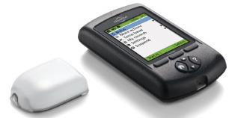
Overview
“Helping children manage their diabetes in a fun and engaging way”
-Focus is towards improving the experience of kids aged 8-15 with Type 1 Diabetes
-Redesigning current technology like the OmniPod

Slide 3
Problems and Solutions
Problems
–Managing Diabetes can be scary and daunting
–Many things to keep track of at any given time--stress
–Current interfaces are not particularly user friendly, let alone kid friendly
Solutions
–Use positive reinforcement and rewards
–Education for better management and necessary skills
–An intuitive interface that makes monitoring your blood sugar easier

Slide 4
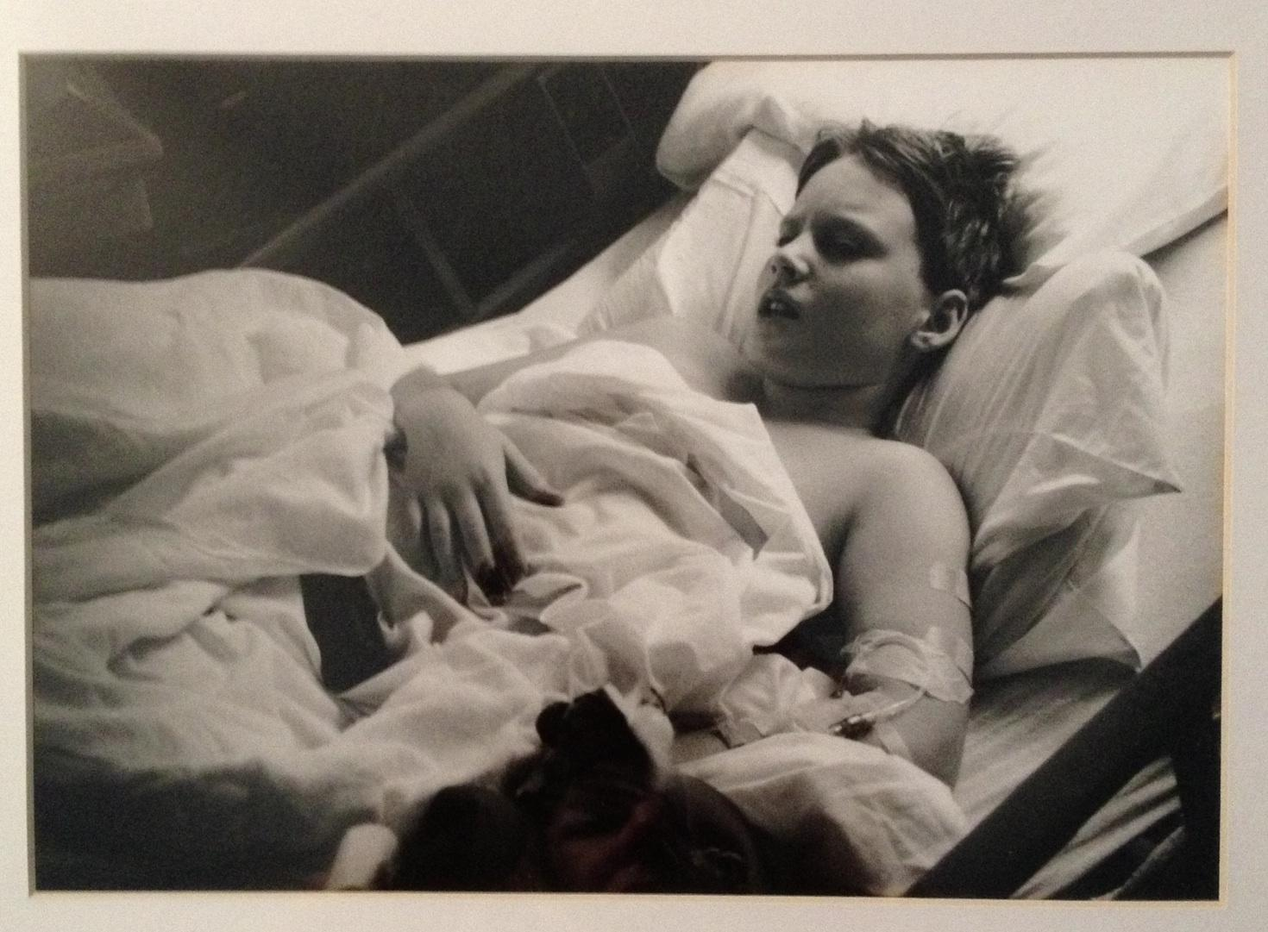
Contextual Inquiry
Participant 1: Mother of a Stanford Student with Type 1 Diabetes
Homemaker
No immediate family with Type 1 Diabetes
Worried that daughter may also be susceptible→ gets her tested
Helps make decisions about diabetes care
“A Mother’s Glimpse of Hell” by R.H.

Slide 5
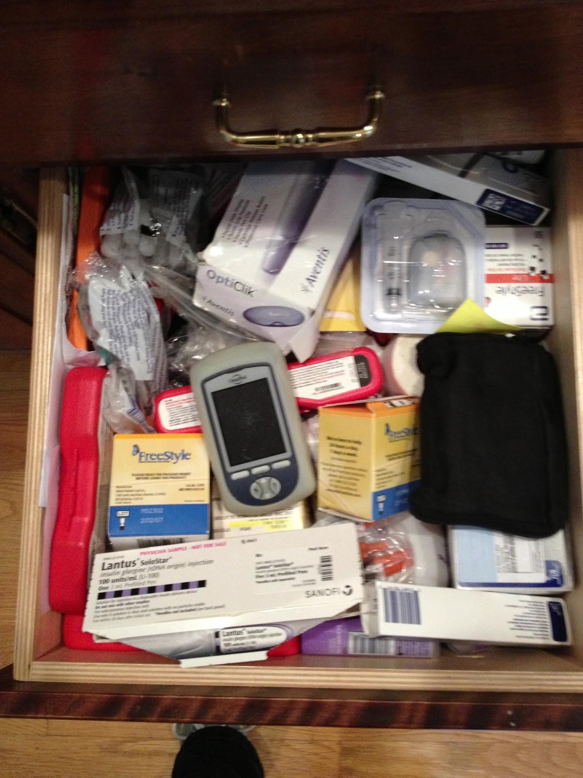
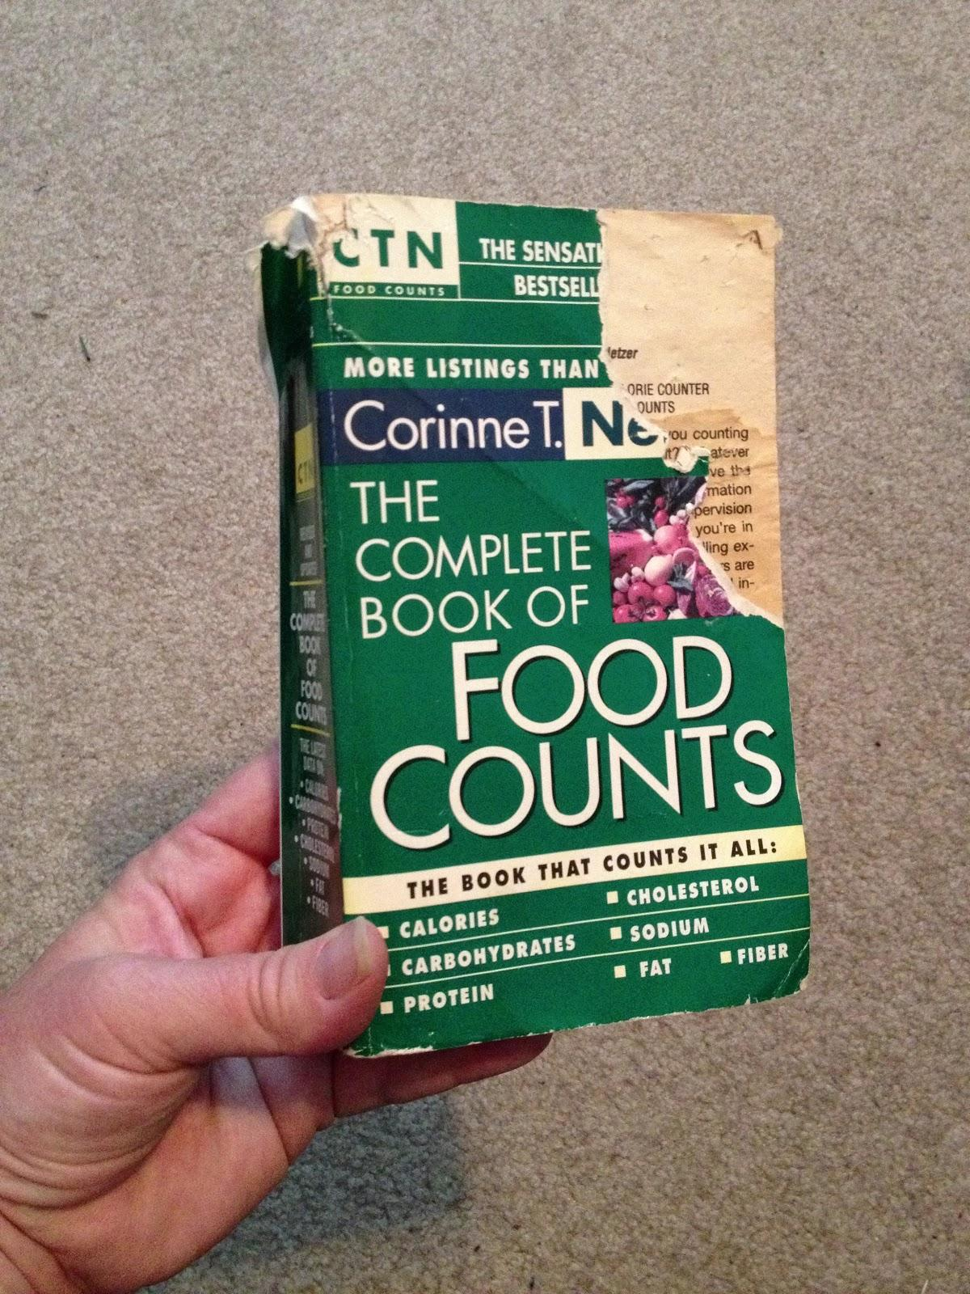
Contextual Inquiry
← Supply drawer with PDM, insulin pump, glucose test strips
← Book to help count carbs

Slide 6
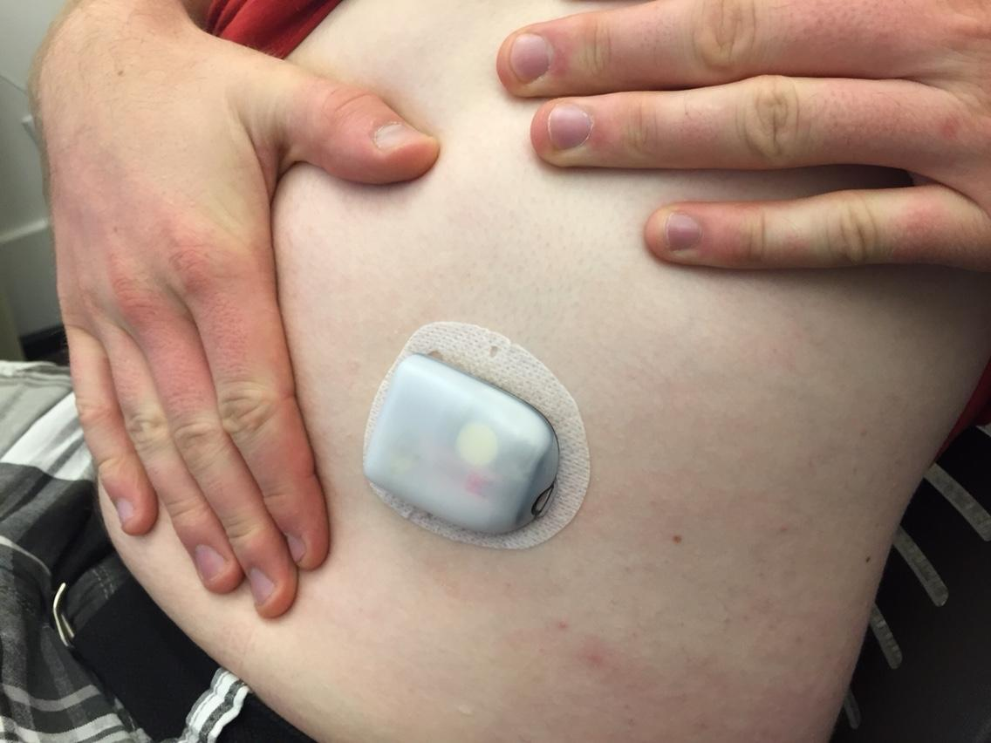
Contextual Inquiry
Participant 2: Son of the previous participant, Stanford senior with Type 1 Diabetes
Was diagnosed when he was 12
Uses a wireless pumping system and must test his blood sugar periodically

Slide 7
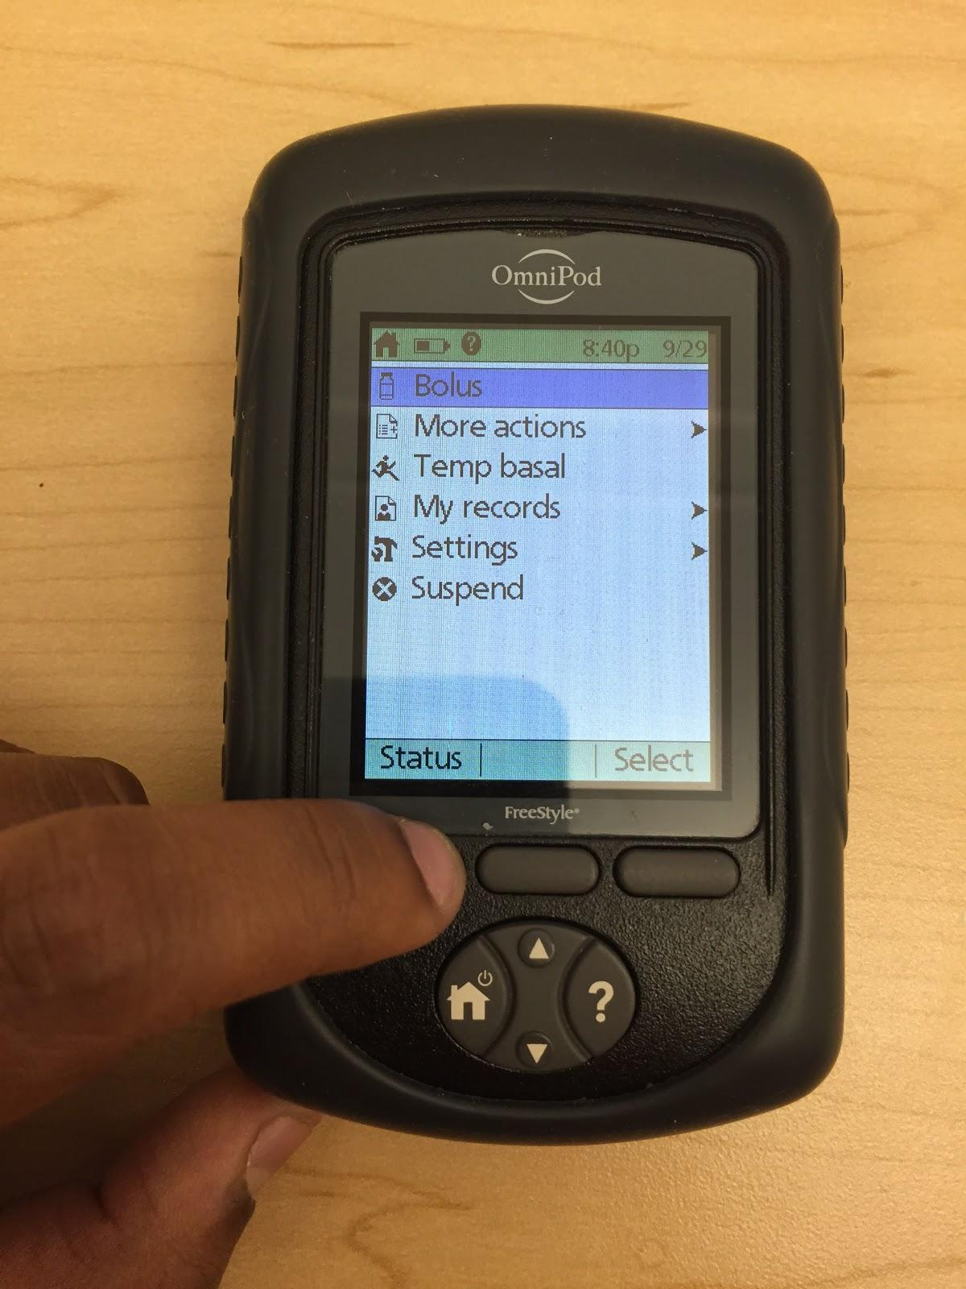
Contextual Inquiry
Omnipod
Tests blood sugar
Has some short term records for blood glucose (bg) levels
Recommends/administers units of insulin based on blood sugar and when you eat

Slide 8
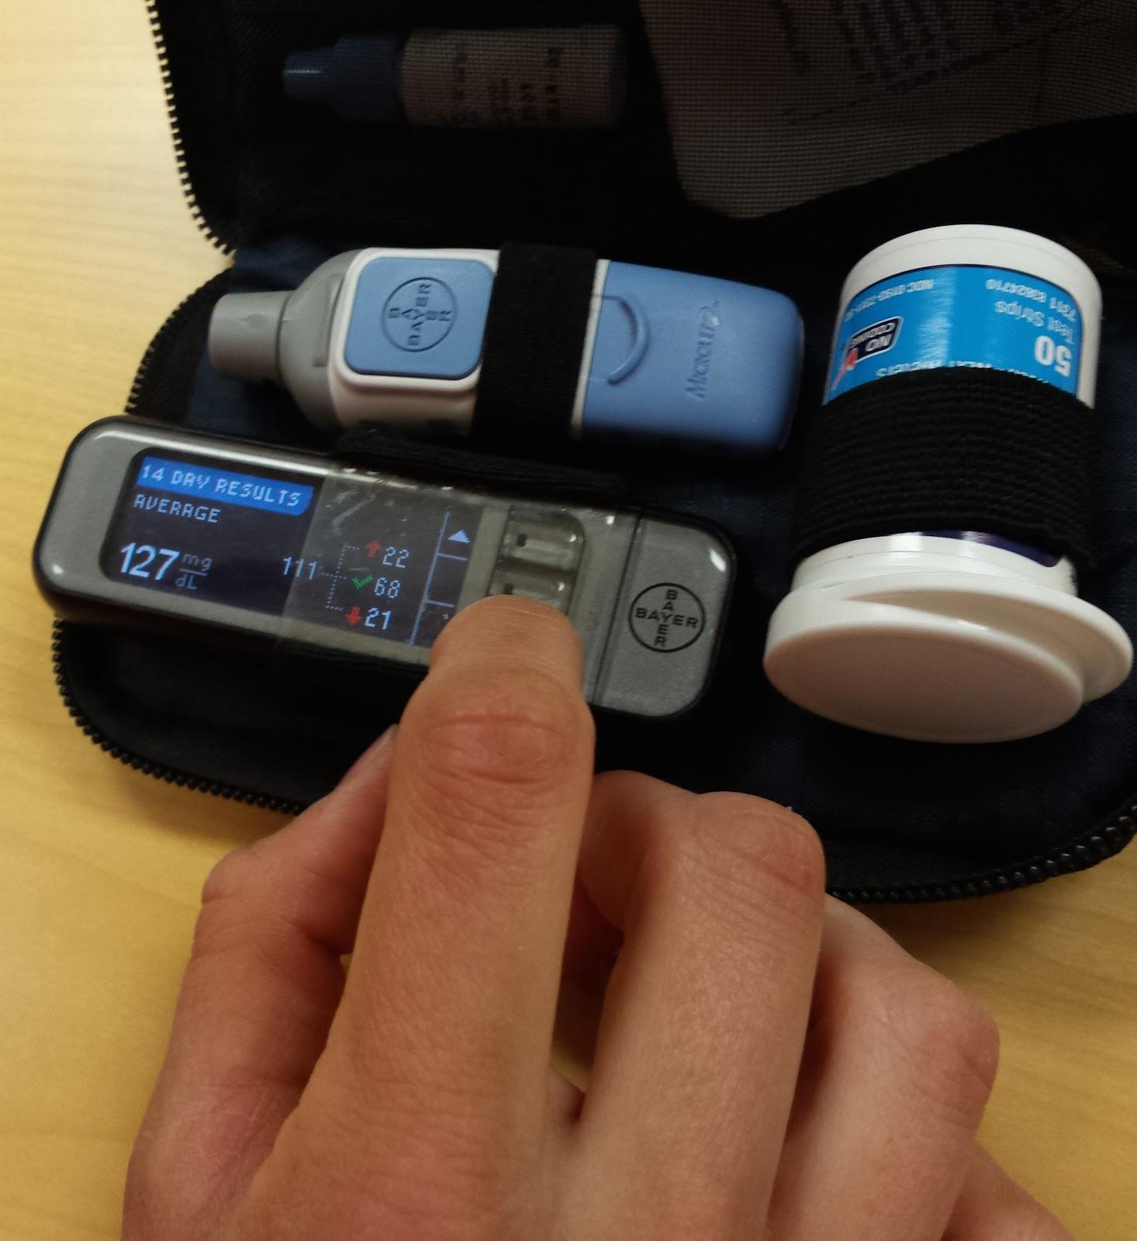
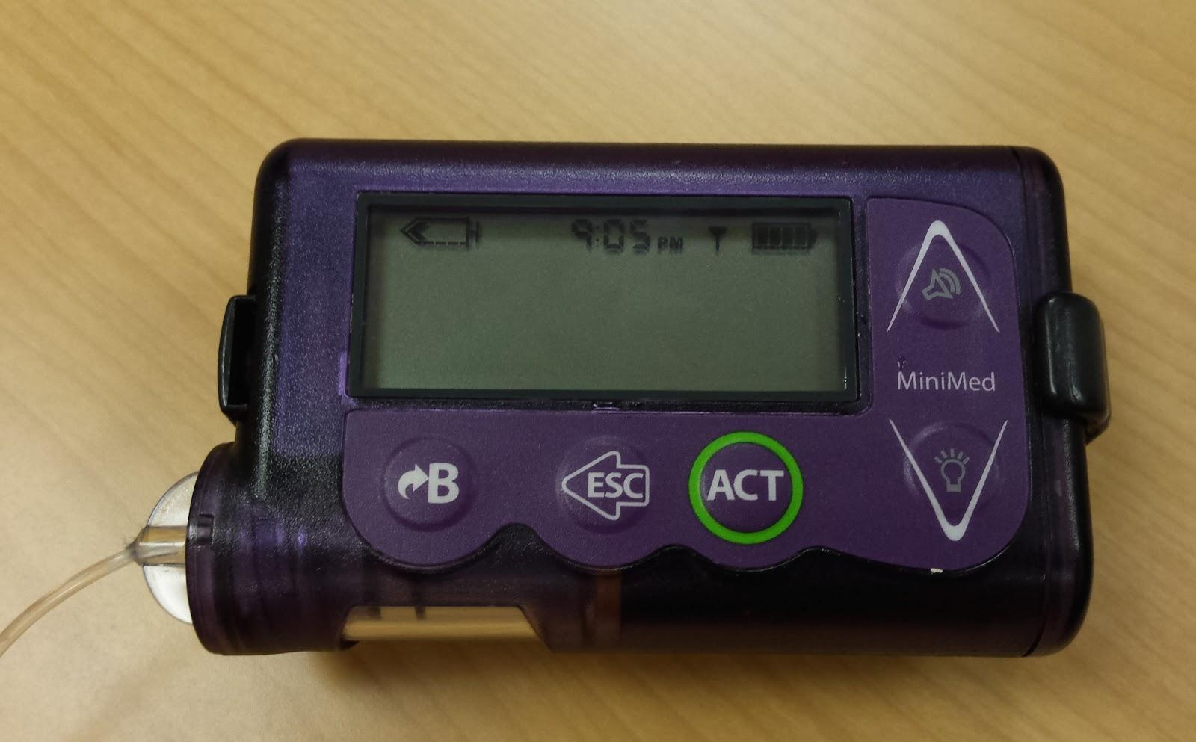
Contextual Inquiry
Participant 3: Junior at Stanford with Type 1 Diabetes
Female, diagnosed at 6
Uses a system that consists
continuous glucose monitoring device
blood sugar test kit
insulin pump

Slide 9
Contextual Inquiry

Slide 10
Task Analysis
1. Who is going to use the system?
Children who have recently been diagnosed with diabetes
2. What tasks do they now perform?
Checking blood sugar
Counting carbs
Administering insulin (with needles or pump)
Replace insulin
Strategically eat snacks
Keep track of supplies

Slide 11
Task Analysis
3. What tasks are desired?
Easy way to count carbs
Precise/fast way to keep track of blood sugar trends and administer insulin
4. How are the tasks learned?
Under guidance of doctor
Parents
Flashcards for counting carbs
Counting carbs with book

Slide 12
Task Analysis
5. Where are the tasks performed?
Everywhere (at meals, gym, school, work, home, etc)
6. What’s the relationship between customer & data?
Customer and doctor/parents must keep track of long term trends
7. What other tools does the customer have?
A way to deliver insulin (shots or wireless system)
A way to look up carbs either through search engine or book

Slide 13
Task Analysis
8. How do users communicate with each other?
In-person/online diabetic communities
Diabetes camps
9. How often are the tasks performed?
Testing blood sugar at least before each meal, after physical activity, anytime the patient feels ill
Bolusing for each meal or snack
Counting carbs for each meal or snack

Slide 14
Task Analysis
10. What are the time constraints on the tasks?
Must test for blood sugar before every meal and before sleeping
Must bolus for insulin immediately before/after eating
11. What happens when things go wrong?
Must be hospitalized if blood sugar is extremely low or high→ patient is unconscious
Glucagon pen to increase blood sugar when patient is suffering from low sugar
911 if unresponsive

Slide 15
Representative Tasks
Checking blood sugar (simple)
Fast (once you are used to it)
Needs to be done several times each day
Must eat snack or cut back on insulin when blood sugar is low
Must drink water and take more insulin when blood sugar is high

Slide 16
Representative Tasks
Counting carbs (moderate)
Needs to be done when eating/snacking
Requires practice
Can cause anxiety
Can be imprecise

Slide 17
Representative Tasks
Administering insulin/bolusing (complex)
What have you eaten?
What was your blood sugar previously?
What activities will you be doing later?
What amount of insulin do you need?

Slide 18
Application Ideas
Social Network
Give diabetics an opportunity to connect
Advice and tips
Sharing progress and victories
Diabetes memes
Notes:
diabetes camp

Slide 19
Application Ideas
2. Artificial Pancreas
Work with system that constantly monitors glucose levels and adjusts insulin doses
Graphical user interface
visually displays information collected
projection on arm?
Alerts when something needs to be adjusted

Slide 20
Application Ideas
Integrated Management System
Educational/motivational games
Teach you the skills you need to manage diabetes (ex: when to check bg, carb counting)
Positive reinforcement→ rewards for good blood sugar levels
Notes:
Avatar

Slide 21
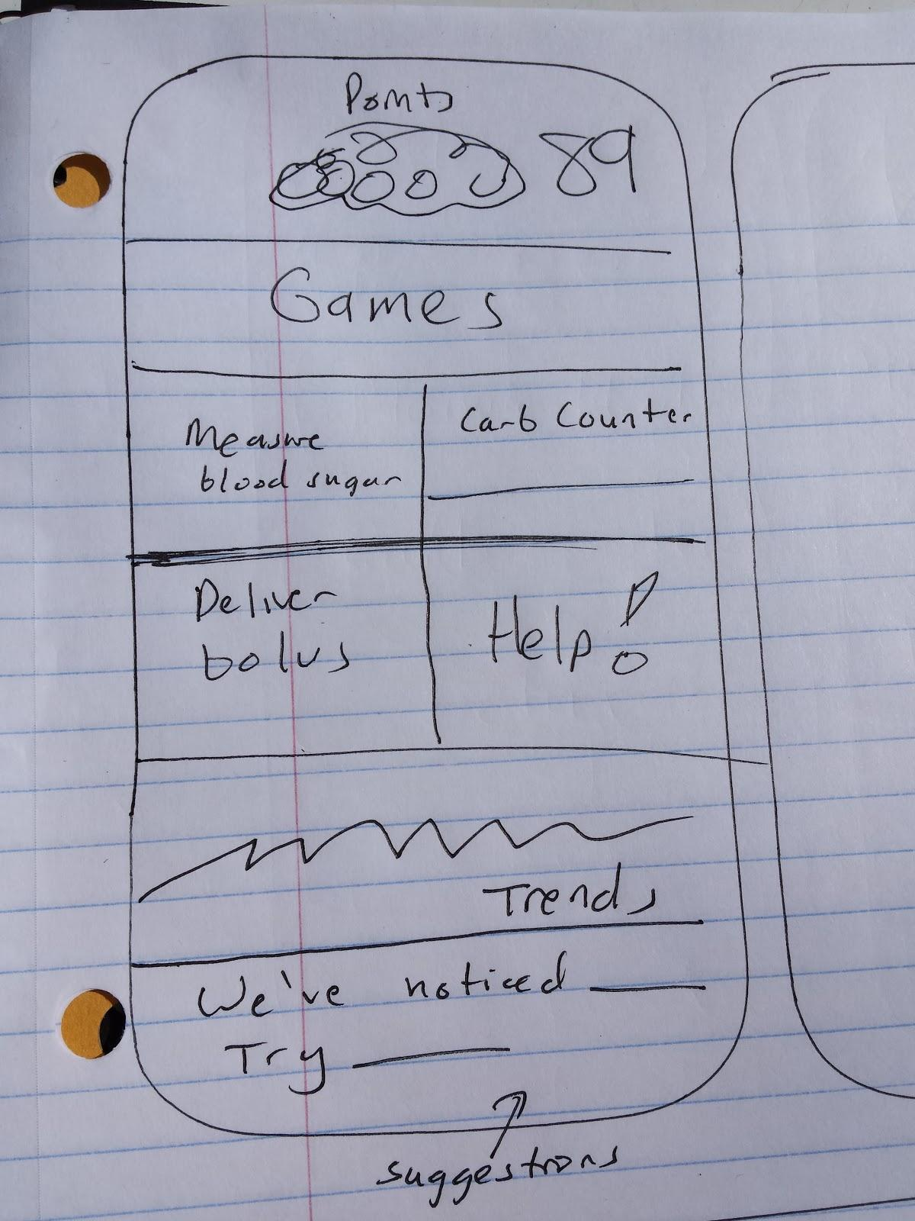
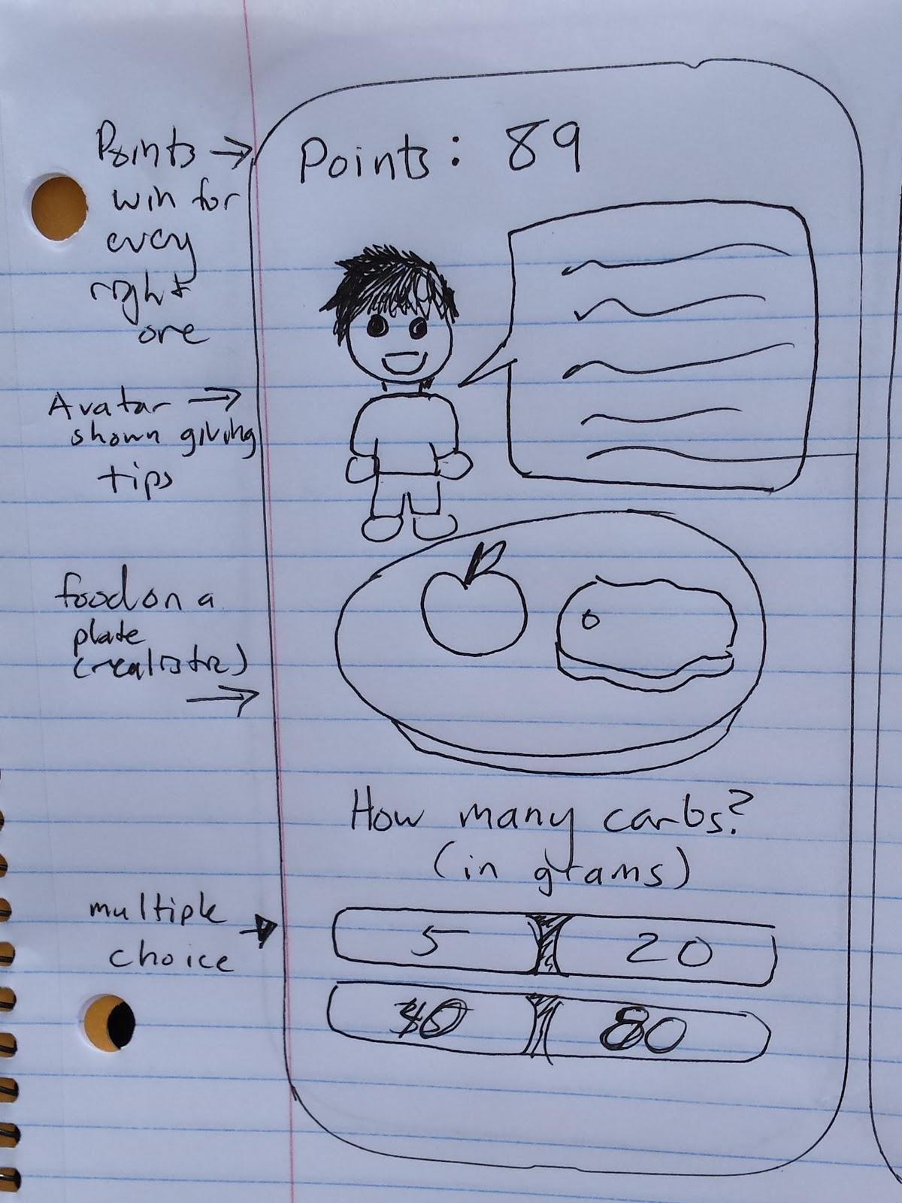
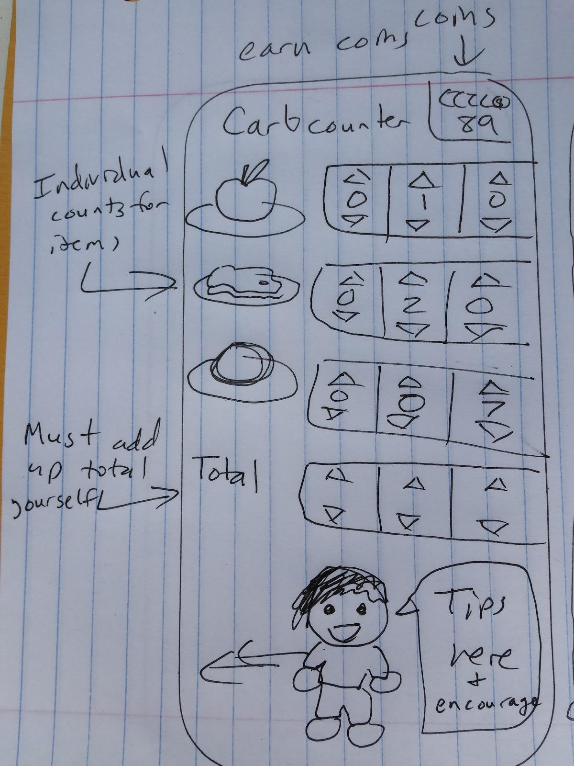
UI Sketches

Slide 22
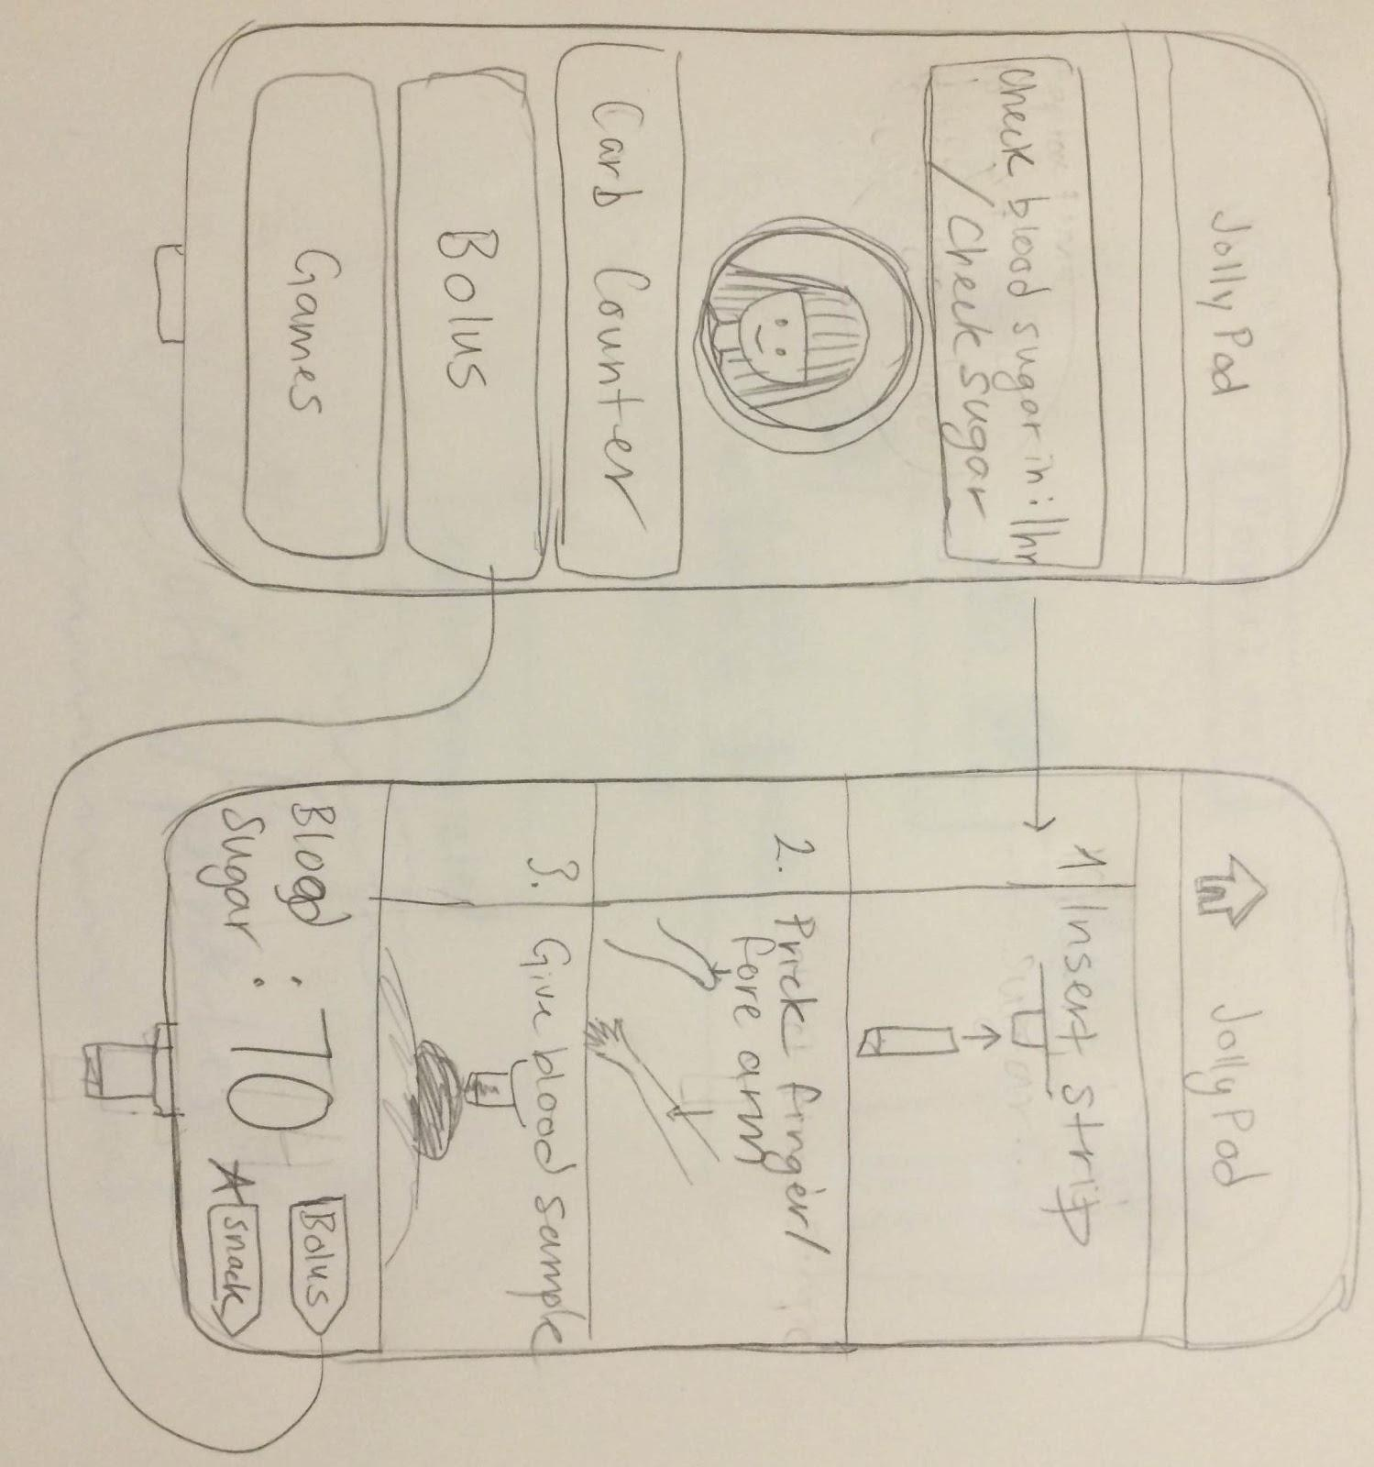
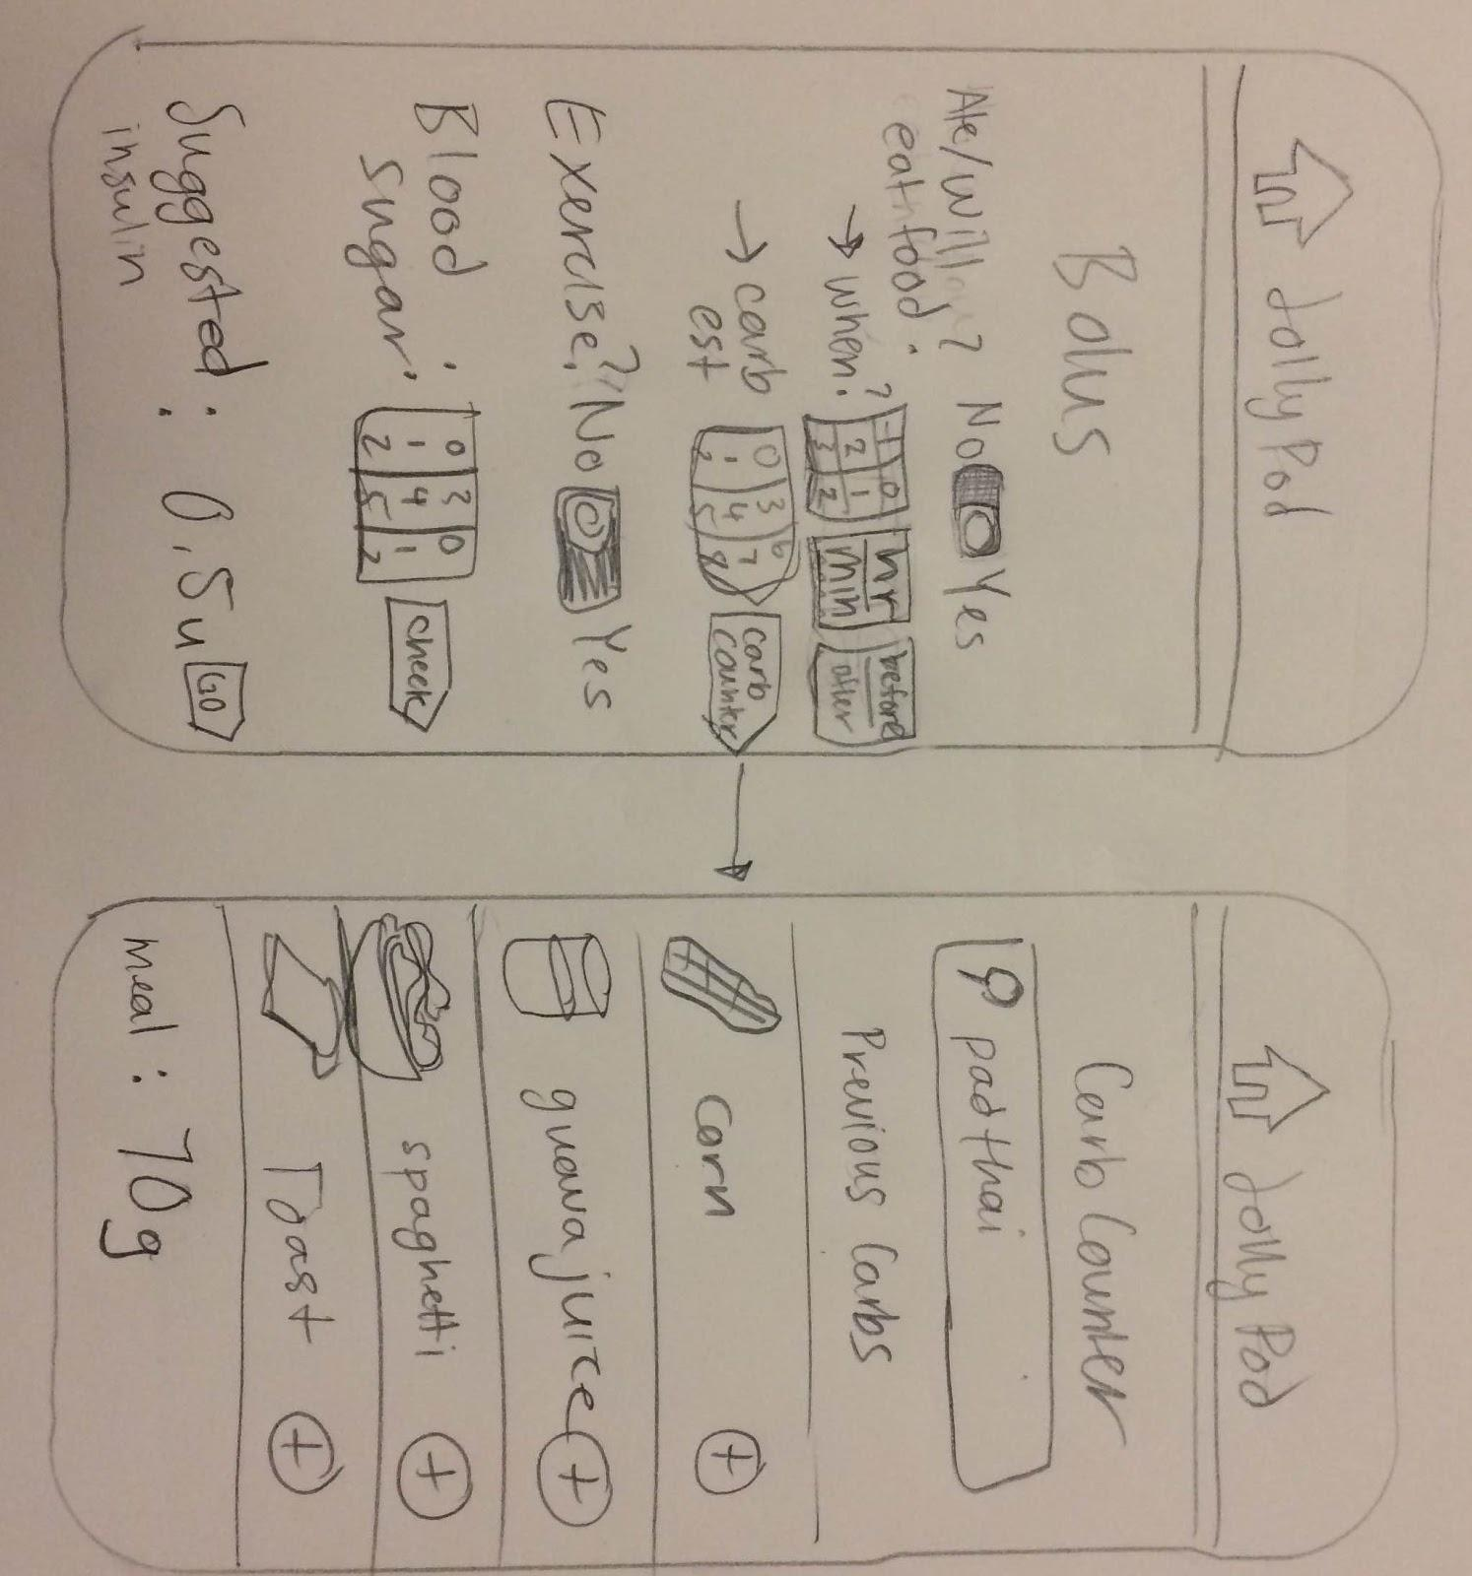
UI Sketches

Slide 23
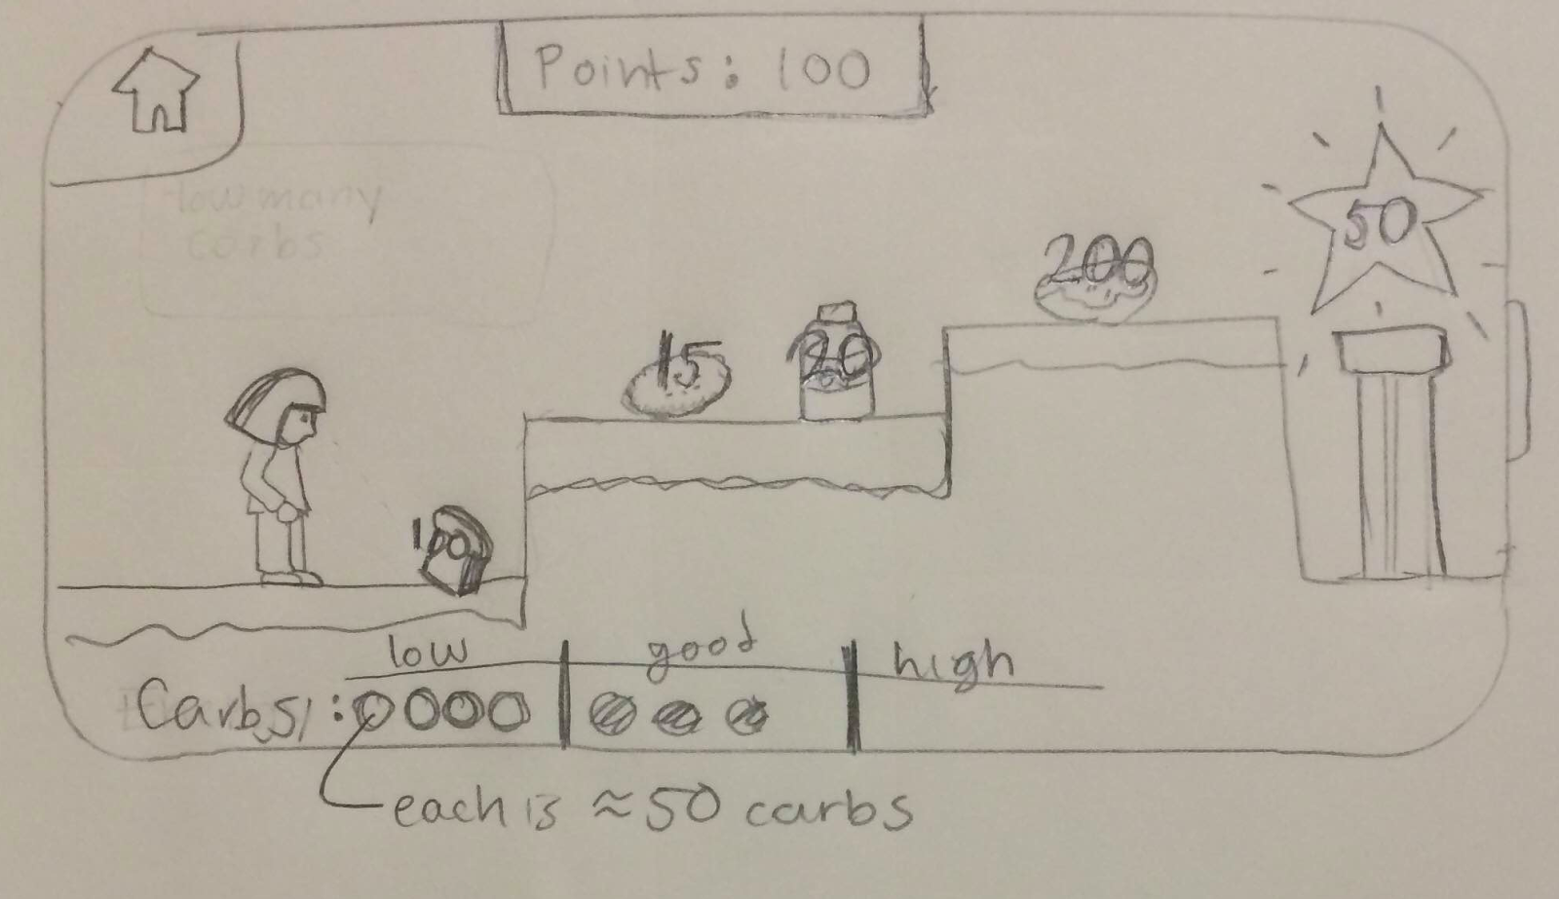
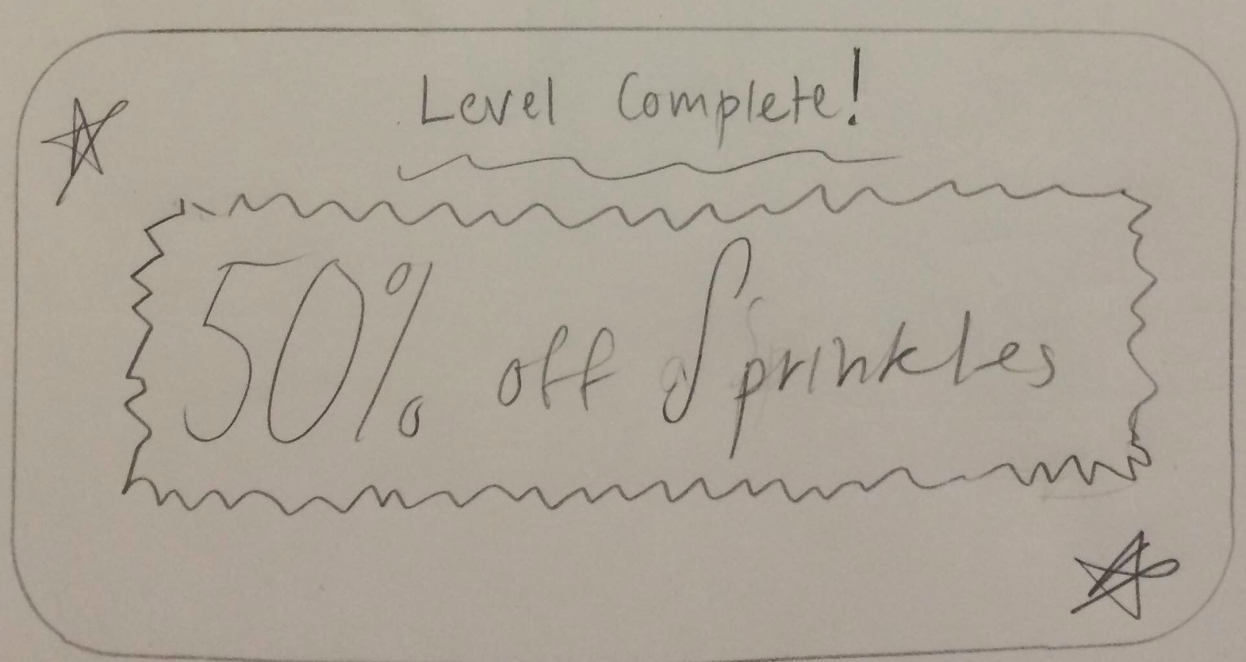
UI Sketches

Slide 24
Summary
Application that simplifies daily tasks
Use games to teach diabetic children necessary skills in a fun way
Positive reinforcement to relieve stress related to managing diabetes

