Slide 1
SpeakEasy
Medium-fi Prototype
Eric Chew, Tommy Truong, Gabriela Groth, Carlos Araujo

Slide 2
3 Representative Tasks
Made tasks more concrete and specific
Understand and reproduce the correct pronunciation of words
Get phrase suggestions for real-life conversations
Integrate language learning into daily life

Slide 3
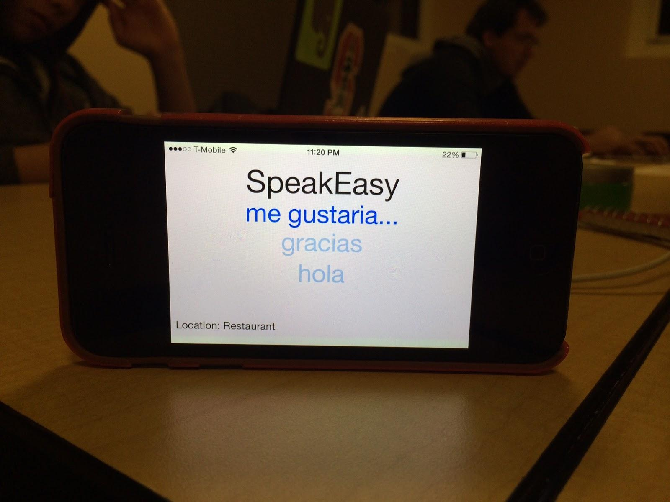
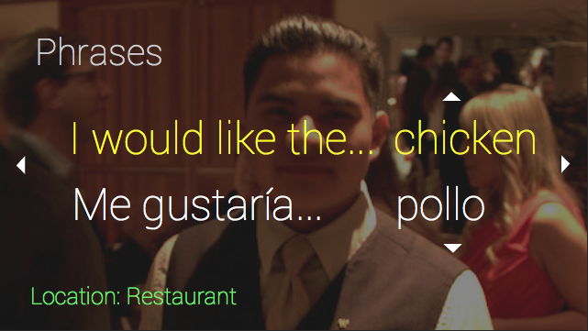
Revised UI Design
Show suggestions in both native and new languages
Added arrows to remind user of what gestures to use
Before | After

Slide 4
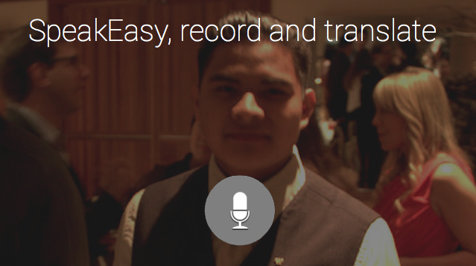
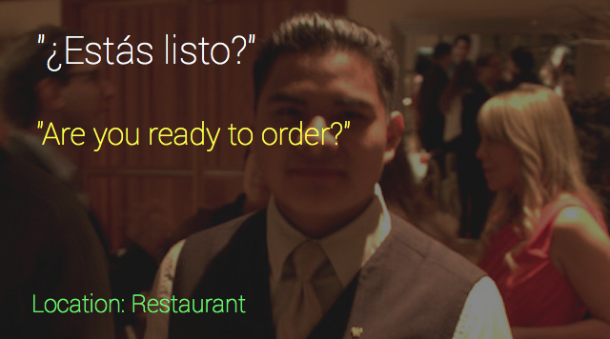
Revised UI Design
Added new command to allow user to translate another person’s speech

Slide 5
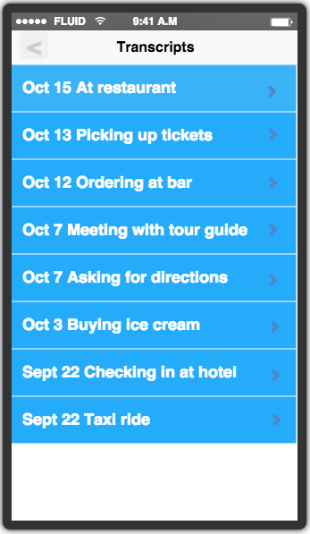
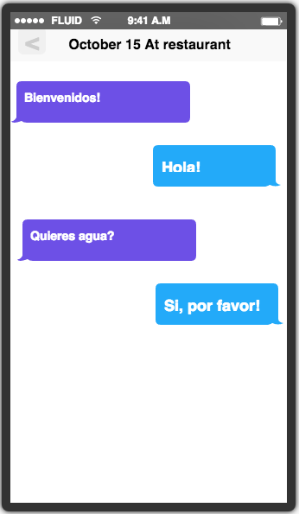
Revised UI Design
Added transcripts of recorded conversations after suggestion from user.

Slide 6
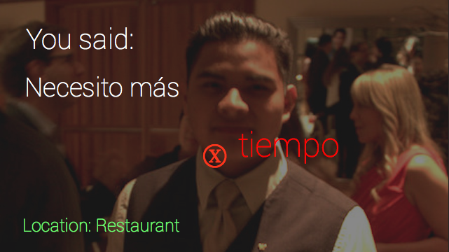
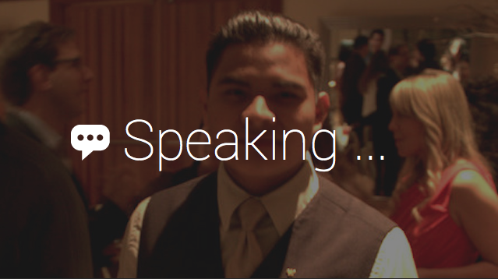
Scenario 1
Use app to correct mispronunciations

Slide 7
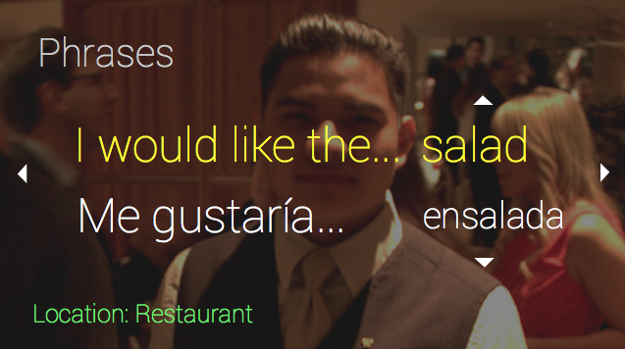
Scenario 2
Get useful phrases for a restaurant setting

Slide 8
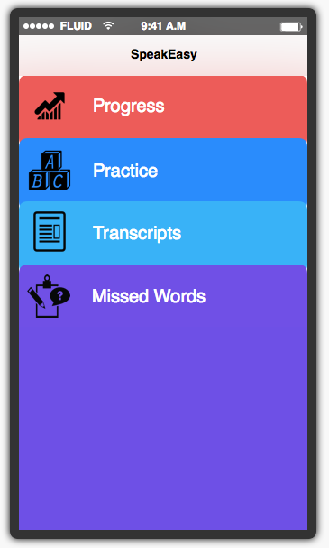
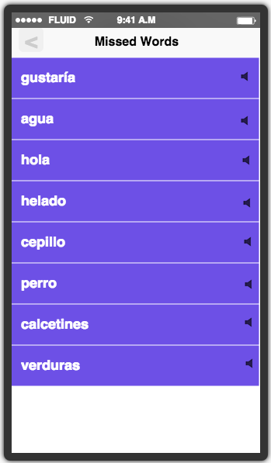
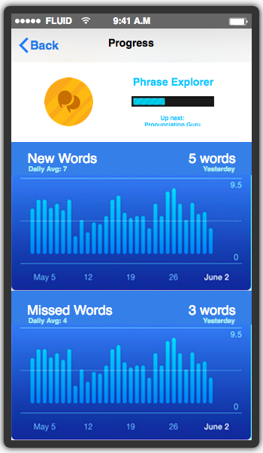
Scenario 3
Get feedback on learning progress

Slide 9
Tools Used
Justinmind prototyper
For Google Glass
Difficult to prototype without actually having Glass
Had to add buttons in place of Glass gestures
Works pretty well to show screens
Fluid UI
For mobile part of application
Easy learning curve
Fast prototype, but no collaborative editing

Slide 10
Summary
Made google glass prototype more intuitive by making indicators for gestures
Added features to mobile app that users felt would be helpful
Made tasks more concrete and specific

