Slide 1
SpeakEasy
Low-fi Prototype
Eric Chew, Tommy Truong, Gabriela Groth, Carlos Araujo

Slide 2
Mission Statement
Enable users to learn language easily and intuitively while having contextual support

Slide 3
Tasks
Intuitive Pronunciation
2. Contextually Sensitive Language Support
Active Language Learning Integration

Slide 4
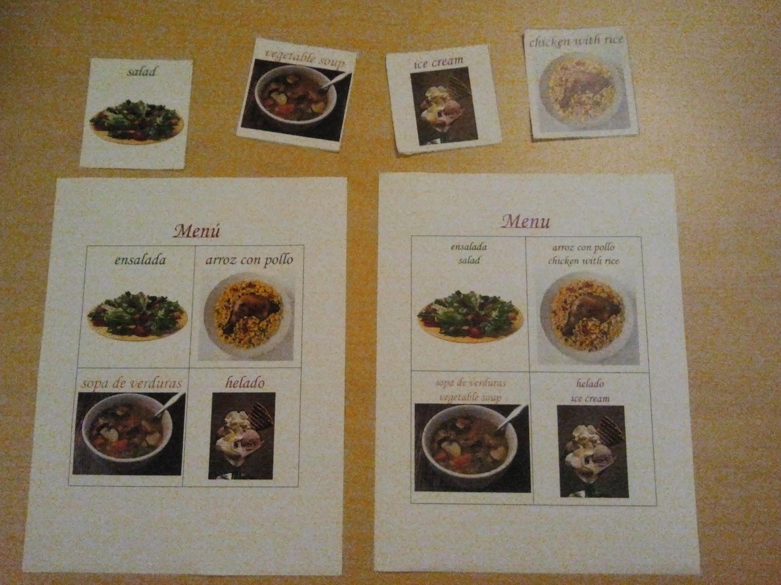
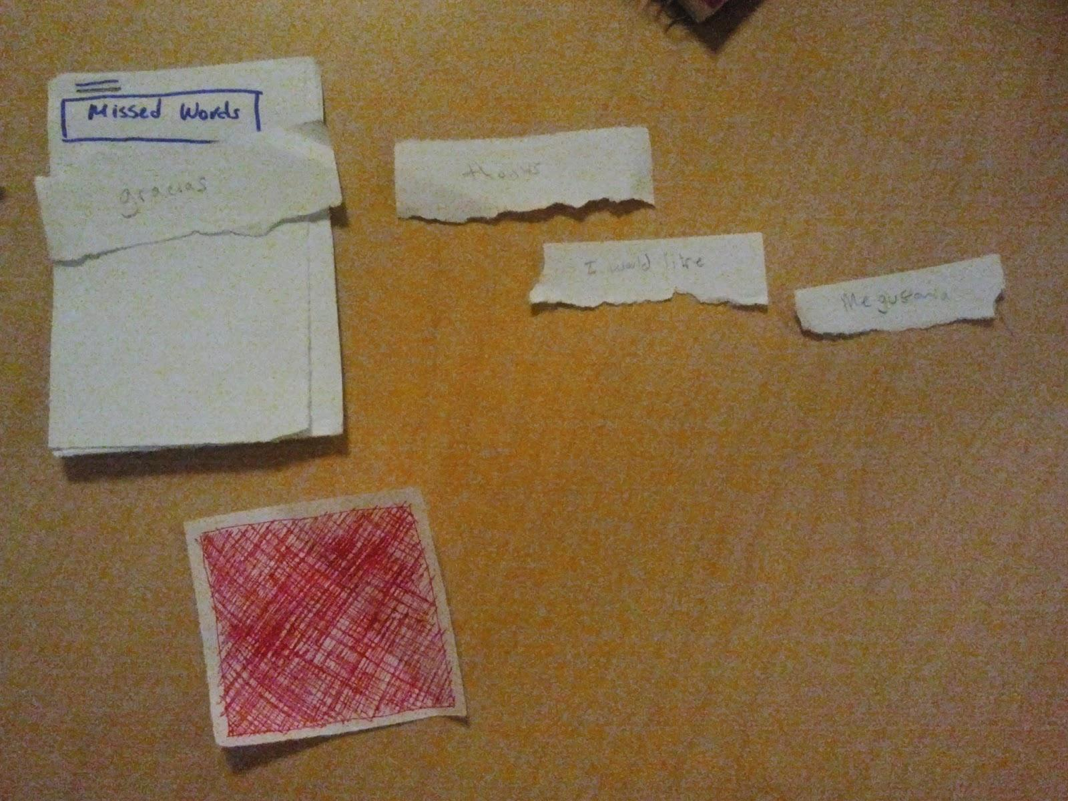
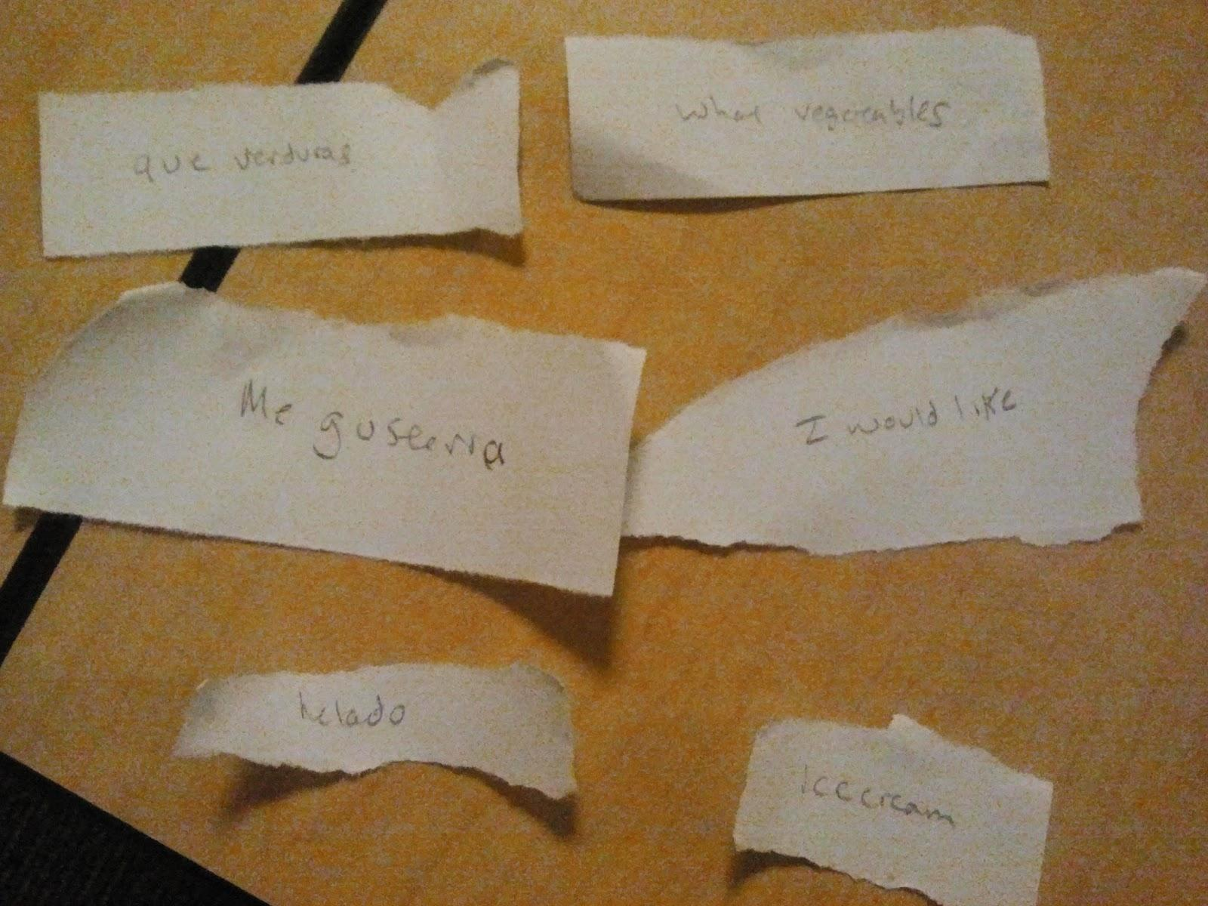
Lo-fi Prototype

Slide 5
Scenario 1: Intuitive Pronunciation

Slide 6
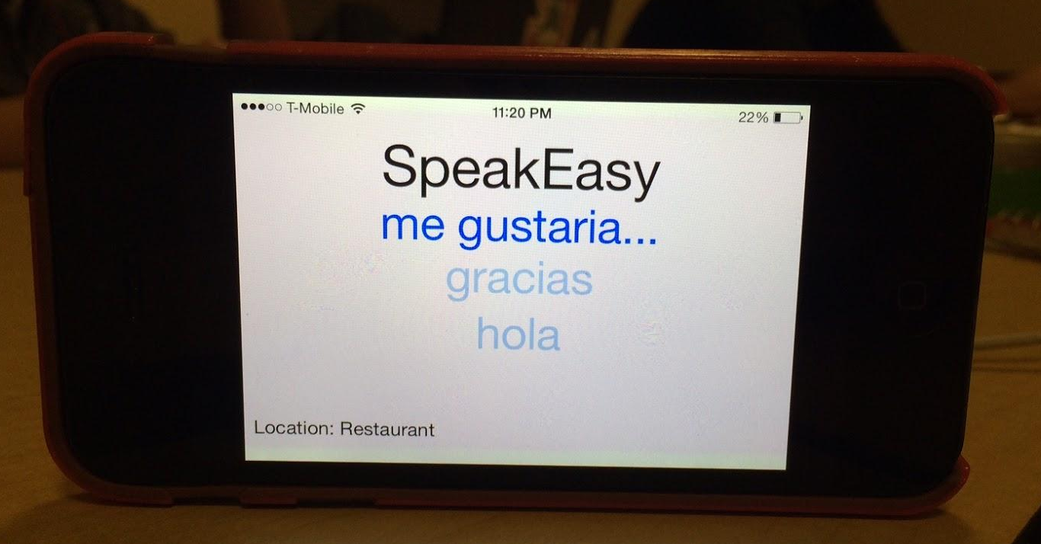
Scenario 2: Contextual Language Support

Slide 7
Scenario 3: Active Language Learning

Slide 8
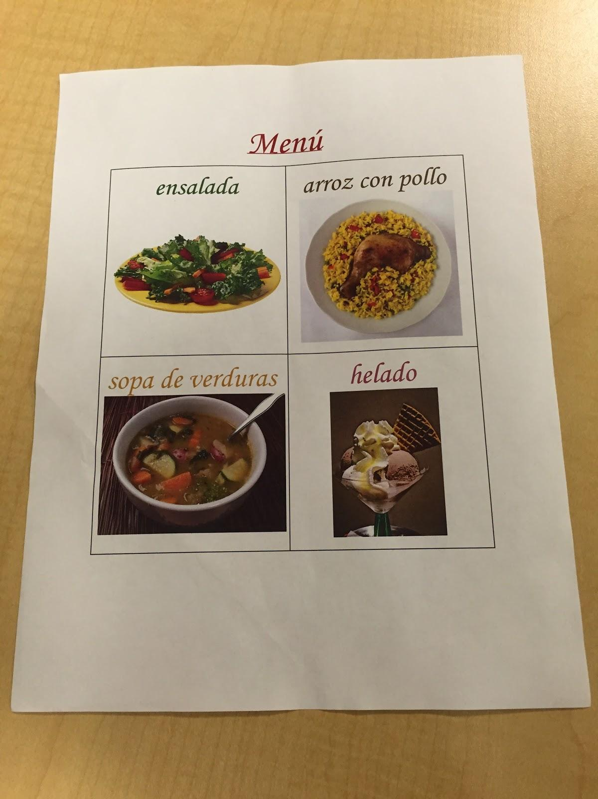
Experimental Method (1/2)
Participants
Know a little bit of Spanish
Stanford students
Not compensated
Testing environment
A restaurant in Mexico
Table and chair to resemble restaurant
Spanish menus with food options

Slide 9
Experimental Method (2/2)
Procedure
Brief overview of app and setting
Carlos played the Mexican waiter
Gabriela typed phrases to help user
Eric took notes of mispronunciation
Tommy took notes of user reactions
Test Measures
How relevant a user found a suggestion
How many times each feature was used
Number of gesture swipes during conversation
Fluency of conversation
Ability to pronounce/learn to pronounce words
Wizard-of-Oz (Gabriela)
Paper Prototype (Eric)

Slide 10
Experimental Results
Swiping from the suggested phrase to translation is slow
Difficulty with understanding what waiter said, unsure of how to respond
Gestures were confusing and unintuitive for new users
People liked that they could review missed words
Suggestions were on-point and useful
Overall, people liked the idea and could see themselves using it

Slide 11
Suggested UI Changes
1. Suggested phrases should show both native and new language at the same time
2. Also provide translations for what the other speaker said
3. Identify more intuitive gestures to use, or have tutorial for new users
4. For added review, keep transcript of conversation

Slide 12
Summary
Designed low-fi prototype to include both paper prototypes and wizard-of-oz techniques
Tested low-fi prototype in a fictional restaurant scenario.
Discovered that gestures needed to be more intuitive, that app must provide more translation support

