Slide 1
SpeakEasy
Eric Chew, Tommy Truong, Gabriela Groth, Carlos Araujo

Slide 2
Problem and Solution
Problem
Current language learning solutions are outside of regular activity and unhelpful when actually communicating in a contextually relevant environment.
Solution
A mobile application that integrates with the users activities to provide on the go and contextually sensitive instruction.

Slide 3
Interviewees?
Tourists From Singapore
A Linguistics Major
First Year Chinese Students
A Remote Student
Stanford Janitors

Slide 4
Why?
Contextual Immersion
Informal Learning
Formal Learning
Online Video Learning
One on One Learning

Slide 5
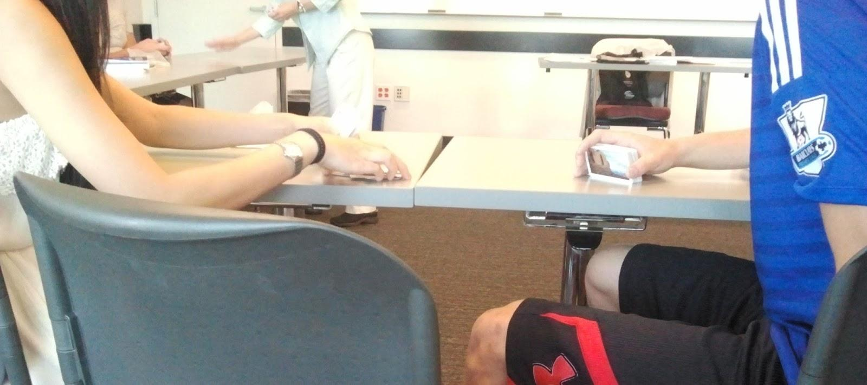
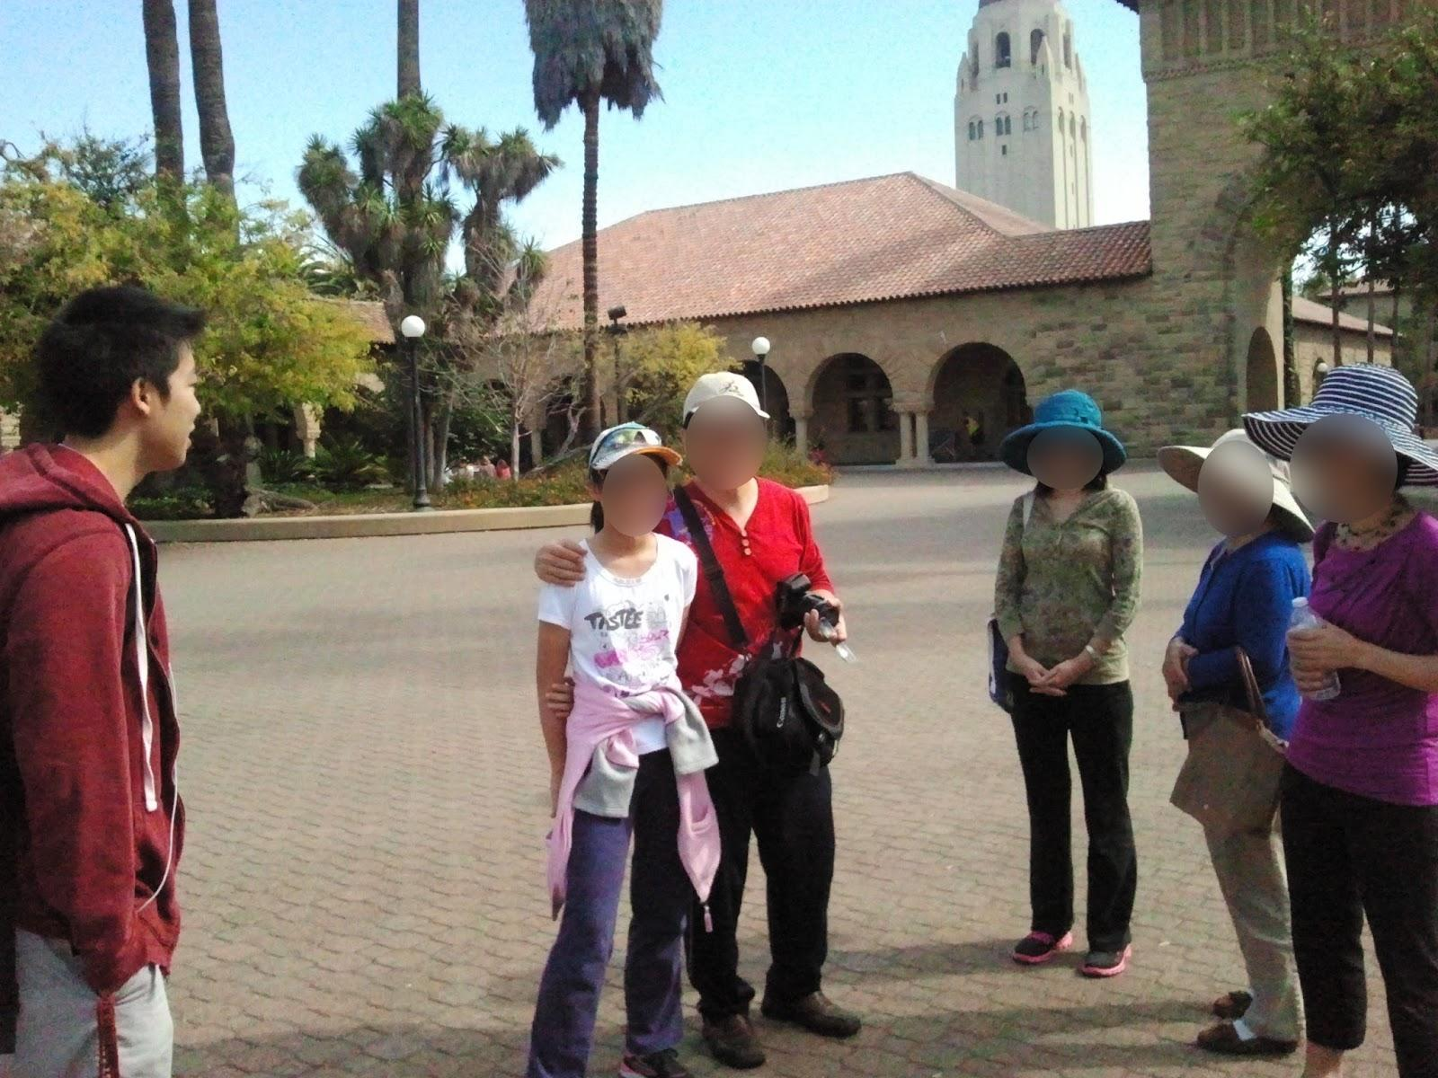
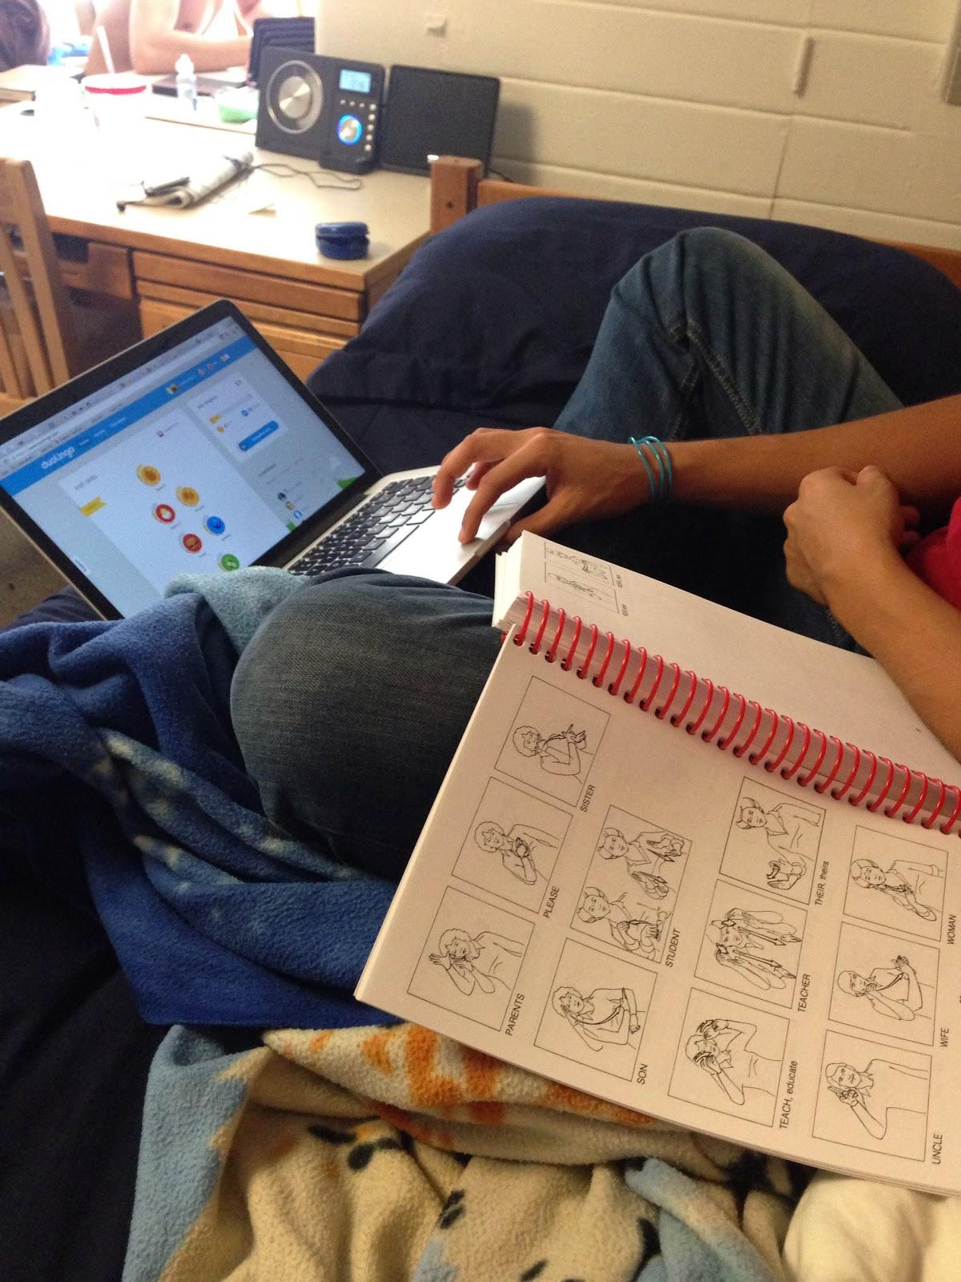
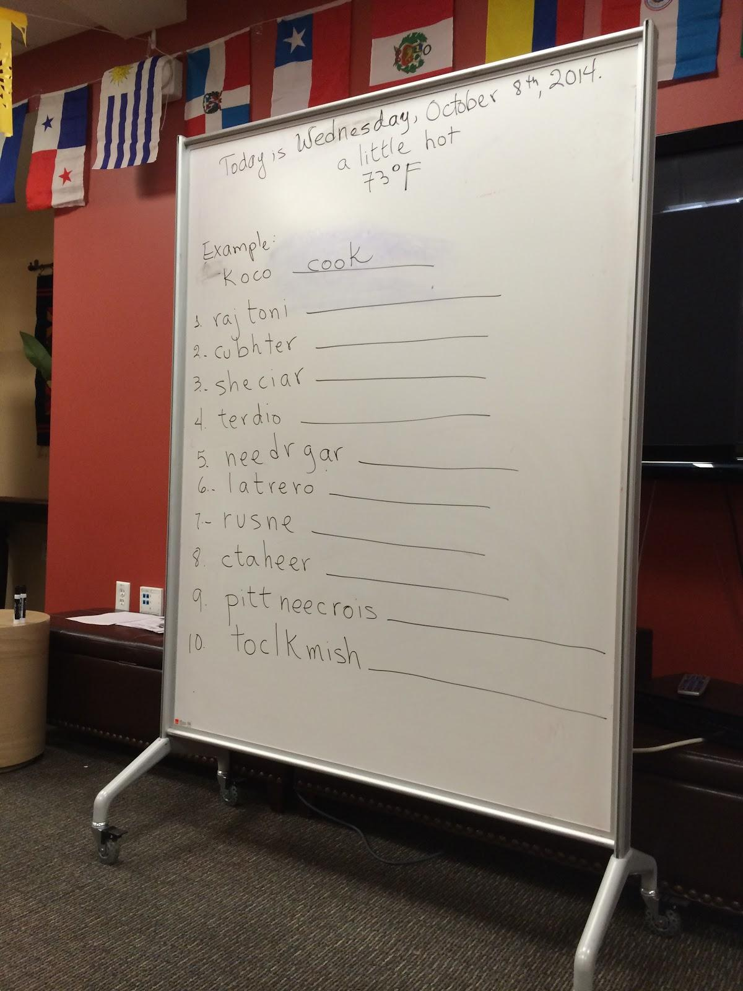
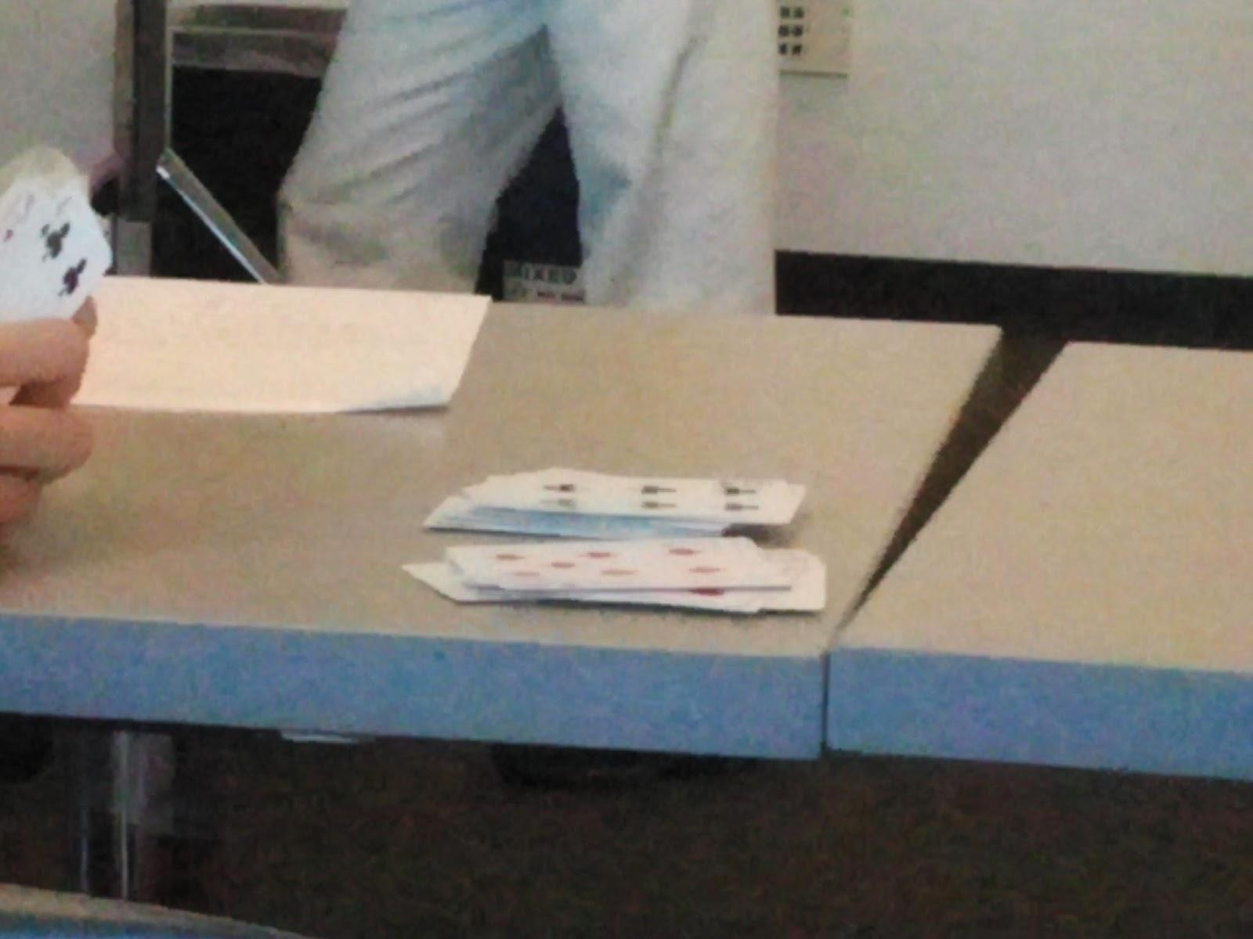
Workspaces

Slide 6
Findings?
Requirements
Learning a language is a repetitive process
It is as visual and contextual as it is oral and aural
Immediate feedback and correction on pronunciation
Behaviors
Disconnected from regular activity and unengaging
Conversation is disjointed as users look for words
Internet offers an accessible repository of vocabulary

Slide 7
Who Are They?
People who want to learn a language on the go

Slide 8
What, Where, How and Wants?
Current Tasks?
Performed Where?
Memorize words/phrases
Participate in activities
Role play scenarios
Search for words online
In a classroom
At home or in their bedroom
By their computer
Desired Tasks?
Achieved Through?
Smoothly converse anywhere
Access live conversation help
Grasp contextual information
Intuitive pronunciation
Trial, error, and correction
Repetition
Routine discrete practice

Slide 9
What Tools Do They Have?
Textbooks
Audio Recordings
Websites
Dictionary
Translation Services
Wikipedia
Duolingo

Slide 10
Constraints
Length of class
Date of travel
Awkwardness
Places to learn

Slide 11
Representative Task 1
Intuitive Pronunciation
Complex
High Importance
High Frequency

Slide 12
Representative Task 2
Context Sensitive Deduction
Complex
High Importance
High Frequency

Slide 13
Representative Task 3
Active and Integrated Learning
Simple
Medium Importance
Medium Frequency

Slide 14
Application Idea 1
High Level Goals
Listens to your daily conversation
Allows for immediate or delayed feedback
Critiques pronunciation, word use, etc.
Tracks progress

Slide 15
Application Idea 2
High Level Goals
Recognizes objects arounds you
Provides immediate translation of objects
Provides various forms of pronunciation

Slide 16
Application Idea 3
High Level Goals
Recognizes your immediate context
Provides autocomplete suggestions based on speech and context
Provides pronunciation guidelines

Slide 17
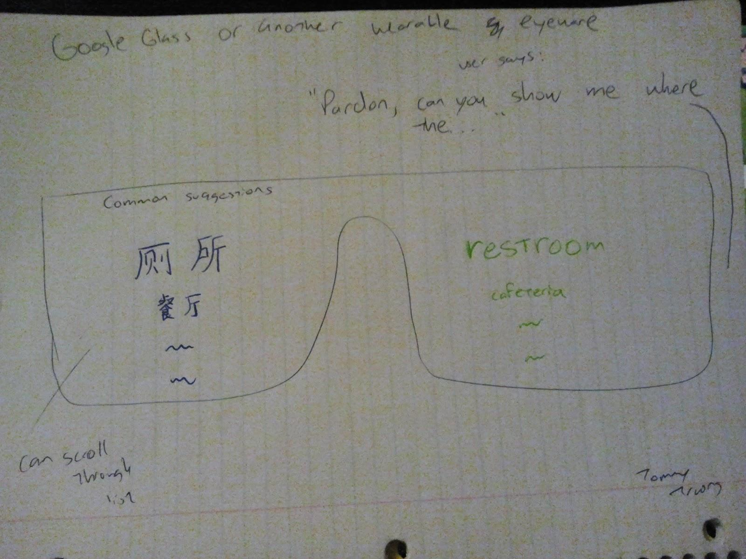
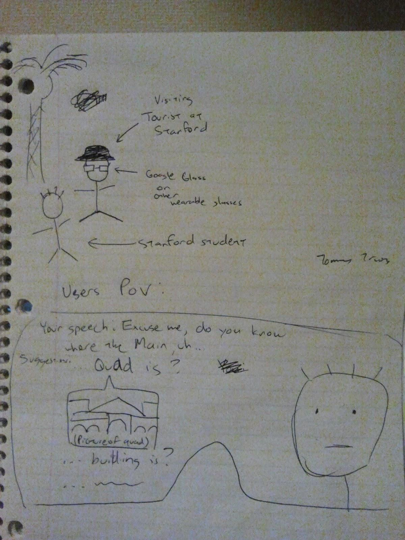
Design Sketch 1

Slide 18
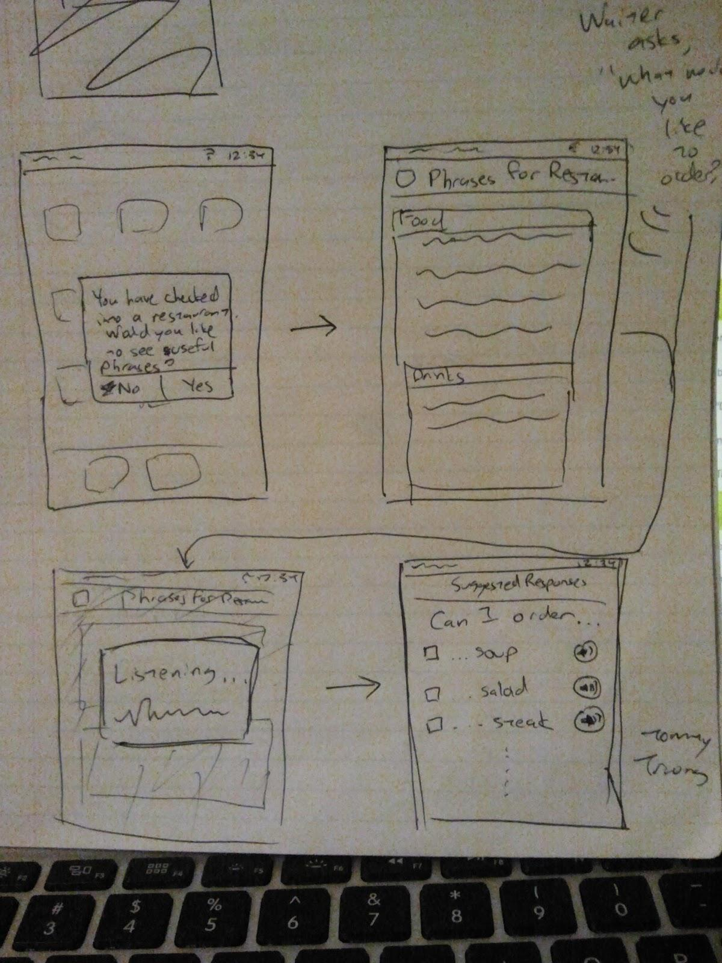
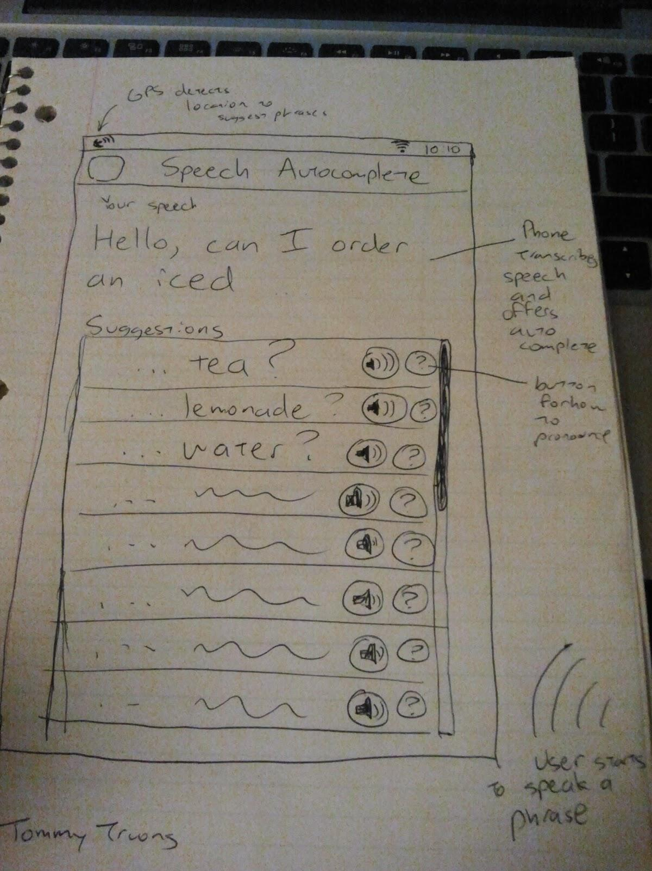
Design Sketch 2

Slide 19
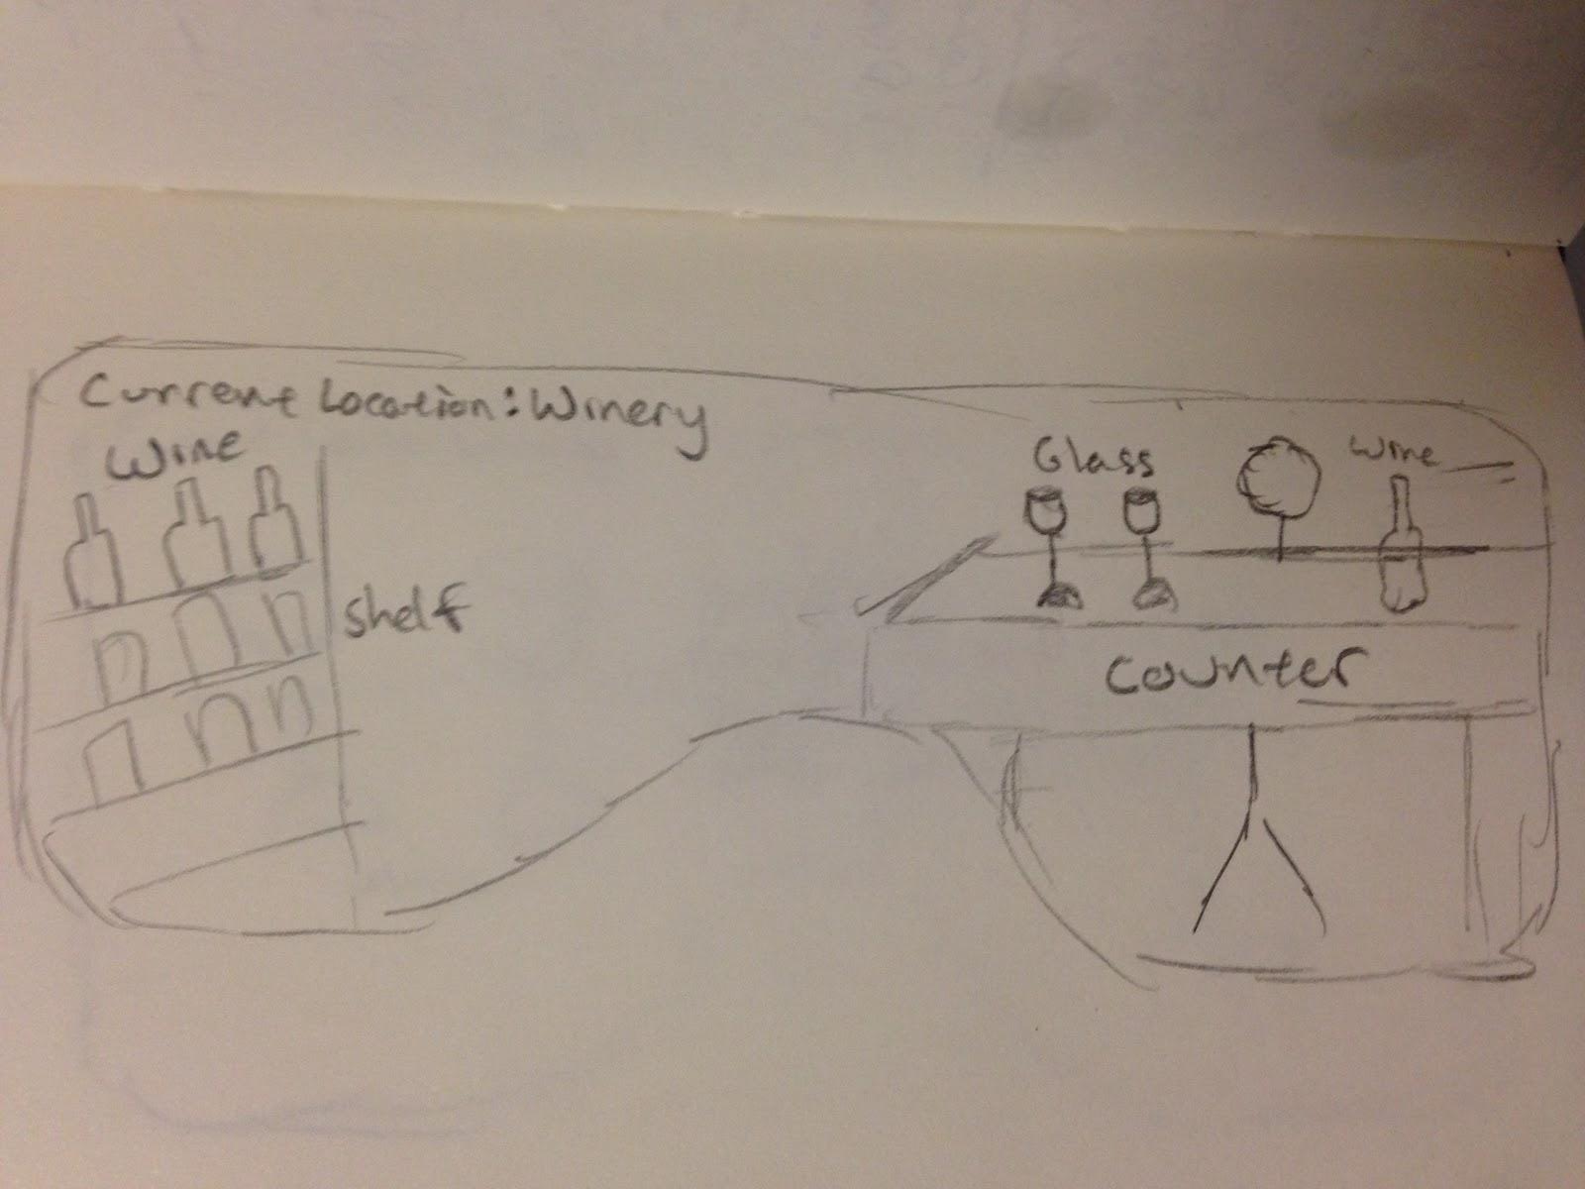
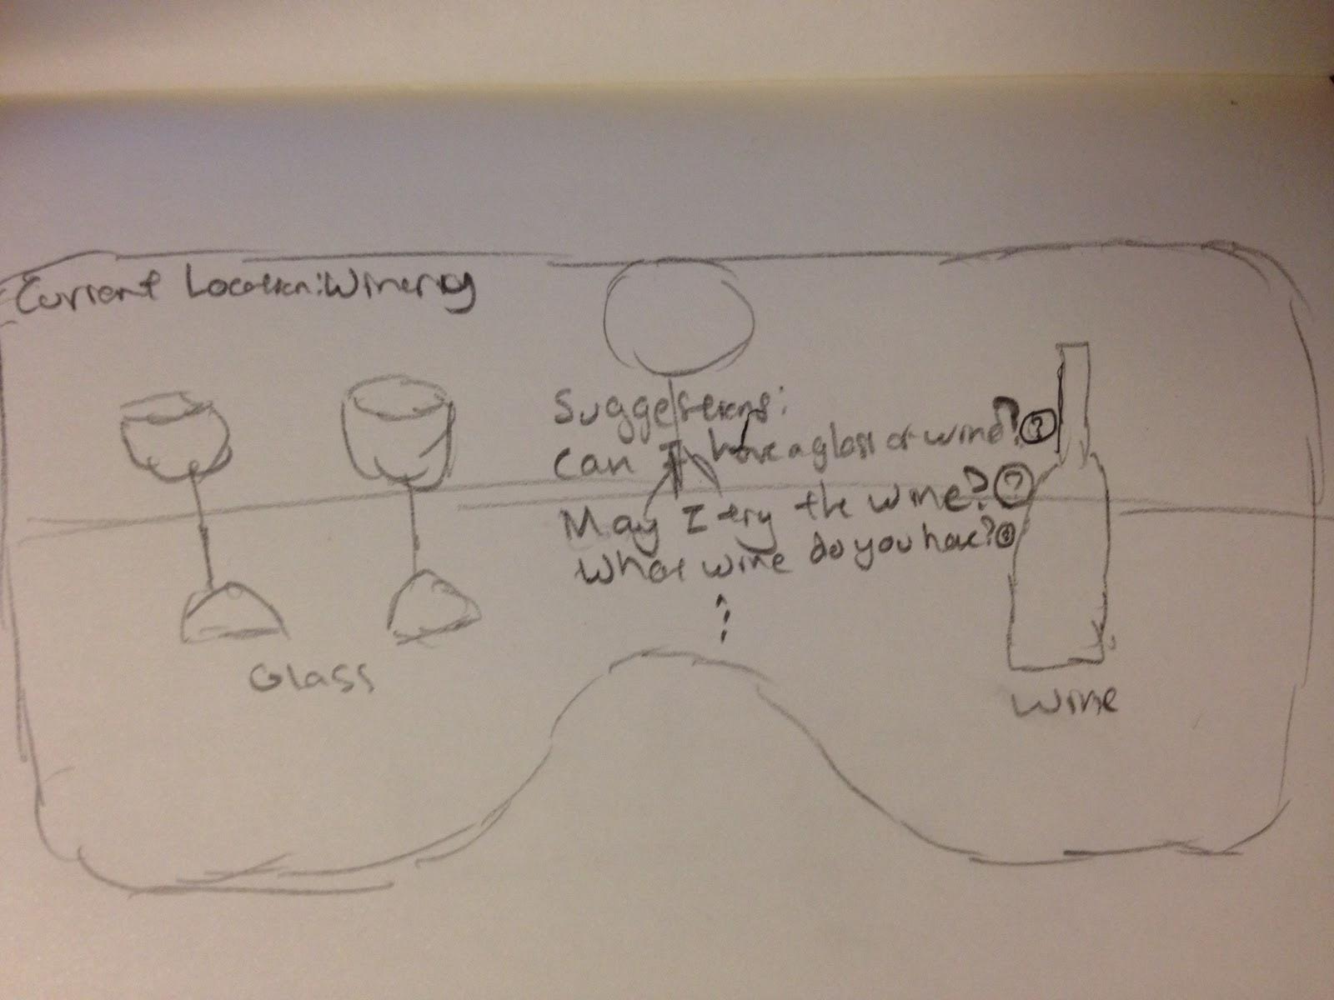
Design Sketch 3

