Slide 1
Zero AD
Augmented Reality Action Adventure Game
Brad Huang, Ashlee Reynolds, David Young, Charles Yu

Slide 2
Overview
Problem & Solution
Contextual Inquiry & Interview
Task Analysis Results
3 Representative Tasks
3 Application Ideas
Early Design Sketches

Slide 3
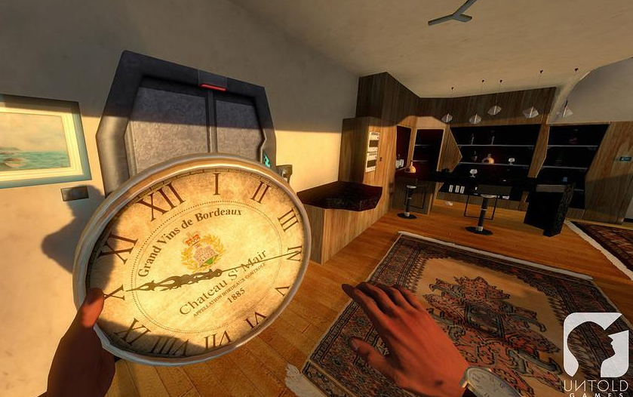
Problem & Solution

Slide 4
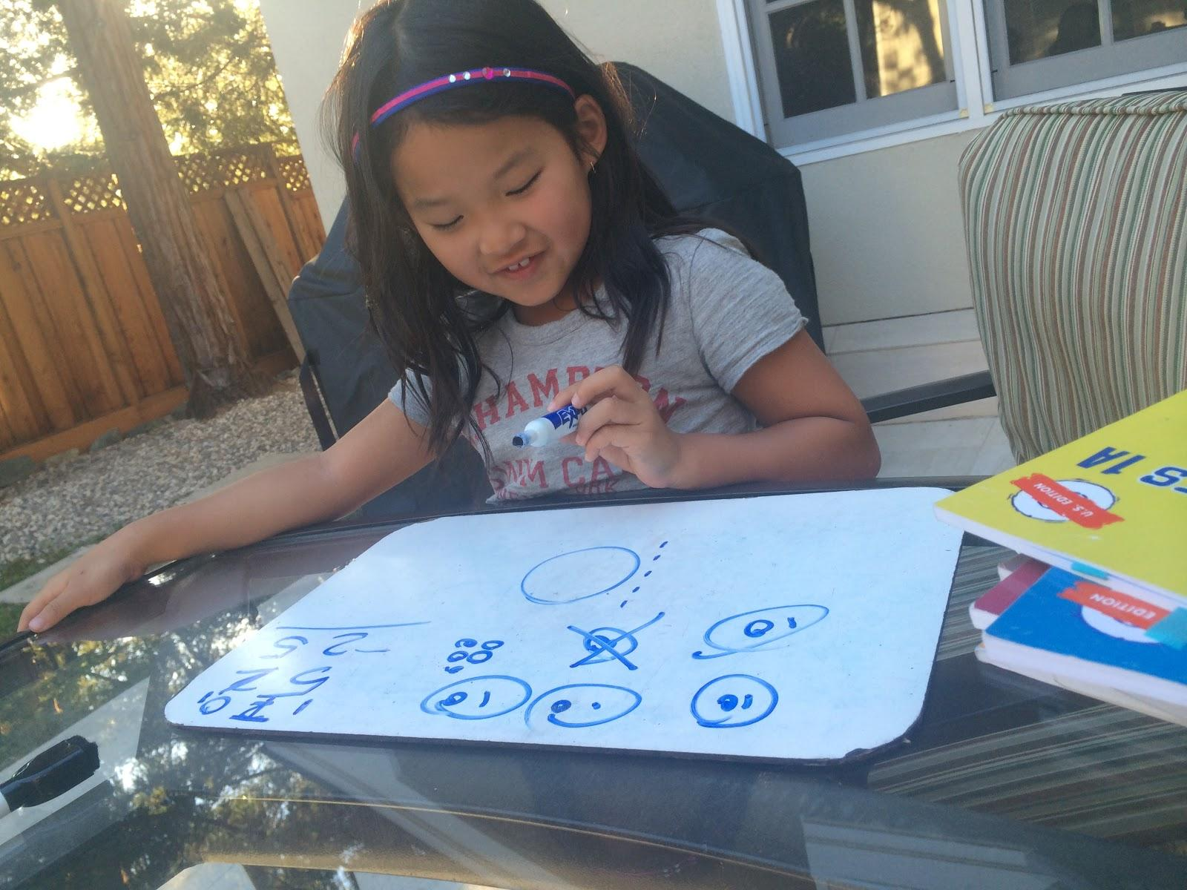
Contextual
Inquiry
Notes:
who
why
how
where

Slide 5
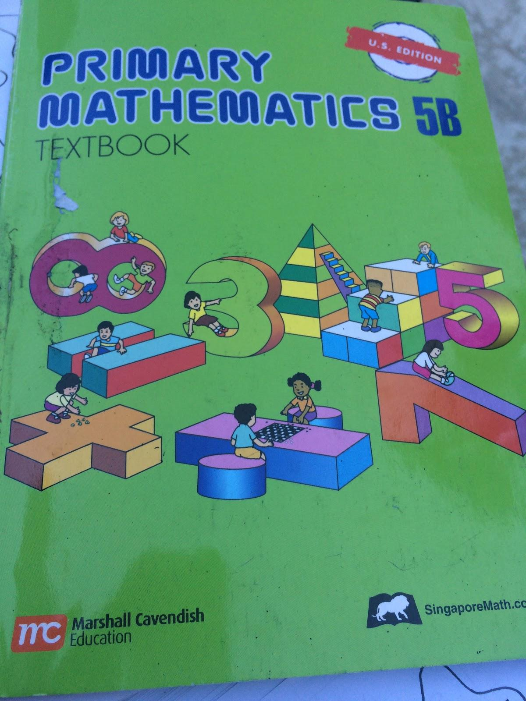
Observations
School is not a challenge, homework is
Like drawing
Like doing things together

Slide 6
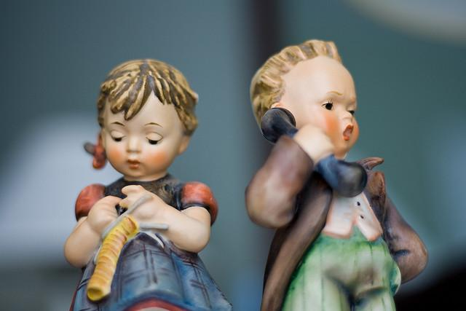
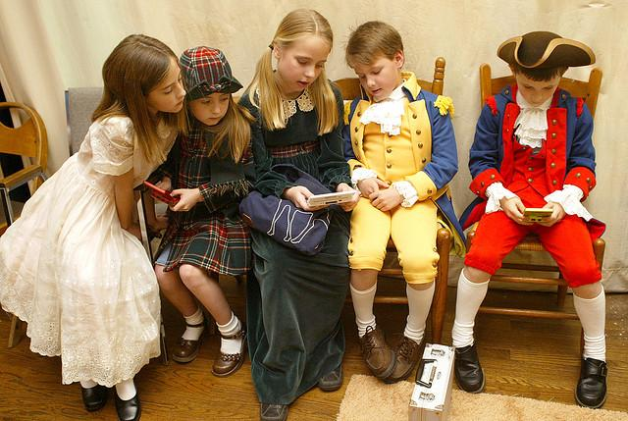
What we learned about children
Rewards
Gender Differences
Social Dimension

Slide 7
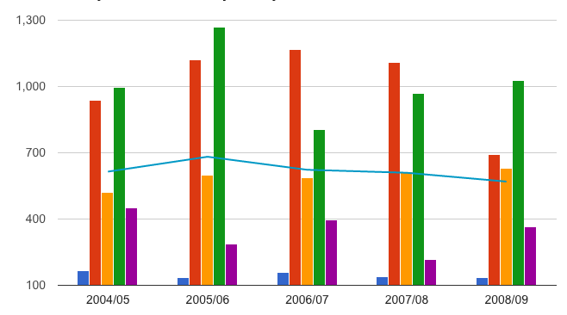
What we learned about parents
Value: Effort > Talent
Don’t want to be too involved in the process
Want progress reports
Adaptive Learning
$$$

Slide 8
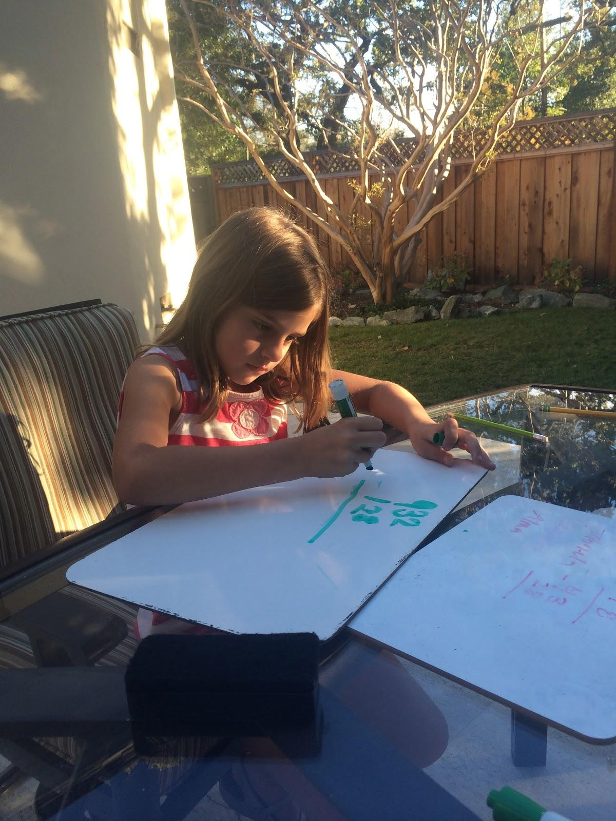
Task Analysis Results

Slide 9
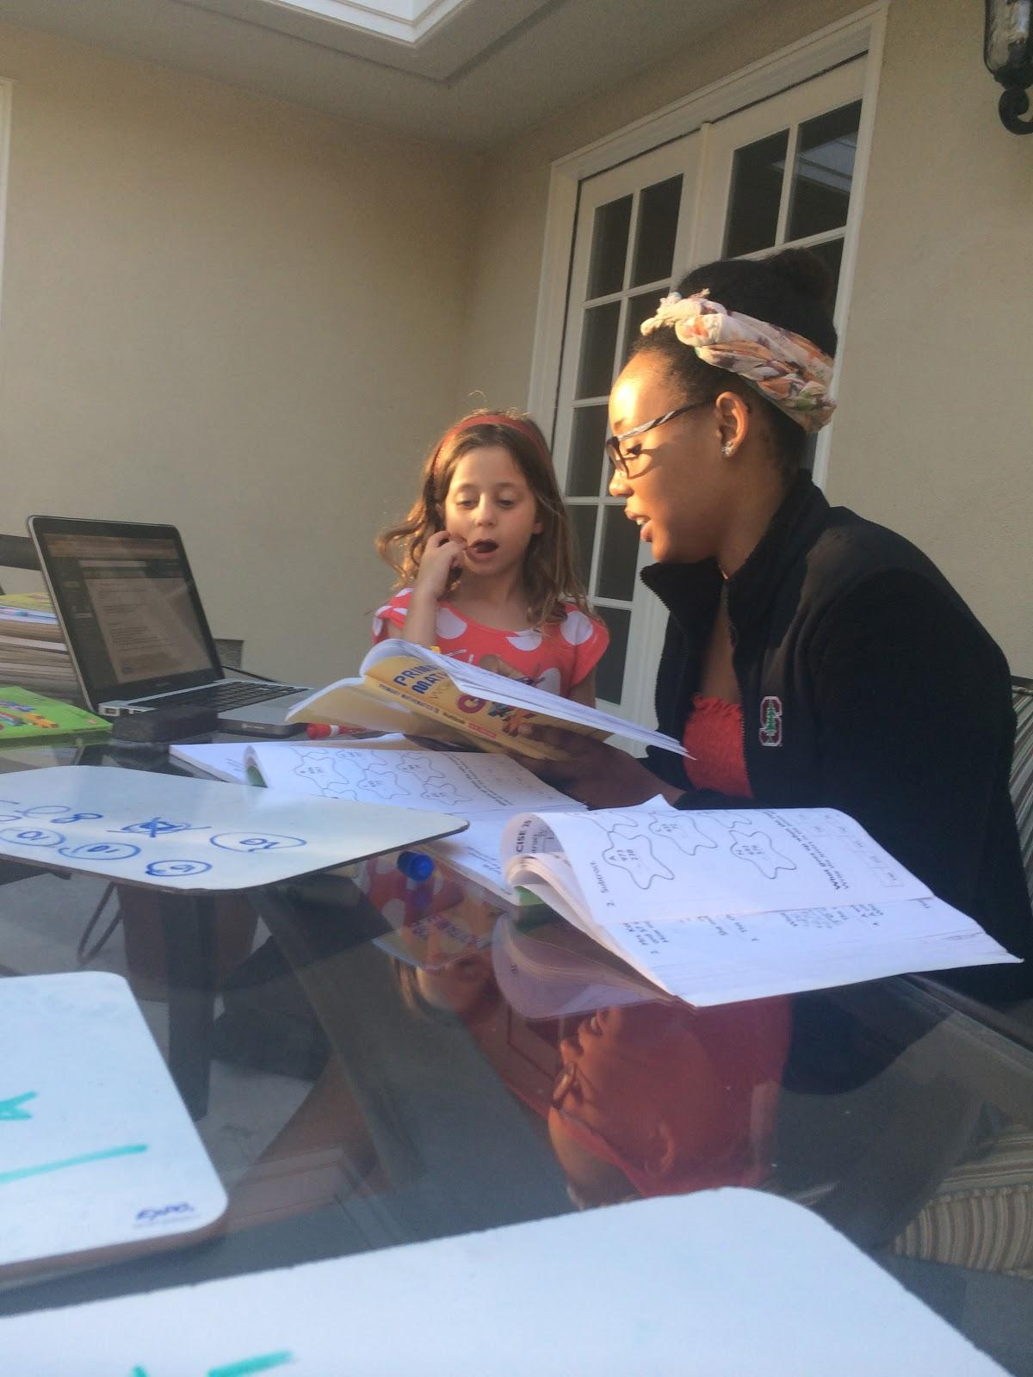
Task Analysis Results

Slide 10
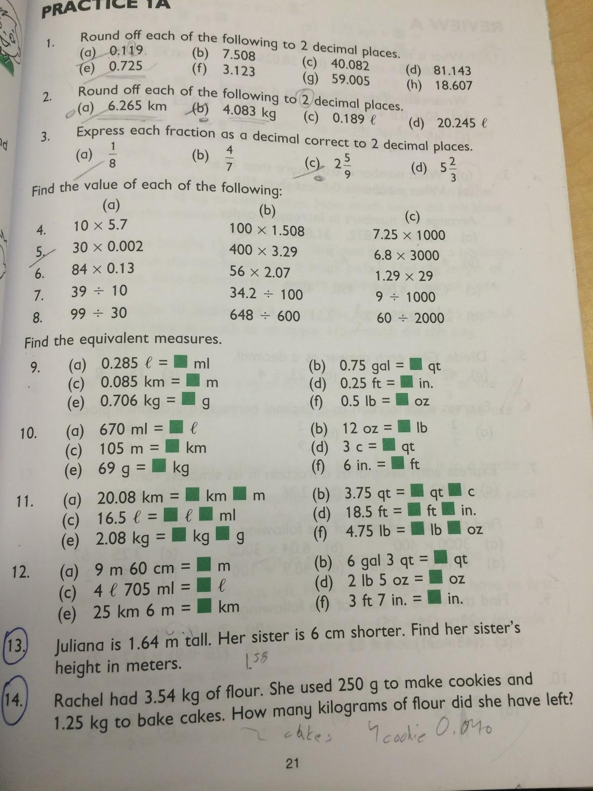
Task Analysis Results

Slide 11
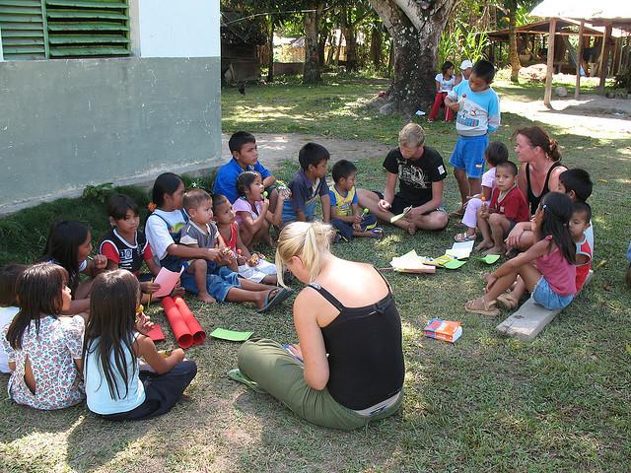
Representative tasks (i)
Children learn Math concepts in school

Slide 12
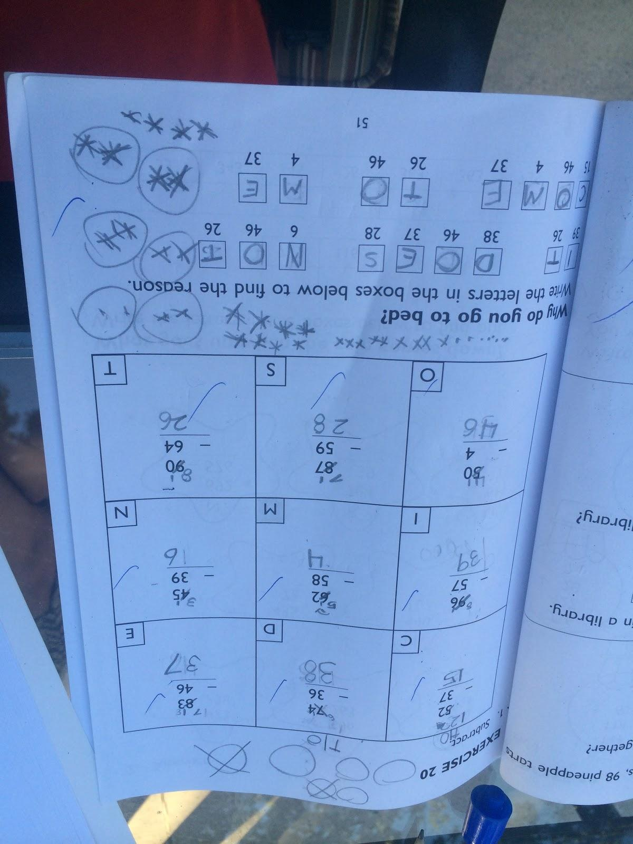
Representative tasks (ii)
Children do homework

Slide 13
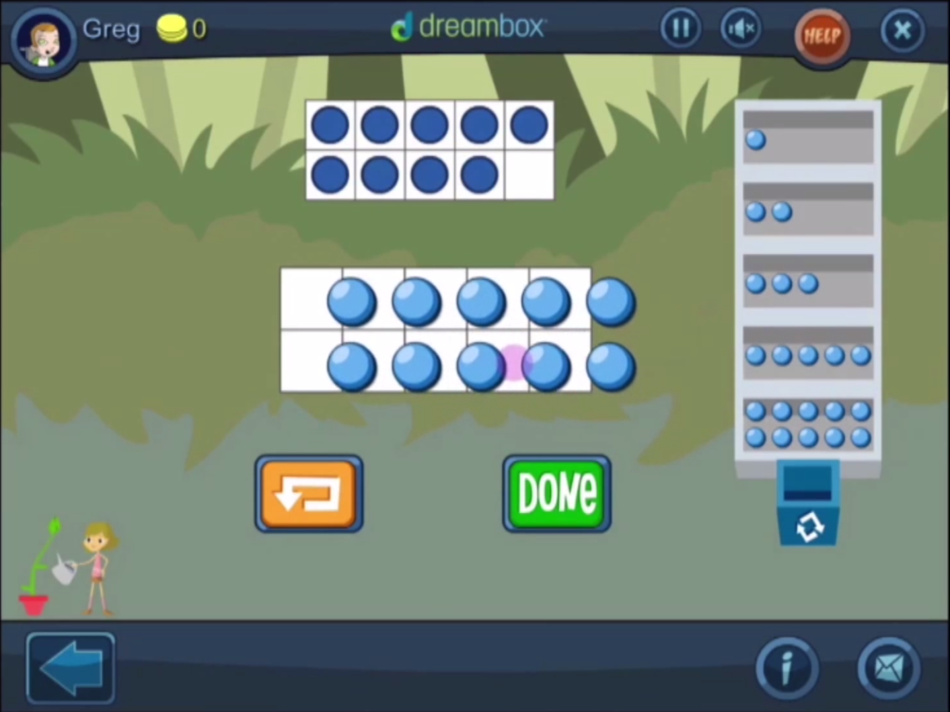
Representative tasks (iii)
Consume some math games

Slide 14
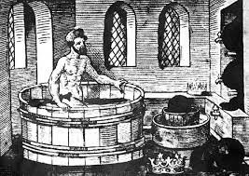
3 Application Ideas (i)
History + Math

Slide 15
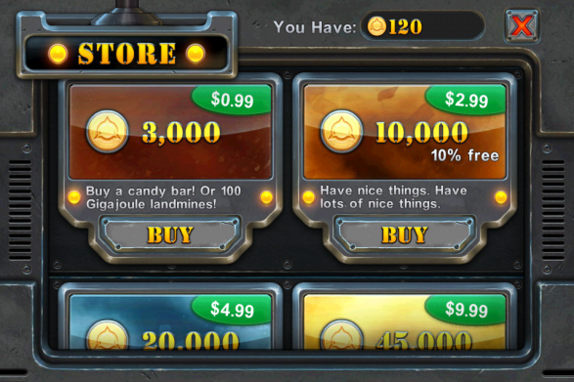
3 Application Ideas (ii)
Math Portal

Slide 16
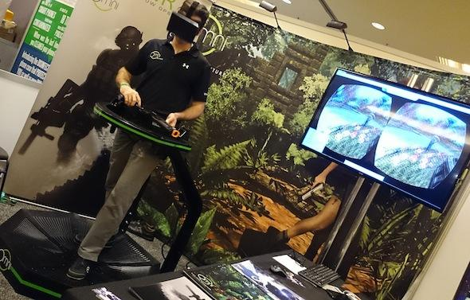
3 application ideas (iii)
Augmented Reality

Slide 17
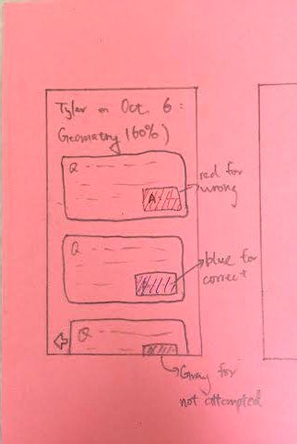
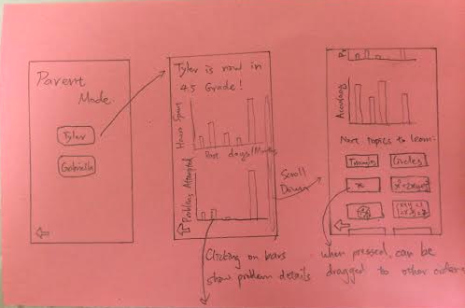
Early design sketches

Slide 18
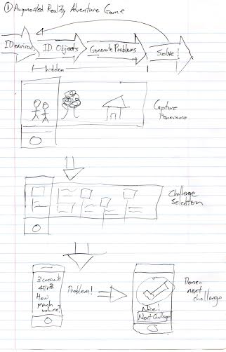
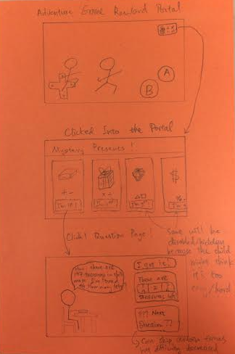
Early design sketches

Slide 19
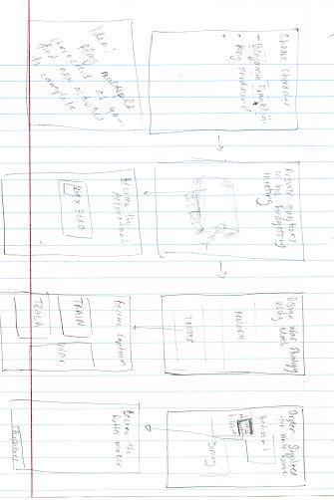
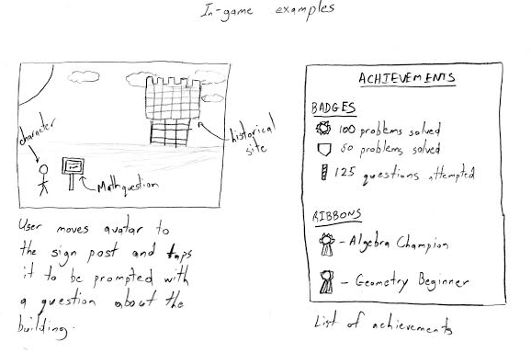
Early design sketches

Slide 20
Summary
Opportunity to engage kids
Math can be fun and engaging
Spontaneous
Dynamic
Solution:
Augmented Reality Adventure Game

Slide 21
Works Cited
Jason Pratt - Boy and Girl - https://www.flickr.com/photos/jasonpratt/2347428960
William Warby - Coins - https://www.flickr.com/photos/wwarby/4860328951
Brittany Randolph - Time Check - https://www.flickr.com/photos/celinesphotographer/440842293
Tim Patterson - Kids -

