Slide 1
KinX
Team Members
Brandon, Development
Jackie, Design
Tony, User Testing / Documentation
Shahab, Manager

Slide 2
Problem
Lacks a social platform
Culture of working and online communication
Families spending less quality time together

Slide 3
Solution
Family
Organization
Connection
KinX approach this problem by addressing family, organization and connection

Slide 4
Overview
Heuristic Evaluation Results
Revised Design
Prototype Implementation Status
Tools
Implemented / Unimplemented features
Wizard of Oz Techniques
Hard-coded Data
Demonstration

Slide 5
Heuristic Evaluation Results
Location of Chat button
[H2-4 Consistency & Standards] [Severity: 3]
Calendar invite options limited
[H2-3 User Control] [Severity 3]
Hamburger menu options confusing
[H2-8 Aesthetic and minimalist design] [Severity 3]
Consistency in Family menu
[H2-4 Consistency and standards] [Severity 3]
Consistency, user control, and aesthetic design are the main issues we need to address in high-fi

Slide 6
Revised Design
Added purple color
Removed non-core functionality (Album, Camera and Location). Kept Chat, Notes, and Events
Moved Home, Chat, Notes, and Events to bottom of screen
Replaced Setting in top left for Back functionality.

Slide 7
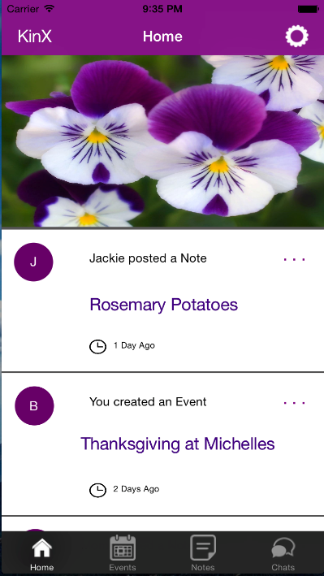
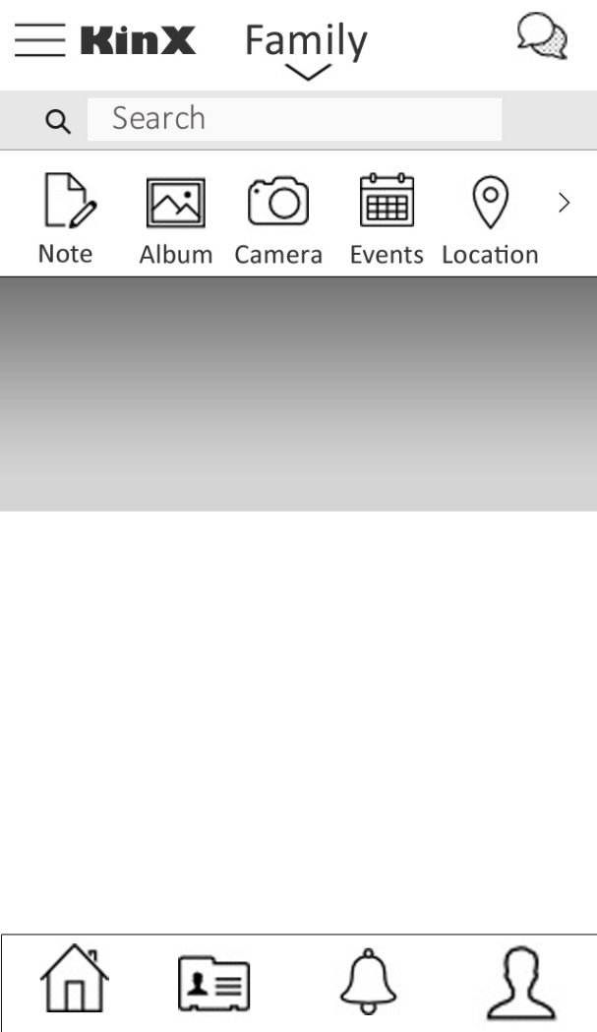
Revised Design

Slide 8
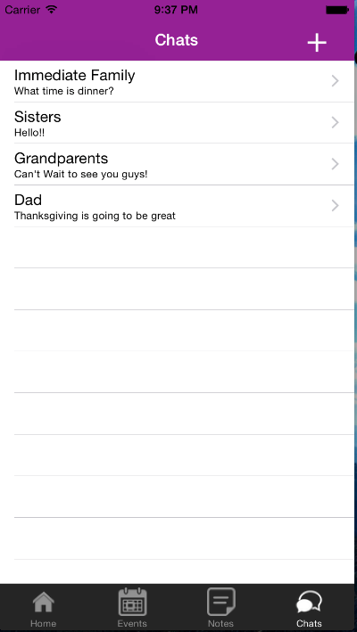
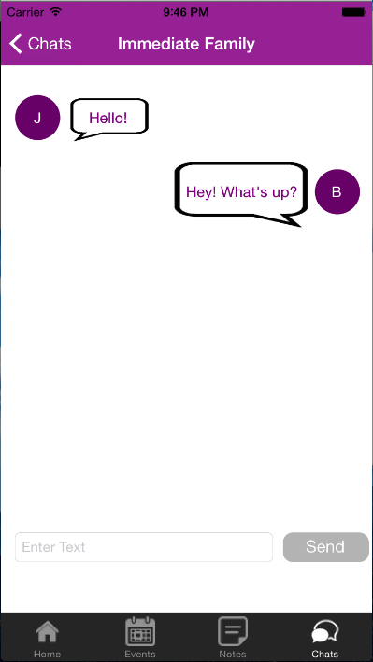
Revised Design

Slide 9
Prototype Implementation
Tools Being Used
XCode, Objective-C
Implemented Features
Home Screen
Chat – Add New Chat, Check previous chats. Note, at this point you can add type in text boxes but clicking send doesn’t do anything. The chat information is currently hard coded.
Clicking Events/Notes goes to pages, but the pages are empty

Slide 10
Prototype Implementation
Brought the prototype from InVision to XCode (actual IOS implementation)
Home Screen redone, added color scheme
Chat interface is there but isn’t fully functional

Slide 11
Unimplemented Features & Plan
Functionality of Chat and fixing the text field movement with keyboard
Text field currently moves up for keyboard but sometimes goes under keyboard
Creating / accessing events
Creating / accessing notes

Slide 12
Limitations
Wizard of Oz techniques
A lot of the info is currently hardcoded and doesn’t mean much
Hard-coded Data
As of now, all chat information is hard coded. Data does not persist

Slide 13
Demonstration

